Slide 1
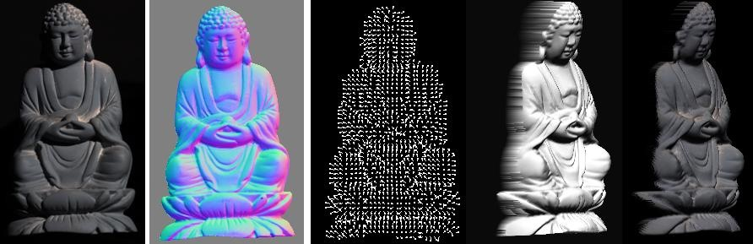
Photometric stereo
CS5670 : Computer Vision

Slide 2
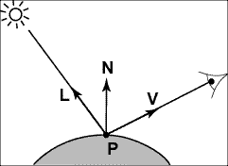
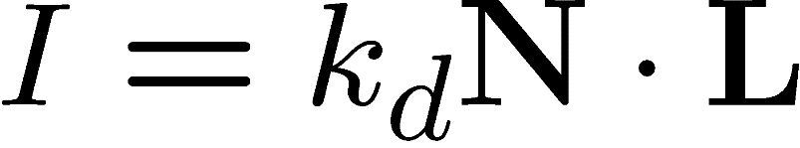
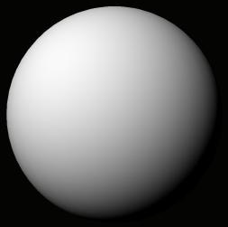
Recap:
Lambertian (Diffuse) Reflectance
I : observed image intensity
k_{d} : object albedo
N : surface normal
L : light source direction
Lambertian sphere with constant albedo lit by a directional light source

Slide 3
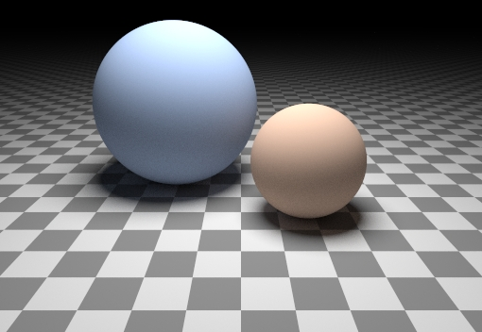
Can we determine shape from lighting?
Are these spheres?
  Or just flat discs painted with varying albedo?

Slide 4

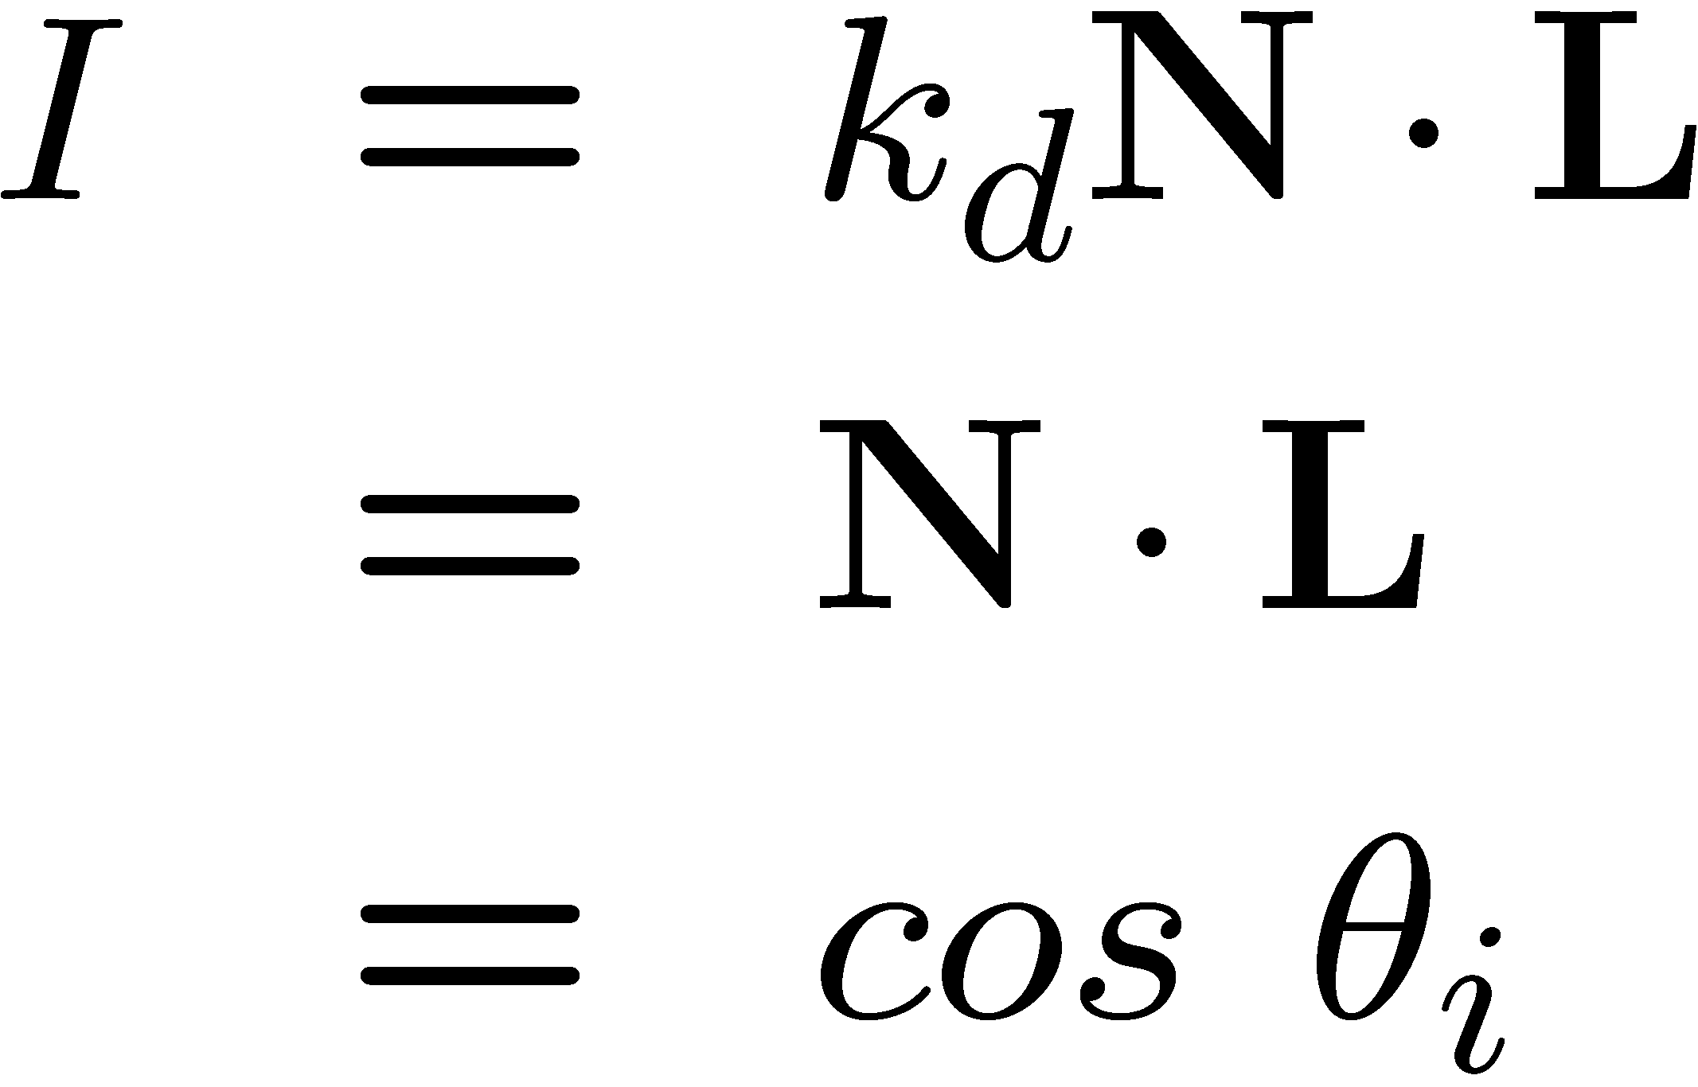

A Single Image: Shape from shading
Suppose (for now)
You can directly measure angle between normal and light source
  Not quite enough information to compute surface shape
  But can be if you add some additional info, for example
    assume a few of the normals are known (e.g., along silhouette)
    constraints on neighboring normals—“integrability”
    smoothness
  Hard to get it to work well in practice
    plus, how many real objects have constant albedo?
    But, deep learning can help

Slide 5
Let’s take more than one photo!

Slide 6






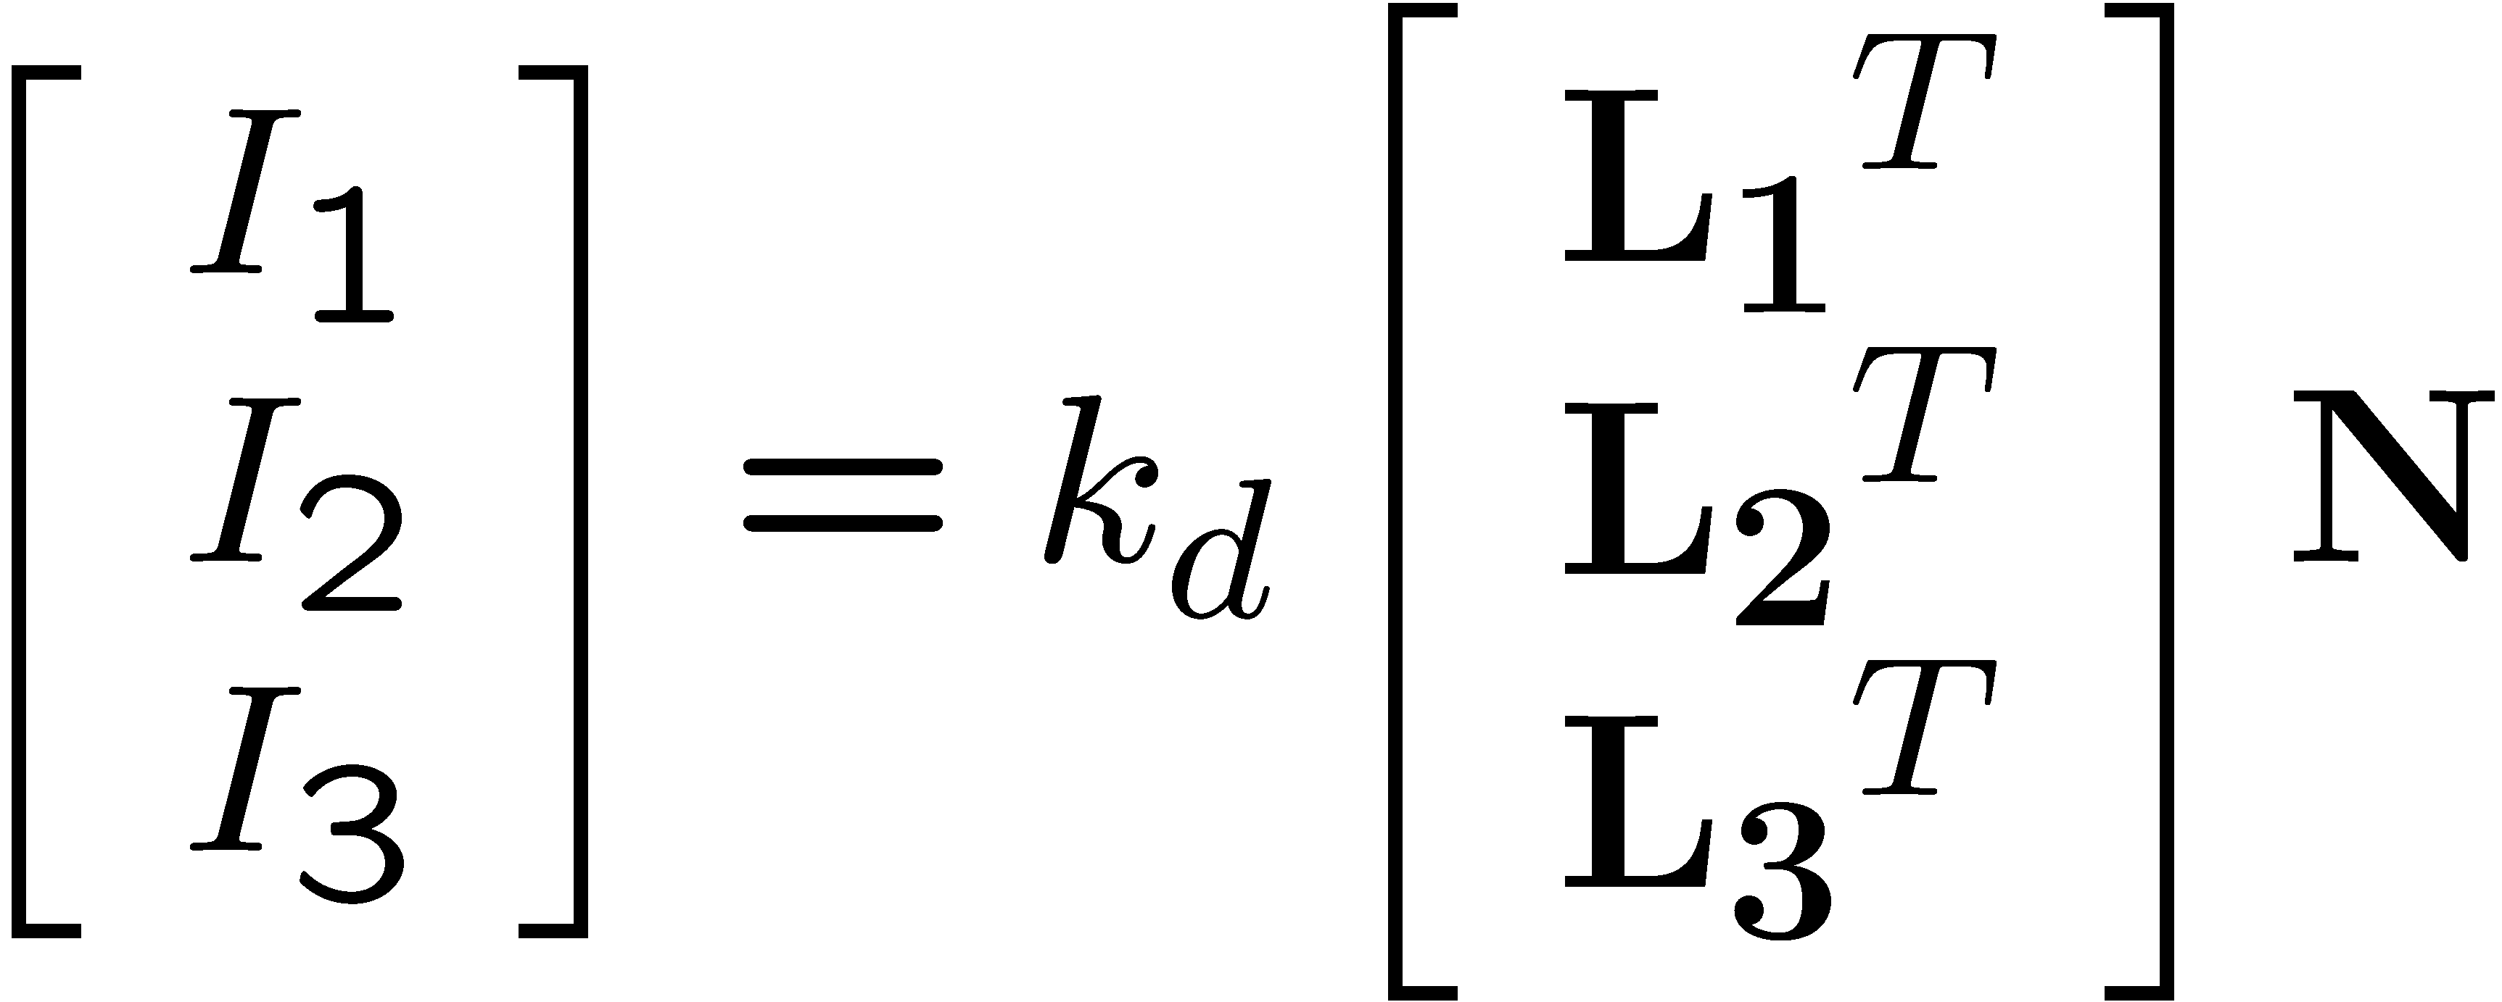
Photometric stereo
N
L₃
L₂
L₁
V
Can write this as a matrix equation:

Slide 7
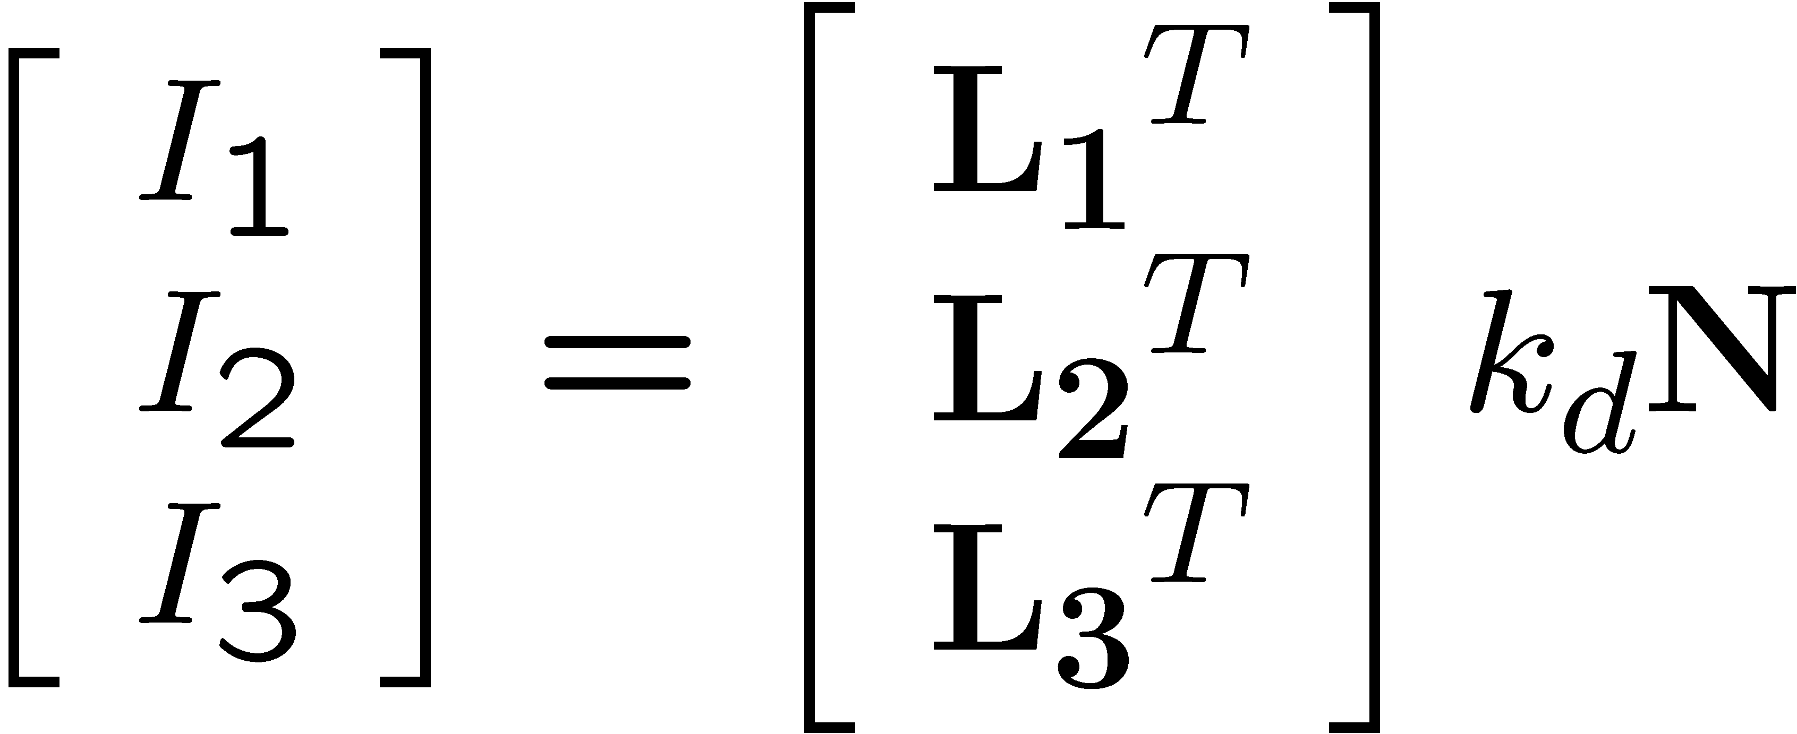


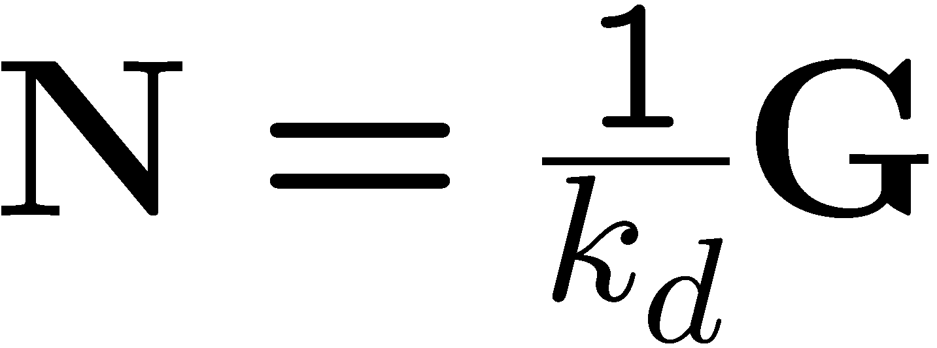





Solving the equations
Solve one such linear system per pixel to solve for that pixel’s surface normal

Slide 8
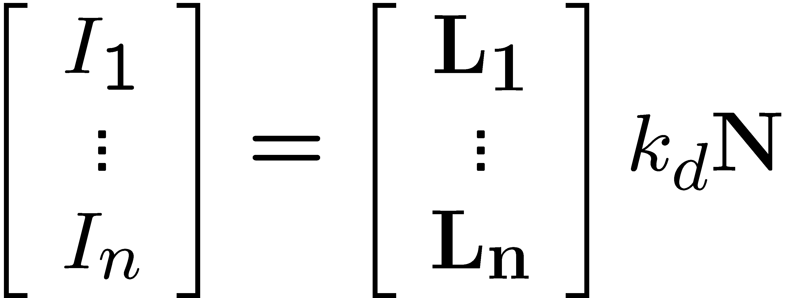
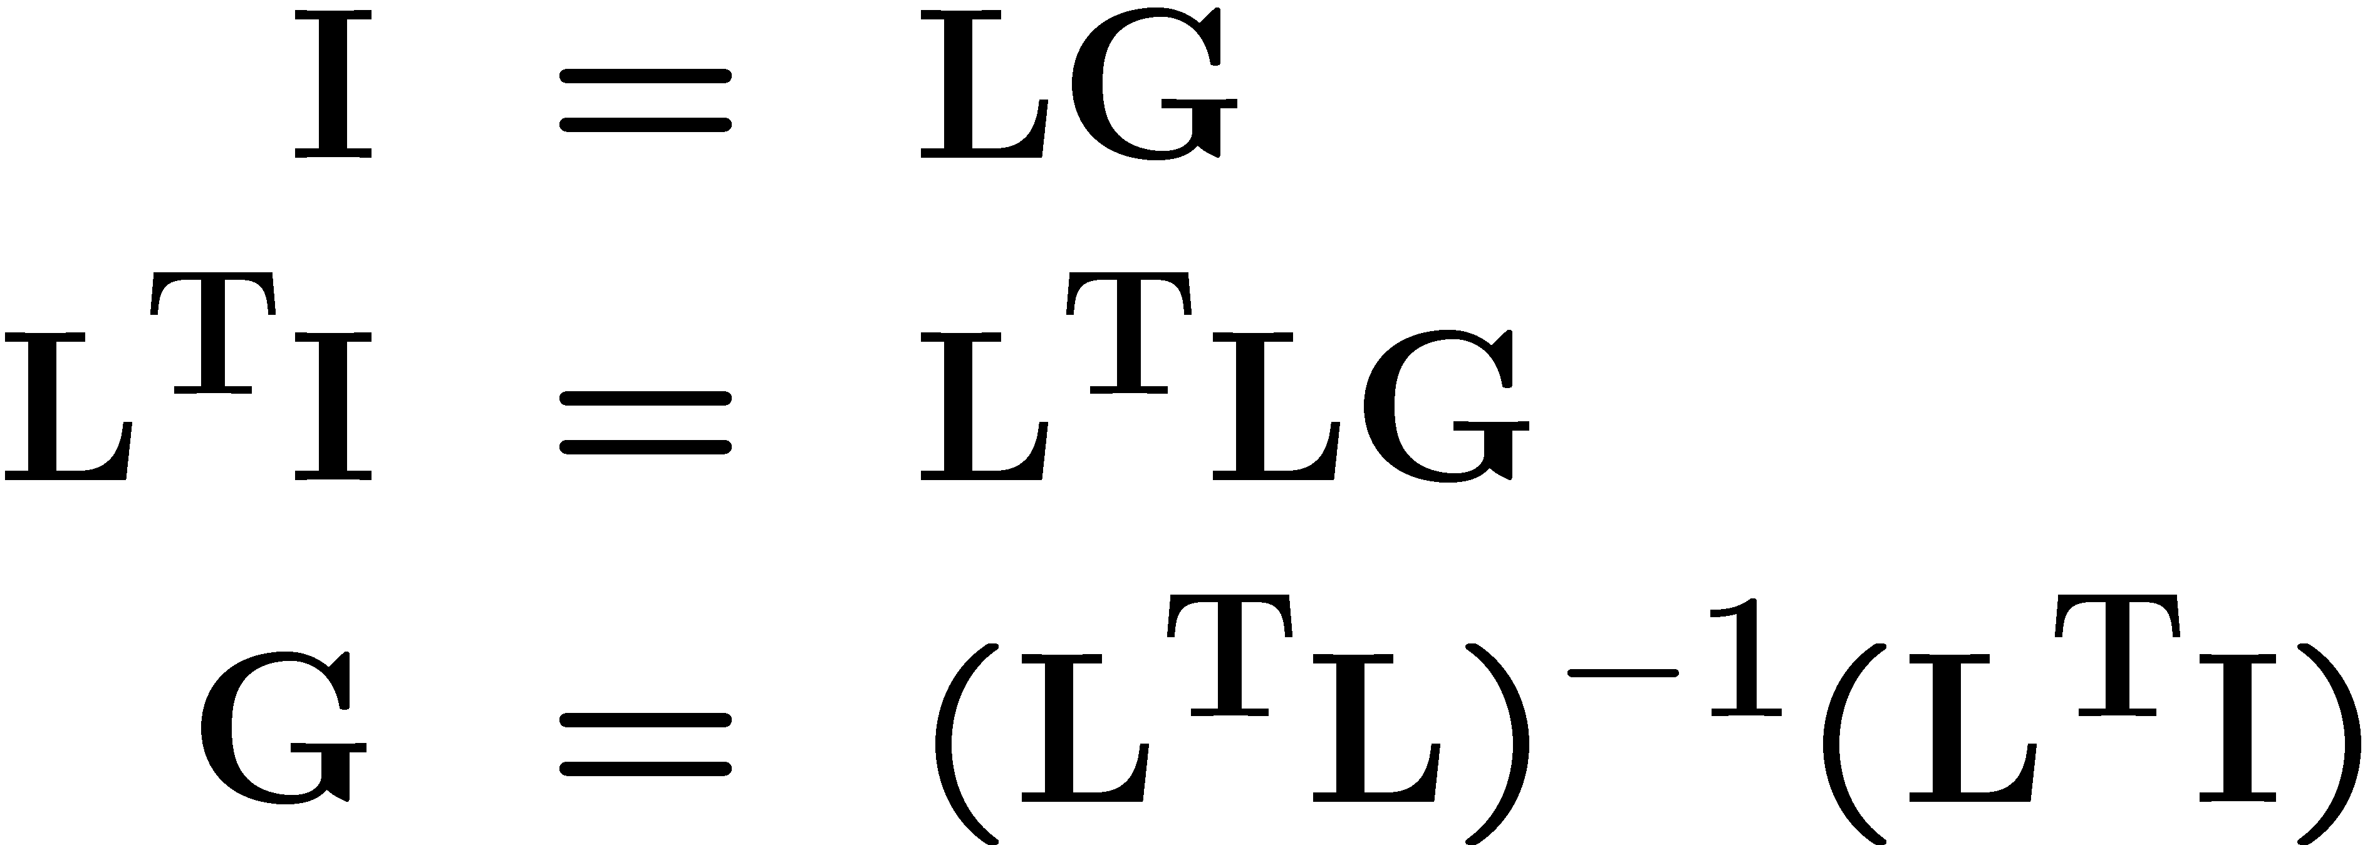
More than three lights
Can get better results by using more than 3 lights
Least squares solution:
Solve for N, k_{d} as before
What’s the size of L^{T}L?

Slide 9
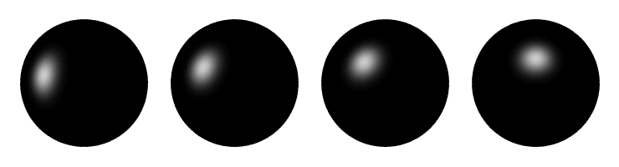
Computing light source directions
Trick: place a chrome sphere in the scene
  the location of the highlight tells you where the light source is

Slide 10

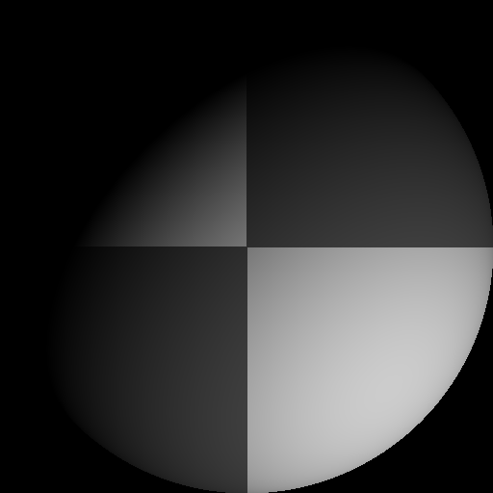
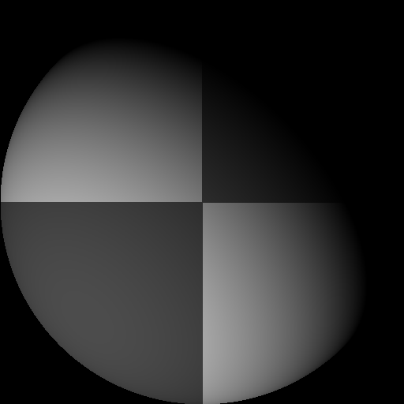
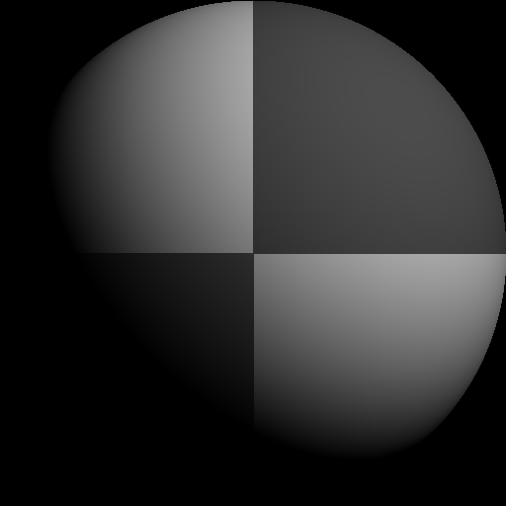

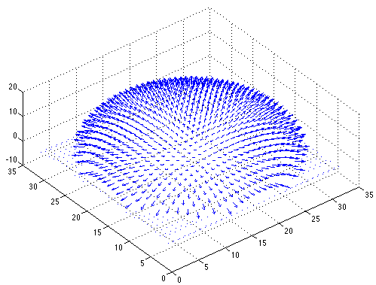

Example
Input views
Recovered albedo
Recovered normal field
Forsyth & Ponce, Sec. 5.4

Slide 11

Depth from normals
Solving the linear system per-pixel gives us an estimated surface normal for each pixel
How can we compute depth from normals?
  Normals are like the “derivative” of the true depth
Input photo
Estimated normals
Estimated normals (needle diagram)

Slide 12
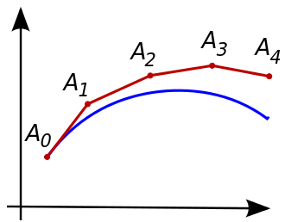
Normal Integration
Integrating a set of derivatives is easy in 1D
  (similar to Euler’s method from diff. eq. class)
Could integrate normals in each column / row separately
  Wouldn’t give a good surface
Instead, we formulate as a linear system and solve for depths that best agree with the surface normals

Slide 13

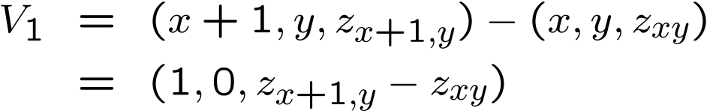


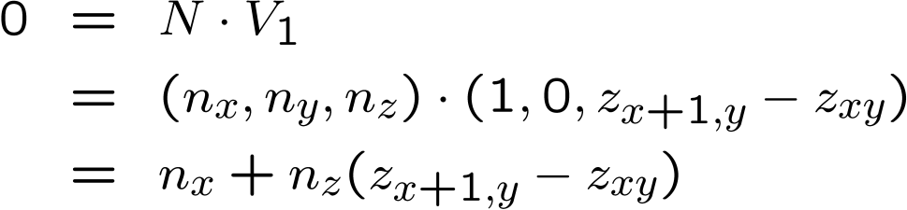

Depth from normals
V₂
V₁
N
Get a similar equation for V₂
  Each normal gives us two linear constraints on z
  compute z values by solving a matrix equation

Slide 14
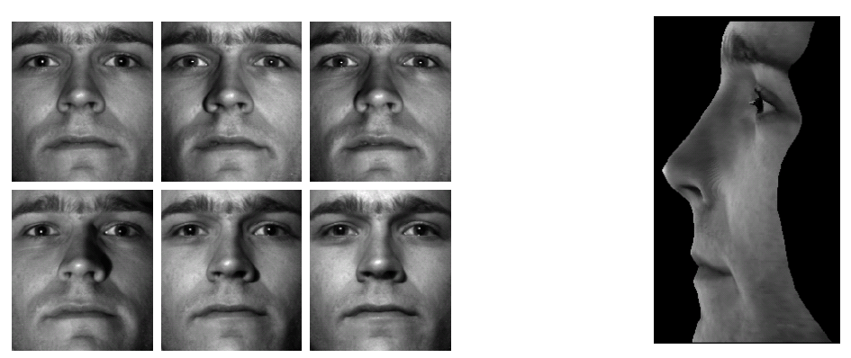
Results
from Athos Georghiades

Slide 15
Results

Slide 16
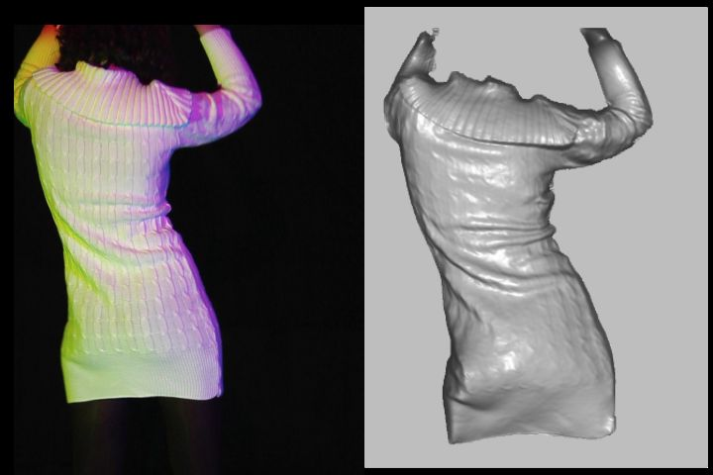
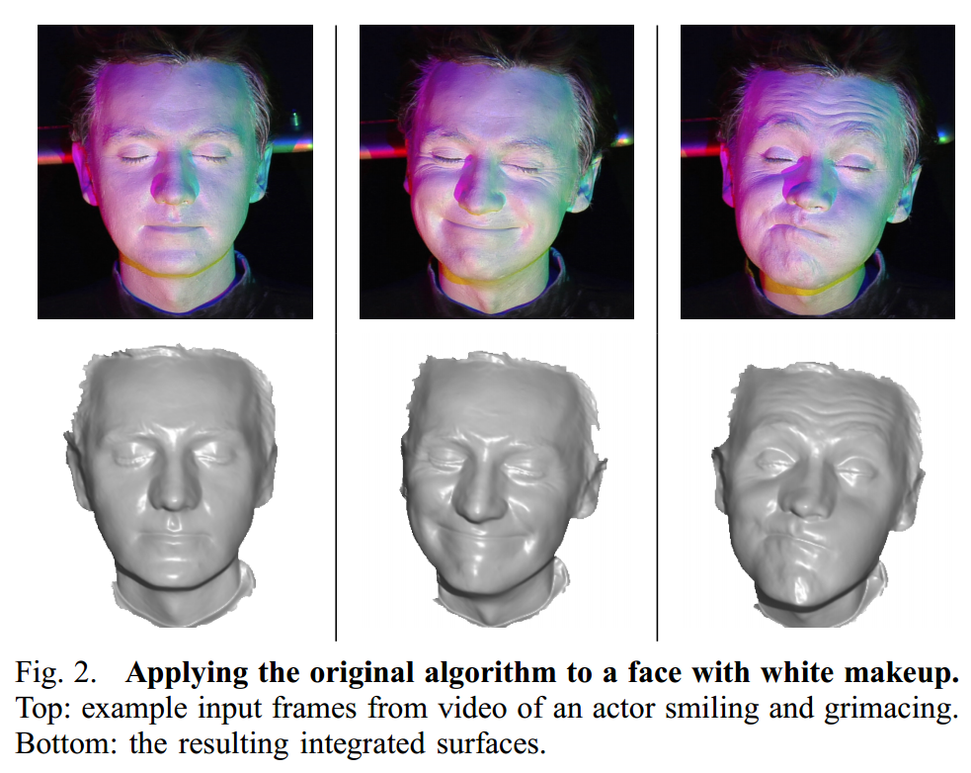
Extension
Photometric Stereo from Colored Lighting
Video Normals from Colored Lights
Gabriel J. Brostow, Carlos Hernández, George Vogiatzis, Björn Stenger, Roberto Cipolla
IEEE TPAMI, Vol. 33, No. 10, pages 2104-2114, October 2011.

Slide 17
Questions?

Slide 18
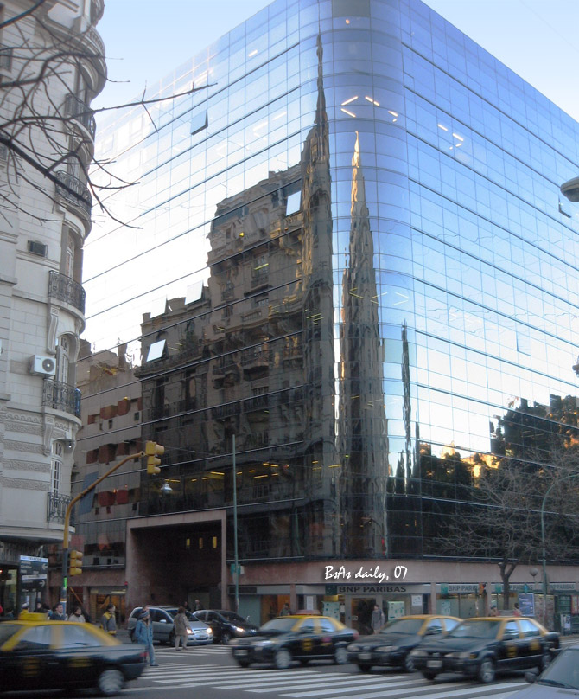
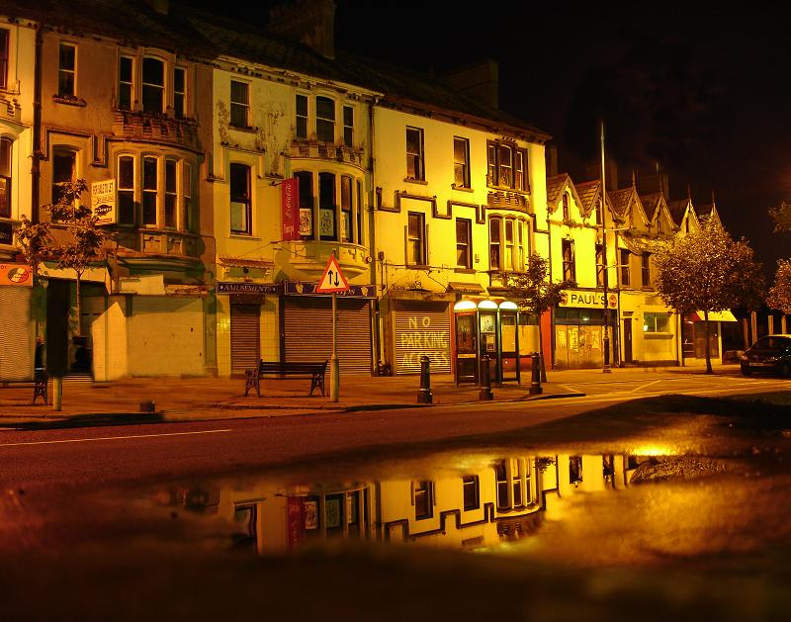
For now, ignore specular reflection
Slides from Photometric Methods for 3D Modeling, Matsushita, Wilburn, Ben-Ezra
Notes:
reflection

Slide 19

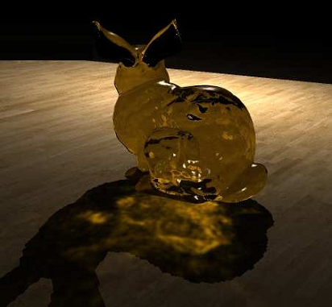
And Refraction…
Slides from Photometric Methods for 3D Modeling, Matsushita, Wilburn, Ben-Ezra

Slide 20
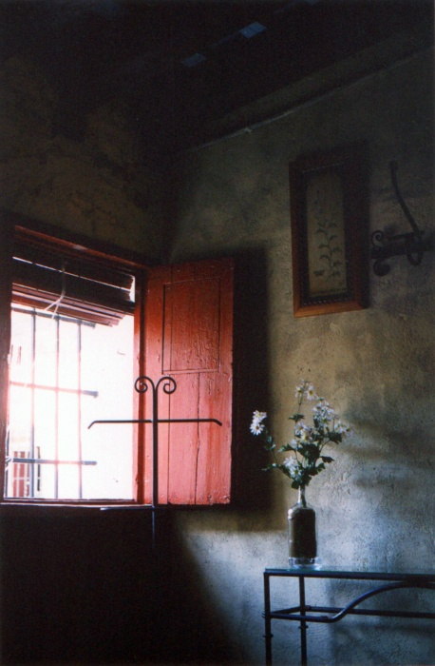
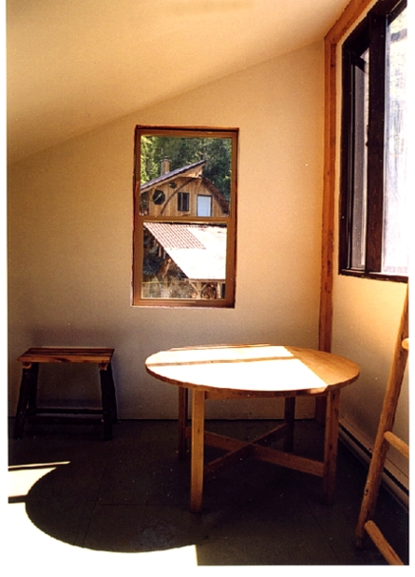
And Interreflections…
Slides from Photometric Methods for 3D Modeling, Matsushita, Wilburn, Ben-Ezra

Slide 21
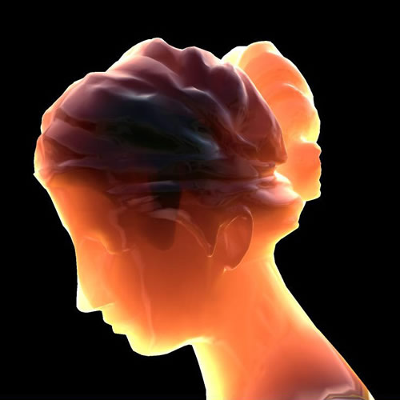
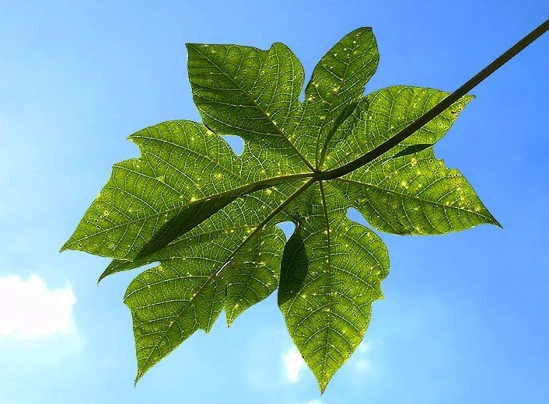
And Subsurface Scattering…
Slides from Photometric Methods for 3D Modeling, Matsushita, Wilburn, Ben-Ezra

Slide 22
Limitations
Bigger problems
  doesn’t work for shiny things, semi-translucent things
  shadows, inter-reflections
Smaller problems
  camera and lights have to be distant
  calibration requirements
    measure light source directions, intensities
    camera response function
Newer work addresses some of these issues
Some pointers for further reading:
  Zickler, Belhumeur, and Kriegman, "Helmholtz Stereopsis: Exploiting Reciprocity for Surface Reconstruction." IJCV, Vol. 49 No. 2/3, pp 215-227.
  Hertzmann & Seitz, “Example-Based Photometric Stereo: Shape Reconstruction with General, Varying BRDFs.” IEEE Trans. PAMI 2005

Slide 23
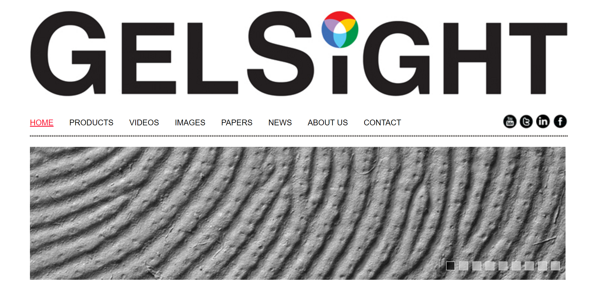
Johnson and Adelson, 2009

Slide 24
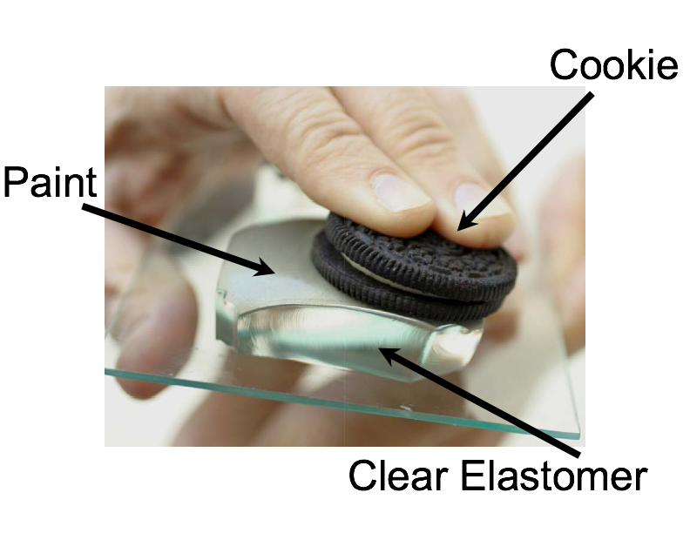
Johnson and Adelson, 2009

Slide 25
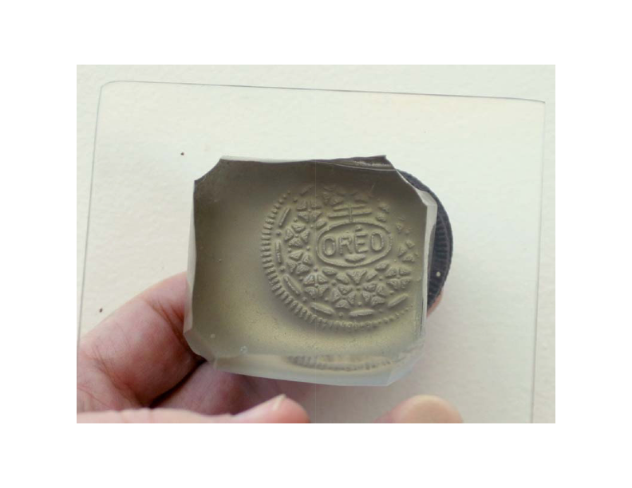

Slide 26
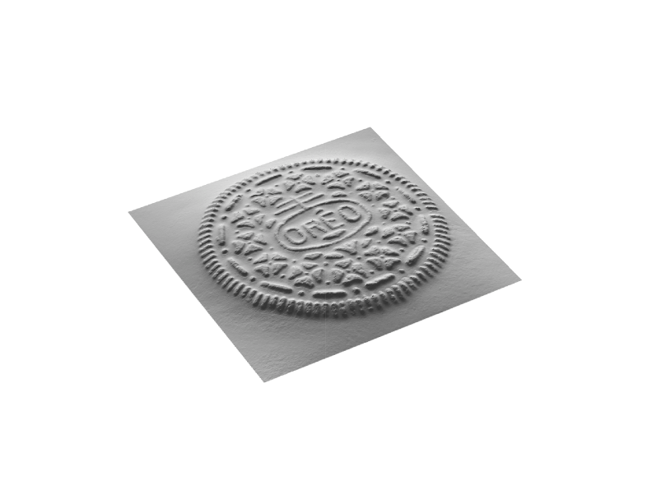

Slide 27
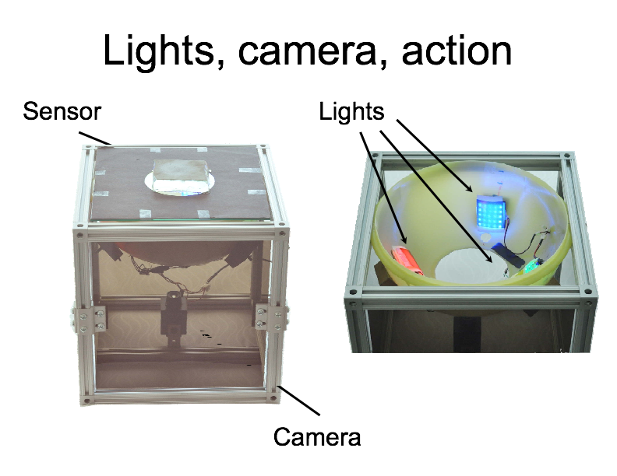

Slide 28
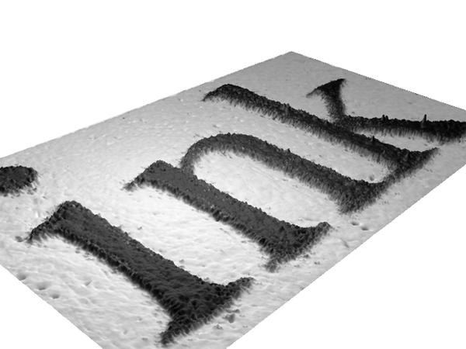

Slide 29
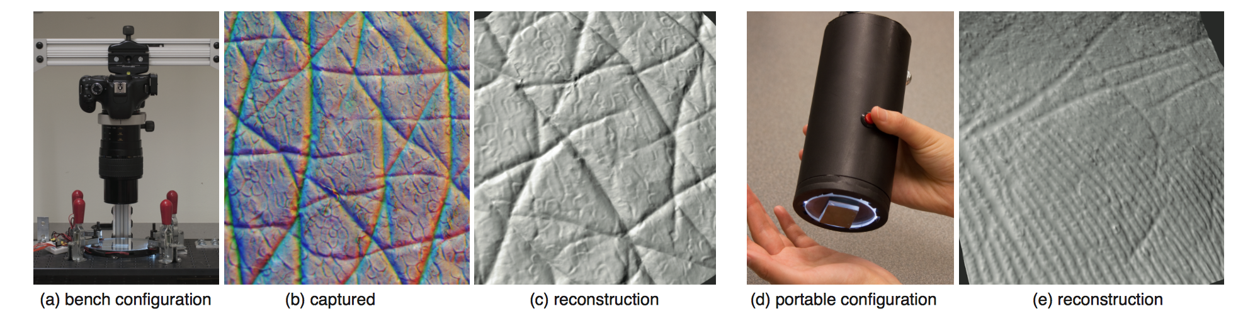
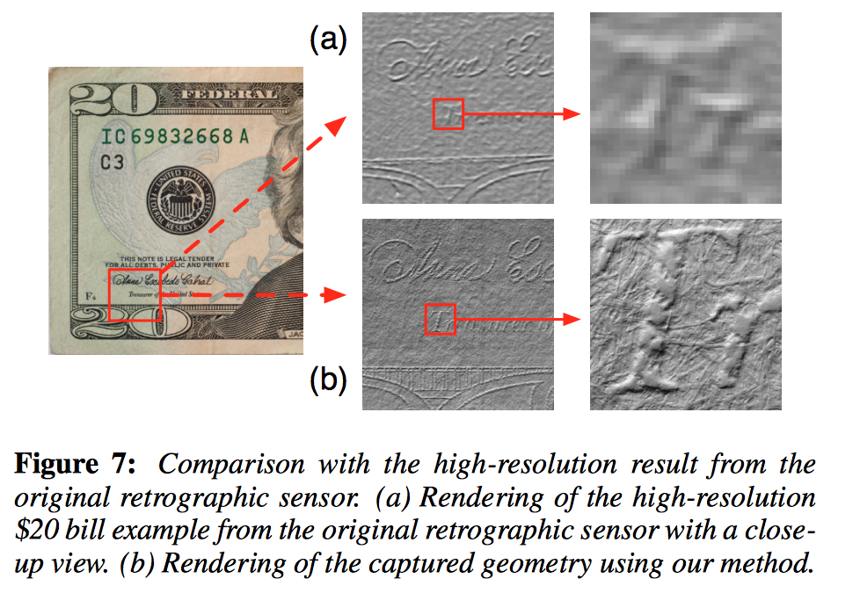

Slide 30
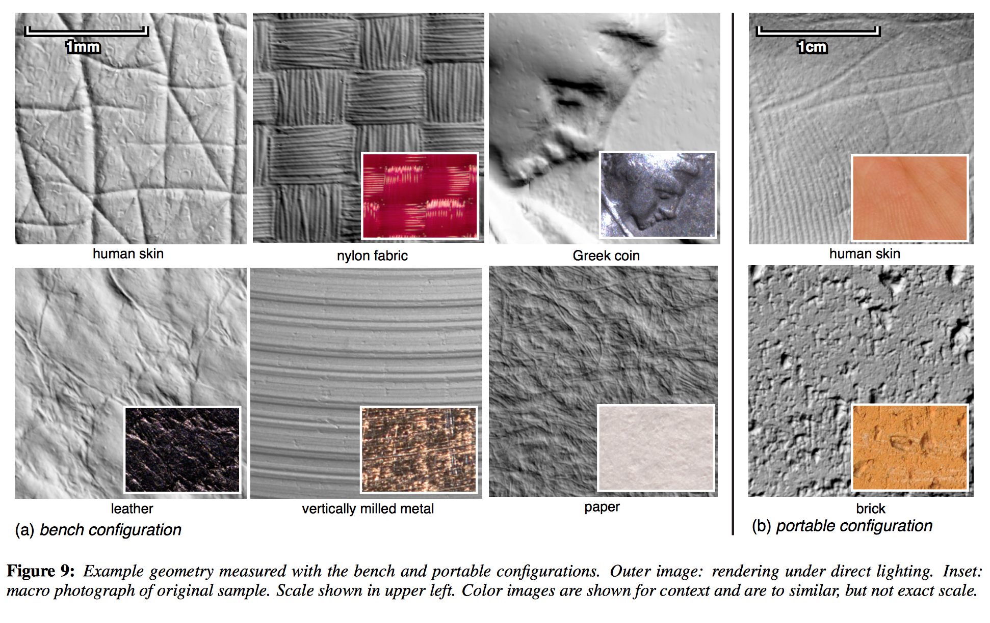

Slide 31
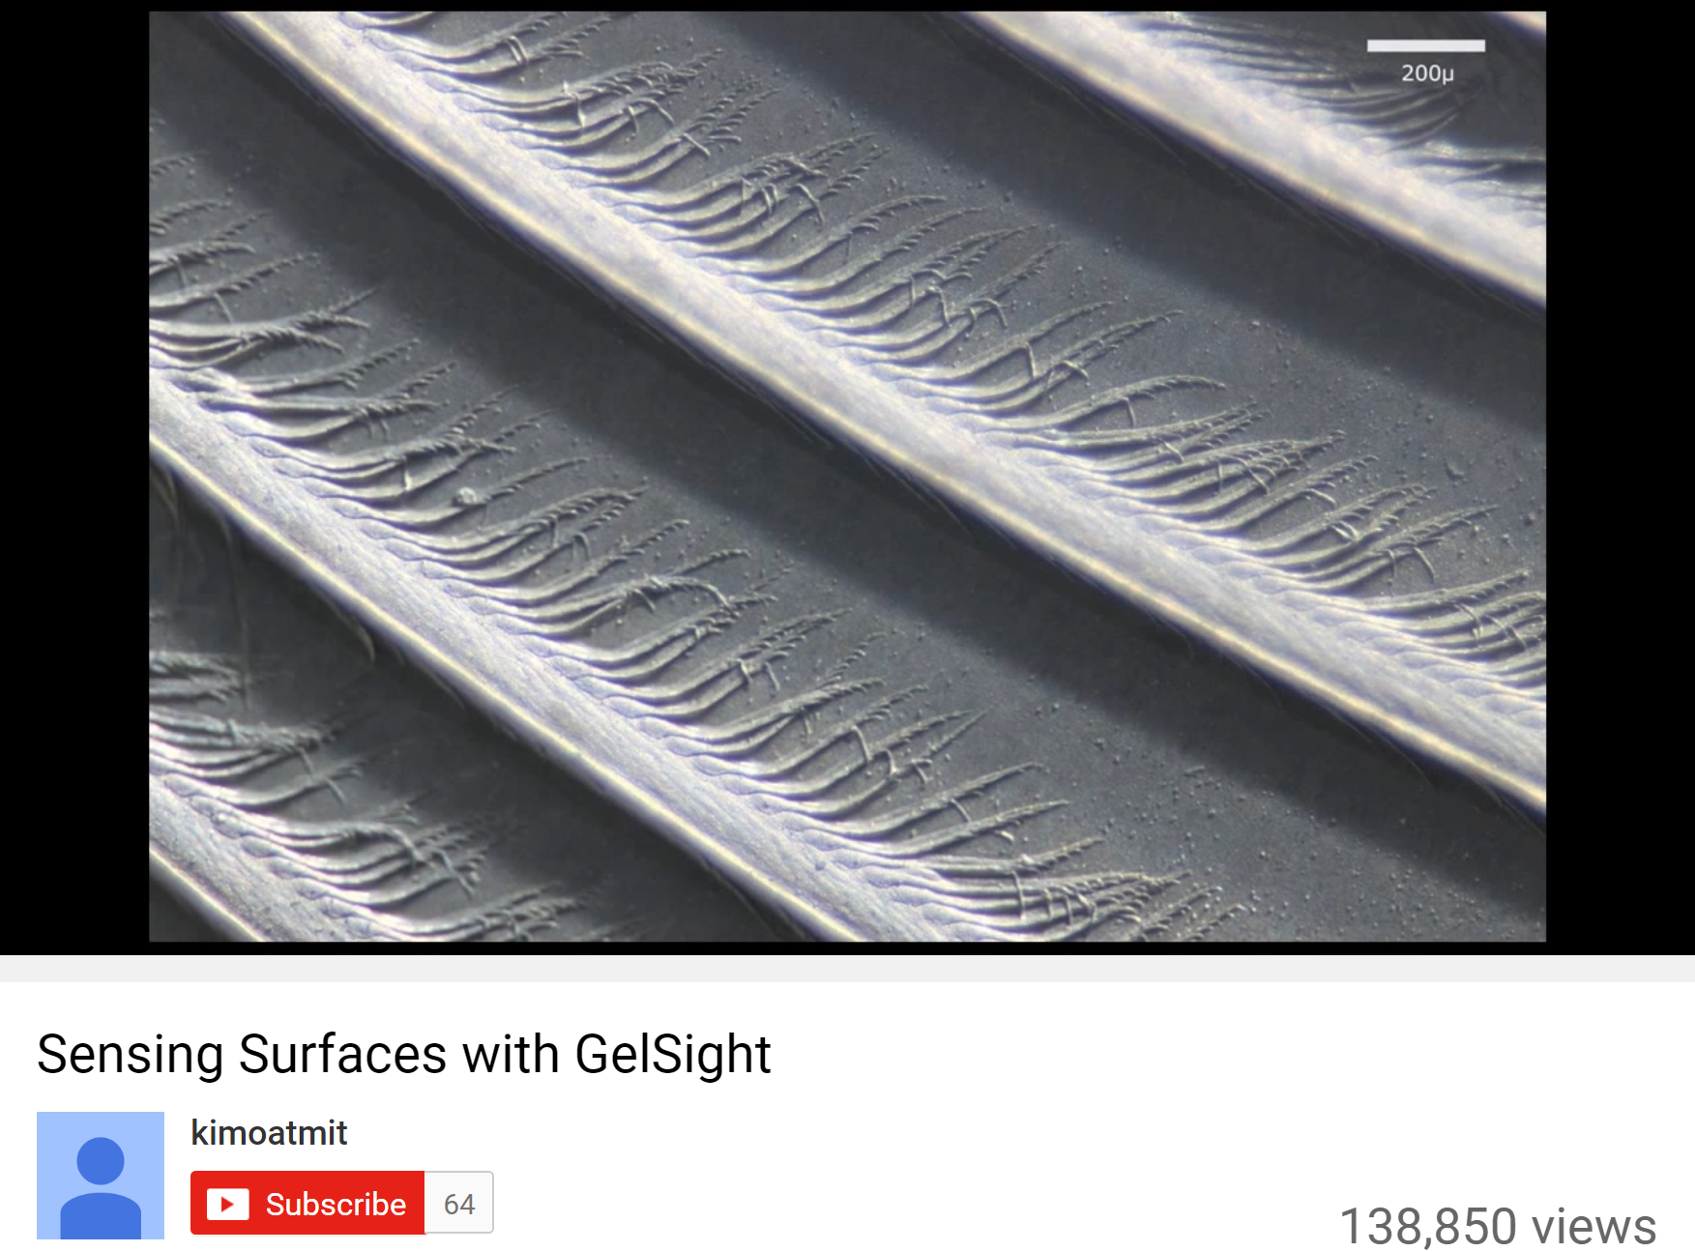
https://www.youtube.com/watch?v=S7gXih4XS7A

Slide 32
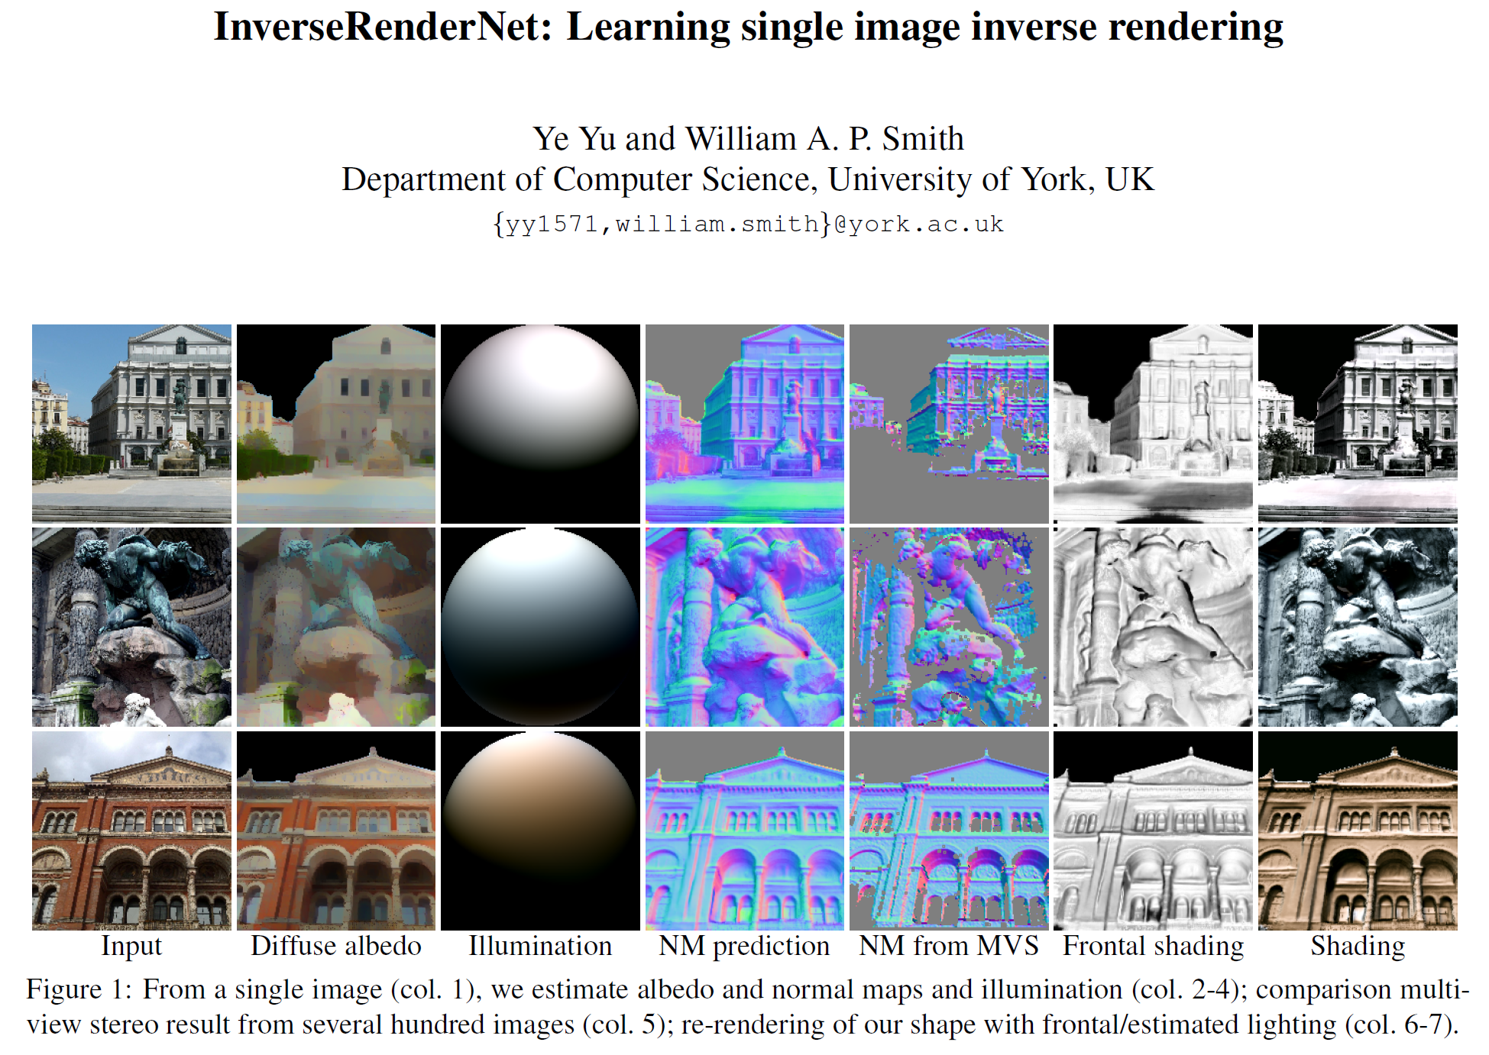

Slide 33
Questions?

