Slide 1
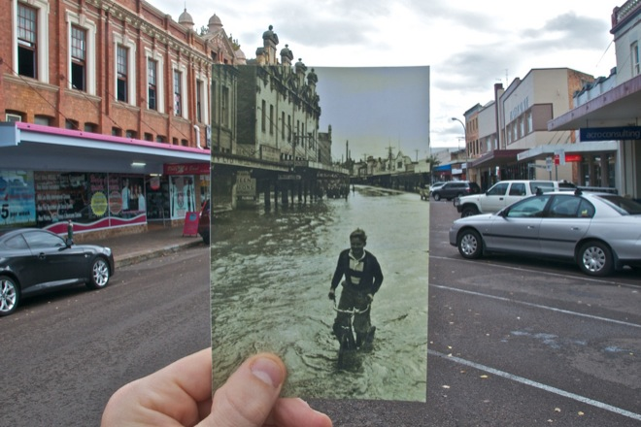
Image alignment
CS5760: Computer Vision
http://www.wired.com/gadgetlab/2010/07/camera-software-lets-you-see-into-the-past/

Slide 2
Reading
Szeliski (1st edition): Chapter 6.1

Slide 3
Announcements
Project 2 due this Friday, March 12 by 7pm
  Please get started now if you haven’t already!
  Report due next Monday, March 15 by 7pm on CMSX
Take-home midterm will be released next Monday, March 15, due Friday, March 19
  Open book, open note (but no Google)
  To be done on your own
No class this Wednesday, March 10 (Wellness Day)

Slide 4
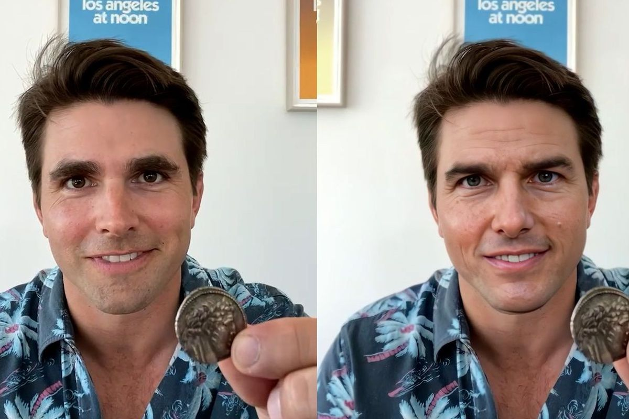
Today in Computer Vision
https://www.theverge.com/2021/3/5/22314980/tom-cruise-deepfake-tiktok-videos-ai-impersonator-chris-ume-miles-fisher

Slide 5
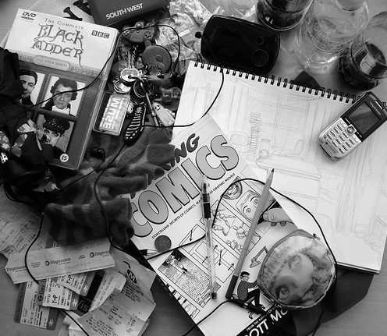
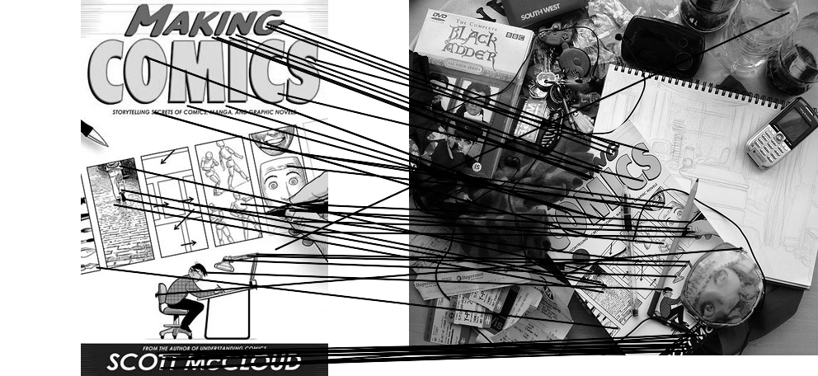
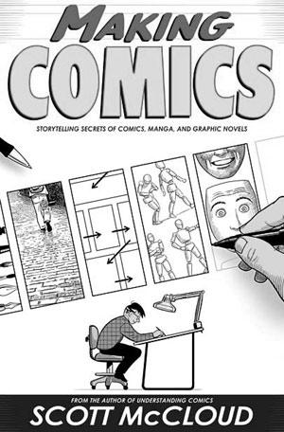
Computing transformations
Given a set of matches between images A and B
  How can we compute the transform T from A to B?
  Find transform T that best “agrees” with the matches

Slide 6
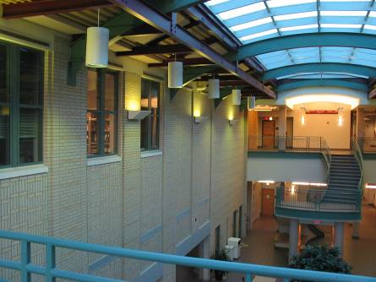
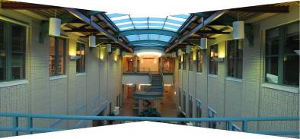
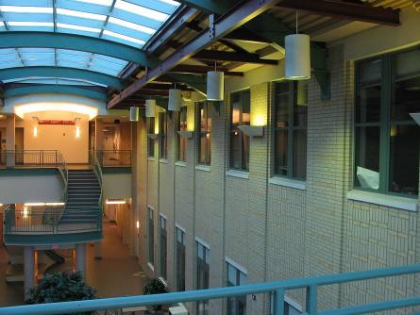
Computing transformations
?

Slide 7
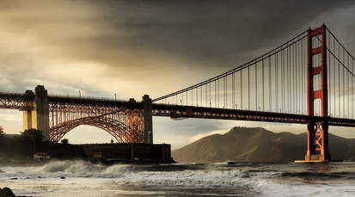


Simple case: translations
How do we solve for
?

Slide 8






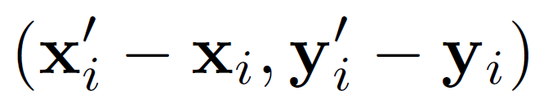
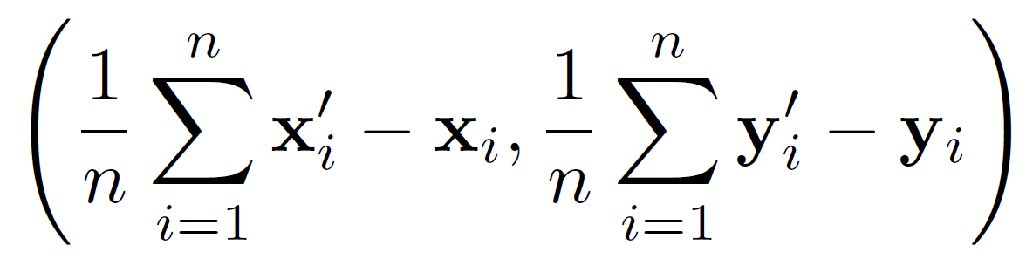
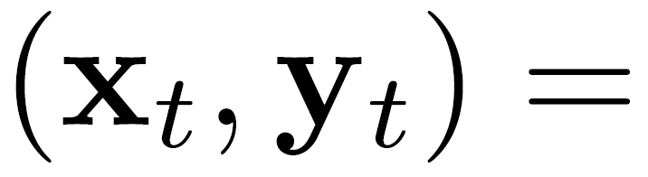
Simple case: translations
Displacement of match i =
Mean displacement =

Slide 9
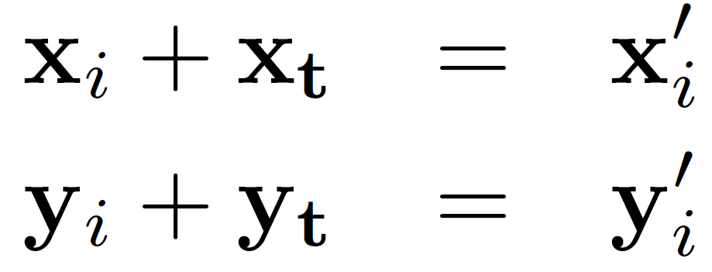
Another view
System of linear equations
  What are the knowns? Unknowns?
  How many unknowns? How many equations (per match)?

Slide 10
Another view
Problem: more equations than unknowns
  “Overdetermined” system of equations
  We will find the least squares solution

Slide 11
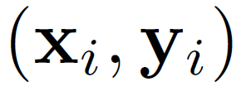
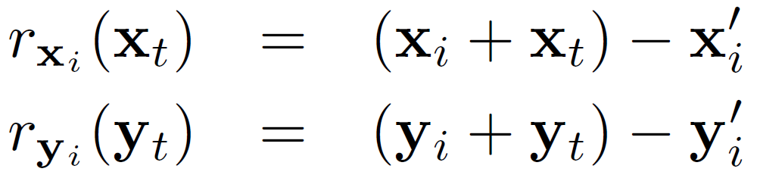
Least squares formulation
For each point
we define the residuals as

Slide 12
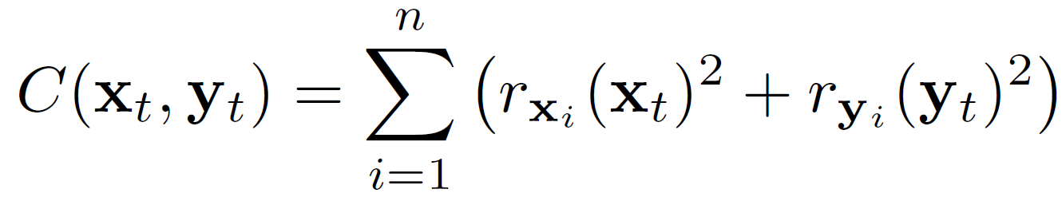
Least squares formulation
Goal: minimize sum of squared residuals
“Least squares” solution
For translations, is equal to mean (average) displacement

Slide 13
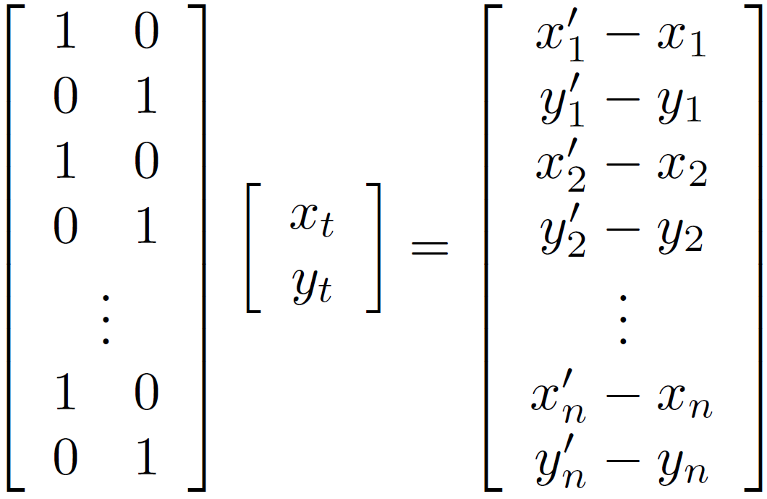




Least squares formulation
Can also write as a matrix equation
2n x 2
2 x 1
2n x 1

Slide 14

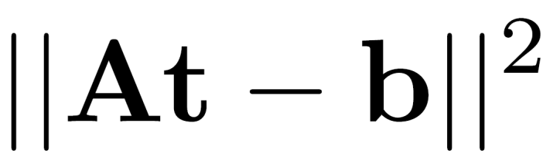
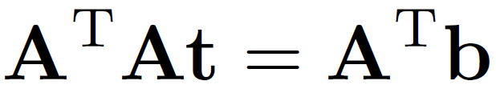
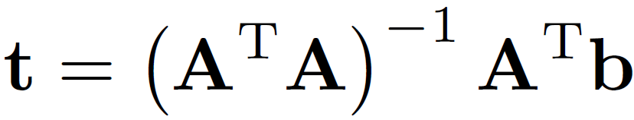
Least squares
Find t that minimizes
To solve, form the normal equations

Slide 15
Questions?

Slide 16
Least squares: linear regression
(y_{i}, x_{i})
y = mx + b

Slide 17
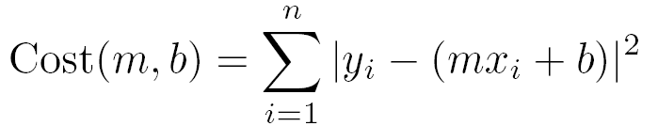
Linear regression
residual error

Slide 18
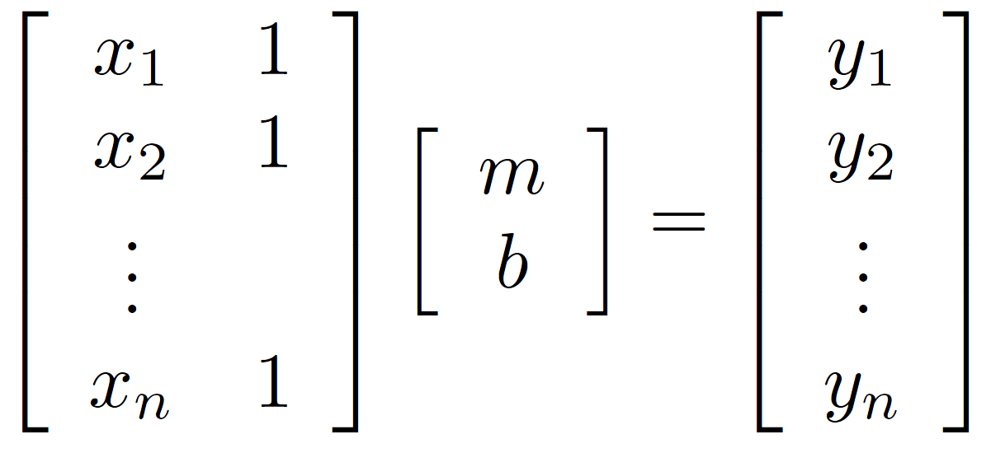
Linear regression

Slide 19
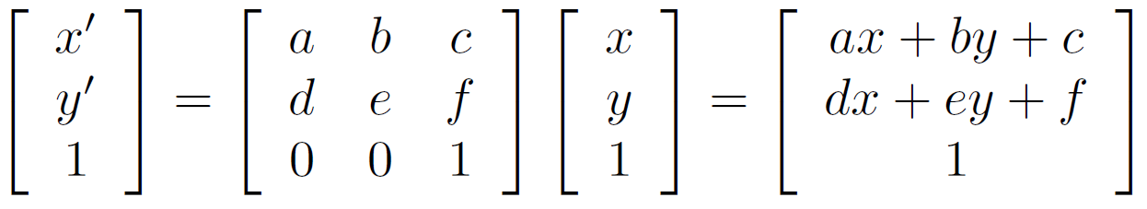
Affine transformations
How many unknowns?
How many equations per match?
How many matches do we need?

Slide 20
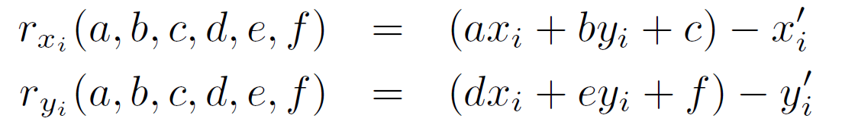

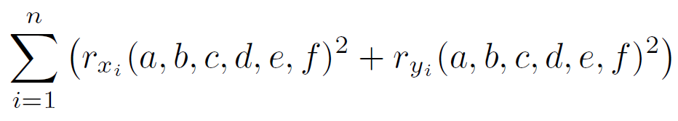
Affine transformations
Residuals:
Cost function:

Slide 21
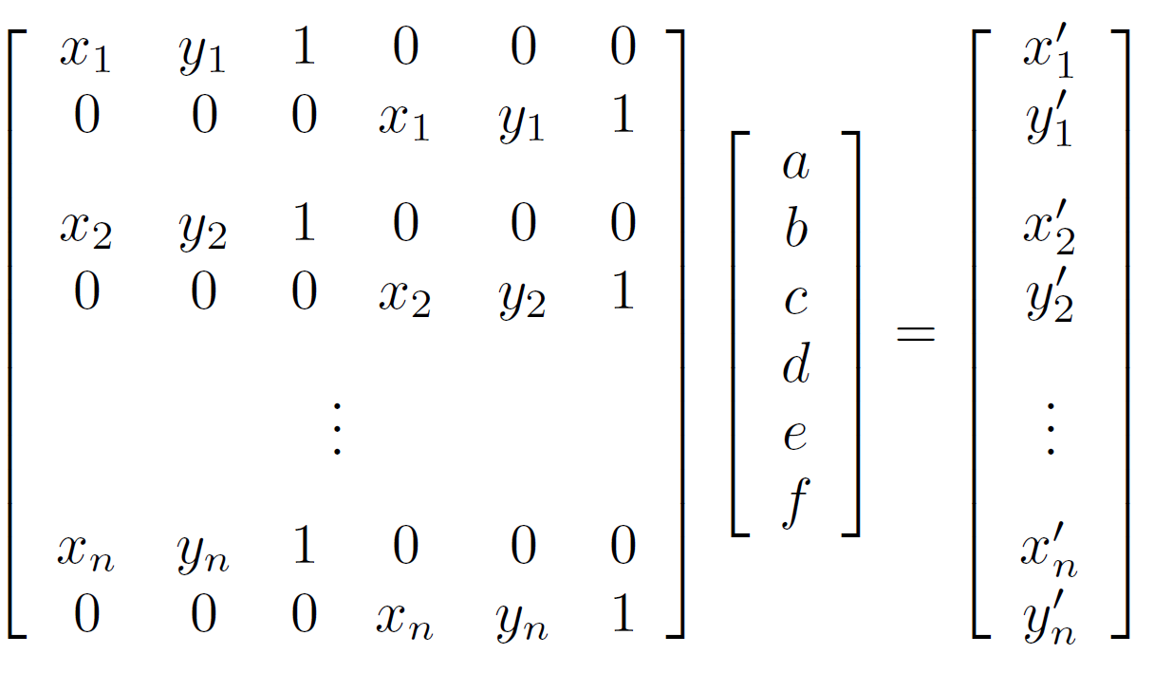
Affine transformations
Matrix form
2n x 6
6 x 1
2n x 1

Slide 22
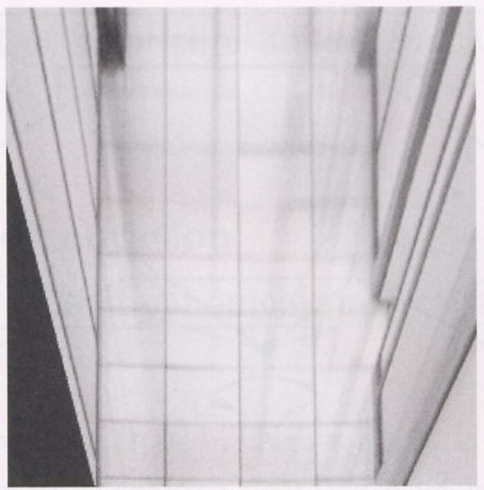
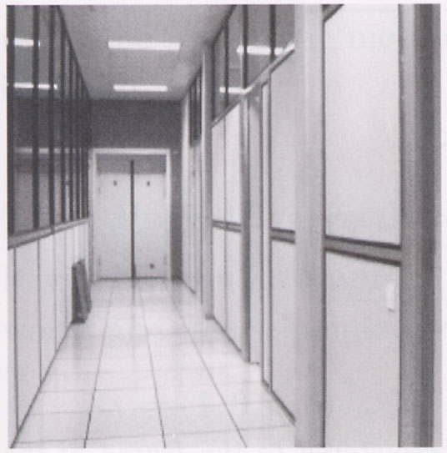
Homographies
p’
p
To unwarp (rectify) an image
  solve for homography H given p and p’
  solve equations of the form: wp’ = Hp
    linear in unknowns: w and coefficients of H
    H is defined up to an arbitrary scale factor
    how many matches are necessary to solve for H?

Slide 23
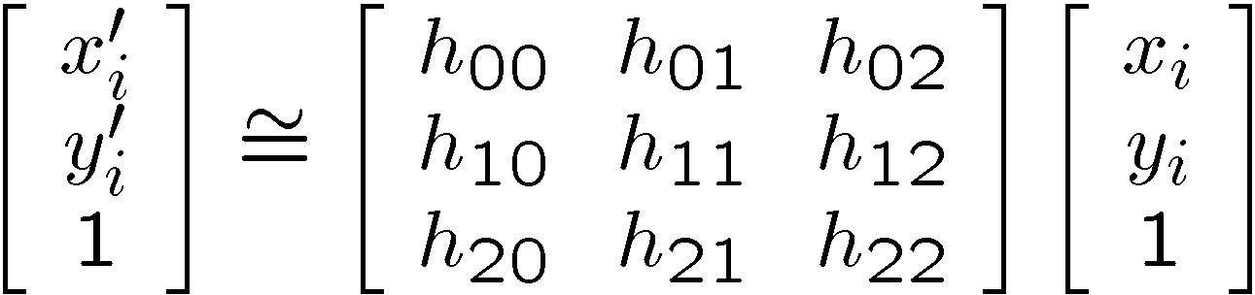
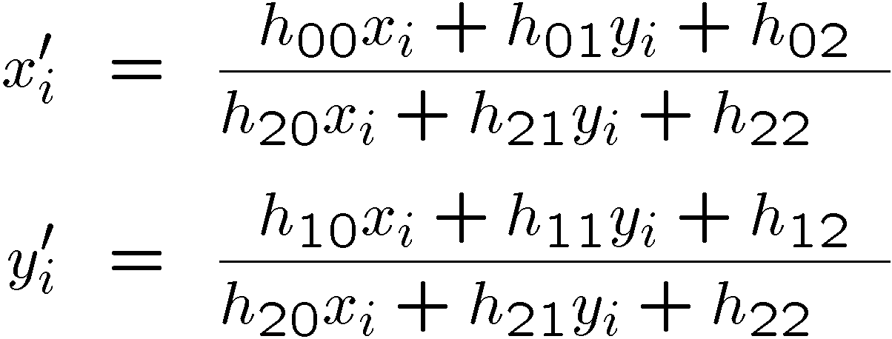
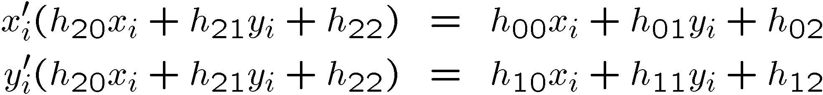
Solving for homographies
Not linear!

Slide 24
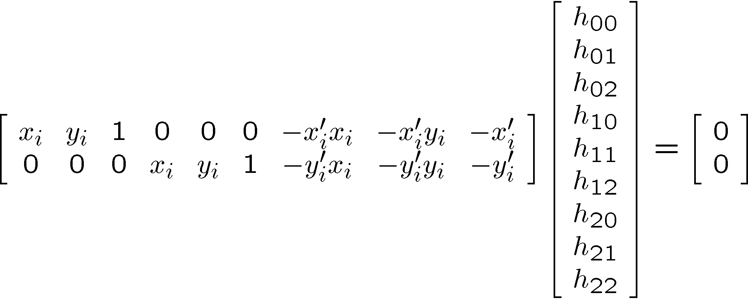
Solving for homographies

Slide 25
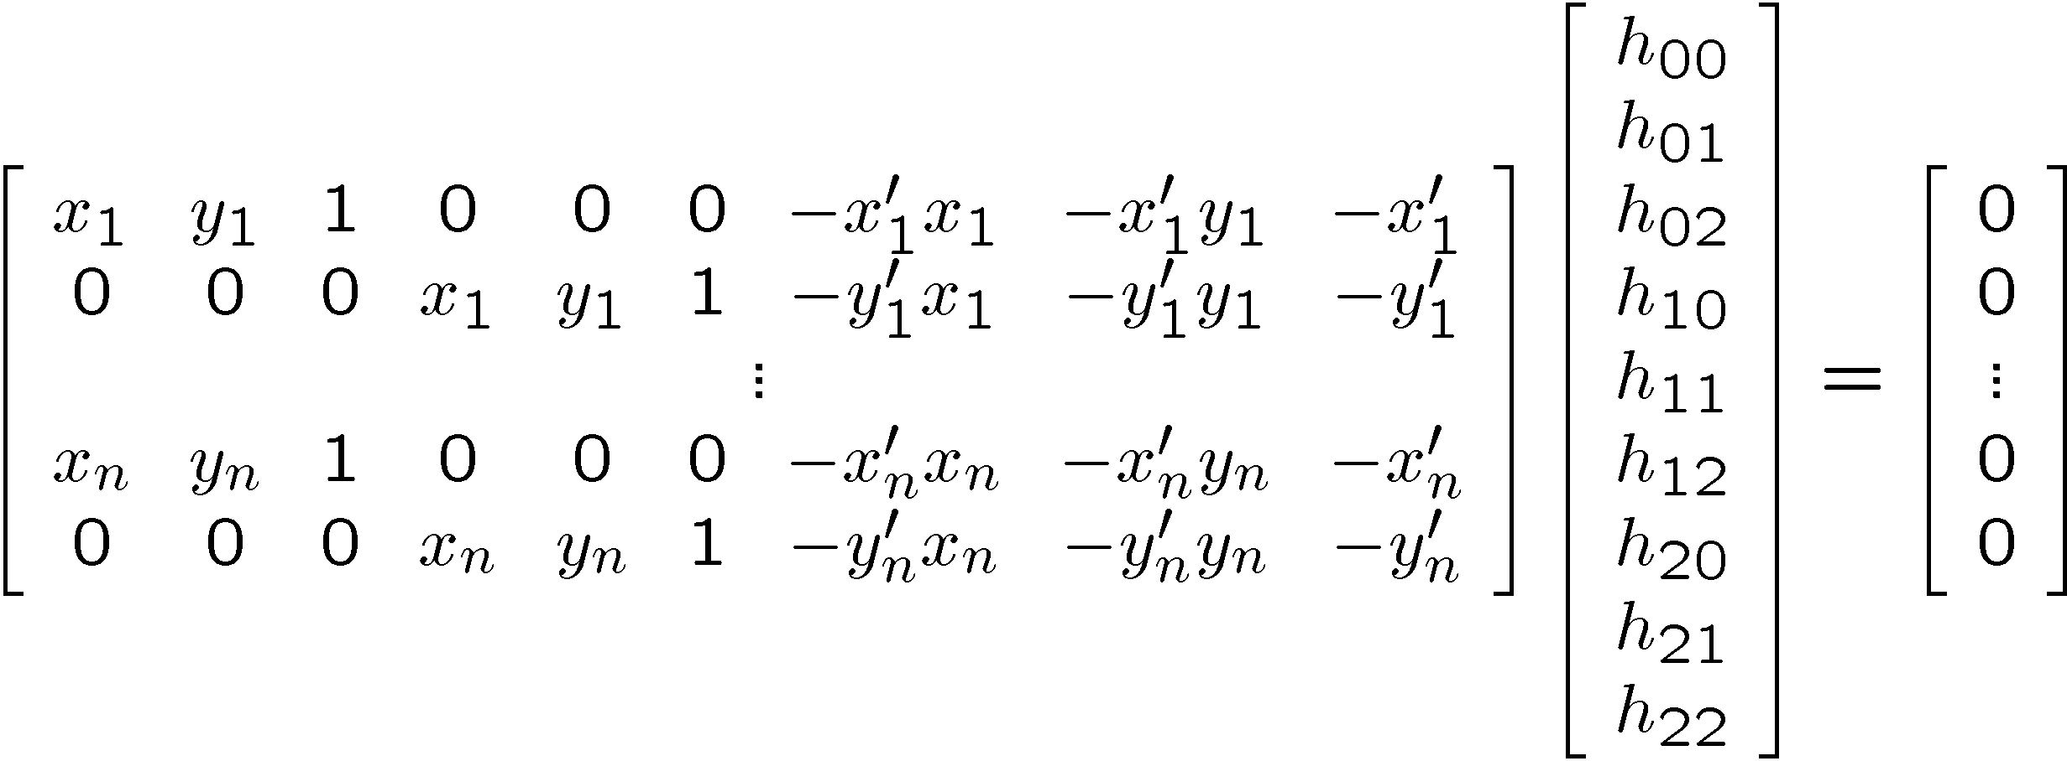





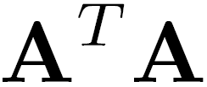
Solving for homographies
2n × 9
9
2n
Defines a least squares problem:
  Since is only defined up to scale, solve for unit vector
  Solution: = eigenvector of with smallest eigenvalue
  Works with 4 or more points

Slide 26





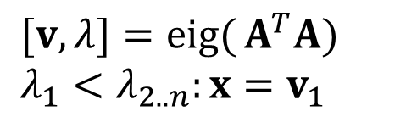
Recap: Two Common Optimization Problems
Problem statement
Solution
$$\operatorname{minimize}{ } {\left\|Ax−b\right\|}^{2}$$
$$x={\left(A^{T}A\right)}^{−1}A^{T}b$$
$$\text{(}\text{least} \text{squares} \text{solution} \text{to} Ax=b)$$
$$x=A\backslash b$$
(matlab)
Problem statement
Solution
$$\operatorname{minimize}{ } x^{T}A^{T}Ax s.t. x^{T}x=1$$
$$[v,λ]=\operatorname{eig}{(}A^{T}A) \\ λ_{1}<λ_{2..n}:x=v_{1}$$
($\text{non}\text{−}\text{trivial} \text{lsq} \text{solution} \text{to} Ax=0$)

Slide 27
Computing transformations

Slide 28
Questions?

Slide 29
Image Alignment Algorithm
Given images A and B
Compute image features for A and B
Match features between A and B
Compute homography between A and B using least squares on set of matches
What could go wrong?

Slide 30
Outliers
outliers
inliers

