Slide 1
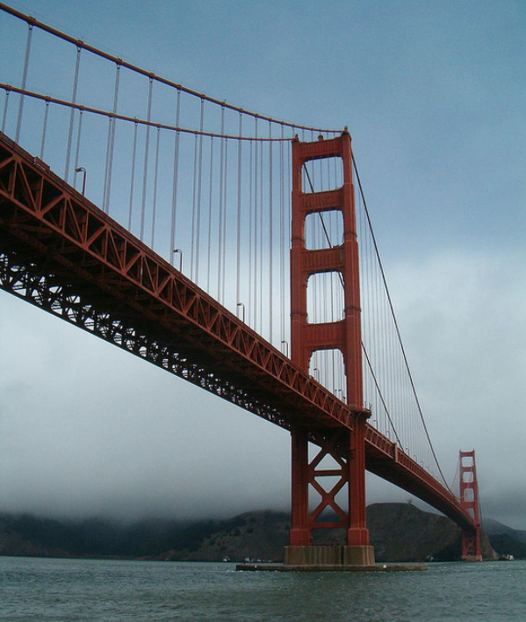
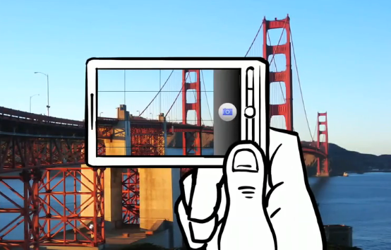
Feature matching
CS5670: Computer Vision

Slide 2
Reading
Szeliski (1st edition): 4.1

Slide 3
Announcements
Project 1 artifact due tonight at 11:59pm on CMSX
Project 2 out today, due Friday, March 12 at 7pm
To be done in groups of two – will host breakout sessions at the end of class (last 10 minutes)
A (slightly shorter) quiz this Wednesday, due 7 minutes after the start of class

Slide 4
Project 2 Demo

Slide 5
Alternate Harris score
For Project 2, you will use an alternate definition of the Harris score:

Slide 6
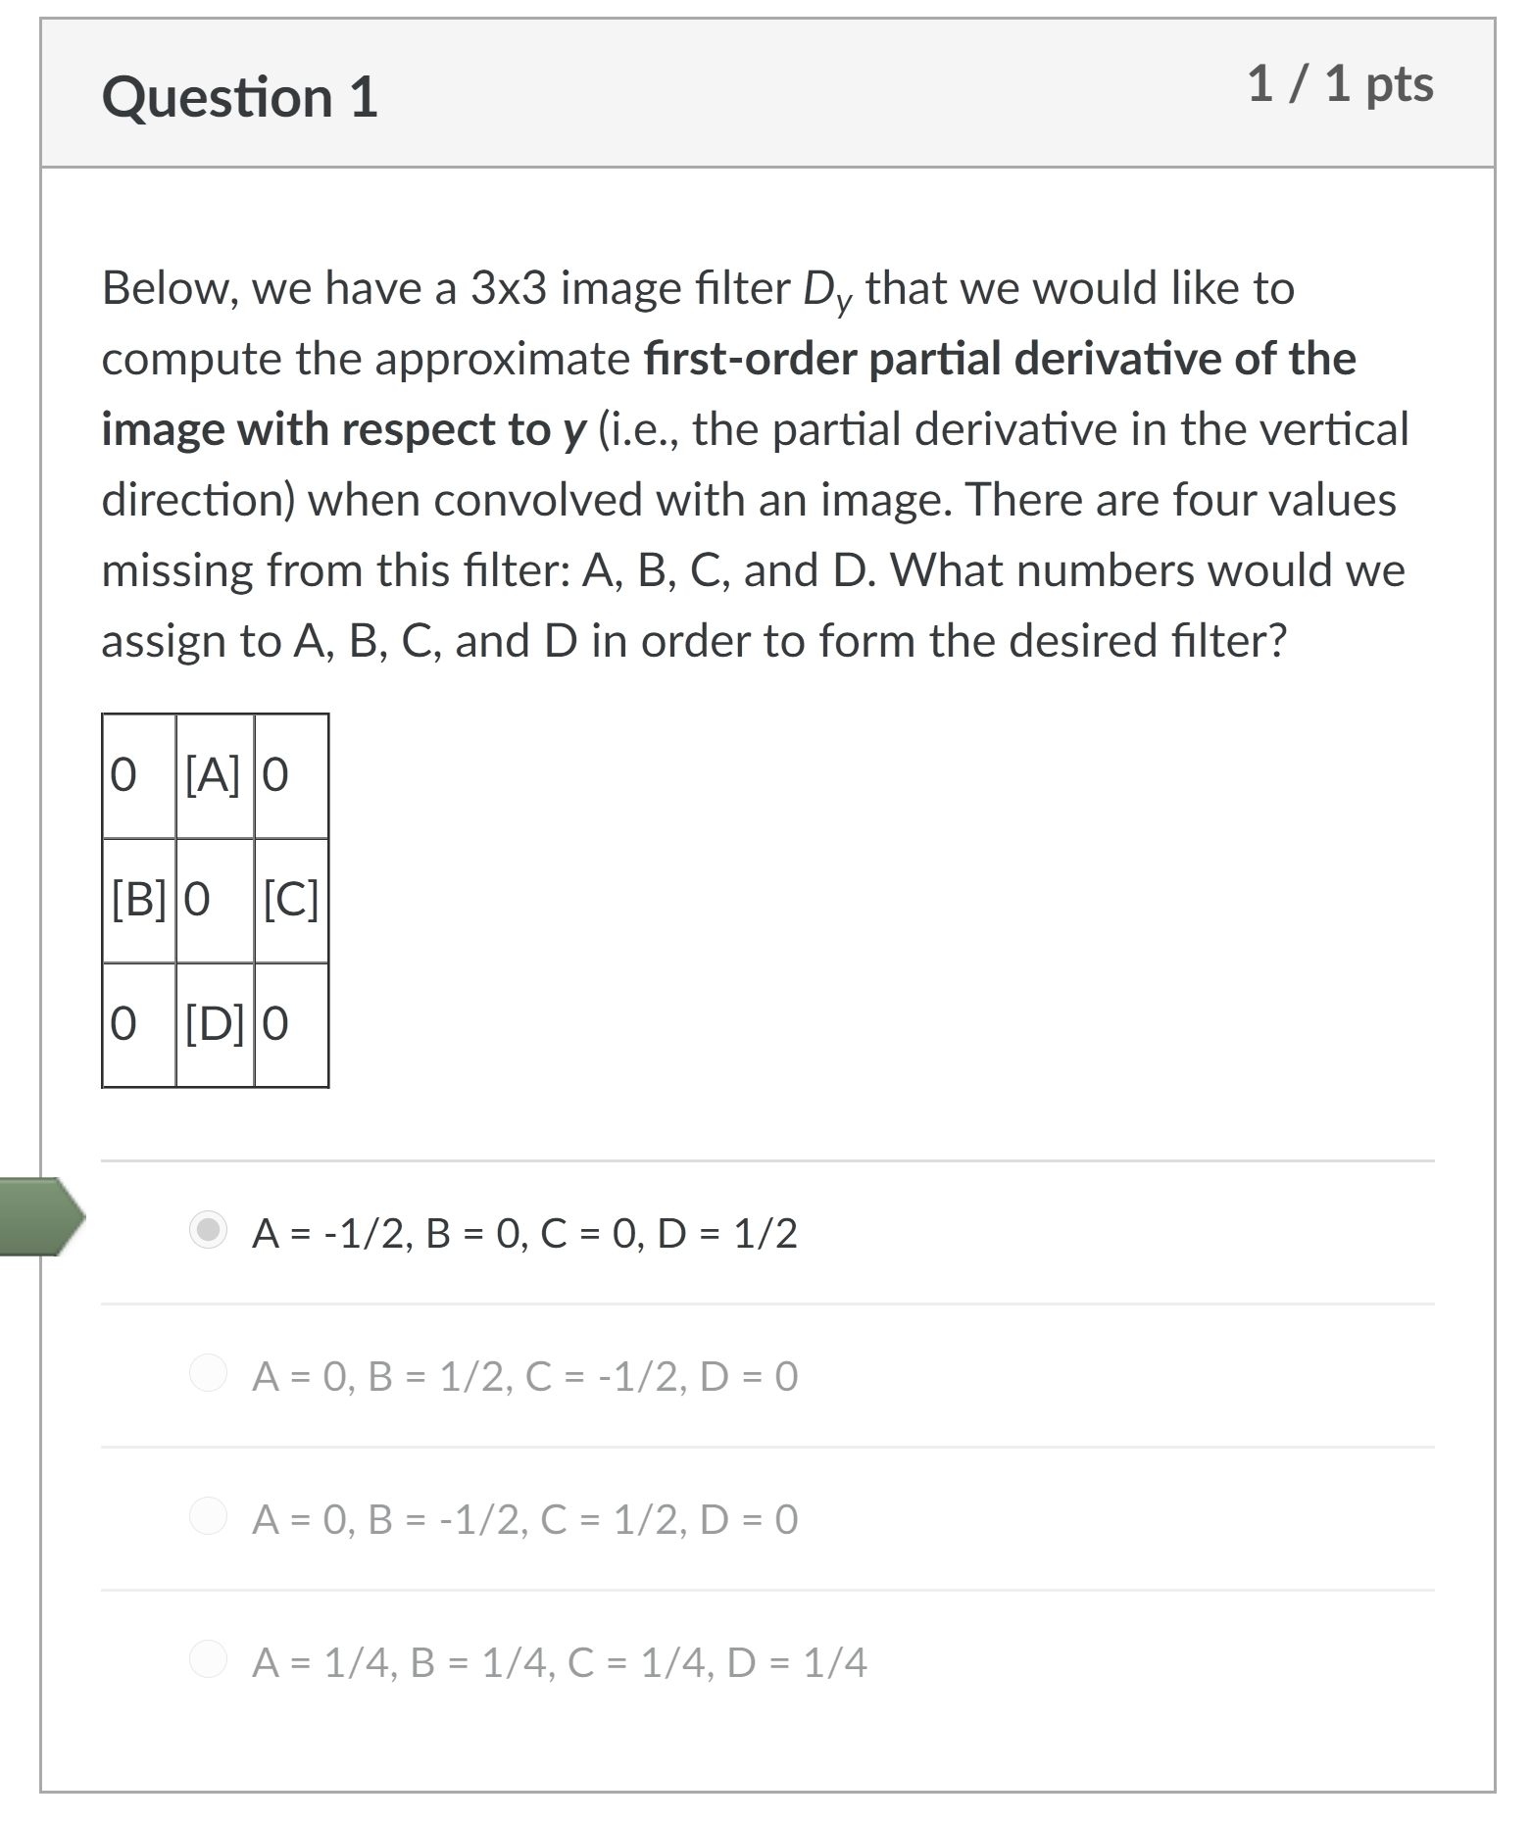
Quiz

Slide 7
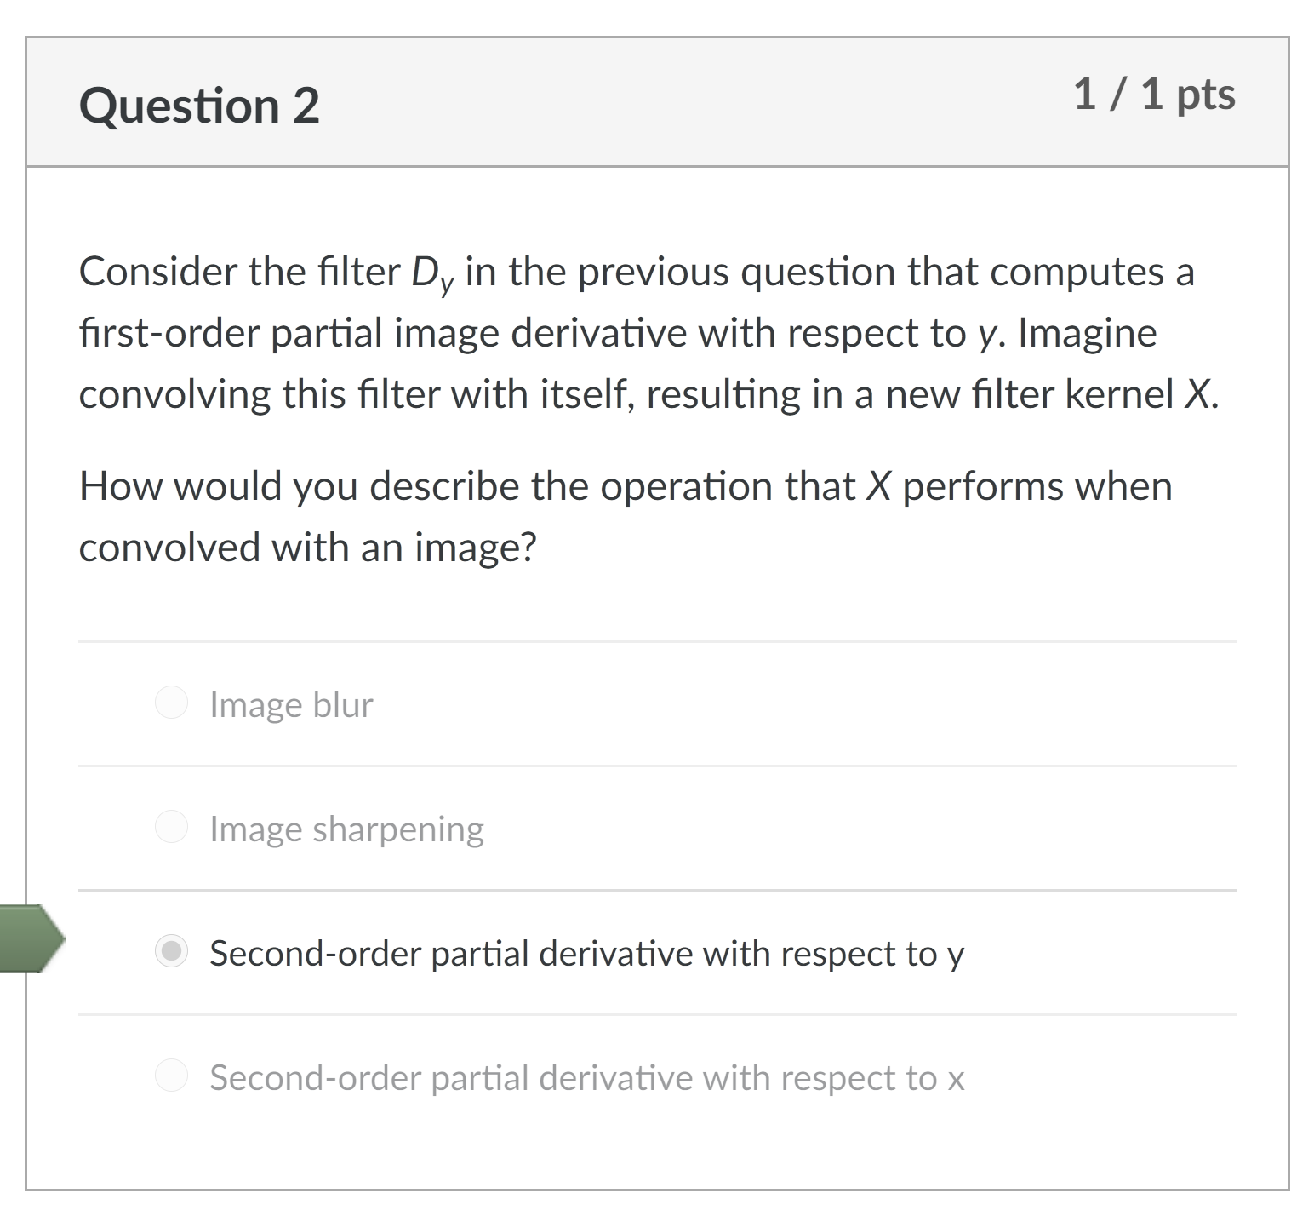
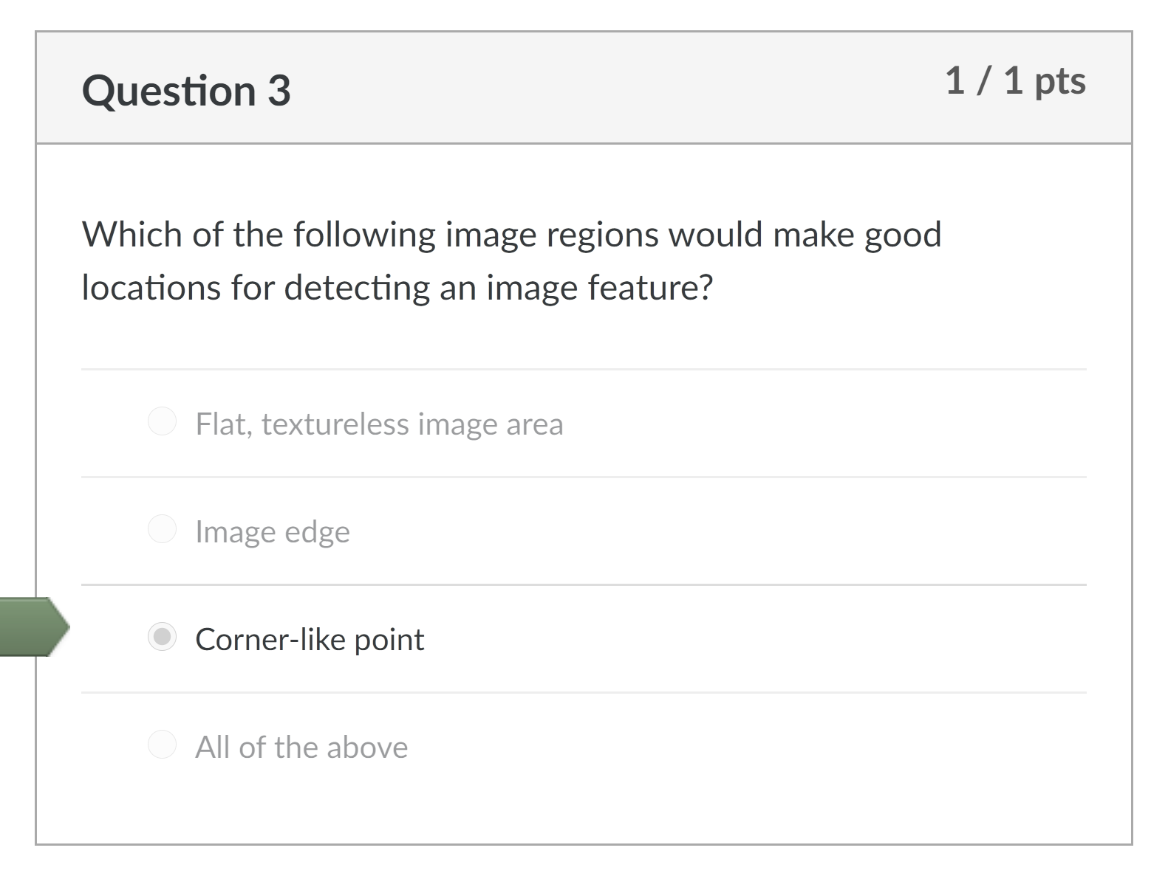
Quiz

Slide 8
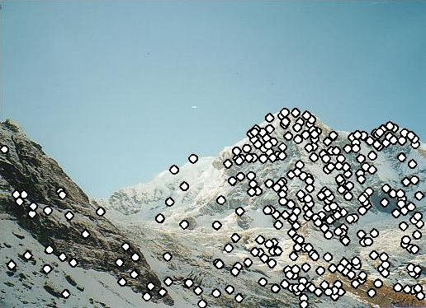
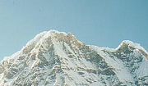

Local features: main components
Detection: Identify the interest points
Description: Extract vector feature descriptor surrounding each interest point.
Matching: Determine correspondence between descriptors in two views
Kristen Grauman

Slide 9
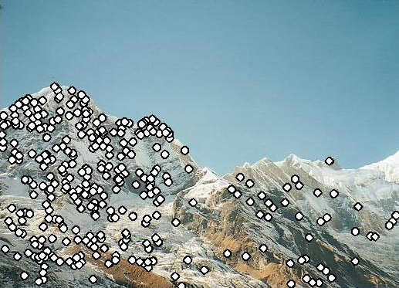
Feature descriptors
We know how to detect good points
Next question: How to match them?
Answer: Come up with a descriptor for each point, find similar descriptors between the two images
?

Slide 10
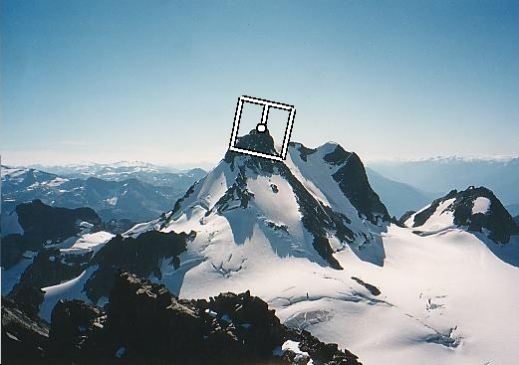
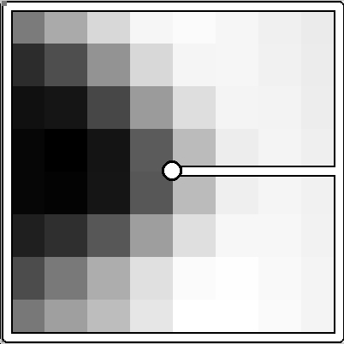
Multiscale Oriented PatcheS descriptor
Take 40x40 square window around detected feature
Scale to 1/5 size (using prefiltering)
Rotate to horizontal
Sample 8x8 square window centered at feature
Intensity normalize the window by subtracting the mean, dividing by the standard deviation in the window (why?)
40 pixels
8 pixels
Adapted from slide by Matthew Brown

Slide 11
Detections at multiple scales

Slide 12
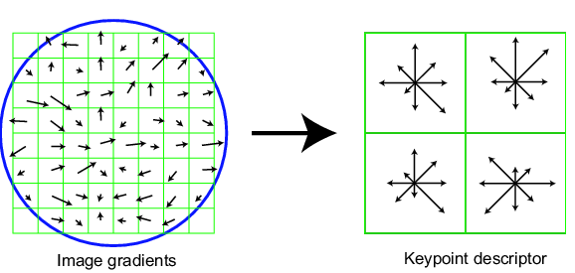
SIFT descriptor
Full version
Divide the 16x16 window into a 4x4 grid of cells (2x2 case shown below)
Compute an orientation histogram for each cell
16 cells * 8 orientations = 128 dimensional descriptor
Adapted from slide by David Lowe

Slide 13
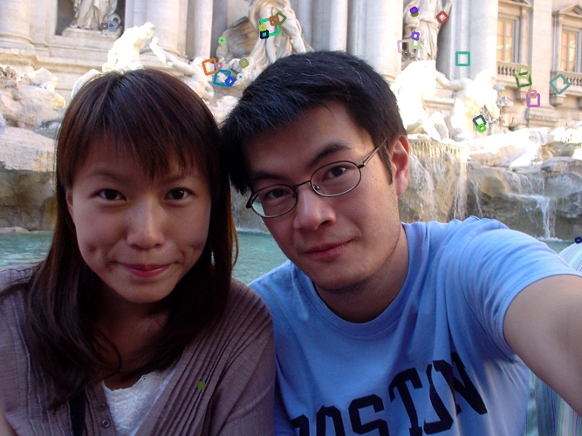
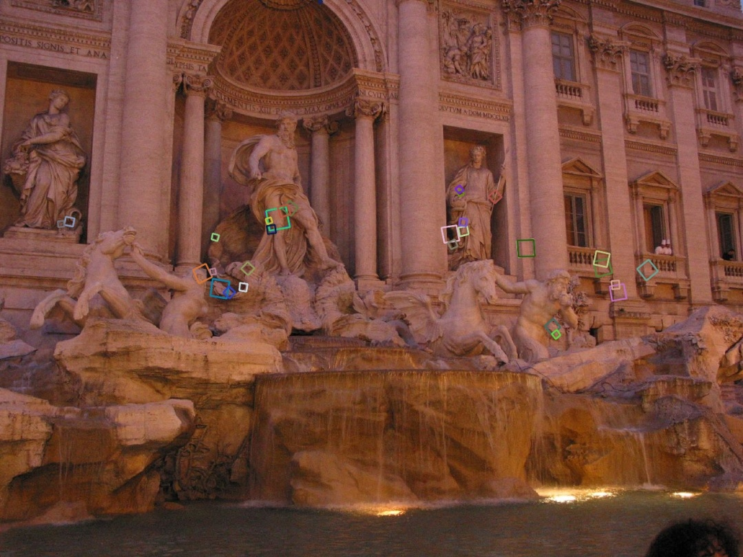
Properties of SIFT
Extraordinarily robust matching technique
Can handle changes in viewpoint (up to about 60 degree out of plane rotation)
Can handle significant changes in illumination (sometimes even day vs. night (below))
Pretty fast—hard to make real-time, but can run in <1s for moderate image sizes
Lots of code available

Slide 14
Questions?

Slide 15
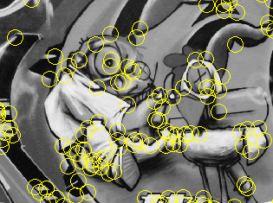
Summary
Keypoint detection: repeatable and distinctive
Corners, blobs, stable regions
Harris, DoG
Descriptors: robust and selective
spatial histograms of orientation
SIFT and variants are typically good for stitching and recognition
Can learn descriptors (and detectors)

Slide 16
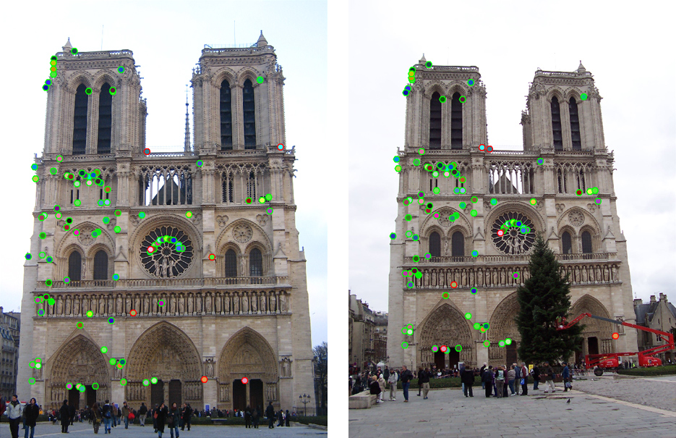
Which features match?

Slide 17
Feature matching
Given a feature in I₁, how to find the best match in I₂?
Define distance function that compares two descriptors
Test all the features in I₂, find the one with min distance

Slide 18
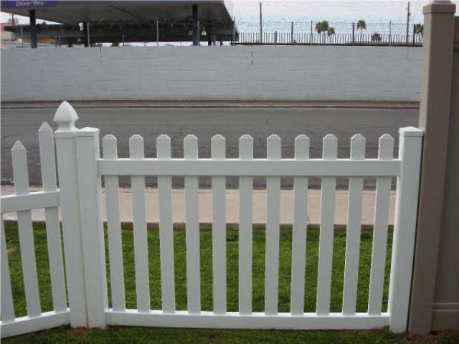
Feature distance
How to define the difference between two features f₁, f₂?
Simple approach: L₂ distance, || f₁ - f₂ ||
can give small distances for ambiguous (incorrect) matches
f₁
f₂
I₁
I₂

Slide 19
Feature distance
How to define the difference between two features f₁, f₂?
Better approach: ratio distance = || f₁ - f₂ || / || f₁ - f₂’ ||
f₂ is the best SSD match to f₁ in I₂
f₂’ is the 2nd best SSD match to f₁ in I₂
gives large values for ambiguous matches
f₁
f₂'
f₂
I₁
I₂

Slide 20
Feature distance
Does the SSD vs “ratio distance” change the best match to a given feature in image 1?

Slide 21
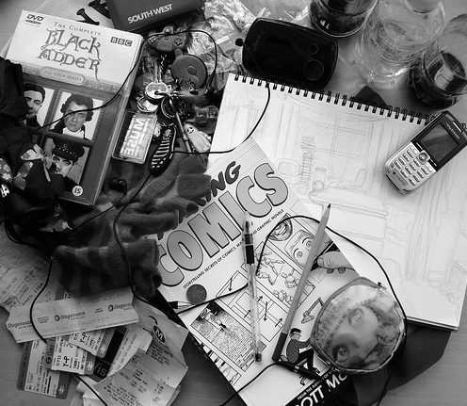
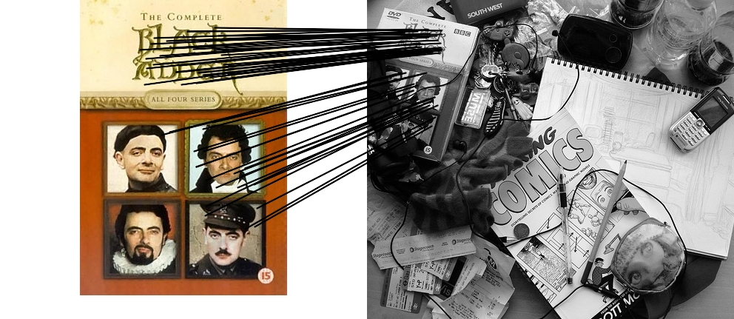
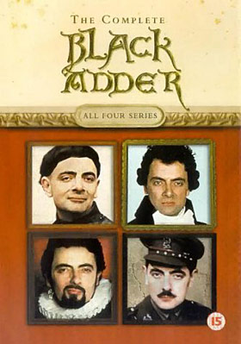
Feature matching example
58 matches (thresholded by ratio score)

Slide 22
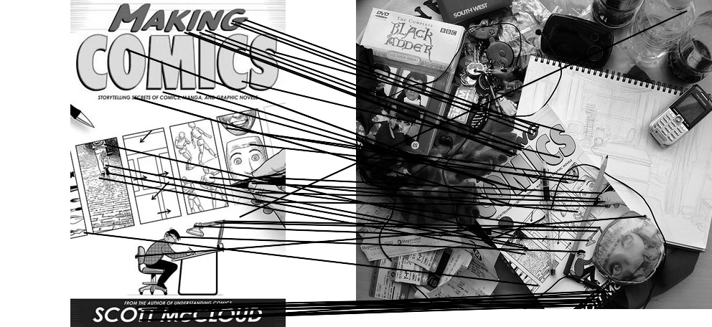

Feature matching example
We’ll deal with outliers later
51 matches (thresholded by ratio score)

Slide 23
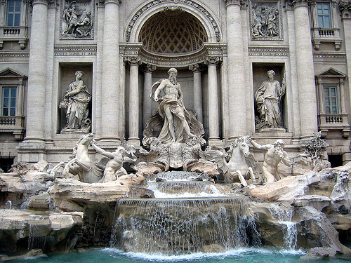
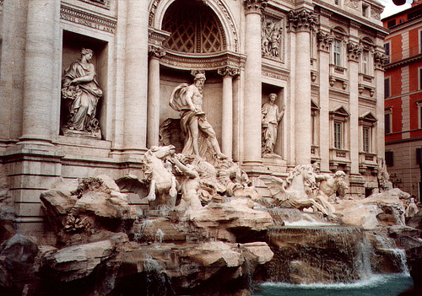
Evaluating the results
How can we measure the performance of a feature matcher?
50
75
200
feature distance

Slide 24
True/false positives
How can we measure the performance of a feature matcher?
The distance threshold affects performance
True positives = # of detected matches that survive the threshold that are correct
False positives = # of detected matches that survive the threshold that are incorrect
50
true match
75
200
false match
feature distance

Slide 25
Example
Suppose our matcher computes 1,000 matches between two images
800 are correct matches, 200 are incorrect (according to an oracle that gives us ground truth matches)
A given threshold (e.g., ratio distance = 0.6) gives us 600 correct matches and 100 incorrect matches that survive the threshold
True positive rate = 600 / 800 = ¾
False positive rate = 100 / 200 = ½

Slide 26
Evaluating the results
How can we measure the performance of a feature matcher?
1
0.7
# true positives surviving threshold
# total correct matches (positives)
true positive rate
recall
0
1
false positive rate
0.1
# false positives surviving threshold
# total incorrect matches (negatives)
1 - specificity

Slide 27
Evaluating the results
How can we measure the performance of a feature matcher?
ROC curve (“Receiver Operator Characteristic”)
1
0.7
Single number: Area Under the Curve (AUC)
E.g. AUC = 0.87
1 is the best
# true positives surviving threshold
# total correct matches (positives)
true positive rate
recall
0
1
false positive rate
0.1
# false positives surviving threshold
# total incorrect matches (negatives)
1 - specificity

Slide 28
ROC curves – summary
By thresholding the score at different thresholds, we can generate sets of matches with different true/false positive rates
ROC curve is generated by computing rates at a set of threshold values swept through the full range of possible threshold
Area under the ROC curve (AUC) summarizes the performance of a feature pipeline (higher AUC is better)

Slide 29
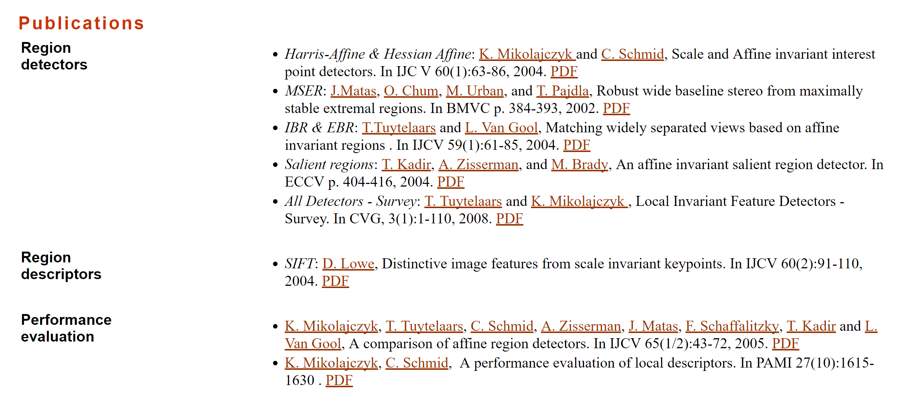
More on feature detection/description
http://www.robots.ox.ac.uk/~vgg/research/affine/
http://www.cs.ubc.ca/~lowe/keypoints/
http://www.vision.ee.ethz.ch/~surf/

Slide 30
Lots of applications
Features are used for:
Image alignment (e.g., mosaics)
3D reconstruction
Motion tracking
Object recognition
Indexing and database retrieval
Robot navigation
… other

Slide 31
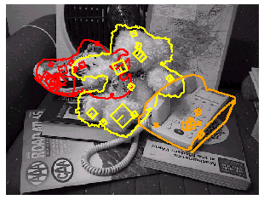
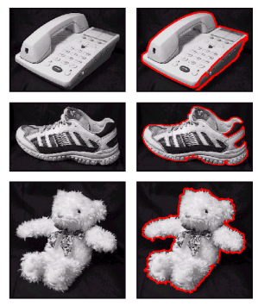
Object recognition (David Lowe)

Slide 32
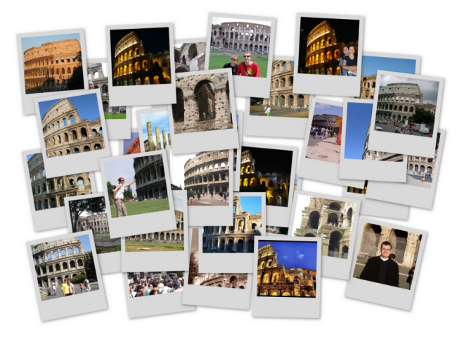
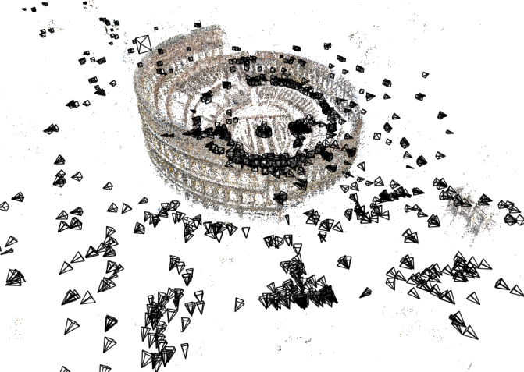
3D Reconstruction
Internet Photos (“Colosseum”)
Reconstructed 3D cameras and points

Slide 33

Sony Aibo
SIFT usage:
Recognize
charging
station
Communicate
with visual
cards
Teach object
recognition

Slide 34
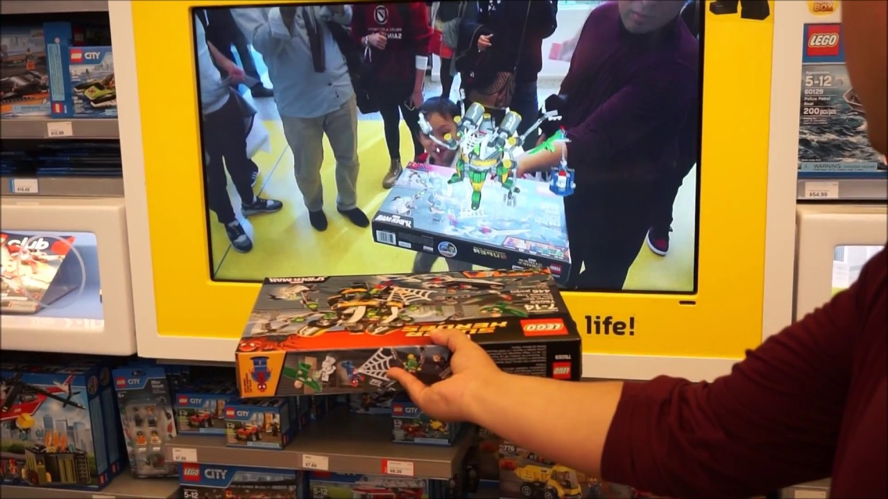
Augmented Reality

Slide 35
Live demo?

Slide 36
Questions?

