Slide 1
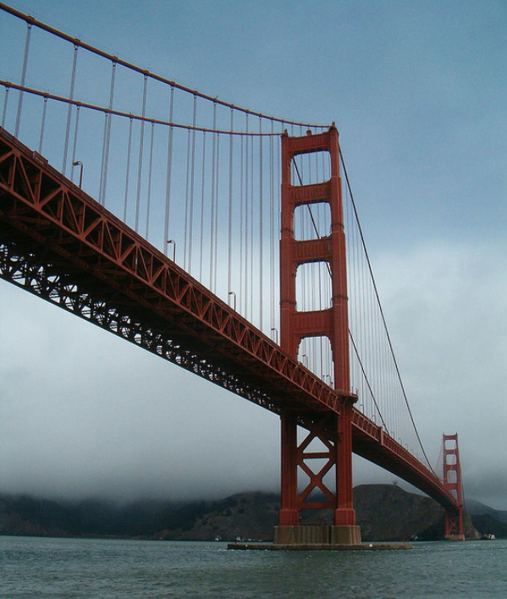
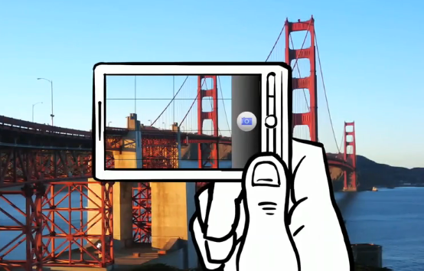
Feature descriptors
CS5670: Computer Vision

Slide 2
Reading
Szeliski (1st edition): 4.1

Slide 3
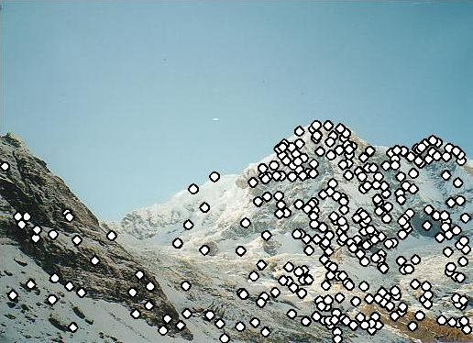
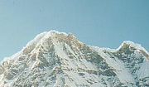

Local features: main components
Detection: Identify the interest points
Description: Extract vector feature descriptor surrounding each interest point.
Matching: Determine correspondence between descriptors in two views
Kristen Grauman

Slide 4
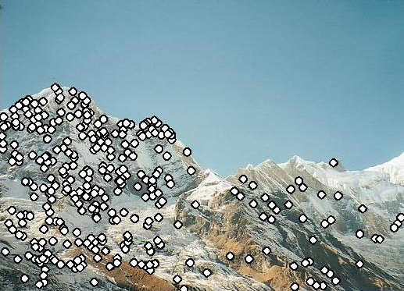
Feature descriptors
We know how to detect good points
Next question: How to match them?
Answer: Come up with a descriptor for each point, find similar descriptors between the two images
?

Slide 5
Feature descriptors
We know how to detect good points
Next question: How to match them?
Lots of possibilities
  Simple option: match square windows around the point
  State of the art approach: SIFT
    David Lowe, UBC http://www.cs.ubc.ca/~lowe/keypoints/
?

Slide 6
Invariance vs. discriminability
Invariance:
  Descriptor shouldn’t change even if image is transformed
Discriminability:
  Descriptor should be highly unique for each point

Slide 7
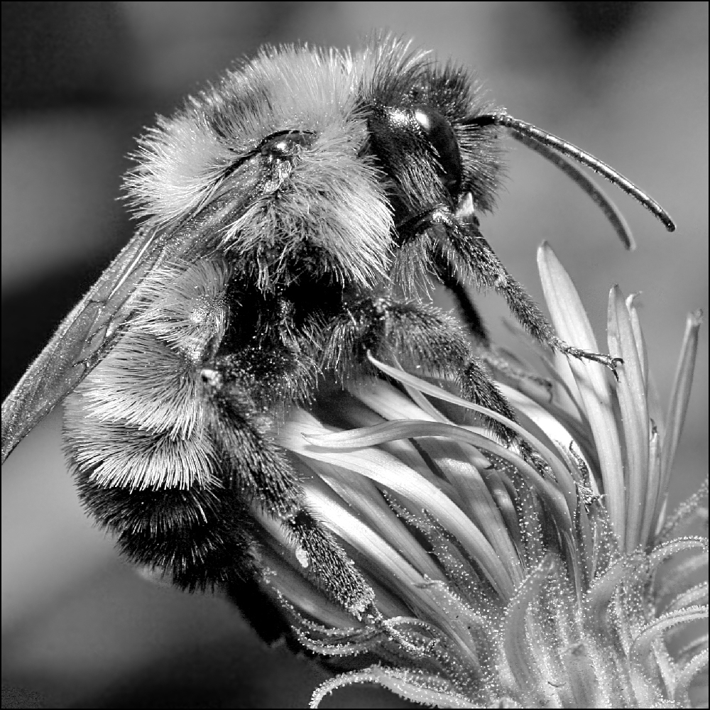
Image transformations revisited
Geometric
  Rotation
  Scale
Photometric
  Intensity change

Slide 8
Invariance
Suppose we are comparing two images I₁ and I₂
  I₂ may be a transformed version of I₁
  What kinds of transformations are we likely to encounter in practice?

Slide 9
Invariant descriptors
We looked at invariant / equivariant detectors
Most feature descriptors are also designed to be invariant to:
  Translation, 2D rotation, scale
They can usually also handle
  Limited 3D rotations (SIFT works up to about 60 degrees)
  Limited affine transforms (some are fully affine invariant)
  Limited illumination/contrast changes

Slide 10
How to achieve invariance
Need both of the following:
Make sure your detector is invariant
2. Design an invariant feature descriptor
  Simplest descriptor: a single 0
    What’s this invariant to?
  Next simplest descriptor: a square, axis-aligned 5x5 window of pixels
    What’s this invariant to?
  Let’s look at some better approaches…

Slide 11
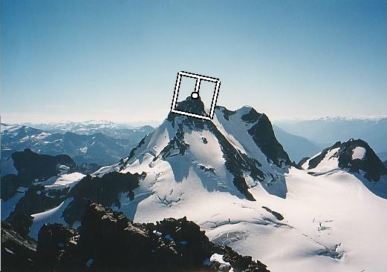
Rotation invariance for feature descriptors
Find dominant orientation of the image patch
  E.g., given by x_{max}, the eigenvector of H corresponding to λ_{max} (the larger eigenvalue)
  Or (better) simply the orientation of the (smoothed) gradient
  Rotate the patch according to this angle
Figure by Matthew Brown

Slide 12
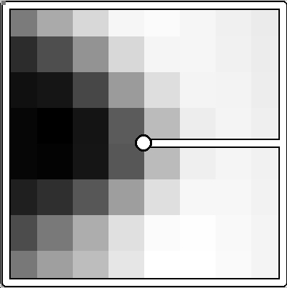
Multiscale Oriented PatcheS descriptor
Take 40x40 square window around detected feature
  Scale to 1/5 size (using prefiltering)
  Rotate to horizontal
  Sample 8x8 square window centered at feature
  Intensity normalize the window by subtracting the mean, dividing by the standard deviation in the window (why?)
40 pixels
8 pixels
Adapted from slide by Matthew Brown

Slide 13
Detections at multiple scales

Slide 14
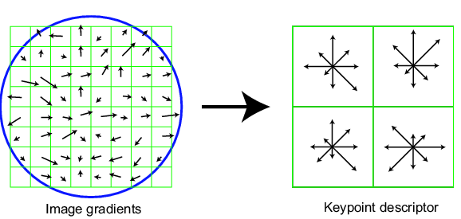
Scale Invariant Feature Transform
Basic idea:
  Take 16x16 square window around detected feature
  Compute edge orientation (angle of the gradient - 90°) for each pixel
  Throw out weak edges (threshold gradient magnitude)
  Create histogram of surviving edge orientations
0
2π
angle histogram
Adapted from slide by David Lowe

Slide 15
SIFT descriptor
Full version
  Divide the 16x16 window into a 4x4 grid of cells (2x2 case shown below)
  Compute an orientation histogram for each cell
  16 cells * 8 orientations = 128 dimensional descriptor
Adapted from slide by David Lowe

Slide 16
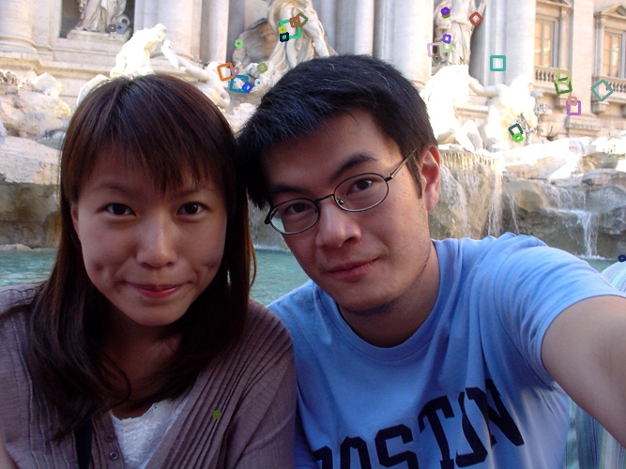
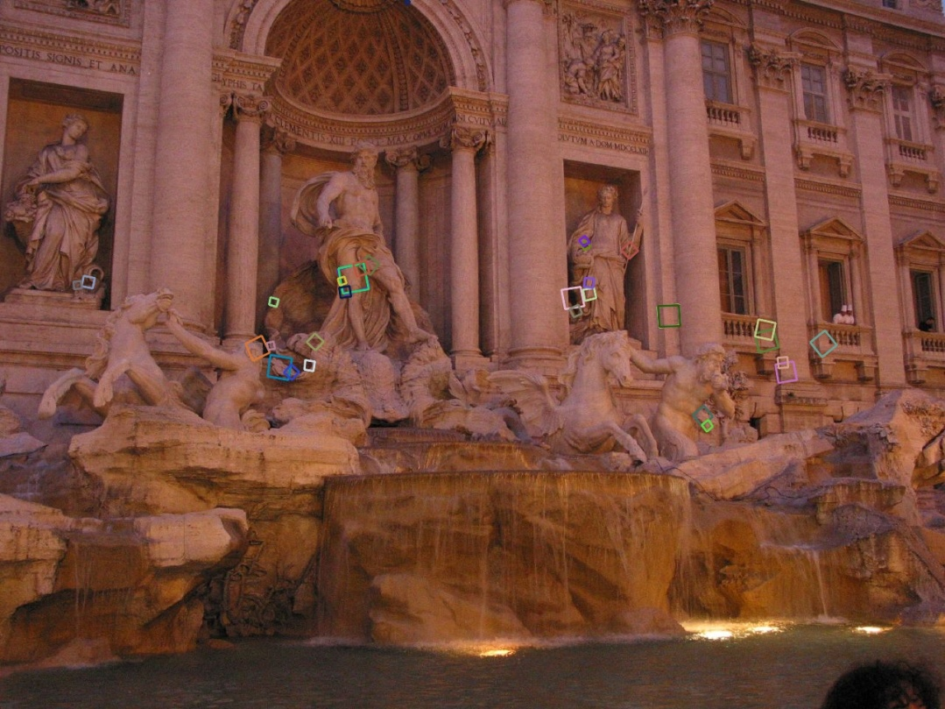
Properties of SIFT
Extraordinarily robust matching technique
  Can handle changes in viewpoint (up to about 60 degree out of plane rotation)
  Can handle significant changes in illumination (sometimes even day vs. night (below))
  Pretty fast—hard to make real-time, but can run in <1s for moderate image sizes
  Lots of code available

Slide 17
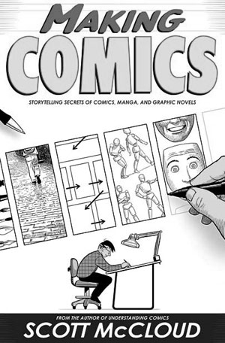
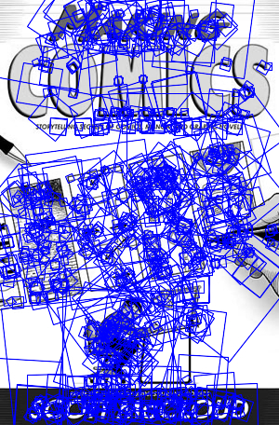
SIFT Example
sift
868 SIFT features

Slide 18
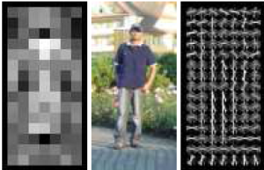
Other descriptors
HOG: Histogram of Gradients (HOG)
  Dalal/Triggs
  Sliding window, pedestrian detection
FREAK: Fast Retina Keypoint
  Perceptually motivated
  Can run in real-time; used in Visual SLAM
LIFT: Learned Invariant Feature Transform
  Learned via deep learning
    https://arxiv.org/abs/1603.09114
Notes:
http://infoscience.epfl.ch/record/175537/files/2069.pdf
FREAK: Fast Retina Keypoint
The Binary Robust Independent Ele- mentary Feature (BRIEF) [5], the Oriented Fast and Ro- tated BRIEF (ORB)[26], and the Binary Robust Invariant Scalable Keypoints[16] (BRISK) are good examples.

Slide 19
Questions?

Slide 20
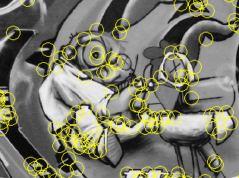
Summary
Keypoint detection: repeatable and distinctive
  Corners, blobs, stable regions
  Harris, DoG
Descriptors: robust and selective
  spatial histograms of orientation
  SIFT and variants are typically good for stitching and recognition
  But, need not stick to one

Slide 21
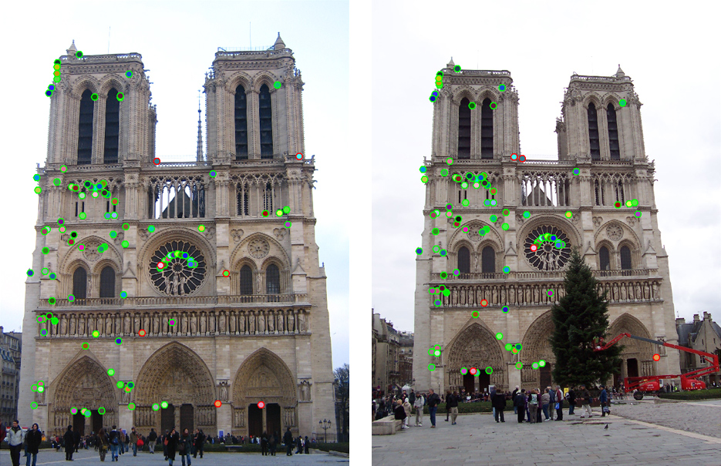
Which features match?

Slide 22
Questions?

