Slide 1
Convolutional neural networks, Part II
CS5670: Computer Vision
Slides from Fei-Fei Li, Justin Johnson, Serena Yeung
http://vision.stanford.edu/teaching/cs231n/

Slide 2
Announcements
Project 5 (Convolutional Neural Networks) released today
Due Wednesday, April 29
Take-home final exam planned May 11-14
Out of 46 votes, about 75% preferred these later dates
If you have a problem with these dates, please let us know

Slide 3
Readings
Convolutional neural networks
http://cs231n.github.io/convolutional-networks/
Stochastic Gradient Descent & Backpropagation
http://cs231n.github.io/optimization-1/
http://cs231n.github.io/optimization-2/
Best practices for training CNNs
http://cs231n.github.io/neural-networks-2/
http://cs231n.github.io/neural-networks-3/

Slide 4
Last time
Neural networks
Convolutional neural networks

Slide 5
Today
Convolutional neural networks (continued)
Training neural networks with backpropagation
Stochastic gradient descent
Data processing and augmentation
CNN architectures
Transfer learning

Slide 6
Image Classification: a core task in computer vision
Assume given set of discrete labels, e.g.
{cat, dog, cow, apple, tomato, truck, … }

Slide 7
Recap: Neural networks
Very coarse generalization:
Linear functions chained together and separated by non-linearities (activation functions), e.g. “max”

Slide 8
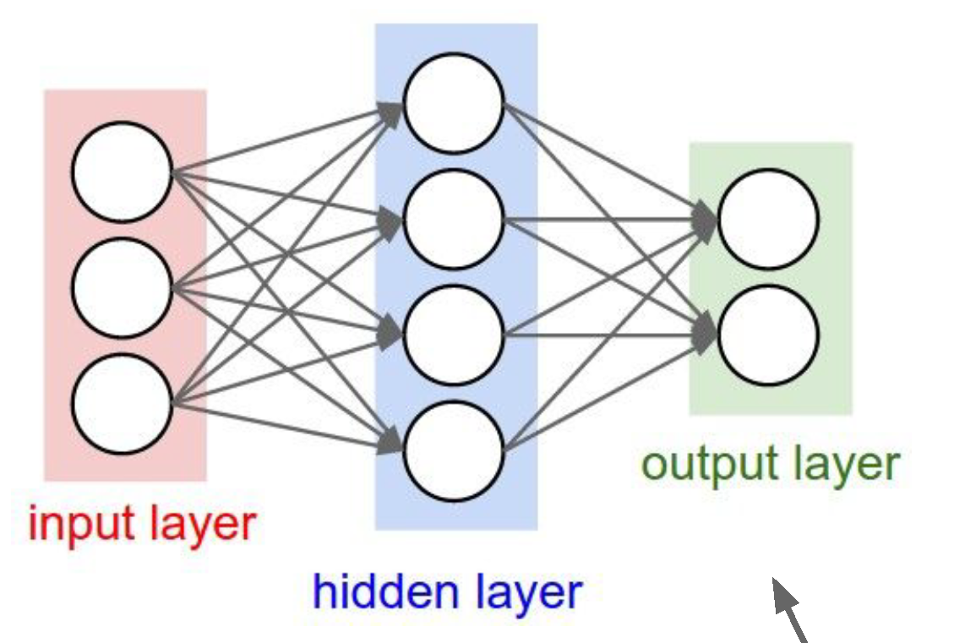
Fully connected neural network architecture
Computation graph for a 2-layer neural network
Neuron or unit

Slide 9
Convolutions as network layers
(weights are learned)

Slide 10
Convolutional layer
(total number of parameters: 6 x (75 + 1) = 456)

Slide 13
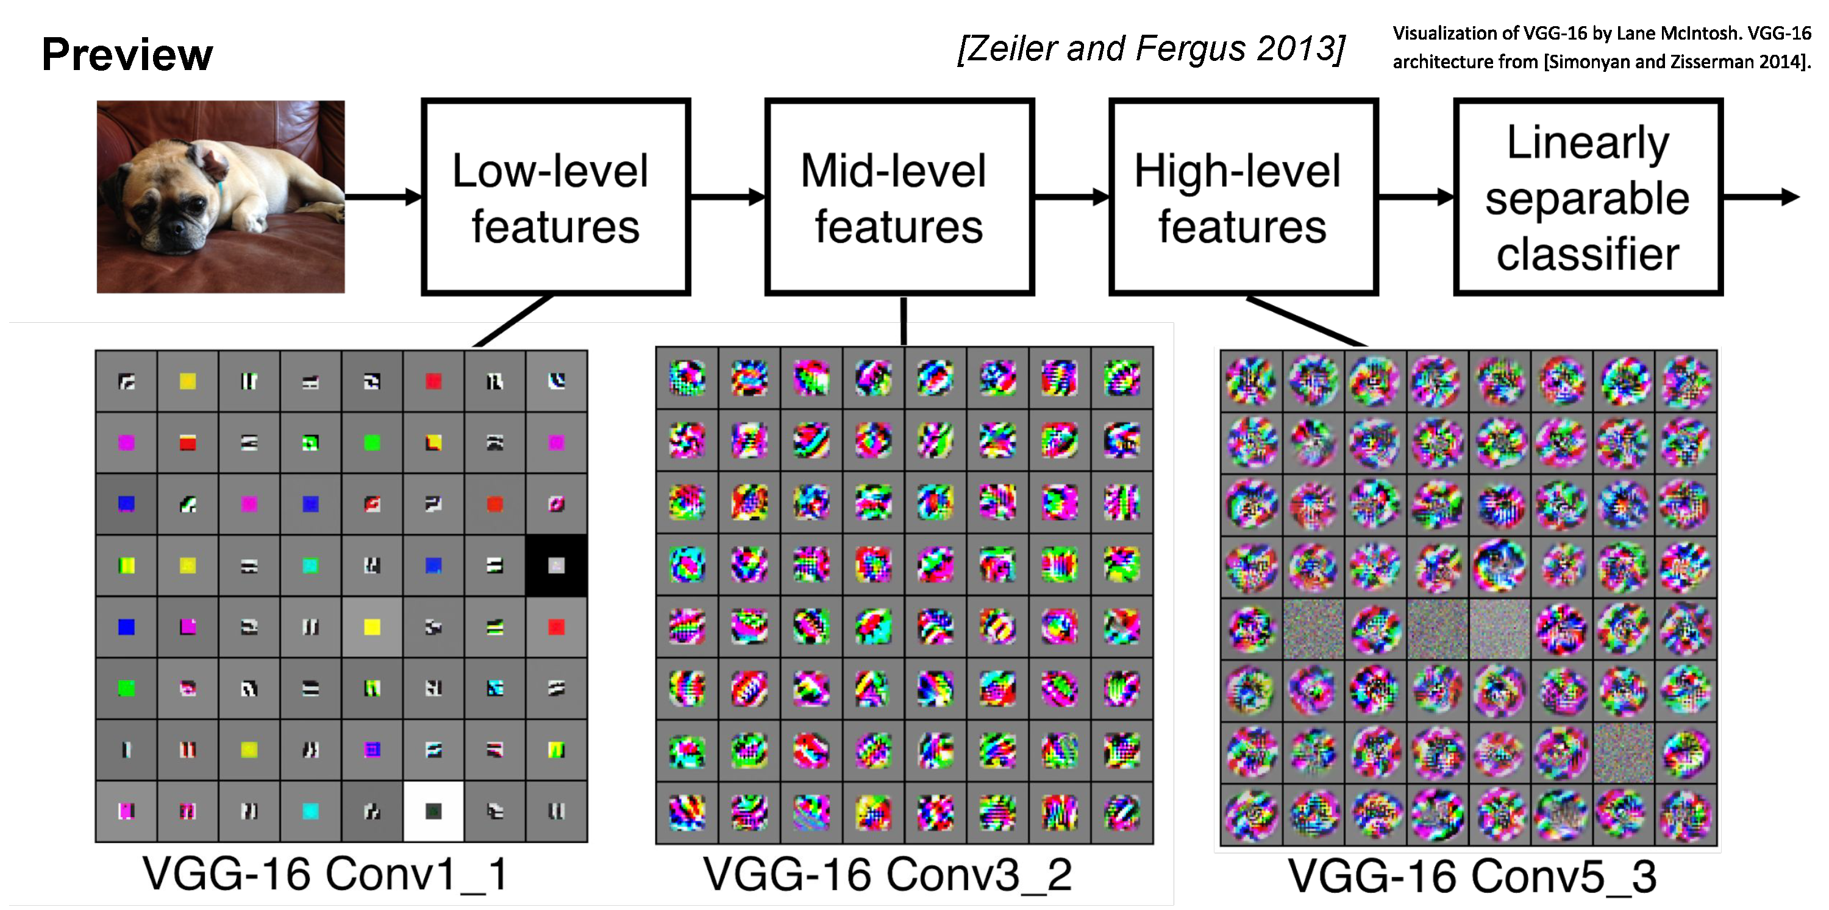

Slide 36
Convolutional layer—properties
Small number of parameters to learn compared to a fully connected layer
Preserves spatial structure—output of a convolutional layer is shaped like an image
Translation equivariant: passing a translated image through a convolutional layer is (almost) equivalent to translating the convolution output (but be careful of image boundaries)

Slide 40
https://cs.stanford.edu/people/karpathy/convnetjs/demo/cifar10.html

Slide 42
Next time: Backpropagation
This is the backwards pass. We compute it with backpropagation

Slide 43
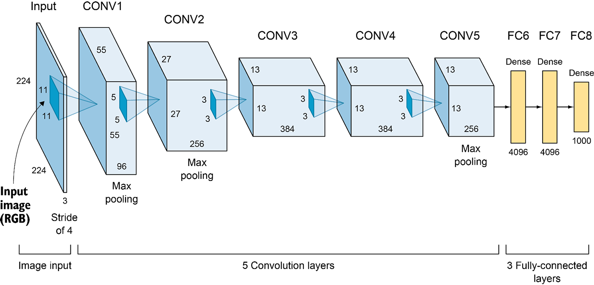
AlexNet (2012)
6M parameters in total
Output: 1,000-D vector (probabilities over 1,000 ImageNet categories)
Elgendy, Deep Learning for Vision Systems, https://livebook.manning.com/book/grokking-deep-learning-for-computer-vision/chapter-5/v-3/

Slide 44
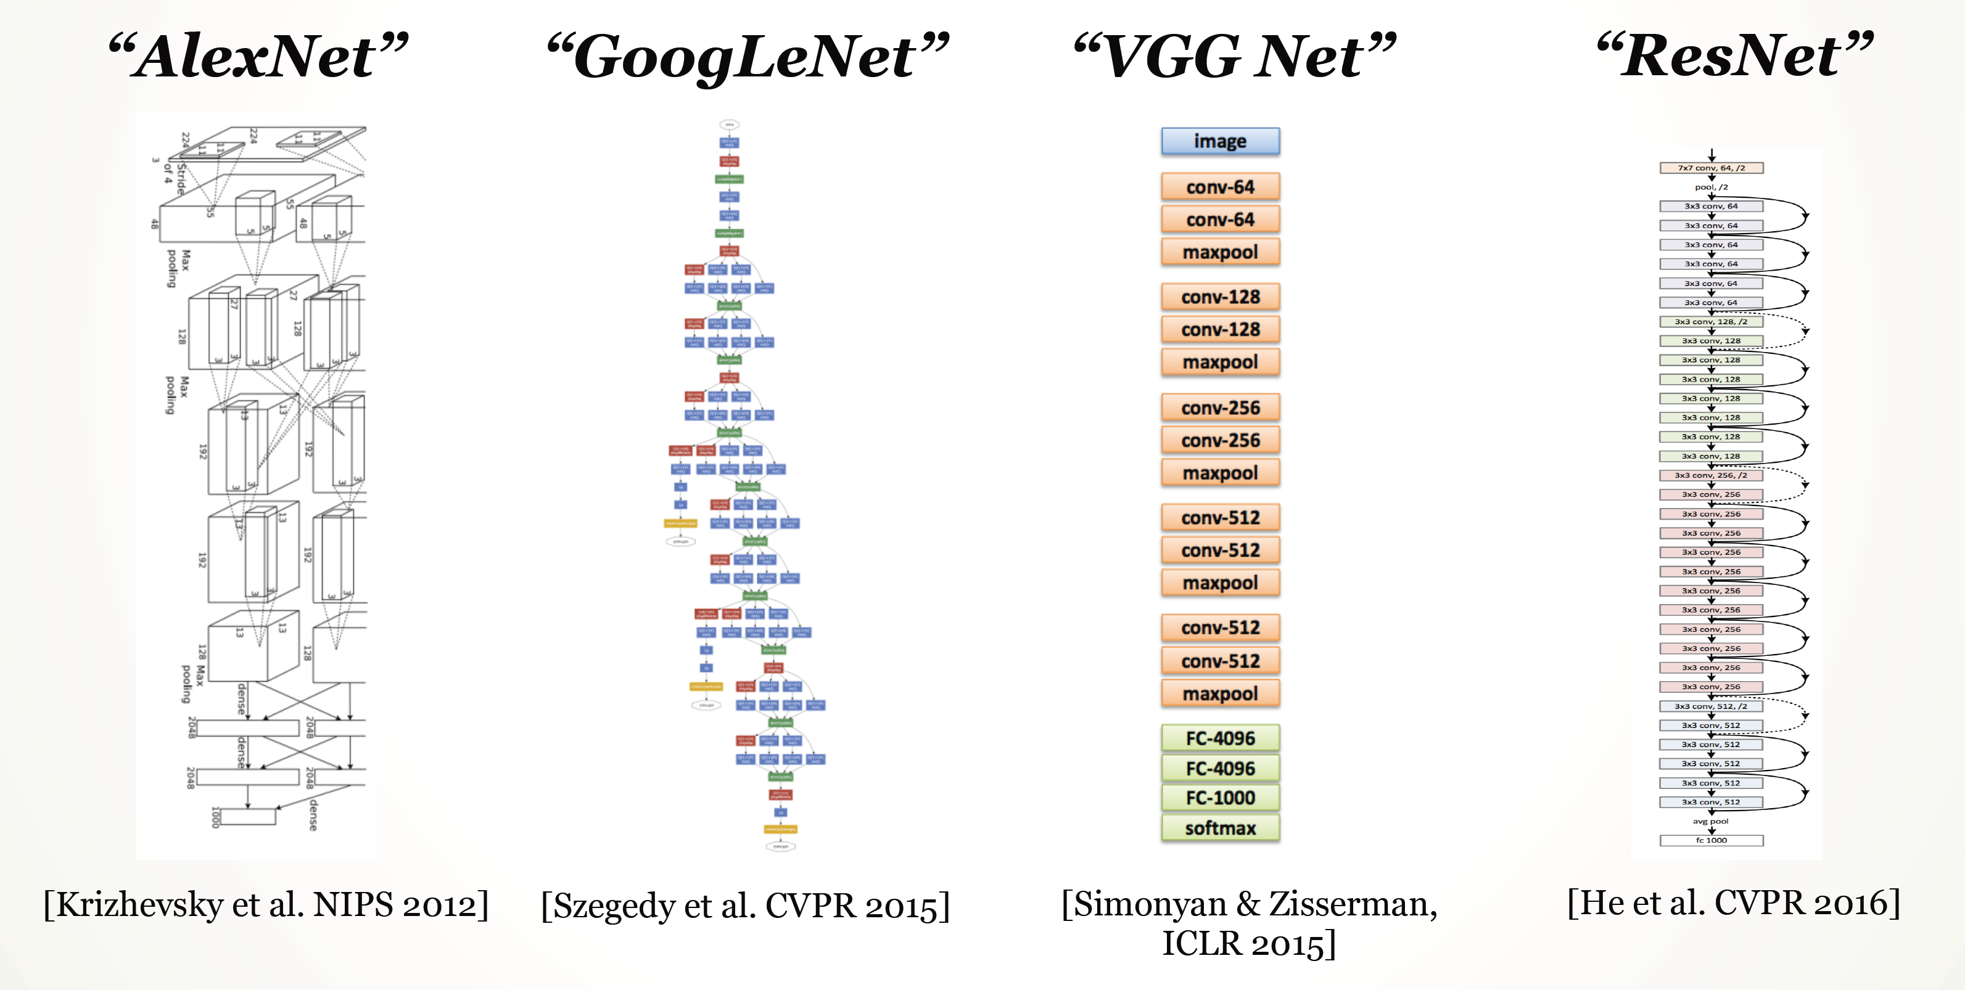

Slide 45
Big picture
A convolutional neural network can be thought of as a function from images to class scores
With millions of adjustable weights…
… leading to a very non-linear mapping from images to features / class scores.
We will set these weights based on classification accuracy on training data…
… and hopefully our network will generalize to new images at test time

Slide 46
Data is key—enter ImageNet
ImageNet (and the ImageNet Large-Scale Visual Recognition Challege, aka ILSVRC) has been key to training deep learning methods
J. Deng, W. Dong, R. Socher, L.-J. Li, K. Li and L. Fei-Fei, ImageNet: A Large-Scale Hierarchical Image Database. CVPR, 2009.
ILSVRC: 1,000 object categories, each with ~700-1300 training images. Test set has 100 images per categories (100,000 total).
Standard ILSVRC error metric: top-5 error (if the correct answer for a given test image is in the top 5 categories, your answer is judged to be correct).

Slide 47
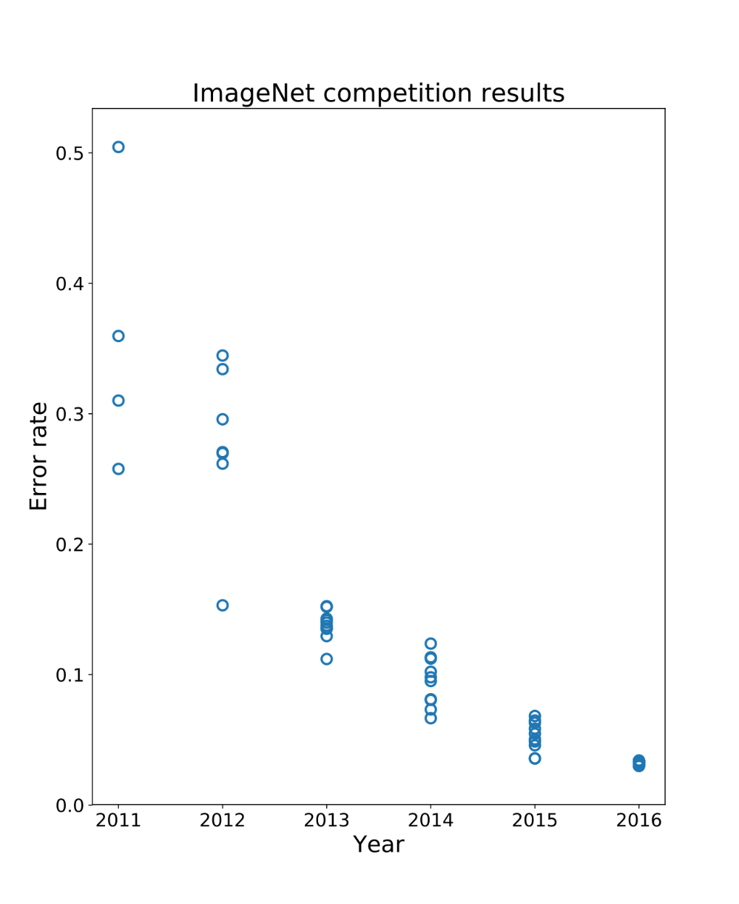
Performance improvements on ILSVRC
ImageNet Large-Scale Visual Recognition Challenge
Held each year from 2011-2017
1000 categories, 1000 training images per category
Test performance on held-out test set of images
Error (lower is better)
{
Deep learning era
Pre-deep learning era (~25%)
AlexNet (16%)

Slide 48
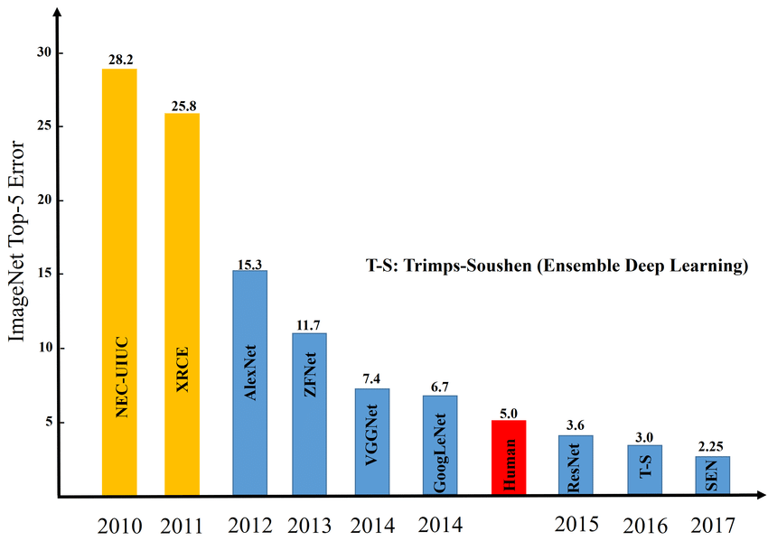
Image credit: Zaid Alyafeai, Lahouari Ghouti

Slide 49
Questions?

Slide 50
Training the network
Now we know what the structure of our function from images -> class scores is (a CNN)
How do we set the weights given training data?

Slide 51
How do we set the weights?
Need to solve an optimization problem:
Find weights W that minimize training loss L over a training set
In general this is a non-linear, non-convex problem
Closed-form solvers do not generally exist, unlike with e.g. least squares problems
Might not find the globally optimal weights
(Side note: some learning problems, such as linear SVMs, do have convex loss functions)

Slide 52
(Bad) idea #1: Random search

Slide 54
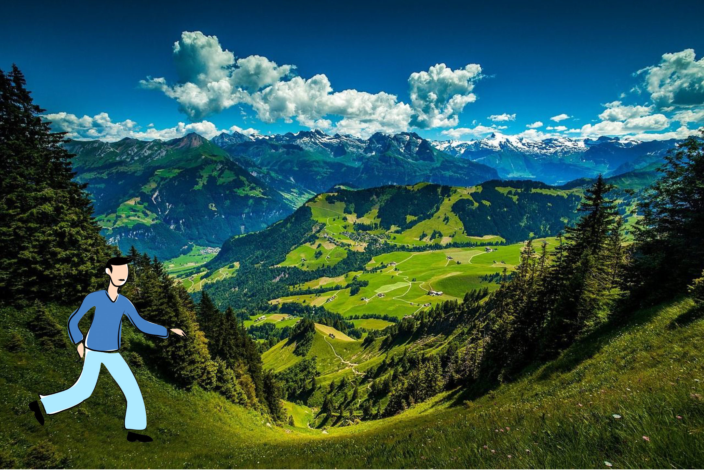
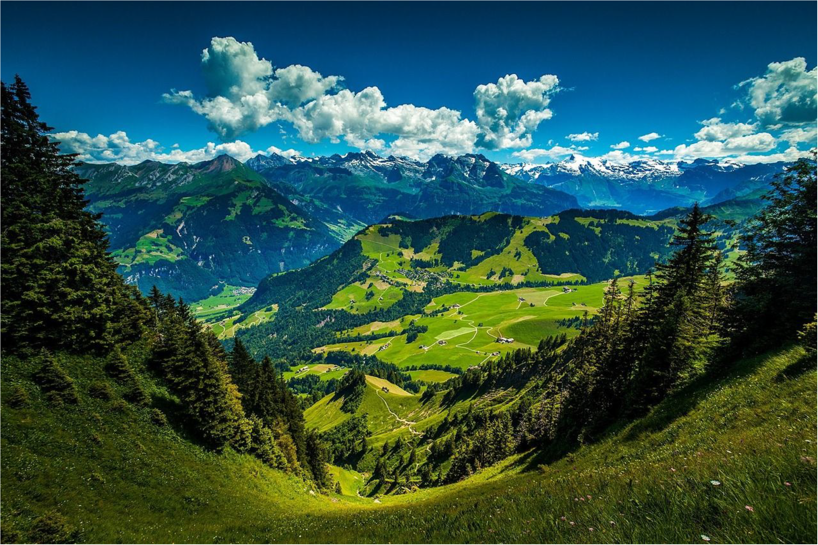
(Good) Idea #2: Gradient descent

Slide 55
(Good) Idea #2: Gradient descent

Slide 56
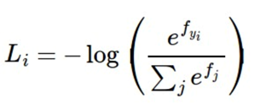
Scores, losses, and gradients
Function f maps images to class scores
Loss function maps class scores to “badness”
f is a deep CNN
Cross-entropy loss
Data loss + regularization
(gradient of L w.r.t. W, computed analytically)

Slide 57
Gradient descent: iteratively follow the slope

Slide 58
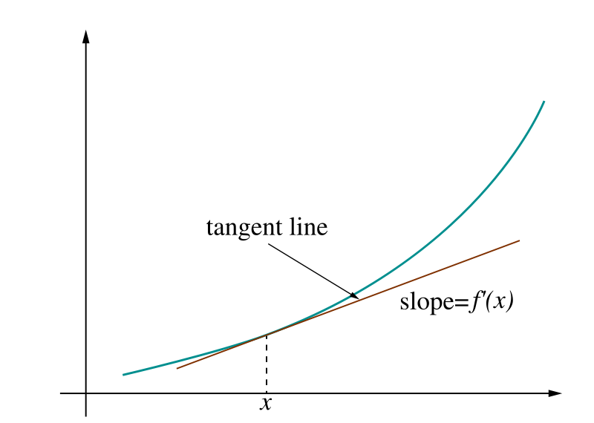
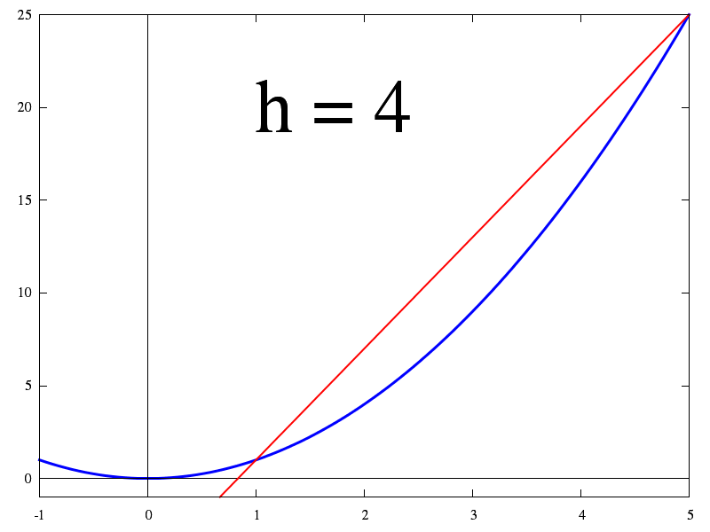
How do we compute gradients for CNNs?
Recall: a function with a single with N parameters
Our loss function involves millions of parameters
Idea 1: Numerically compute derivatives

Slide 67
But the loss is just a function of W!

Slide 69
Idea #2: Calculating gradients analytically

Slide 70
Idea #2: Calculating gradients analytically

Slide 72
Better idea: computation graphs + backpropagation
Forward pass: compute loss using current weights
Backwards pass: compute gradients of loss w.r.t. weights, then update the weights
(backpropagation algorithm)

Slide 86
Backpropagation
General idea: Recursive application of the chain rule (calculus 101) backwards through a computation graph
Can reuse intermediate calculations computed during the forwards pass during the backwards pass
Natural extensions from scalar computations to vector computations
Deep learning frameworks like Pytorch / TensorFlow support efficient automated backpropagation via automatic differentiation and GPU acceleration

Slide 88
Questions?

Slide 89
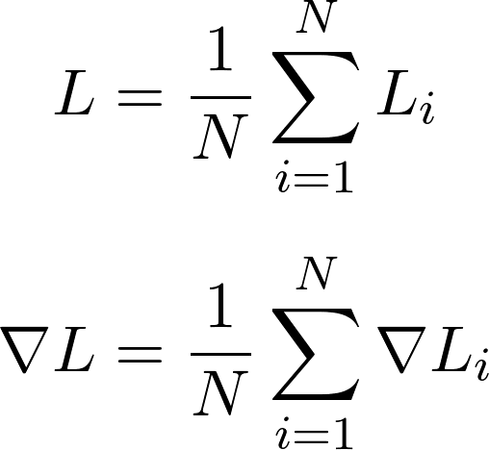
What if the training data is very large?
Recall that ImageNet has >1.2M training images
Computing the value of the loss and its gradient over the entire training set is very expensive in terms of computation
Loss function is summed over all N training images
Gradient is also summed over all N training images

Slide 90
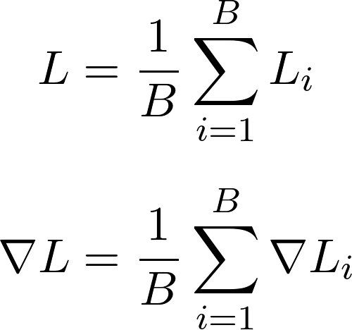
Alternative: stochastic gradient descent
Approximate the sum using a minibatch of examples
e.g., 32, 64, or 128 examples
For each step of gradient descent, choose a different batch
Where B (e.g. 32) is the minibatch size

Slide 91
Stochastic gradient descent (SGD)
A full pass through the dataset (i.e., using batches that cover the training data) is called an epoch
Usually need to train for multiple epochs, i.e., multiple full passes through the dataset to converge
Stochastic gradient descent approximates the true gradient, but works remarkably well in practice

Slide 100
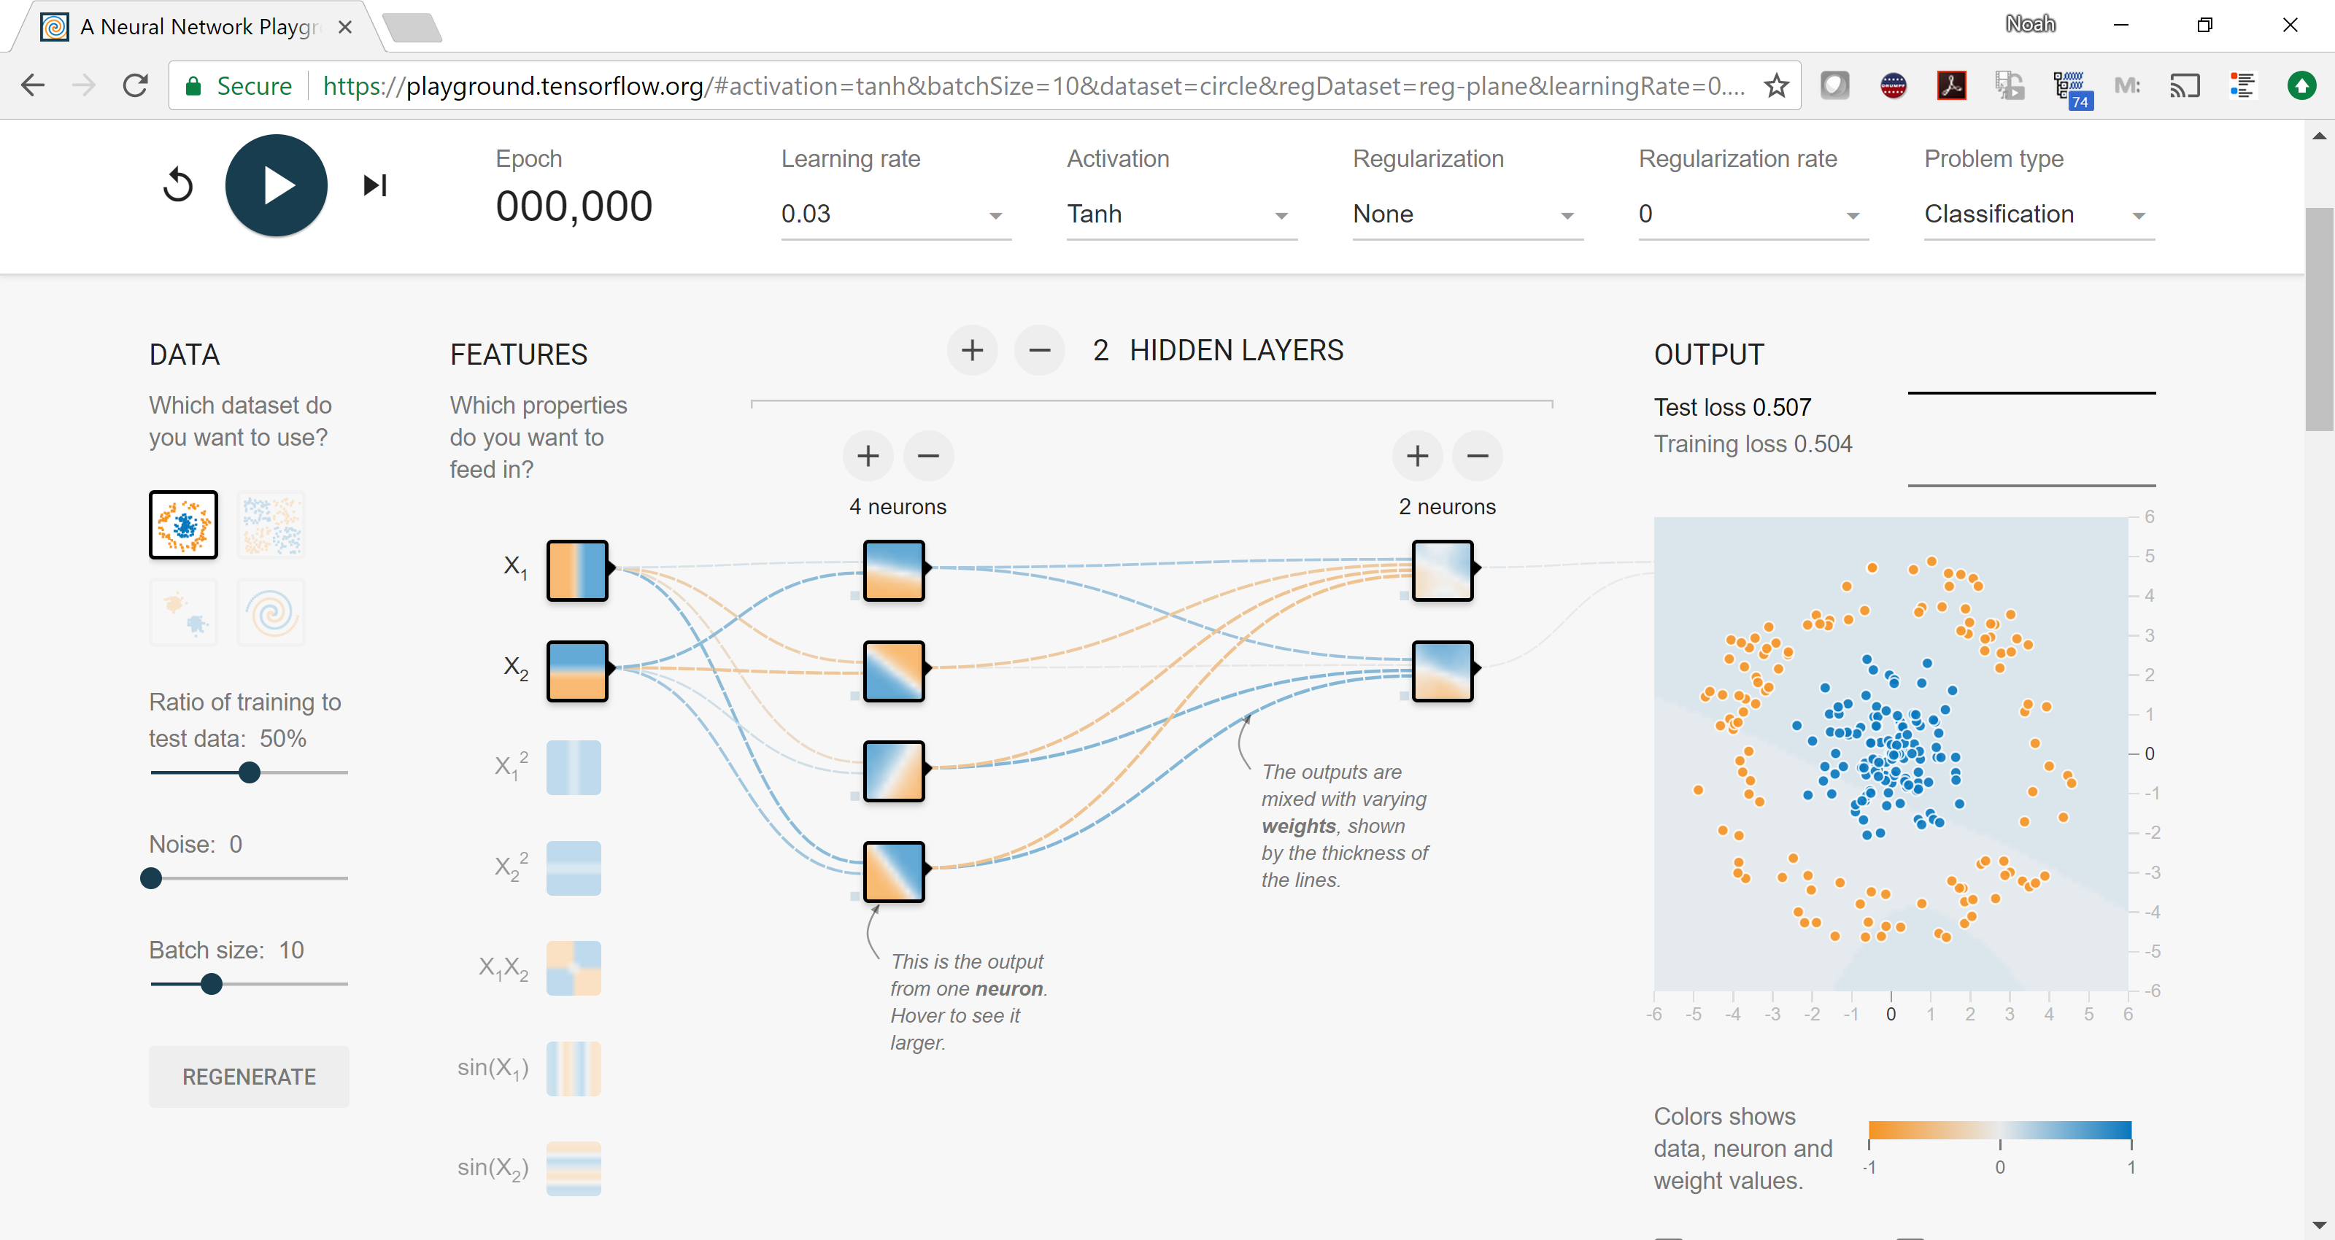
(2) Choose your architecture
https://playground.tensorflow.org/

Slide 101
(2) Choose your architecture
Very common modern choice

Slide 102
(if you use ReLU activations, folks tend to initialize bias to small positive number)

Slide 103
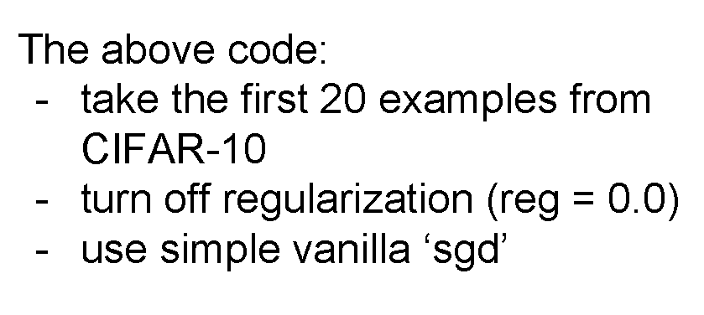

Slide 106
(4) Find a learning rate

Slide 109
(+batch size)

Slide 110
Questions?

Slide 122
Common modern approach: start with a ResNet architecture pre-trained on ImageNet, and fine-tune on your (smaller) dataset

Slide 123
Questions?

