Slide 1
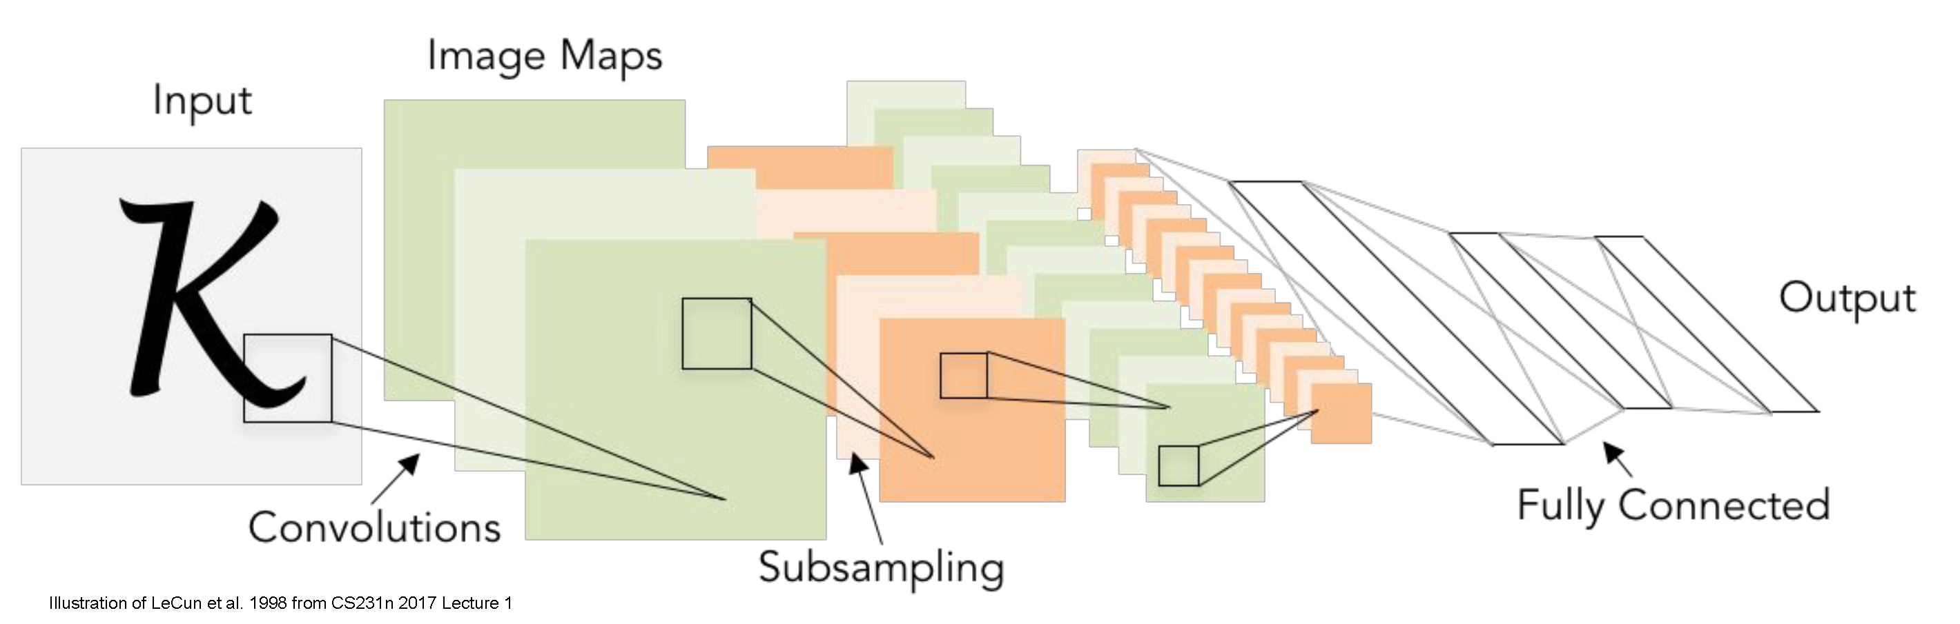
Convolutional neural networks
CS5670: Computer Vision
Slides from Fei-Fei Li, Justin Johnson, Serena Yeung
http://vision.stanford.edu/teaching/cs231n/

Slide 2
Announcements
Project 4 due this Friday, April 17, by 11:59pm on CMSX
Project 5 (Convolutional Neural Networks) will be released next Monday, April 20
  Due Wednesday, April 29
Take-home final exam, timing TBA but likely released on May 4 and due on May 7

Slide 3
Readings
Neural networks
  http://cs231n.github.io/neural-networks-1/
  http://cs231n.github.io/neural-networks-2/
  http://cs231n.github.io/neural-networks-3/
  http://cs231n.github.io/neural-networks-case-study/
Convolutional neural networks
  http://cs231n.github.io/convolutional-networks/

Slide 4
Last time
Image classification
  k-nearest neighbors
  Linear classiciation
  Score functions
  Cross-entropy loss functions

Slide 5
Today
Neural networks
Convolutional neural networks

Slide 6
Fifth Place

Slide 7
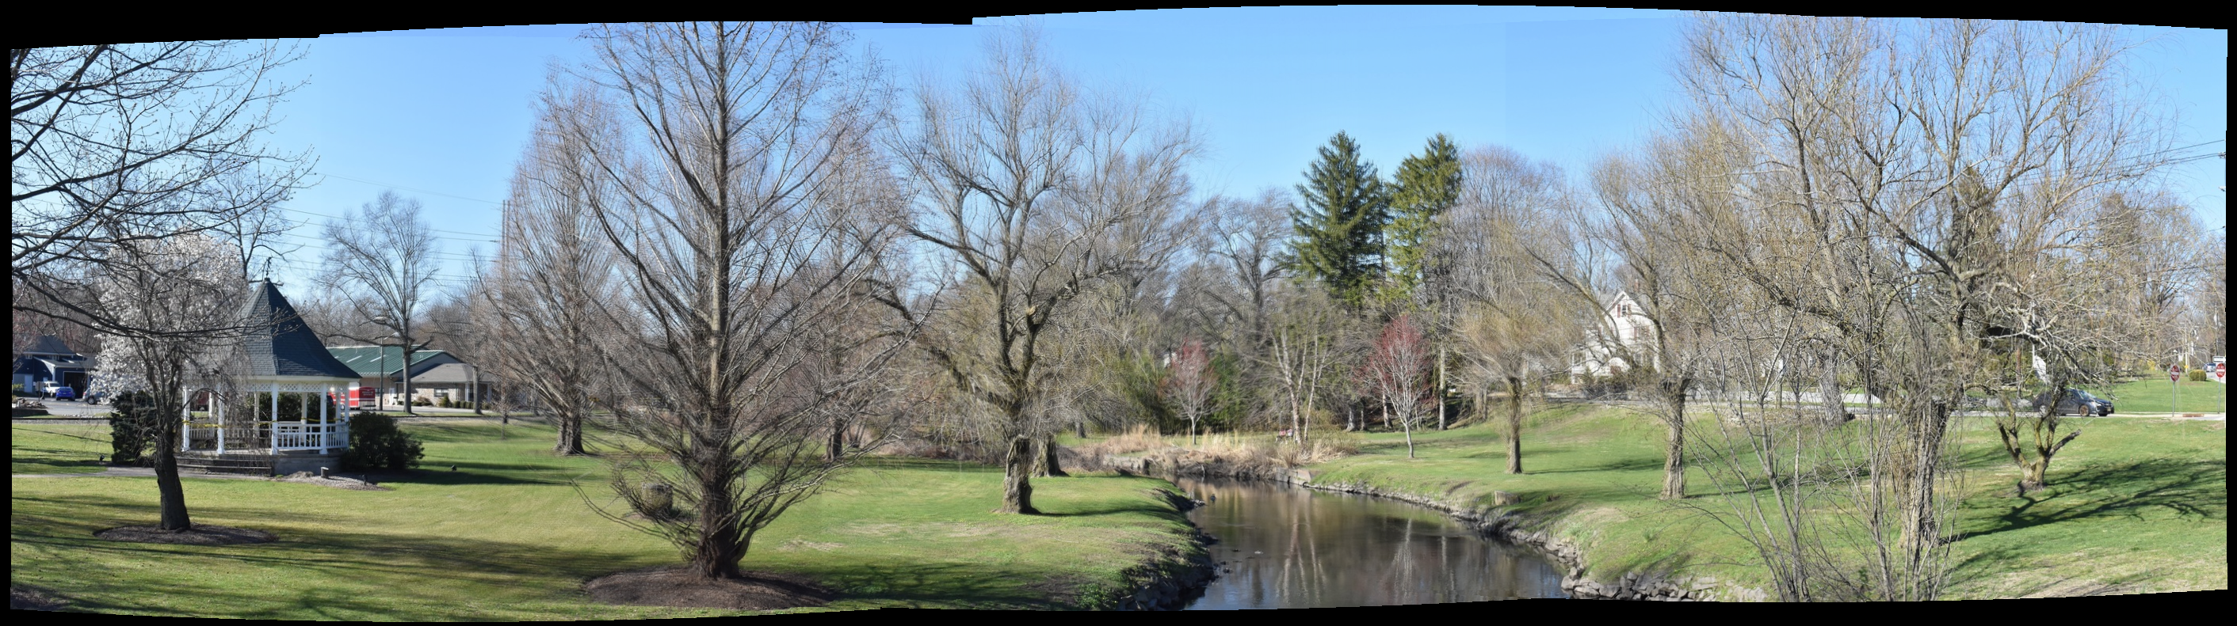
Bar Kadosh and Ben Kadosh

Slide 8
Third Place (tied)

Slide 9
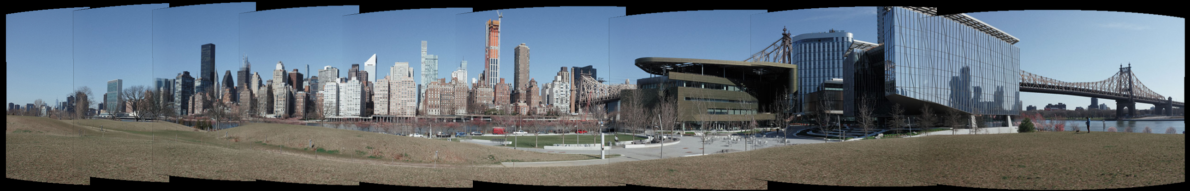
Suli Li and Wenyi Chu

Slide 10

Mahimna Kelkar and Pablo Herrera

Slide 11
Second Place

Slide 12
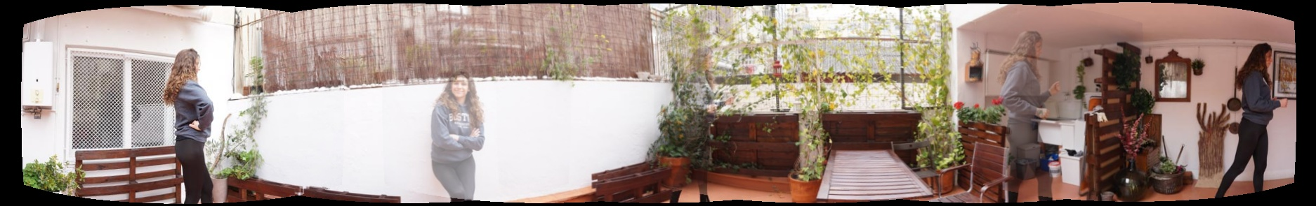
Irene Font Peradejordi and Shreya Chandrasekar

Slide 13
First Place

Slide 14
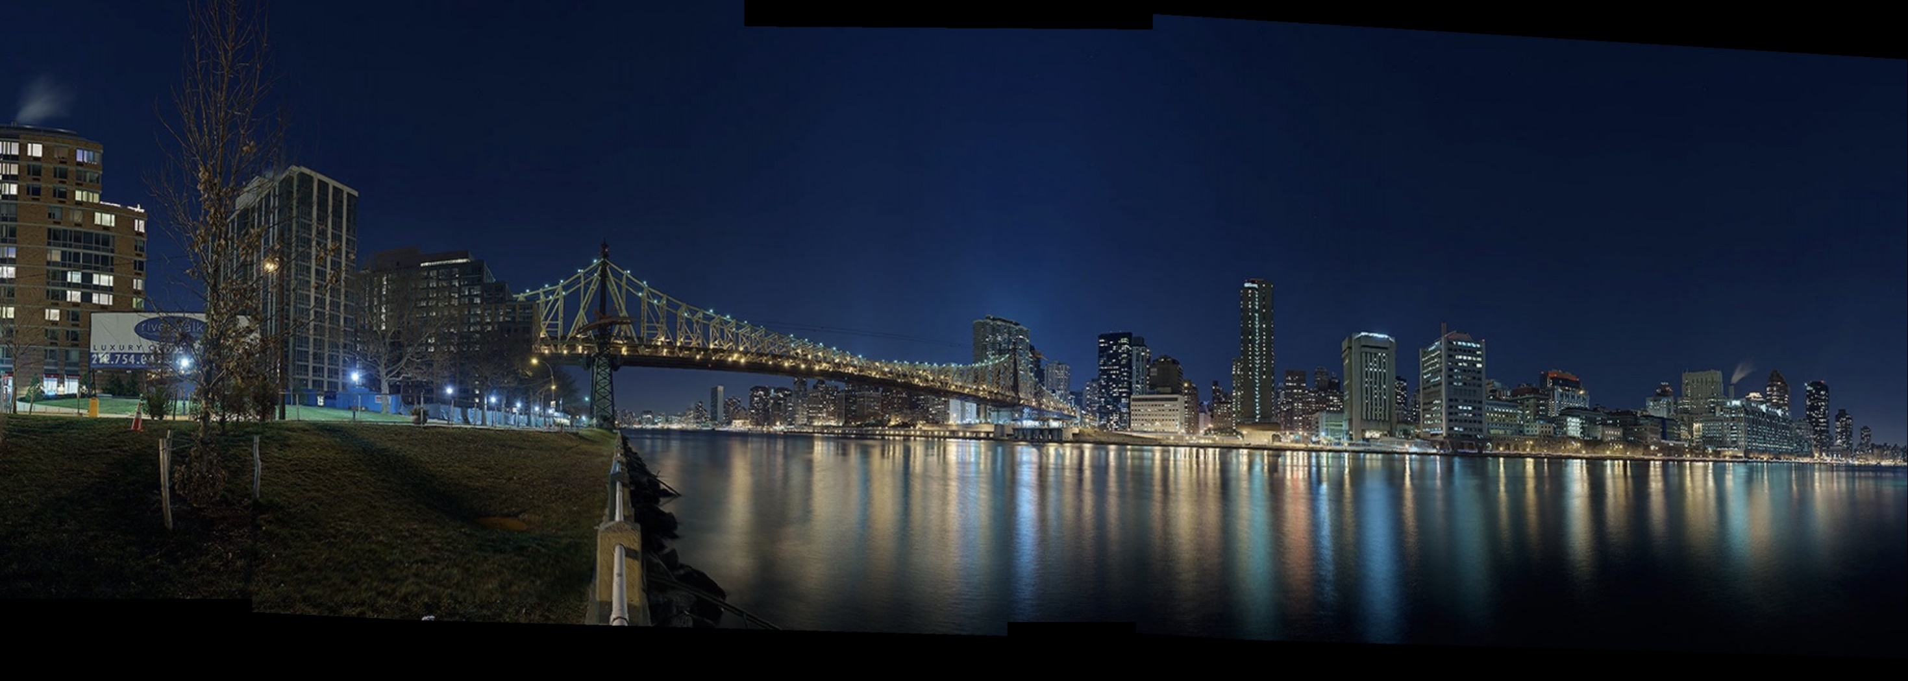
Surya Omesh Allena and
Sarath Chandra Chennareddy

Slide 15
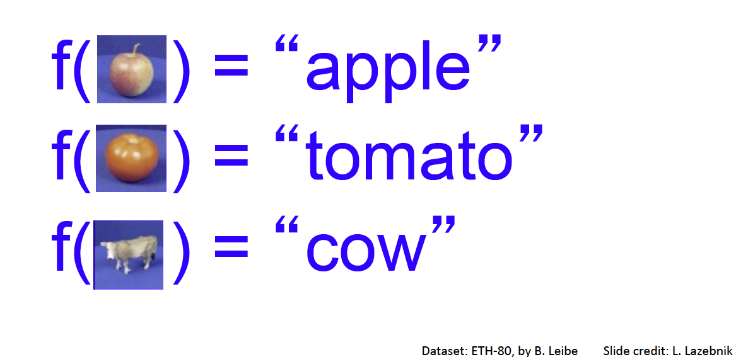
Image Classification: a core task in computer vision
Assume given set of discrete labels, e.g.
{cat, dog, cow, apple, tomato, truck, … }

Slide 16

Image classification demo
https://cloud.google.com/vision/docs/drag-and-drop
See also:
https://aws.amazon.com/rekognition/
https://www.clarifai.com/
https://azure.microsoft.com/en-us/services/cognitive-services/computer-vision/
…

Slide 17

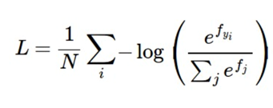
Recap: linear classification
Have score function and loss function
  Score function maps an input data instance (e.g., an image) to a vector of scores, one for each category
  Last time, our score function is based on linear classifier
Find W and b to minimize a loss, e.g. cross-entropy loss
f: score function
x: input instance
W, b: parameters of a linear (actually affine) function

Slide 18
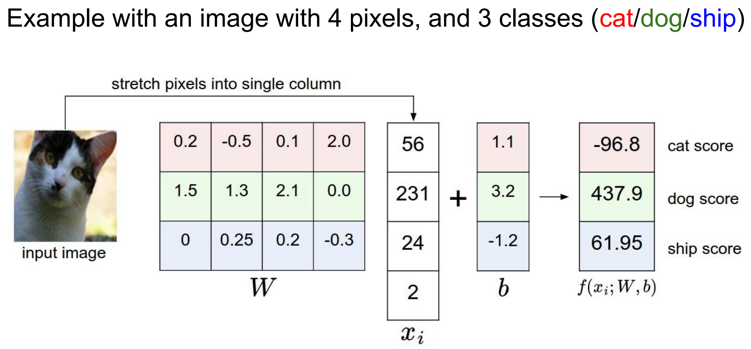
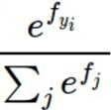
Recap: Image classification
0.06
0.82
0.12
Softmax “probabilities”

Slide 19
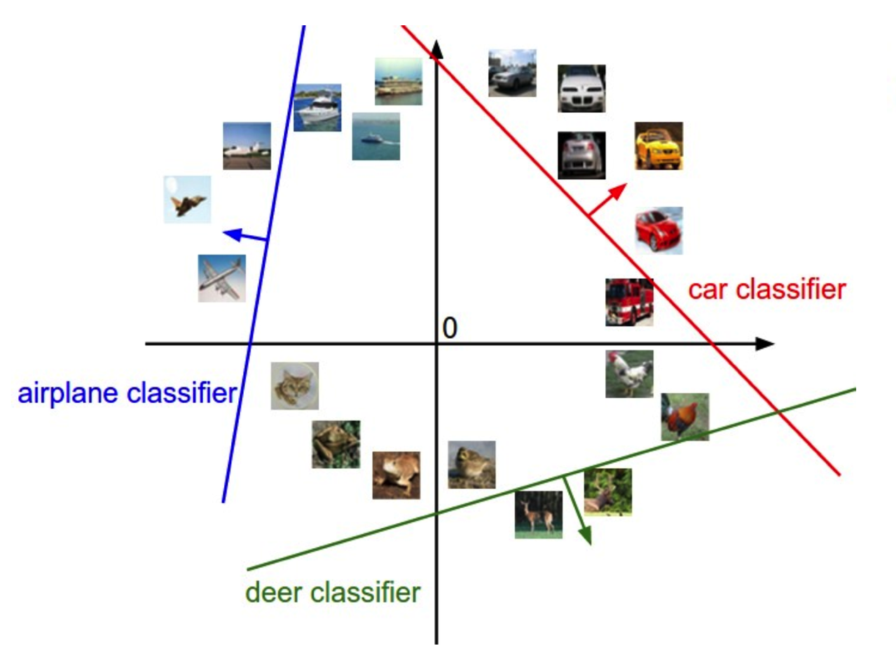
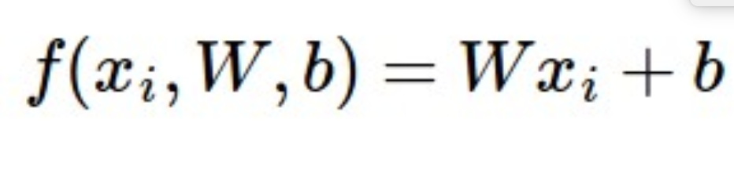
Linear classifiers separate features space into half-spaces

Slide 20
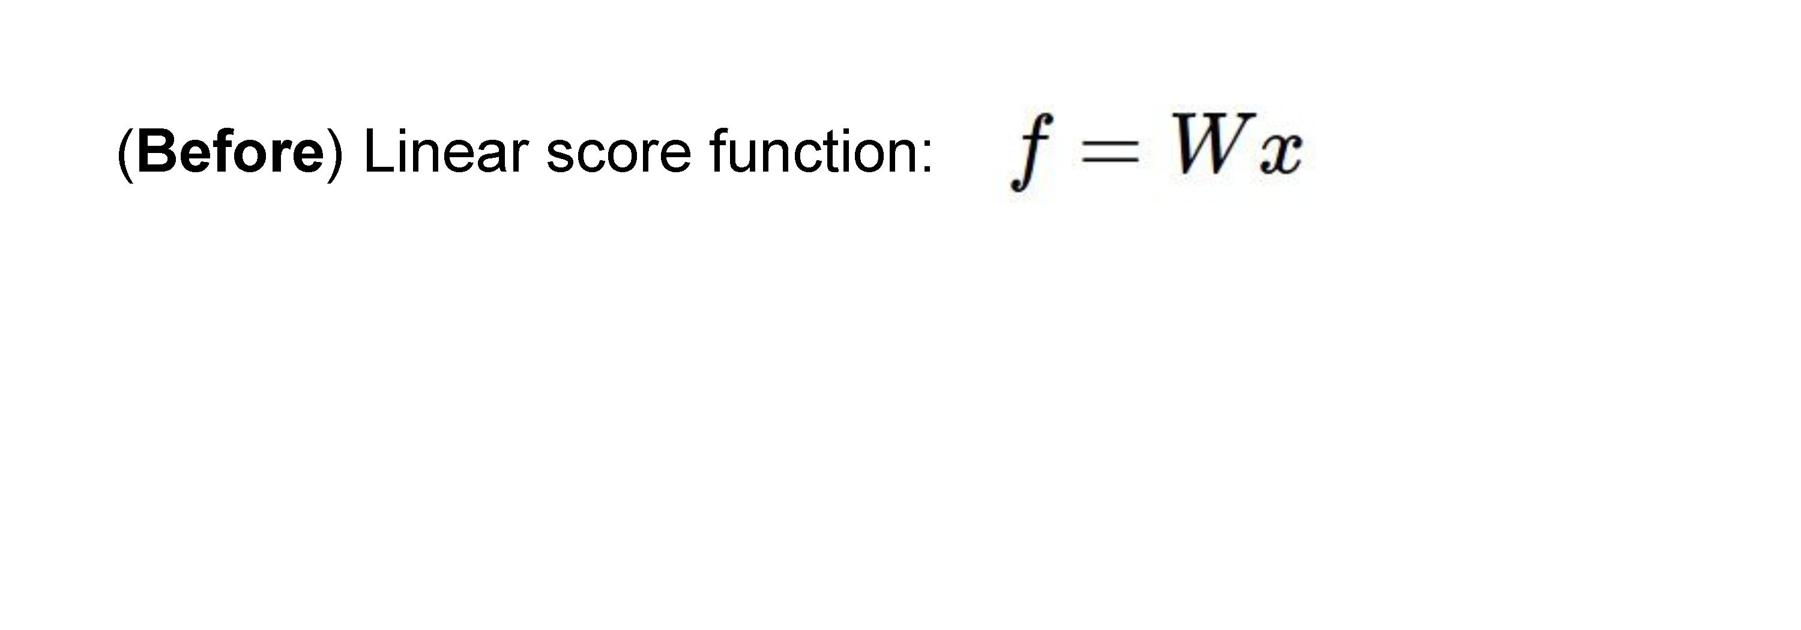
Neural networks

Slide 21
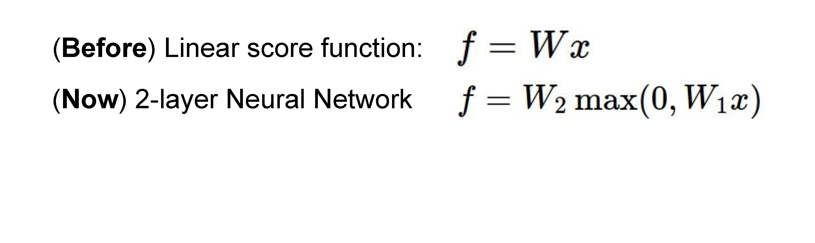
Neural networks

Slide 22
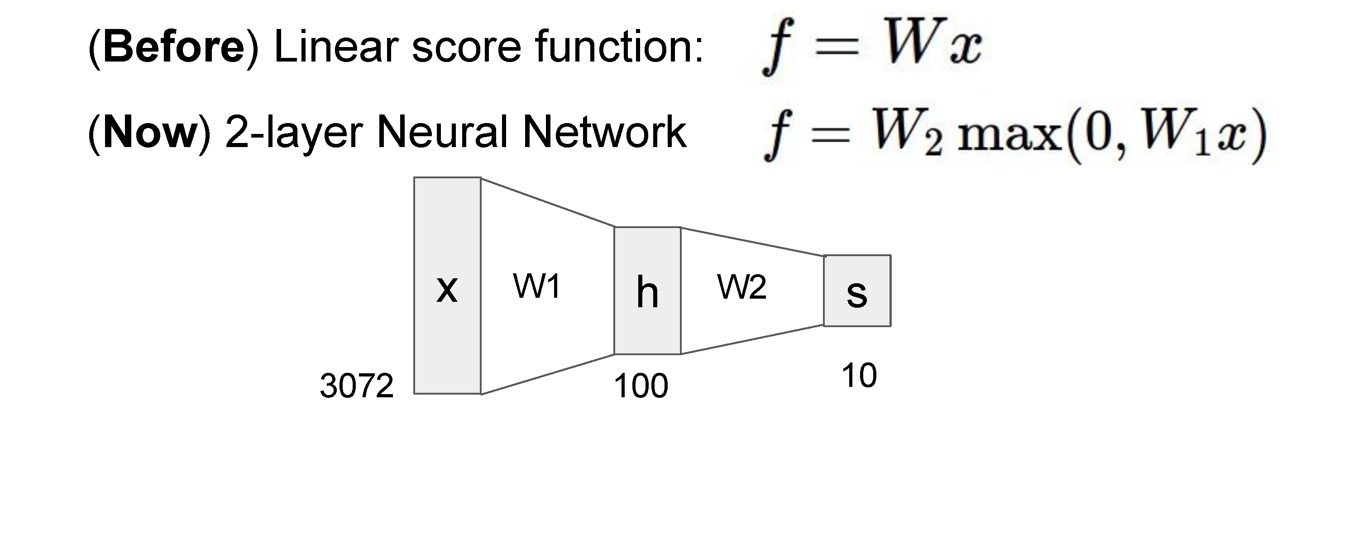
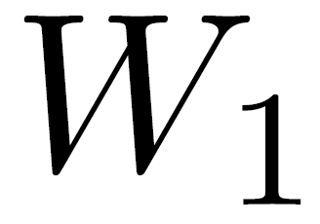
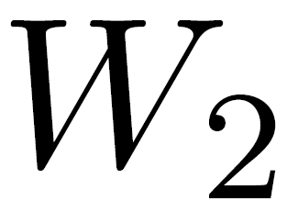
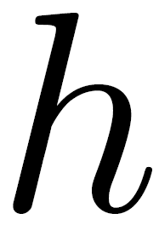
Neural networks
(10 x 100 matrix)
(100 x 3072 matrix)
100D intermediate vector

Slide 23
Neural networks
Total number of weights to learn:
3,072 x 100 + 100 x 10 = 308,200

Slide 24
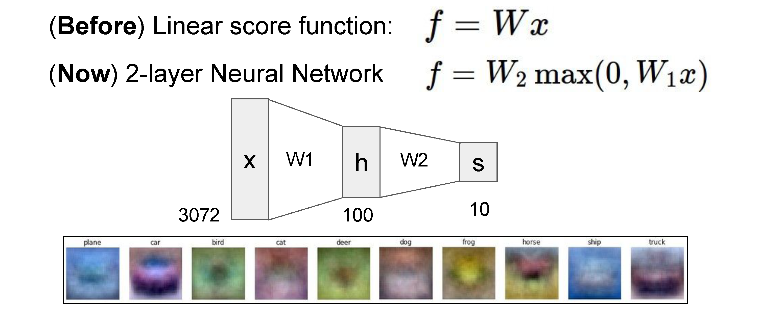
Neural networks

Slide 25
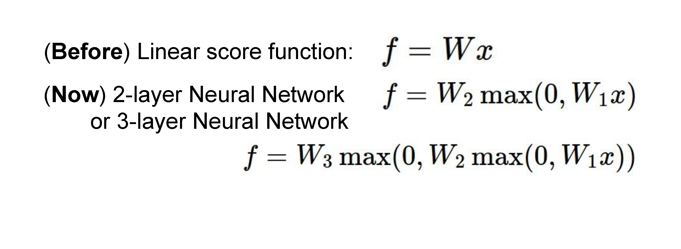
Neural networks
also called “Multi-Layer Perceptrons” (MLPs)

Slide 26

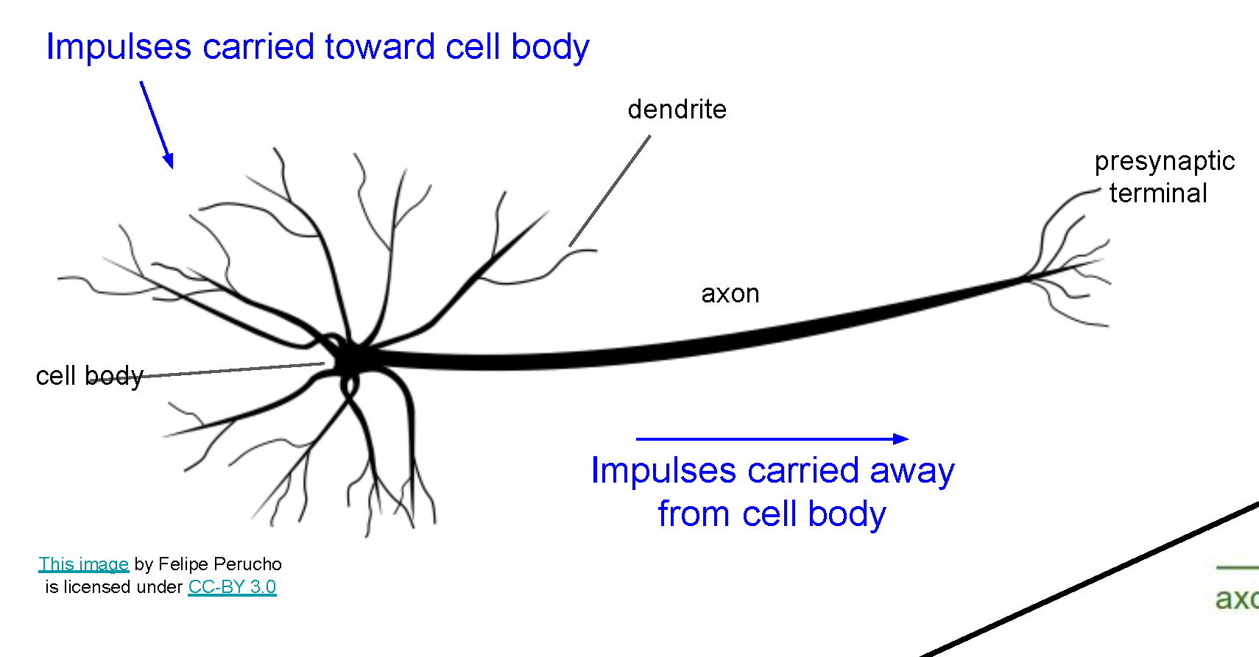
Neural networks
Very coarse generalization of neural networks:
  Linear functions chained together and separated by non-linearities (activation functions), e.g. “max”
  Why separate linear functions with non-linear functions?
  Very roughly inspired by real neurons

Slide 27
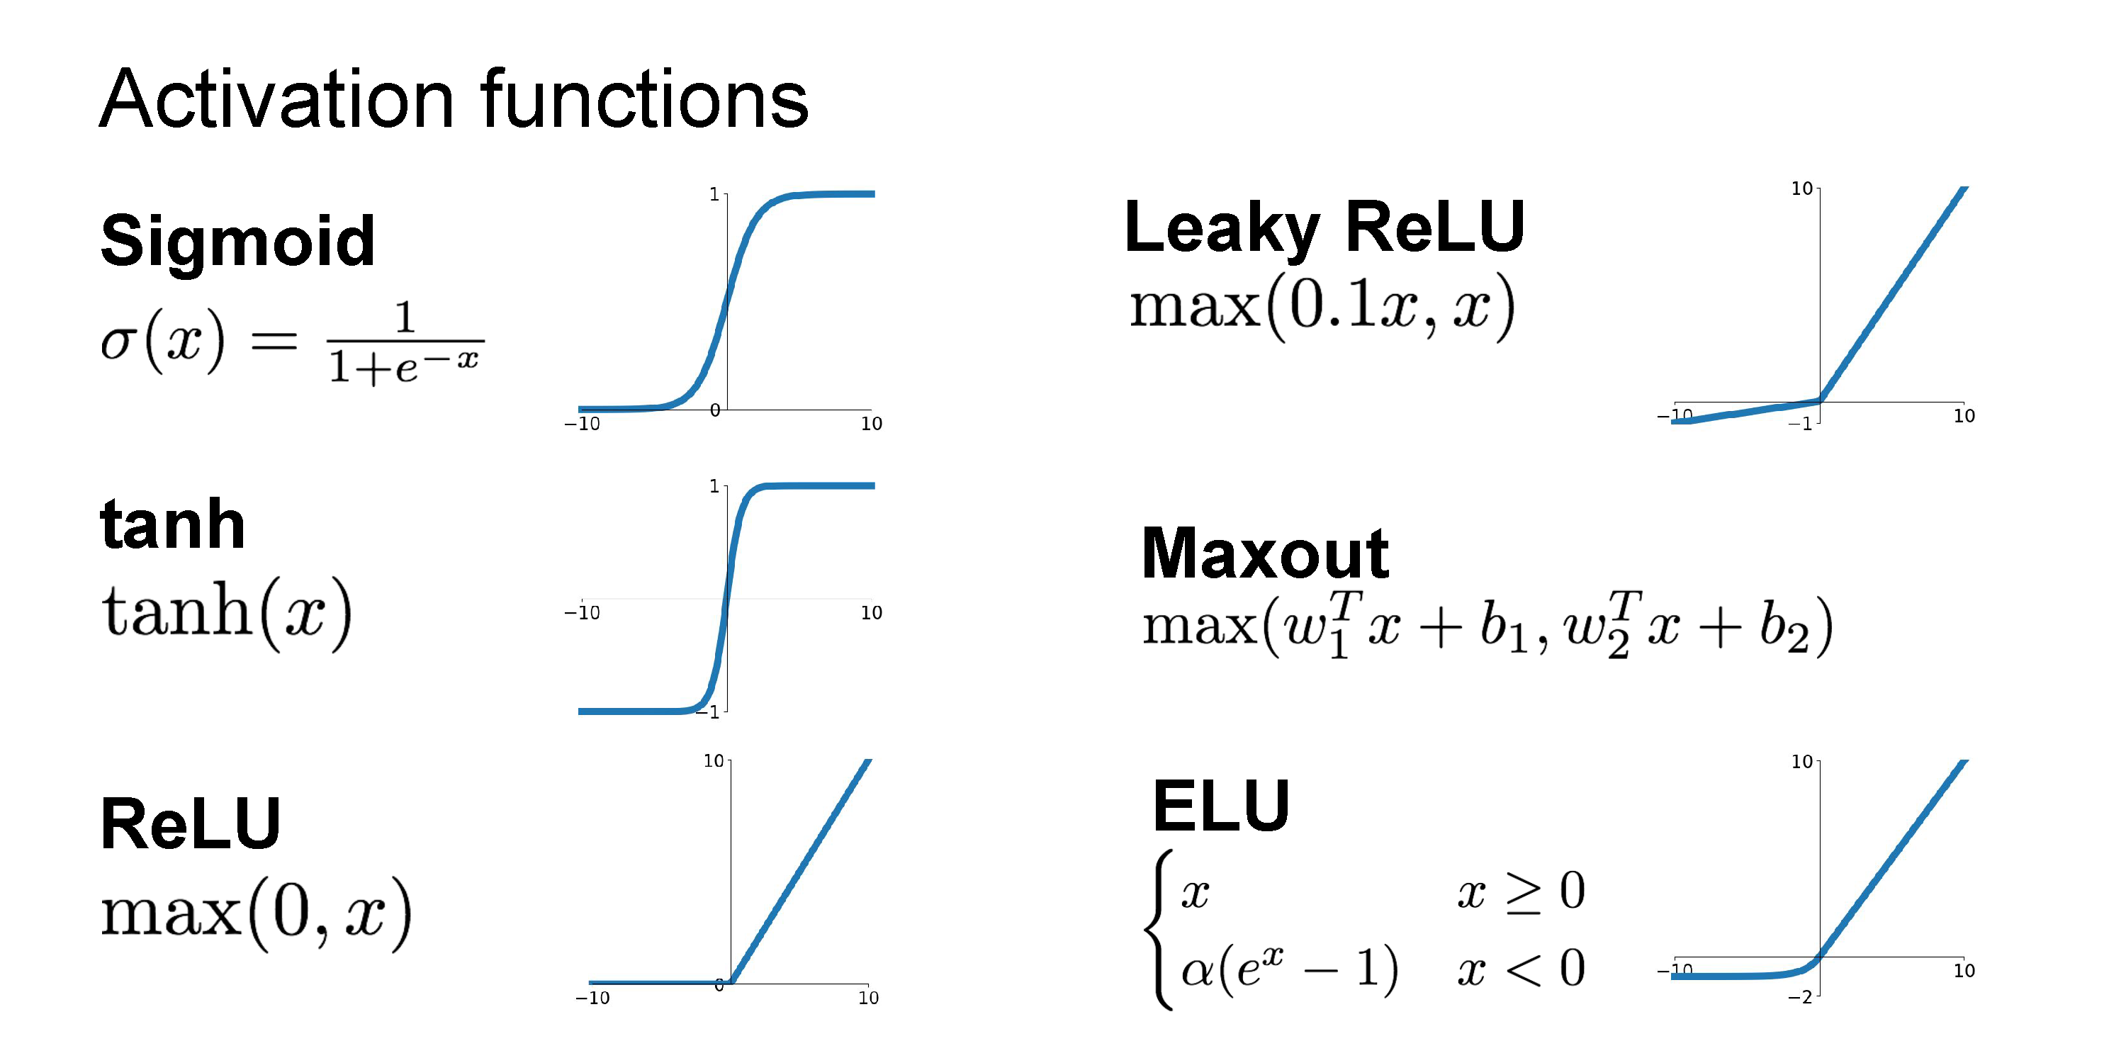

Slide 28
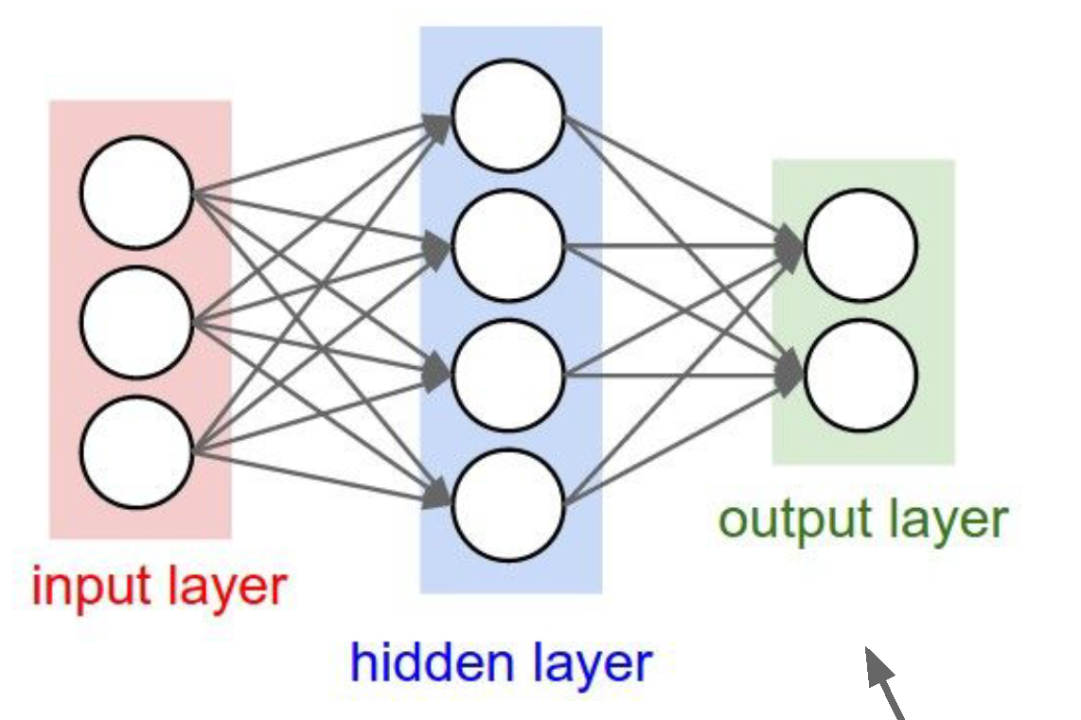
Neural network architecture
Computation graph for a 2-layer neural network
Neuron or unit

Slide 29
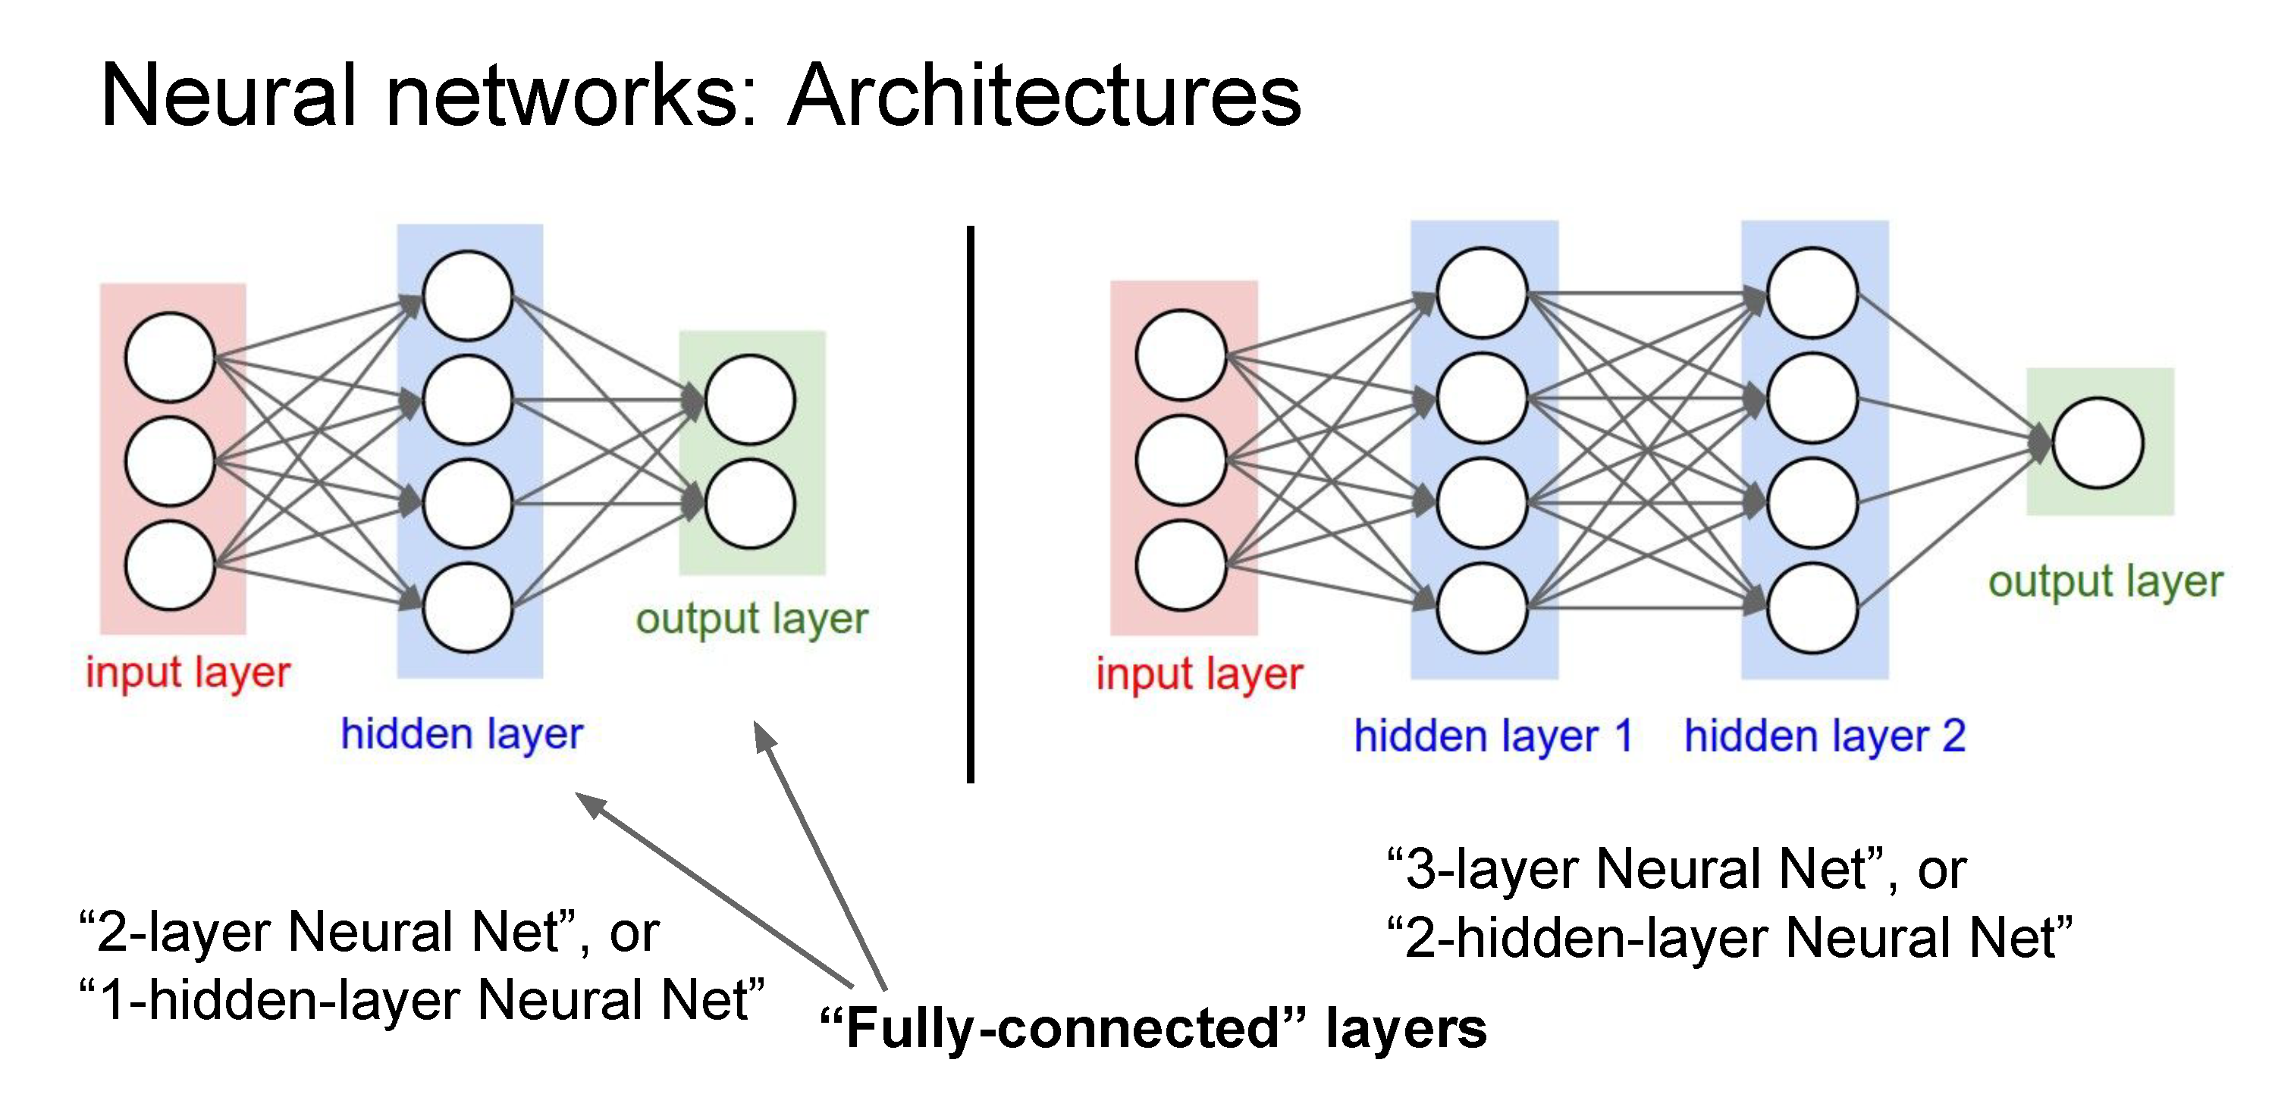
Deep networks typically have many layers and potentially millions of parameters

Slide 30
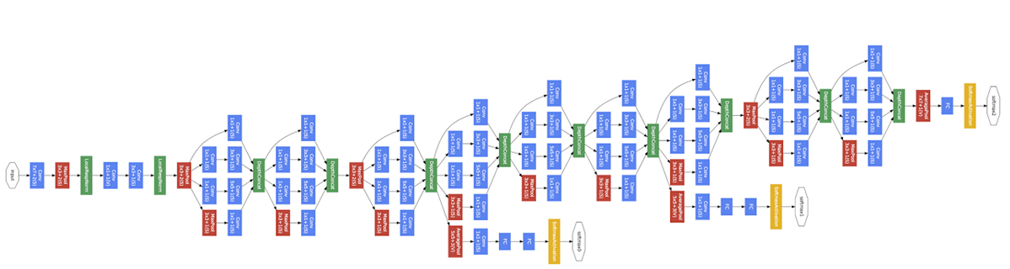
Deep neural network
Inception network (Szegedy et al, 2015)
22 layers

Slide 31
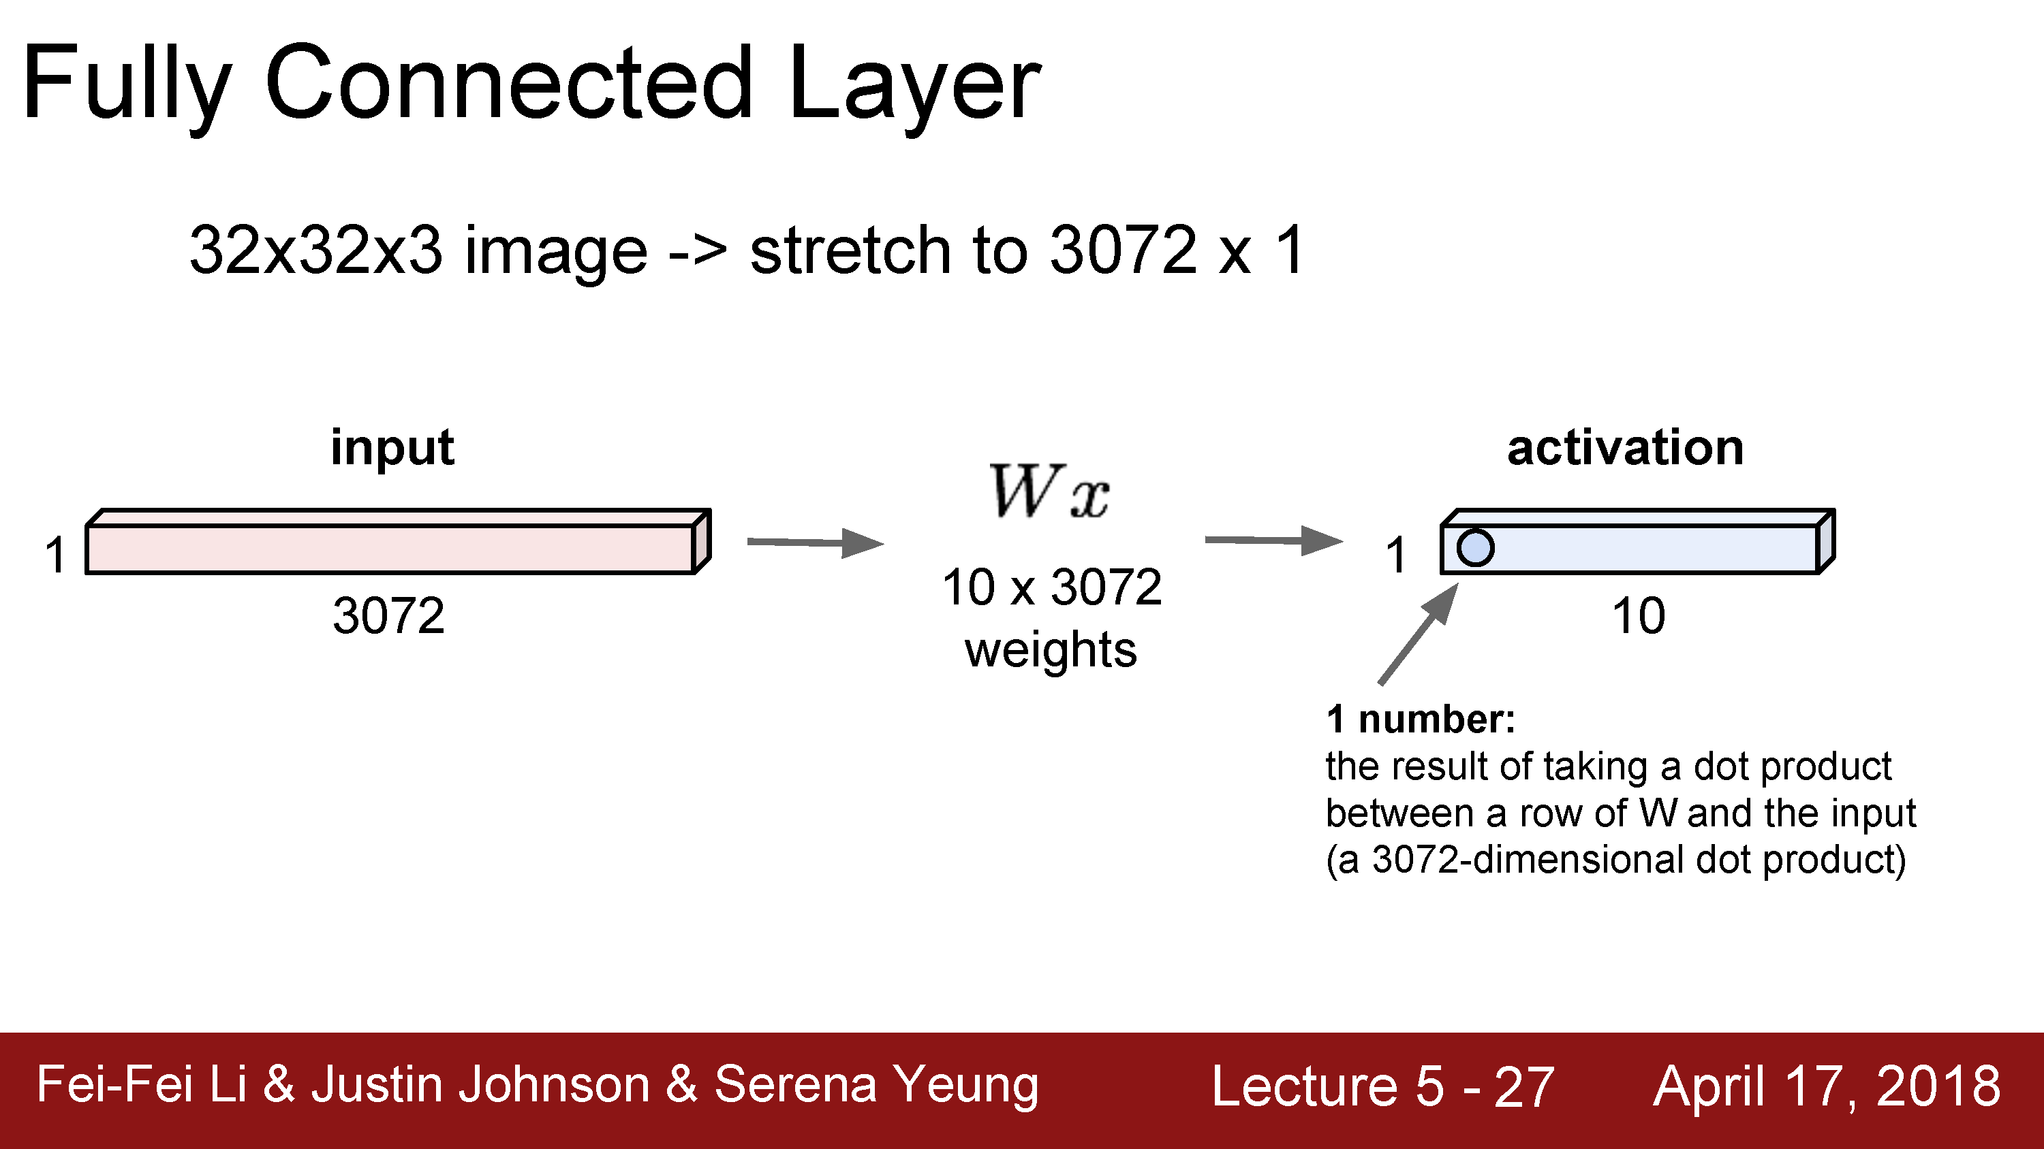

Slide 32
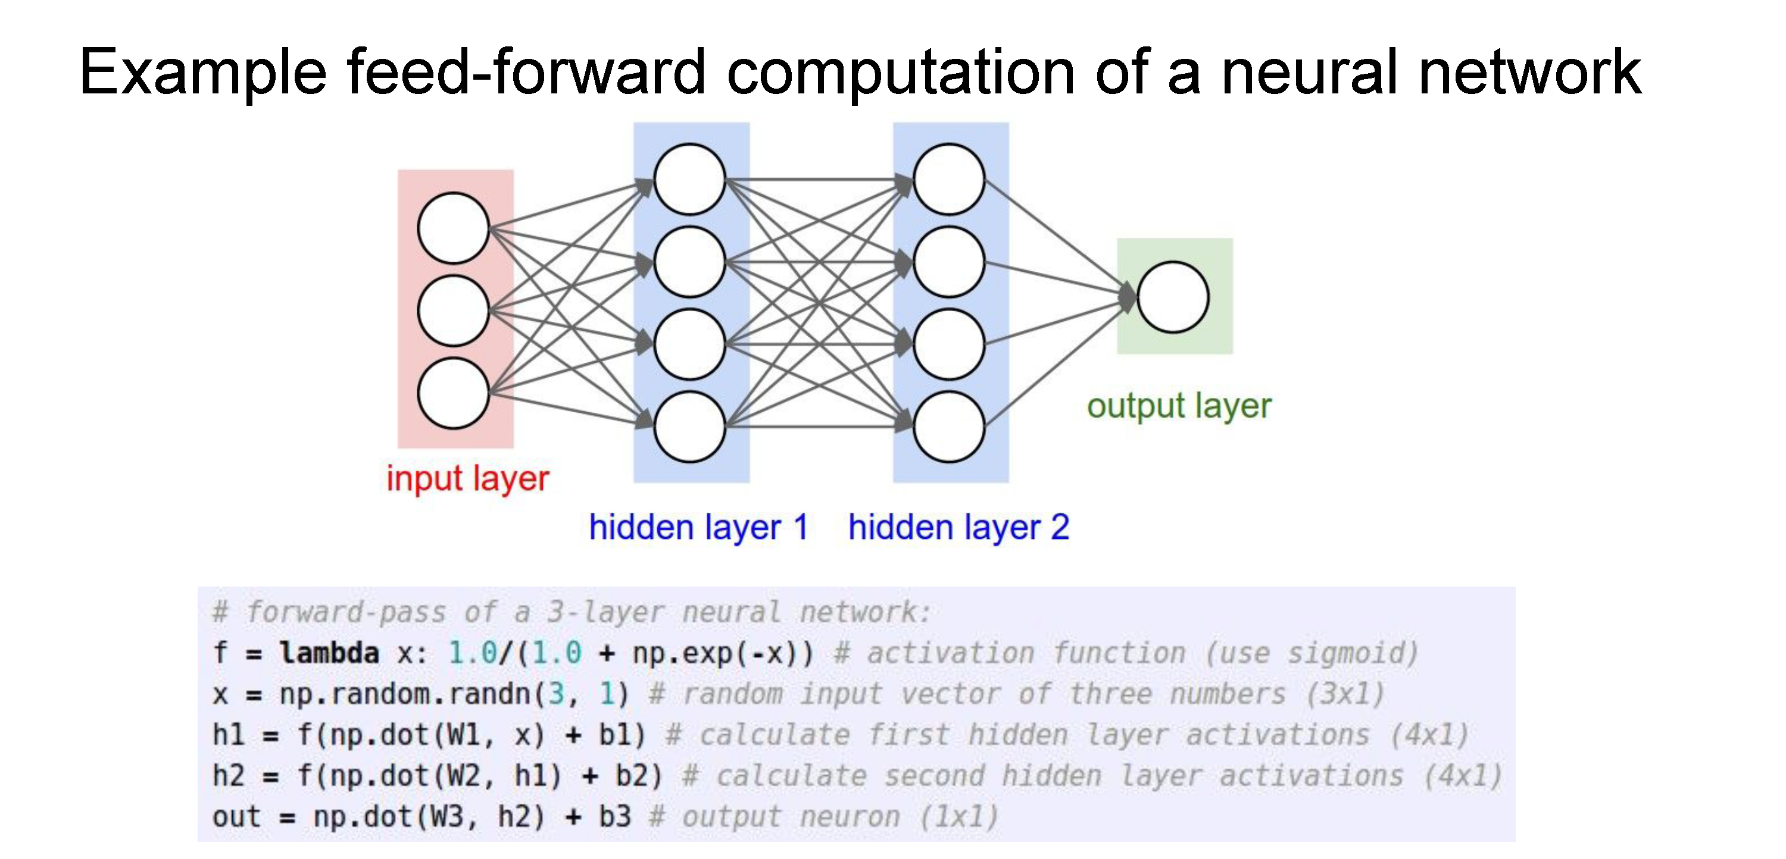

Slide 33
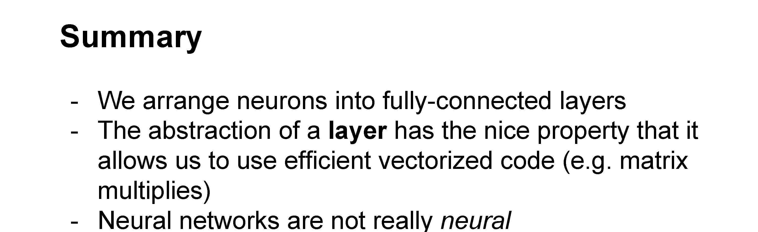

Slide 34
Optimizing parameters with gradient descent
How do we find the best W and b parameters?
In general: gradient descent
  Start with a guess of a good W and b (or randomly initialize them)
  Compute the loss function for this initial guess and the gradient of the loss function
  Step some distance in the negative gradient direction (direction of steepest descent)
  Repeat steps 2 & 3
Note: efficiently performing step 2 for deep networks is called backpropagation

Slide 35
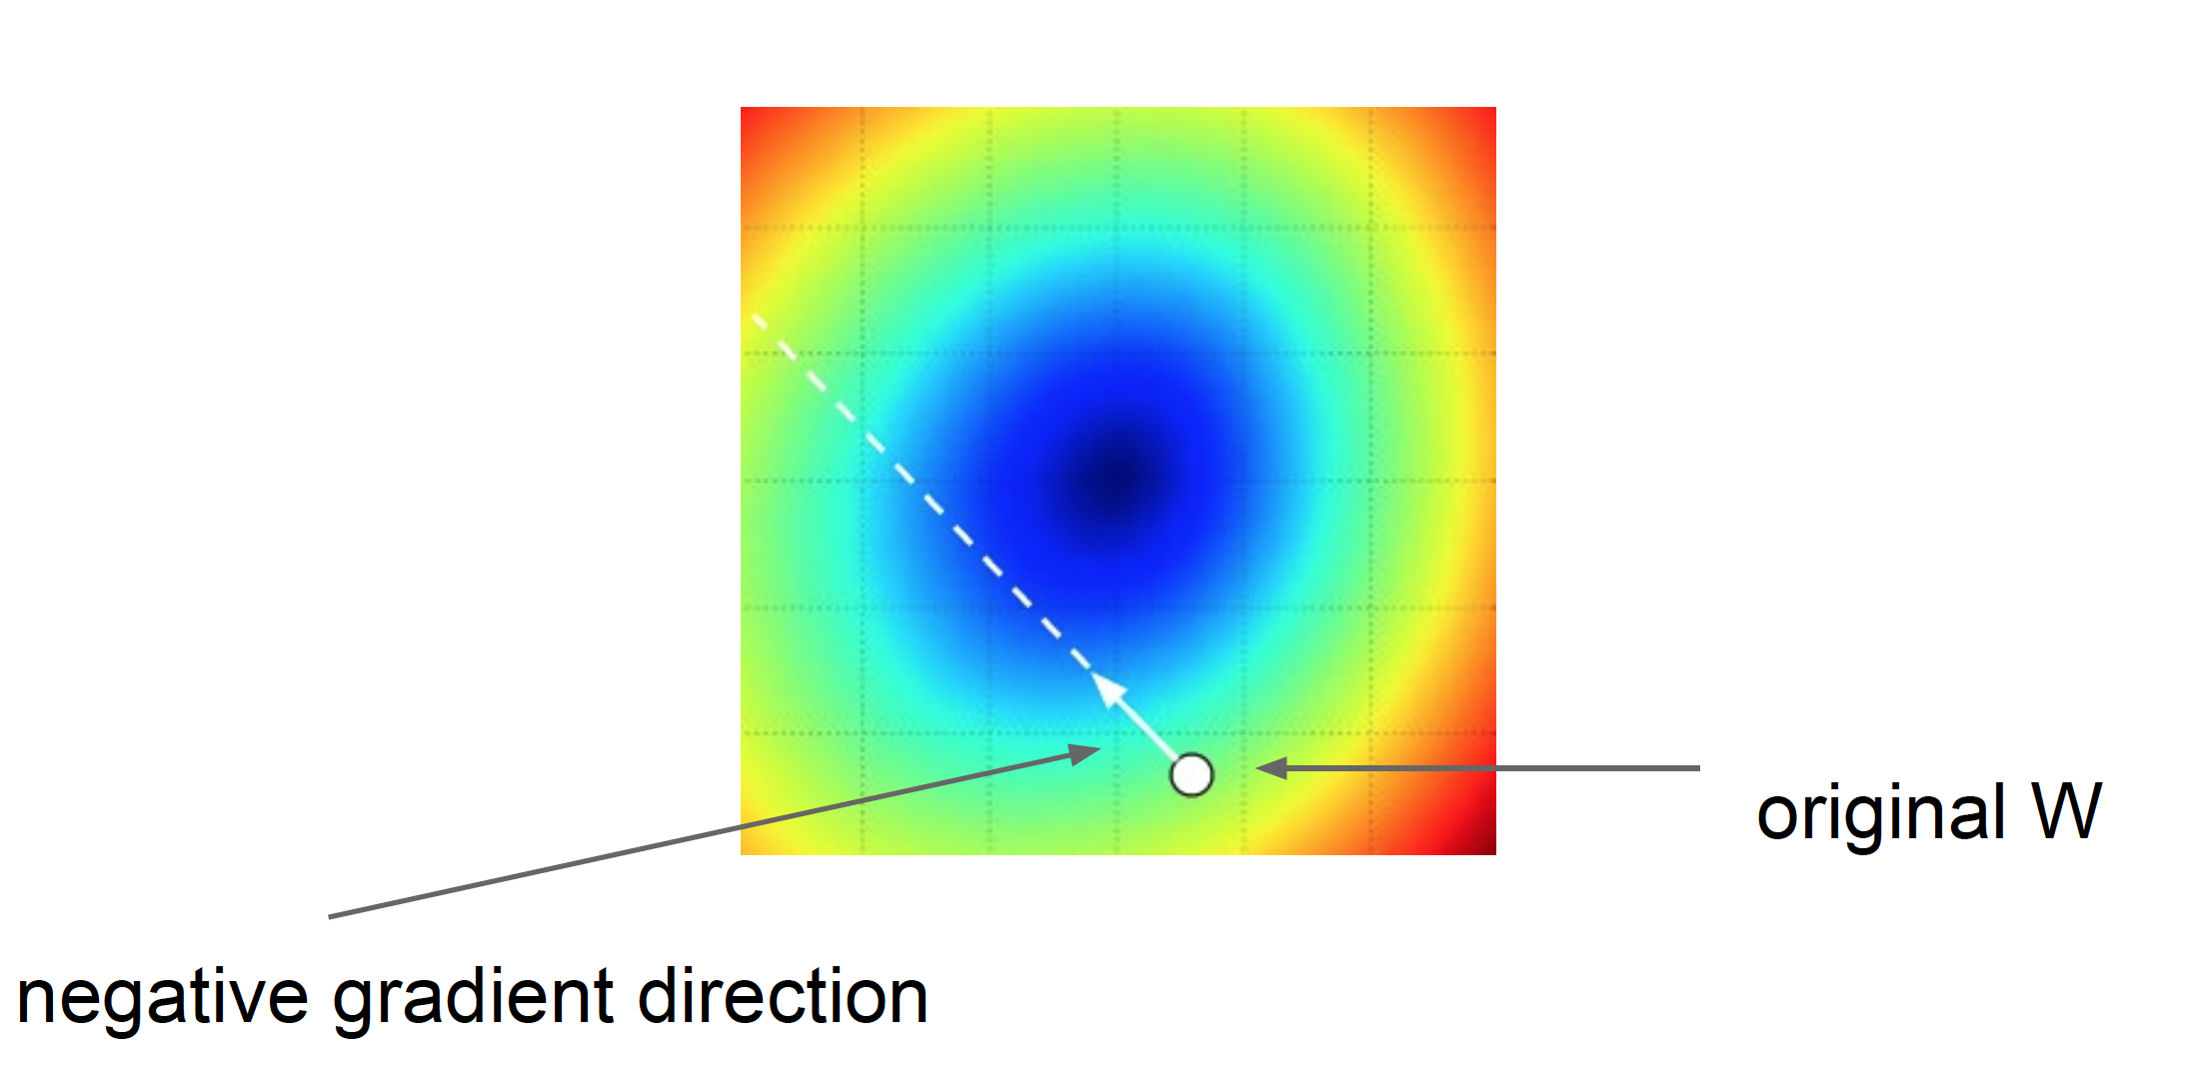
Gradient descent: walk in the direction opposite gradient
Q: How far?
A: Step size: learning rate
Too big: will miss the minimum
Too small: slow convergence

Slide 36
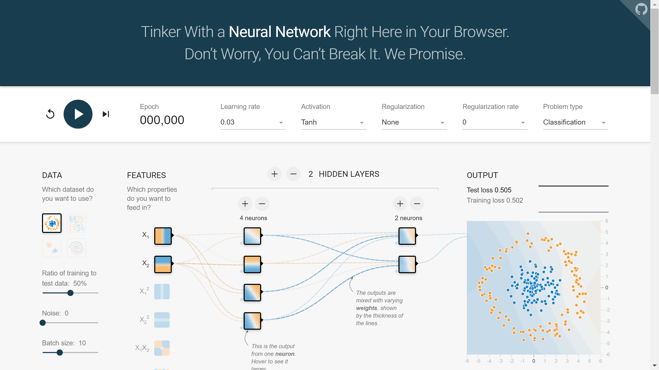
2D example: TensorFlow Playground
https://playground.tensorflow.org

Slide 37
Questions?

Slide 38
Convolutional neural networks

Slide 39
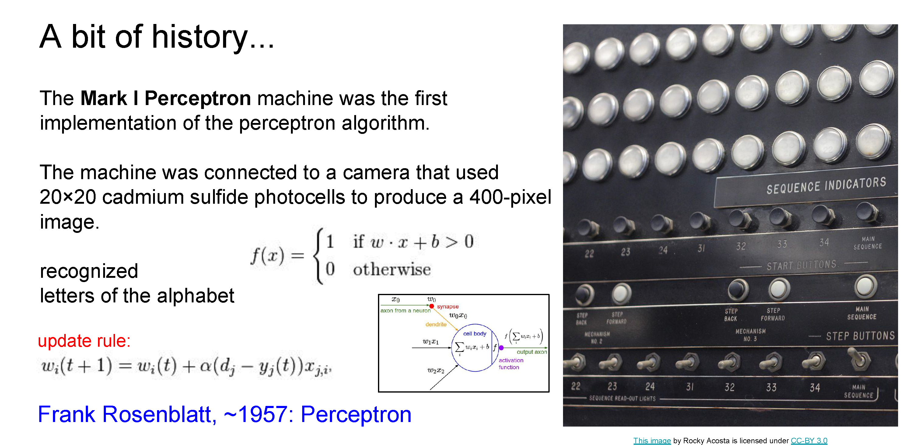

Slide 40
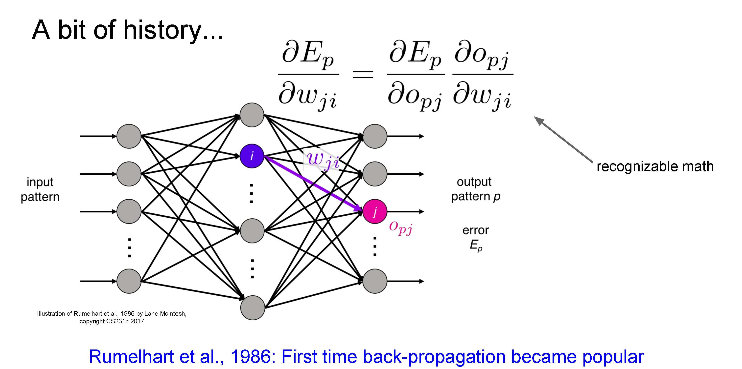

Slide 41
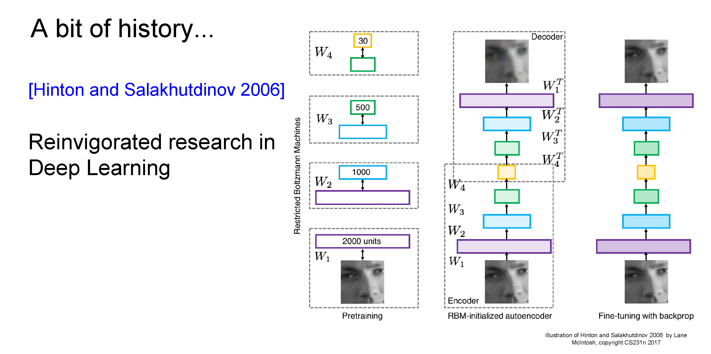
Hinton and Salakhutdinov. Reducing the Dimensionality of Data with Neural Networks. Science, 2016.

Slide 42
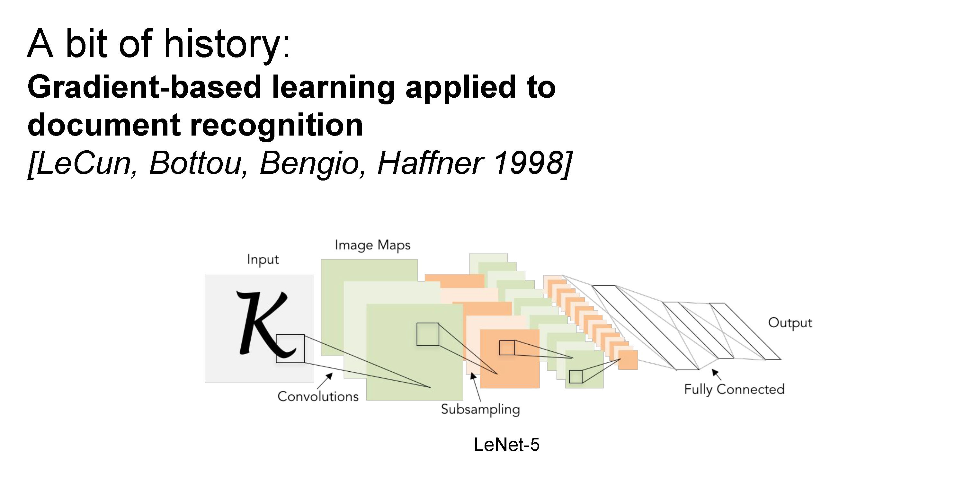

Slide 43
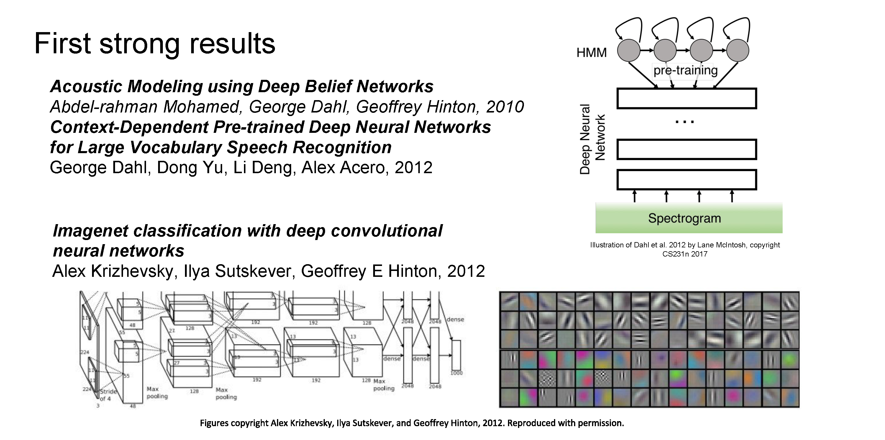

Slide 44
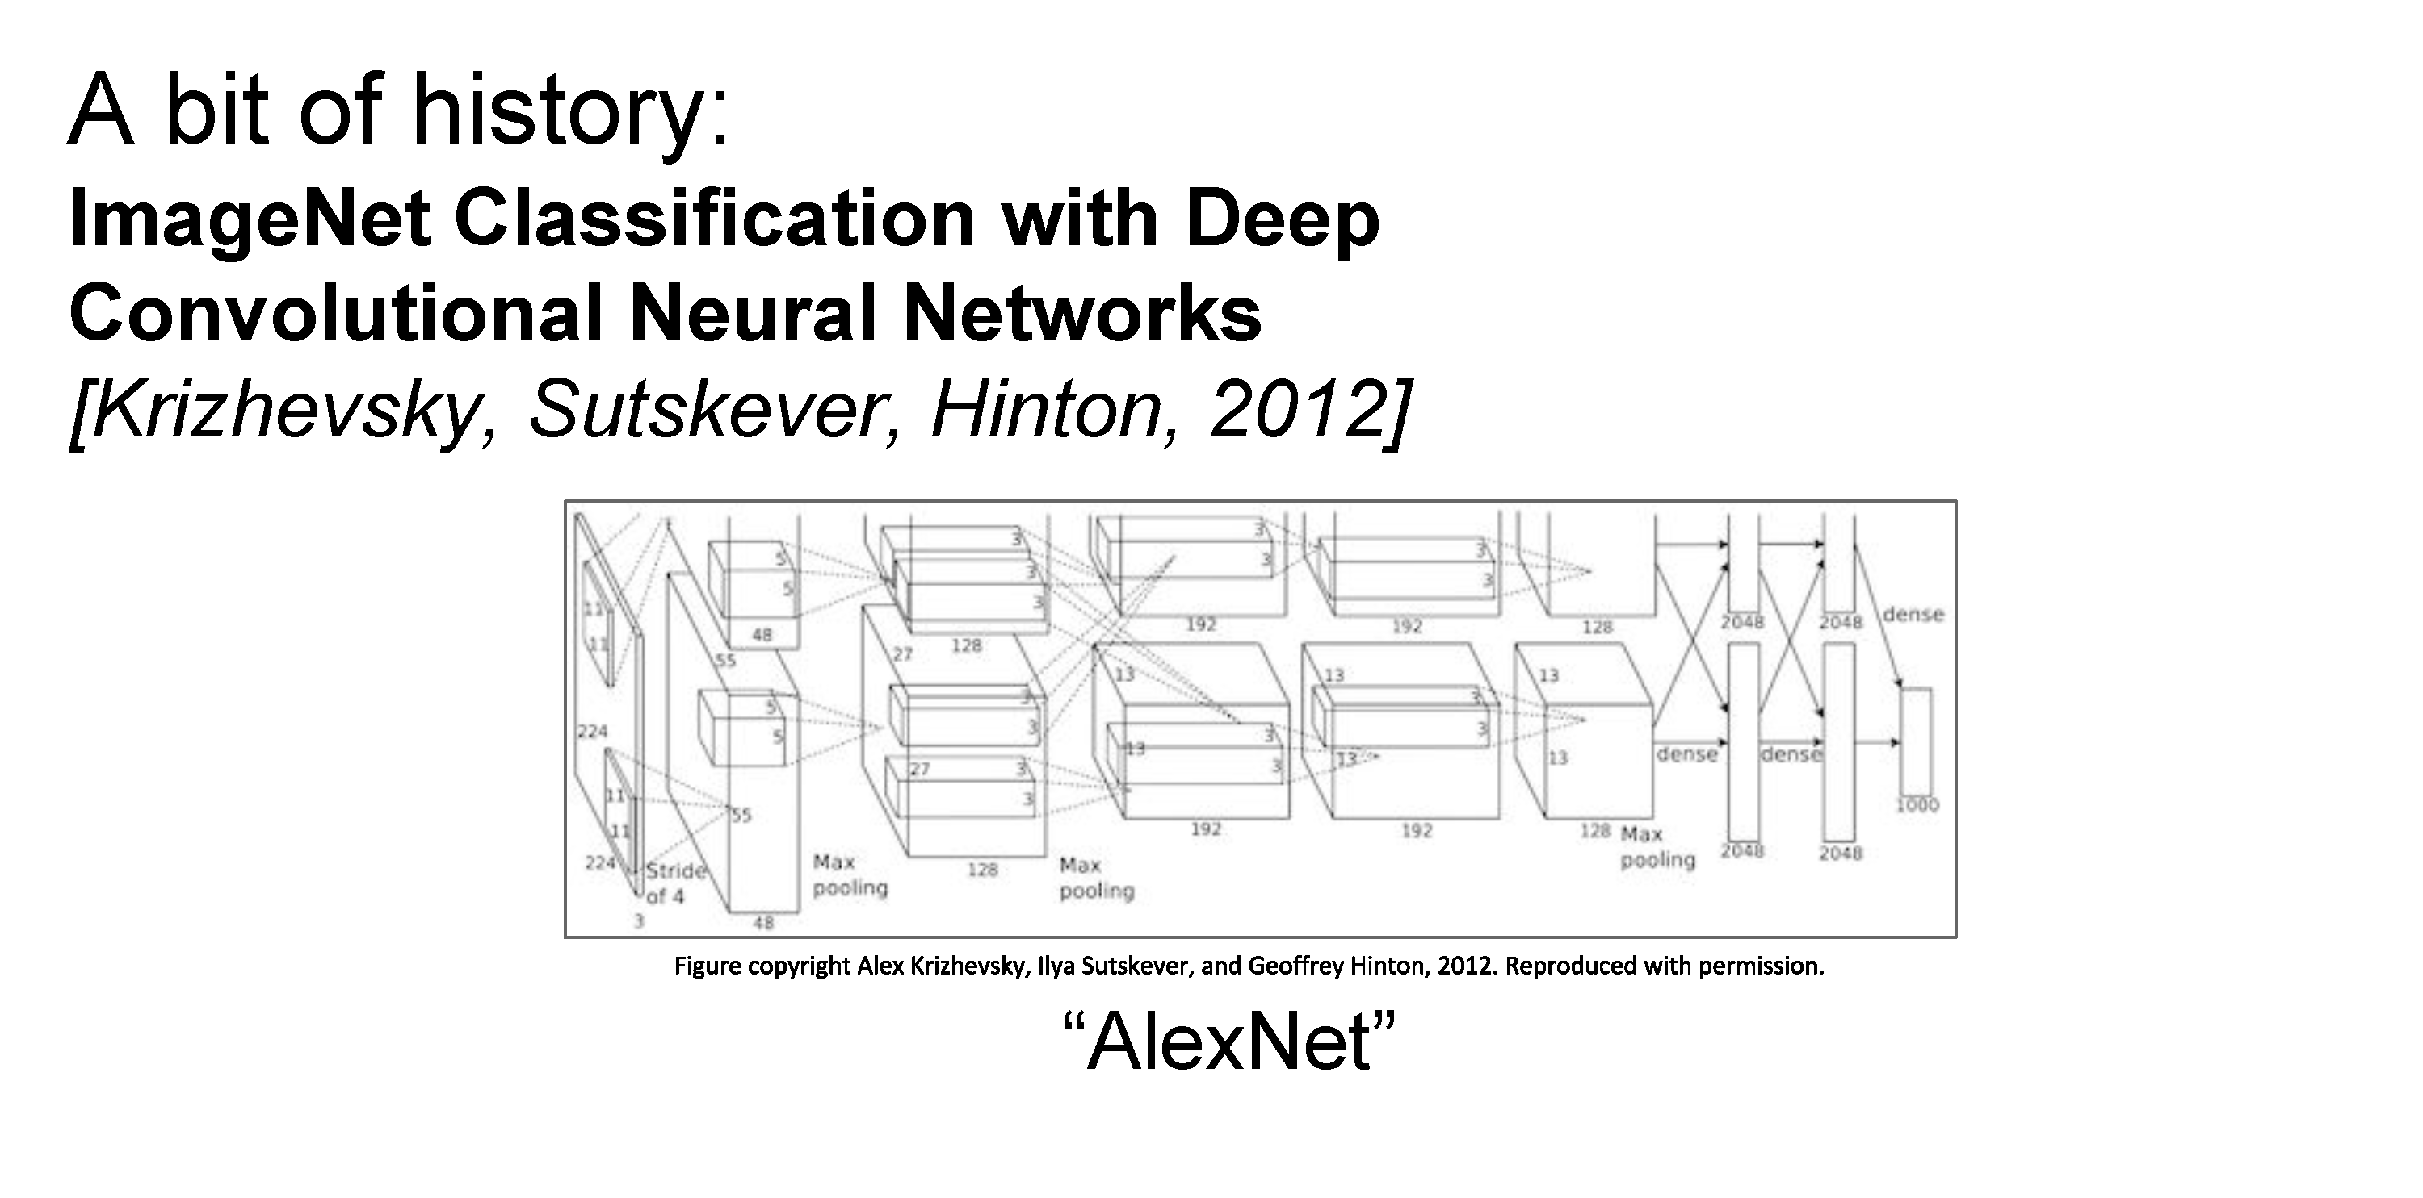

Slide 45
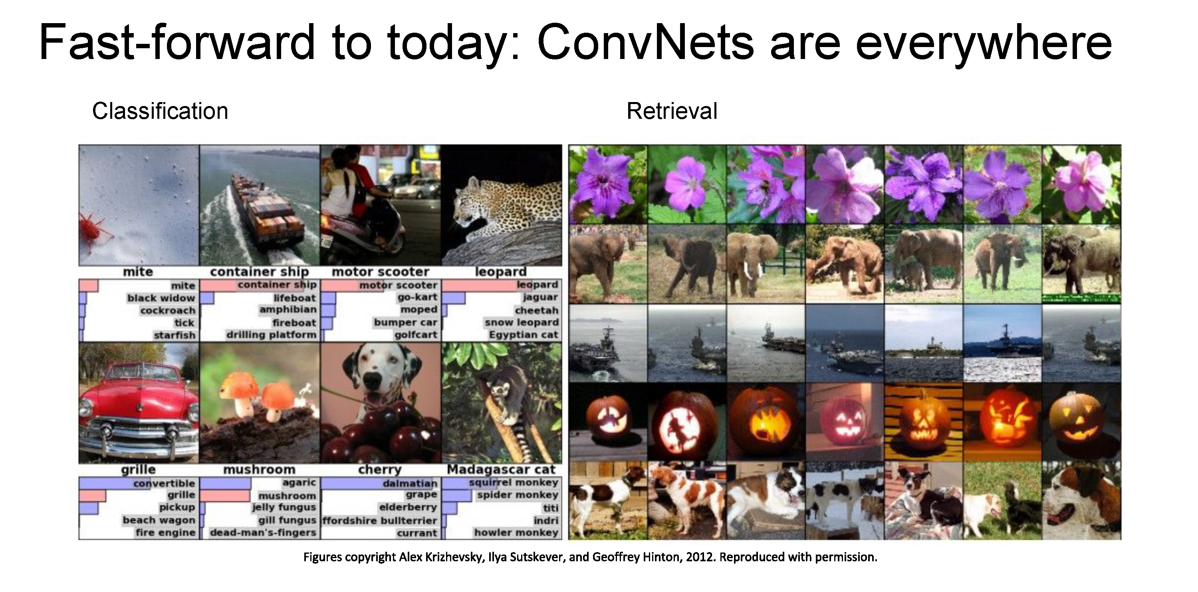

Slide 46
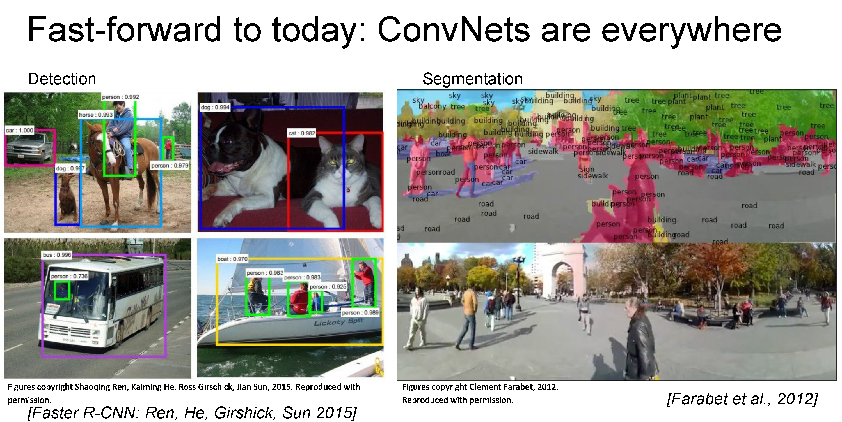

Slide 47
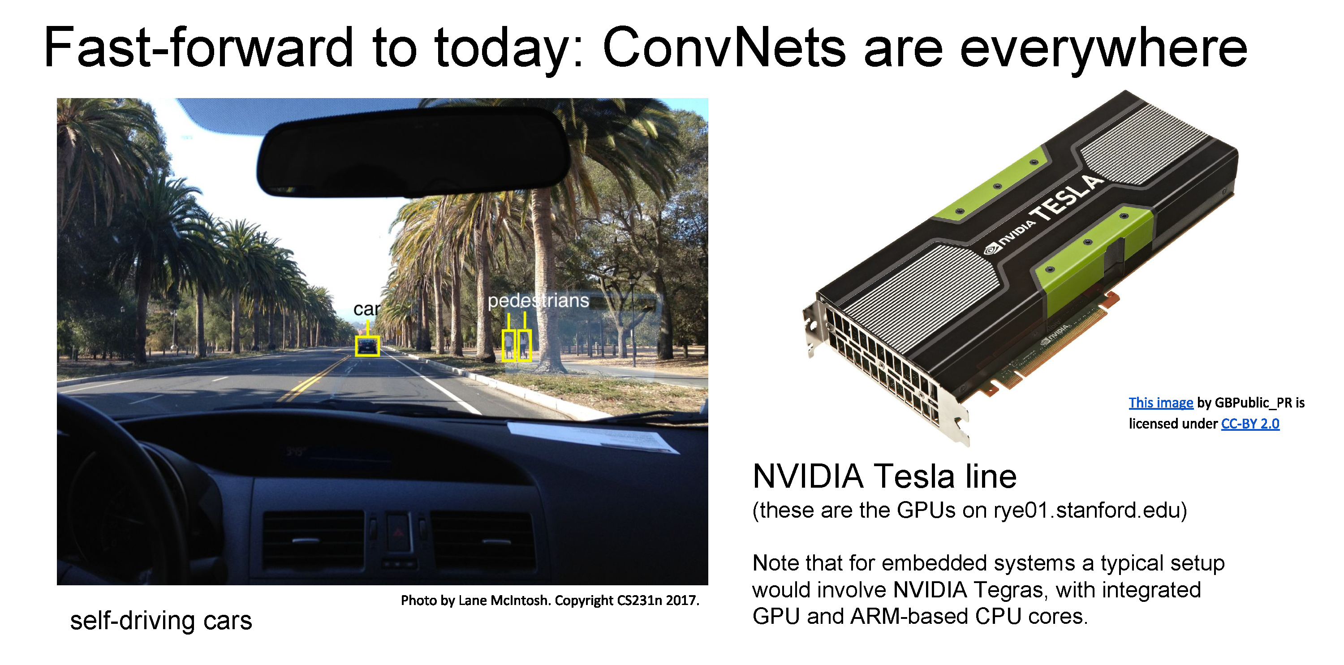

Slide 48
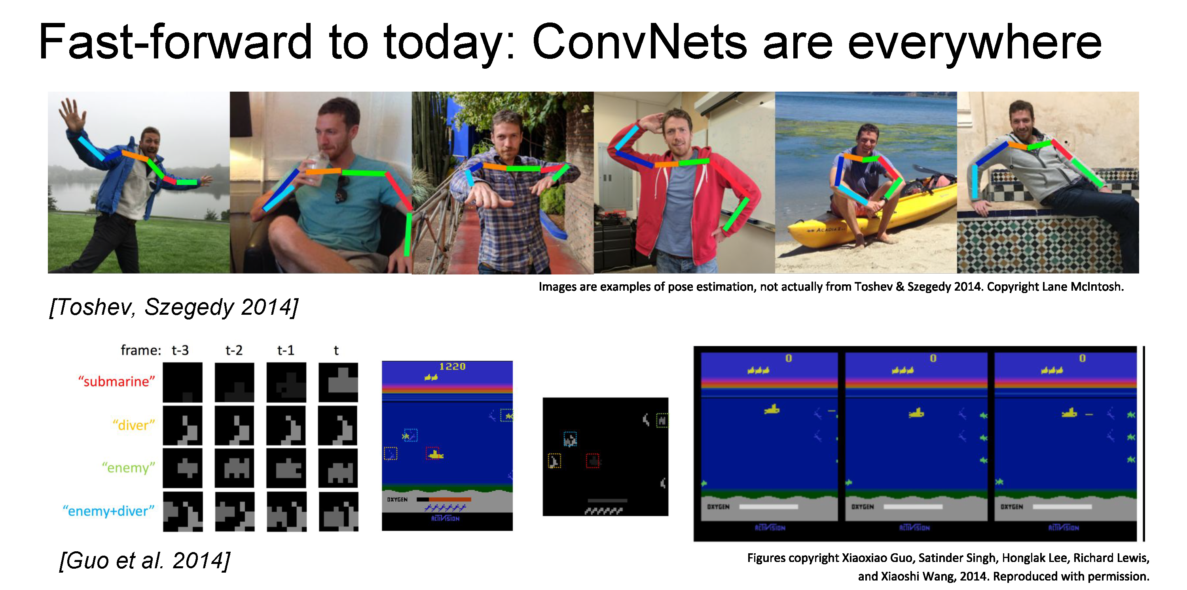

Slide 49
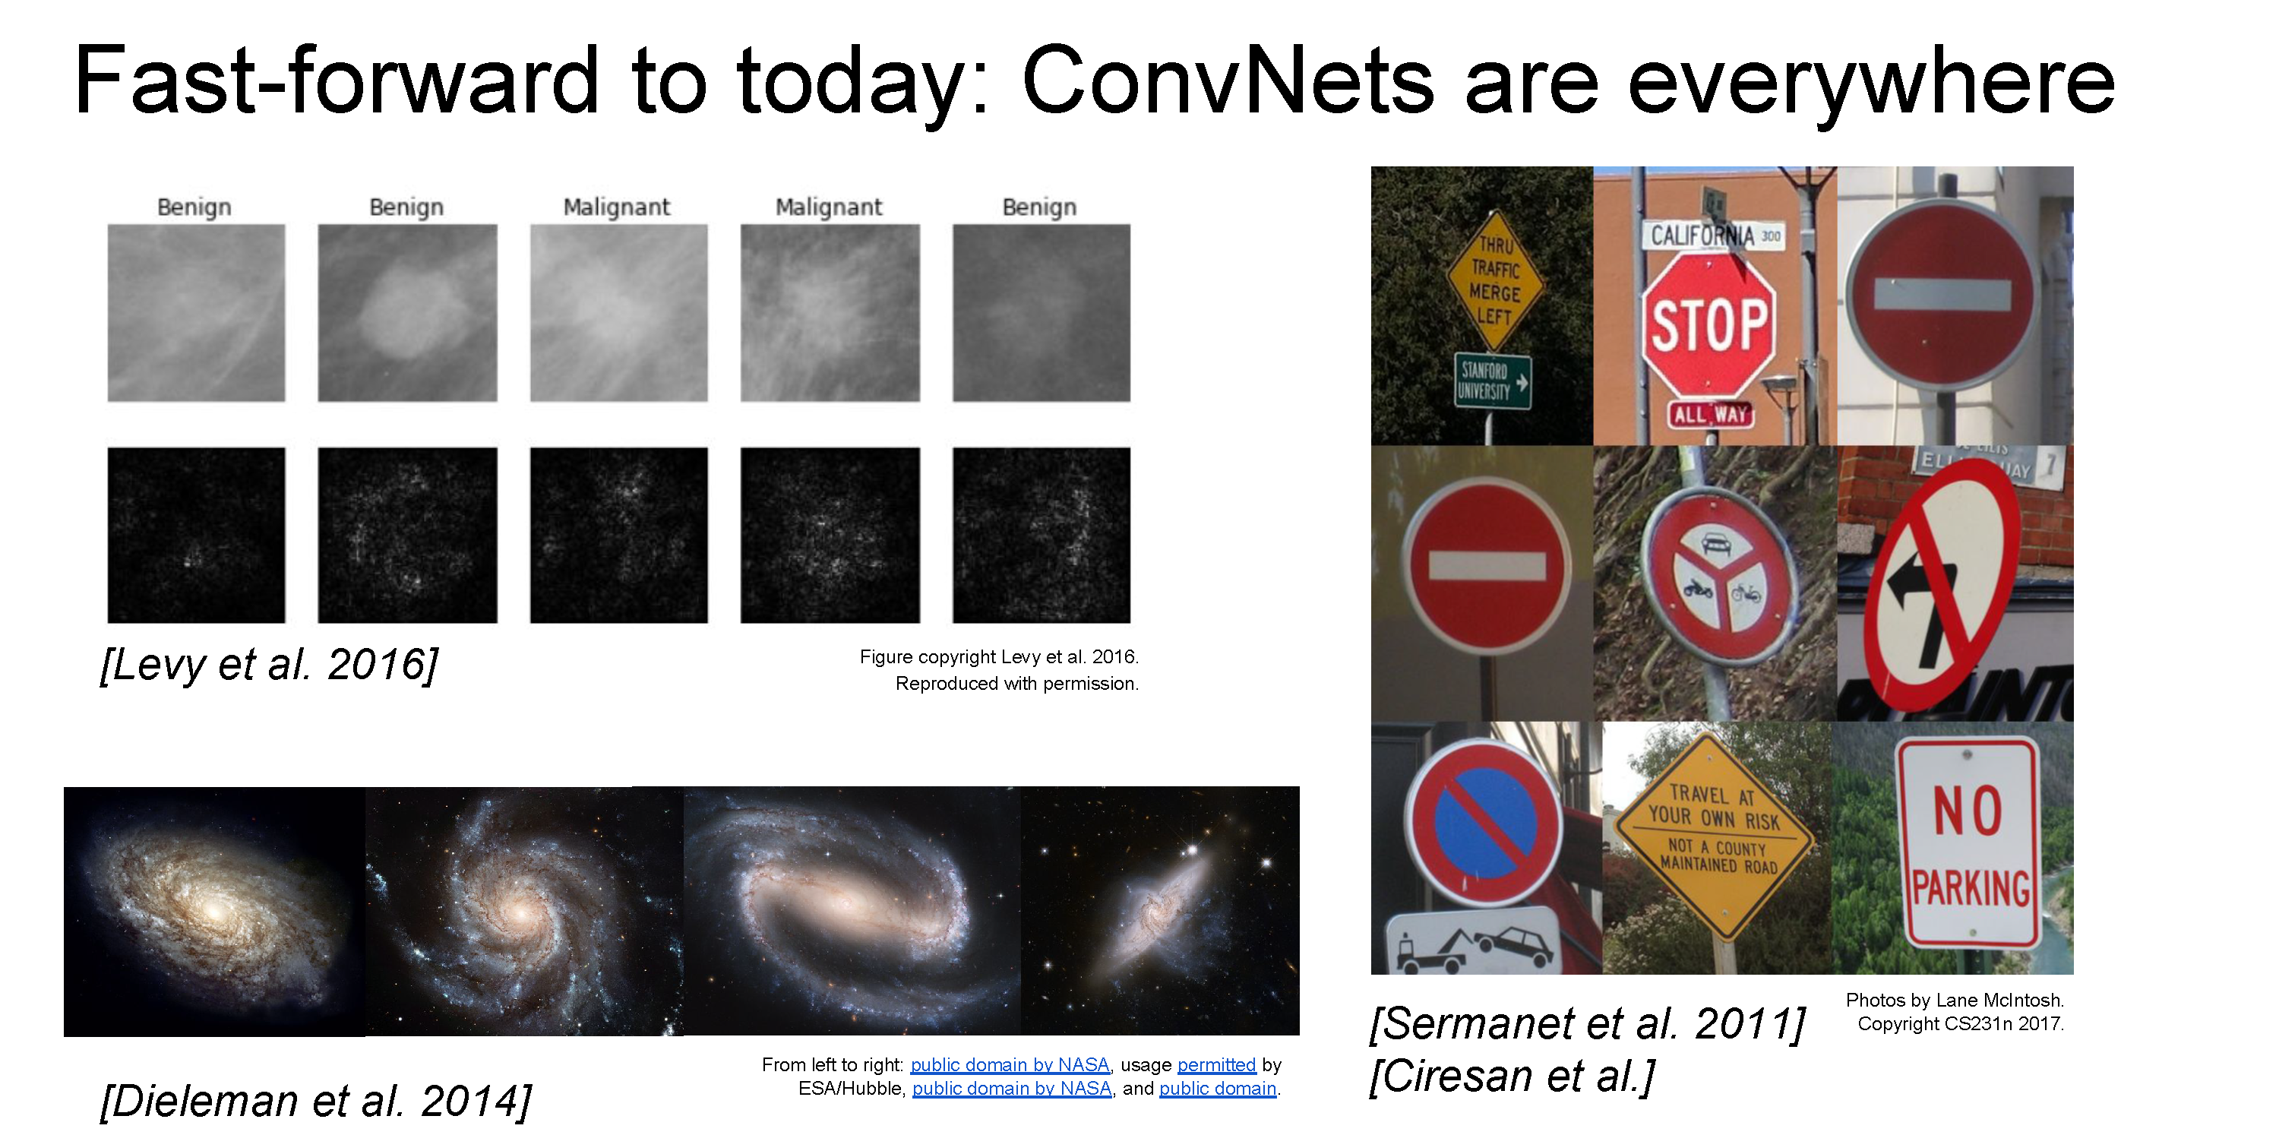

Slide 50
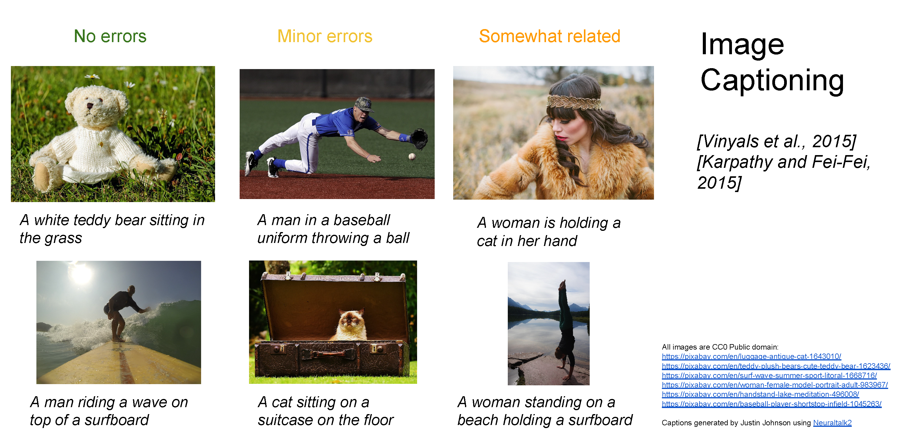

Slide 51
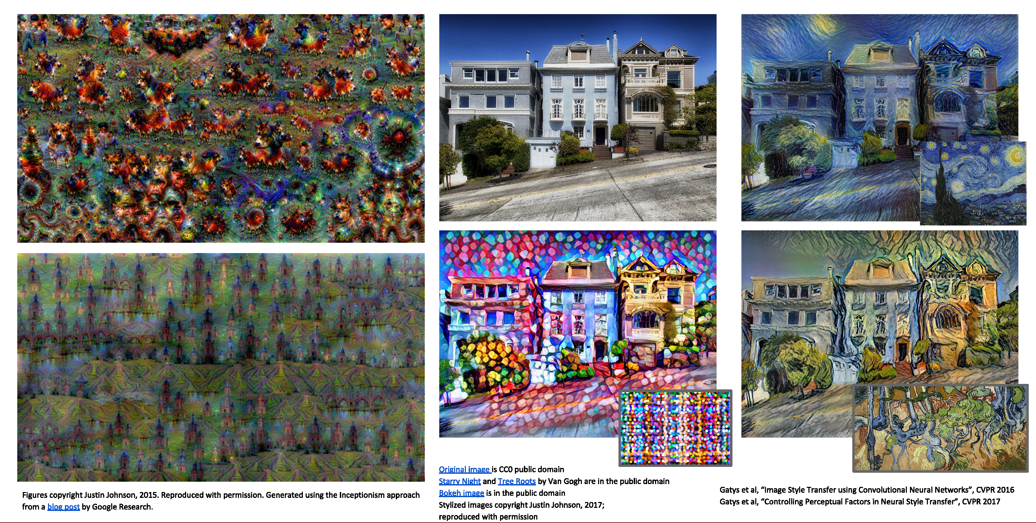

Slide 52
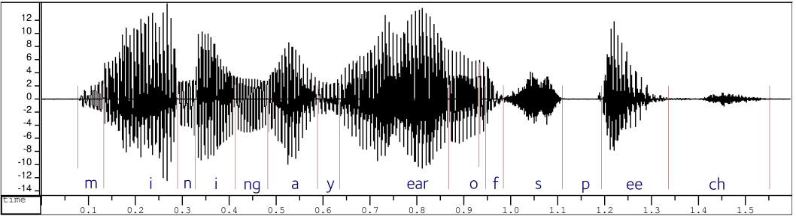

Convolutional neural networks
Version of deep neural networks designed for signals
  1D signals (e.g., speech waveforms)
  2D signals (e.g., images)

Slide 53
Motivation – Feature Learning

Slide 54
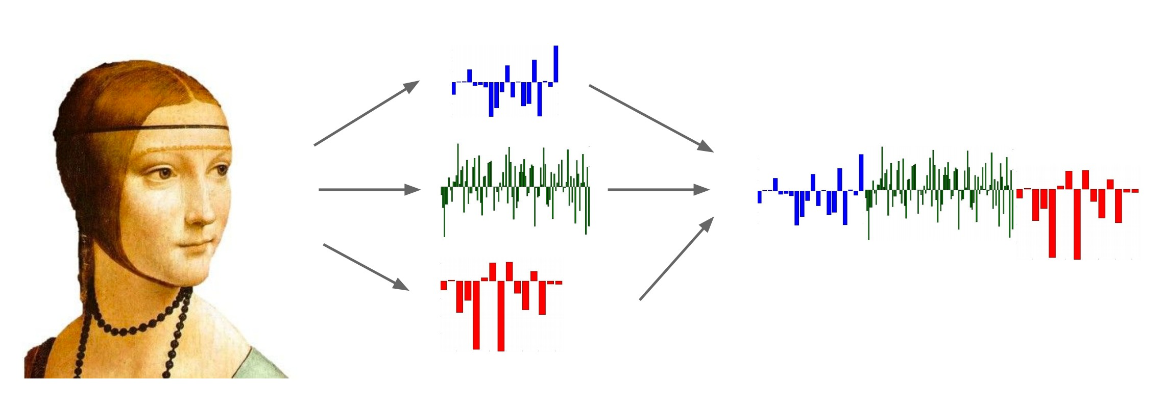
Life Before Deep Learning
SVM
Ans
Input Pixels
Extract Hand-Crafted Features
Concatenate into a vector x
Linear Classifier
Figure: Karpathy 2016

Slide 55
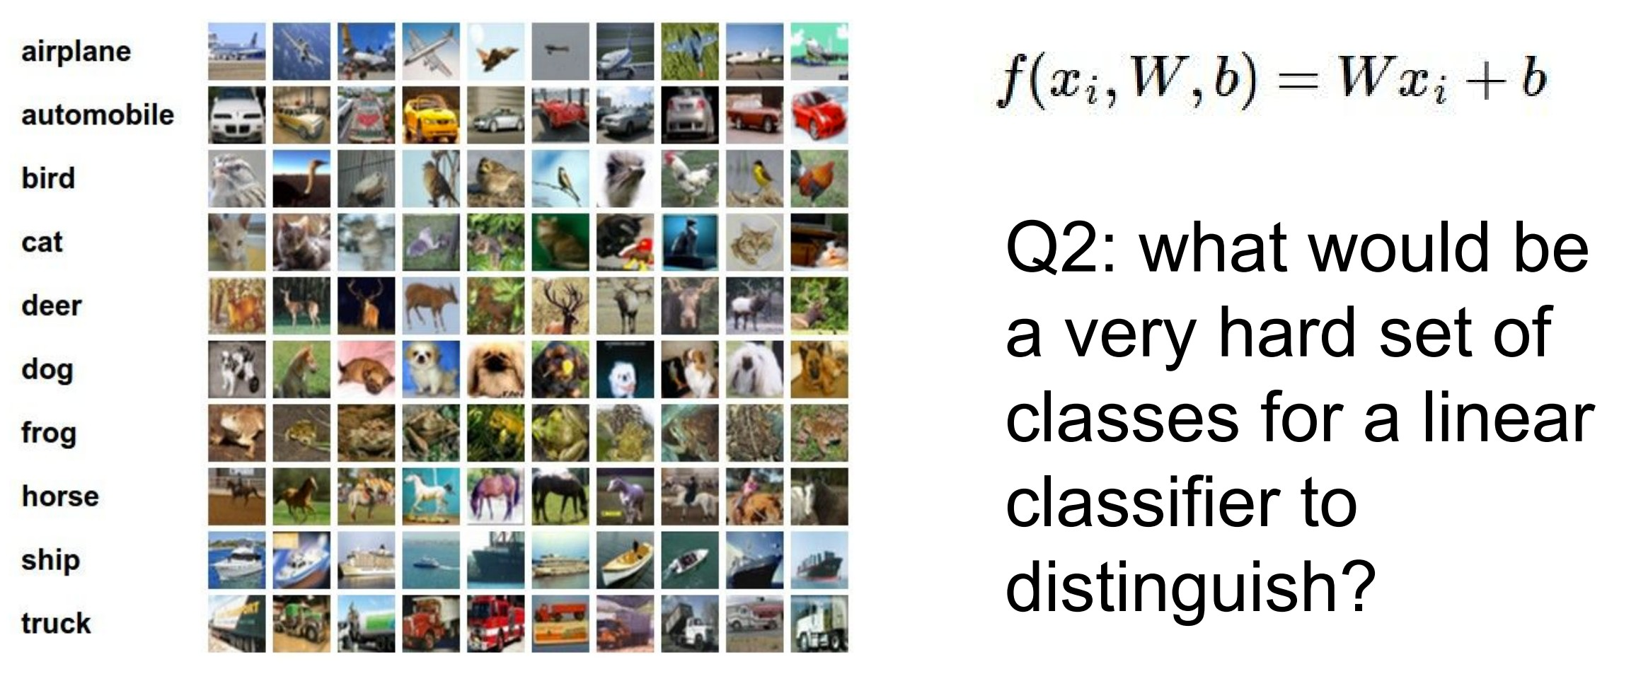
Why use features? Why not pixels?
Q: What would be a
very hard set of classes for a linear classifier to distinguish?
(assuming x = pixels)
Slide from Karpathy 2016

Slide 56
Linearly separable classes

Slide 57
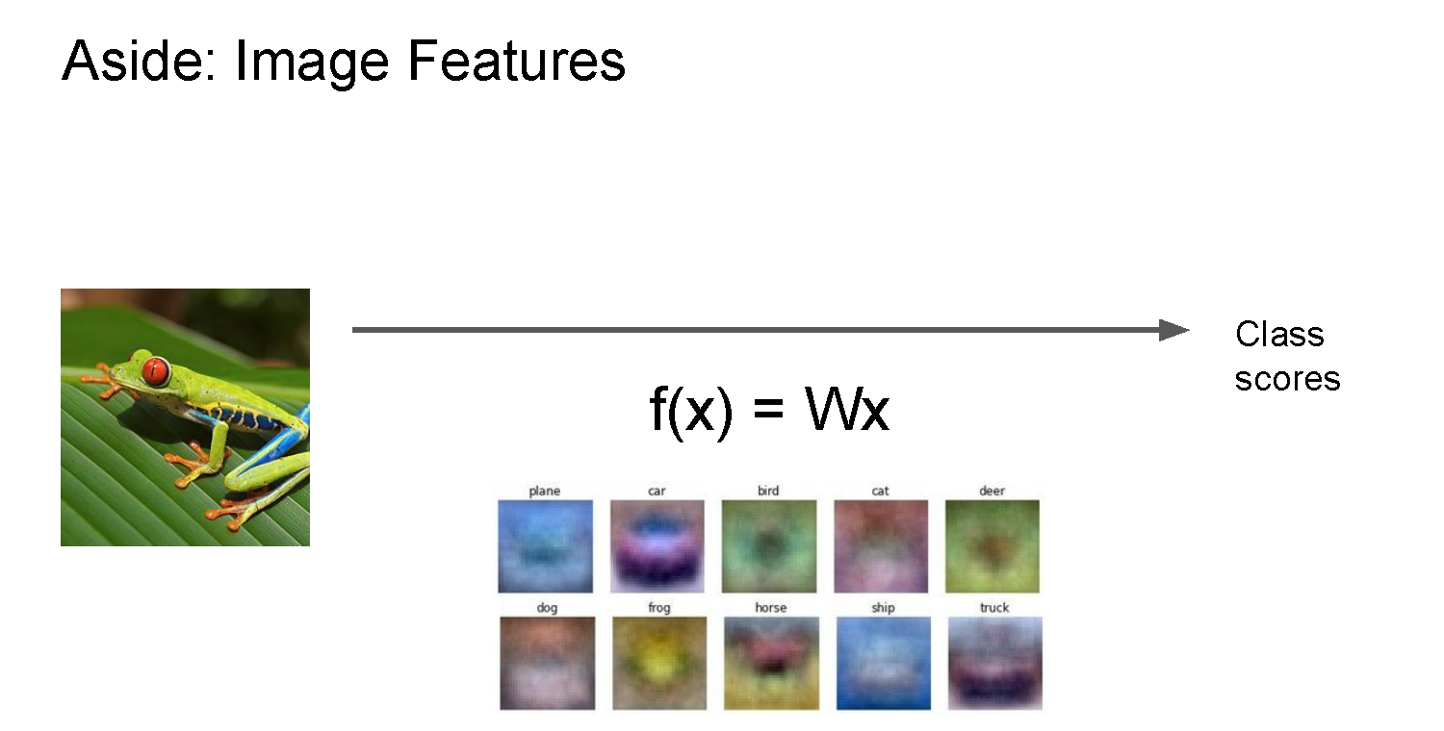

Slide 58
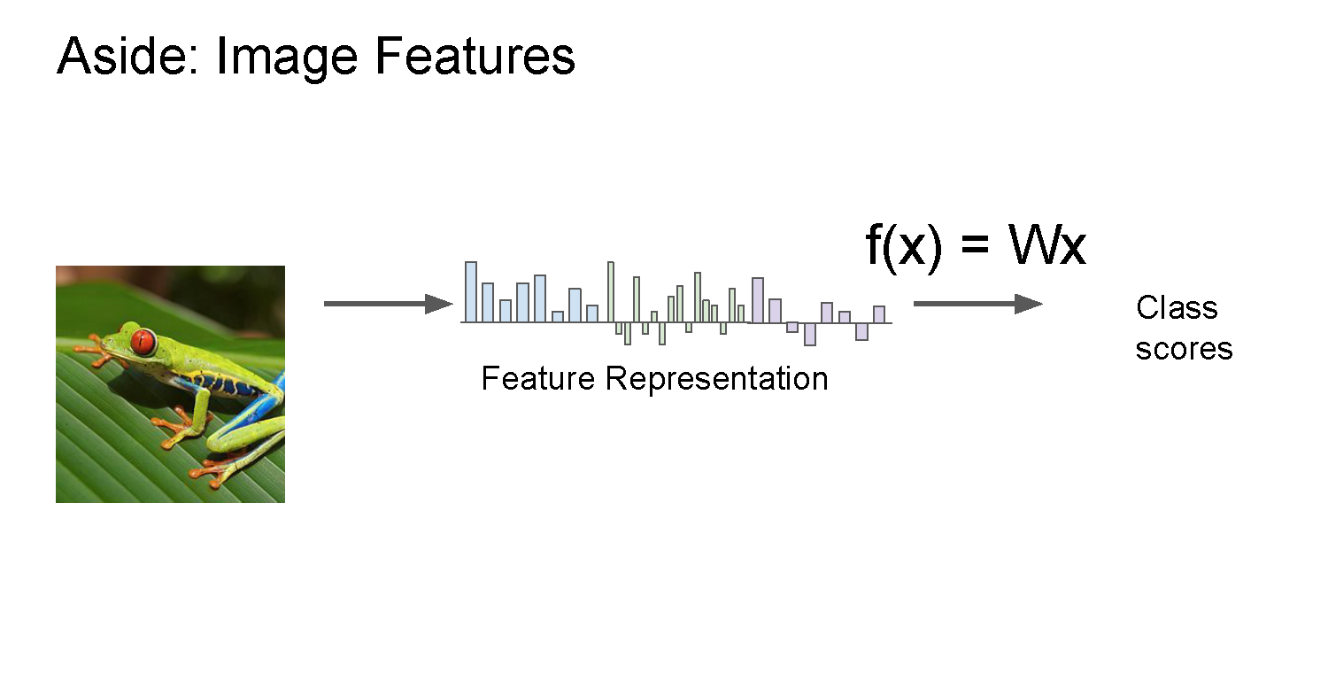

Slide 59
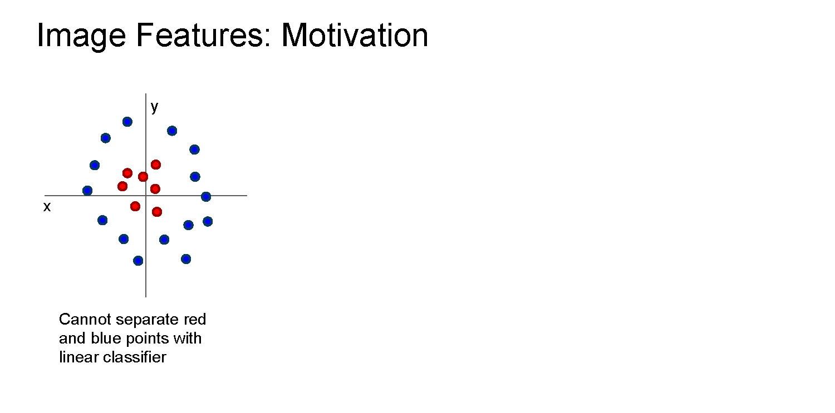

Slide 60
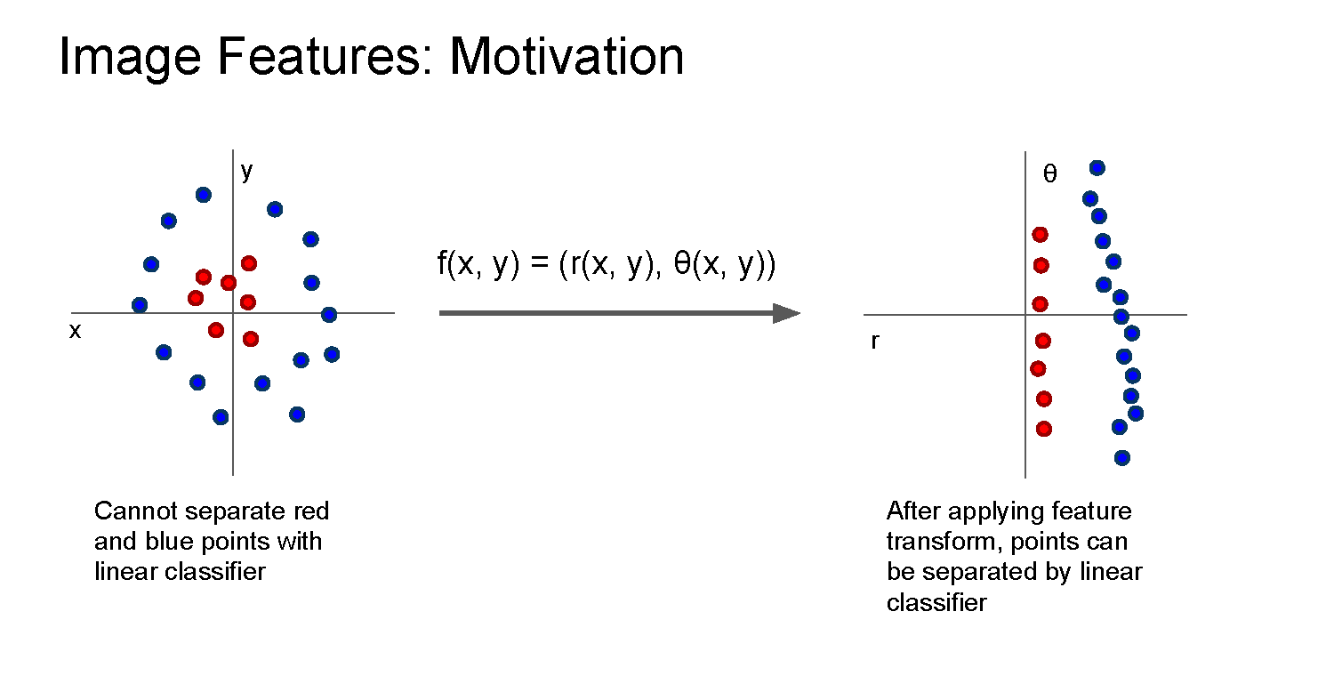

Slide 61
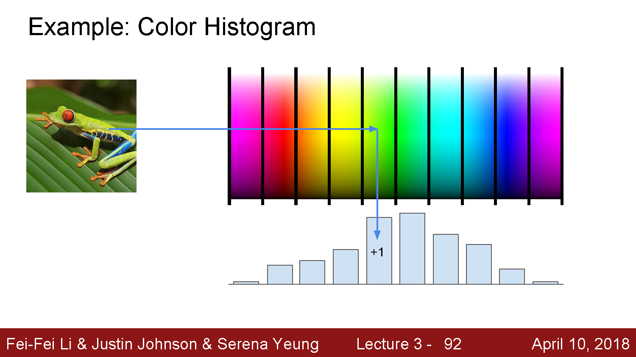

Slide 62


Slide 63


Slide 64


The last layer of (most) CNNs is a linear classifier
This piece is just a linear classifier
Ans
(GoogLeNet)
Input Pixels
Perform everything with a big neural network, trained end-to-end
Key: perform enough processing so that by the time you get to the end of the network, the classes are linearly separable

Slide 65




Example: Visualizing AlexNet in 2D with t-SNE
Linear Classifier
(2D visualization using t-SNE)
[Donahue, “DeCAF: DeCAF: A Deep Convolutional …”, arXiv 2013]

Slide 66
Convolutional neural networks
Layer types:
  Fully-connected layer
  Convolutional layer
  Pooling layer

Slide 67


Slide 68
Same as a linear classifer!

Slide 69


Slide 70


Slide 71


Slide 72
Number of weights: 5 x 5 x 3 + 1 = 76
(vs. 3072 for a fully-connected layer)
(+1 for bias)

Slide 73


Slide 74


Slide 75


Slide 76

(total number of parameters: 6 x (75 + 1) = 456)

Slide 77


Slide 78


Slide 79


Slide 80


Slide 81


Slide 82


Slide 83


Slide 84


Slide 85


Slide 86


Slide 87


Slide 88


Slide 89


Slide 90


Slide 91


Slide 92


Slide 93


Slide 94


Slide 95


Slide 96


Slide 97


Slide 98


Slide 99


Slide 100


Slide 101


Slide 102


Slide 103


Slide 104


Slide 105

https://cs.stanford.edu/people/karpathy/convnetjs/demo/cifar10.html

Slide 106


Slide 107
AlexNet

Slide 108


Slide 109
Big picture
A convolutional neural network can be thought of as a function from images to class scores
  With millions of adjustable weights…
  … leading to a very non-linear mapping from images to features / class scores.
  We will set these weights based on classification accuracy on training data…
  … and hopefully our network will generalize to new images at test time

Slide 110

Performance improvements on ILSVRC
ImageNet Large-Scale Visual Recognition Challenge
Held each year from 2011-2017
1000 categories, 1000 training images per category
Test performance on held-out test set of images
{
Deep learning era
Pre-deep learning era
AlexNet

Slide 111
Questions?

