Slide 1
Announcements
Project 3 Due Friday
Artifact due at the same time
We are planning to announce new grading guidelines this week

Slide 2
The Fundamental Matrix & Structure from Motion

Slide 3
The Many Meanings of Vectors and Cross Products
One algebraic form can have many geometric interpretations
Let’s review the algebra, and some of the geometry relevant for today…

Slide 4
Cross-Products: The Algebra
Compute 3D vector c that has a dot product of zero with both 3D vectors a, and b

Slide 5
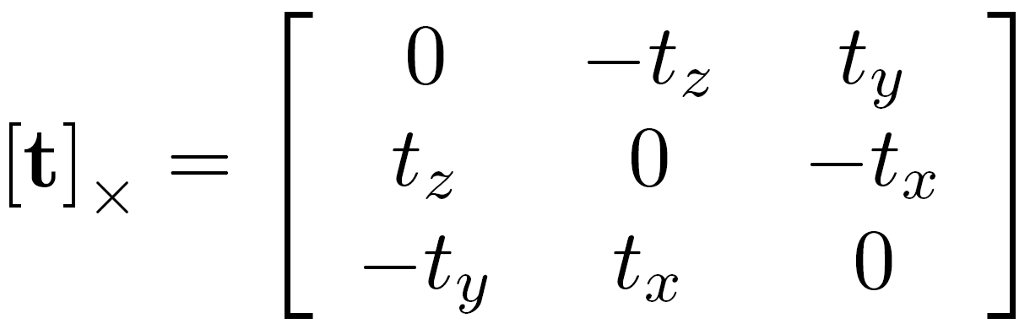
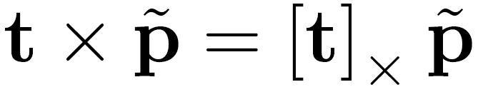
Cross-Product as Linear Operator
  Useful fact: Cross product with a vector t can be represented as multiplication with a (skew-symmetric) 3x3 matrix

Slide 6
Cross Products: Geometric Interpretation
The cross product of two vectors is the normal vector to plane between that contains them

Slide 7
Point-Line Duality and the Cross-Product
A point in 3D
A line in 3D is defined by the equation
Points and lines are both vectors of the same dimension with a homogeneous coordinate

Slide 8
Point-Line Duality and the Cross-Product
The line between two points is just the cross product of the two points

Slide 9
Point-Line Duality and the Cross-Product
The intersection of two lines is the cross produce of those lines

Slide 10
Point-Line Duality and the Cross-Product
One vector can have multiple interpretations
I suggest:
  First think about the geometry
  Then the representation
  Then the algebra

Slide 11
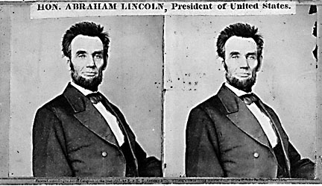
Back to stereo
Where do epipolar lines come from?

Slide 12




Two-view geometry
Where do epipolar lines come from?
3D point lies somewhere along r
epipolar line
epipolar line
(projection of r)
epipolar plane
0
Image 1
Image 2

Slide 13

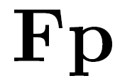
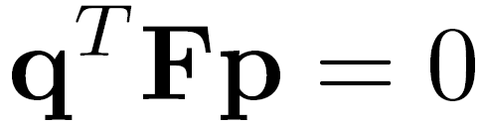
Fundamental matrix
epipolar line
epipolar line
(projection of ray)
epipolar plane
0
Image 1
Image 2
This epipolar geometry of two views is described by a Very Special 3x3 matrix , called the fundamental matrix
maps (homogeneous) points in image 1 to lines in image 2!
The epipolar line (in image 2) of point p is:
Epipolar constraint on corresponding points:

Slide 14


Fundamental matrix
epipolar line
epipolar line
(projection of ray)
epipolar plane
0
Two Special points: e₁ and e₂ (the epipoles): projection of one camera into the other

Slide 15
Fundamental matrix
0
Two Special points: e₁ and e₂ (the epipoles): projection of one camera into the other
All of the epipolar lines in an image pass through the epipole

Slide 16
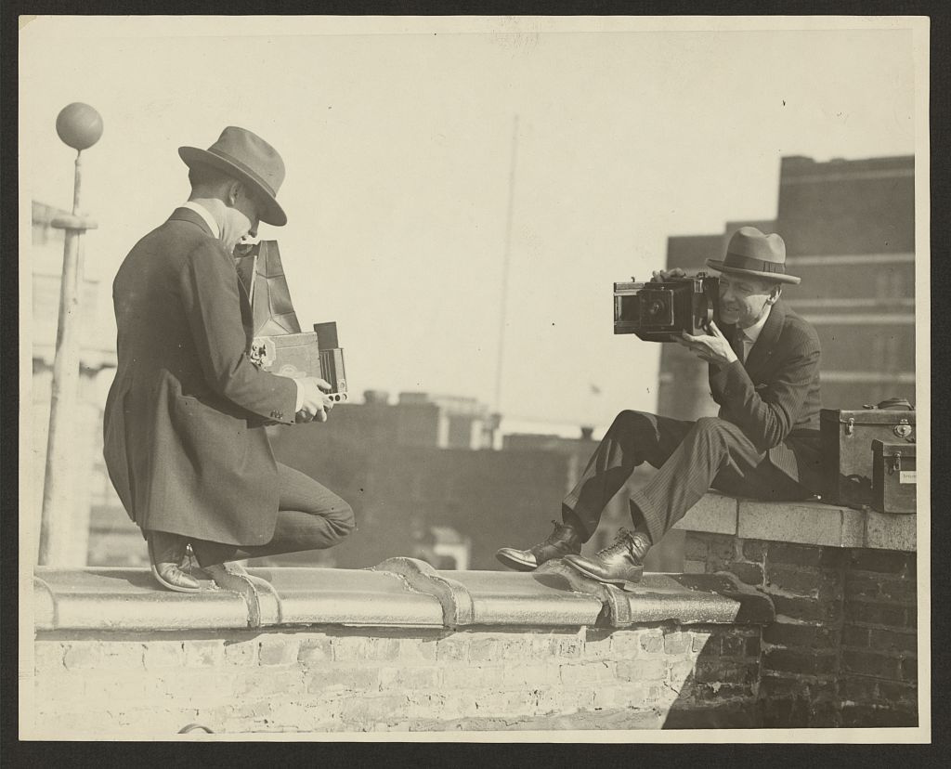
Epipoles

Slide 17

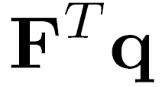
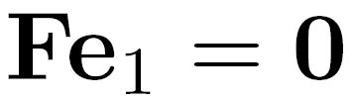
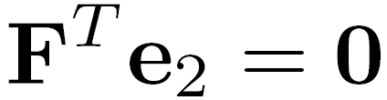
Properties of the Fundamental Matrix
is the epipolar line associated with
is the epipolar line associated with
and
is rank 2
How many degrees of freedom does F have?
T
Notes:
Rank 1 null space
How many parameters?
4 points to 4 other points, that would be 8

Slide 18
Fundamental matrix
0
Why does F exist?
Let’s derive it…

Slide 19

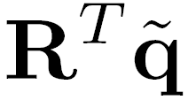

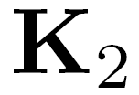

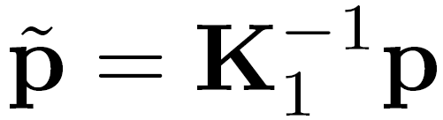
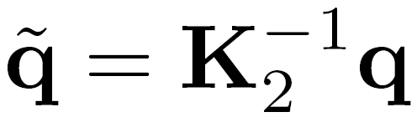
Fundamental matrix – calibrated case
0
: intrinsics of camera 1
: intrinsics of camera 2
: translation of cam 2 wrt cam 1
: rotation of image 2 w.r.t. camera 1
: ray through p in camera 1’s (and world) coordinate system
: ray through q in camera 2’s coordinate system
Notes:
Intrinsic maps between image coordinates and rays

Slide 20

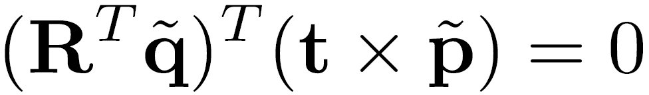
Fundamental matrix – calibrated case
0
, , and are coplanar
epipolar plane can be represented as

Slide 21
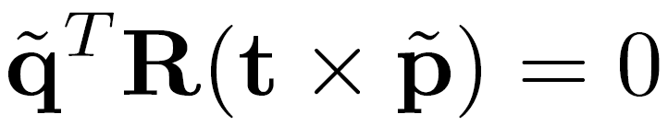
Fundamental matrix – calibrated case
0

Slide 22
Fundamental matrix – calibrated case
0
One more substitution:
  Cross product with t (on left) can be represented as a 3x3 matrix

Slide 23
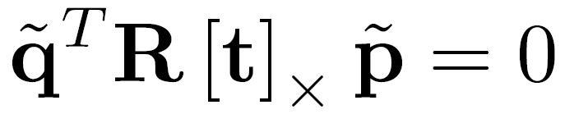
Fundamental matrix – calibrated case
0

Slide 24
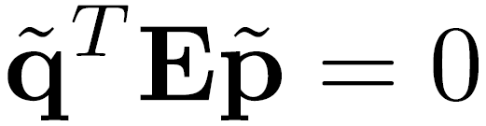

Fundamental matrix – calibrated case
0
: ray through p in camera 1’s (and world) coordinate system
: ray through q in camera 2’s coordinate system
{
the “Essential matrix”

Slide 25
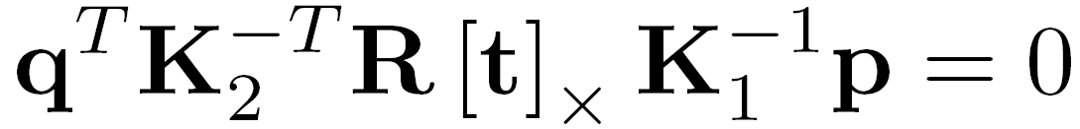

Fundamental matrix – uncalibrated case
0
: intrinsics of camera 1
: intrinsics of camera 2
: translation of cam 2 wrt cam 1
: rotation of image 2 w.r.t. camera 1
the Fundamental matrix

Slide 26
Putting the “Fun” in “Fundamental Matrix”
https://www.youtube.com/watch?v=DgGV3l82NTk

Slide 27
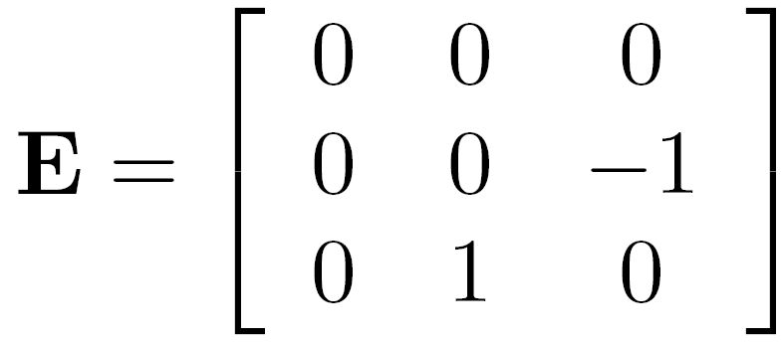
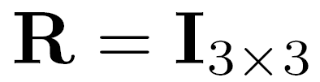
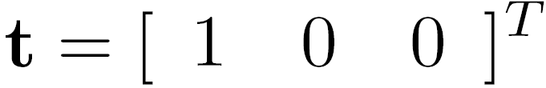
Rectified case

Slide 28
Stereo image rectification
reproject image planes onto a common plane parallel to the line between optical centers
pixel motion is horizontal after this transformation
two homographies (3x3 transform), one for each input image reprojection
C. Loop and Z. Zhang. Computing Rectifying Homographies for Stereo Vision. IEEE Conf. Computer Vision and Pattern Recognition, 1999.

Slide 29
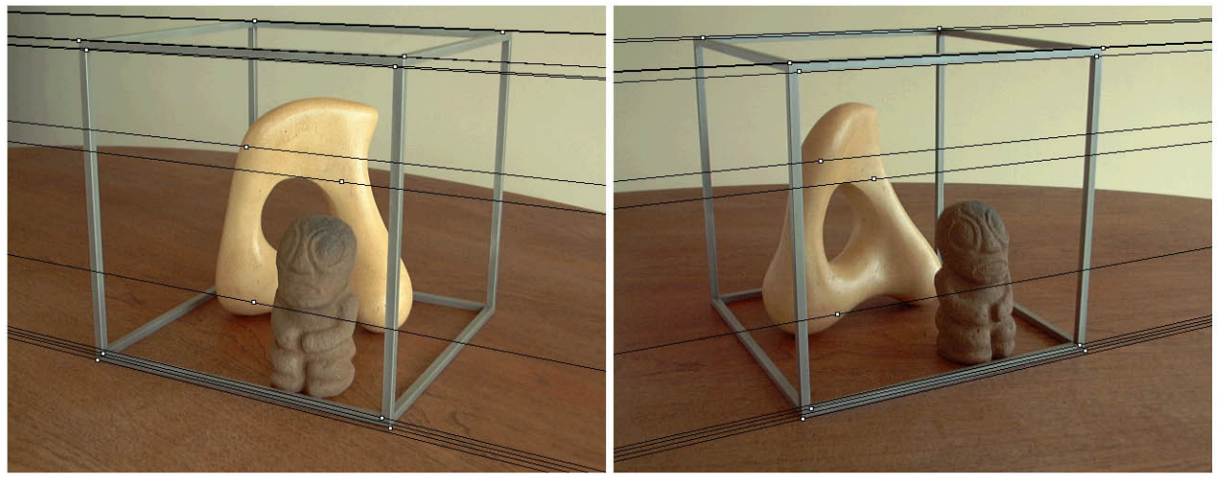
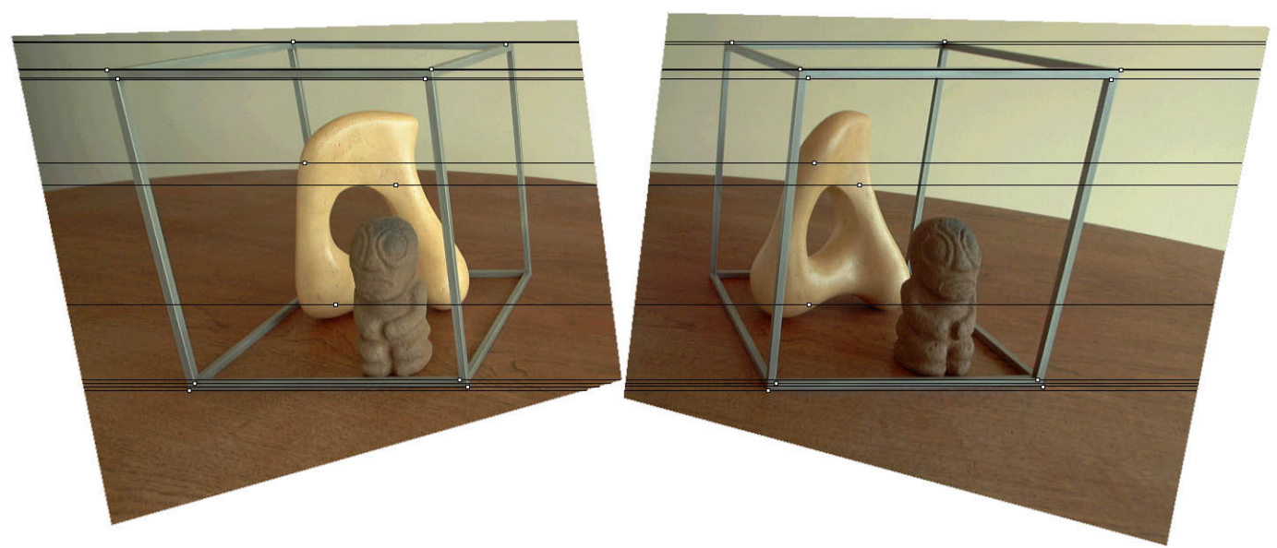
Original stereo pair
After rectification

Slide 30
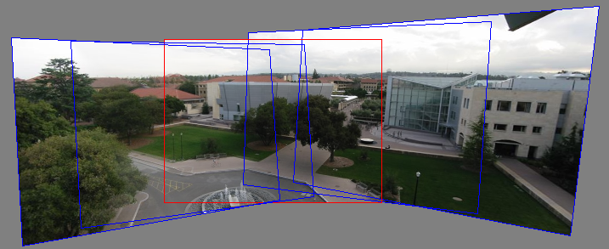


Relationship with homography?
Images taken from the same center of projection? Use a homography!

Slide 31
Questions?

Slide 32


Estimating F
If we don’t know K₁, K₂, R, or t, can we estimate F for two images?
Yes, given enough correspondences

Slide 33
Estimating F – 8-point algorithm
The fundamental matrix F is defined by
for any pair of matches x and x’ in two images.
Let x=(u,v,1)^{T} and x’=(u’,v’,1)^{T},
each match gives a linear equation

Slide 34
8-point algorithm
Like with homographies, instead of solving , we seek f to minimize , least eigenvector of .
Notes:
Same trick as homographies

Slide 35
8-point algorithm – Problem?
F should have rank 2
To enforce that F is of rank 2, F is replaced by F’ that minimizes subject to the rank constraint.
This is achieved by SVD. Let , where
, let
then is the solution.

Slide 36
8-point algorithm
% Build the constraint matrix
A = [x2(1,:)'.*x1(1,:)' x2(1,:)'.*x1(2,:)' x2(1,:)' ...
x2(2,:)'.*x1(1,:)' x2(2,:)'.*x1(2,:)' x2(2,:)' ...
x1(1,:)' x1(2,:)' ones(npts,1) ];
[U,D,V] = svd(A);
% Extract fundamental matrix from the column of V
% corresponding to the smallest singular value.
F = reshape(V(:,9),3,3)';
% Enforce rank2 constraint
[U,D,V] = svd(F);
F = U*diag([D(1,1) D(2,2) 0])*V';

Slide 37
8-point algorithm
Pros: it is linear, easy to implement and fast
Cons: susceptible to noise

Slide 38
Problem with 8-point algorithm
~10000
~10000
~100
~10000
~10000
~100
~100
~100
1
Orders of magnitude difference
between column of data matrix
→ least-squares yields poor results
!
Notes:
Precision and conditioning

Slide 39
Normalized 8-point algorithm
normalized least squares yields good results
Transform image to ~[-1,1]x[-1,1]
(0,500)
(700,500)
(-1,1)
(1,1)
(0,0)
(0,0)
(700,0)
(-1,-1)
(1,-1)

Slide 40
Normalized 8-point algorithm
Transform input by ,
Call 8-point on to obtain

Slide 41
Normalized 8-point algorithm
[x1, T1] = normalise2dpts(x1);
[x2, T2] = normalise2dpts(x2);
A = [x2(1,:)'.*x1(1,:)' x2(1,:)'.*x1(2,:)' x2(1,:)' ...
x2(2,:)'.*x1(1,:)' x2(2,:)'.*x1(2,:)' x2(2,:)' ...
x1(1,:)' x1(2,:)' ones(npts,1) ];
[U,D,V] = svd(A);
F = reshape(V(:,9),3,3)';
[U,D,V] = svd(F);
F = U*diag([D(1,1) D(2,2) 0])*V';
% Denormalise
F = T2'*F*T1;

Slide 42
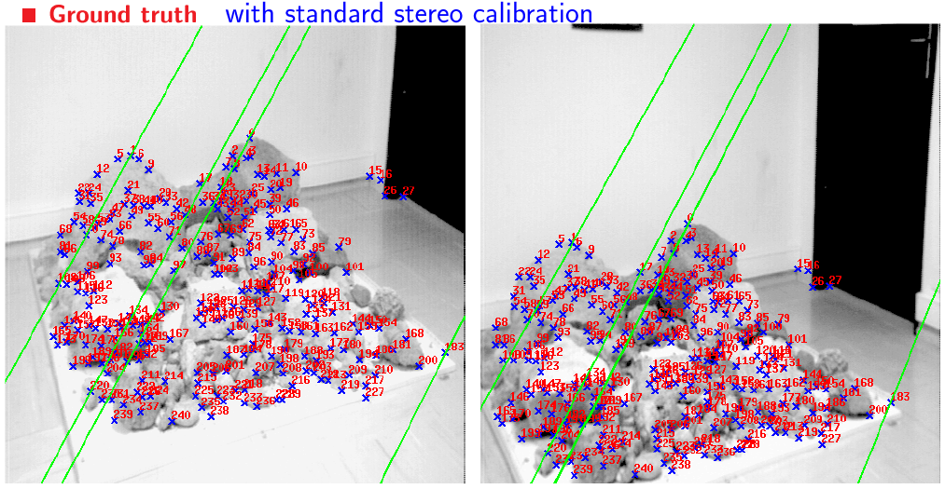
Results (ground truth)

Slide 43
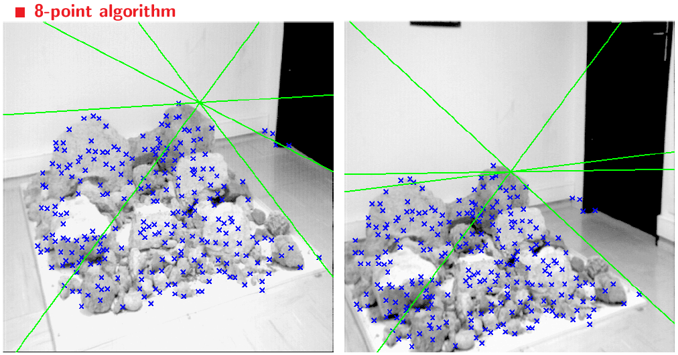
Results (8-point algorithm)

Slide 44
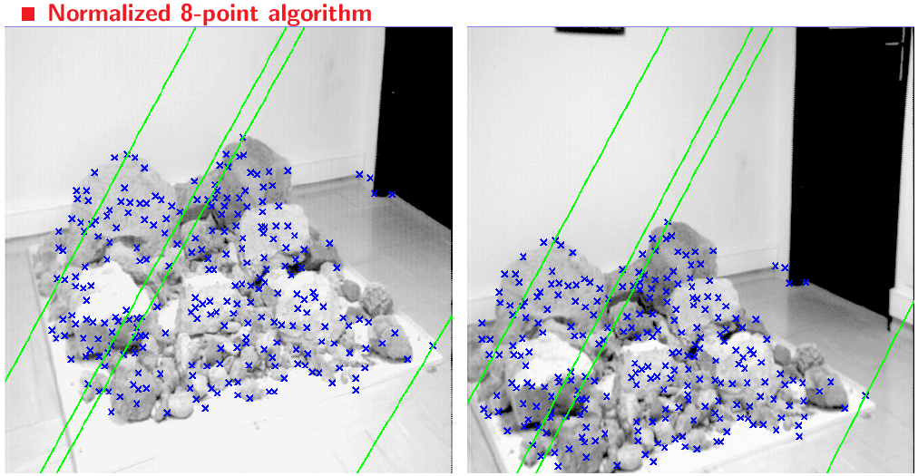
Results (normalized 8-point algorithm)

Slide 45
What about more than two views?
The geometry of three views is described by a 3 x 3 x 3 tensor called the trifocal tensor
The geometry of four views is described by a 3 x 3 x 3 x 3 tensor called the quadrifocal tensor
After this it starts to get complicated…

Slide 46
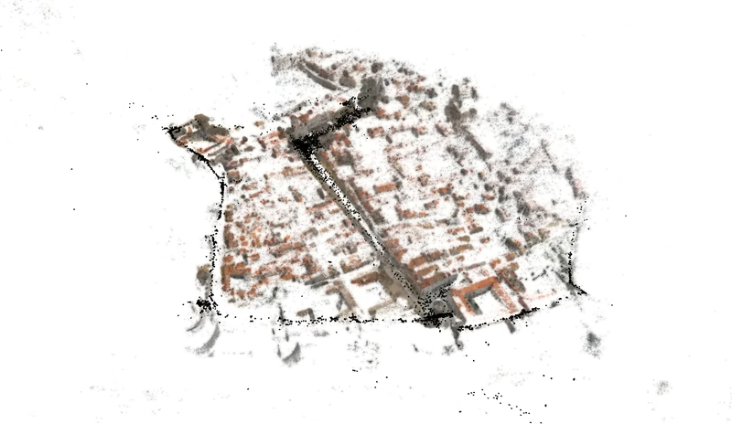
Large-scale structure from motion
Dubrovnik, Croatia. 4,619 images (out of an initial 57,845).
Total reconstruction time: 23 hours
Number of cores: 352

Slide 47

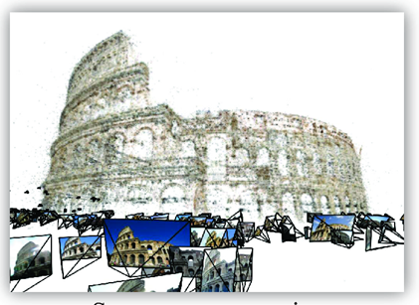
Structure from motion
CS5670: Computer Vision
Abe Davis, Slides by Noah Snavely

Slide 48
Readings
Szeliski, Chapter 7.1 – 7.4

Slide 49
Structure from motion
Multi-view stereo assumes that cameras are calibrated
  Extrinsics and intrinsics are known for all views
How do we compute calibration if we don’t know it? In general, this is called structure from motion

Slide 50
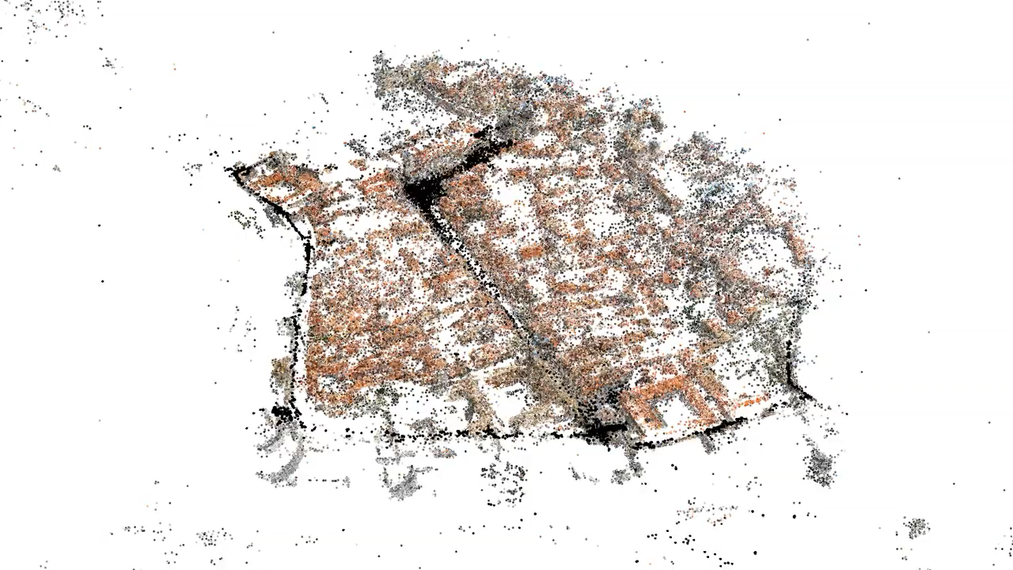
Large-scale structure from motion
Dubrovnik, Croatia. 4,619 images (out of an initial 57,845). Total reconstruction time: 23 hours Number of cores: 352

Slide 51


Two views
Solve for Fundamental matrix / Essential matrix
Factorize into intrinsics, rotation, and translation

Slide 52
What about more than two views?
The geometry of three views is described by a 3 x 3 x 3 tensor called the trifocal tensor
The geometry of four views is described by a 3 x 3 x 3 x 3 tensor called the quadrifocal tensor
After this it starts to get complicated…
  Instead, we explicitly solve for camera poses and scene geometry

Slide 53
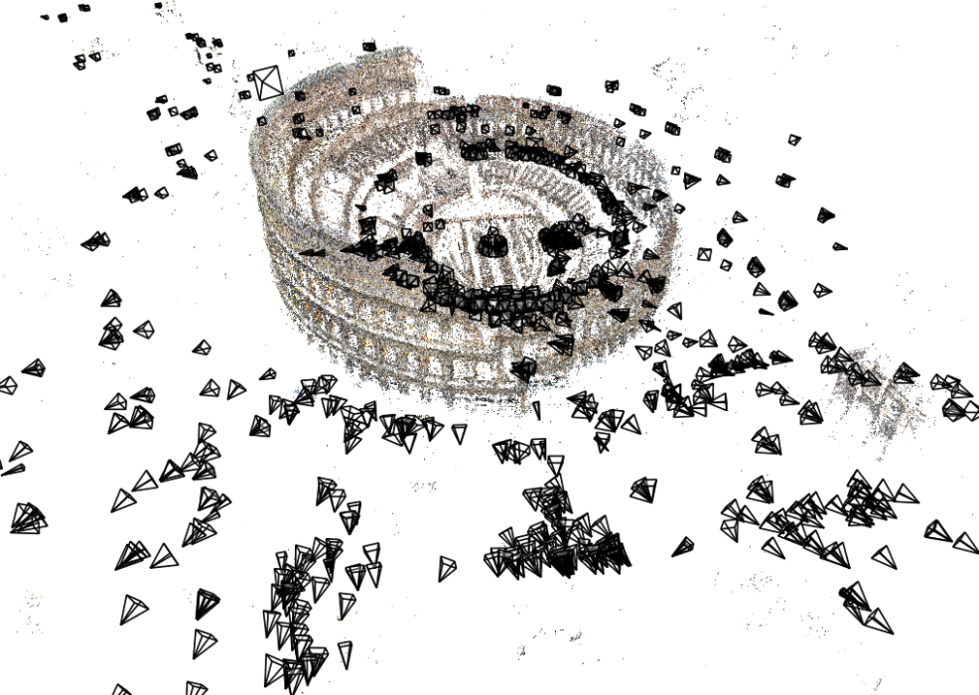
Structure from motion
Given many images, how can we
  a) figure out where they were all taken from?
  b) build a 3D model of the scene?
  This is (roughly) the structure from motion problem

Slide 54
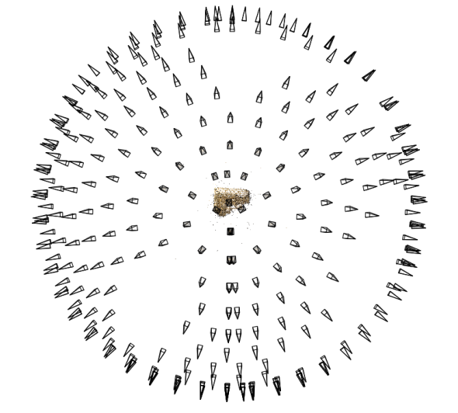
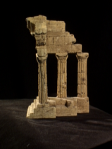
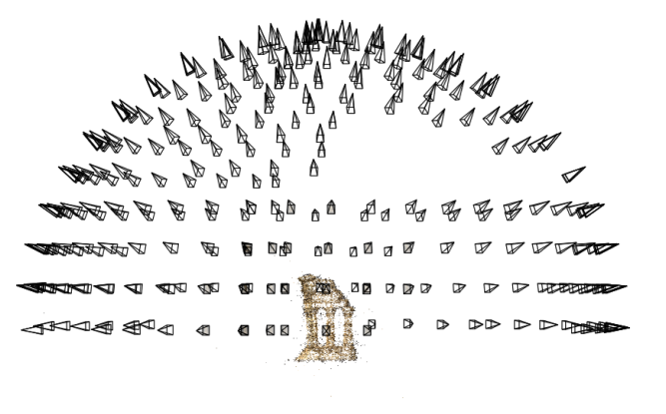
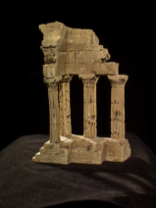
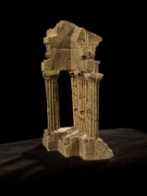
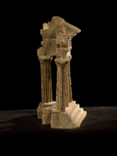
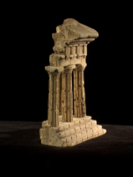
Structure from motion
Reconstruction (side)
(top)
Input: images with points in correspondence p_{i,j} = (u_{i,j},v_{i,j})
Output
  structure: 3D location x_{i} for each point p_{i}
  motion: camera parameters R_{j} , t_{j} possibly K_{j}
Objective function: minimize reprojection error

Slide 55
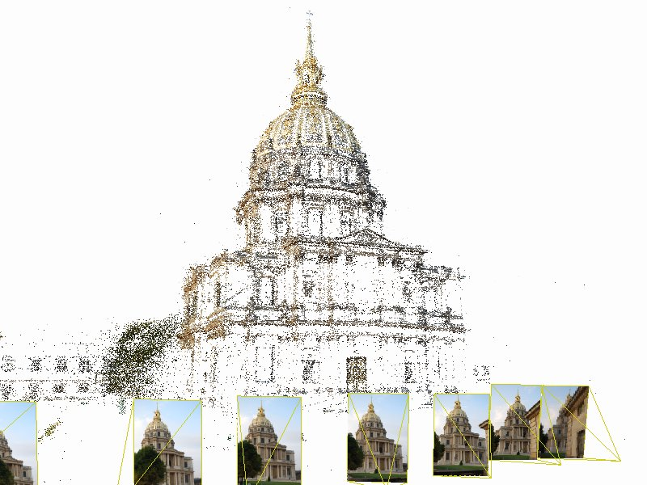
Also doable from video

Slide 56
What we’ve seen so far…
2D transformations between images
Translations, affine transformations, homographies…
Fundamental matrices
Represent relationships between 2D images in the form of corresponding 2D lines
What’s new: Explicitly representing 3D geometry of cameras and points

Slide 57
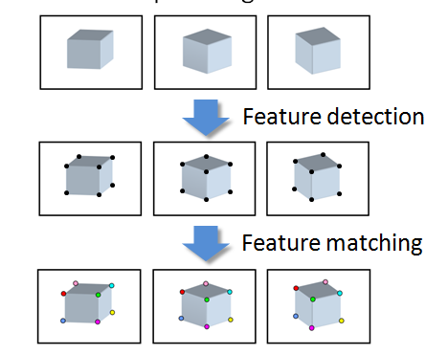
Input

Slide 58
Camera calibration and triangulation
Suppose we know 3D points
  And have matches between these points and an image
  How can we compute the camera parameters?
Suppose we have known camera parameters, each of which observes a point
  How can we compute the 3D location of that point?

Slide 59
Structure from motion
SfM solves both of these problems at once
A kind of chicken-and-egg problem
  (but solvable)

Slide 60
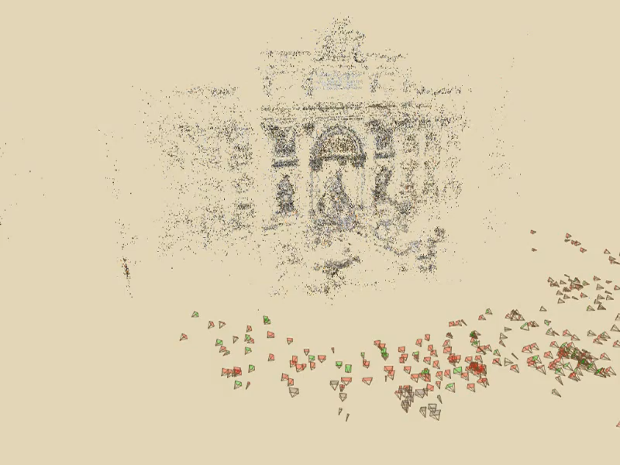
Photo Tourism
Notes:
Here’s how the same set of photos appear in our photo explorer. Our system takes the set of photos and automatically determines the relative positions and orientations from which each photo was taken. We can then load the photos into our immersive 3D browser where the user can visualize and explore the photos using spatial relationships.

Slide 61
First step: how to get correspondence?
Feature detection and matching

Slide 62
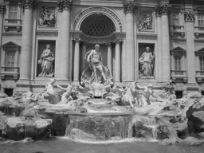




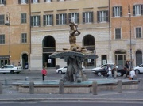








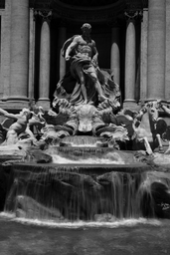

Feature Detection
Detect features using SIFT [Lowe, IJCV 2004]
Notes:
So, we begin by detecting SIFT features in each photo.
[We detect SIFT features in each photo, resulting in a set of feature locations and 128-byte feature descriptors…]

Slide 63





Feature Detection
Detect features using SIFT [Lowe, IJCV 2004]
Notes:
So, we begin by detecting SIFT features in each photo.
[We detect SIFT features in each photo, resulting in a set of feature locations and 128-byte feature descriptors…]

Slide 64




Feature Matching
Detect features using SIFT [Lowe, IJCV 2004]
Match features between each pair of images
Refine matching using RANSAC to estimate fundamental matrix between each pair
Notes:
So, we begin by detecting SIFT features in each photo.
[We detect SIFT features in each photo, resulting in a set of feature locations and 128-byte feature descriptors…]

Slide 65
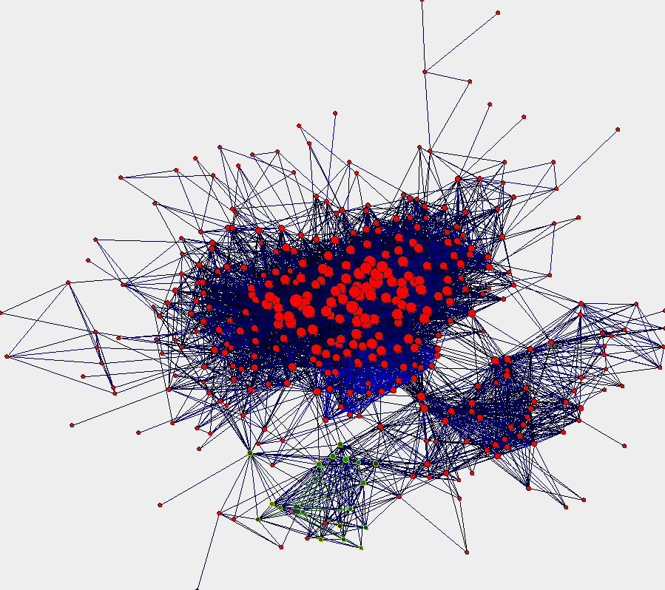
Image connectivity graph
Graph of connectivity based on matched features
(graph layout produced using the Graphviz toolkit: http://www.graphviz.org/)
Notes:
Trevi fountain

Slide 66
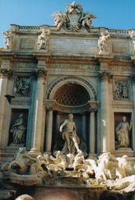
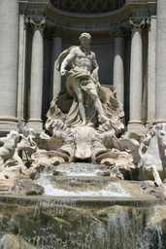
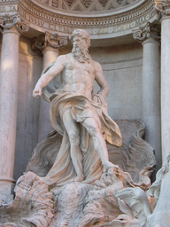
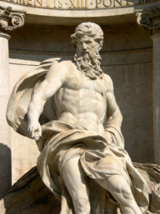
Correspondence estimation
Link up pairwise matches to form connected components of matches across several images
Image 1
Image 2
Image 3
Image 4
Notes:
The next step of our reconstruction algorithm is to link up matches between pairs of images into correspondences between multiple images, by finding connected components of matches. Suppose among these images, these features are matched only between consecutive pairs of images, perhaps because the scales of the images are so different. During correspondence estimation we link these matches and consider them to be 2D projections of a single 3D point in the scene.

Slide 67
Input

Slide 68

Structure from motion
X₄
X₁
X₃
minimize
X₂
g(R, T, X)
X₅
non-linear least squares
X₇
X₆
p_{1,1}
p_{1,3}
p_{1,2}
Camera 1
Camera 3
R₁,t₁
R₃,t₃
Camera 2
R₂,t₂
Notes:
Structure from motion solves the following problem:
Given a set of images of a static scene with 2D points in correspondence, shown here as color-coded points, find…
a set of 3D points P and
a rotation R and position t of the cameras that explain the observed correspondences. In other words, when we project a point into any of the cameras, the reprojection error between the projected and observed 2D points is low.
This problem can be formulated as an optimization problem where we want to find the rotations R, positions t, and 3D point locations P that minimize sum of squared reprojection errors f. This is a non-linear least squares problem and can be solved with algorithms such as Levenberg-Marquart. However, because the problem is non-linear, it can be susceptible to local minima. Therefore, it’s important to initialize the parameters of the system carefully. In addition, we need to be able to deal with erroneous correspondences.

Slide 69
Problem size
What are the variables?
How many variables per camera?
How many variables per point?
Trevi Fountain collection
  466 input photos
  + > 100,000 3D points
  = very large optimization problem

Slide 70
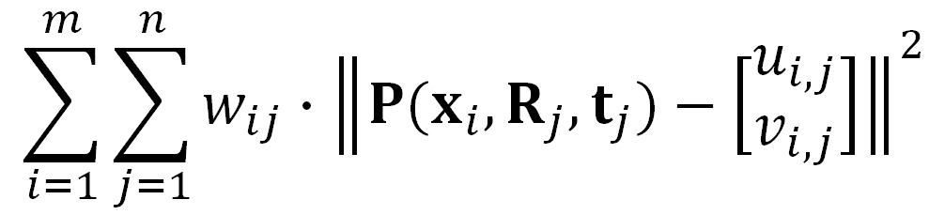

Structure from motion
Minimize sum of squared reprojection errors:
Minimizing this function is called bundle adjustment
  Optimized using non-linear least squares, e.g. Levenberg-Marquardt
predicted
image location
observed
image location
indicator variable:
is point i visible in image j ?
Notes:
Levenberg markart

Slide 71
Is SfM always uniquely solvable?

Slide 72

Is SfM always uniquely solvable?
No…

Slide 73





Incremental structure from motion
Notes:
To help get good initializations for all of the parameters of the system, we reconstruct the scene incrementally, starting from two photographs and the points they observe.

Slide 74

Incremental structure from motion
Notes:
To help get good initializations for all of the parameters of the system, we reconstruct the scene incrementally, starting from two photographs and the points they observe.

Slide 75

Incremental structure from motion
Notes:
We then add several photos at a time to the reconstruction, refine the model, and repeat until no more photos match any points in the scene.

Slide 76

Incremental structure from motion
Time-lapse reconstruction of Dubrovnik, Croatia, viewed from above

Slide 77

Photo Explorer (Part of Noah’s PhD work)

Slide 78


Slide 79


Slide 80


Slide 81

https://en.wikipedia.org/wiki/Libration

Slide 82
Questions?

Slide 83









SfM – Failure cases
Necker reversal
Notes:
Necker reversal ambiguity:
This arises because an object rotating by ρ and its mirror image rotating by −ρ generate the same image under parallel projection, see figure 14.9(a). Thus, structure is only recovered up to a reflection about the frontal plane. This ambiguity is absent in the perspective case because the points have different depths in the two interpretations and so do not project to coincident image points.

Slide 84


Slide 85
SfM applications
3D modeling
Surveying
Robot navigation and mapmaking
Visual effects…
  (see video)

Slide 86
SfM applications
3D modeling
Surveying
Robot navigation and mapmaking
Virtual and augmented reality
Visual effects (“Match moving”)
  https://www.youtube.com/watch?v=RdYWp70P_kY

Slide 87

Applications – Hyperlapse
https://www.youtube.com/watch?v=SOpwHaQnRSY
https://www.youtube.com/watch?v=sA4Za3Hv6ng

Slide 88
PhotoTourism

Slide 89


Applications: Visual Reality & Augmented Reality
Oculus
Hololens
https://www.youtube.com/watch?v=KOG7yTz1iTA
https://www.youtube.com/watch?v=FMtvrTGnP04

Slide 90


Applications: Simultaneous localization and mapping (SLAM)
https://www.youtube.com/watch?v=k43xJs3Roqg
https://www.youtube.com/watch?v=ZR1yXFAslSk

Slide 91

Application: Simultaneous localization and mapping (SLAM)
Scape: Building the ‘AR Cloud’: Part Three —3D Maps, the Digital Scaffolding of the 21st Century
https://medium.com/scape-technologies/building-the-ar-cloud-part-three-3d-maps-the-digital-scaffolding-of-the-21st-century-465fa55782dd

Slide 92


Application: AR walking directions

Slide 93
Questions?

