Slide 1
Light & Perception
CS5670
March 16, 2020

Slide 2
Remote Lectures
Today we are trying out Zoom lecture
  If all goes well, this will likely be the main method of holding class moving forward
  Some lectures may end up being pre-recorded, but we will have office hours where you can ask questions
You will be able to complete the course remotely (including exams)
  Specifics to come

Slide 3
Announcements
Assignment 3 deadline extended to Friday March 27, 11:59pm EDT
Artifact due at the same time

Slide 4
Road map
Today: Light & Perception
  Readings: Szeliski, 2.2, 2.3.2
Finishing up geometry
  ~3 more lectures
Next:
  Recognition
  Classification
  Deep learning,
  A sample of hot topics in computer vision

Slide 5
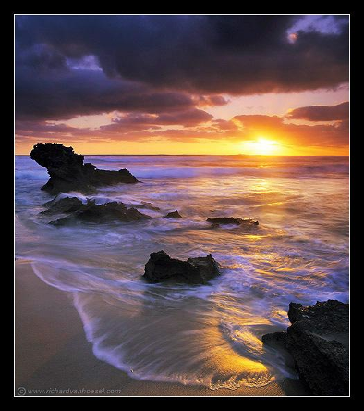
Light & Perception
CS5670: Computer Vision
Abe Davis (most slides from Noah Snavely)

Slide 6
Properties of light
Today
  What is light?
  How do we measure it?
  How does light propagate?
  How does light interact with matter?

Slide 7
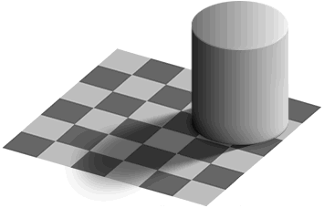
Reflectance, Illumination, and Perception
by Ted Adelson

Slide 8
Reflectance, Illumination, and Perception
by Ted Adelson

Slide 9
Reflectance, Illumination, and Perception
by Ted Adelson

Slide 10

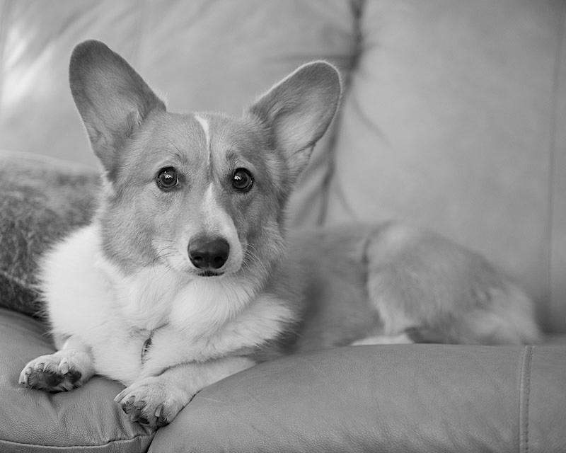
From Lecture 1:
Light
Image Plane
Observer
Notes:
Now, typically the way you would generate this kind of interactive 3D content is by having a 3D model of your bunny over here.

Slide 11
Reflectance
Light
Image Plane
Observer
Notes:
Now, typically the way you would generate this kind of interactive 3D content is by having a 3D model of your bunny over here.

Slide 12
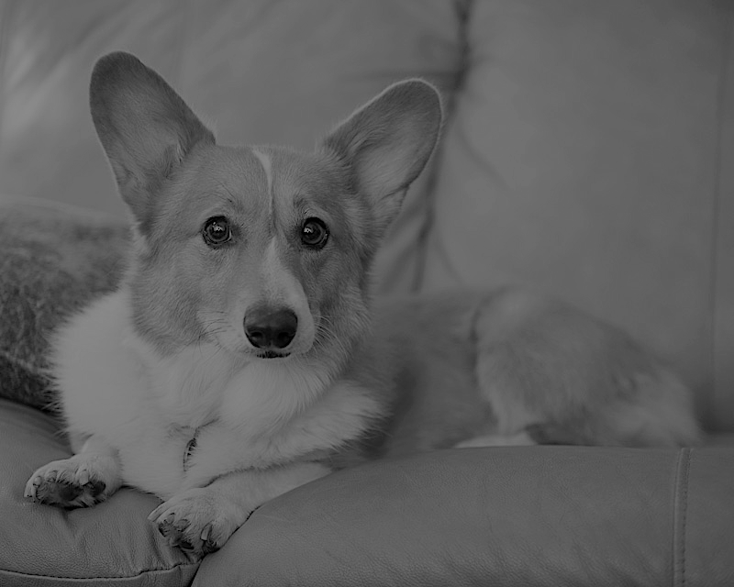
Illumination
Light
Image Plane
Observer

Slide 13
Illumination
Light
Image Plane
Observer
Notes:
Now, typically the way you would generate this kind of interactive 3D content is by having a 3D model of your bunny over here.

Slide 14
What Determines the Brightness of a Surface?
Illumination
  What light hits a surface
Reflectance
  How the surface reflects light
The brightness of a pixel is an ambiguous combination of illumination and reflectance…
Reflected Light
Illumination
Reflectance

Slide 15
Reflectance and Illumination In Popular Culture…

Slide 16
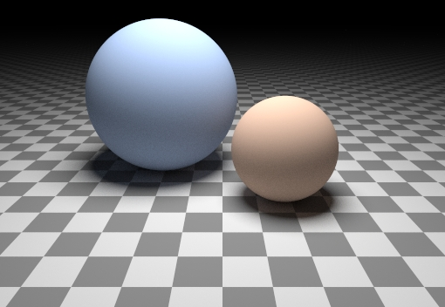
Perception is Solving an Under-Constrained Problem
Are these spheres, or just flat discs painted with varying albedo?
  Probably spheres…
  The flat disk trick would only work from one perspective, so it seems pretty unlikely…

Slide 17
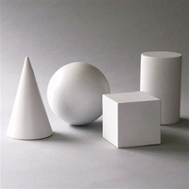
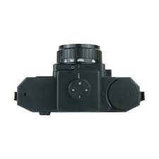
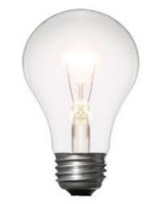
What we know: Stereo
Key Idea: use feature motion to understand shape
Notes:
Helmholtz reciprocity

Slide 18
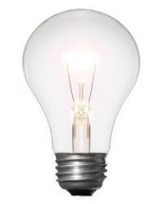
Next: Photometric Stereo
Key Idea: use pixel brightness to understand shape

Slide 19
Next: Photometric Stereo
Key Idea: use pixel brightness to understand shape
Notes:
And I think this slide is probably meant to indicate that if we are able to control the lighting by, say, turning an additional light on, this offers a lot of additional information

Slide 20
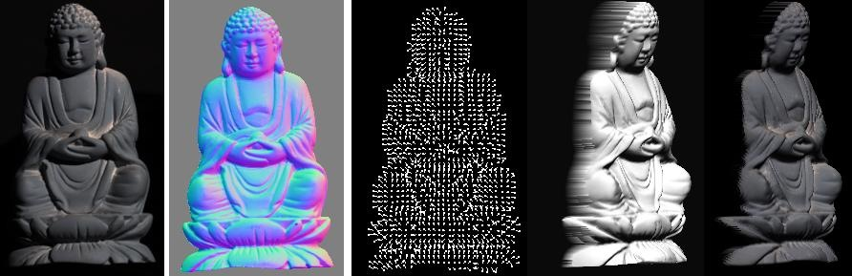
Photometric Stereo
What results can you get?
Input
(1 of 12)
Normals (RGB colormap)
Normals (vectors)
Shaded 3D
rendering
Textured 3D
rendering

Slide 21
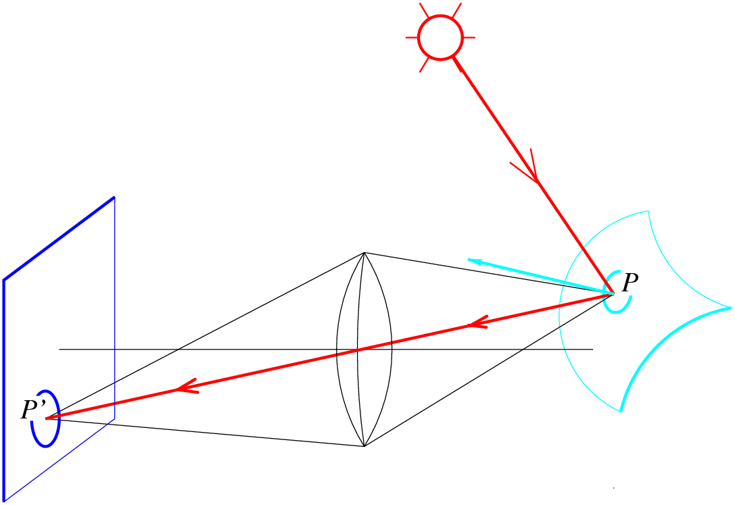
Radiometry
What determines the brightness of an image pixel?
Light source
properties
Sensor characteristics
Surface
shape
Exposure
Surface reflectance
properties
Optics
Slide by L. Fei-Fei

Slide 22

What is light?
Electromagnetic radiation (EMR) moving along rays in space
  R(λ) is EMR, measured in units of power (watts)
    λ is wavelength
Light field
  We can describe all of the light in the scene by specifying the radiation (or “radiance” along all light rays) arriving at every point in space and from every direction

Slide 23
Color perception
Electromagnetic radiation (EMR) moving along rays in space
  R(λ) is EMR, measured in units of power (watts)
    λ is wavelength
Perceiving light
  How do we convert radiation into “color”?
  What part of the spectrum do we see?

Slide 24
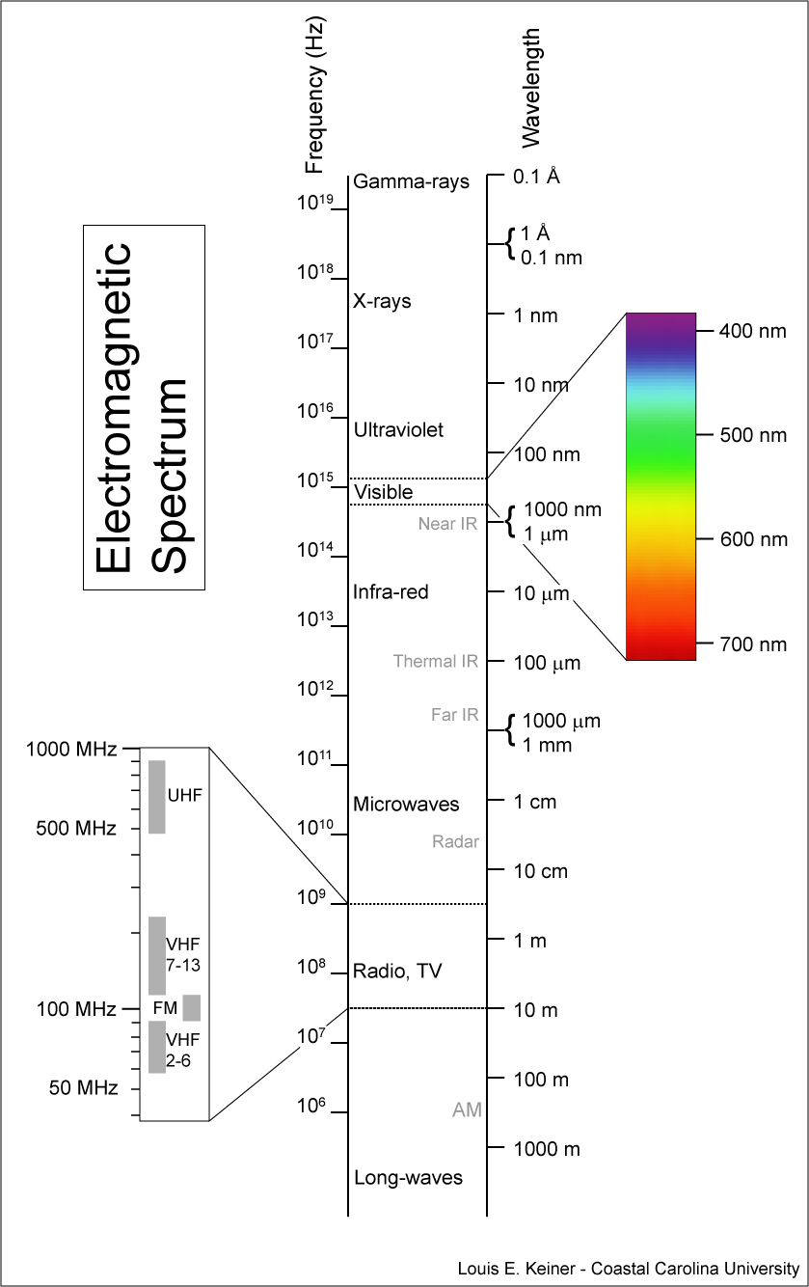
Visible light
We “see” electromagnetic radiation in a range of wavelengths

Slide 25
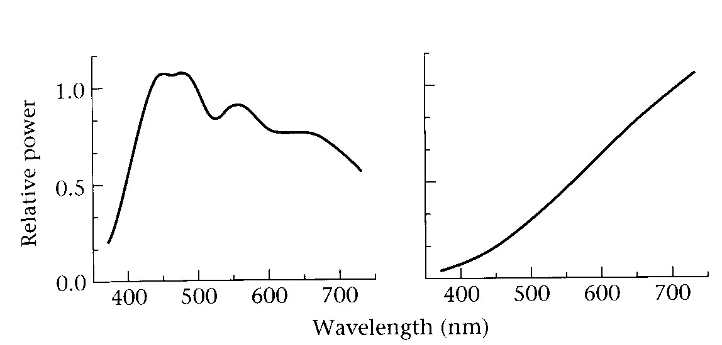
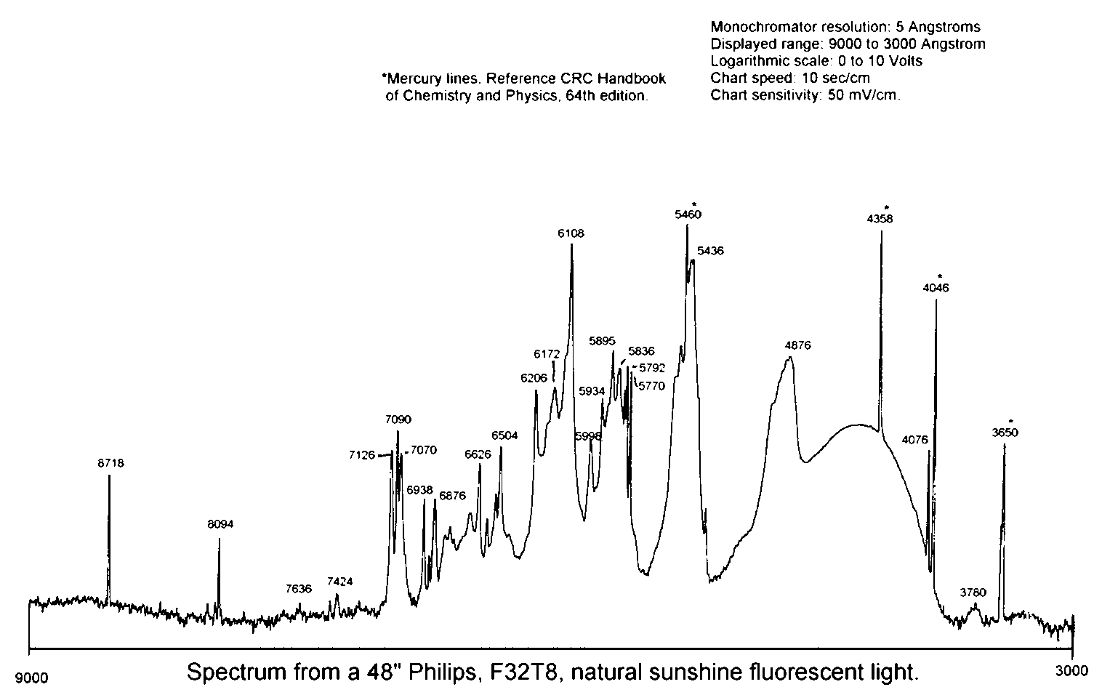
Light spectrum
The appearance of light depends on its power spectrum
  How much power (or energy) at each wavelength
daylight
tungsten bulb
fluorescent bulb
Our visual system converts a light spectrum into “color”
  This is a rather complex transformation

Slide 26
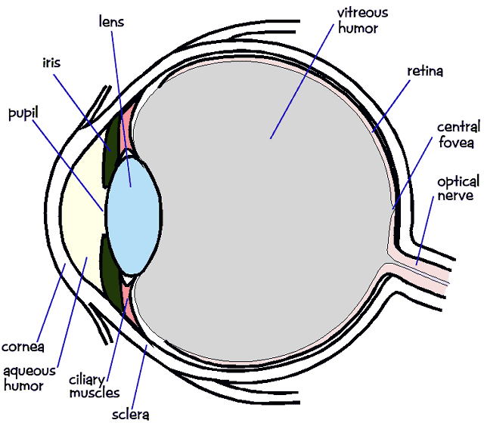
The human visual system
Color perception
  Light hits the retina, which contains photosensitive cells
    rods and cones
  These cells convert the spectrum into a few discrete values

Slide 27
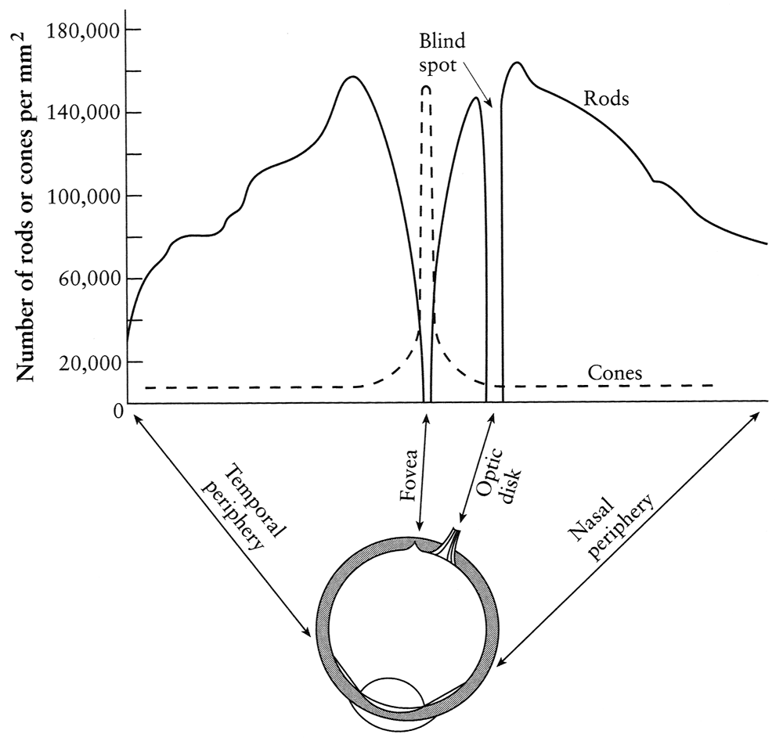
Density of rods and cones
Rods and cones are non-uniformly distributed on the retina
  Rods responsible for intensity, cones responsible for color
  Fovea - Small region (1 or 2°) at the center of the visual field containing the highest density of cones (and no rods).
  Less visual acuity in the periphery—many rods wired to the same neuron

Slide 28
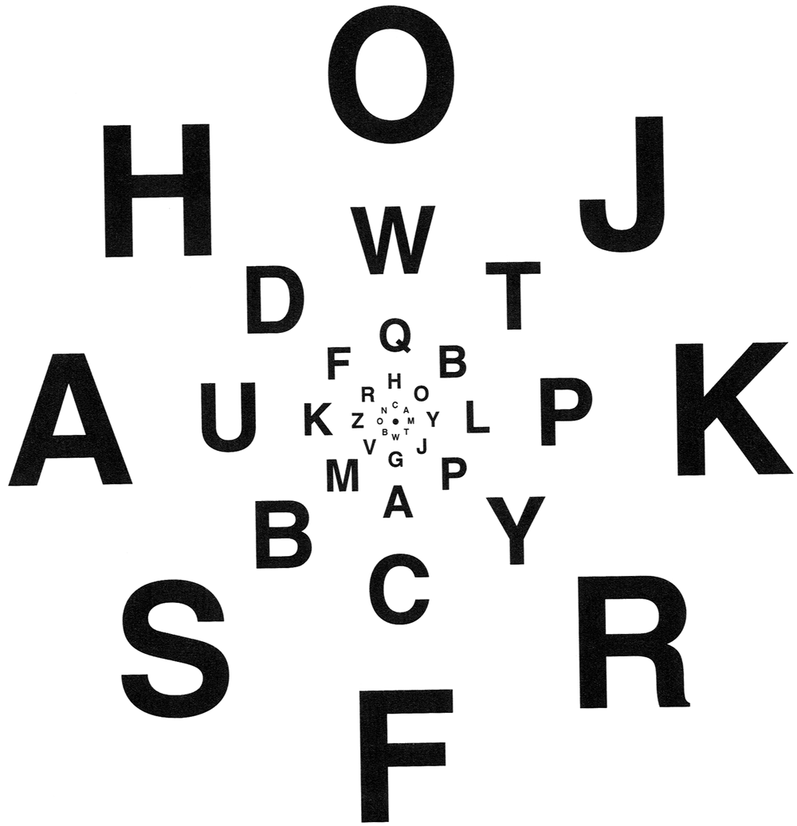
Demonstrations of visual acuity
With one eye shut, at the right distance, all of these letters should appear equally legible (Glassner, 1.7).

Slide 29
Demonstrations of visual acuity
With left eye shut, look at the cross on the left. At the right distance, the circle on the right should disappear (Glassner, 1.8).

Slide 30

Brightness contrast and constancy
The apparent brightness depends on the surrounding region
  brightness contrast: a constant colored region seems lighter or darker depending on the surrounding intensity:
    http://www.sandlotscience.com/Contrast/Checker_Board_2.htm
  brightness constancy: a surface looks the same under widely varying lighting conditions.

Slide 31
Light response is nonlinear
Our visual system has a large dynamic range
  We can resolve both light and dark things at the same time
  One mechanism for achieving this is that we sense light intensity on a logarithmic scale
    an exponential intensity ramp will be seen as a linear ramp
  Another mechanism is adaptation
    rods and cones adapt to be more sensitive in low light, less sensitive in bright light.

Slide 32
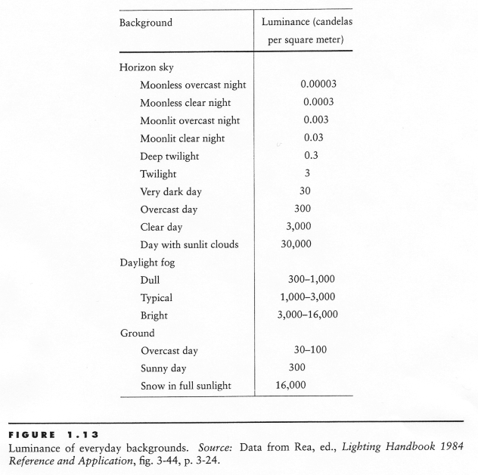
Visual dynamic range
A piece of white paper can be 1,000,000,000 times brighter in outdoor sunlight than in a moonless night.
BUT in a given lighting condition, light ranges over only about two orders of
magnitude.
Notes:
***THIS IS ANOTHER REASON WHY LOW LIGHT PHOTOGRAPHY IS SO ANNOYING***

Slide 33
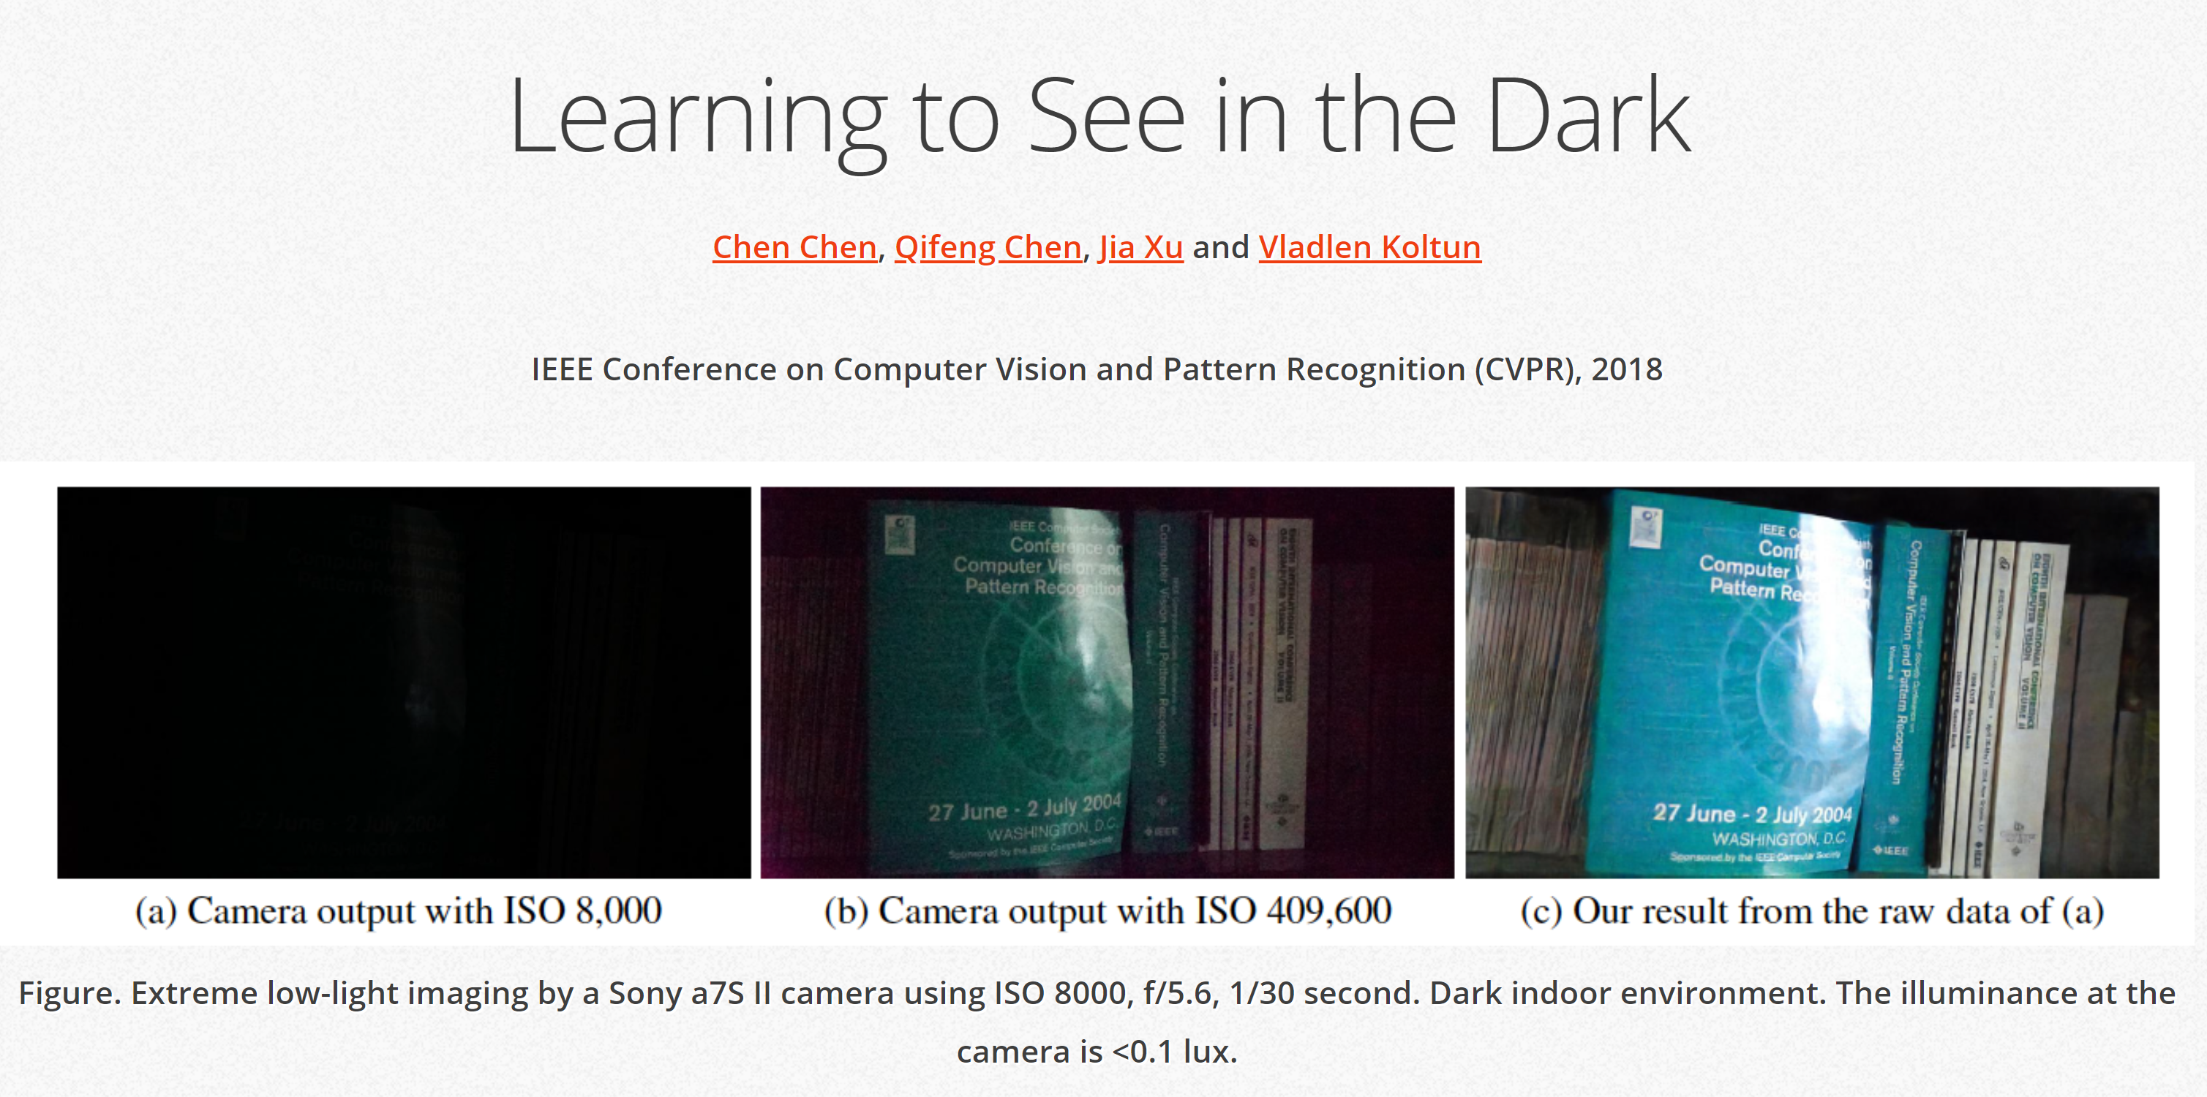
http://cchen156.web.engr.illinois.edu/SID.html

Slide 34



Visual dynamic range
Dark night
Indoor lighting
cloudy day
Sunny day
If we were sensitive to this whole range all the time, we wouldn’t be able to
discriminate lightness levels in a typical scene.
The visual system solves this problem by restricting the ‘dynamic range’ of its
response to match the current overall or ‘ambient’ light level.
Dark night
Indoor lighting
cloudy day
Sunny day
Dark night
Indoor lighting
cloudy day
Sunny day

Slide 35
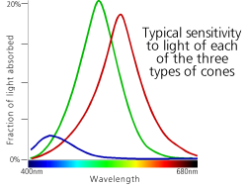
Color perception
L response curve
Three types of cones
  Each is sensitive in a different region of the spectrum
    but regions overlap
    Short (S) corresponds to blue
    Medium (M) corresponds to green
    Long (L) corresponds to red
  Different sensitivities: we are more sensitive to green than red
    varies from person to person (and with age)
  Colorblindness—deficiency in at least one type of cone

Slide 36
Color perception
M
L
Power
S
Wavelength
Rods and cones act as filters on the spectrum
  To get the output of a filter, multiply its response curve by the spectrum, integrate over all wavelengths
    Each cone yields one number
  Q: How can we represent an entire spectrum with 3 numbers?
  A: We can’t! Most of the information is lost.
    As a result, two different spectra may appear indistinguishable
      such spectra are known as metamers
      http://www.cs.brown.edu/exploratories/freeSoftware/repository/edu/brown/cs/exploratories/applets/spectrum/metamers_guide.html

Slide 37
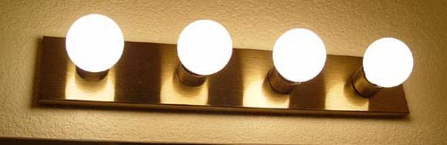
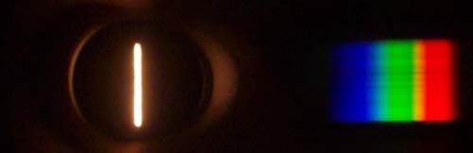
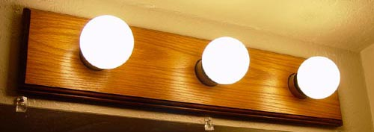
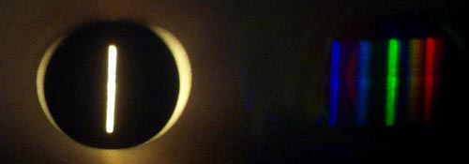
What kind of bulb is it?
http://www.chemistryland.com/CHM107Lab/Exp7/Spectroscope/Spectroscope.html

Slide 38
Perception summary
The mapping from radiance to perceived color is quite complex!
  We throw away most of the data
  We apply a logarithm
  Brightness affected by pupil size
  Brightness contrast and constancy effects
The same is true for cameras
  But we have tools to correct for these effects
    (Computational Photography)

Slide 39
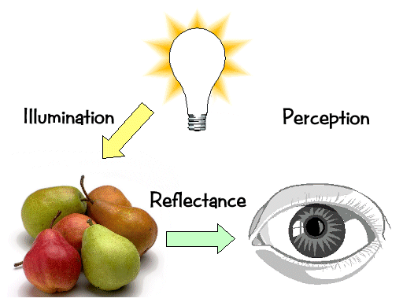
Light transport

Slide 40
Light sources
Basic types
  point source
  directional source
    a point source that is infinitely far away
  area source
    a union of point sources
More generally
  a light field can describe *any* distribution of light sources
What happens when light hits an object?

Slide 41
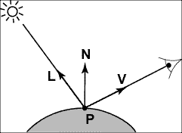
Modeling Image Formation
We need to reason about:
  How light interacts with the scene
  How a pixel value is related to light energy in the world
Track a “ray” of light all the way from light source to the sensor

Slide 42
Directional Lighting
Key property: all rays are parallel
Equivalent to an infinitely distant point source

Slide 43
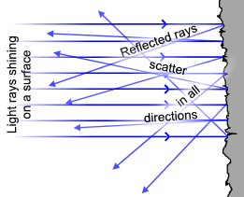
Lambertian Reflectance
Image intensity
Surface normal
Light direction
Image intensity
cos(angle between N and L)

Slide 44
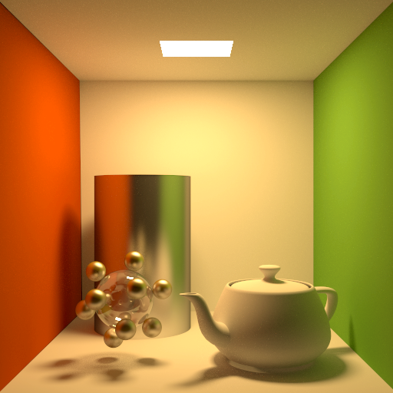
Materials - Three Forms
Ideal diffuse (Lambertian)
Ideal
specular
Directional
diffuse
© Kavita Bala, Computer Science, Cornell University
Notes:
There are several types of surfaces that are assumed to make up the world.
Ideal diffuse. It is similar to the diffuse emitter in that it emits all incident light equally in all outgoing directions. When light hits the surface it is reflected uniformly anywhere in the hemisphere above the surface.
Ideal specular (perfect mirrors). Light is reflected exactly in the mirror direction of the incoming light. A perfect mirror is such a surface.
Directional diffuse (almost all materials in the world). Incoming light is reflected into the hemisphere to different extents. If the object is more glossy then more of the incoming energy reflects close to the mirror direction. If it is more diffuse then the reflection is more uniform.

Slide 45
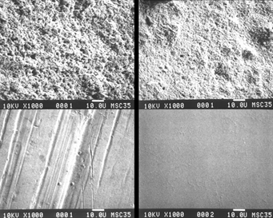
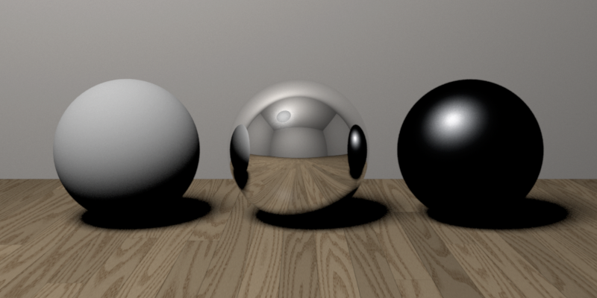
Reflectance—Three Forms
Ideal diffuse (Lambertian)
Ideal
specular
Directional
diffuse
© Kavita Bala, Computer Science, Cornell University
Notes:
Why spheres?!

Slide 46
Ideal Diffuse Reflection
Characteristic of multiple scattering materials
An idealization but reasonable for matte surfaces
© Kavita Bala, Computer Science, Cornell University

Slide 47
Lambertian Reflectance
Reflected energy is proportional to cosine of angle between L and N (incoming)
Measured intensity is viewpoint-independent (outgoing)

Slide 48
Lambertian Reflectance: Incoming
Reflected energy is proportional to cosine of angle between L and N

Slide 49
Lambertian Reflectance: Incoming
Reflected energy is proportional to cosine of angle between L and N

Slide 50
Lambertian Reflectance: Incoming
Reflected energy is proportional to cosine of angle between L and N
Light hitting surface is proportional to the cosine

Slide 51
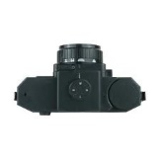
Lambertian Surfaces: Appearance vs Reflected Photons
Appearance is the same from every angle
Radiant Intensity? (how many photons reflected per angle)
Note for those following the 2020 videos:
This and the following two slides were changed after the initial recording of the lecture. These slides were then presented in the following lecture on photometric stereo
Notes:
Emission rate of photons: B0 cos theta
Radiance: (Photons/second)/(area steradian)
Looking down get B0/dA
Looking at angle get B0 cos theta/(dA cos theta)

Slide 52
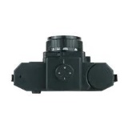
Lambertian Surfaces: Appearance vs Reflected Photons
Appearance is the same from every angle
Radiant Intensity? (how many photons reflected per angle)
Notes:
Emission rate of photons: B0 cos theta
Radiance: (Photons/second)/(area steradian)
Looking down get B0/dA
Looking at angle get B0 cos theta/(dA cos theta)

Slide 53
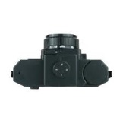
Lambertian Surfaces: Appearance vs Reflected Photons
Appearance is the same from every angle
Radiant Intensity? (how many photons reflected per angle)
Lambert's cosine law:
Notes:
Emission rate of photons: B0 cos theta
Radiance: (Photons/second)/(area steradian)
Looking down get B0/dA
Looking at angle get B0 cos theta/(dA cos theta)
Pixel=\mathbf{B}_{0}\mathbf{A}_{0}\frac{\cos{\theta}}{\cos{\theta}}

Slide 54
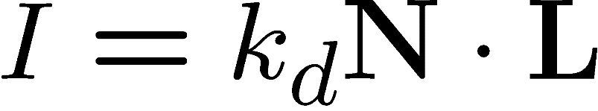

Image Formation Model: Final
Diffuse albedo: what fraction of incoming light is reflected?
  Introduce scale factor
Light intensity: how much light is arriving?
  Compensate with camera exposure (global scale factor)
Camera response function
  Assume pixel value is linearly proportional to incoming energy (perform radiometric calibration if not)

Slide 55
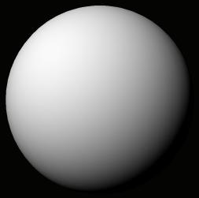


A Single Image: Shape from Shading
Assume is 1 for now.
What can we measure from one image?
  is the angle between N and L
  Add assumptions:
    Constant albedo
    A few known normals (e.g. silhouettes)
    Smoothness of normals
In practice, SFS doesn’t work very well:
assumptions are too restrictive,
too much ambiguity in nontrivial scenes.

Slide 56
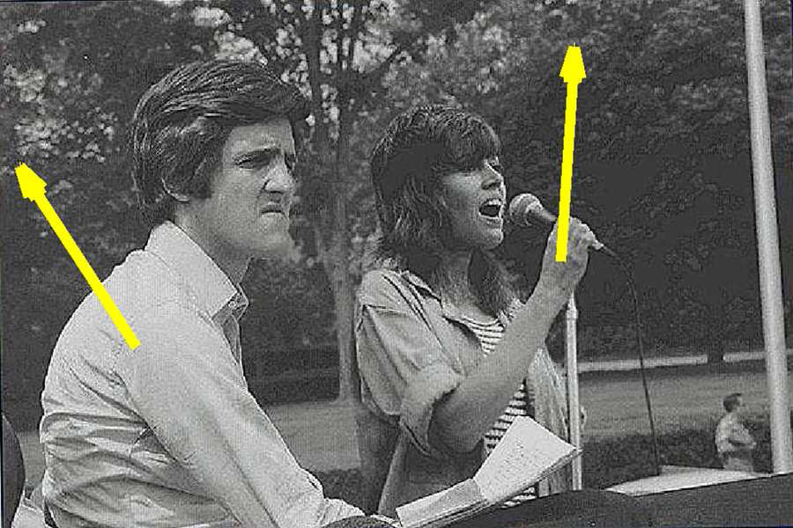
Application: Detecting composite photos
Real photo
Fake photo

Slide 57
Questions?

