Slide 1

CS5670: Stereo
Presented by Abe Davis
Most slides from Noah Snavely
Who probably based some of them on slides from other academics,
because that’s what everyone does…

Slide 2
Coronavirus Updates
Subsequent lectures will be virtual until otherwise noted, meaning either:
  Presented live over Zoom, or
  Posted as a video with scheduled office hours for questions (reverse classroom style)
Abe’s Office hours today:
  Right after class, shortened
  Let me know if you have questions but can’t make this
  Will try to schedule office hours over Zoom moving forward
Please be patient with us as we adapt
  Clarifications on last lecture will be sent out and/or presented on Monday
  Some grading may take a bit longer than usual, but we are working on it
  We hope to be back on pace by the end of next week

Slide 3
Announcements
Project 3 is out
  Code is due Monday, March 23, by 11:59pm
  Artifact due Wednesday, March 25, by 11:59pm
Default groups are imported from Project 2
  You can change these if you want

Slide 4

Stereo Vision as Localizing Points in 3D
An object point will project to some point in our image
That image point corresponds to a ray in the world
Two rays intersect at a single point, so if we want to localize points in 3D we need 2 eyes

Slide 5
Stereo Trickery: VR

Slide 6
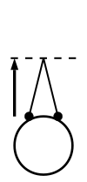

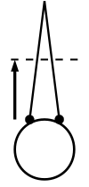
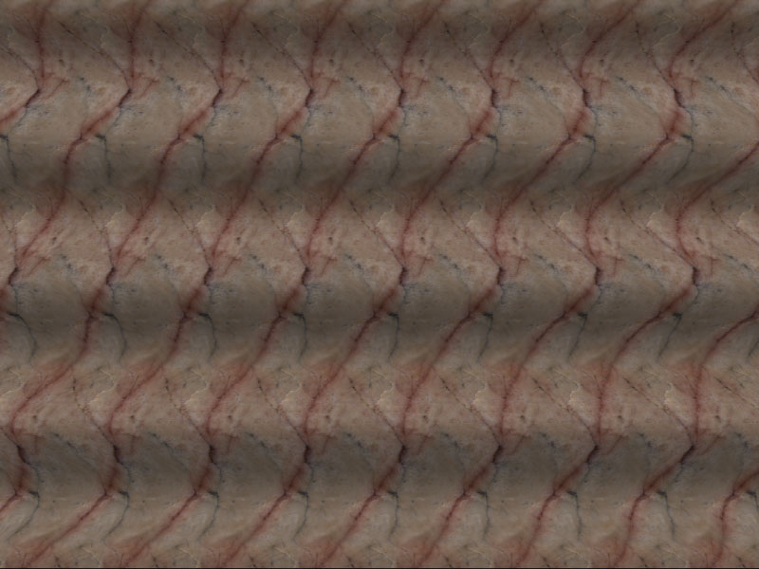

Stereo Trickery: Autostereograms
Normal
Cross-eyed
Wall-eyed
Look “To infinity and beyond!”
Single image stereogram, by Niklas Een

Slide 7
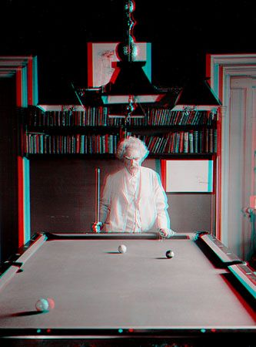
Stereo Trickery: Old-school 3D Glasses
Mark Twain at Pool Table", no date, UCR Museum of Photography

Slide 8

Stereo
Given two images from different viewpoints
  How can we compute the depth of each point in the image?
  Based on how much each pixel moves between the two images

Slide 9
Epipolar geometry
epipolar lines
(x₁, y₁)
(x₂, y₁)
Two images captured by a purely horizontal translating camera
(rectified stereo pair)
x₂ -x₁ = the disparity of pixel (x₁, y₁)

Slide 10
Your basic stereo matching algorithm
Match Pixels in Conjugate Epipolar Lines
  Assume brightness constancy
  This is a challenging problem
  Hundreds of approaches
    A good survey and evaluation: http://www.middlebury.edu/stereo/

Slide 11
Your basic stereo algorithm
For each epipolar line
For each pixel in the left image
    compare with every pixel on same epipolar line in right image
    pick pixel with minimum match cost
Improvement: match windows

Slide 12
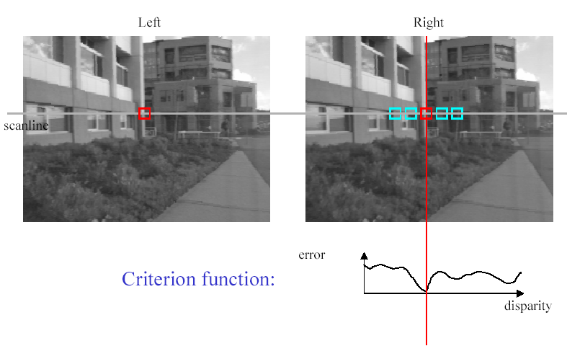
Stereo matching based on SSD
SSD
^{d}min d
Best matching disparity

Slide 13


Window size
W = 3
W = 20
Effect of window size
Better results with adaptive window
  T. Kanade and M. Okutomi, A Stereo Matching Algorithm with an Adaptive Window: Theory and Experiment,, Proc. International Conference on Robotics and Automation, 1991.
  D. Scharstein and R. Szeliski. Stereo matching with nonlinear diffusion. International Journal of Computer Vision, 28(2):155-174, July 1998
  Smaller window
  Larger window
Notes:
smaller window: more detail, more noise
bigger window: less noise, more detail

Slide 14


Stereo results
  Data from University of Tsukuba
  Similar results on other images without ground truth
Scene
Ground truth

Slide 15


Results with window search
Window-based matching
(best window size)
Ground truth

Slide 16

Better methods exist...
State of the art method (circa 1999)
  Boykov et al., Fast Approximate Energy Minimization via Graph Cuts,
  International Conference on Computer Vision, September 1999.
Ground truth
    For the latest and greatest: http://www.middlebury.edu/stereo/

Slide 17
Stereo as energy minimization
What defines a good stereo correspondence?
  Match quality
    Want each pixel to find a good match in the other image
  Smoothness
    If two pixels are adjacent, they should (usually) move about the same amount

Slide 18

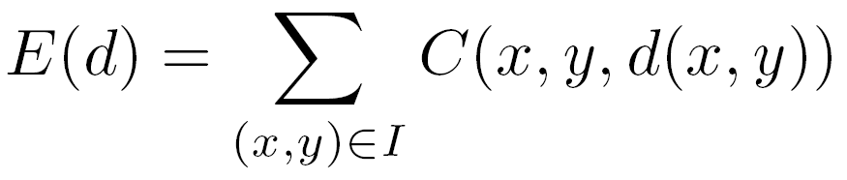

Stereo as energy minimization
Find disparity map d that minimizes an energy function
Simple pixel / window matching
=
SSD distance between windows I(x, y) and J(x + d(x,y), y)

Slide 19
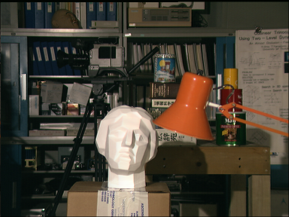
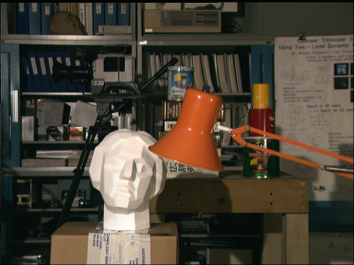
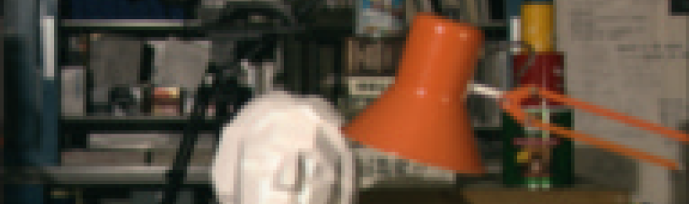
Stereo as energy minimization
y = 141
d
x
C(x, y, d); the disparity space image (DSI)

Slide 20
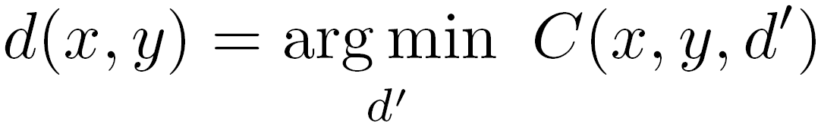
Stereo as energy minimization
y = 141
d
x
Simple pixel / window matching: choose the minimum of each column in the DSI independently:

Slide 21
Greedy selection of best match

Slide 22
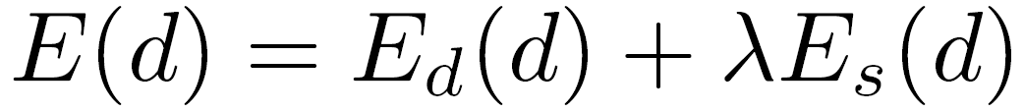
Stereo as energy minimization
Better objective function
{
{
match cost
smoothness cost
    Want each pixel to find a good match in the other image
    Adjacent pixels should (usually) move about the same amount

Slide 23
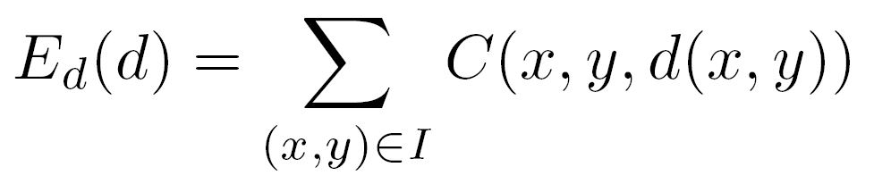
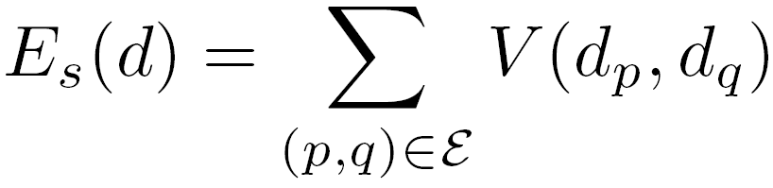

Stereo as energy minimization
match cost:
smoothness cost:
: set of neighboring pixels
4-connected neighborhood
8-connected neighborhood

Slide 24
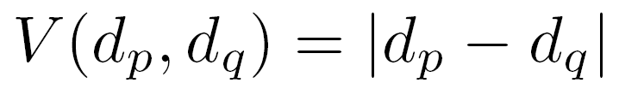
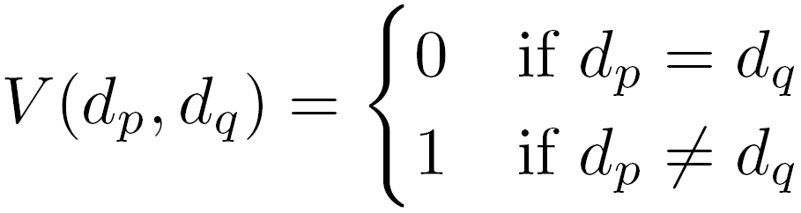
Smoothness cost
Now the energy contributed by one pixel depends on the disparity assigned to its neighbors!
How do we choose V?
L₁ distance
“Potts model”

Slide 25
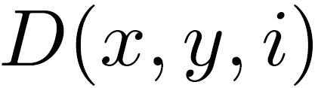
Dynamic programming
Can minimize this independently per scanline using dynamic programming (DP)
Basic idea: incrementally build a table of costs D one column at a time
: minimum cost of solution such that d(x,y) = i
Base case:
(L = max disparity)
Recurrence:

Slide 26
Dynamic programming
y = 141
d
x
Finds “smooth”, low-cost path through DPI from left to right

Slide 27
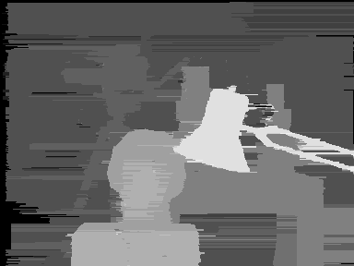
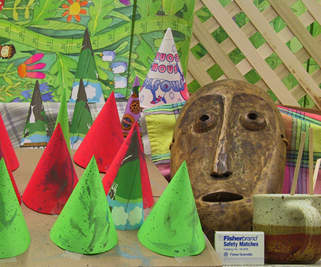
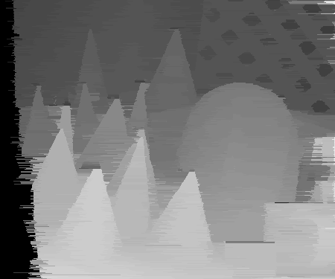
Dynamic Programming
What’s with the streaks?

Slide 28
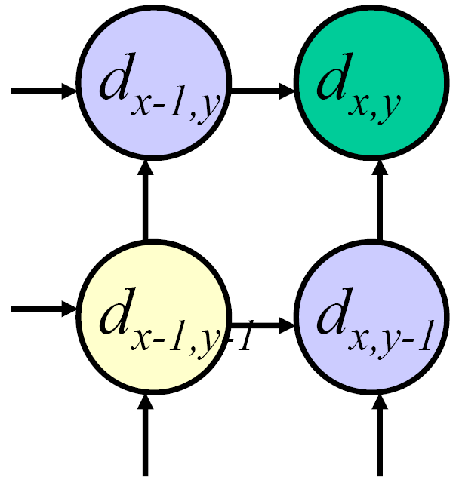
Dynamic programming
Can we apply this trick in 2D as well?
No: d_{x,y-1} and d_{x-1,y} may depend on different values of d_{x-1,y-1}
Slide credit: D. Huttenlocher

Slide 29
Stereo as a minimization problem
The 2D problem has many local minima
  Gradient descent doesn’t work well
And a large search space
  n x m image w/ k disparities has k^{nm} possible solutions
  Finding the global minimum is NP-hard in general
Good approximations exist… we’ll see this soon

Slide 30
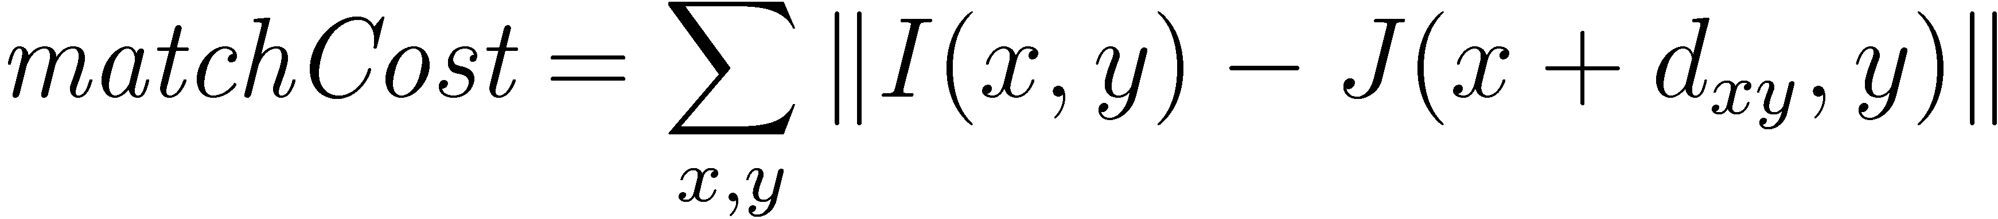
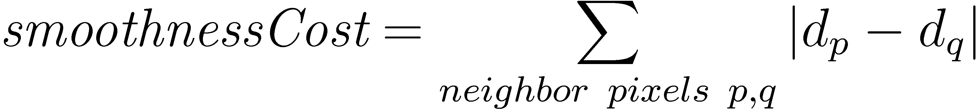
Stereo as energy minimization
Expressing this mathematically
  Match quality
    Want each pixel to find a good match in the other image
  Smoothness
    If two pixels are adjacent, they should (usually) move about the same amount
We want to minimize
  This is a special type of energy function known as an
  MRF (Markov Random Field)
    Effective and fast algorithms have been recently developed:
      Graph cuts, belief propagation….
      for more details (and code): http://vision.middlebury.edu/MRF/
      Great tutorials available online (including video of talks)

Slide 31
Questions?

Slide 32
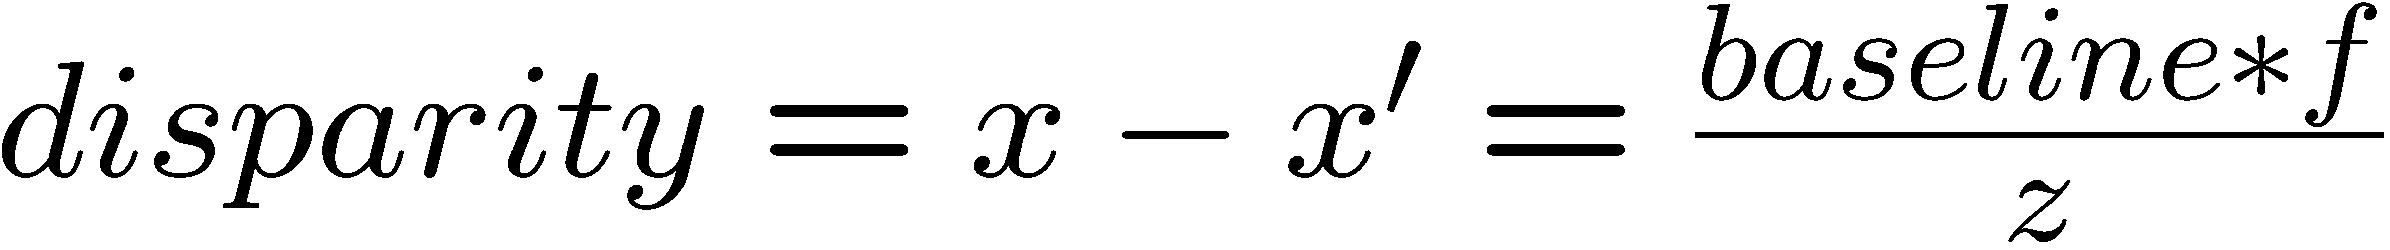
Depth from disparity
X
z
x
x’
f
f
C
baseline
C’

Slide 33
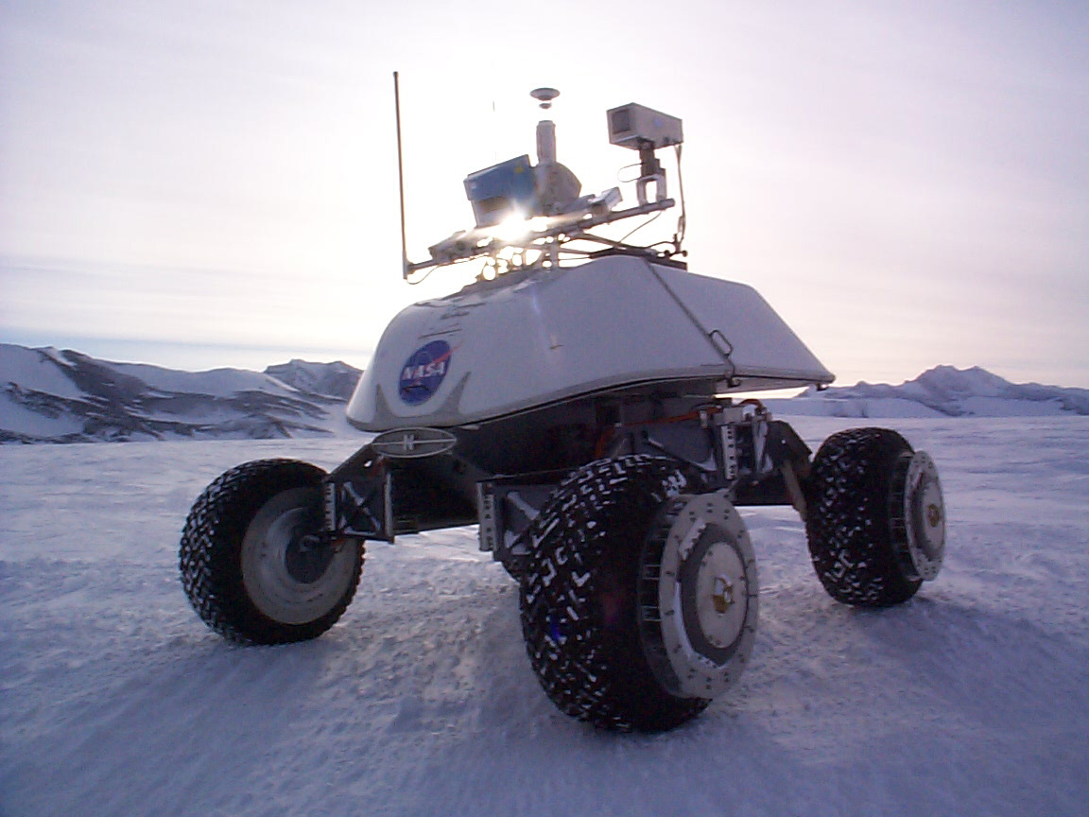
Real-time stereo
Nomad robot searches for meteorites in Antartica
  http://www.frc.ri.cmu.edu/projects/meteorobot/index.html
Used for robot navigation (and other tasks)
  Several real-time stereo techniques have been developed (most based on simple discrete search)

Slide 34
Stereo reconstruction pipeline
Steps
  Calibrate cameras
  Rectify images
  Compute disparity
  Estimate depth
  Camera calibration errors
  Poor image resolution
  Occlusions
  Violations of brightness constancy (specular reflections)
  Large motions
  Low-contrast image regions
What will cause errors?

Slide 35

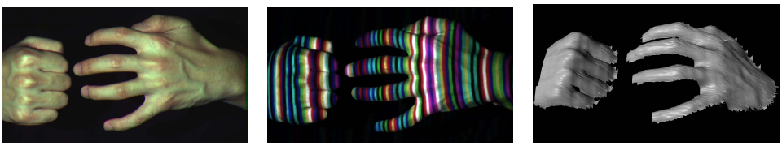
Active stereo with structured light
Li Zhang’s one-shot stereo

Slide 36
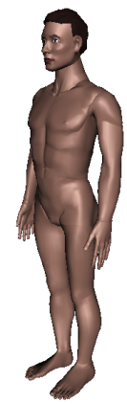
Active stereo with structured light
Li Zhang’s one-shot stereo
camera 1
camera 1
projector
projector
camera 2
Project “structured” light patterns onto the object
  simplifies the correspondence problem
  basis for active depth sensors, such as Kinect and iPhone X (using IR)

Slide 37
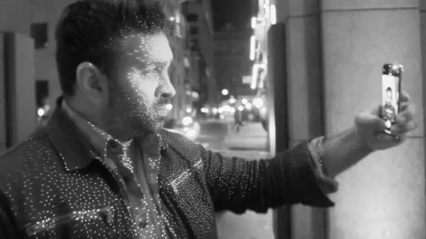
Active stereo with structured light
https://ios.gadgethacks.com/news/watch-iphone-xs-30k-ir-dots-scan-your-face-0180944/

Slide 38
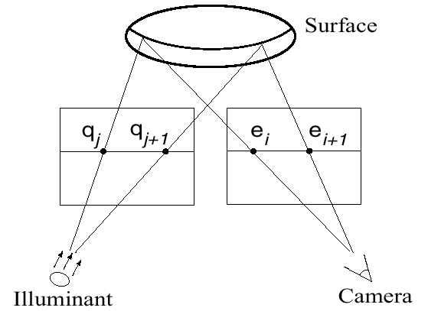
Active stereo with structured light

Slide 39

Laser scanning
Digital Michelangelo Project
http://graphics.stanford.edu/projects/mich/
Optical triangulation
  Project a single stripe of laser light
  Scan it across the surface of the object
  This is a very precise version of structured light scanning

Slide 40

Laser scanned models
  The Digital Michelangelo Project, Levoy et al.

Slide 41
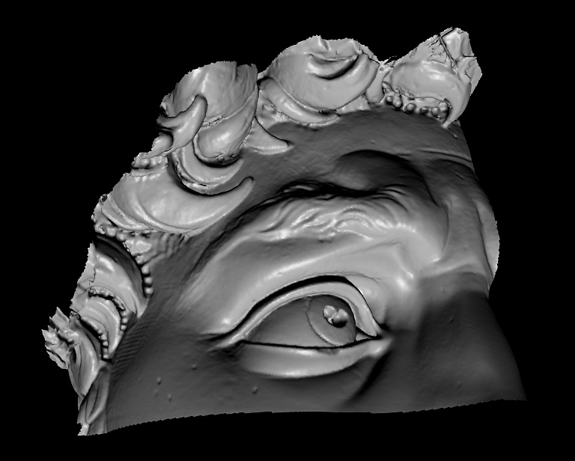
Laser scanned models
  The Digital Michelangelo Project, Levoy et al.

Slide 42
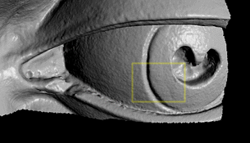
Laser scanned models
  The Digital Michelangelo Project, Levoy et al.

Slide 43
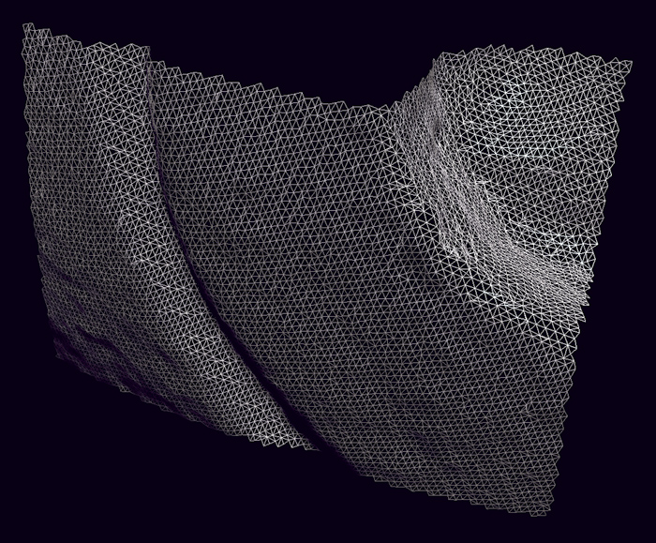
Laser scanned models
  The Digital Michelangelo Project, Levoy et al.

Slide 44
Questions?

