Slide 1
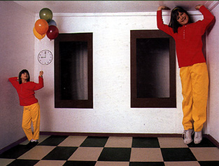
Single-View Modeling
CS5670: Computer Vision
Noah Snavely

Slide 2

Congratulations to Noah!
It’s Baby Charlie!

Slide 3
Some Notes
I (Abe) will take on most of the instructor duties moving forward
  I will defer to Noah’s precedent on course structure and policy whenever possible
Bear with us on the transition
  First time teaching a course, but frequently give talks (hopefully this will translate well…)
  If I can’t answer a question in class, I will try to answer it at the beginning of next class or send out a correction.
  I may occasionally describe things differently from Noah---don’t hesitate to ask for clarifications

Slide 4
Single-View Modeling
Ames Room
Readings
  Mundy, J.L. and Zisserman, A., Geometric Invariance in Computer Vision, Appendix: Projective Geometry for Machine Vision, MIT Press, Cambridge, MA, 1992,
  (read 23.1 - 23.5, 23.10)
    available online: http://www.cs.cmu.edu/~ph/869/papers/zisser-mundy.pdf

Slide 5
Announcements
Midterm Due Today
Assignment 3 (DEMO)

Slide 6
Roadmap ahead
The next few lectures will finish up geometry
  Next up is recognition / learning
We already know about camera geometry & panoramas
Coming up
  Single-view modeling (today)
  Two-view geometry
  Multi-view geometry

Slide 7
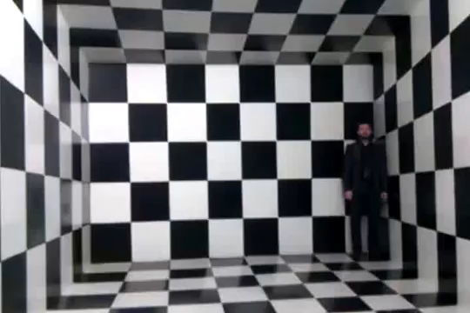
Ames Room
https://www.youtube.com/watch?v=bZGWRJyo0YU

Slide 8

Notes:
https://www.youtube.com/watch?v=hCV2Ba5wrcs

Slide 9
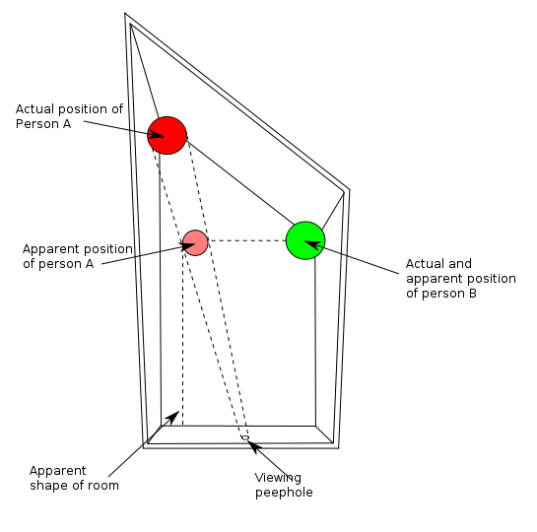
Ames Room: What does this illustrate?
Computer vision is under-constrained
One image has multiple explanations
  We are good at picking the most likely one
“Are children small, or just far away?”
-Magical Mysteries
by Thrilla Killa Klownz
SNL Digital Short

Slide 10
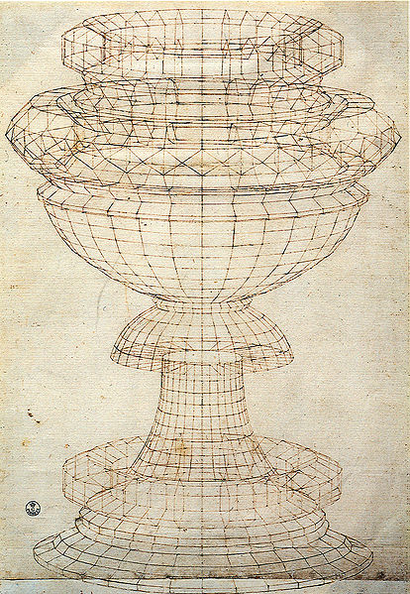
Projective geometry—what’s it good for?
Uses of projective geometry
  Drawing
  Measurements
  Mathematics for projection
  Undistorting images
  Camera pose estimation
  Object recognition
Paolo Uccello

Slide 11
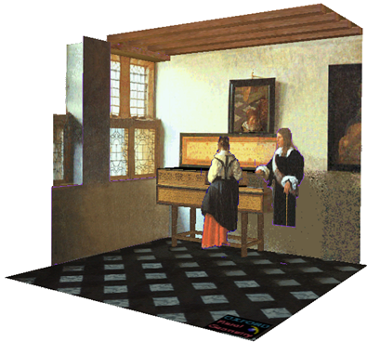
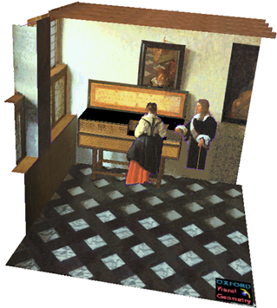

Applications of projective geometry
Vermeer’s Music Lesson
Reconstructions by Criminisi et al.

Slide 12

Making measurements in images
https://www.warbyparker.com/pd/instructions

Slide 13

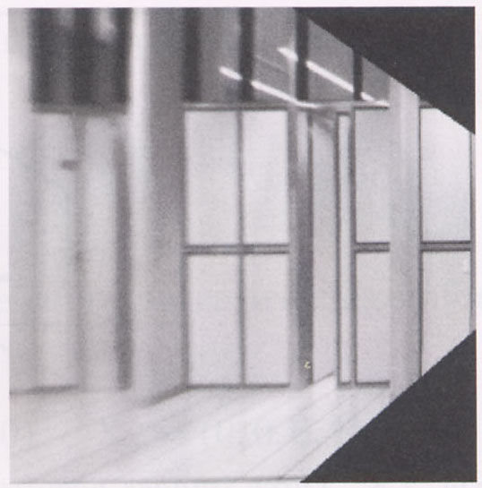

Measurements on planes
4
3
2
1
1
2
3
4
Approach: unwarp then measure
Notes:
homography!

Slide 14
Homogeneous coordinates and lines
(X,Y,W) same as (SX,SY,SW)
Line in projective plane
  ax + by + c = 0
  aX + bY + cW = 0
  u^{T}p = p^{T}u =0
    u = [a,b,c] ^{T} and p = [X,Y,W] ^{T}
    (x,y) Euclidean = (X/W,Y/W)
    W = 0? Ideal points, points at infinity (X,Y,0)

Slide 15
Homogeneous Coordinates & Projection (Review?)
z=1
(Image plane)
p= (x, y, z)
y-axis
(Image Coordinates)
p’= (?,?,1)
z-axis
1
z
Homogenization =
Apply Similar Triangles Rule
p’= (?,?,1)
p’= (x/z, y/z, 1)

Slide 16
Point and line duality
  A line l is a homogeneous 3-vector
  It is ⊥ to every point (ray) p on the line: l.p=0
p₁
p₂
  What is the line l spanned by rays p₁ and p₂ ?
    l is ⊥ to p₁ and p₂ ⇒ l = p₁ × p₂
    l can be interpreted as a plane normal
l
  What is the intersection of two lines l₁ and l₂ ?
    p is ⊥ to l₁ and l₂ ⇒ p = l₁ × l₂
  Points and lines are dual in projective space
l₁
p
l₂

Slide 17
Ideal points and lines
(a,b,0)
-y
(sx,sy,0)
-y
-z
x
image plane
-z
image plane
x
Ideal point (“point at infinity”)
  p ≅ (x, y, 0) – parallel to image plane
  It has infinite image coordinates
Ideal line
  l ≅ (a, b, 0) – parallel to image plane
  Corresponds to a line in the image (finite coordinates)
    goes through image origin (principal point)

Slide 18
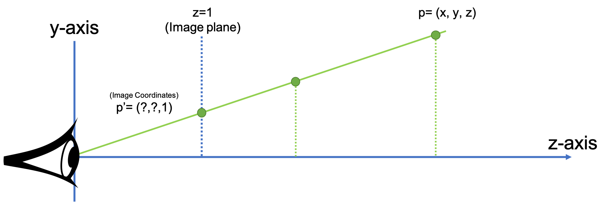
3D projective geometry
These concepts generalize naturally to 3D
  Homogeneous coordinates
    Projective 3D points have four coords: P = (X,Y,Z,W)
  Duality
    A plane N is also represented by a 4-vector
    Points and planes are dual in 3D: N·P=0
    Three points define a plane, three planes define a point
When z-axis is no longer the optical axis of our imaging system (eye or camera), we need to add a new homogeneous coordinate

Slide 19
3D to 2D: perspective projection
Projection:
Notes:
Preserved: lines, incidence
Not preserved: lengths, angles, parallelism

Slide 20
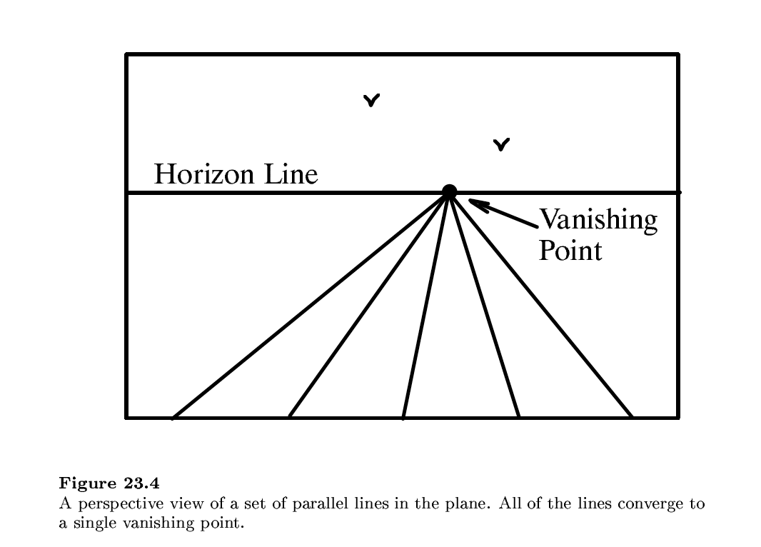

Slide 21
Vanishing points (1D)
image plane
vanishing point
camera
center
ground plane
Vanishing point
  projection of a point at infinity
  can often (but not always) project to a finite point in the image
camera
center
image plane
ground plane

Slide 22
Vanishing points (2D)
image plane
vanishing point
camera
center
line on ground plane

Slide 23
Vanishing points
image plane
vanishing point V
camera
center
C
line on ground plane
line on ground plane
Properties
  Any two parallel lines (in 3D) have the same vanishing point v
  The ray from C through v is parallel to the lines
  An image may have more than one vanishing point
    in fact, every image point is a potential vanishing point
Notes:
How to determine which lines in the scene vanish at a given pixel?

Slide 24
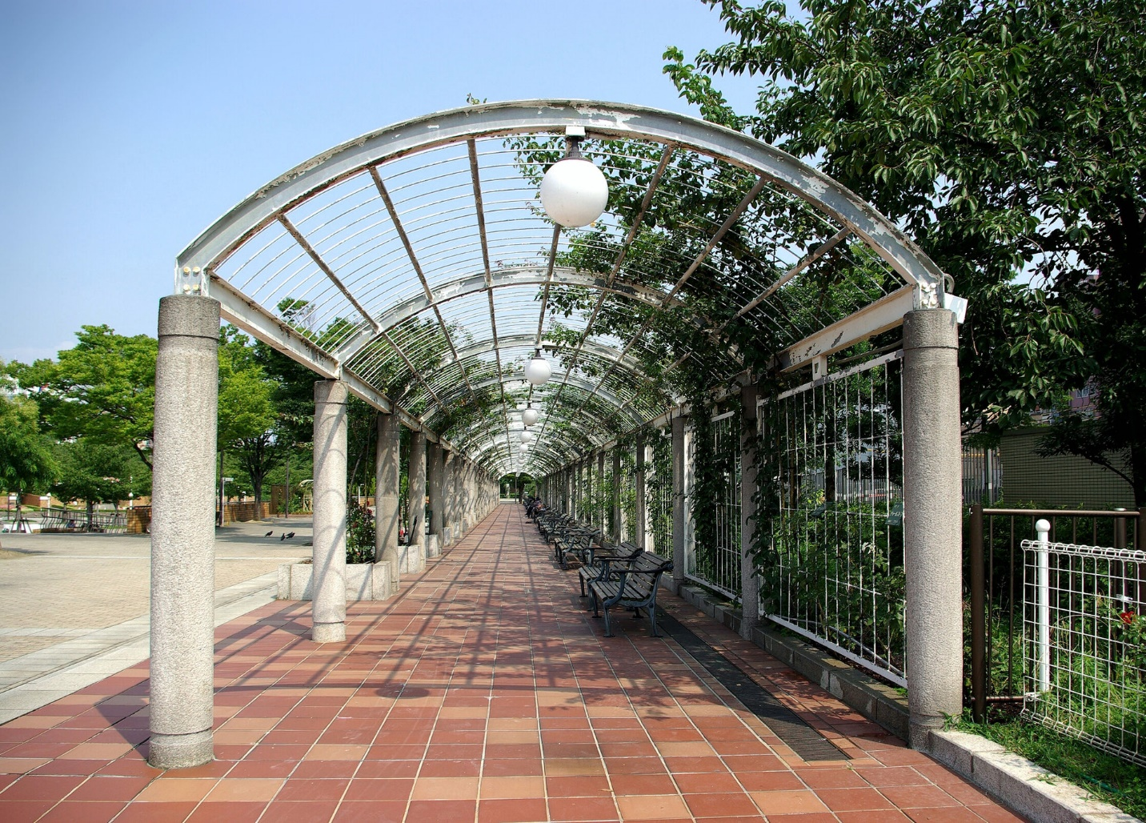
One-point perspective

Slide 25
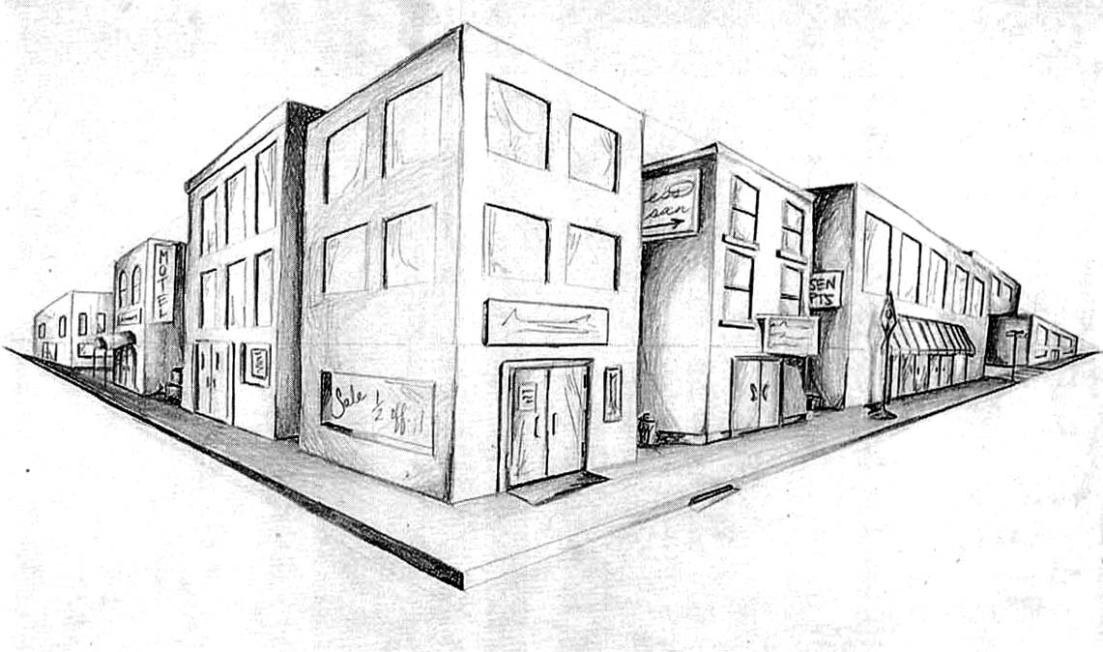
Two-point perspective
v_{y}
v_{x}

Slide 26
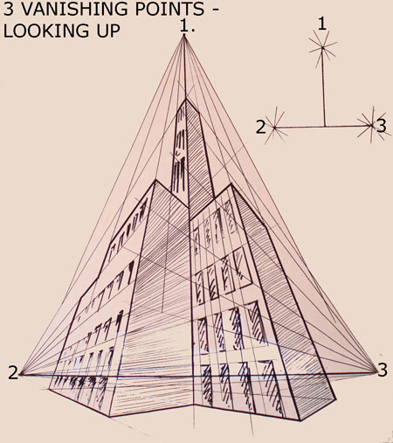
Three-point perspective

Slide 27
Questions?

Slide 28
Vanishing lines
v₁
v₂
Multiple Vanishing Points
  Any set of parallel lines on the plane define a vanishing point
  The union of all of these vanishing points is the horizon line
    also called vanishing line
  Note that different planes (can) define different vanishing lines

Slide 29
Vanishing lines
Multiple Vanishing Points
  Any set of parallel lines on the plane define a vanishing point
  The union of all of these vanishing points is the horizon line
    also called vanishing line
  Note that different planes (can) define different vanishing lines

Slide 30
Computing vanishing points
V
P₀
D

Slide 31
Computing vanishing points
V
P₀
D
Takeaway:
Every directions maps to a vanishing point. Every vanishing point maps to a direction
Properties
  P∞ is a point at infinity, v is its projection
  Depends only on line direction
  Parallel lines P₀ + tD, P₁ + tD intersect at P∞

Slide 32
Computing vanishing lines
v₁
l
v₂
C
l
ground plane
Properties
  l is intersection of horizontal plane through C with image plane
  Compute l from two sets of parallel lines on ground plane
  All points at same height as C project to l
    points higher than C project above l
  Provides way of comparing height of objects in the scene

Slide 33

Riddle me this…
Notes:
Is this parachuter higher or lower than the person taking this picture?
Lower—he is below the horizon

Slide 34
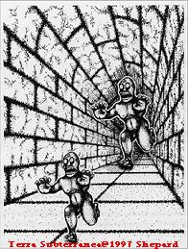
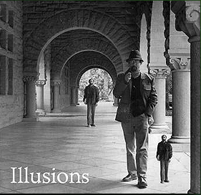
Fun with vanishing points

Slide 35
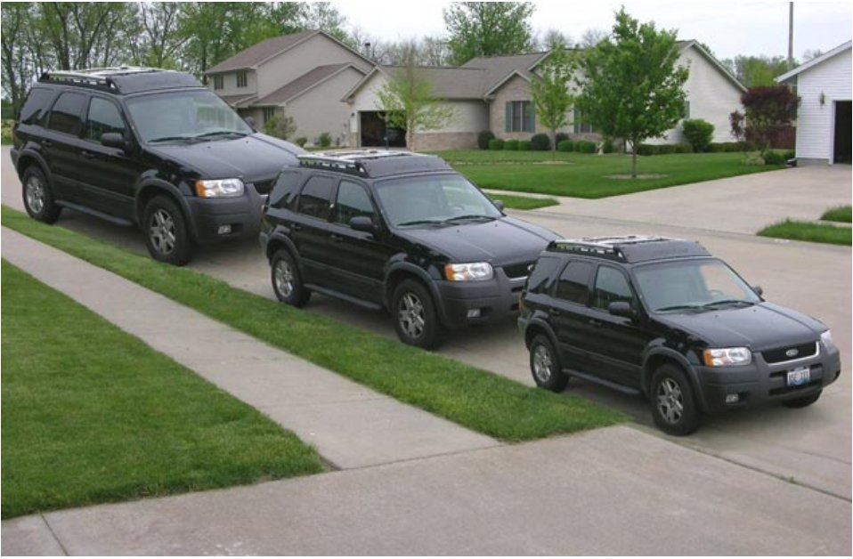
Lots of fun with vanishing points

Slide 36
Perspective cues

Slide 37
Perspective cues

Slide 38
Perspective cues

Slide 39
Comparing heights
Vanishing
Point

Slide 40
Measuring height
5.4
5
How high is the camera?
Camera height
4
3.3
3
2.8
2
1

Slide 41
Computing vanishing points (from lines)
v
q₂
q₁
p₂
p₁
Intersect p₁q₁ with p₂q₂
Least squares version
  Better to use more than two lines and compute the “closest” point of intersection
  See notes by Bob Collins for one good way of doing this:
    http://www-2.cs.cmu.edu/~ph/869/www/notes/vanishing.txt

Slide 42


Measuring height without a ruler
H
R

Slide 43
Measuring height without a ruler
C
Z
ground plane
Compute Z from image measurements
  Need more than vanishing points to do this

Slide 44
The cross ratio
A Projective Invariant
  Something that does not change under projective transformations (including perspective projection)
The cross-ratio of 4 collinear points
P₄
P₃
P₂
P₁
Can permute the point ordering
  4! = 24 different orders (but only 6 distinct values)
This is the fundamental invariant of projective geometry

Slide 45
Measuring height
∞
scene cross ratio
T (top of object)
t
r
R (reference point)
C
H
b
R
image cross ratio
v_{Z}
B (bottom of object)
ground plane
scene points represented as
image points as

Slide 46
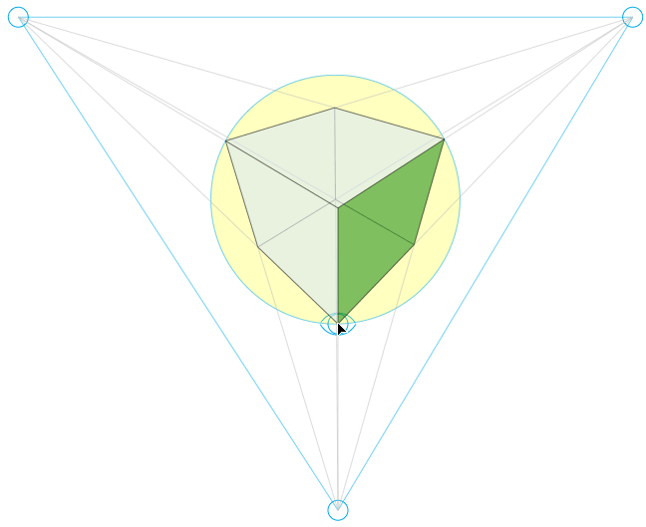
Finding the vertical (z) vanishing point
Find intersection of projections of vertical lines

Slide 47

Measuring height
v_{z}
r
vanishing line (horizon)
t₀
t
v_{x}
v
v_{y}
H
R
H
b₀
b
image cross ratio

Slide 48
Measuring height
v_{z}
r
t₀
vanishing line (horizon)
v_{x}
v
v_{y}
m₀
t₁
b₀
b₁
b
What if the point on the ground plane b₀ is not known?
  Here the person is standing on the box, height of box is known
  Use one side of the box to help find b₀ as shown above

Slide 49
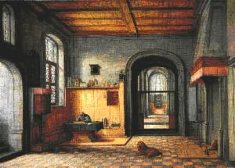
3D modeling from a photograph
St. Jerome in his Study, H. Steenwick

Slide 50
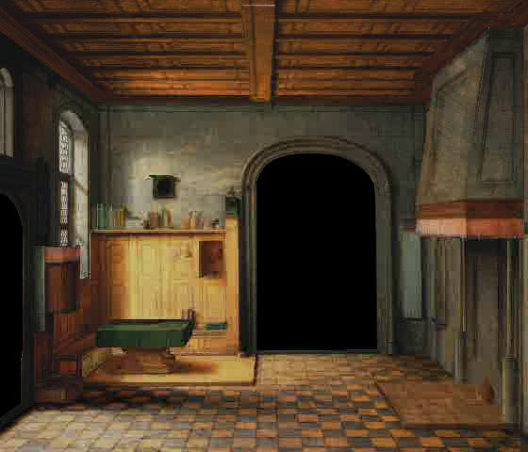
3D modeling from a photograph

Slide 51
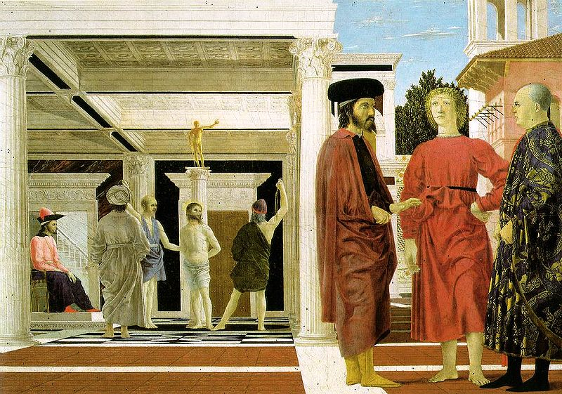
3D modeling from a photograph
Flagellation, Piero della Francesca

Slide 52
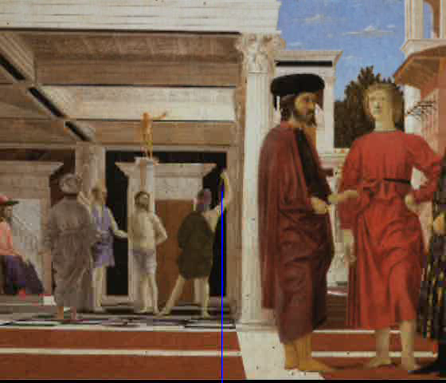
3D modeling from a photograph
video by Antonio Criminisi

Slide 53

3D modeling from a photograph

Slide 54
Related problem: camera calibration
Goal: estimate the camera parameters
  Version 1: solve for 3x4 projection matrix
  Version 2: solve for camera parameters separately
    intrinsics (focal length, principal point, pixel size)
    extrinsics (rotation angles, translation)
    radial distortion

Slide 55
Vanishing points and projection matrix
= v_{x} (X vanishing point)
similarly,
π
=
v
,
π
=
v
2
Y
3
Z
Not So Fast! We only know v’s up to a scale factor
  Can fully specify by providing 3 additional reference points with known coordinates

Slide 56

Calibration using a reference object
Place a known object in the scene
  identify correspondence between image and scene
  compute mapping from scene to image
Issues
  must know geometry very accurately
  must know 3D->2D correspondence

Slide 57
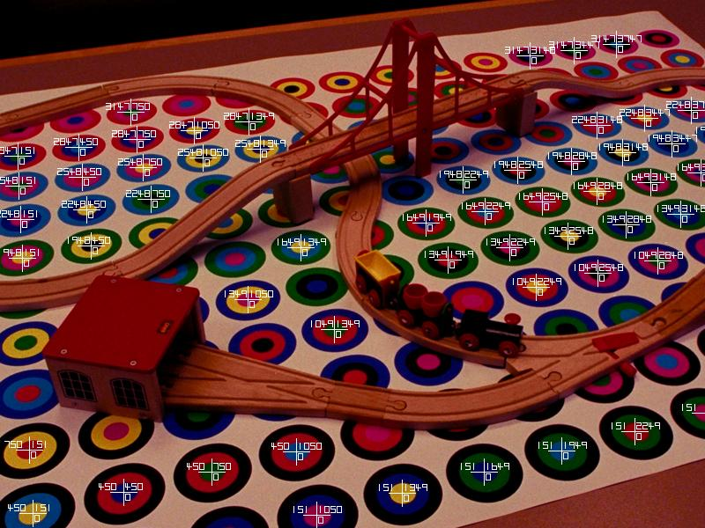
Chromaglyphs
Courtesy of Bruce Culbertson, HP Labs
http://www.hpl.hp.com/personal/Bruce_Culbertson/ibr98/chromagl.htm

Slide 58
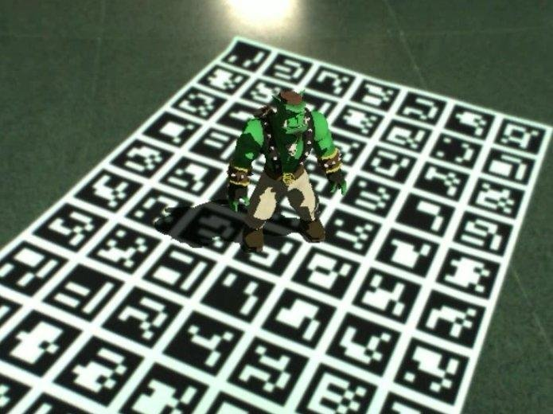
AR codes
ArUco

Slide 59
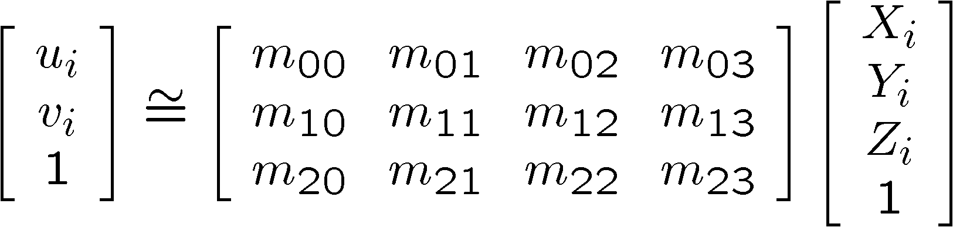
Estimating the projection matrix
Place a known object in the scene
  identify correspondence between image and scene
  compute mapping from scene to image

Slide 60
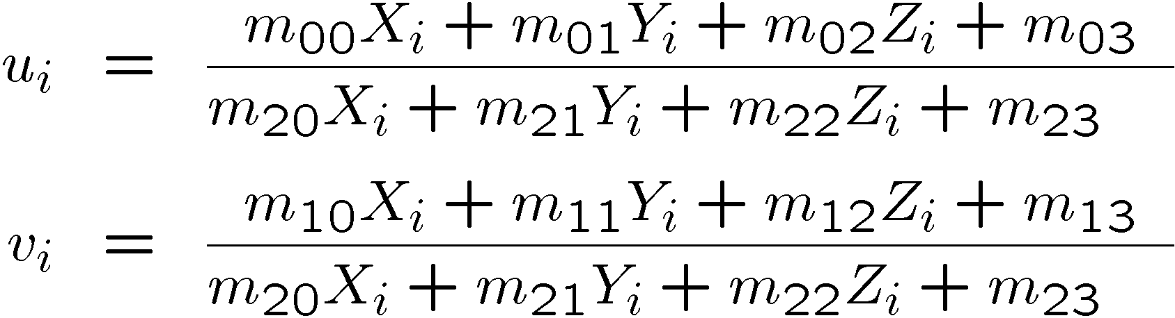
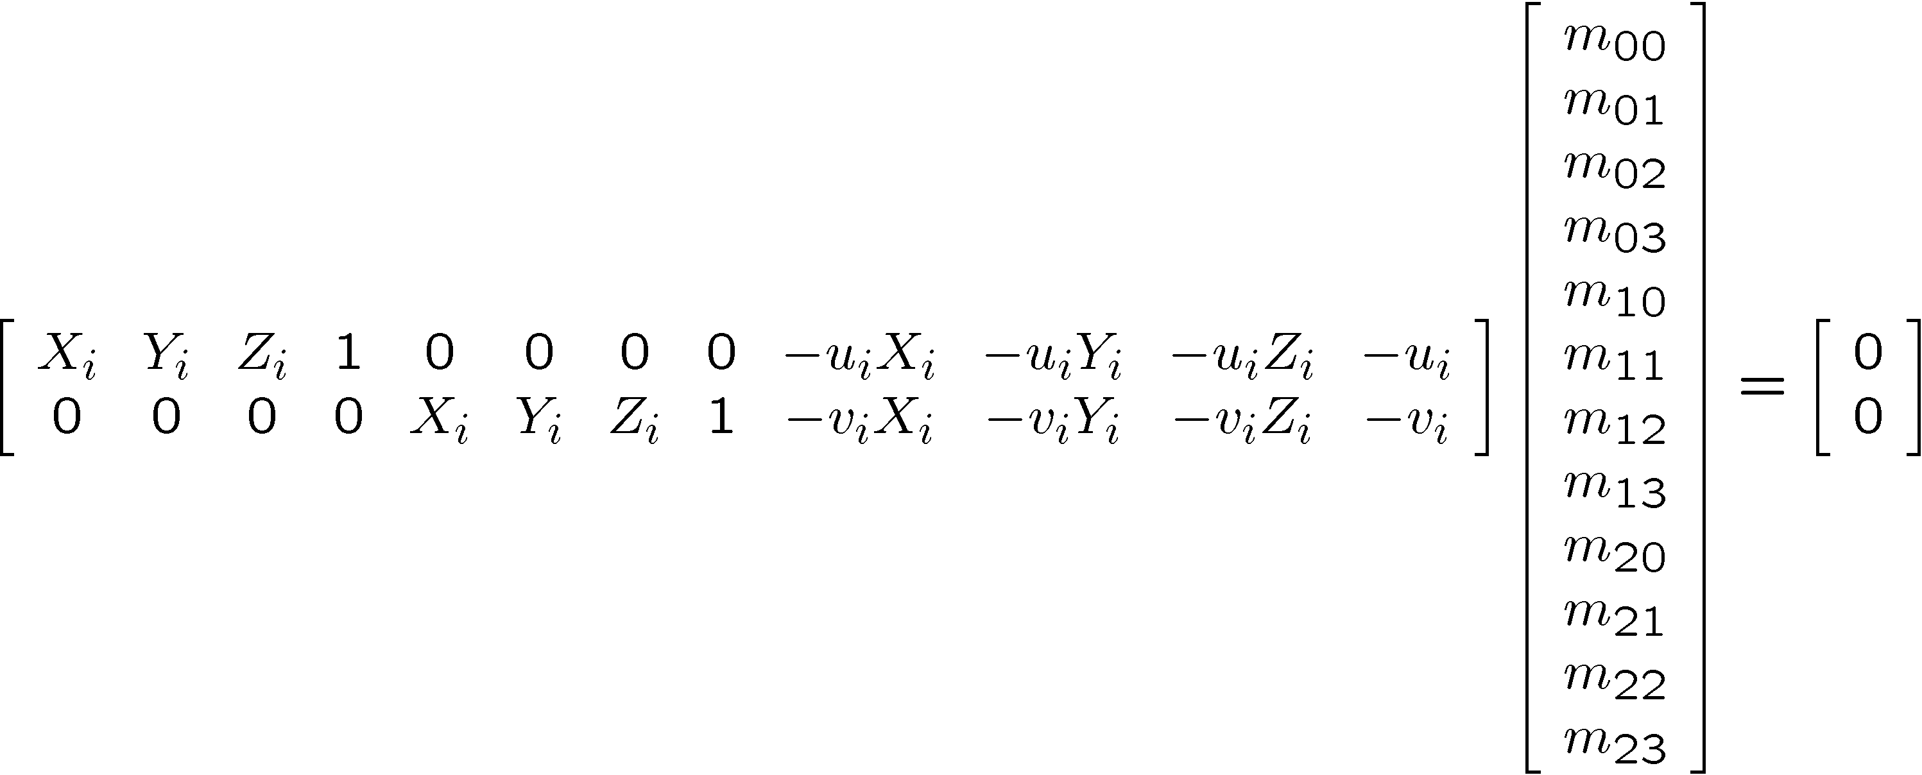
Direct linear calibration

Slide 61
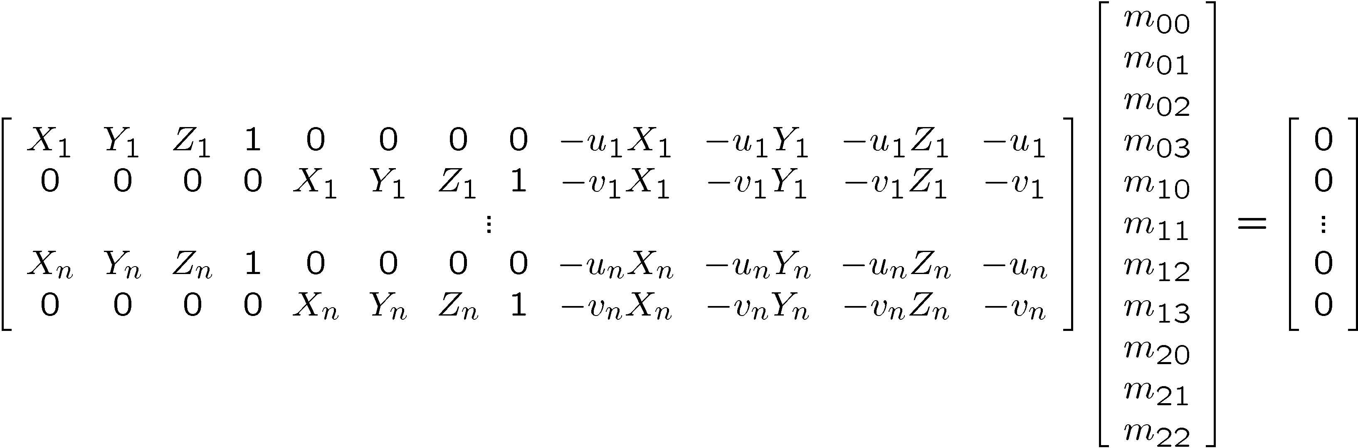
Direct linear calibration
Can solve for m_{ij} by linear least squares
  use eigenvector trick that we used for homographies

Slide 62
Direct linear calibration
Advantage:
  Very simple to formulate and solve
Disadvantages:
  Doesn’t tell you the camera parameters
  Doesn’t model radial distortion
  Hard to impose constraints (e.g., known f)
  Doesn’t minimize the right error function
For these reasons, nonlinear methods are preferred
  Define error function E between projected 3D points and image positions
    E is nonlinear function of intrinsics, extrinsics, radial distortion
  Minimize E using nonlinear optimization techniques

Slide 63
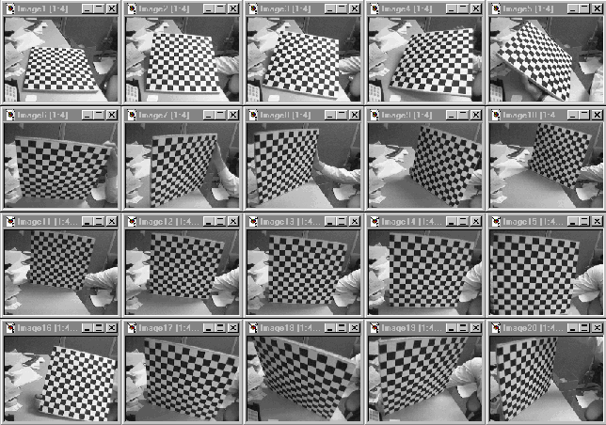
Alternative: multi-plane calibration
Images courtesy Jean-Yves Bouguet
Advantage
  Only requires a plane
  Don’t have to know positions/orientations
  Good code available online! (including in OpenCV)
    Matlab version by Jean-Yves Bouget: http://www.vision.caltech.edu/bouguetj/calib_doc/index.html
    Zhengyou Zhang’s web site: http://research.microsoft.com/~zhang/Calib/

Slide 64
Some Related Techniques
Image-Based Modeling and Photo Editing
  Mok et al., SIGGRAPH 2001
  http://graphics.csail.mit.edu/graphics/ibedit/
Single View Modeling of Free-Form Scenes
  Zhang et al., CVPR 2001
  http://grail.cs.washington.edu/projects/svm/index.htm
Tour Into The Picture
  Anjyo et al., SIGGRAPH 1997
  http://www.mizuno.org/gl/tip/

Slide 65
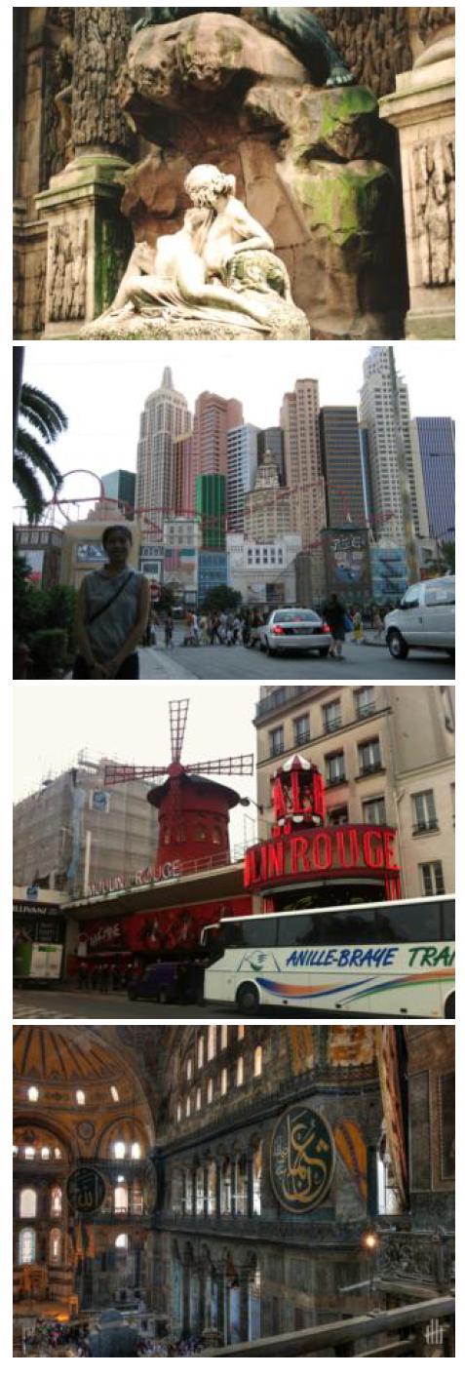
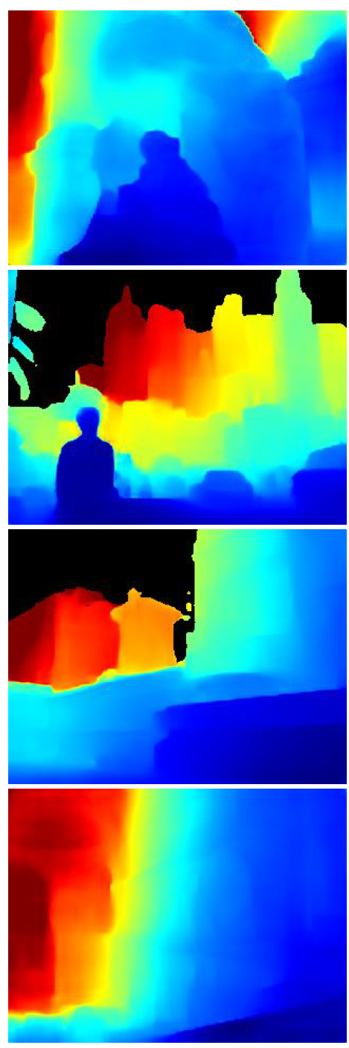
Single-image depth prediction
Deep learning
Image
Depth map

Slide 66
Using Classic Vision to Understand Modern Learning
Vision is under-constrained
  Many explanations for the same image
  Some prior assumptions always necessary
Deep learning is a tool for developing data-driven priors
Understanding the geometry of image formation guides this process
  Designing learnable representations
  Designing deep architectures
  Curating data

Slide 67
Questions?

