Slide 1

Lecture 2: Edge detection
CS5670: Computer Vision
From Sandlot Science

Slide 2

Announcements
Office hours available on course webpage

Slide 3
Announcements
Project 1 (Hybrid Images) is now on the course webpage (see Projects link)
  Due Monday, Feb 10, by 11:59pm on CMS
  Artifact due Wednesday, Feb 12, by 11:59pm
  Project to be done individually
  Voting system for favorite artifacts (with small amount of extra credit)
  We provide a Python environment (or course VM) for you to develop & run the assignments

Slide 4
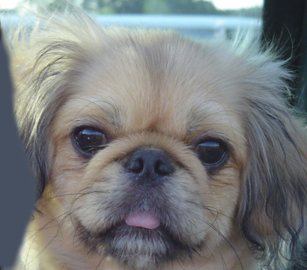
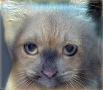
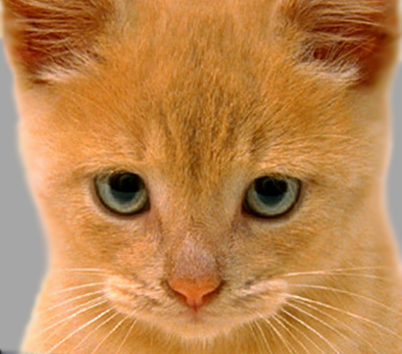
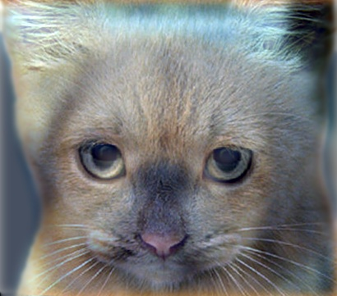

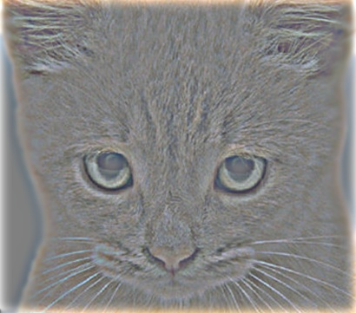
Project 1: Hybrid Images

Slide 5
Project 1 Demo

Slide 6
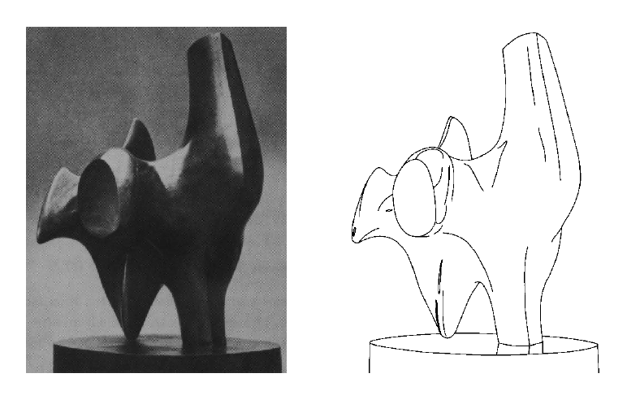
Edge detection
Convert a 2D image into a set of curves
  Extracts salient features of the scene
  More compact than pixels
TexPoint fonts used in EMF.
Read the TexPoint manual before you delete this box.: AAA

Slide 7
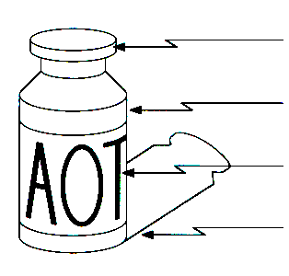
Origin of Edges
surface normal discontinuity
depth discontinuity
surface color discontinuity
illumination discontinuity
Edges are caused by a variety of factors

Slide 8
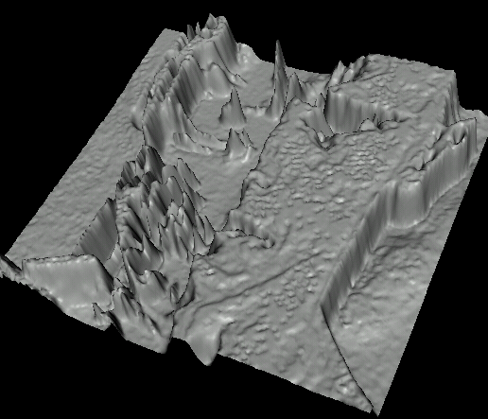

Images as functions…
Edges look like steep cliffs

Slide 9

Characterizing edges
An edge is a place of rapid change in the image intensity function
intensity function
(along horizontal scanline)
image
first derivative
edges correspond to
extrema of derivative
Source: L. Lazebnik

Slide 10
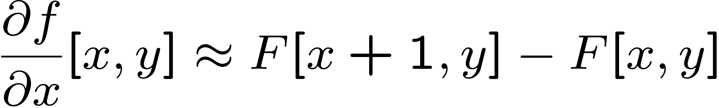




Image derivatives
How can we differentiate a digital image F[x,y]?
  Option 1: reconstruct a continuous image, f, then compute the derivative
  Option 2: take discrete derivative (finite difference)
How would you implement this as a linear filter?
1 | -1
 | -1
 | 1
:
:
Source: S. Seitz

Slide 11
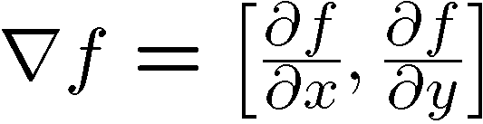
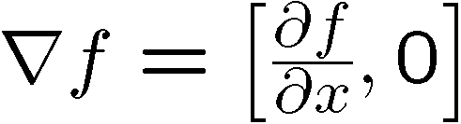
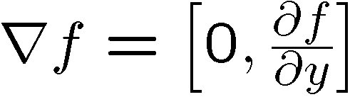
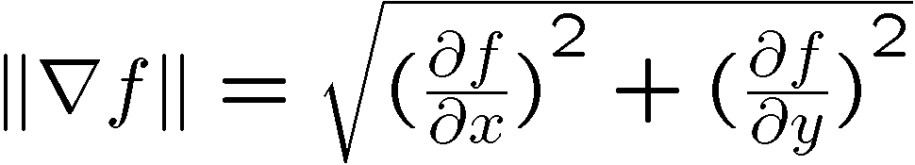
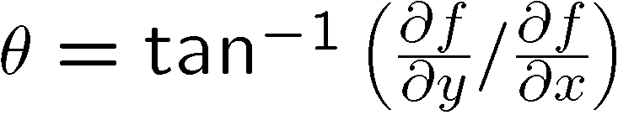
Image gradient
The gradient of an image:
The gradient points in the direction of most rapid increase in intensity
The edge strength is given by the gradient magnitude:
The gradient direction is given by:
  how does this relate to the direction of the edge?
Source: Steve Seitz
Notes:
give definition of partial derivative: lim h->0 [f(x+h,y) – f(x,y)]/h

Slide 12
Image gradient
Source: L. Lazebnik

Slide 13


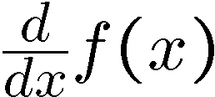
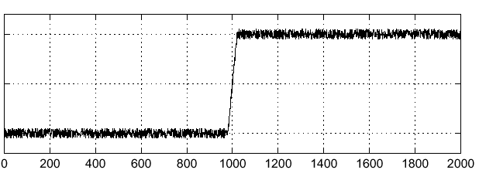
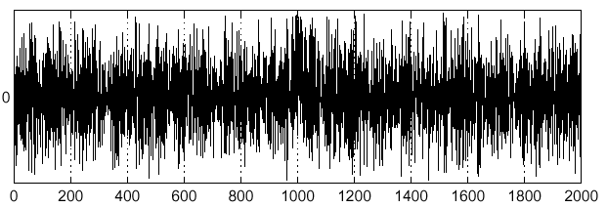
Effects of noise
Noisy input image
Where is the edge?
Source: S. Seitz
Notes:
How to fix?

Slide 14
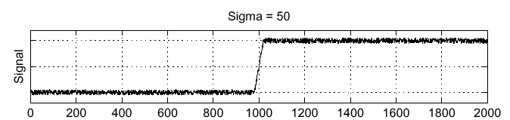
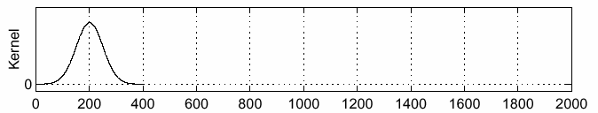
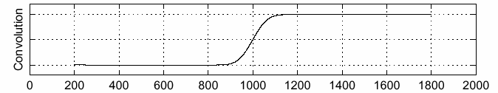
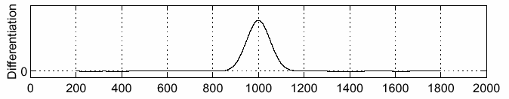
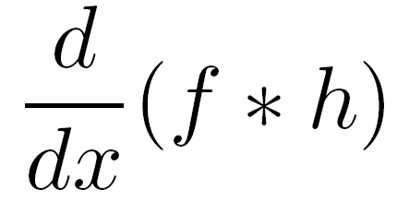
Solution: smooth first
f
h
f * h
To find edges, look for peaks in
Source: S. Seitz

Slide 15
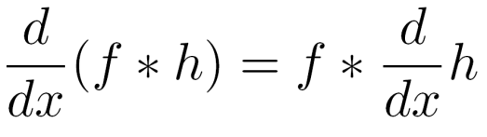
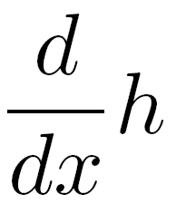
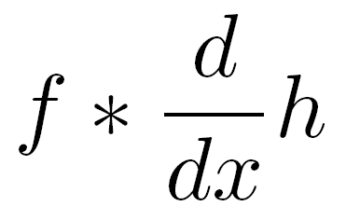
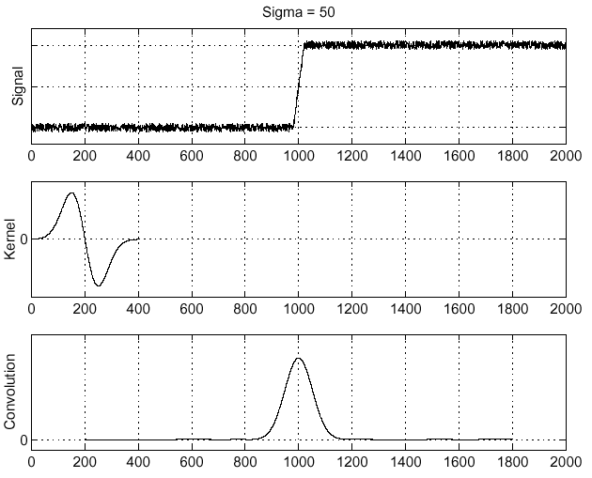
Associative property of convolution
Differentiation is convolution, and convolution is associative:
This saves us one operation:
f
Source: S. Seitz

Slide 16
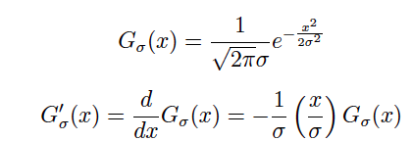
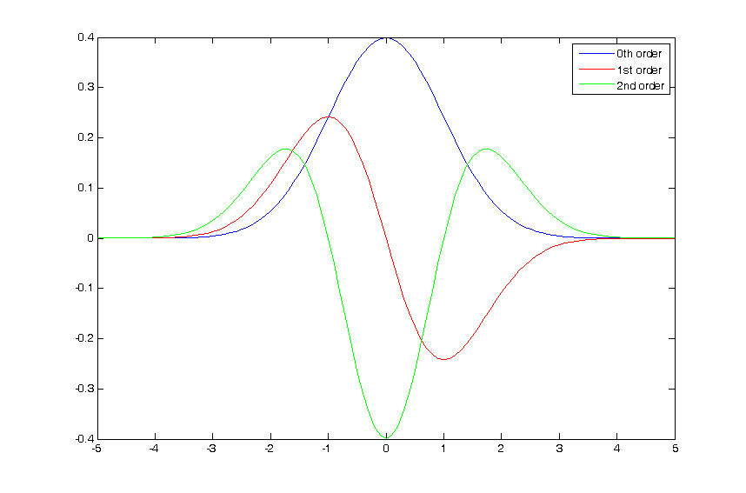
The 1D Gaussian and its derivatives

Slide 17
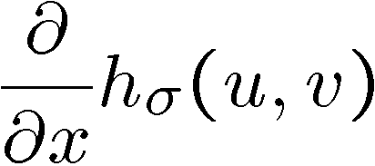
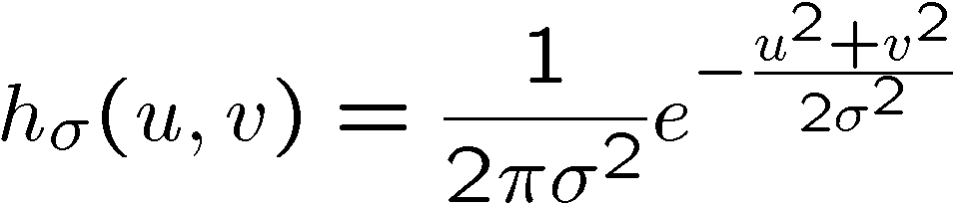
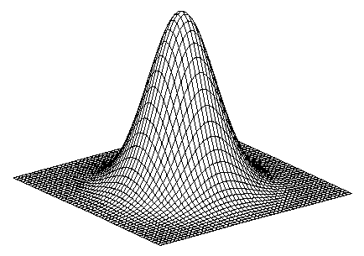
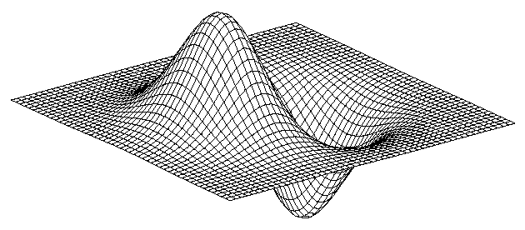
2D edge detection filters
derivative of Gaussian (x)
Gaussian
Notes:
How many 2nd derivative filters are there? There are four 2nd partial derivative filters.
In practice, it’s handy to define a single 2nd derivative filter—the Laplacian

Slide 18
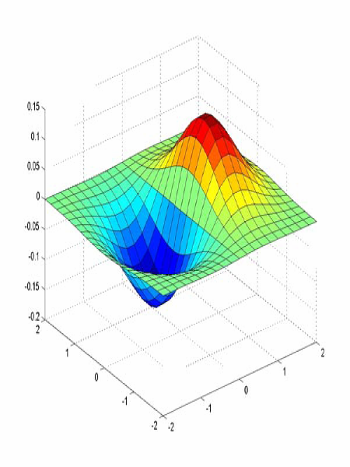
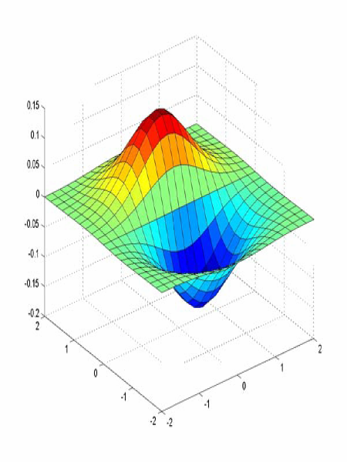
Derivative of Gaussian filter
x-direction
y-direction

Slide 19



The Sobel operator
Common approximation of derivative of Gaussian
-1 | 0 | 1
-2 | 0 | 2
-1 | 0 | 1
1 | 2 | 1
0 | 0 | 0
-1 | -2 | -1
The standard defn. of the Sobel operator omits the 1/8 term
    doesn’t make a difference for edge detection
    the 1/8 term is needed to get the right gradient magnitude
Notes:
19
Q: Why might these work better?
A: more stable when there is noise

Slide 20
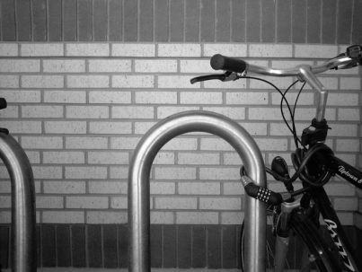
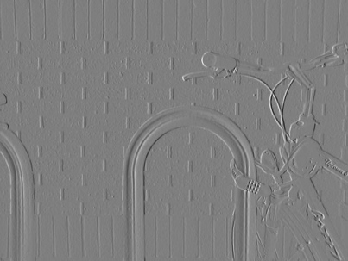
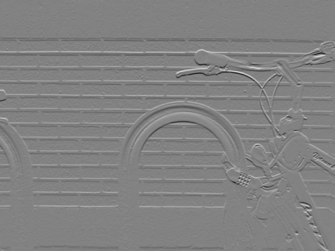
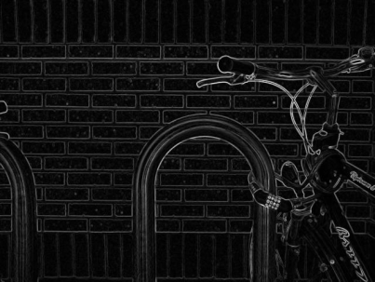

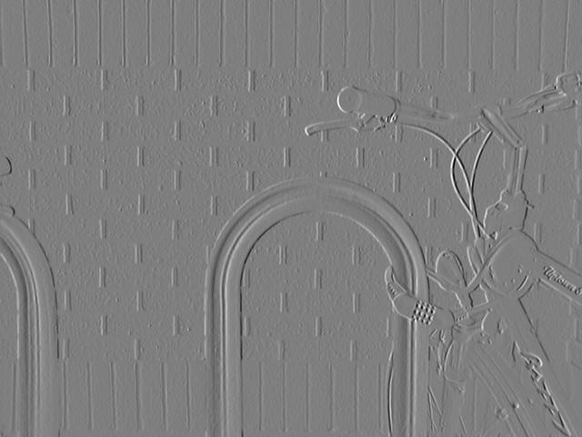
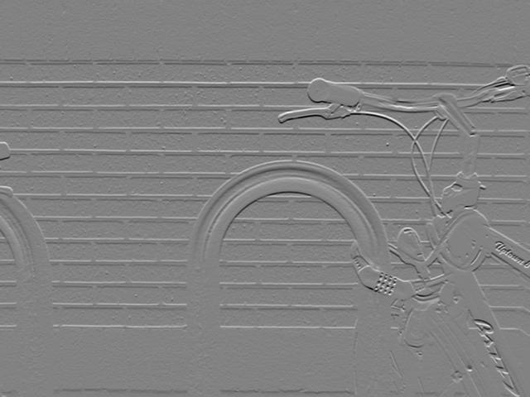
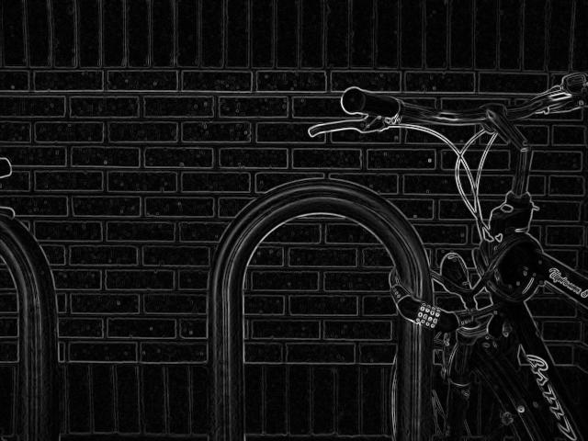
Sobel operator: example
Source: Wikipedia

Slide 21
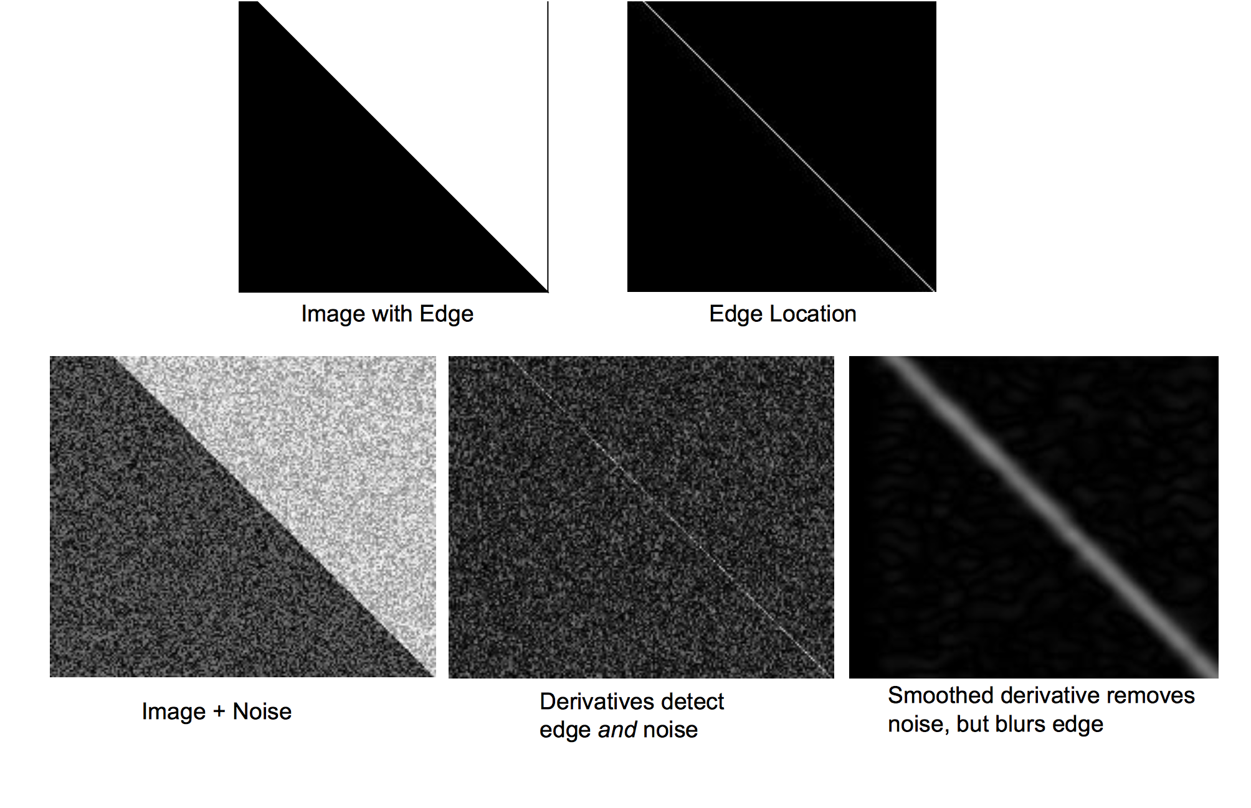

Slide 22
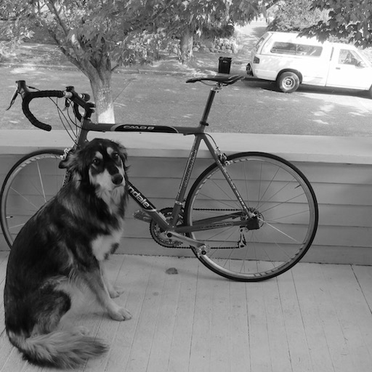
Example
original image
Demo: http://bigwww.epfl.ch/demo/ip/demos/edgeDetector/
Image credit: Joseph Redmon

Slide 23
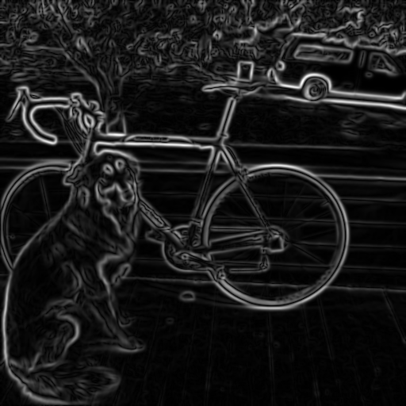
Finding edges
smoothed gradient magnitude

Slide 24

Finding edges
where is the edge?
thresholding

Slide 25
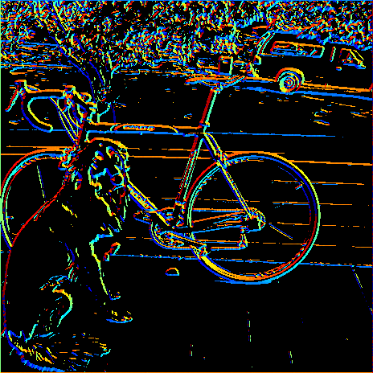
Get Orientation at Each Pixel
Get orientation (below, threshold at minimum gradient magnitude)
theta = atan2(gy, gx)
360
Gradient orientation angle
0

Slide 26

Non-maximum supression
Check if pixel is local maximum along gradient direction
  requires interpolating pixels p and r

Slide 27
Before Non-max Suppression

Slide 28
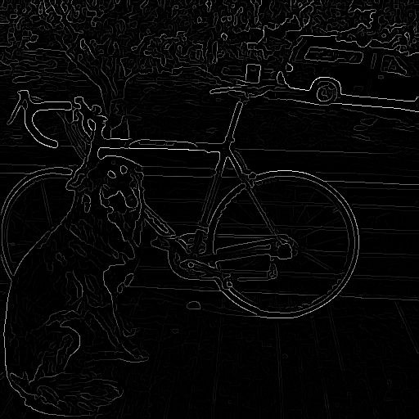
After Non-max Suppression

Slide 29
Thresholding edges
Still some noise
Only want strong edges
2 thresholds, 3 cases
  R > T: strong edge
  R < T but R > t: weak edge
  R < t: no edge
Why two thresholds?

Slide 30
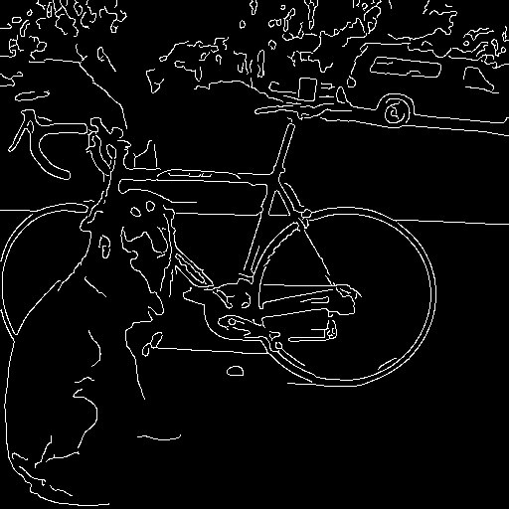
Connecting edges
Strong edges are edges!
Weak edges are edges
iff they connect to strong
Look in some neighborhood
(usually 8 closest)

Slide 31

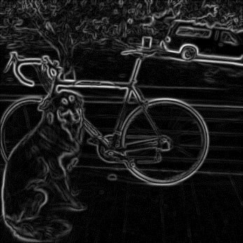


Canny edge detector
MATLAB: edge(image,‘canny’)
Filter image with derivative of Gaussian
Find magnitude and orientation of gradient
Non-maximum suppression
Linking and thresholding (hysteresis):
  Define two thresholds: low and high
  Use the high threshold to start edge curves and the low threshold to continue them
Source: D. Lowe, L. Fei-Fei, J. Redmon

Slide 32

Canny edge detector
Our first computer vision pipeline!
Still a widely used edge detector in computer vision
Depends on several parameters:
J. Canny, A Computational Approach To Edge Detection, IEEE Trans. Pattern Analysis and Machine Intelligence, 8:679-714, 1986.
high threshold
low threshold
: width of the Gaussian blur

Slide 33
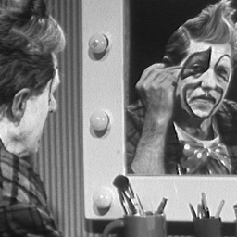
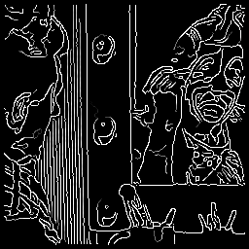




Canny edge detector
original
Canny with
Canny with
The choice of depends on desired behavior
  large detects “large-scale” edges
  small detects fine edges
Source: S. Seitz

Slide 34



Scale space [Witkin 83]
first derivative peaks
larger
Gaussian filtered signal
Properties of scale space (w/ Gaussian smoothing)
  edge position may shift with increasing scale (σ)
  two edges may merge with increasing scale
  an edge may not split into two with increasing scale

Slide 35
Questions?

