Slide 1
Training, Transfer Learning, & Generative Models
By Abe Davis
With some slides from
Jin Sun, Noah Snavely, Philipp Isola

Slide 2
Announcements
Project 5 (Convolutional Neural Networks) released today
  Due Wednesday, April 29
Take-home final exam planned May 11-14

Slide 3
This Lecture (and maybe part of the next one)
Visualizing Deep Classification
A Review of Overfitting
Regularization in Deep Learning
How to Train Deep Nets
Transfer Learning
Generative Models
Transpose Convolution

Slide 4
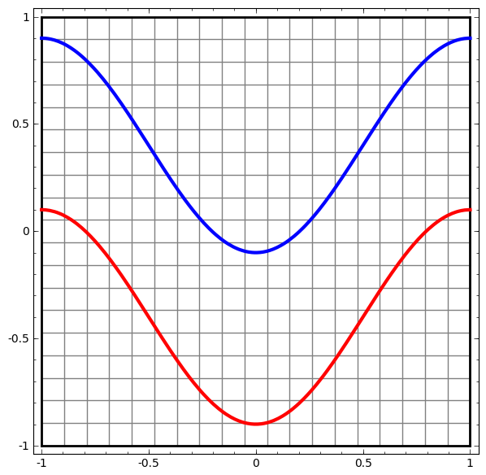
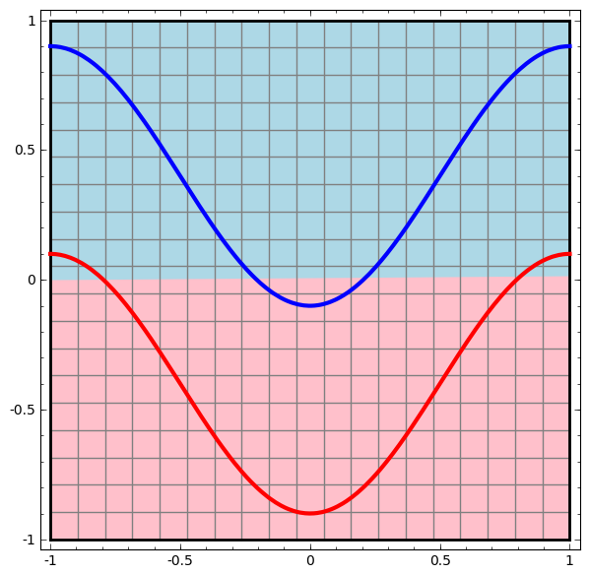
Visualizing Linear Classification
Classification Problem:
Separate Red & Blue
Linear Solution
Based on http://colah.github.io/posts/2014-03-NN-Manifolds-Topology/
Notes:
http://colah.github.io/posts/2014-03-NN-Manifolds-Topology/
layer_defs = [];
layer_defs.push({type:'input', out_sx:1, out_sy:1, out_depth:2});
layer_defs.push({type:'fc', num_neurons:3, activation: 'tanh'});
layer_defs.push({type:'softmax', num_classes:2});
net = new convnetjs.Net();
net.makeLayers(layer_defs);
trainer = new convnetjs.SGDTrainer(net, {learning_rate:0.01, momentum:0.1, batch_size:10, l2_decay:0.001});

Slide 5
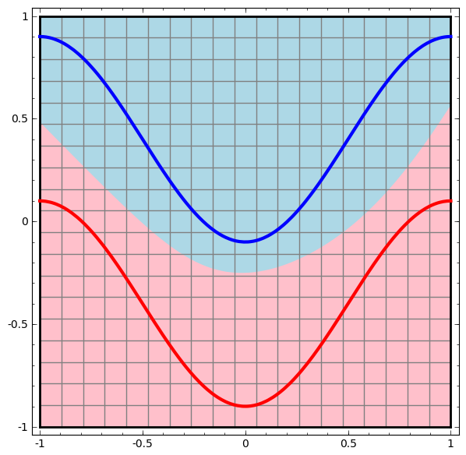
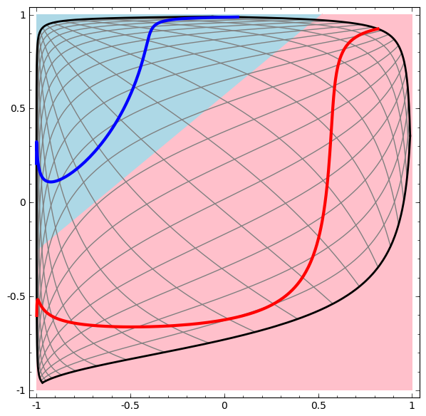
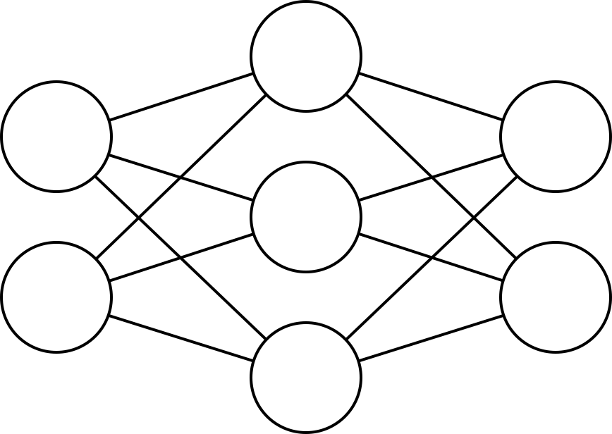
Visualizing Classification With a Neural Network
Hidden Layer
input
Output
Output y of Neuron from Hidden Layer
Example Network
Output x of Neuron from Hidden Layer
Classification Results for Every Point in Original Space
Classification Results for Every Point in Transformed Feature Space
Based on http://colah.github.io/posts/2014-03-NN-Manifolds-Topology/
Notes:
http://colah.github.io/posts/2014-03-NN-Manifolds-Topology/
Based on http://colah.github.io/posts/2014-03-NN-Manifolds-Topology/
layer_defs = [];
layer_defs.push({type:'input', out_sx:1, out_sy:1, out_depth:2});
layer_defs.push({type:'fc', num_neurons:3, activation: 'tanh'});
layer_defs.push({type:'softmax', num_classes:2});
net = new convnetjs.Net();
net.makeLayers(layer_defs);
trainer = new convnetjs.SGDTrainer(net, {learning_rate:0.01, momentum:0.1, batch_size:10, l2_decay:0.001});

Slide 6
Demo
https://cs.stanford.edu/people/karpathy/convnetjs/demo/classify2d.html

Slide 7
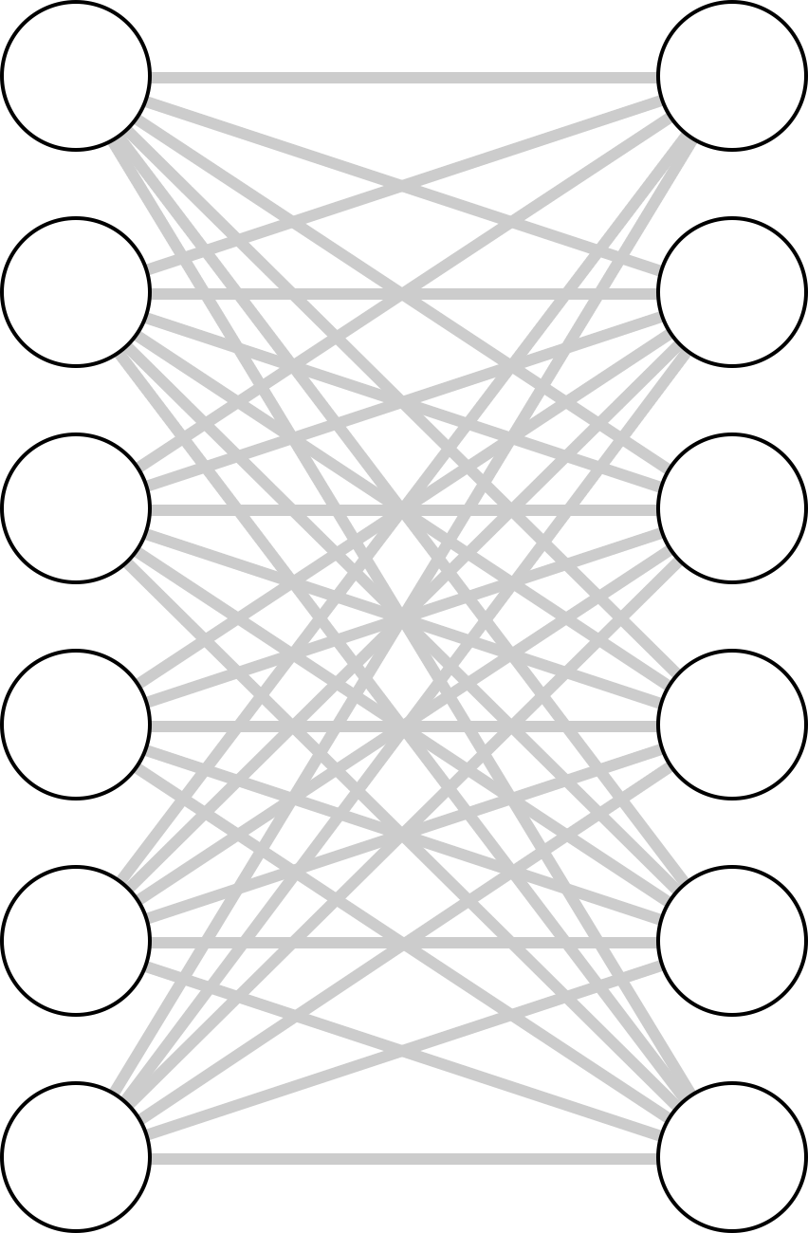
What Makes Training Deep Nets Hard?
It’s easy to get high training accuracy:
  Use a huge, fully connected network with tons of layers
  Let it memorize your training data
Its hard to get high test accuracy
…
…
This would be an example of overfitting

Slide 8
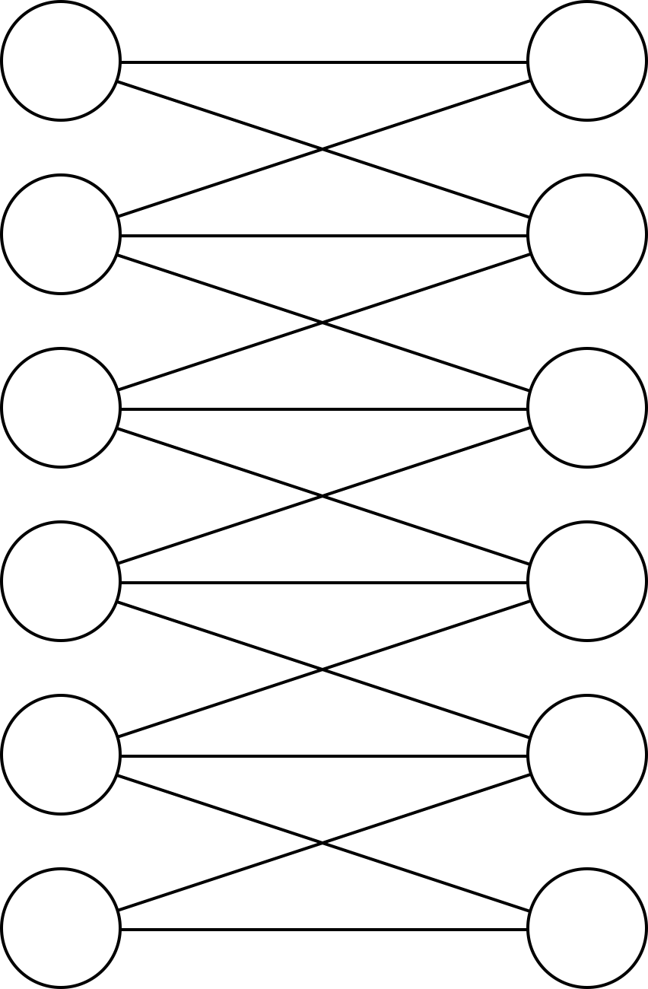
Related Question: Why Convolutional Layers?
A fully connected layer can generally represent the same functions as a convolutional one
  Think of the convolutional layer as a version of the FC layer with constraints on parameters
What is the advantage of CNNs?
Convolutional Layer
Fully Connected Layer

Slide 9
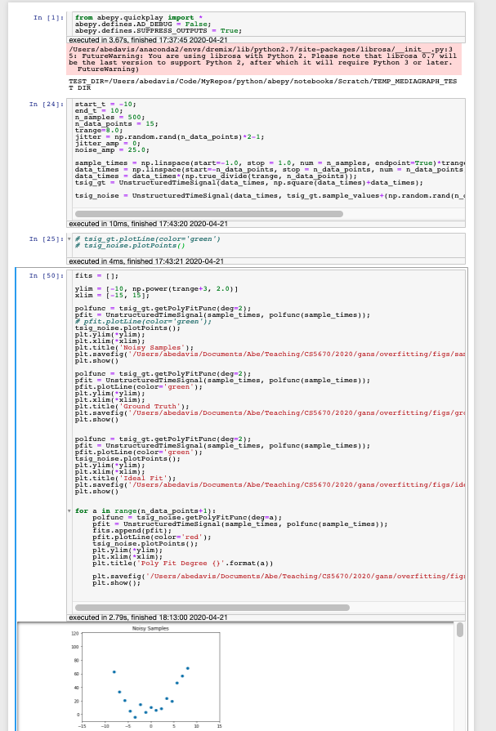
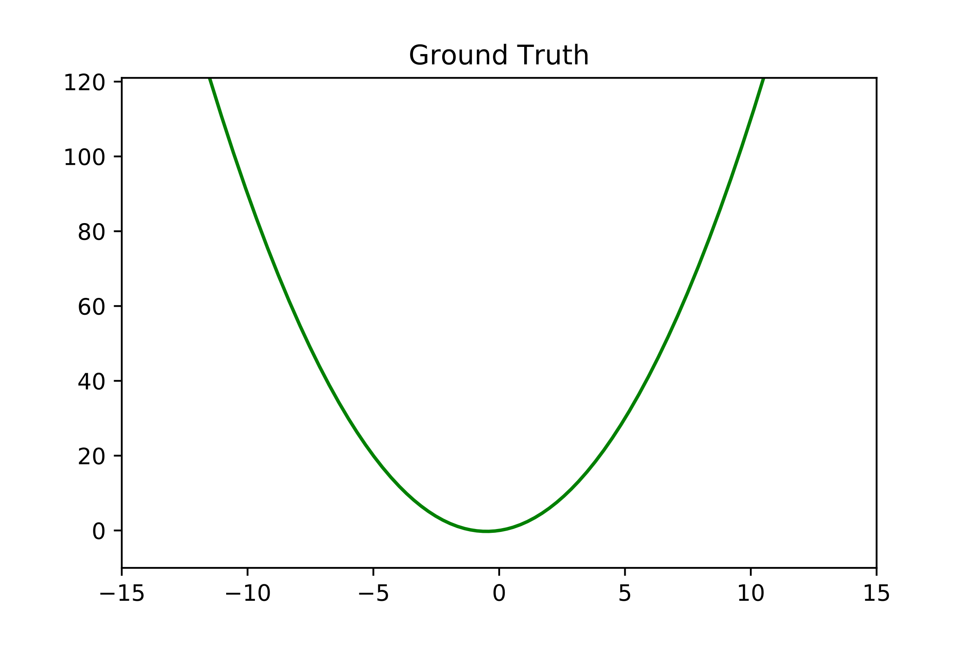
A Review of Overfitting

Slide 10
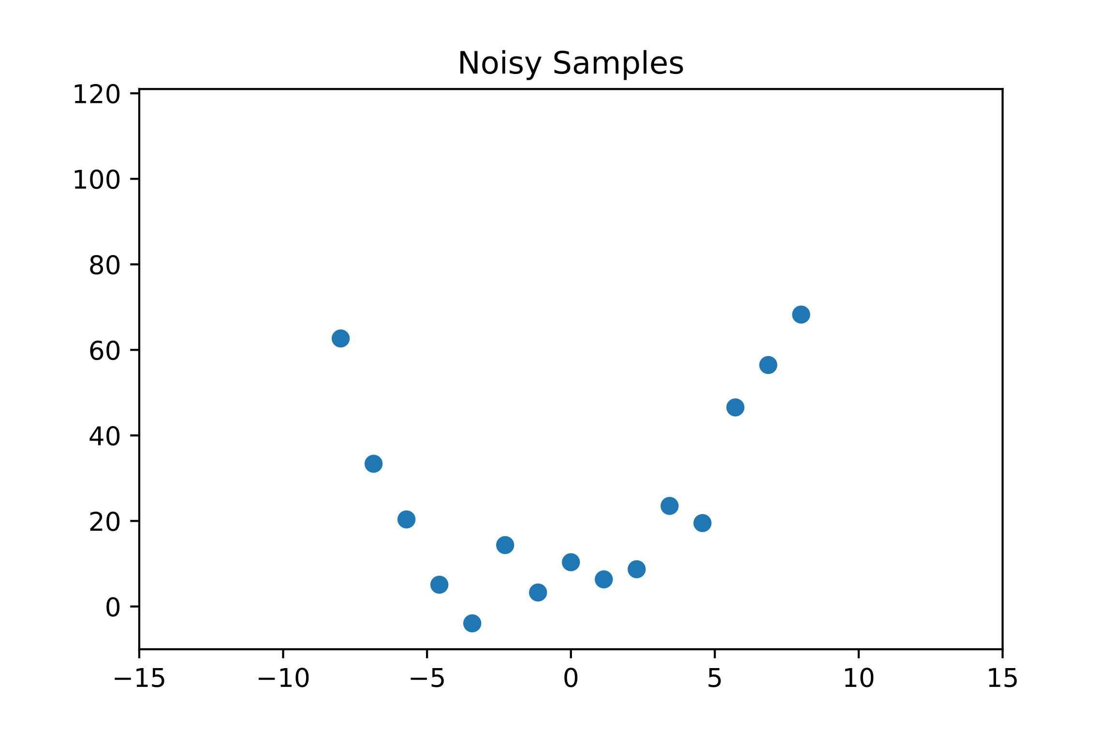
Overfitting: More Parameters, More Problems
Non-Deep Example: consider the function
Let’s take some noisy samples of the function…
Notes:
P_N(x) = \sum_{k=0}^N x^kp_k

Slide 11
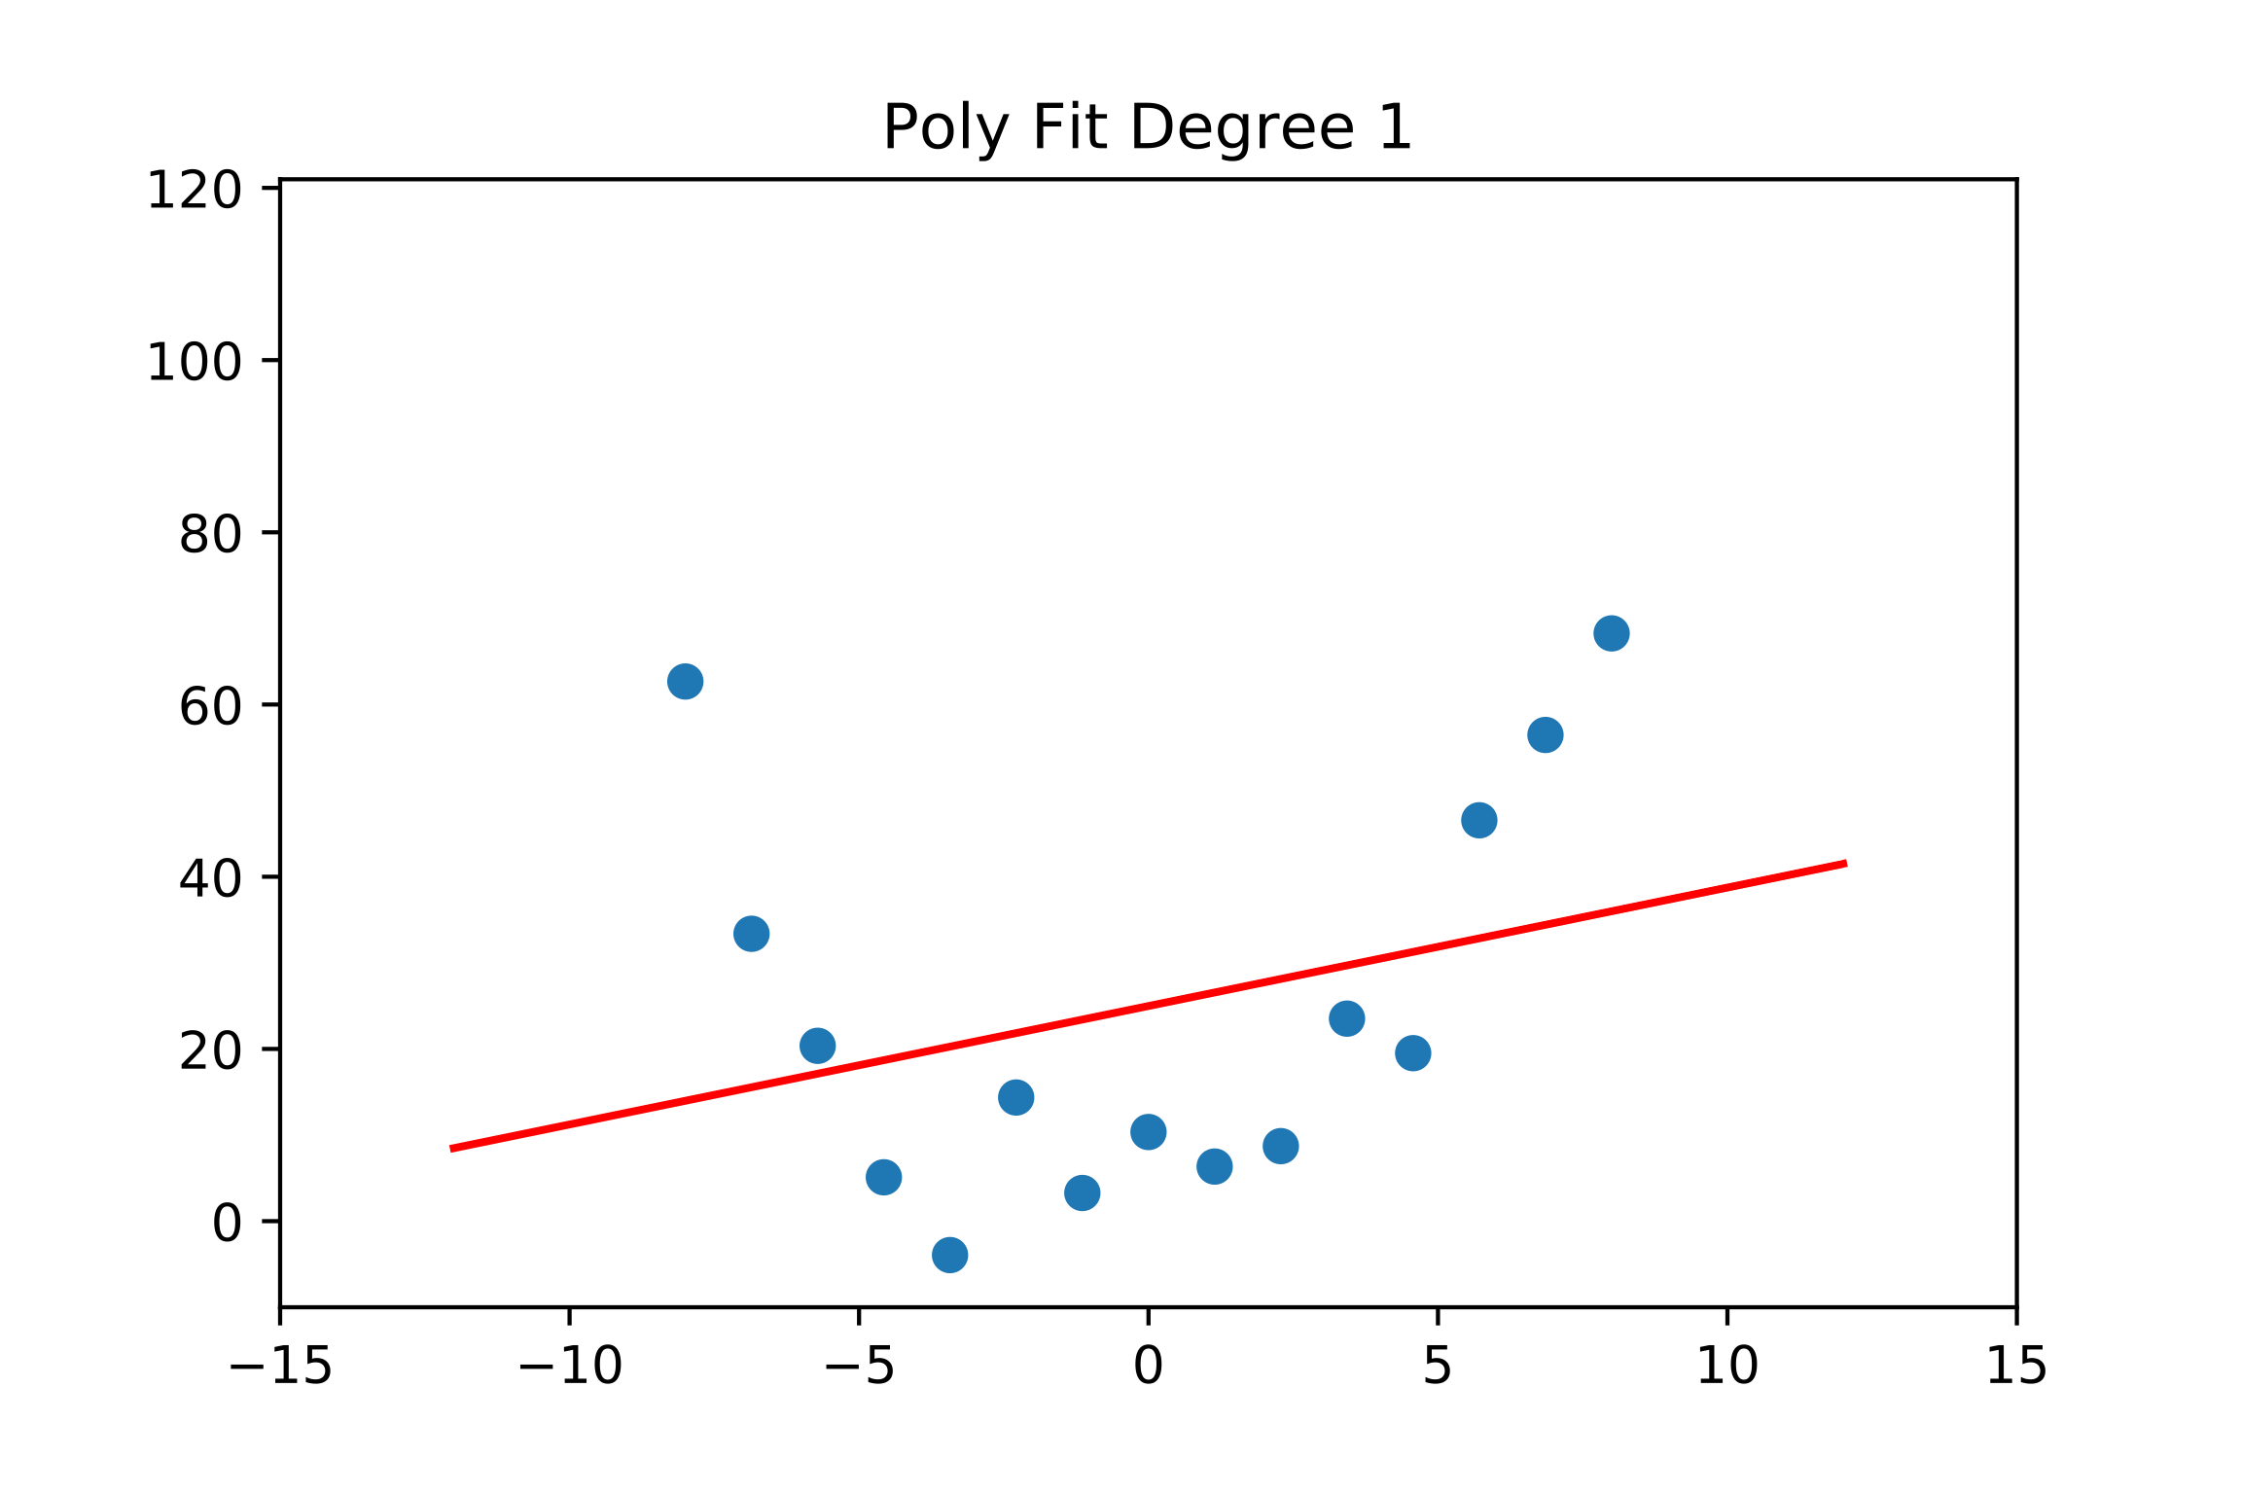
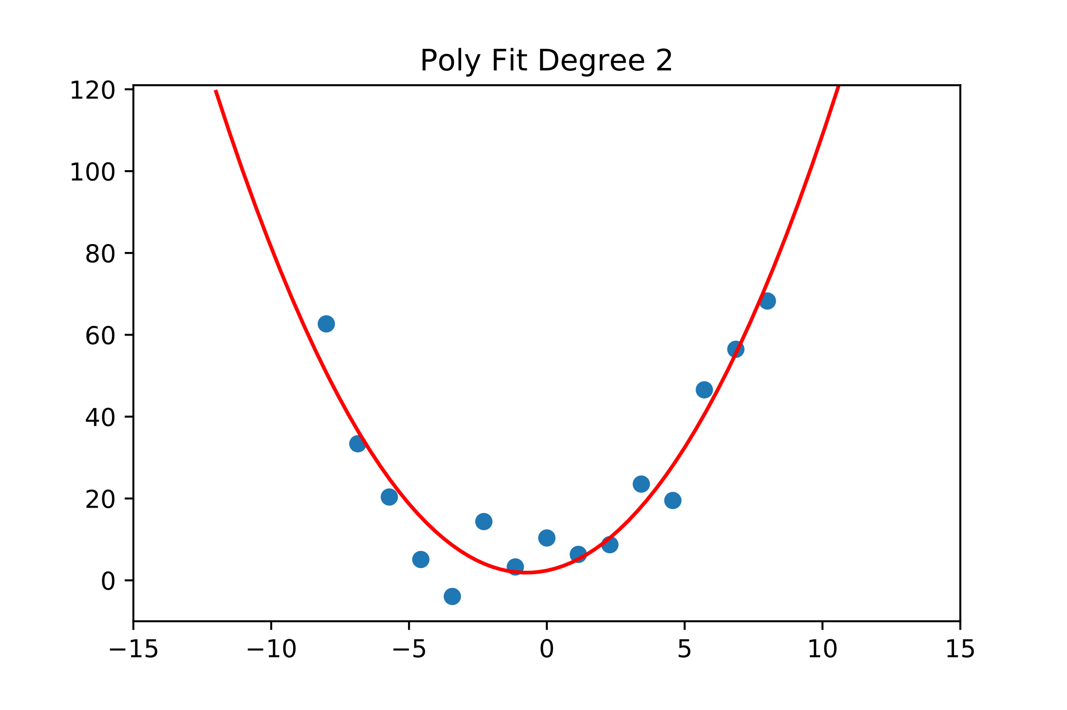
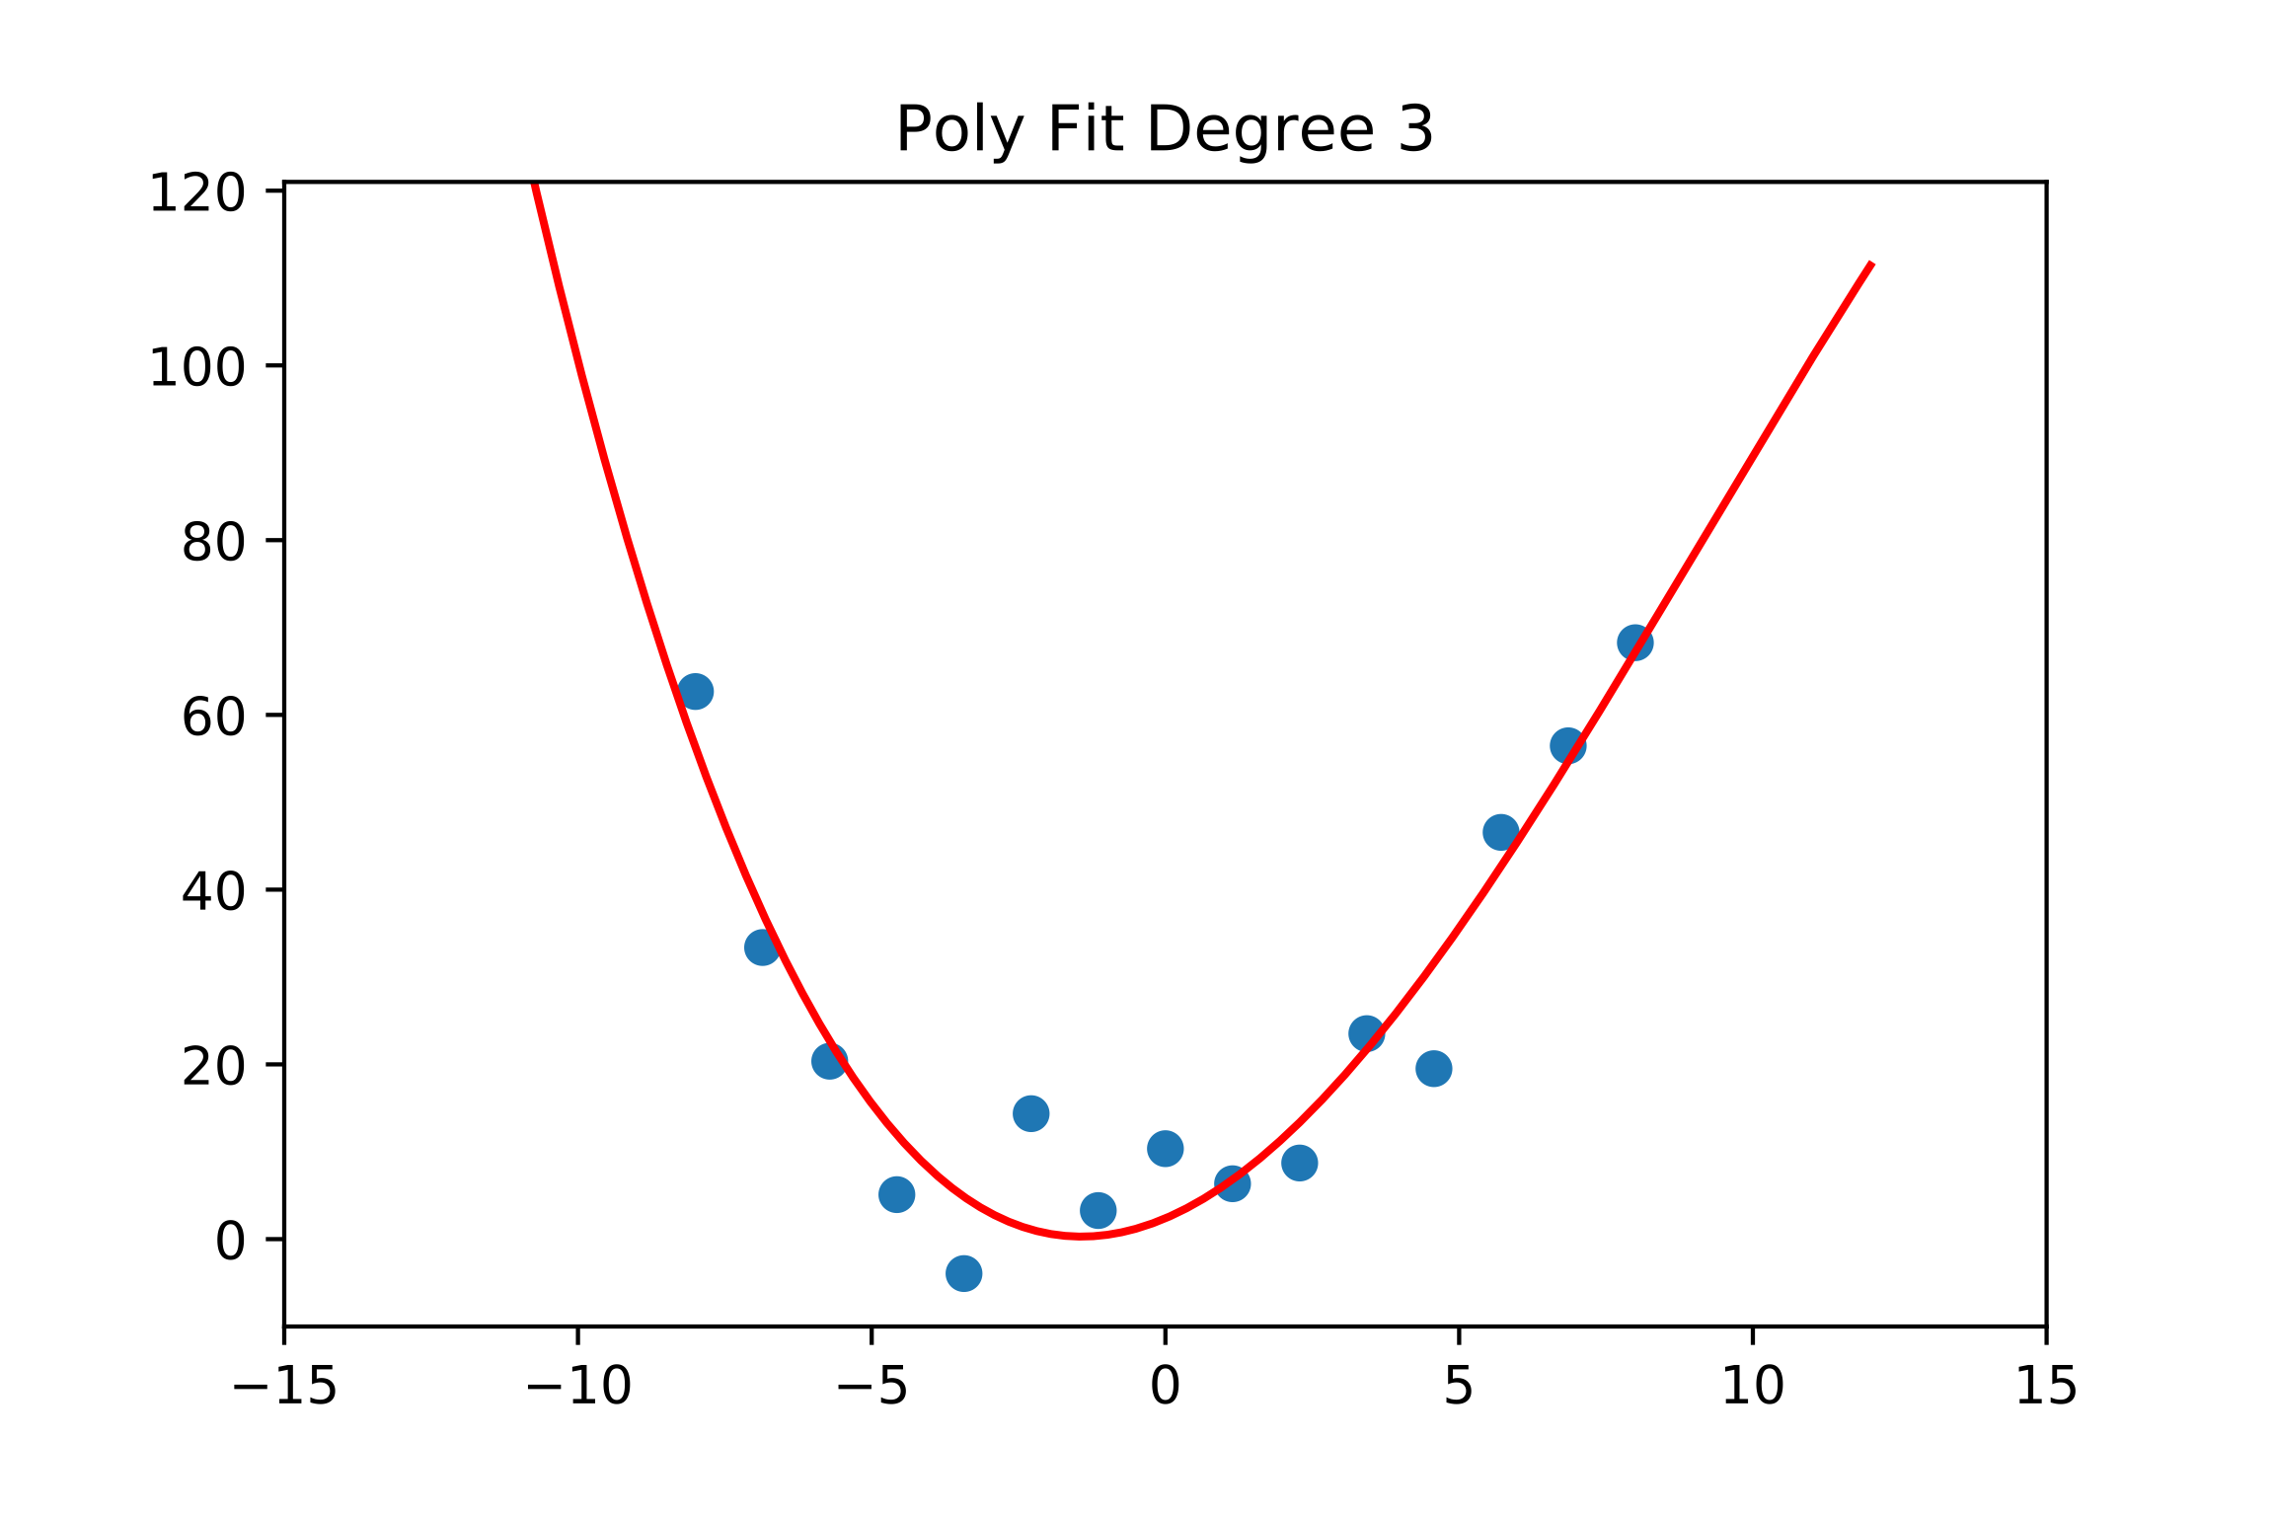
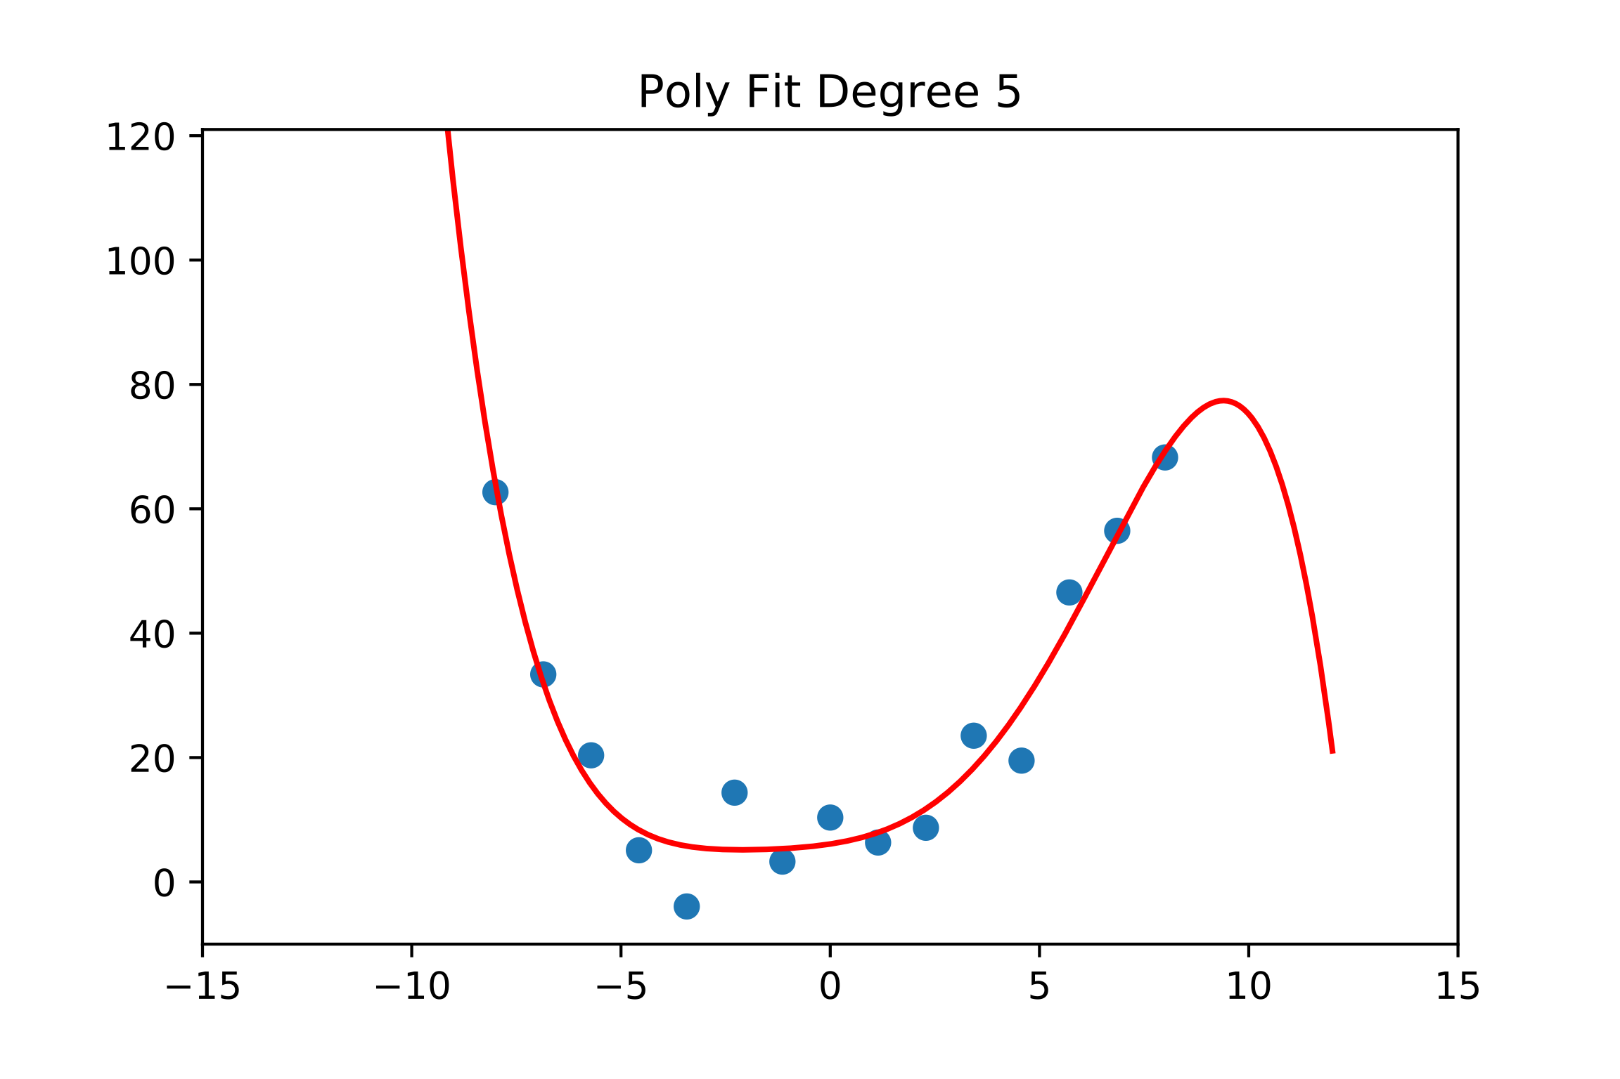
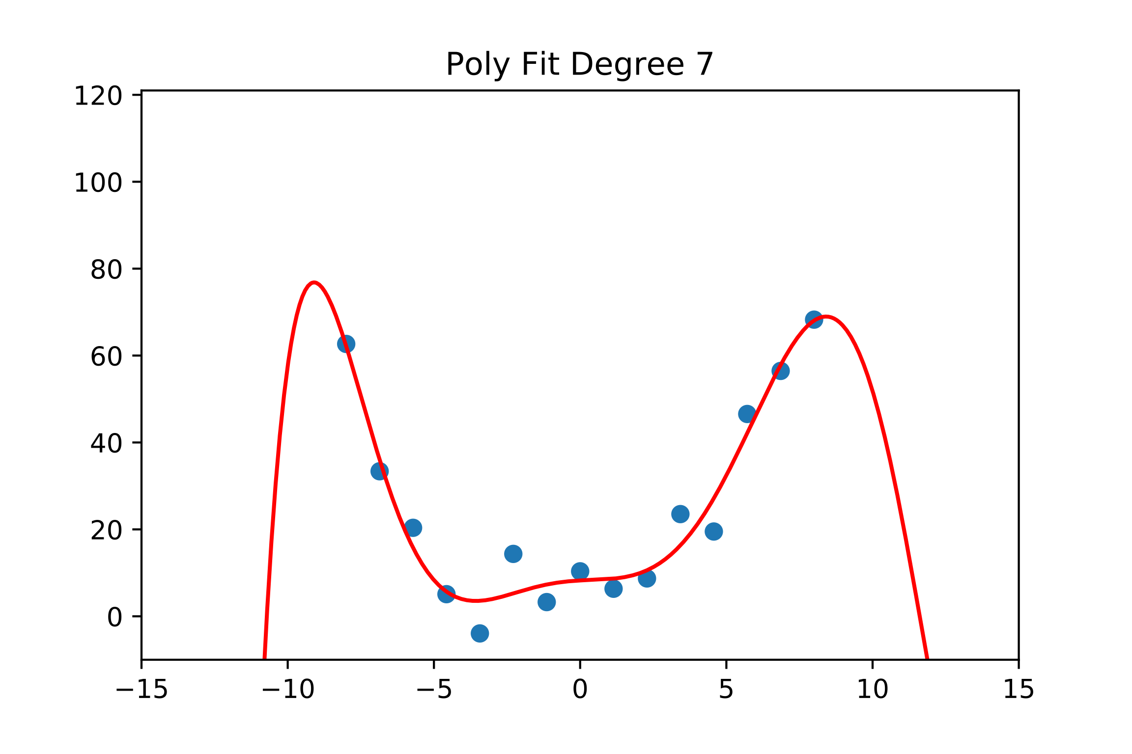
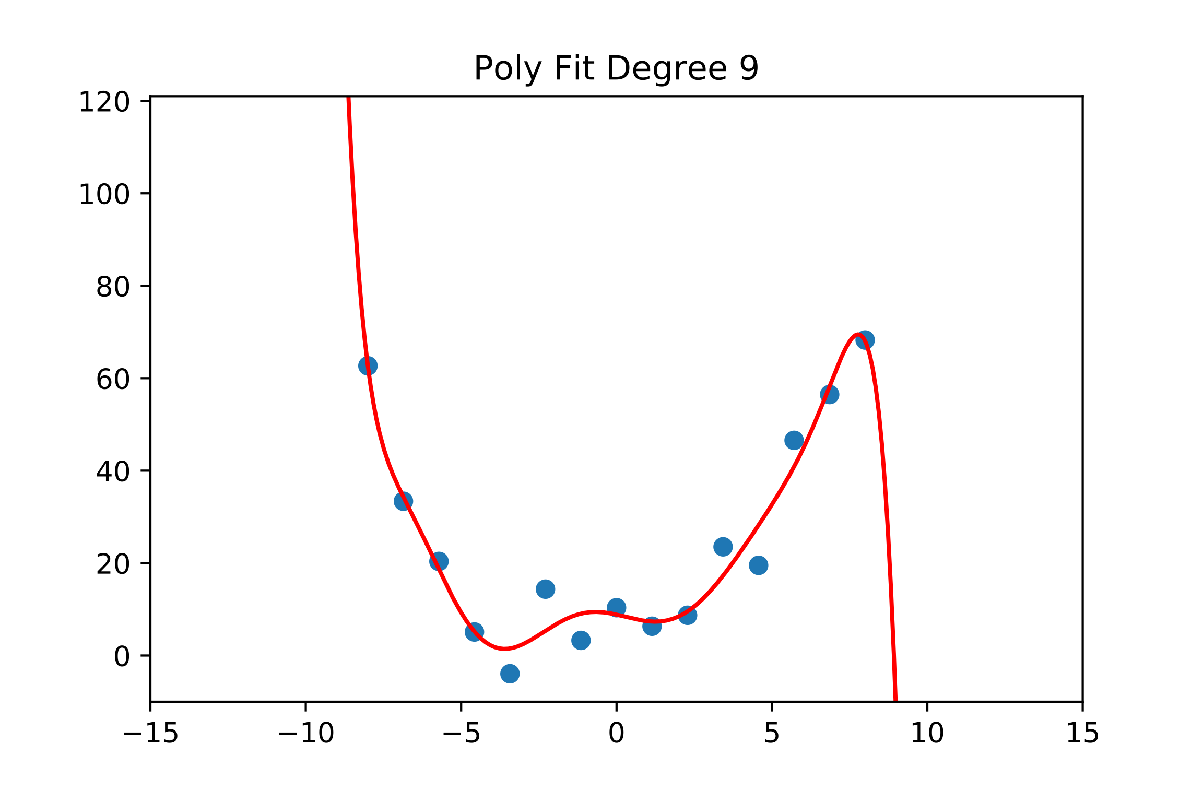
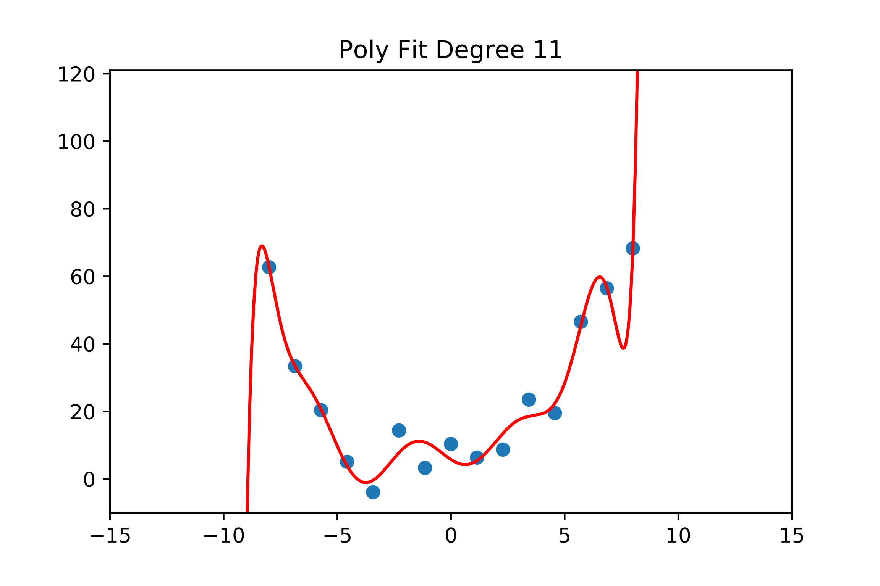
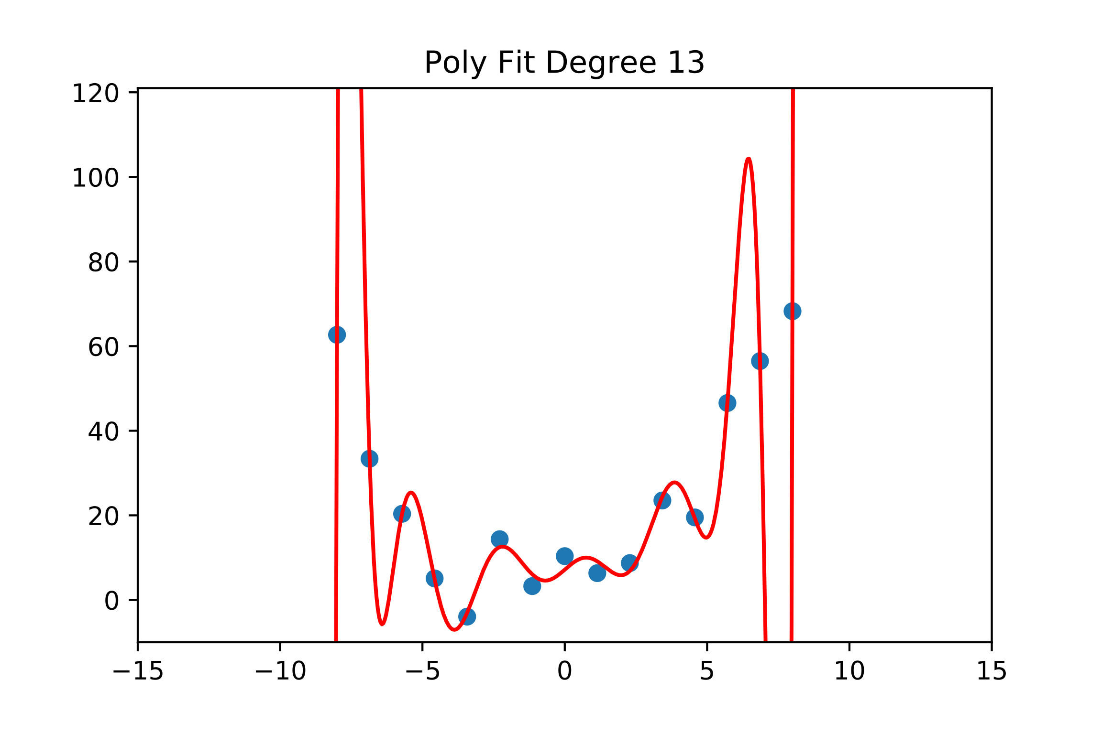
Overfitting: More Parameters, More Problems
Now lets fit a polynomial to our samples of the form
Notes:
P_N(x) = \sum_{k=0}^N x^kp_k

Slide 12
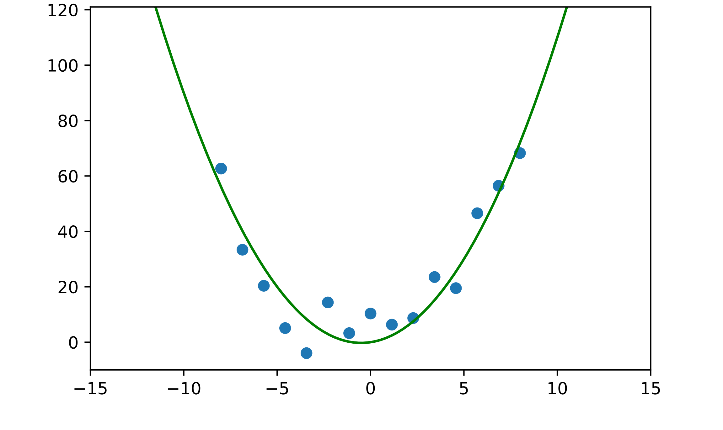
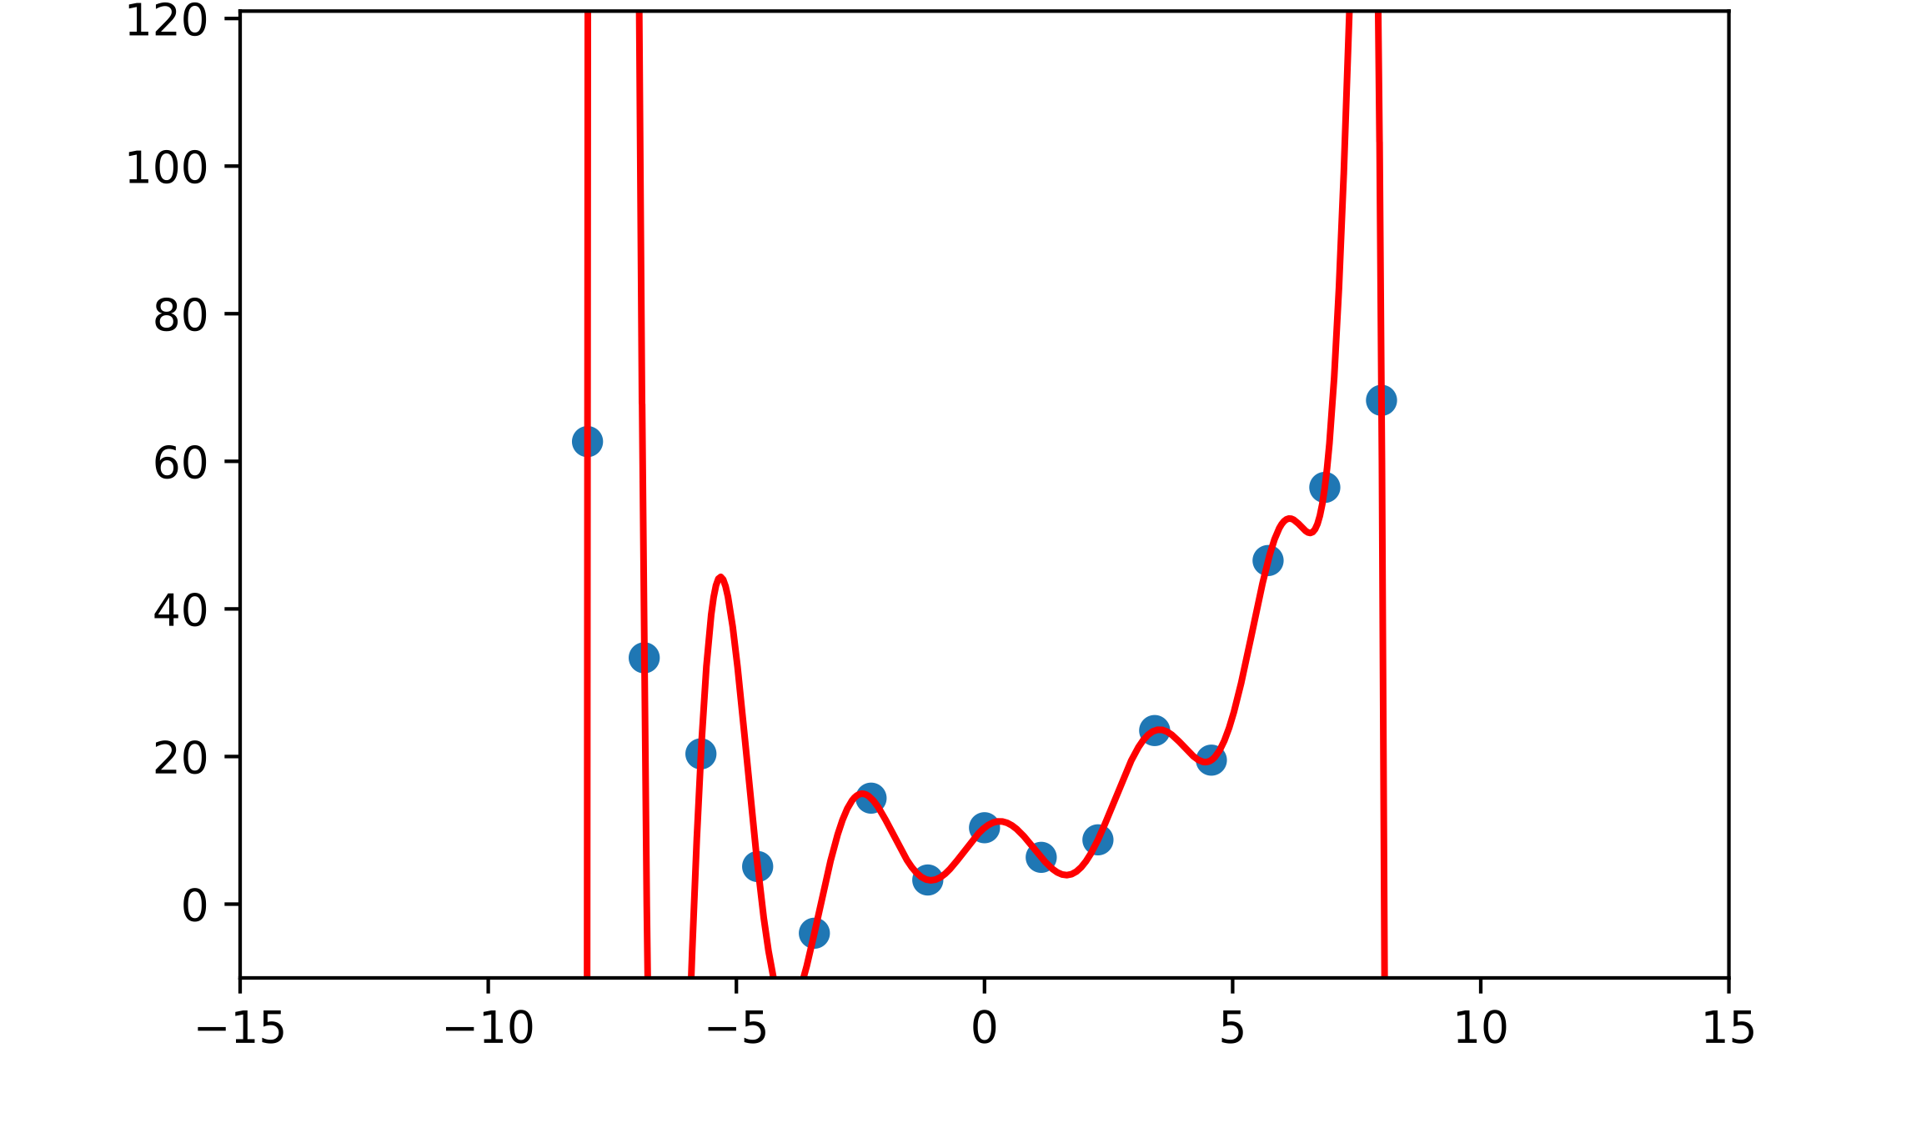
Overfitting: More Parameters, More Problems
A Model with more parameters can represent more functions
E.g.,: if then
More parameters will often reduce training error but increase testing error. This is overfitting.
When overfitting happens, models do not generalize well.
Degree 2 Fit
Degree 15 Fit

Slide 13
Deep Learning: More Parameters, More Problems?
More parameters let us represent a larger space of functions
The larger that space is, the harder our optimization becomes
This means we need:
  More data
  More compute resources
  Etc.
Convolutional Layer
Fully Connected Layer

Slide 14
Deep Learning: More Parameters, More Problems?
A convolutional layer looks for components of a function that are spatially-invariant
Convolutional Layer
Fully Connected Layer

Slide 15
How to Avoid Overfitting: Regularization
In general:
  More parameters means higher risk of overfitting
  More constraints/conditions on parameters can help
If a model is overfitting, we can
  Collect more data to train on
  Regularize: add some additional information or assumptions to better constrain learning
Regularization can be done through:
  the design of architecture
  the choice of loss function
  the preparation of data
  …

Slide 16
Regularization: Architecture Choice
“Bigger” architectures (typically, those with more parameters) tend to be more at risk of overfitting.
Convolutional Layer
Fully Connected Layer

Slide 17
Regularization: Dropout
At training time, randomly “drop” (zero out) some fraction of the connections in your network
This will prevent your network from relying too heavily on any specific connections
Encourages redundancy/consensus across various paths through the network
Srivastava, Nitish, et al. ”Dropout: a simple way to prevent neural networks from overfitting”, JMLR 2014

Slide 18
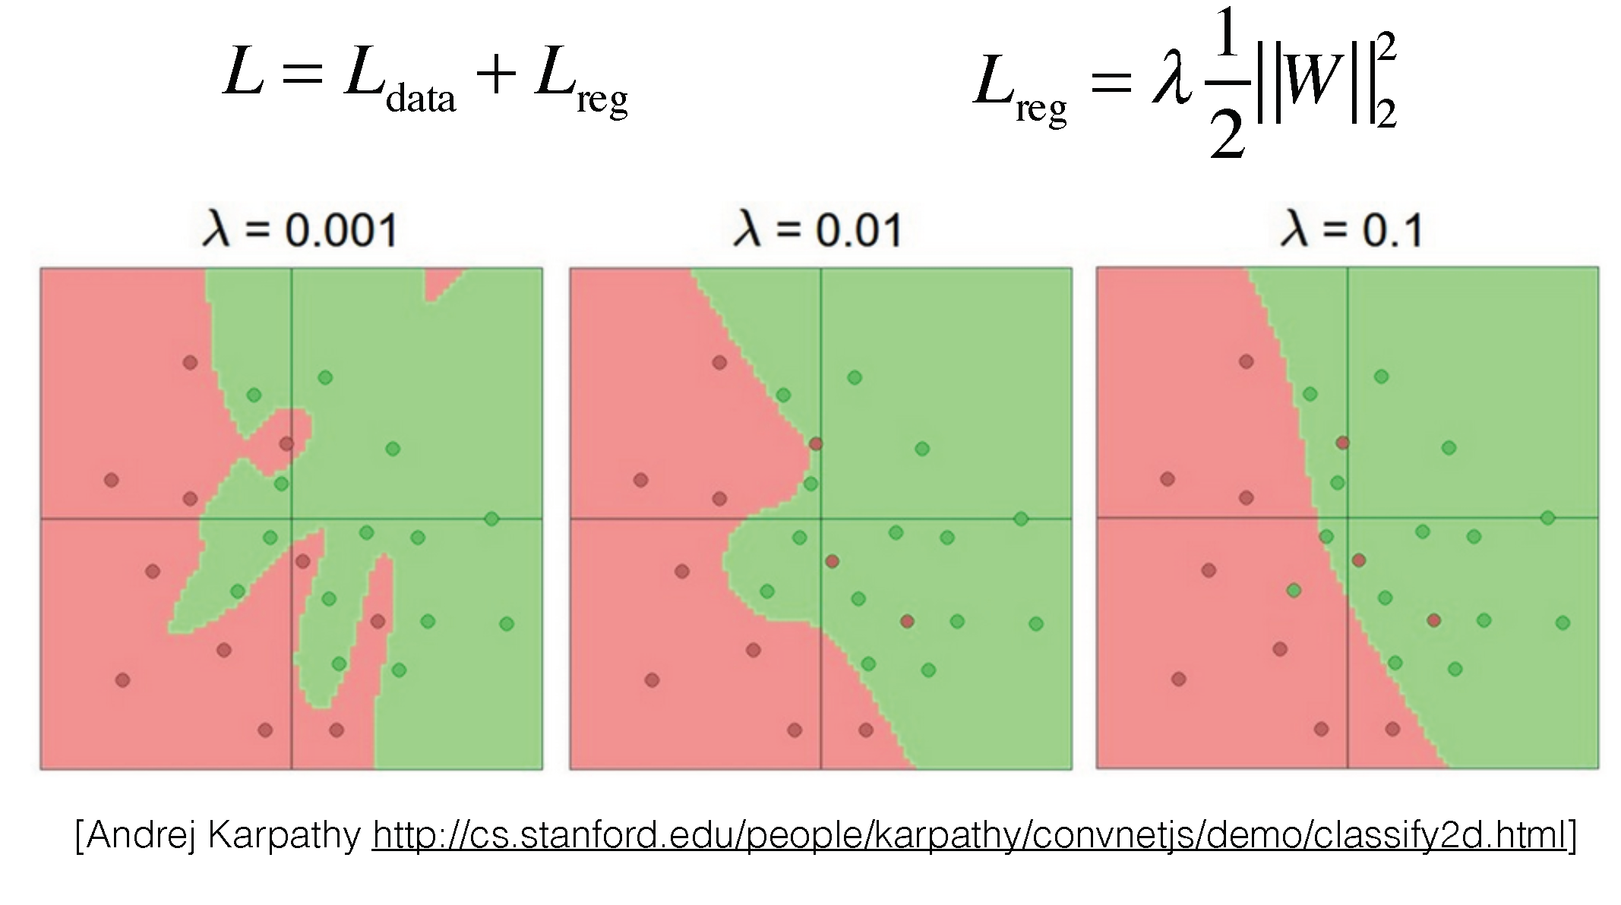
Regularization: In the Loss Function
Notes:
https://cs.stanford.edu/people/karpathy/convnetjs/demo/classify2d.html

Slide 19
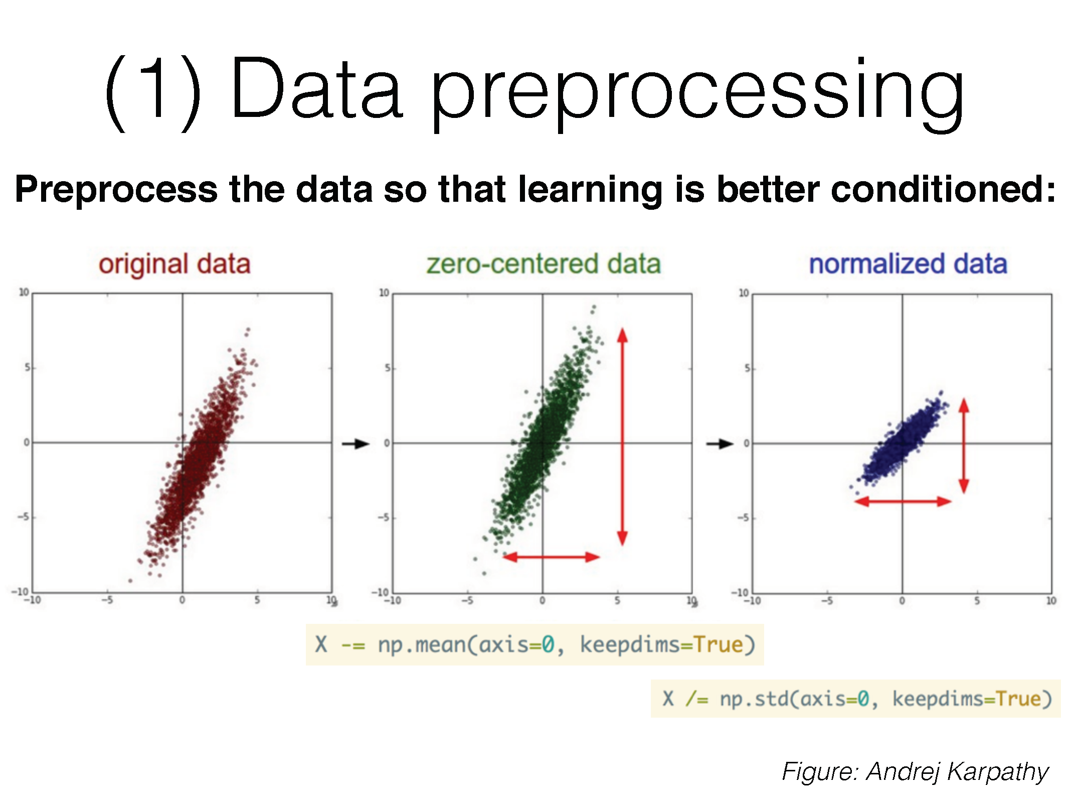
Regularization: In Data Preparation

Slide 20
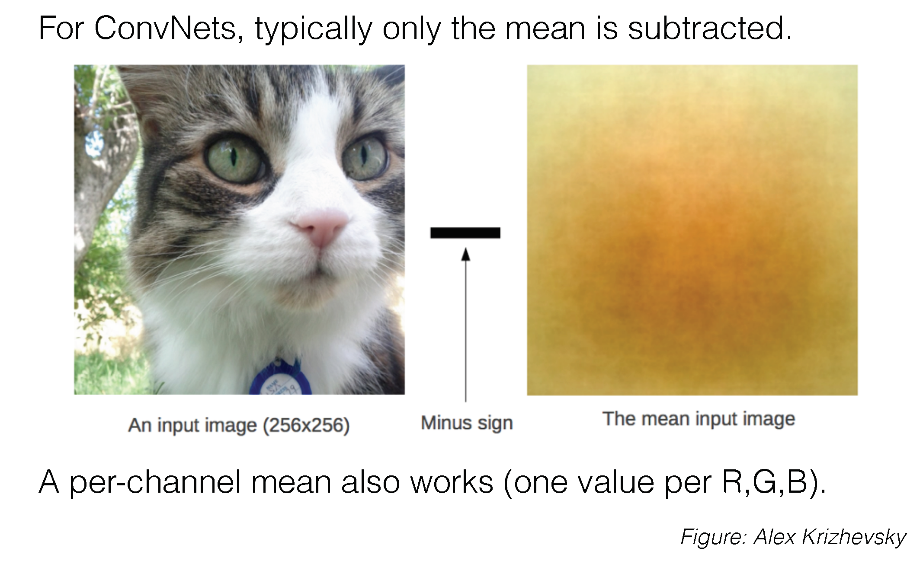
Regularization: In Data Preparation

Slide 21
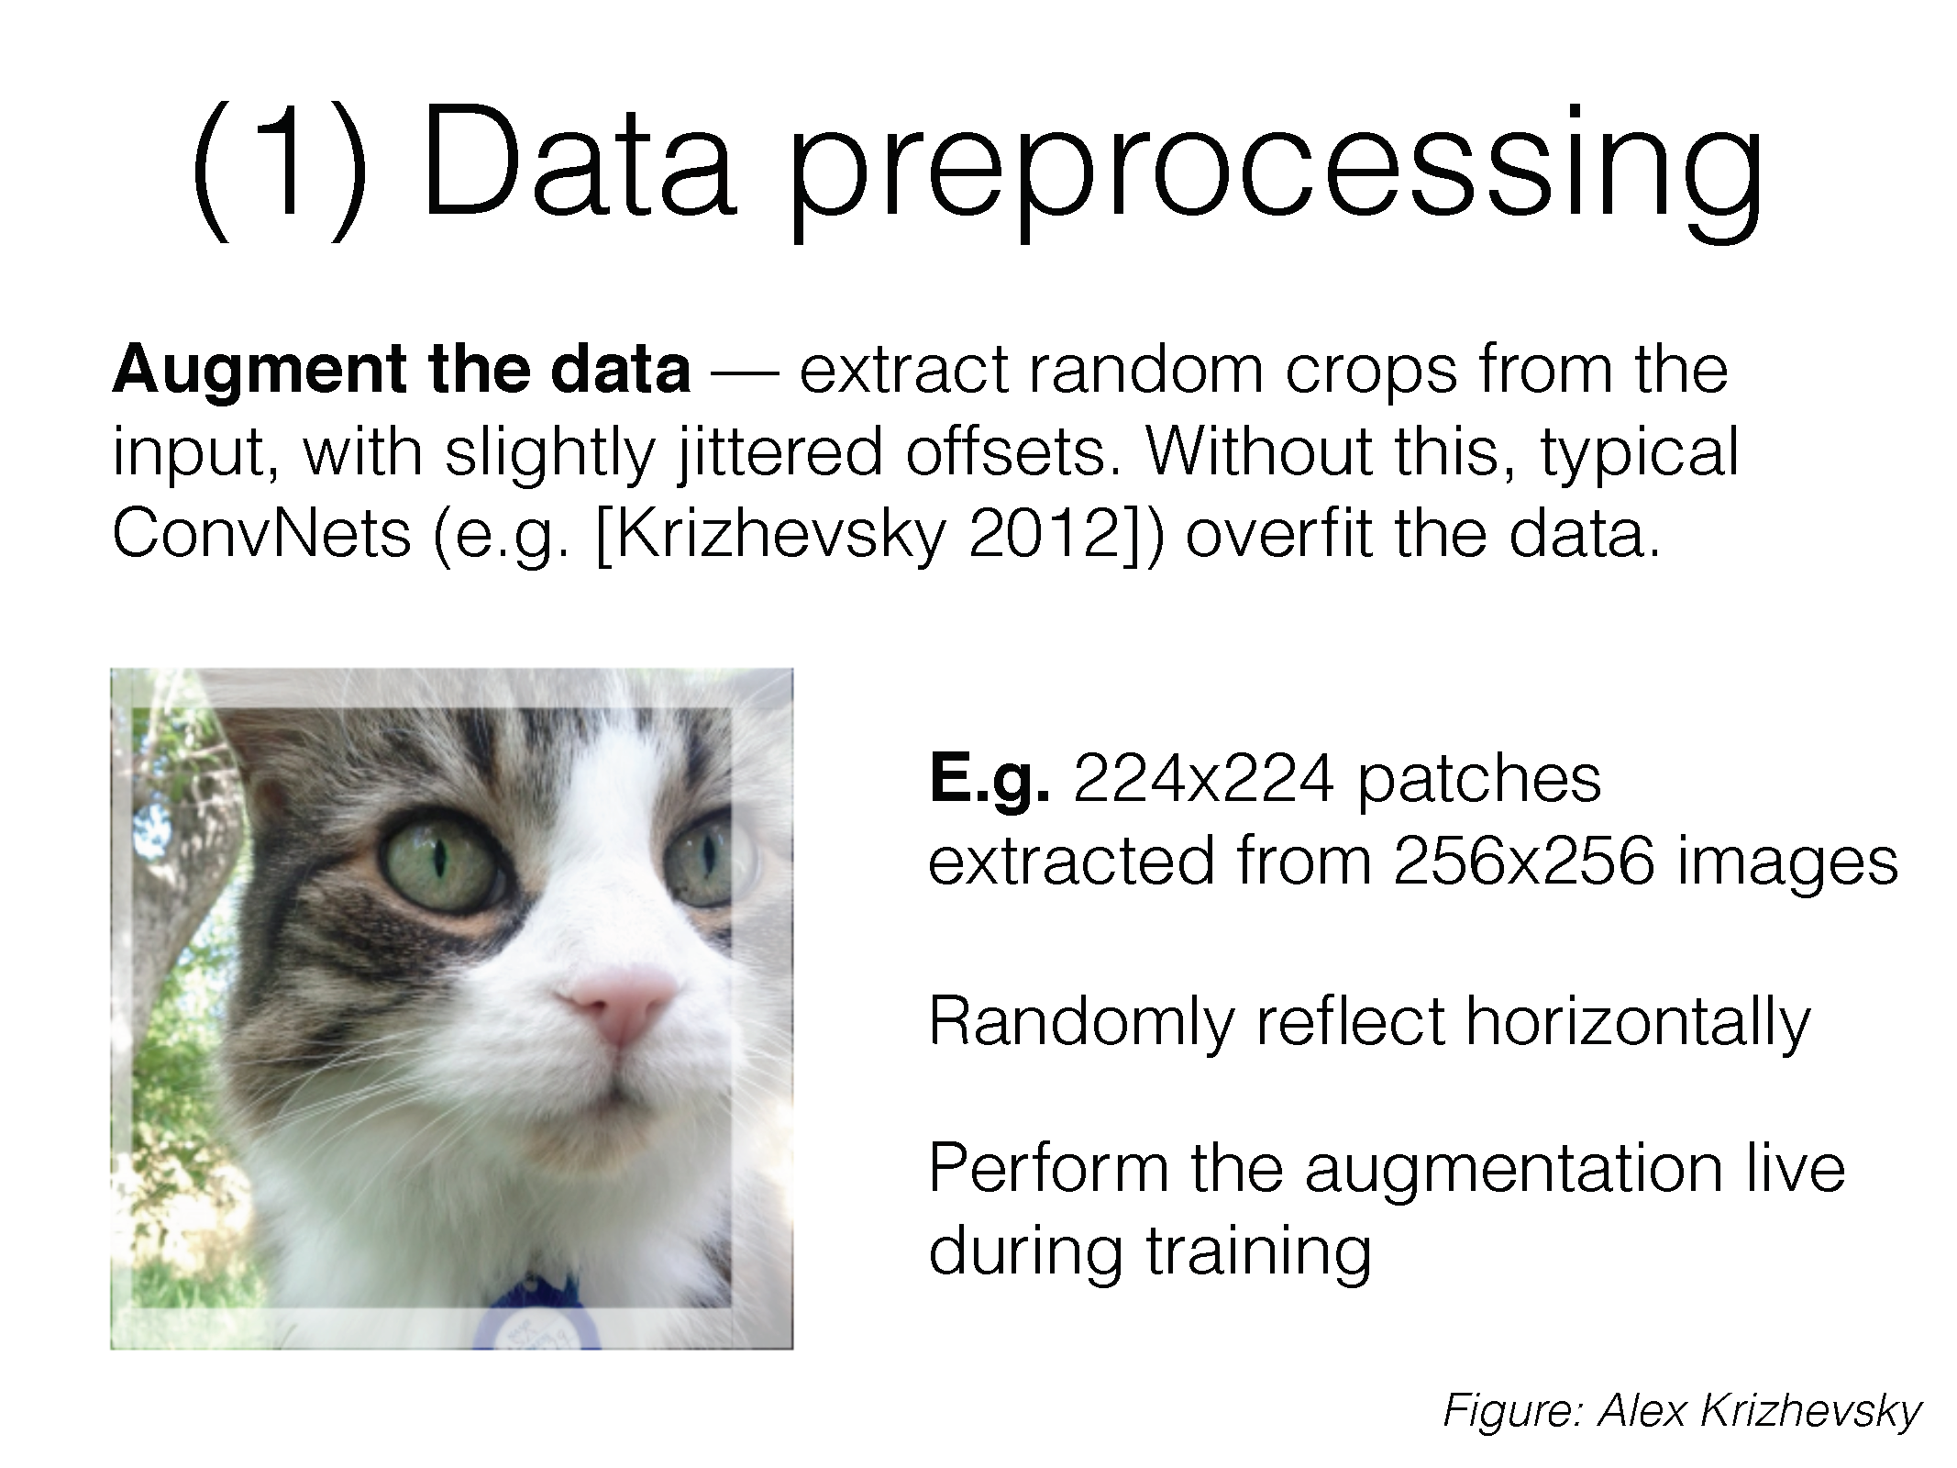
Regularization: In Data Preparation

Slide 22
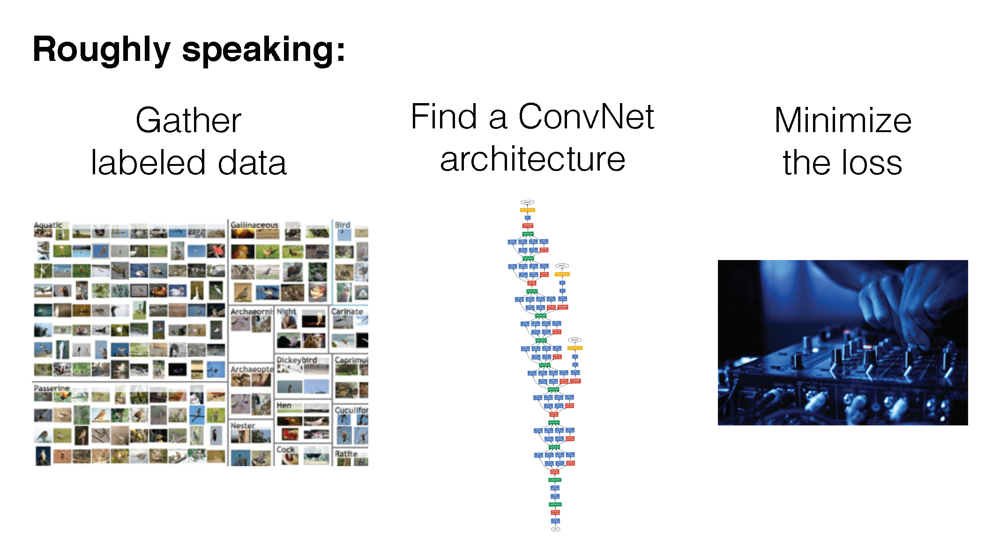
Putting It All Together: How To Train Deep Nets

Slide 23
Training a Convolutional Neural Network
Split and preprocess your data
Choose your network architecture
Initialize the weights
Find a learning rate and regularization strength/strategy
Minimize the loss and monitor the progress
Fiddle with things until they work

Slide 24
(1) Data Pre-Processing
Examples:
Normalizing and centering Data
Data Augmentation
  Random Cropping
  Mirror Flips

Slide 25
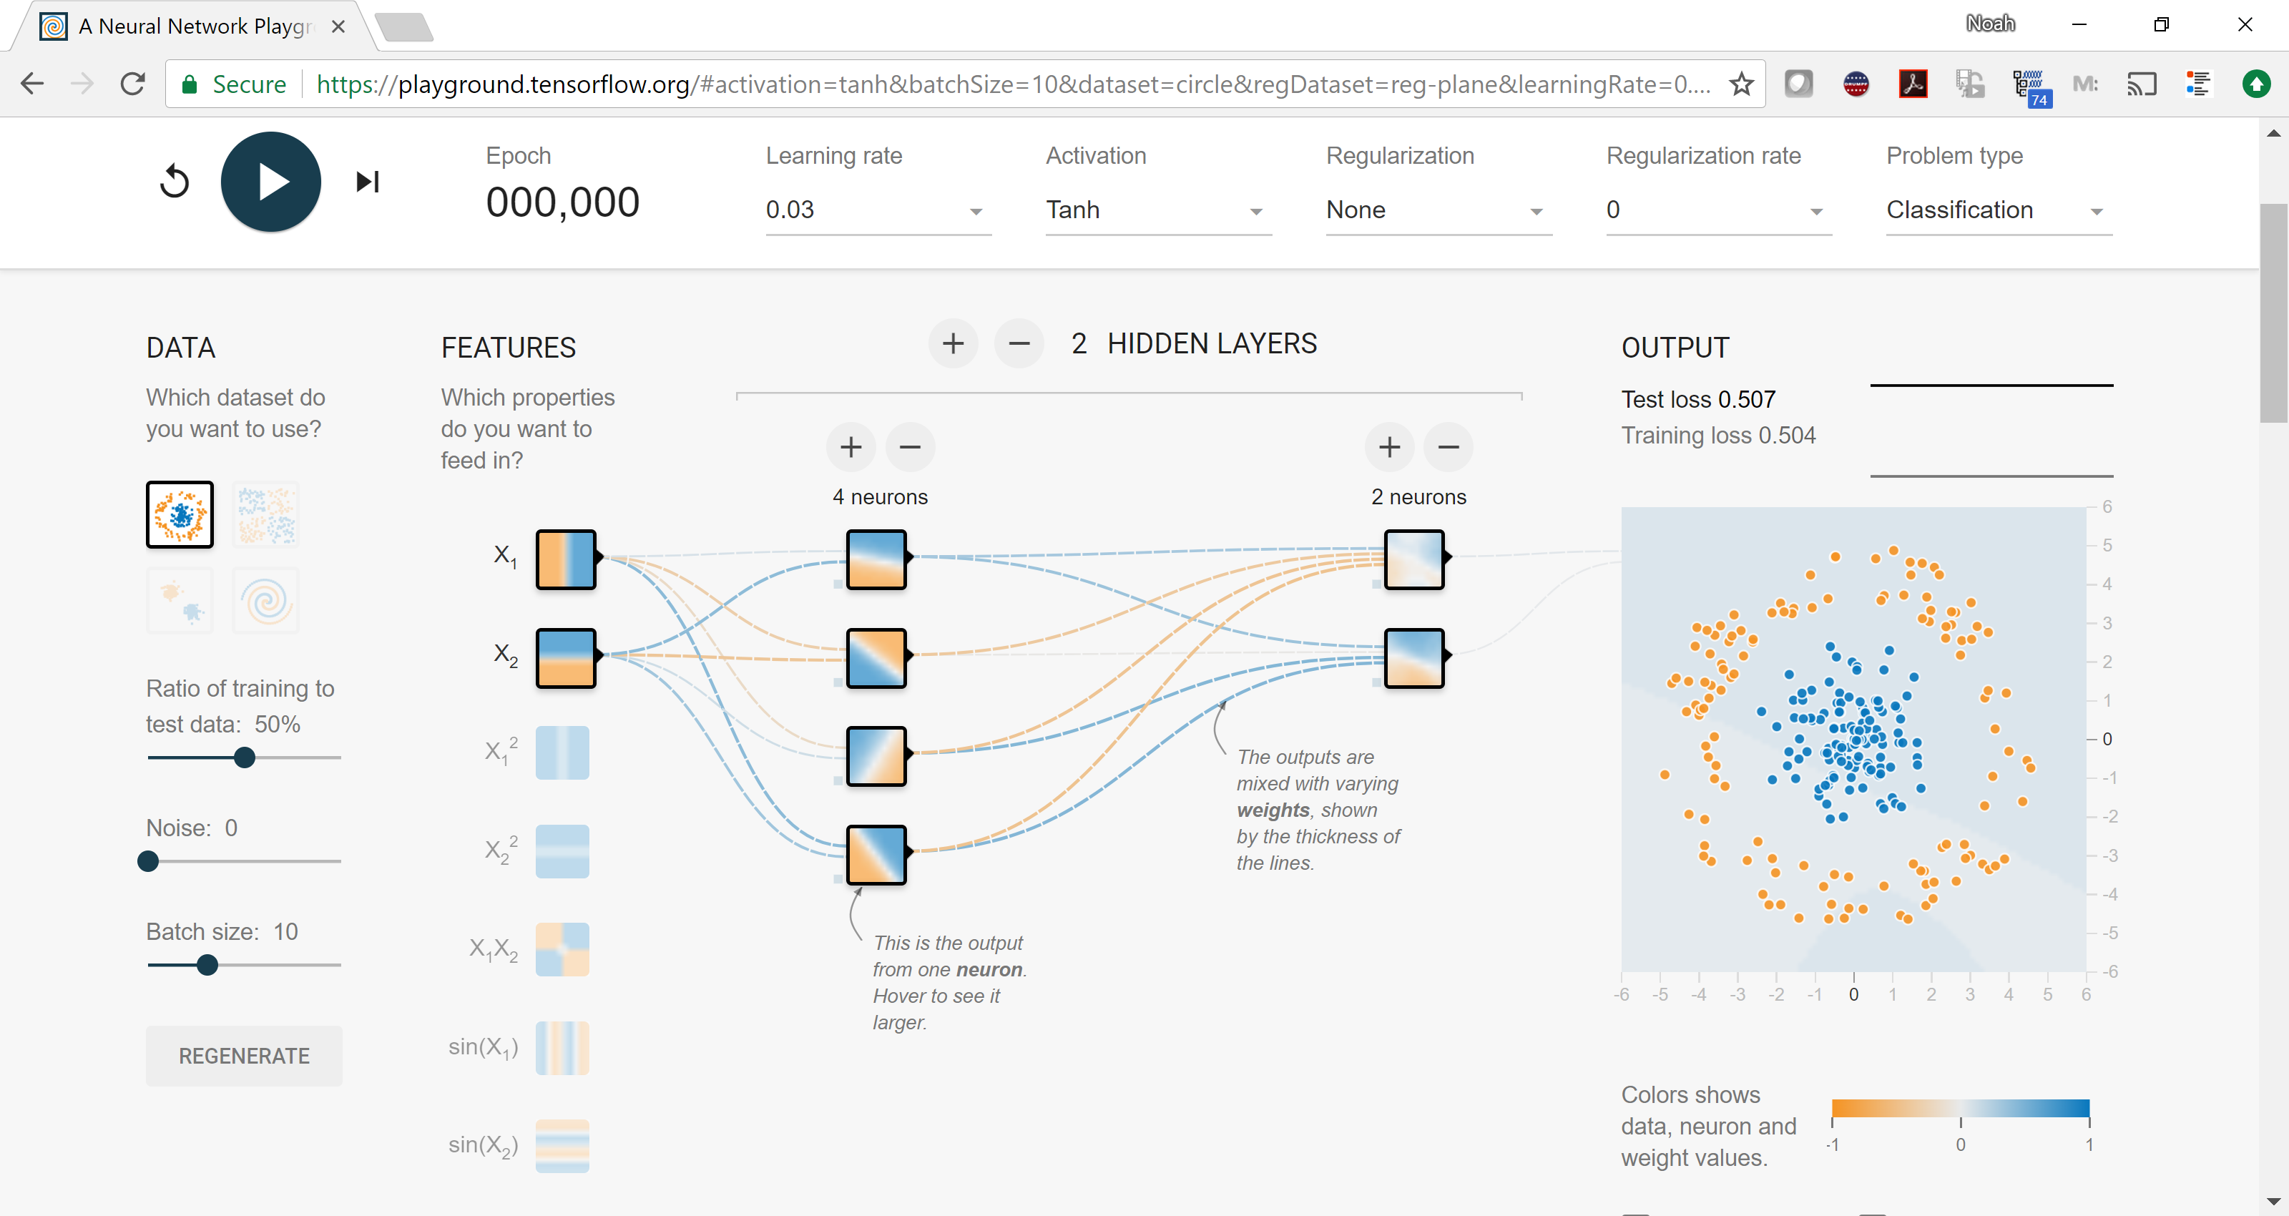
(2) Choose your architecture
https://playground.tensorflow.org/
(we will come back to this later)

Slide 26
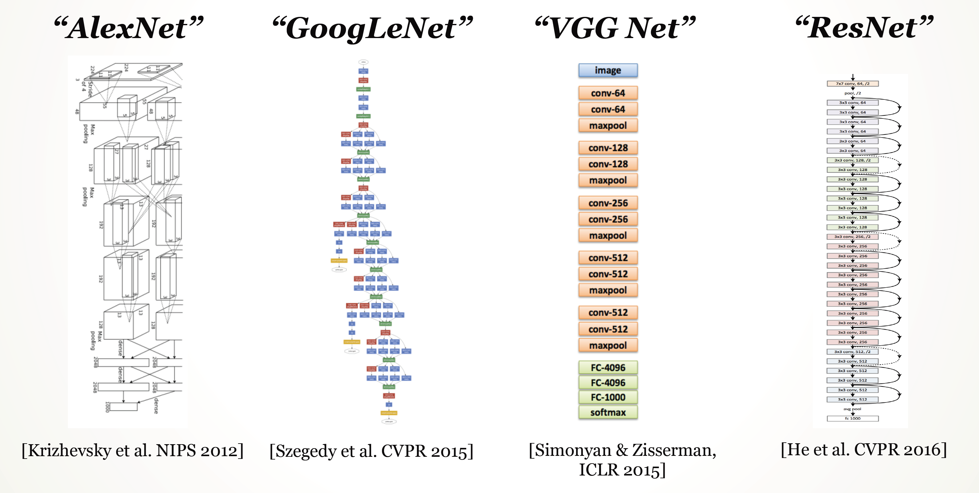
(2) Choose your architecture
Very common modern choice

Slide 27
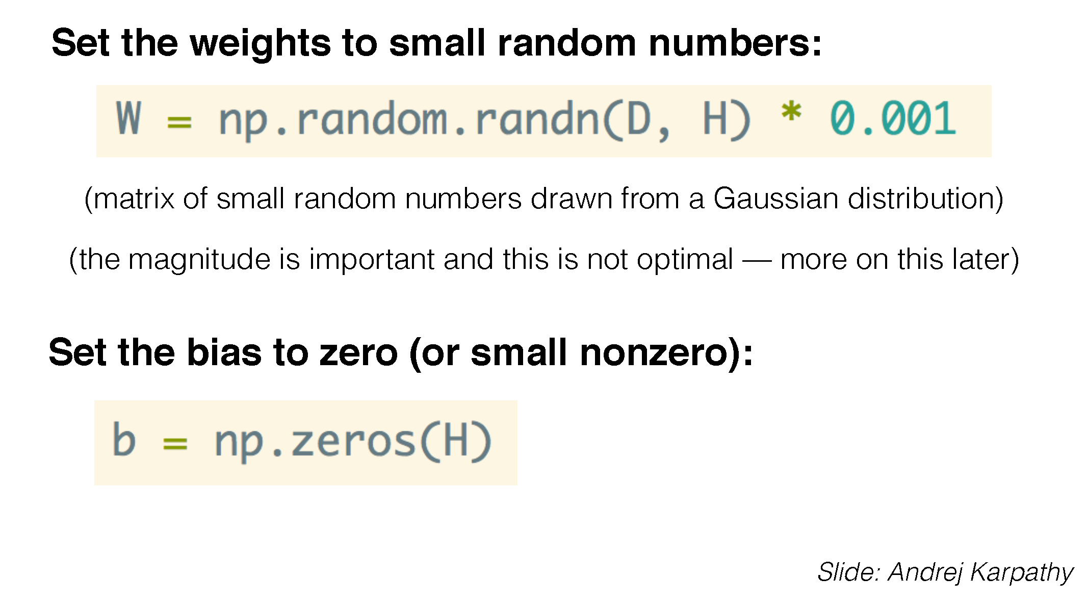
(3) Initialize Your Weights
(if you use ReLU activations, folks tend to initialize bias to small positive number)

Slide 28
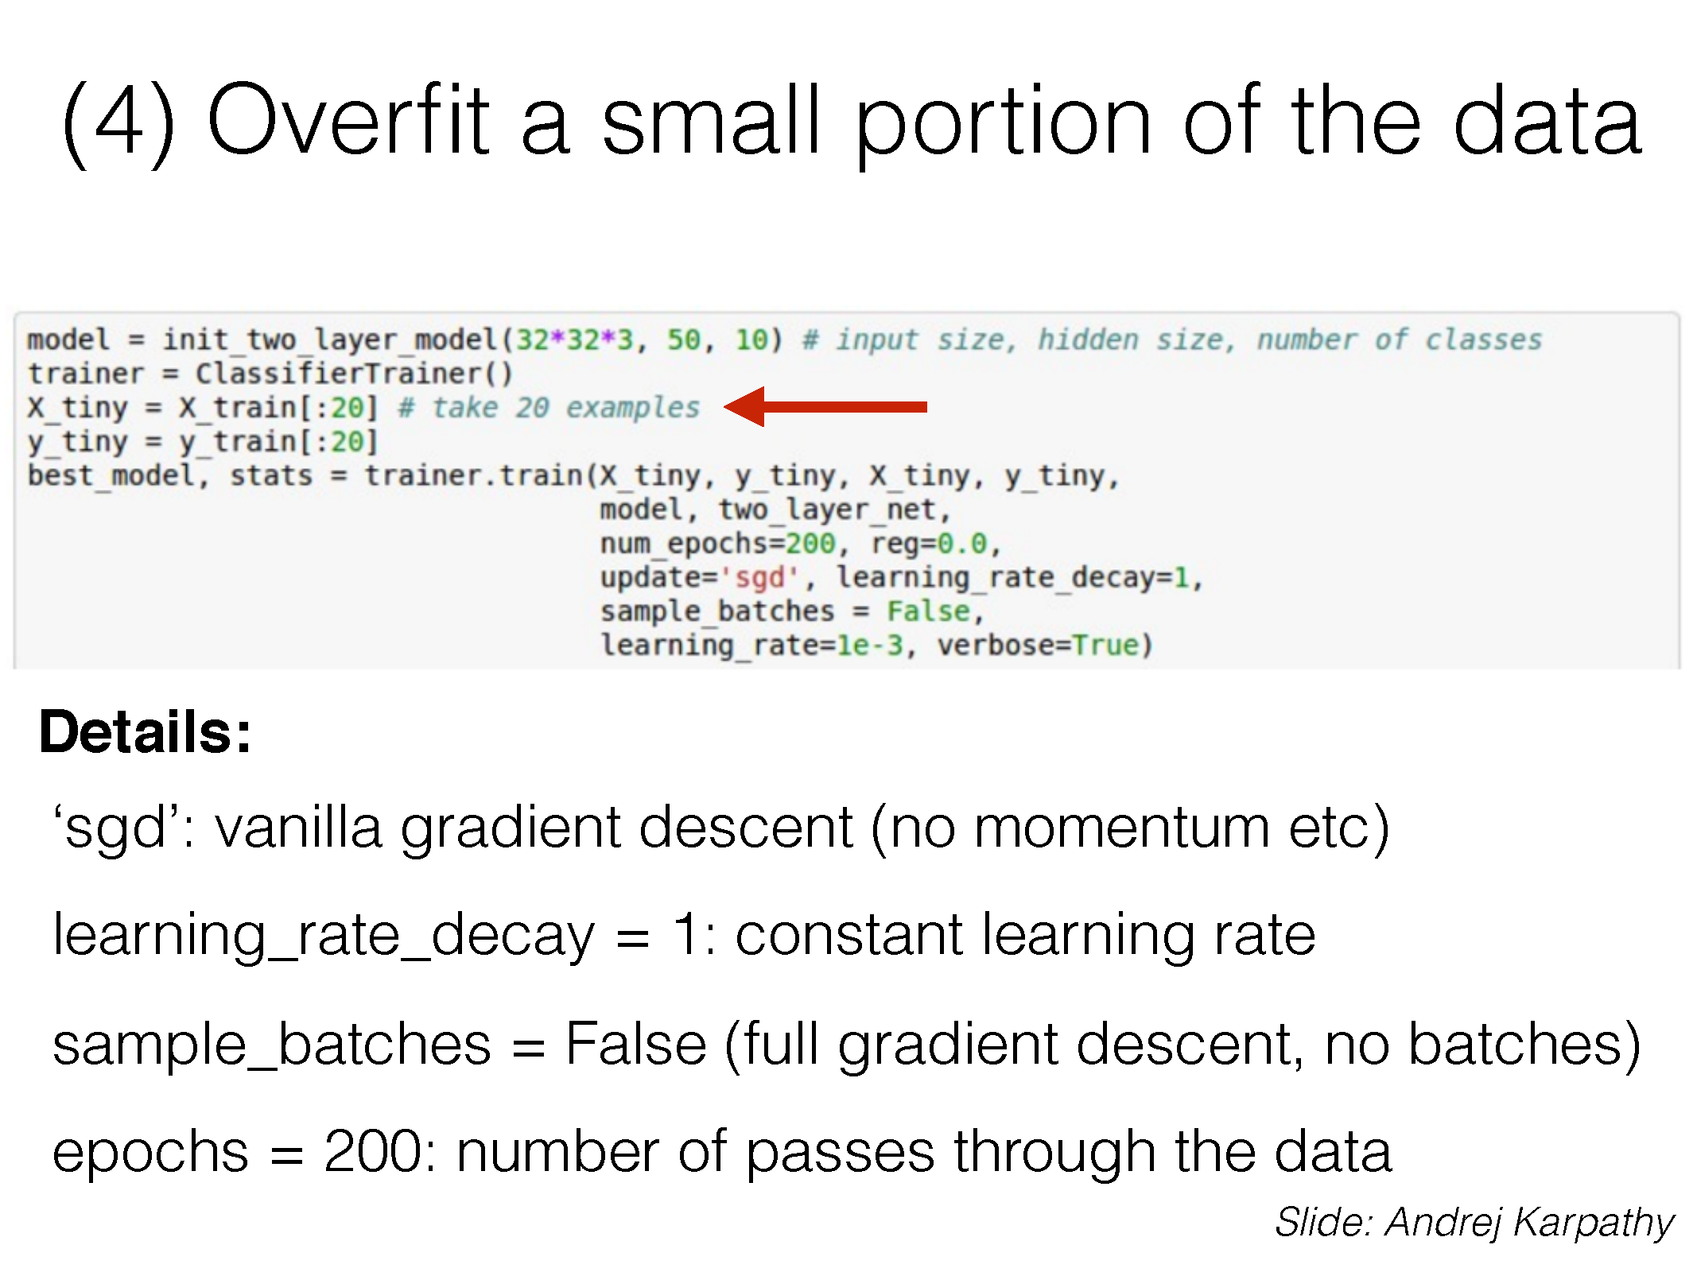
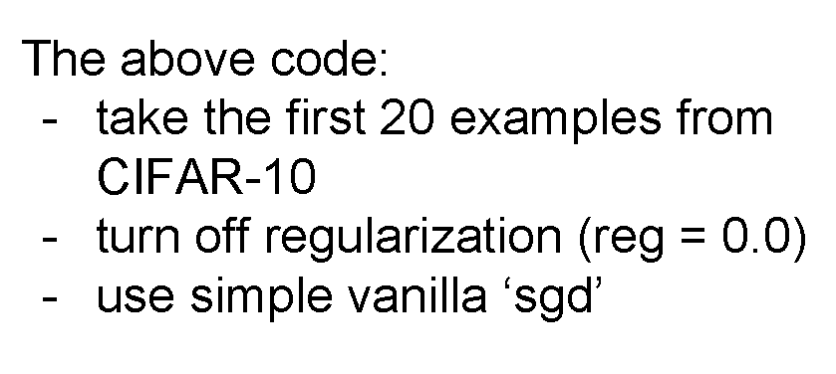
(3) Start with a Small Portion of the Data

Slide 29
(3) Start with a Small Portion of the Data

Slide 30
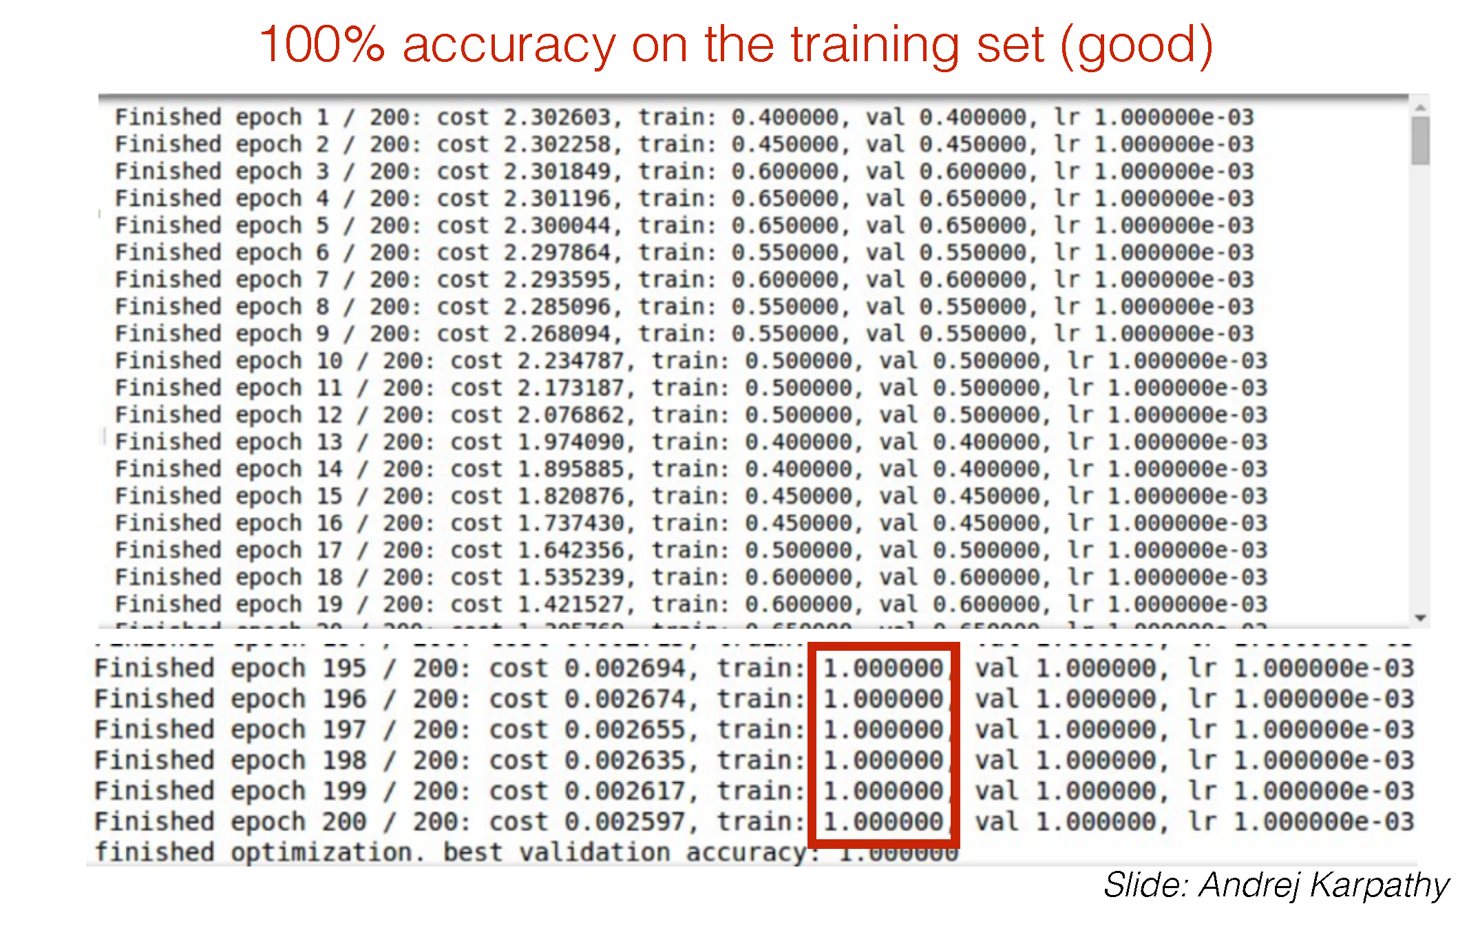
(3) Start with a Small Portion of the Data

Slide 31
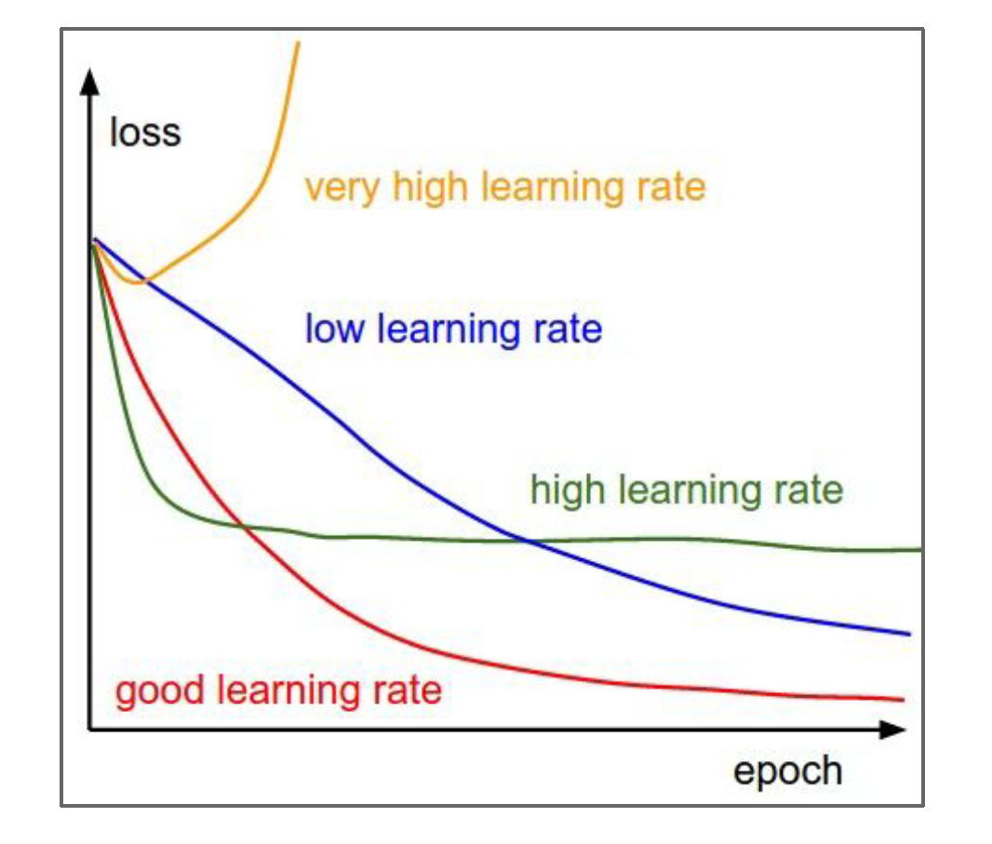
(4) Find a learning rate
Too high won’t converge
Too low will converge slowly

Slide 32
Aside: Some Training Vocabulary
An Epoch is one complete pass through your training data
An iteration of SGD happens on a batch of examples.
The Batch Size is the number of examples in a single training batch.
The number of iterations per epoch depends on the total number of examples divided by the batch size.

Slide 33
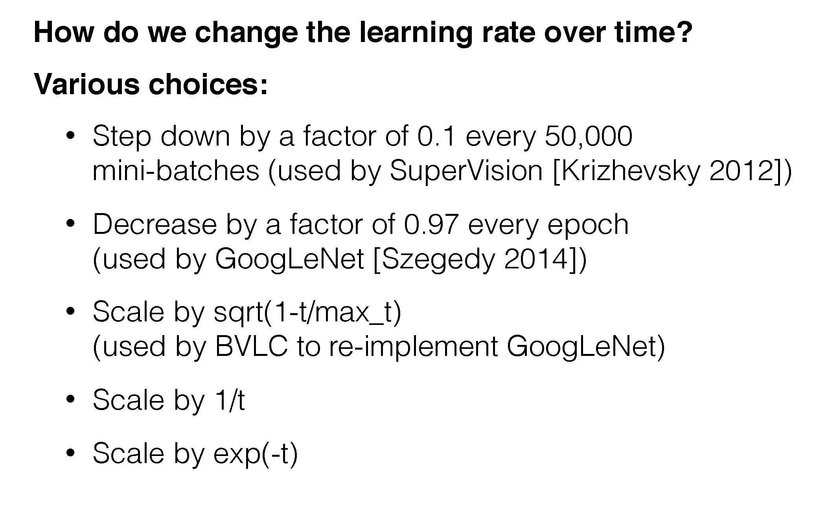
(4b) Choosing a Learning Rate Schedule

Slide 34
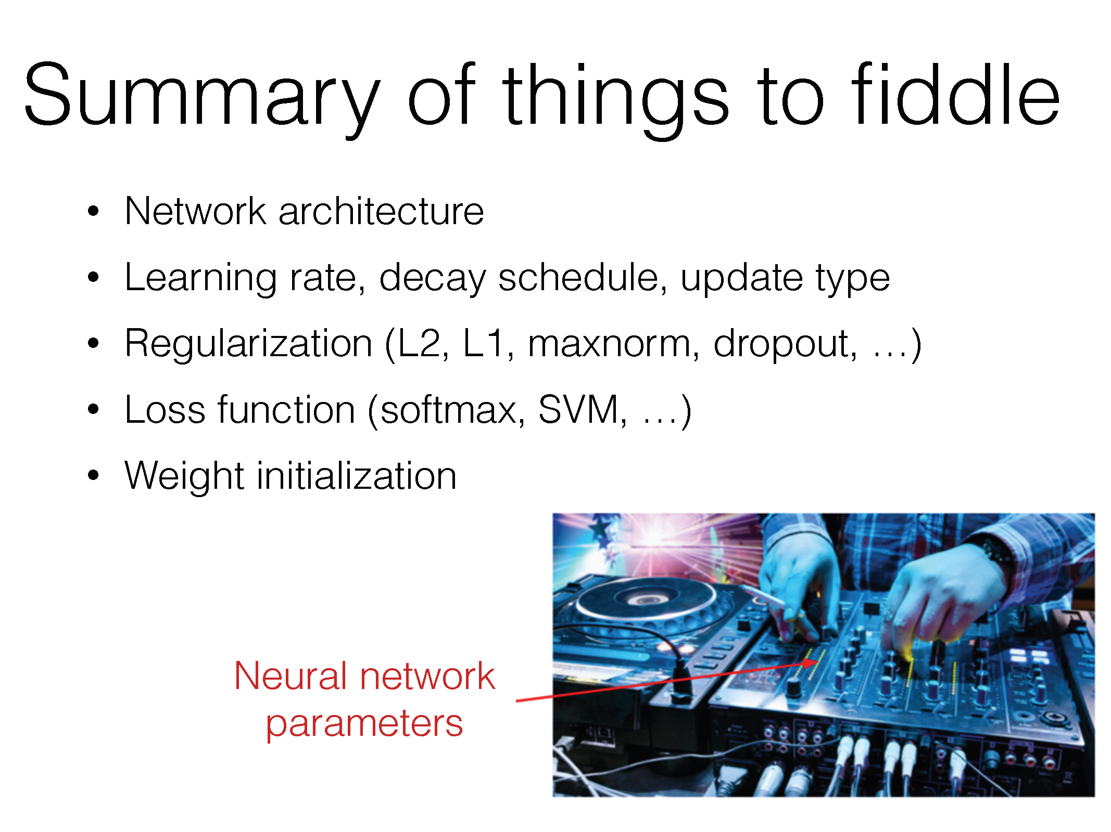

Slide 35
(+batch size)

Slide 36
Questions?

Slide 37
Demo
https://playground.tensorflow.org/
(we will come back to this later)

Slide 38
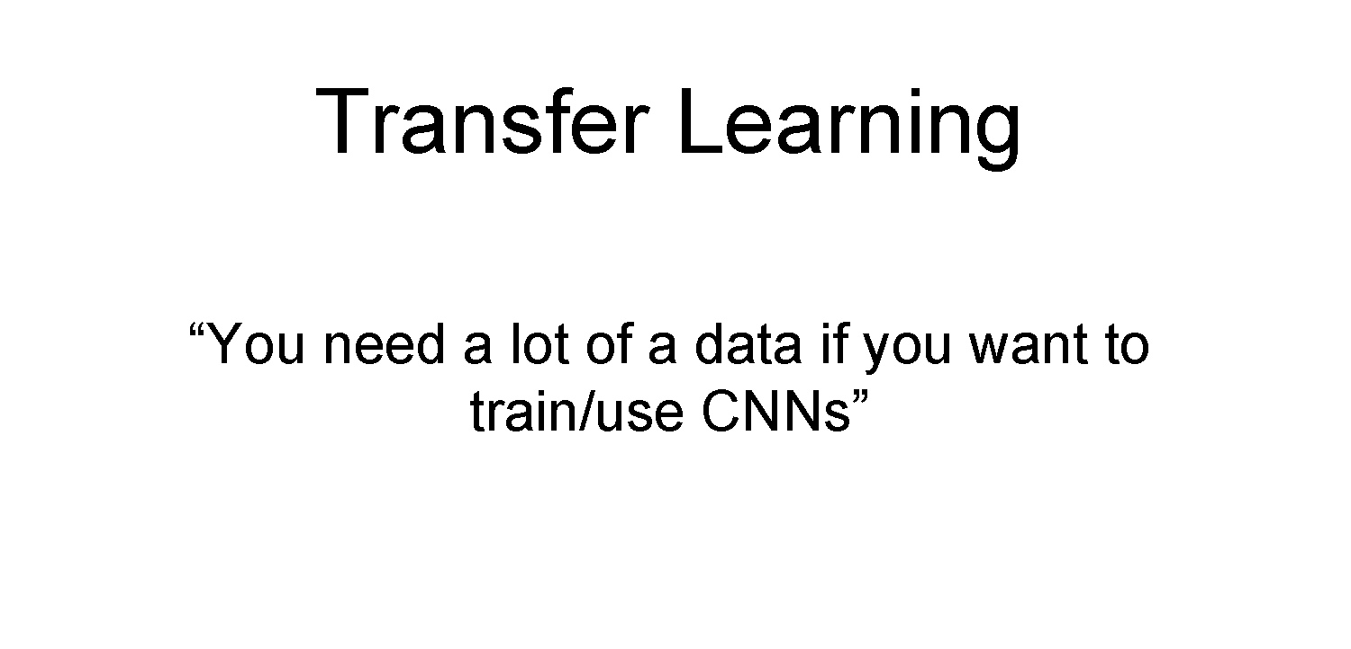

Slide 39
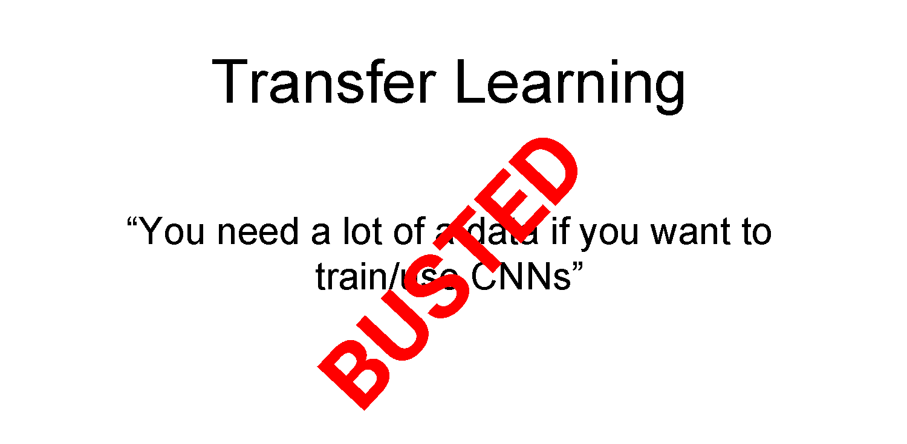

Slide 40
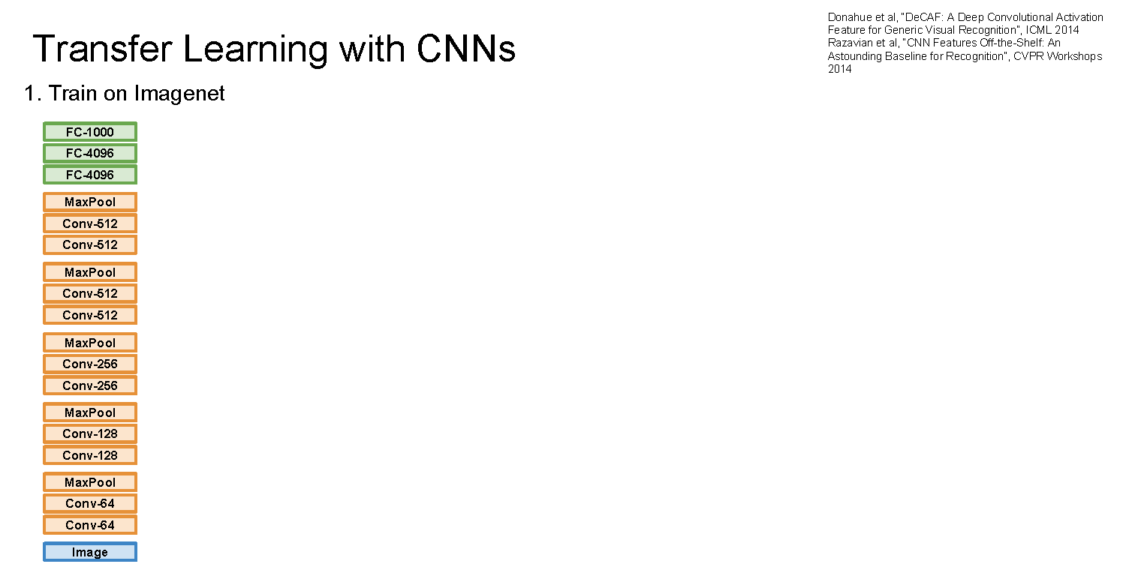

Slide 41
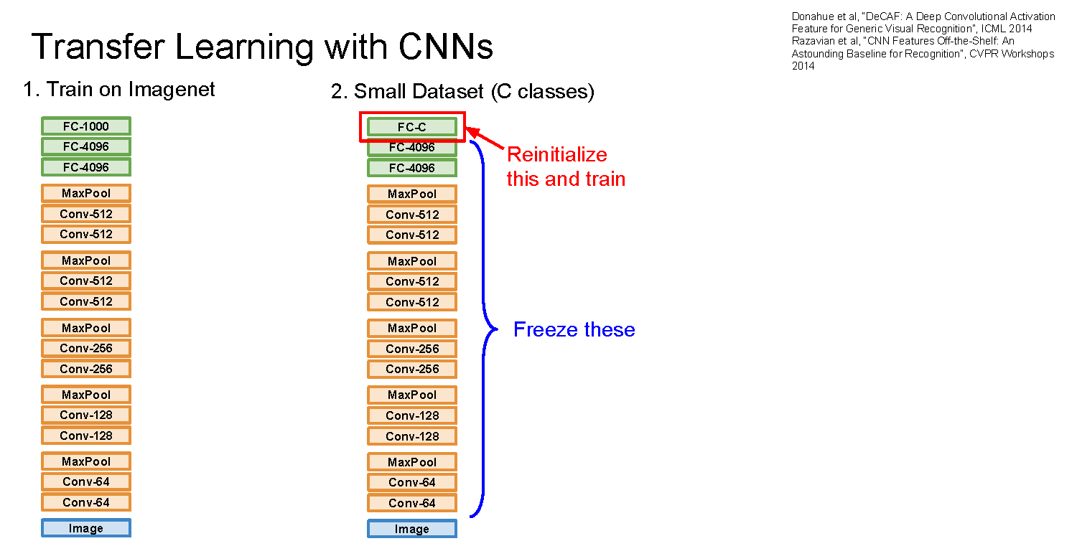

Slide 42
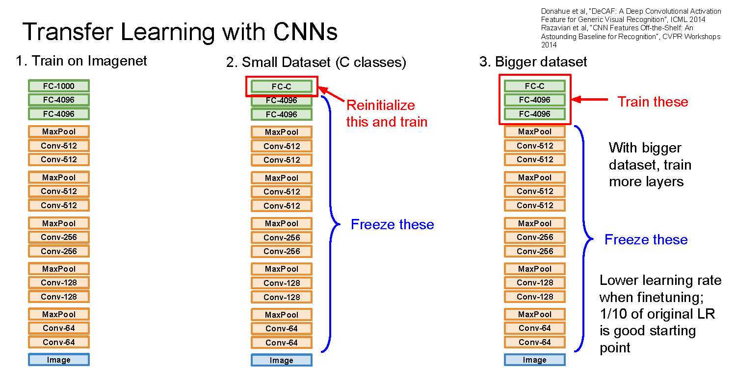

Slide 43
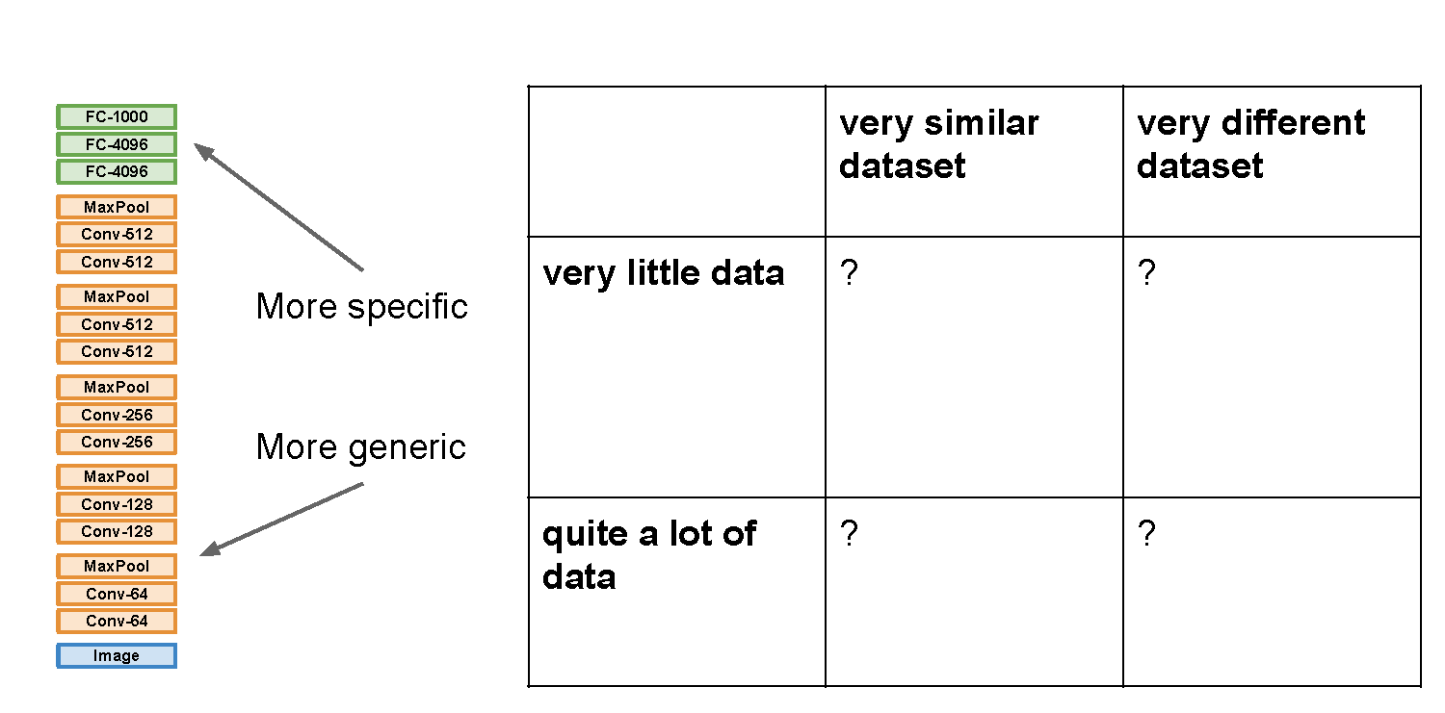

Slide 44
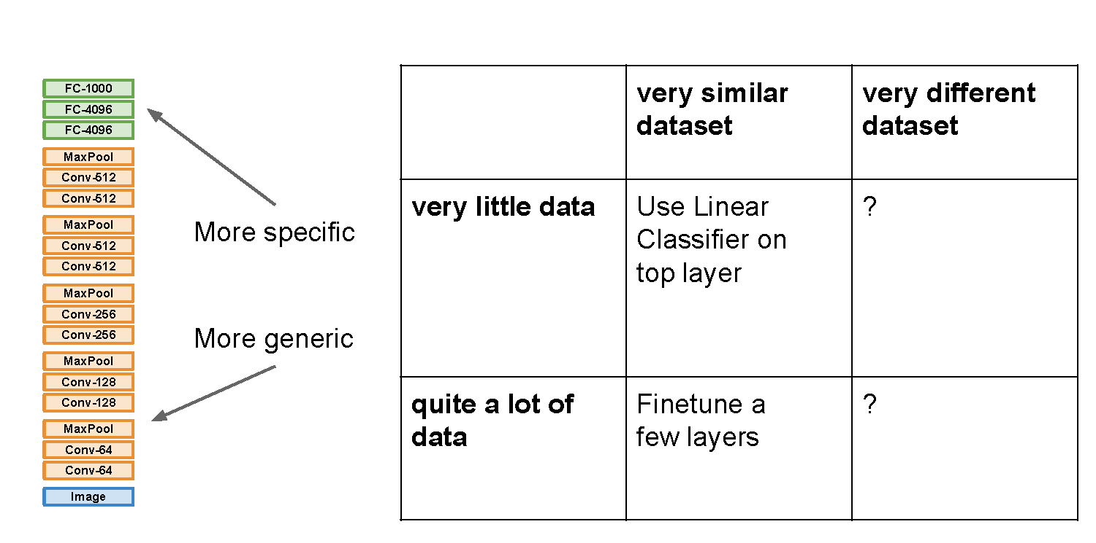

Slide 45
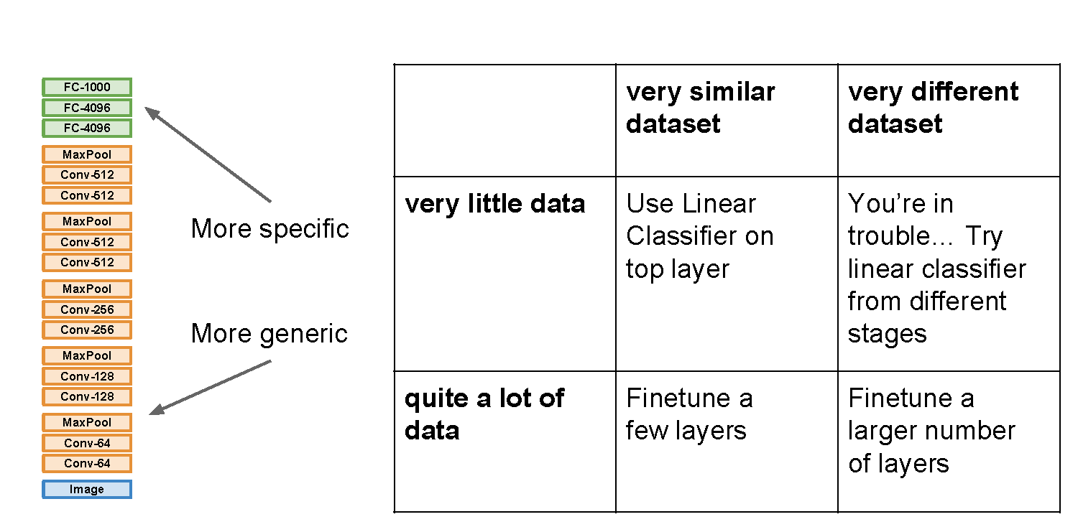

Slide 46
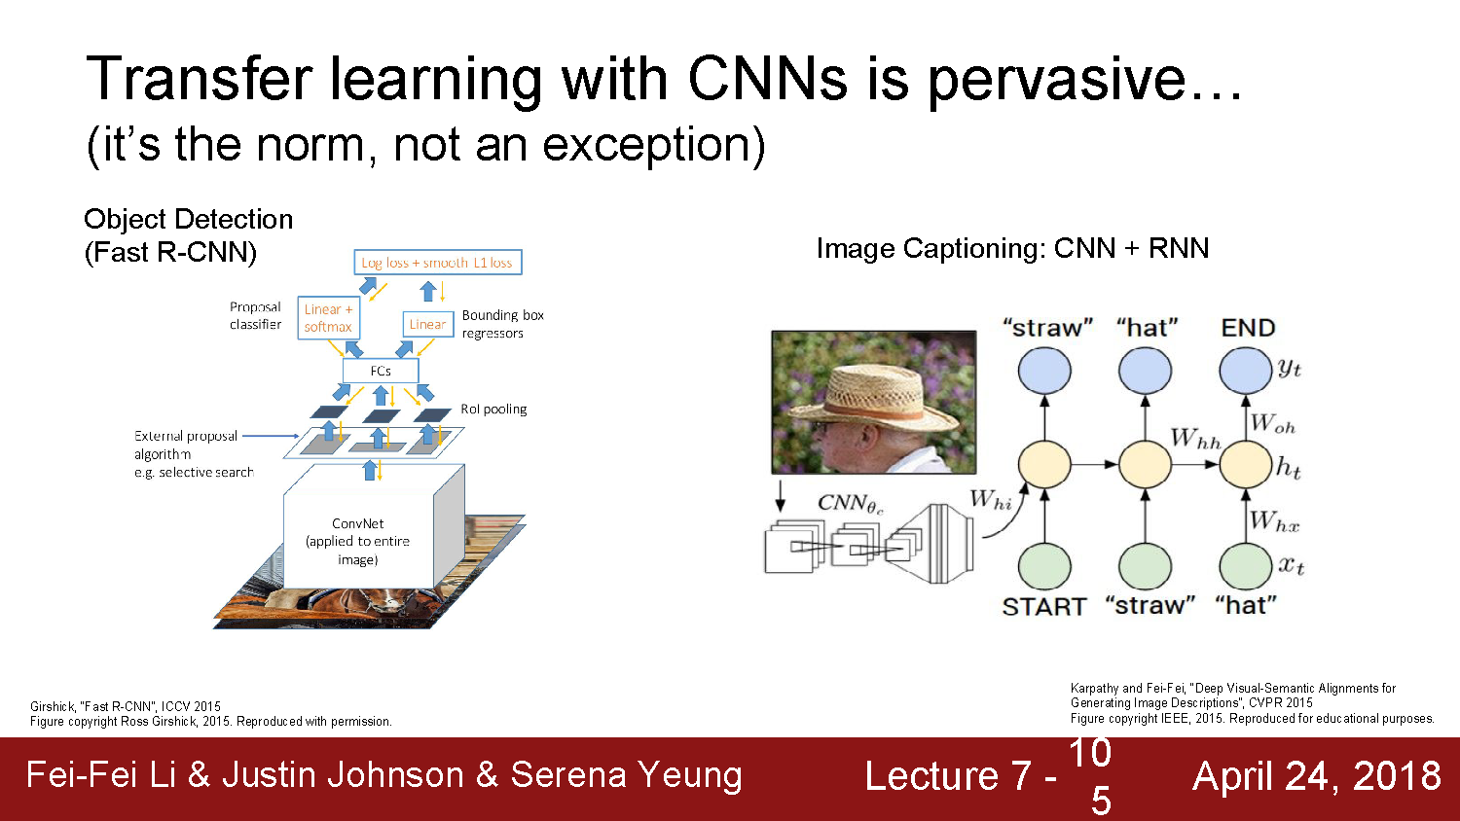

Slide 47
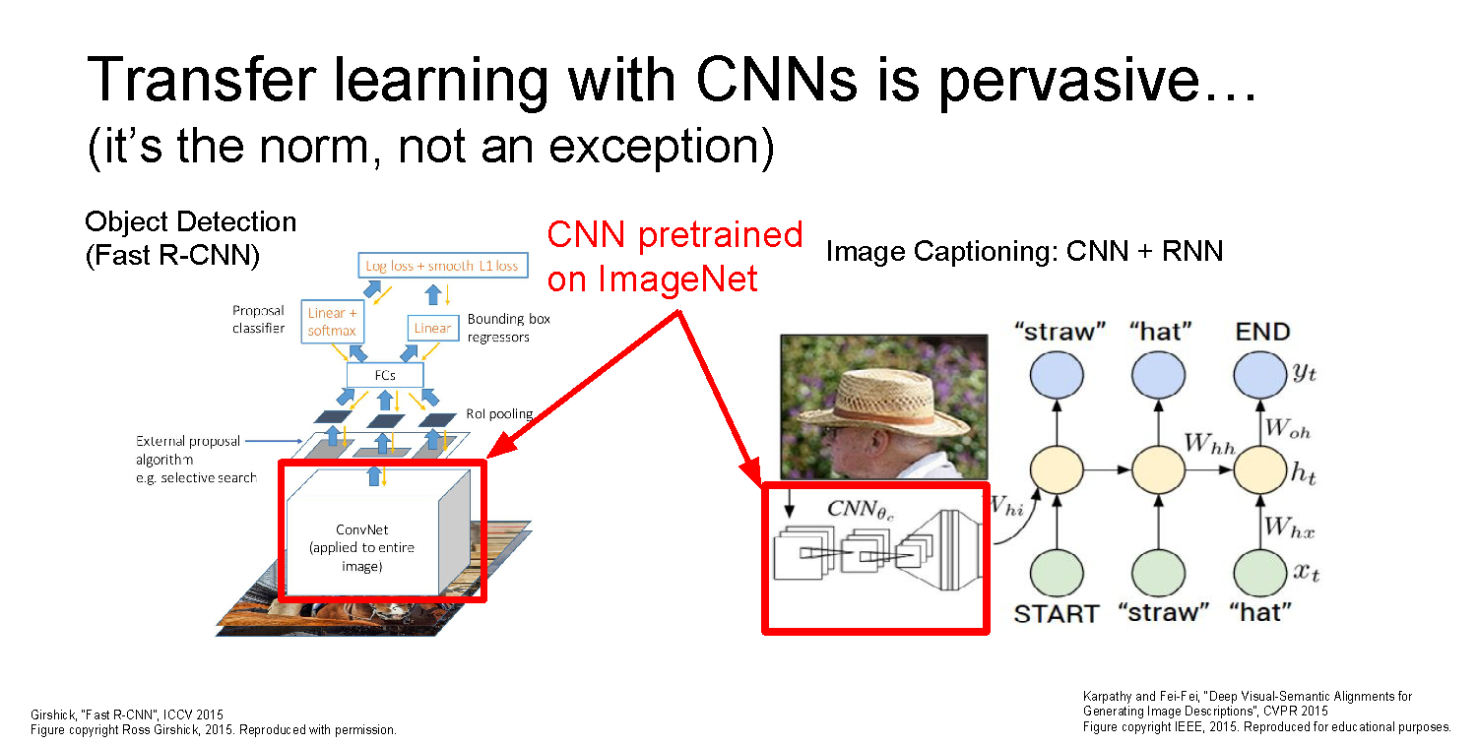

Slide 48
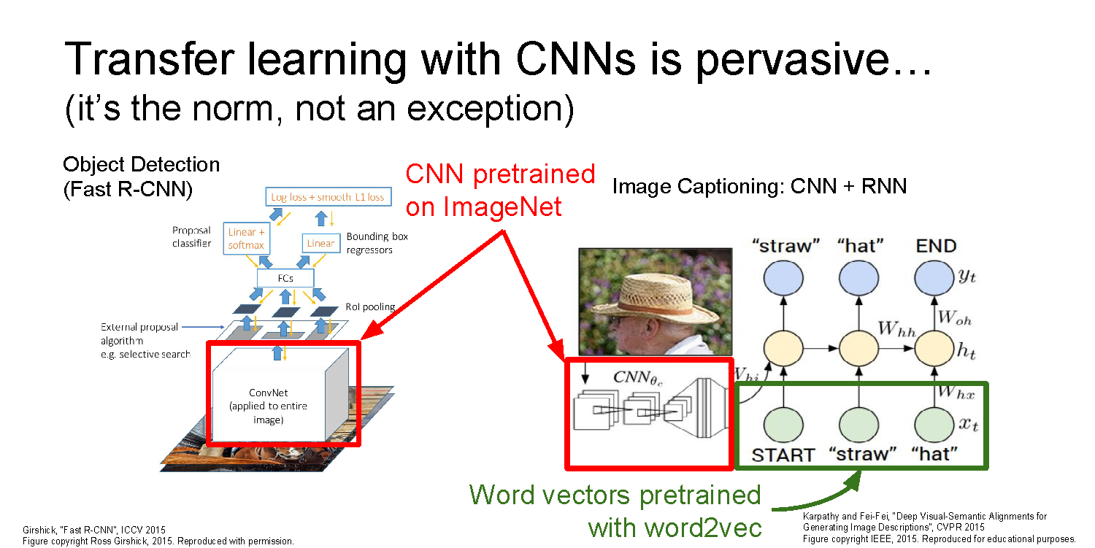

Slide 49
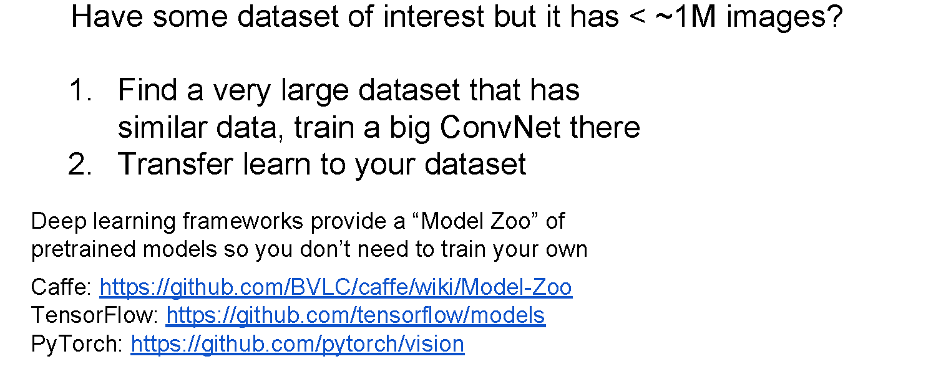
Some Takeaways
Common modern approach: start with a ResNet architecture pre-trained on ImageNet, and fine-tune on your (smaller) dataset

Slide 50
Questions?

Slide 51
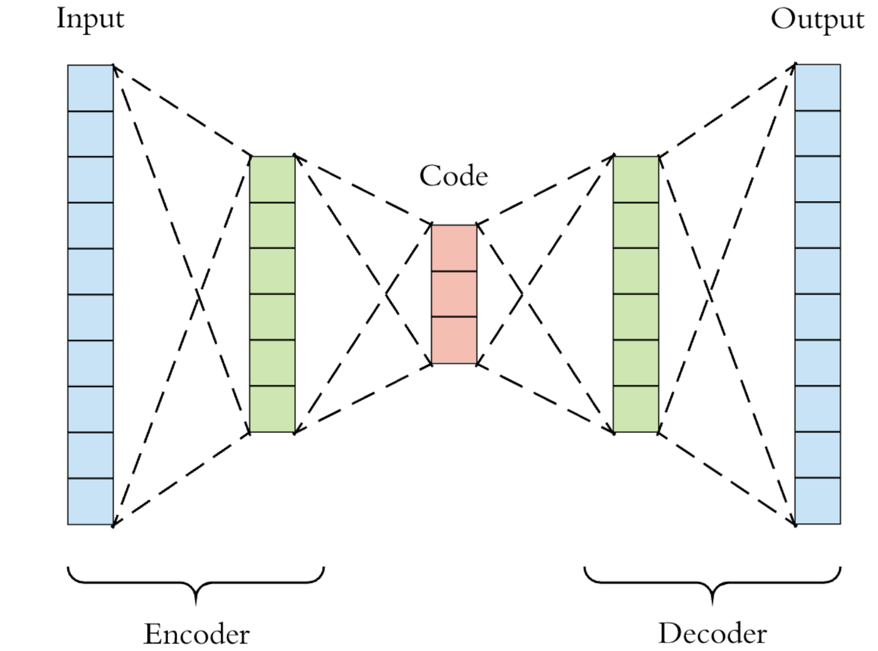
Autoencoders: Unsupervised Dimensionality Reduction
Learn a transformation into some compressed space (encoder)
Learn a transformation from compressed space back to original content (decoder)
Loss function can be difference between input and decoded output
Does not require labels!

Slide 52
Autoencoders: Unsupervised Dimensionality Reduction
Good way to learn useful features from large amounts of unlabeled data
  E.g., for transfer learning
We can do this with CNNs, but we need some way to expand feature dimensionality…
For this we will use Transpose Convolution

Slide 54
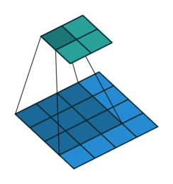
Regular Convolution
Stride: The step size used when computing the convolution
Padding: What is assumed about pixels “outside” of image bounds
Output
(Green)
Input
(Blue)
Kernel size: 3x3
Padding: 0
Stride: 0
Animations from: https://github.com/vdumoulin/conv_arithmetic
Notes:
Kernel size: kernel is discussed in the previous section. The kernel size defines the field of view of the convolution.
Stride: it defines the step size of the kernel when sliding through the image. Stride of 1 means that the kernel slides through the image pixel by pixel. Stride of 2 means that the kernel slides through image by moving 2 pixels per step (i.e., skipping 1 pixel). We can use stride (>= 2) for downsampling an image.
Padding: the padding defines how the border of an image is handled. A padded convolution (‘same’ padding in Tensorflow) will keep the spatial output dimensions equal to the input image, by padding 0 around the input boundaries if necessary. On the other hand, unpadded convolution (‘valid’ padding in Tensorflow) only perform convolution on the pixels of the input image, without adding 0 around the input boundaries. The output size is smaller than the input size.
Animations from

Slide 55
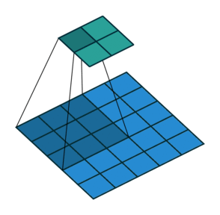
Regular Convolution
Output
(Green)
Stride: The step size used when computing the convolution
Padding: What is assumed about pixels “outside” of image bounds
Input
(Blue)
Kernel size: 3x3
Padding: 0
Stride: 1
Animations from: https://github.com/vdumoulin/conv_arithmetic
Notes:
Kernel size: kernel is discussed in the previous section. The kernel size defines the field of view of the convolution.
Stride: it defines the step size of the kernel when sliding through the image. Stride of 1 means that the kernel slides through the image pixel by pixel. Stride of 2 means that the kernel slides through image by moving 2 pixels per step (i.e., skipping 1 pixel). We can use stride (>= 2) for downsampling an image.
Padding: the padding defines how the border of an image is handled. A padded convolution (‘same’ padding in Tensorflow) will keep the spatial output dimensions equal to the input image, by padding 0 around the input boundaries if necessary. On the other hand, unpadded convolution (‘valid’ padding in Tensorflow) only perform convolution on the pixels of the input image, without adding 0 around the input boundaries. The output size is smaller than the input size.

Slide 56
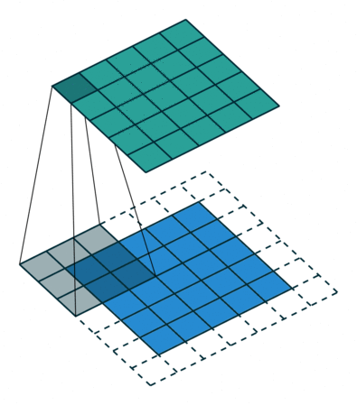
Regular Convolution
Output
(Green)
Stride: The step size used when computing the convolution
Padding: What is assumed about pixels “outside” of image bounds
Input
(Blue)
Kernel size: 3x3
Padding: “same” (1)
Stride: 0
Animations from: https://github.com/vdumoulin/conv_arithmetic
Notes:
Kernel size: kernel is discussed in the previous section. The kernel size defines the field of view of the convolution.
Stride: it defines the step size of the kernel when sliding through the image. Stride of 1 means that the kernel slides through the image pixel by pixel. Stride of 2 means that the kernel slides through image by moving 2 pixels per step (i.e., skipping 1 pixel). We can use stride (>= 2) for downsampling an image.
Padding: the padding defines how the border of an image is handled. A padded convolution (‘same’ padding in Tensorflow) will keep the spatial output dimensions equal to the input image, by padding 0 around the input boundaries if necessary. On the other hand, unpadded convolution (‘valid’ padding in Tensorflow) only perform convolution on the pixels of the input image, without adding 0 around the input boundaries. The output size is smaller than the input size.

Slide 57

Regular Convolution
Output
(Green)
Stride: The step size used when computing the convolution
Padding: What is assumed about pixels “outside” of image bounds
Stride is applied to the output and padding is applied to the input
Input
(Blue)
Kernel size: 3x3
Padding: 1
Stride: 1
Animations from: https://github.com/vdumoulin/conv_arithmetic
Notes:
Kernel size: kernel is discussed in the previous section. The kernel size defines the field of view of the convolution.
Stride: it defines the step size of the kernel when sliding through the image. Stride of 1 means that the kernel slides through the image pixel by pixel. Stride of 2 means that the kernel slides through image by moving 2 pixels per step (i.e., skipping 1 pixel). We can use stride (>= 2) for downsampling an image.
Padding: the padding defines how the border of an image is handled. A padded convolution (‘same’ padding in Tensorflow) will keep the spatial output dimensions equal to the input image, by padding 0 around the input boundaries if necessary. On the other hand, unpadded convolution (‘valid’ padding in Tensorflow) only perform convolution on the pixels of the input image, without adding 0 around the input boundaries. The output size is smaller than the input size.

Slide 58



Transpose Convolution: Upscaling Our Data
Stride applied to input
Padding applied to output (think of it as removing boundary pixels)
Kernel size: 3x3
Padding: 0
Stride: 0
Kernel size: 3x3
Padding: 0
Stride: 1
Kernel size: 3x3
Padding: 1
Stride: 1
Animations from: https://github.com/vdumoulin/conv_arithmetic
Notes:
Kernel size: kernel is discussed in the previous section. The kernel size defines the field of view of the convolution.
Stride: it defines the step size of the kernel when sliding through the image. Stride of 1 means that the kernel slides through the image pixel by pixel. Stride of 2 means that the kernel slides through image by moving 2 pixels per step (i.e., skipping 1 pixel). We can use stride (>= 2) for downsampling an image.
Padding: the padding defines how the border of an image is handled. A padded convolution (‘same’ padding in Tensorflow) will keep the spatial output dimensions equal to the input image, by padding 0 around the input boundaries if necessary. On the other hand, unpadded convolution (‘valid’ padding in Tensorflow) only perform convolution on the pixels of the input image, without adding 0 around the input boundaries. The output size is smaller than the input size.

Slide 59
Generative Models
Abe Davis
Some slides from Jin Sun, Phillip Isola

