Slide 1
Python Debugging Session
CS 5670
Qianqian Wang

Slide 2
PyCharm Debugging Techniques
See here for basic tutorials

Slide 3
Virtualenv Environment Configurations
In Settings/Preferences dialog (⌘,), select Project: <project name> | Project Interpreter.
In the Project Interpreter page, click and select Add.
In the left-hand pane of the Add Python Interpreter dialog box, select Virtualenv Environment.
Select Existing environment, Specify the virtual environment in your file system, e.g., {full path to}/cs5670_python_env/bin/python2.7
Reference: Pycharm Help Page

Slide 4
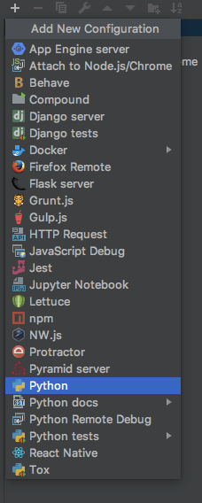
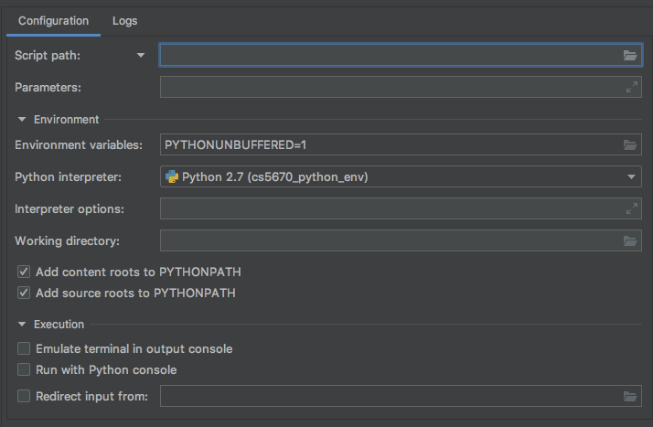
Run/Debug Configurations
Open the Run/Debug Configuration dialog [via Run | Edit Configurations]
Ex. path to gui.py
Ex. parameters of gui.py [-t resources/sample-correspondance.json -c resources/sample-config.json]
Reference: Pycharm Help Page

Slide 5
Use Pycharm Debugger
Set breakpoints: just click in the left gutter
Click Debug Button
Start Debugging!
Step through your program
Create a watch
Evaluate an expression or enable the Python console in the Debugger
Reference: Pycharm Help Page

Slide 6
Numpy array visualization
During debugging, click ‘View as Array’ to visualize the array
Want to visualize high-dimensional array? Try proper slicing

Slide 7
Virtual Machine
v.s.
Python Virtual Environment

Slide 8
Different levels of isolation:
Python Virtual Environment: isolate only python packages
VMs: isolate everything
Applications running in a virtual environment share an underlying operating system, while VM systems can run different operating systems.

Slide 9
Numpy Basics

Slide 10
Slicing [Manual]
Tips:
Slicing is simply setting an ordered subset.
range: a:b, ‘:’ is a special character that represents the range
logical mask
any subset
Indexing a single element can be viewed as slicing.
Compare X[a, b, c] with X[a:a+1, b:b+1, c:c+1].
Dimension loss and expansion.
Loss:
set the slicing range for a dimension to a single scalar
np.sum, np.mean, np.median, ...
Expansion:
np.newaxis, np.reshape, ...
What is an N Dimensional array?
Write explicitly, X[0:m₁, 0:m₂, …, 0:m_{N}]
N: number of dimensions (axes)
m₁, m₂, …, m_{N}: length of each dimension (axis)

Slide 11
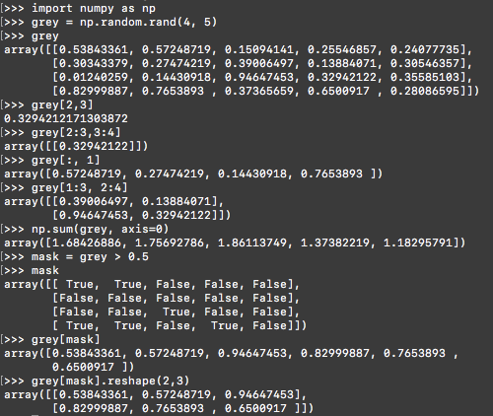
Slicing Examples
Practices:
Given an RGB image X[0:h, 0:w, 0:3]
Get G channel of a RGB image
X[:, :, 1]
RGB to BGR
X[:, :, [2, 1, 0]]
Center-crop a RGB image
X[r₁:r₂, c₁:c₂ , :]
Downsample a RGB image by a factor of 2
X[0:h:2, 0:w:2, :]

Slide 12
Stacking[Manual] and Concatenating [Manual]
np.stack(), np.concatenate()
np.stack() requires that all input array must have the same shape, and the stacked array has one more dimension than the input arrays.
np.concatenate() requires that the input arrays must have the same shape, except in the dimension corresponding to axis

Slide 13
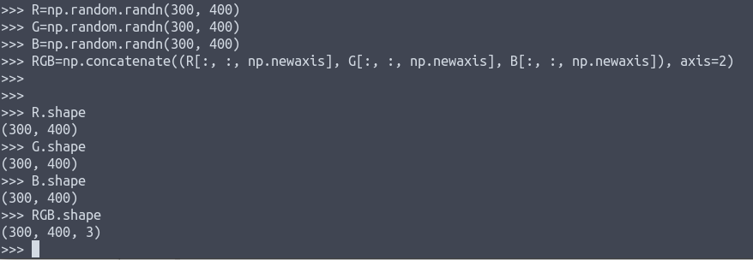
Concatenation Examples

Slide 14
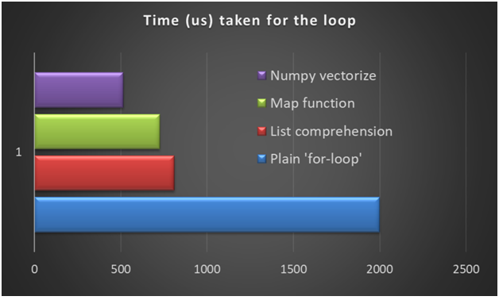
Vectorization
Turn your loops to Numpy vector manipulation
Vectorization enables fast parallel computation

Slide 15
Vectorization
Example 1: element-wise multiplication
For-Loop -- Inefficient | Numpy Vector -- Efficient!
>>> a = [1, 2, 3, 4, 5] >>> b = [6, 7, 8, 9, 10] >>> [x * y for x, y in zip(a, b)] [6, 14, 24, 36, 50] | >>> import numpy as np >>> a = np.array([1, 2, 3, 4, 5]) >>> b = np.array([6, 7, 8, 9, 10]) >>> a * b array([ 6, 14, 24, 36, 50])

Slide 16
Vectorization
Example 2: compute gaussian kernel
For Loop | hc = height // 2 wc = width // 2 gaussian = np.zeros((height, width)) for i in range(height): for j in range(width): gaussian[i, j] = np.exp(-((i - hc)**2 + (j - wc)**2)/(2.0*sigma**2)) gaussian /= np.sum(gaussian)
Numpy Vector | hc = height // 2 wc = width // 2 grid = np.mgrid[-hc:hc+1, -wc:wc+1] # 2 x height x width gaussian = np.exp(-np.sum(grid**2, axis=0)/(2.0*sigma**2)) gaussian /= np.sum(gaussian)

Slide 17
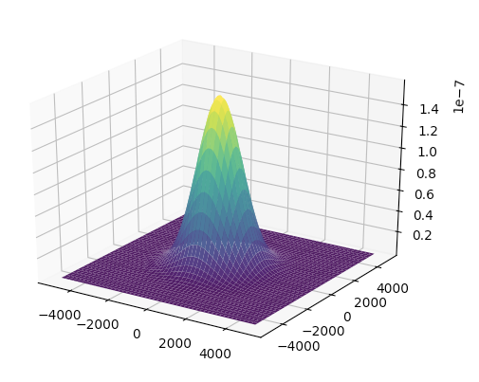
Vectorization
Example 2: compute gaussian kernel and plot
Height = width = 9999, sigma = 1000
For Loop: ~106s
Vectorization: ~12s

Slide 18
Other useful functions:
vector operations: inner product [np.inner()], outer product [np.outer()], cross product [np.cross()], matrix multiplication [np.dot()] , matrix inverse [np.linalg.inv()]
special matrices/vectors: np.zeros(), np.ones(), np.identity(), np.linspace(), np.arange()
matrix reshaping: np.reshape(), np.transpose()
(row_axis, column_axis, channel_axis) → (channel_axis, row_axis, column_axis): np.transpose(X,[2, 0, 1])
statistics: np.min(), np.max(), np.mean(), np.median(), np.sum()
logical arrays: np.logical_and(), np.logical_or(), np.logical_not()

Slide 19
Q & A

