Slide 1
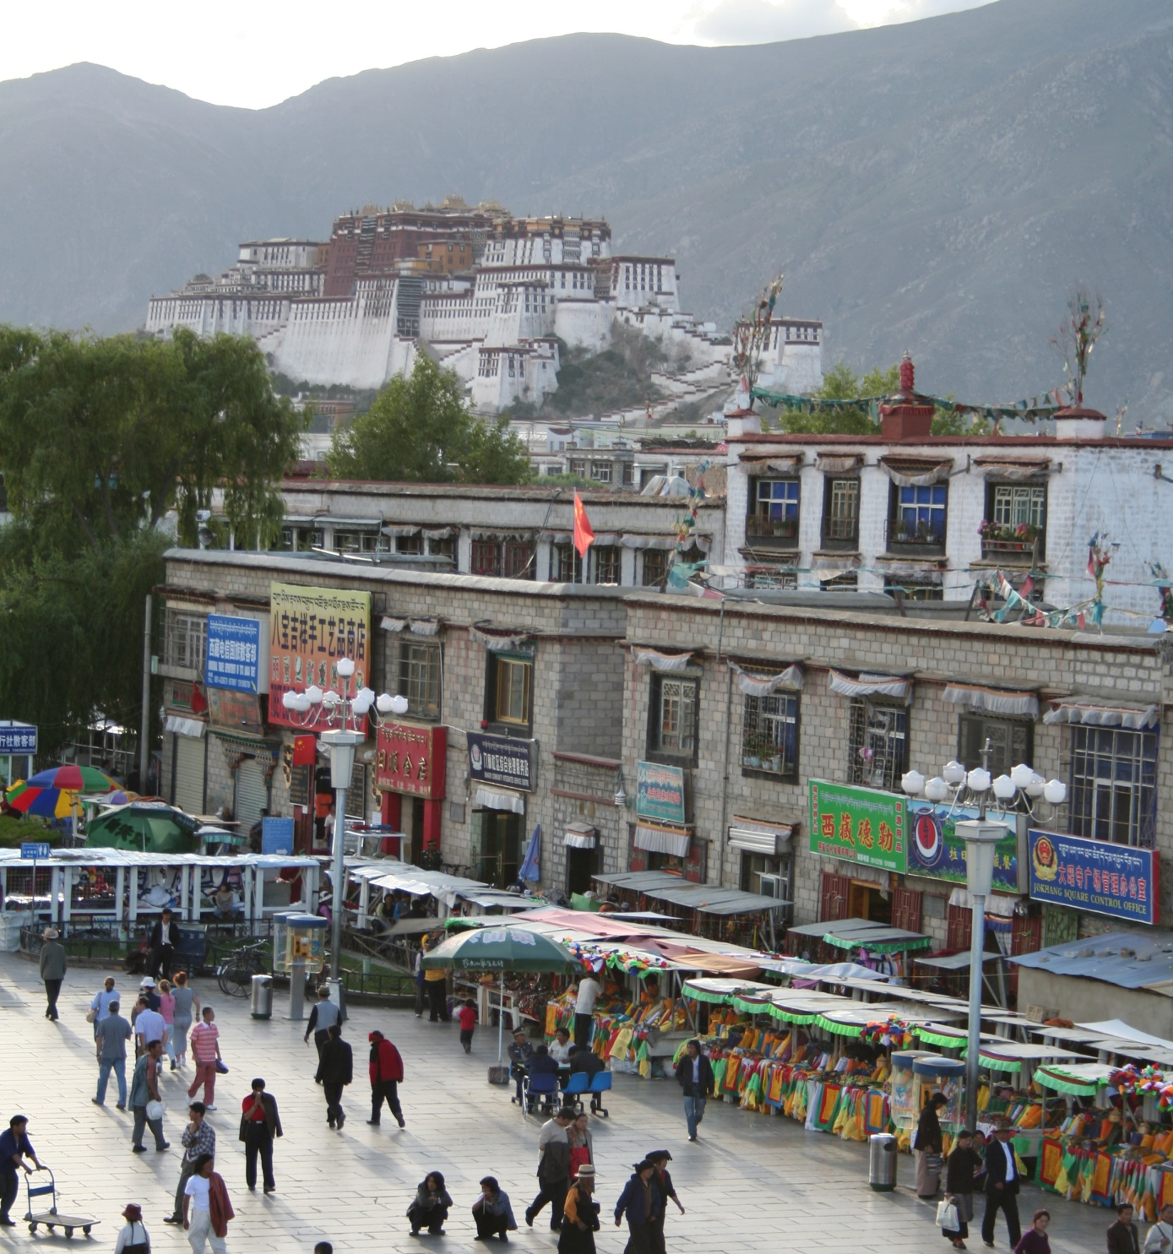
Introduction to Recognition
CS5670: Intro to Computer Vision
Noah Snavely
mountain
tree
building
banner
street lamp
vendor
people

Slide 2
Where we go from here
What we know: Geometry
  What is the shape of the world?
  How does that shape appear in images?
  How can we infer that shape from one or more images?
What’s next: Recognition
  What are we looking at?

Slide 3
What do we mean by “object recognition”?
Next slides adapted from
Li, Fergus, & Torralba’s excellent short course on category and object recognition

Slide 4
Verification: is that a lamp?

Slide 5
Detection: where are the people?

Slide 6
Identification: is that Potala Palace?

Slide 7
Object categorization
mountain
tree
building
banner
street lamp
vendor
people

Slide 8
Scene and context categorization
outdoor
city
…

Slide 9
Activity / Event Recognition
what are these people doing?

Slide 10
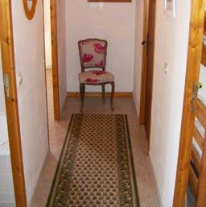

Object recognition
Is it really so hard?
Find the chair in this image
Output of normalized correlation
This is a chair

Slide 11
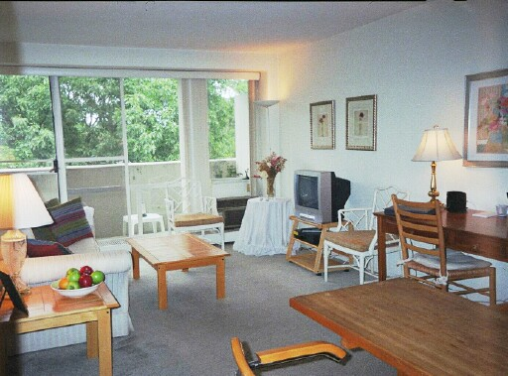

Object recognition
Is it really so hard?
Find the chair in this image
Pretty much garbage
Simple template matching is not going to do the trick

Slide 12
Object recognition
Is it really so hard?
Find the chair in this image
A “popular method is that of template matching, by point to point correlation of a model pattern with the image pattern. These techniques are inadequate for three-dimensional scene analysis for many reasons, such as occlusion, changes in viewing angle, and articulation of parts.” Nivatia & Binford, 1977.

Slide 13
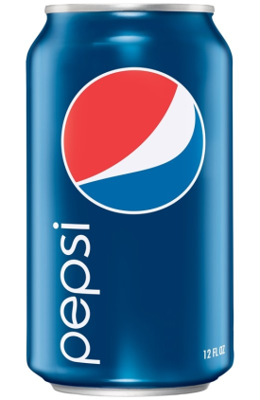

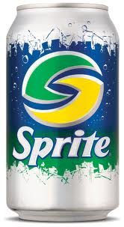
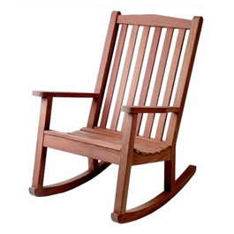
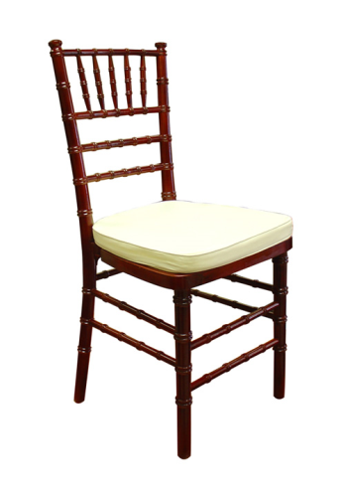
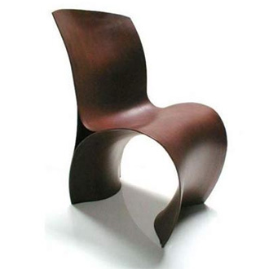
Why not use SIFT matching for everything?
Works well for object instances (or distinctive images such as logos)
Not great for generic object categories

Slide 14
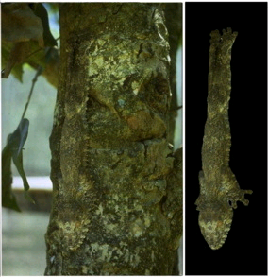
And it can get a lot harder
Brady, M. J., & Kersten, D. (2003). Bootstrapped learning of novel objects. J Vis, 3(6), 413-422

Slide 15
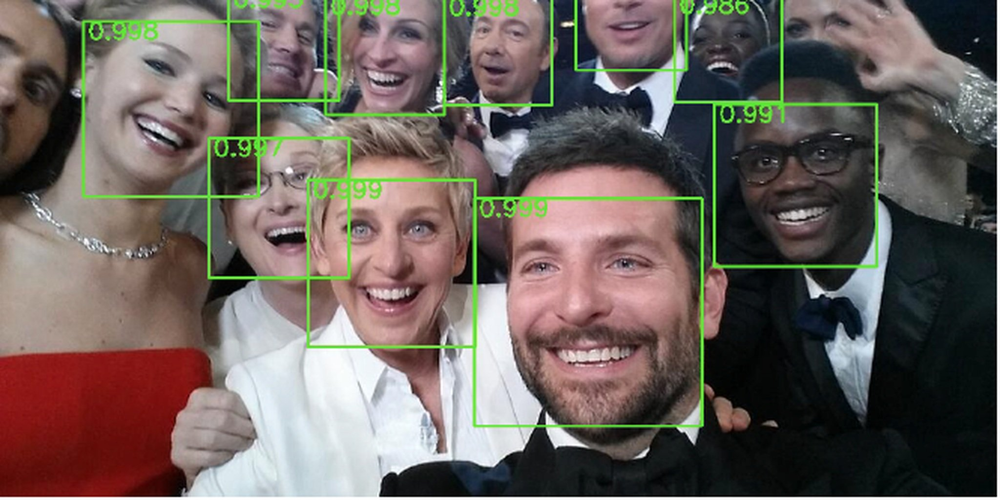
Applications: Photography

Slide 16
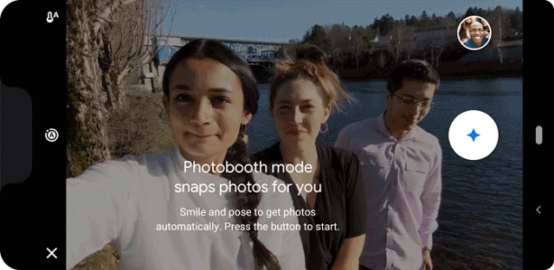
Applications: Shutter-free Photography
Take Your Best Selfie Automatically, with Photobooth on Pixel 3
https://ai.googleblog.com/2019/04/take-your-best-selfie-automatically.html
(Also features “kiss detection”)

Slide 17
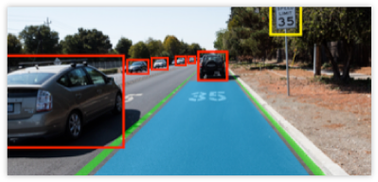
Applications:
Assisted / autonomous driving
https://www.extremetech.com/extreme/226071-nvidia-goes-all-in-on-self-driving-cars-including-a-robotic-car-racing-league

Slide 18
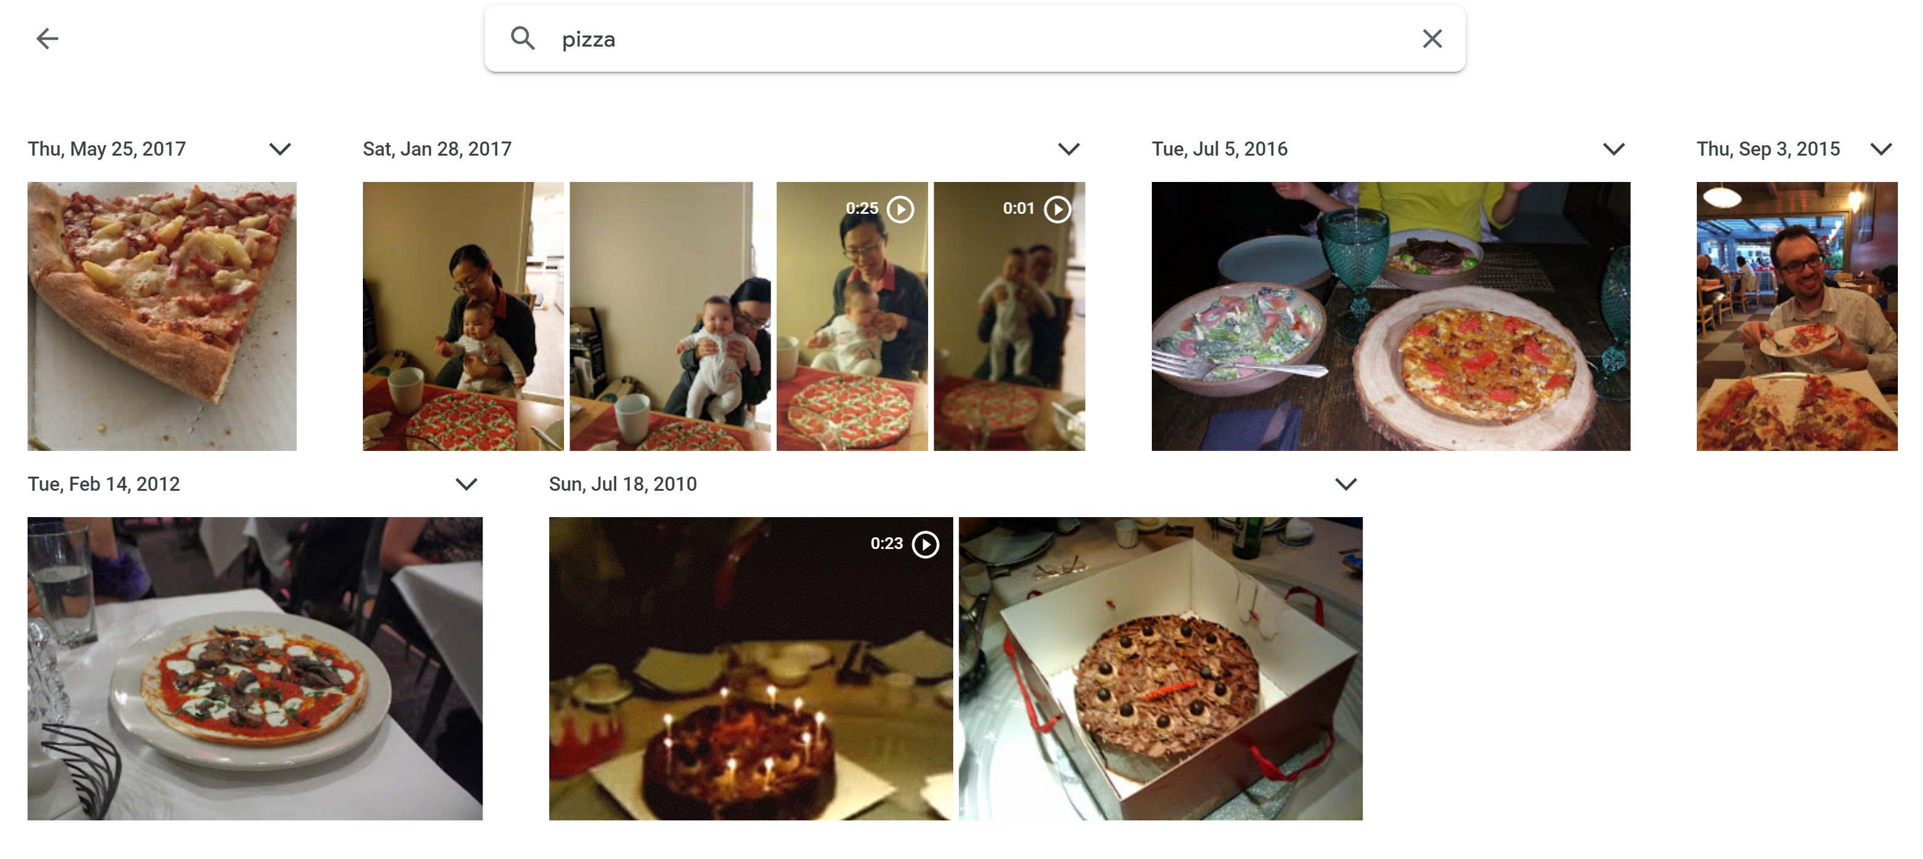
Applications: Photo organization
Source: Google Photos

Slide 19
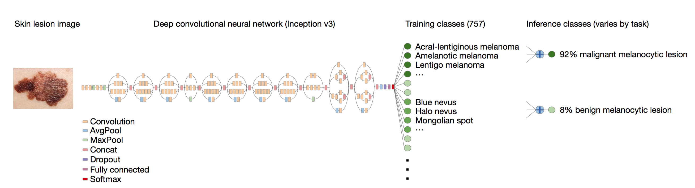
Applications: medical imaging
Dermatologist-level classification of skin cancer
https://cs.stanford.edu/people/esteva/nature/

Slide 20
Applications
And the list goes on…
  Amazon Go (Cashierless stores)

Slide 21
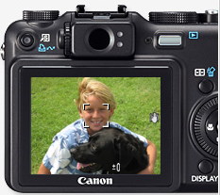
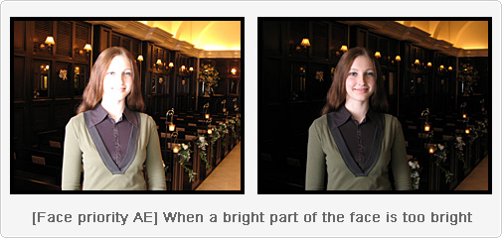
Applications: Computational photography

Slide 22
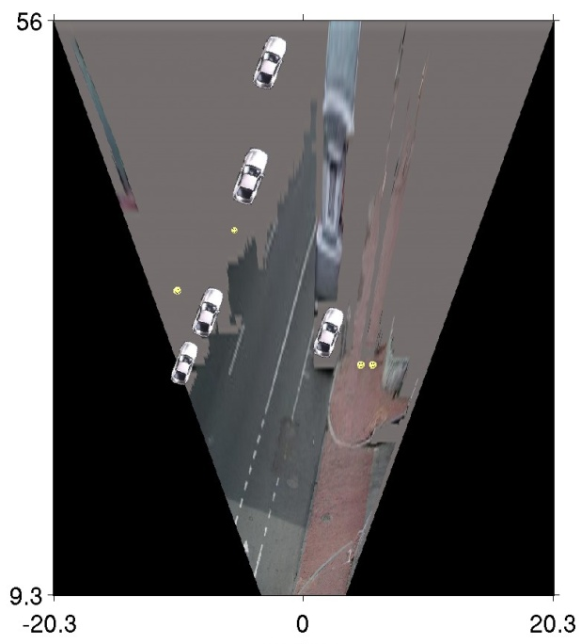
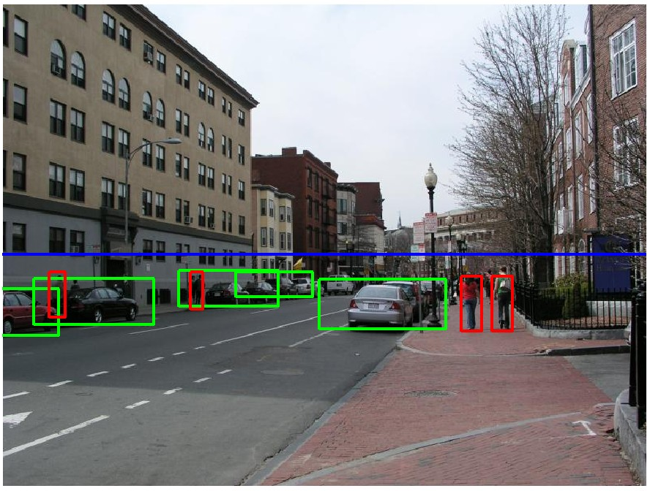
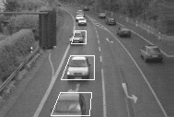
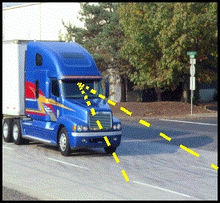
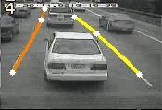
Applications: Assisted driving
Pedestrian and car detection
meters
Ped
Ped
Car
meters
Lane detection
Collision warning systems with adaptive cruise control,
Lane departure warning systems,
Rear object detection systems,

Slide 23
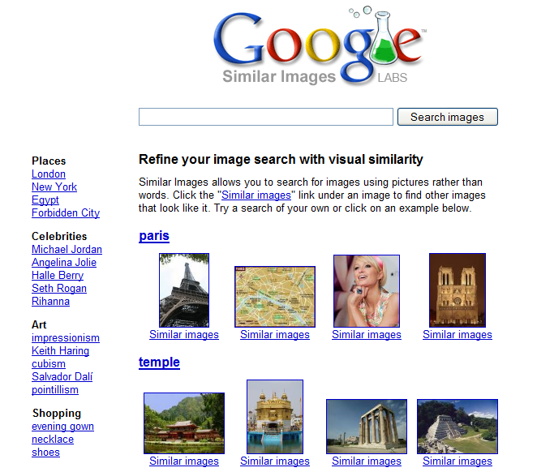
Applications: image search

Slide 24
How do human do recognition?
We don’t completely know yet
But we have some experimental observations.

Slide 25
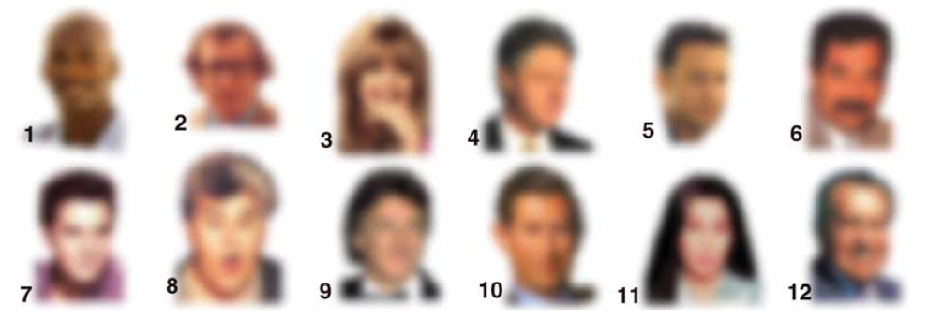
Observation 1
We can recognize familiar faces even in low-resolution images

Slide 26
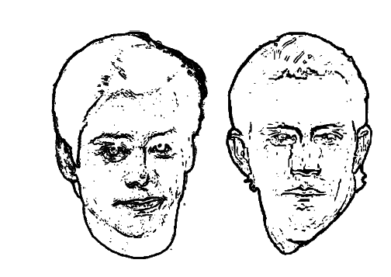
Observation 2:
Jim Carrey
Kevin Costner
High frequency information is not enough

Slide 27
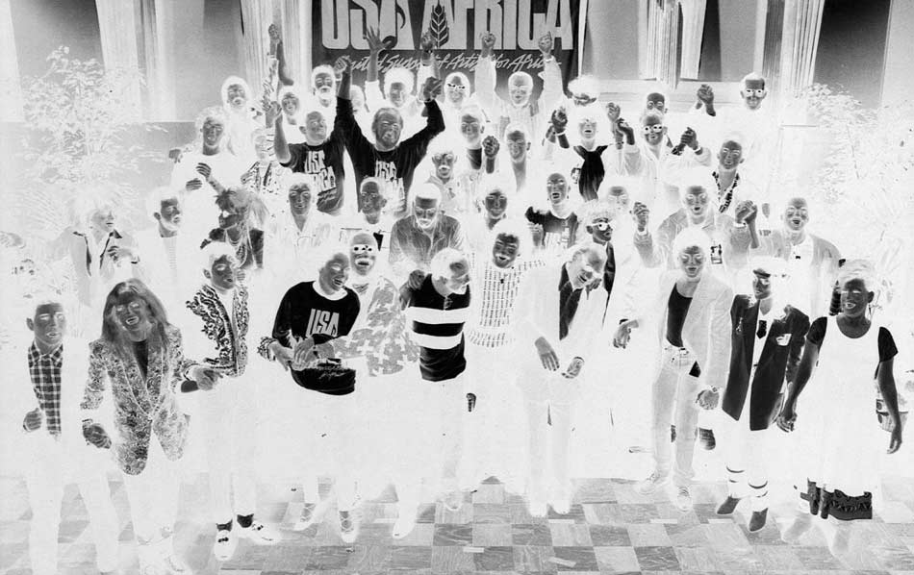
Observation 3:

Slide 28
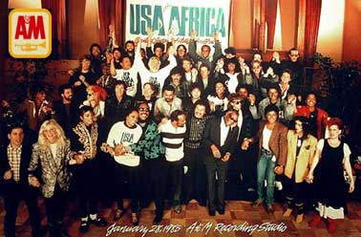
Observation 3:
Negative contrast is difficult

Slide 29
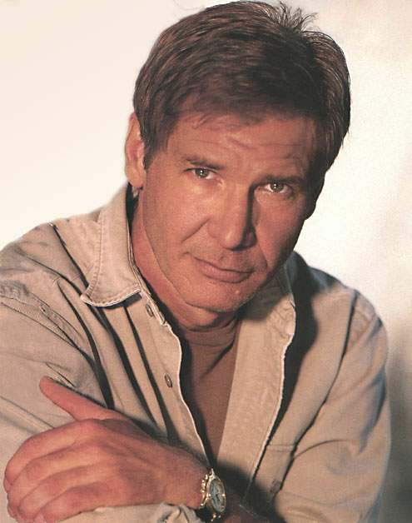
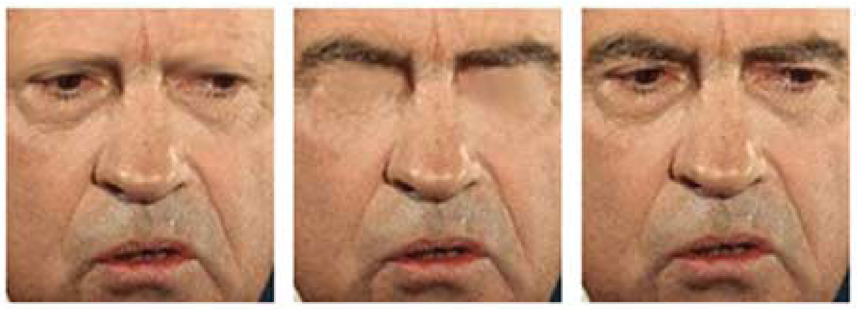
What is the single most important facial features for recognition?

Slide 30
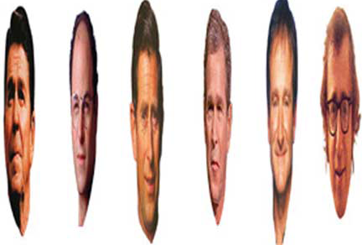
Observation 4:
Image Warping is OK

Slide 31
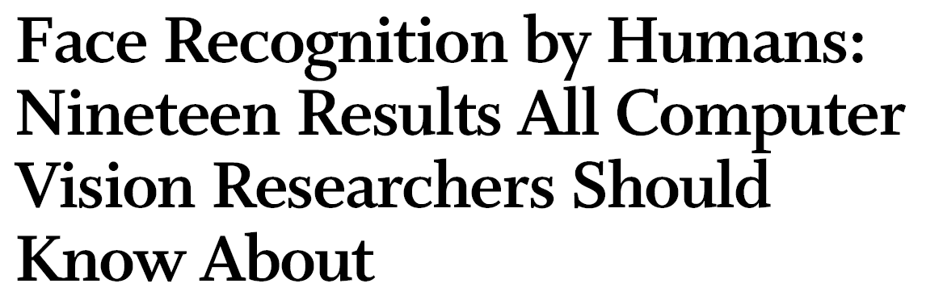
The list goes on
http://web.mit.edu/bcs/sinha/papers/19results_sinha_etal.pdf

Slide 32
Why is this hard?
Variability:
Camera position
Illumination
Shape parameters
Svetlana Lazebnik
Notes:
One could argue that invariance is the key challenge to computer vision. But is this still true with big data?

Slide 33
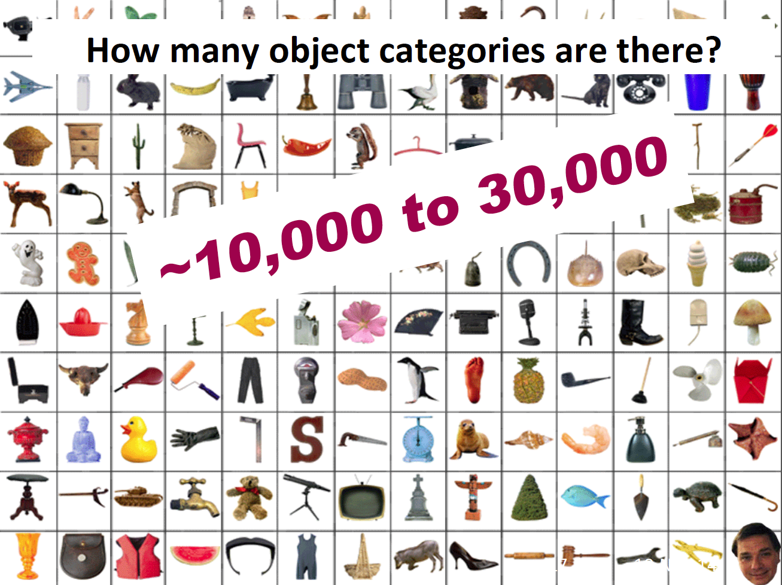

Slide 34
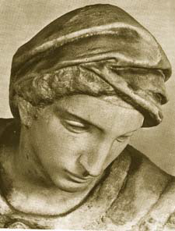
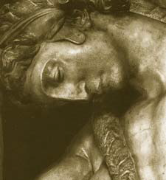
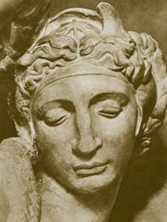
Challenge: variable viewpoint
Michelangelo 1475-1564

Slide 35
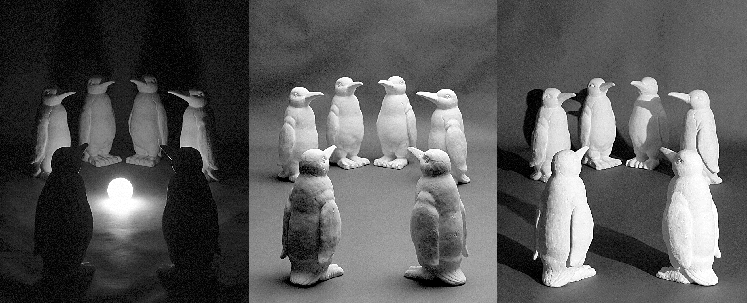
Challenge: variable illumination
image credit: J. Koenderink

Slide 36
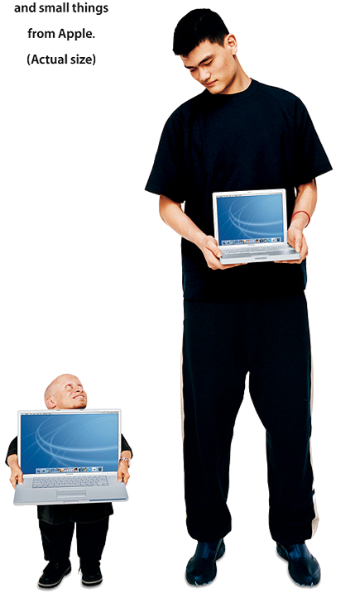
Challenge: scale

Slide 37
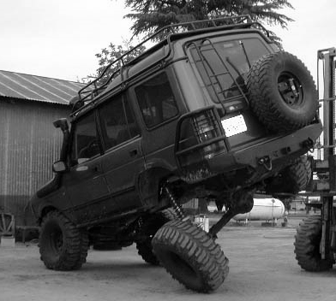
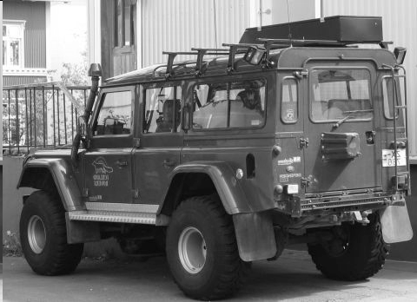
Challenge: deformation

Slide 38
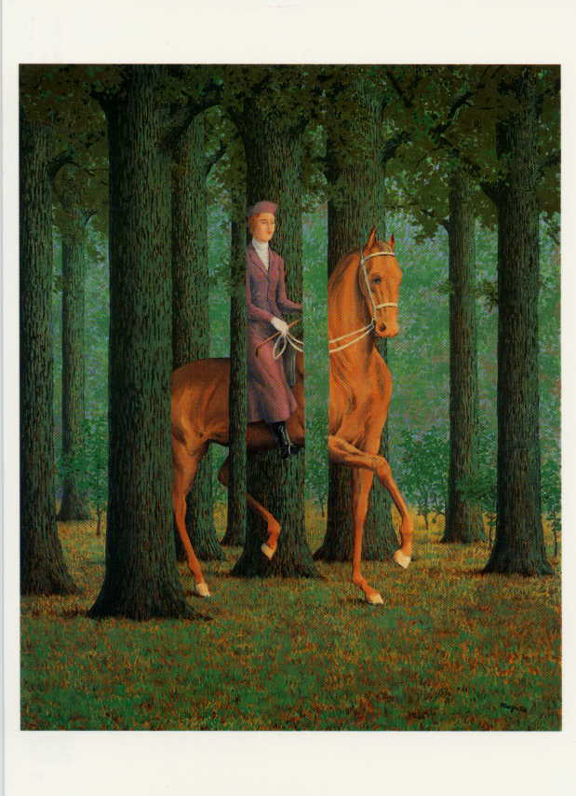
Challenge: Occlusion
Magritte, 1957

Slide 39
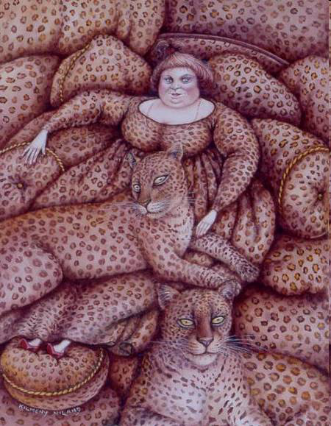
Challenge: background clutter
Kilmeny Niland. 1995

Slide 40


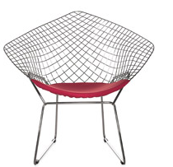


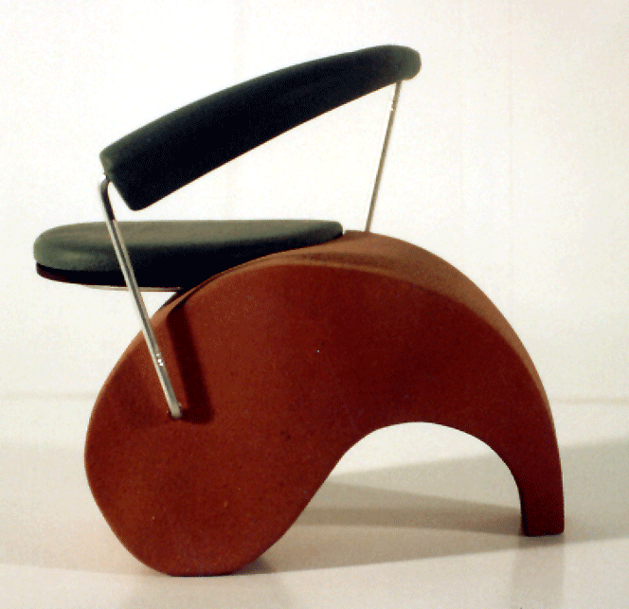
Challenge: intra-class variations
Svetlana Lazebnik
Notes:
Note English language issues. Try to not let language confound things.

Slide 41
History of ideas in recognition
1960s – early 1990s: the geometric era
Svetlana Lazebnik

Slide 42
θ
Variability:
Camera position
Illumination
Alignment
Shape: assumed known
Roberts (1965); Lowe (1987); Faugeras & Hebert (1986); Grimson & Lozano-Perez (1986); Huttenlocher & Ullman (1987)
Svetlana Lazebnik

Slide 43
Instance Recognition
Alignment: fitting a model to a transformation between pairs of features (matches) in two images
x_{i}
x_{i}
Find transformation T
that minimizes
'
T
Svetlana Lazebnik

Slide 44
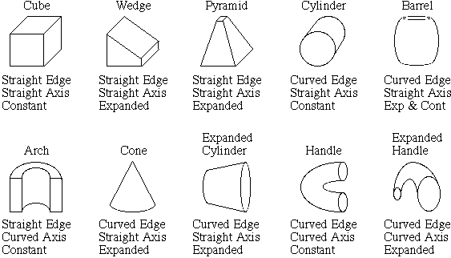
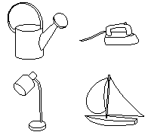
Recognition by components
Biederman (1987)
Primitives (geons)
Objects
http://en.wikipedia.org/wiki/Recognition_by_Components_Theory
Svetlana Lazebnik

Slide 45
History of ideas in recognition
1960s – early 1990s: the geometric era
1990s: appearance-based models
Svetlana Lazebnik

Slide 46
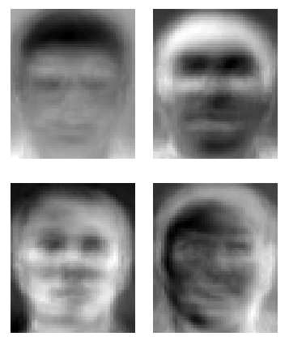
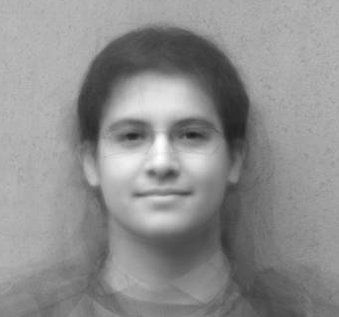
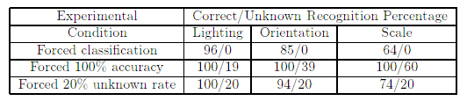
Eigenfaces (Turk & Pentland, 1991)
Average face
Basis faces
Svetlana Lazebnik
Notes:
An image can be compressed and reconstructed by starting from the mean, and adding a small number of scaled signed images. The scaled signed images come from doing PCA (or eigenvalue analysis) and adding the eigenfaces.

Slide 47
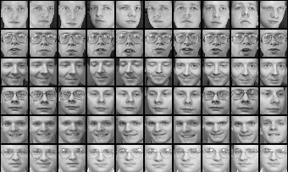
Limitations of global appearance models
Requires global registration of patterns
Not robust to clutter, occlusion, geometric transformations
Svetlana Lazebnik

Slide 48
History of ideas in recognition
1960s – early 1990s: the geometric era
1990s: appearance-based models
1990s – present: sliding window approaches
Svetlana Lazebnik

Slide 49

Sliding window approaches

Slide 50

Sliding window approaches
Turk and Pentland, 1991
Belhumeur, Hespanha, & Kriegman, 1997
Schneiderman & Kanade 2004
Viola and Jones, 2000
Schneiderman & Kanade, 2004
Agrawal and Roth, 2002
Poggio et al. 1993

Slide 51
History of ideas in recognition
1960s – early 1990s: the geometric era
1990s: appearance-based models
Mid-1990s: sliding window approaches
Late 1990s: local features
Svetlana Lazebnik

Slide 52
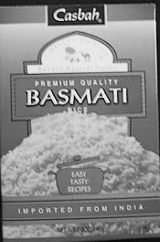
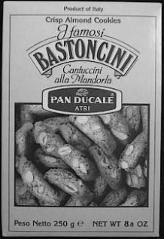




Local features for object instance recognition
D. Lowe (1999, 2004)

Slide 53
History of ideas in recognition
1960s – early 1990s: the geometric era
1990s: appearance-based models
Mid-1990s: sliding window approaches
Late 1990s: local features
Early 2000s: parts-and-shape models

Slide 54

Parts-and-shape models
Model:
  Object as a set of parts
  Relative locations between parts
  Appearance of part
Figure from [Fischler & Elschlager 73]

Slide 55

Representing people

Slide 56

Discriminatively trained part-based models
P. Felzenszwalb, R. Girshick, D. McAllester, D. Ramanan, "Object Detection with Discriminatively Trained Part-Based Models," PAMI 2009

Slide 57
History of ideas in recognition
1960s – early 1990s: the geometric era
1990s: appearance-based models
Mid-1990s: sliding window approaches
Late 1990s: local features
Early 2000s: parts-and-shape models
Mid-2000s: bags of features
Svetlana Lazebnik

Slide 58


Bag-of-features models
Svetlana Lazebnik

Slide 59



Bag-of-features models
Bag of ‘words’
Object
Svetlana Lazebnik

Slide 60
History of ideas in recognition
1960s – early 1990s: the geometric era
1990s: appearance-based models
Mid-1990s: sliding window approaches
Late 1990s: local features
Early 2000s: parts-and-shape models
Mid-2000s: bags of features
2012-: data-driven methods, deep learning (now Turing award-winning idea)
Svetlana Lazebnik

Slide 61
What Matters in Recognition?
Learning Techniques
  E.g. choice of classifier or inference method
Representation
  Low level: SIFT, HoG, GIST, edges
  Mid level: Bag of words, sliding window, deformable model
  High level: Contextual dependence
  Deep learned features
Data
  More is always better (as long as it is good data)
  Annotation is the hard part

Slide 62
Types of Recognition
Instance recognition
  Recognizing a known object but in a new viewpoint, with clutter and occlusion
  Location/Landmark Recognition
    Recognize Paris, Rome, ... in photographs
    Ideas from information retrieval
Category recognition
  Harder problem, even for humans
  Bag of words, part-based, recognition and segmentation

Slide 63

Simultaneous recognition, detection, and segmentation
Notes:
Label each pixel with its class (say dog, grass) and use CRF to do the segmentation.

Slide 64


PASCAL VOC 2005-2012
20 object classes 22,591 images
Classification: person, motorcycle
Detection
Segmentation
Person
Motorcycle
Action: riding bicycle
Everingham, Van Gool, Williams, Winn and Zisserman.
The PASCAL Visual Object Classes (VOC) Challenge. IJCV 2010.

Slide 65


20 object categories (aeroplane to TV/monitor)
Three (+2) challenges:
  Classification challenge (is there an X in this image?)
  Detection challenge (draw a box around every X)
  Segmentation challenge (which class is each pixel?)
Notes:
+2 action classification and person layout.

Slide 66

Notes:
Images downloaded from flickr. 500k images downloaded. Random subset selected for annotation.
Full annotation

Slide 67


is
is there a cat?

Slide 68


Precision / Recall for a Category X
Precision:
Recall:
In reality, methods give a continuous-valued score for each image / category ➔ PR curve
Notes:
Precision: Images Classified as X (denominator). BUT only some number of them actually have X. 90/100
Recall: Images that contain X (denominator). How many of them do you find?
Say 100 images have a bike.
If it returns 200 images then precision is 0.5, but all the 100 are included then recall is 1.
If it returns 50 images and they all have a bike, then precision is 1.0, but recall is 0.5
information retrieval scenario, the instances are documents and the task is to return a set of relevant documents given a search term; or equivalently, to assign each document to one of two categories, "relevant" and "not relevant". In this case, the "relevant" documents are simply those that belong to the "relevant" category. Recall is defined as the number of relevant documents retrieved by a search divided by the total number of existing relevant documents, while precision is defined as the number of relevant documents retrieved by a search divided by the total number of documents retrieved by that search.

Slide 69

"Precisionrecall" by Walber - Own work. Licensed under CC BY-SA 4.0 via Wikimedia Commons - http://commons.wikimedia.org/wiki/File:Precisionrecall.svg#mediaviewer/File:Precisionrecall.svg

Slide 70

Precision / Recall Curve
Similar to the ROC curves you saw in Project 2

Slide 71


Slide 72

Pascal VOC 2007 Average Precision
Notes:
2007 was not the first year, but it’s the first year with 20 classes and the same evaluation metric (AP vs Area under ROC)

Slide 73

Pascal VOC 2012 Average Precision

Slide 74


Slide 75


Slide 76



Slide 77


Slide 78



“Intersection over union” (IoU) score
Source: https://www.pyimagesearch.com/2016/11/07/intersection-over-union-iou-for-object-detection/

Slide 79




“Intersection over union” (IoU) score
Source: https://www.pyimagesearch.com/2016/11/07/intersection-over-union-iou-for-object-detection/

Slide 80


Slide 81


Slide 82


Slide 83


Slide 84


Slide 85
A brief history of image recognition
What worked in 2011 (pre-deep-learning era in computer vision)
  Optical character recognition
  Face detection
  Instance-level recognition (what logo is this?)
  Pedestrian detection (sort of)
  … that’s about it

Slide 86

A brief history of image recognition
What works now, post-2012 (deep learning era)
  Robust object classification across thousands of object categories (outperforming humans)
“Spotted salamander”

Slide 87


A brief history of image recognition
What works now, post-2012 (deep learning era)
  Face recognition at scale

Slide 88
A brief history of image recognition
What works now, post-2012 (deep learning era)
  High-quality face synthesis (but not yet for completely general scenes)

Slide 89

These people are not real – they were produced by our generator that allows control over different aspects of the image.
A Style-Based Generator Architecture for Generative Adversarial Networks
Tero Karras (NVIDIA), Samuli Laine (NVIDIA), Timo Aila (NVIDIA)
http://stylegan.xyz/paper

Slide 90
What Matters in Recognition?
Learning Techniques
  E.g. choice of classifier or inference method
Representation
  Low level: SIFT, HoG, GIST, edges
  Mid level: Bag of words, sliding window, deformable model
  High level: Contextual dependence
  Deep learned features
Data
  More is always better (as long as it is good data)
  Annotation is the hard part

Slide 91
What Matters in Recognition?
Learning Techniques
  E.g. choice of classifier or inference method
Representation
  Low level: SIFT, HoG, GIST, edges
  Mid level: Bag of words, sliding window, deformable model
  High level: Contextual dependence
  Deep learned features
Data
  More is always better (as long as it is good data)
  Annotation is the hard part

Slide 92
Where to from here?
Scene Understanding
  Big data – lots of images
  Crowd-sourcing – lots of people
  Deep Learning – lots of compute

Slide 93

24 Hrs in Photos
http://www.kesselskramer.com/exhibitions/24-hrs-of-photos
installation by Erik Kessels

Slide 94


Slide 95


Slide 96
Data Sets
ImageNet
  Huge, Crowdsourced, Hierarchical, Iconic objects
PASCAL VOC
  Not Crowdsourced, bounding boxes, 20 categories
SUN Scene Database, Places
  Not Crowdsourced, 397 (or 720) scene categories
LabelMe (Overlaps with SUN)
  Sort of Crowdsourced, Segmentations, Open ended
SUN Attribute database (Overlaps with SUN)
  Crowdsourced, 102 attributes for every scene
OpenSurfaces
  Crowdsourced, materials
Microsoft COCO
  Crowdsourced, large-scale objects

Slide 97

Large Scale Visual Recognition Challenge (ILSVRC) 2010-2012
20 object classes 22,591 images
1000 object classes 1,431,167 images
Dalmatian
http://image-net.org/challenges/LSVRC/{2010,2011,2012}

Slide 98

Variety of object classes in ILSVRC

Slide 99

Variety of object classes in ILSVRC

Slide 100



Notes:
899 categories from Abbey to Zoo
For each of those categories we perform keyword searches on the Internet to find candidate scenes, and manually filter each category according to strict guidelines (e.g. what distinguishes a pasture and a corral). We end up with 130, 519 images.
It turns out that, even with an Internet worth of imagery, some categories are sparsely sampled. For all the experiments in this talk, we used only the 397 well-sampled categories with at least 100 unique images.

Slide 101

What are attributes?
What do we want to know about this object?
Object recognition expert:
“Dog”

Slide 102



Next step: Infer object properties
Can I poke with it?
Can I put stuff in it?
Is it alive?
What shape is it?
Is it soft?
Does it have a tail?
Will it blend?

Slide 103
What are attributes?
What do we want to know about this object?
Object recognition expert:
“Dog”
Person in the Scene:
“Big pointy teeth”, “Can move fast”, “Looks angry”

Slide 104
Why infer properties
We want detailed information about objects
“Dog”
vs.
“Large, angry animal with pointy teeth”

Slide 105




Why infer properties
2. We want to be able to infer something about unfamiliar objects
Familiar Objects
New Object

Slide 106
Why infer properties
2. We want to be able to infer something about unfamiliar objects
If we can infer properties…
Familiar Objects
New Object
Has Stripes
Has Ears
Has Eyes
….
Has Four Legs
Has Mane
Has Tail
Has Snout
….
Brown
Muscular
Has Snout
….
Has Stripes (like cat)
Has Mane and Tail (like horse)
Has Snout (like horse and dog)

Slide 107



Why infer properties
3. We want to make comparisons between objects or categories
What is unusual about this dog?
What is the difference between horses and zebras?

Slide 108
Questions?

