Slide 1
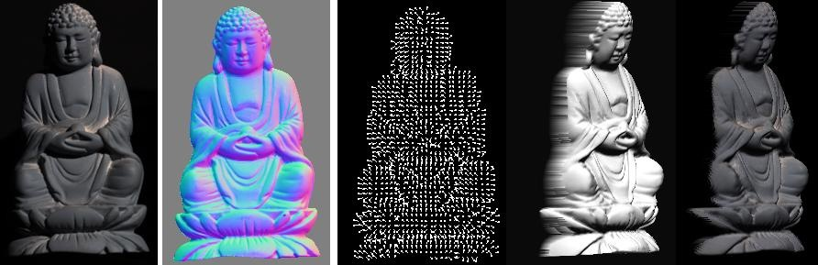
Photometric stereo
CS5670 : Computer Vision
Noah Snavely

Slide 2
Announcements
Project 3 released
Due Monday, April 22, by 11:59pm
To be done in groups of 2
Demo by Kai

Slide 3
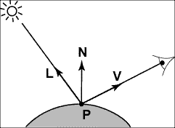
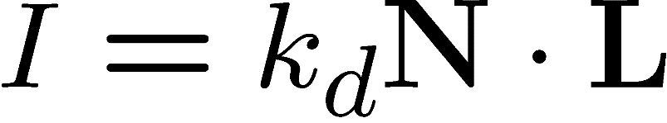
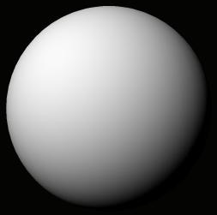
Recap: Lambertian (Diffuse) Reflectance
I : observed image intensity
k_{d} : object albedo
N : surface normal
L : light source direction
Lambertian sphere with constant albedo lit by a directional light source

Slide 4
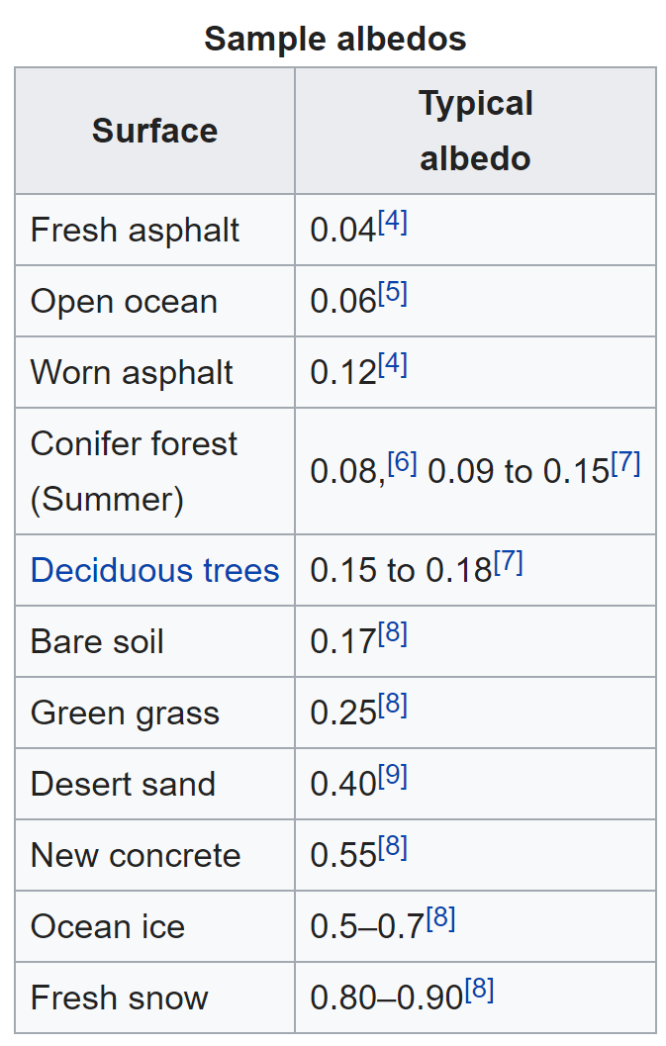
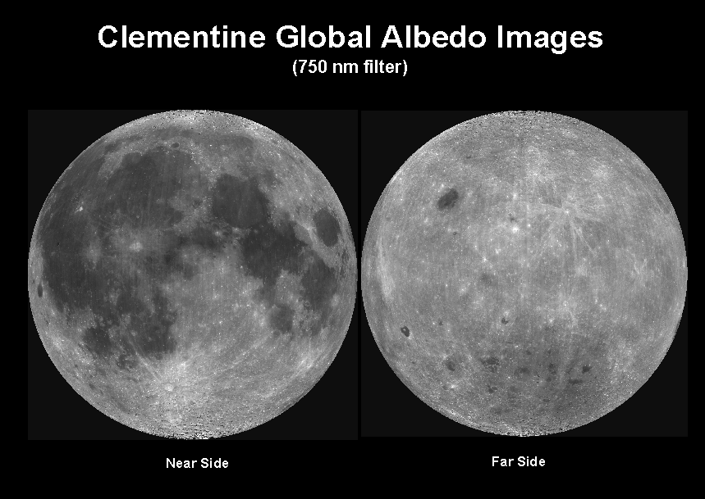
Objects can have varying albedo and albedo varies with wavelength
Source: https://en.wikipedia.org/wiki/Albedo

Slide 5
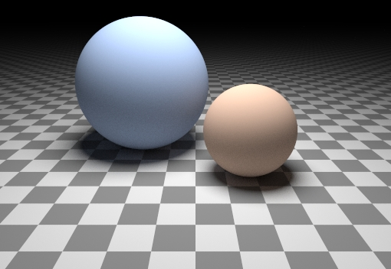
Can we determine shape from lighting?
Are these spheres?
Or just flat discs painted with varying albedo?

Slide 6



A Single Image: Shape from Shading
Assume is 1 for now.
What can we measure from one image?
is the angle between N and L
Add assumptions:
Constant albedo
A few known normals (e.g. silhouettes)
Smoothness of normals
In practice, SFS doesn’t work very well:
assumptions are too restrictive,
too much ambiguity in nontrivial scenes.

Slide 7

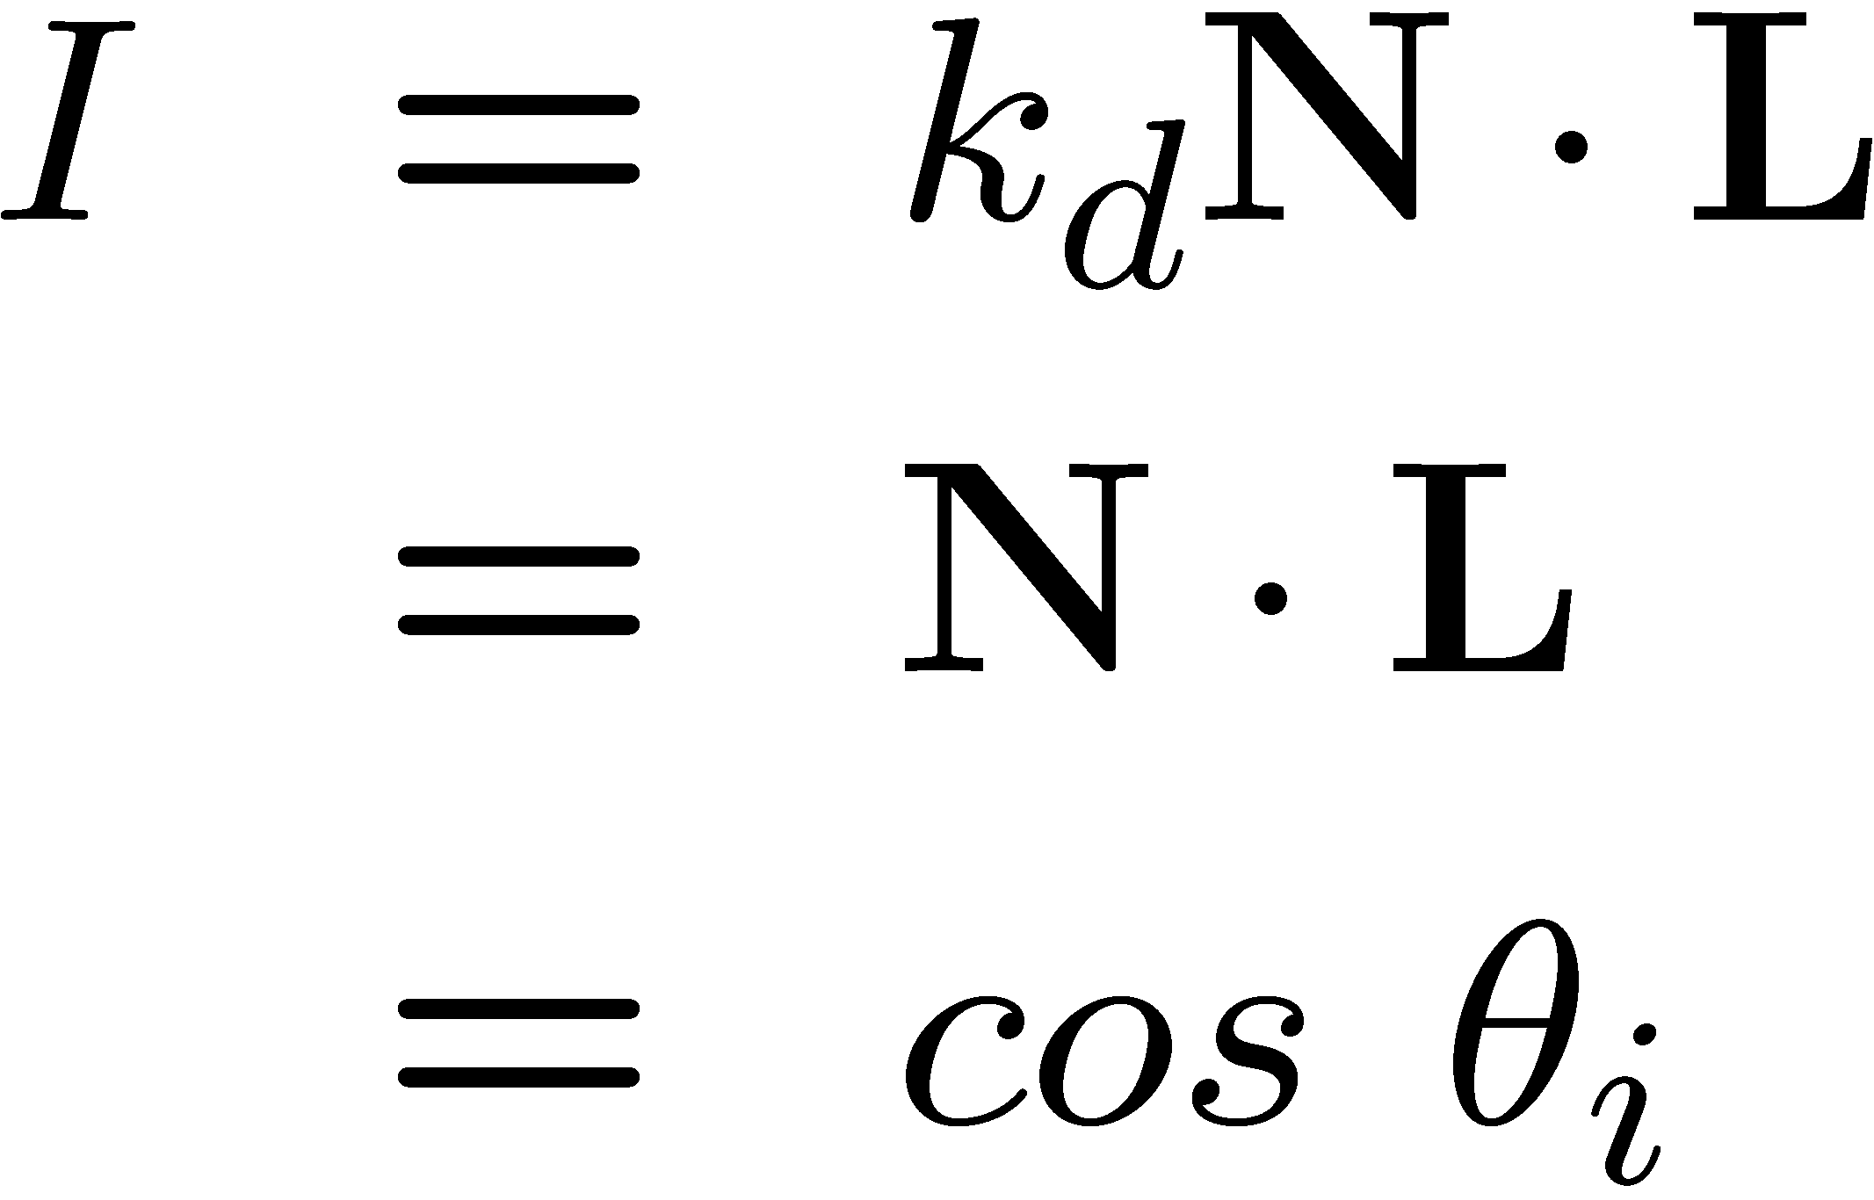


Shape from shading
Suppose
You can directly measure angle between normal and light source
Not quite enough information to compute surface shape
But can be if you add some additional info, for example
assume a few of the normals are known (e.g., along silhouette)
constraints on neighboring normals—“integrability”
smoothness
Hard to get it to work well in practice
plus, how many real objects have constant albedo?
But, deep learning can help

Slide 8
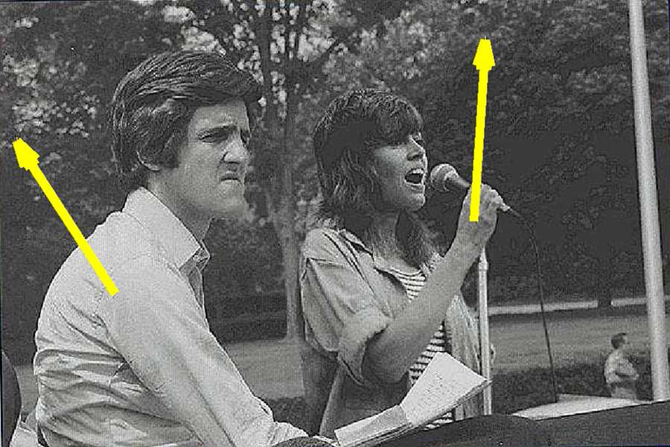
Application: Detecting composite photos
Real photo
Fake photo

Slide 9
Diffuse reflection
Demo
http://www.math.montana.edu/frankw/ccp/multiworld/twothree/lighting/applet1.htm
http://www.math.montana.edu/frankw/ccp/multiworld/twothree/lighting/learn2.htm

Slide 10
Let’s take more than one photo!

Slide 11




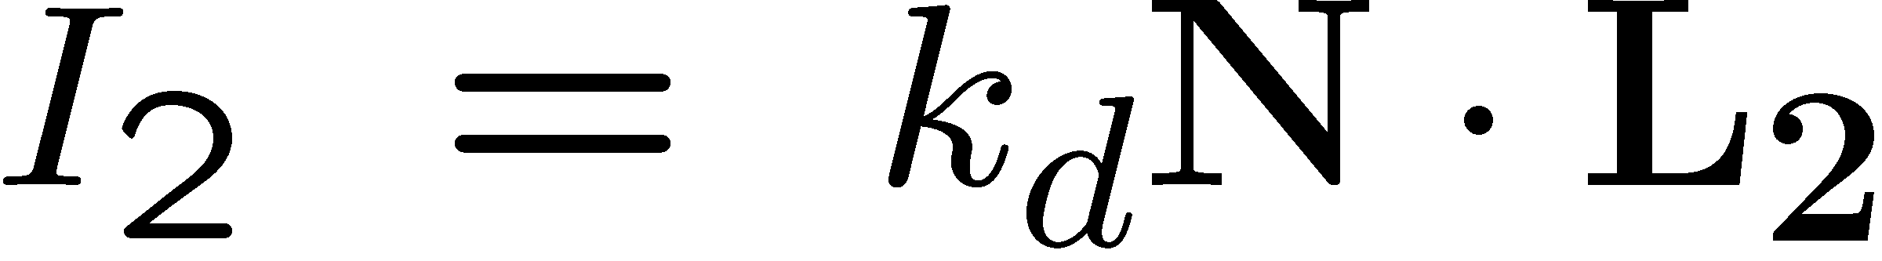

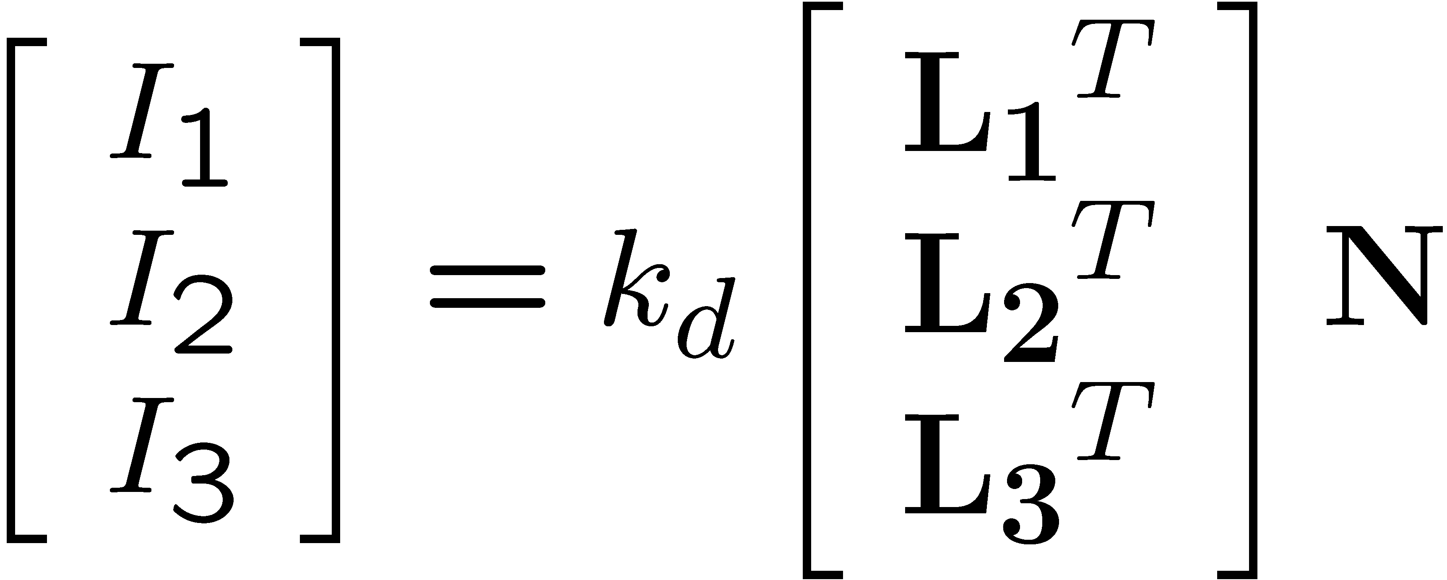
Photometric stereo
N
L₃
L₂
L₁
V
Can write this as a matrix equation:

Slide 12
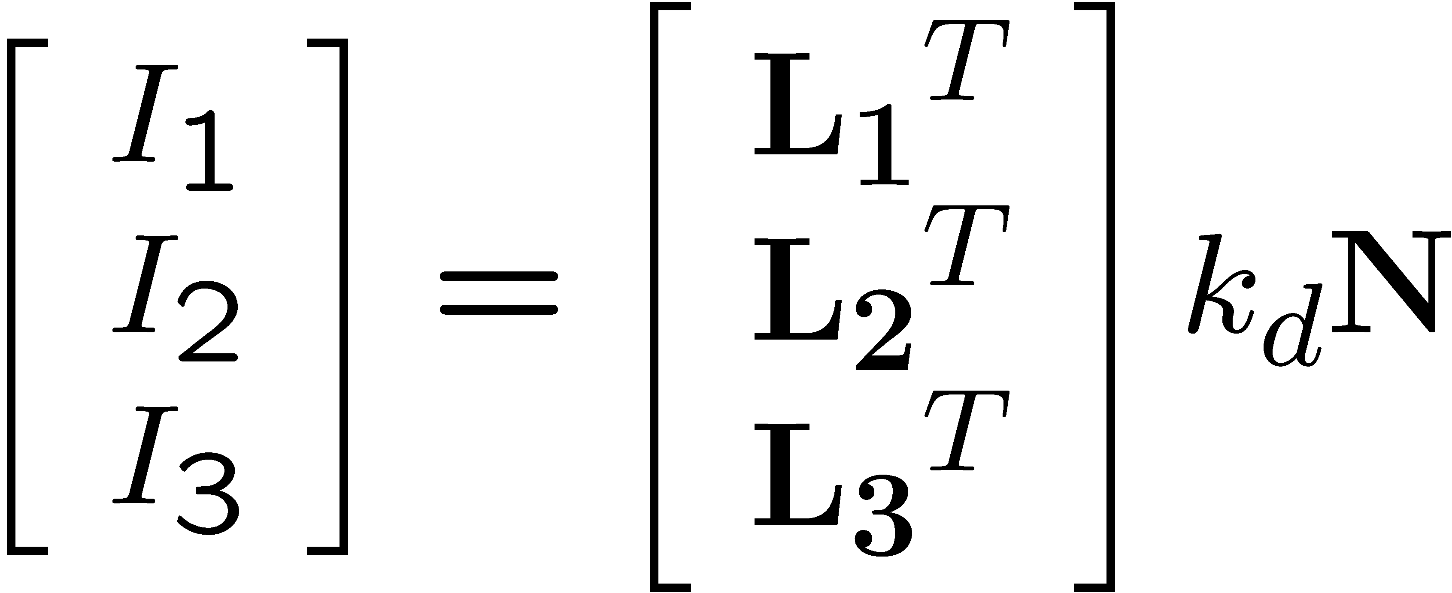







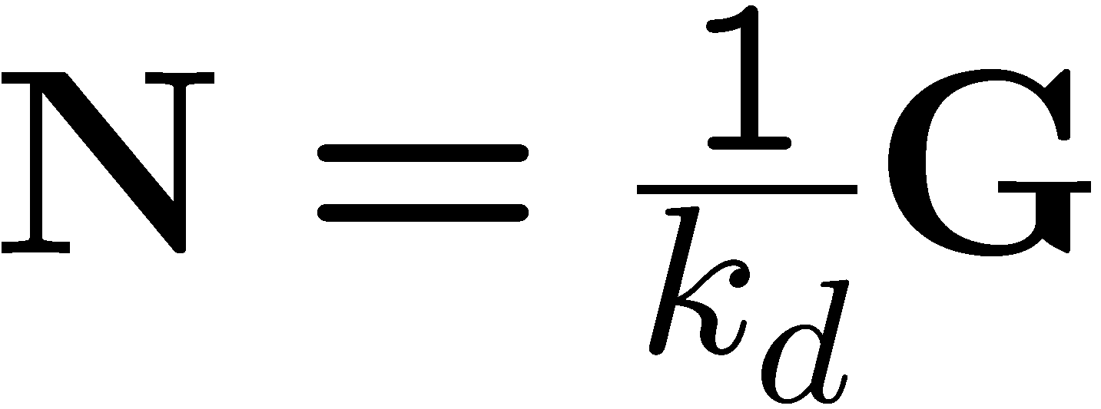
Solving the equations
Solve one such linear system per pixel to solve for that pixel’s surface normal

Slide 13
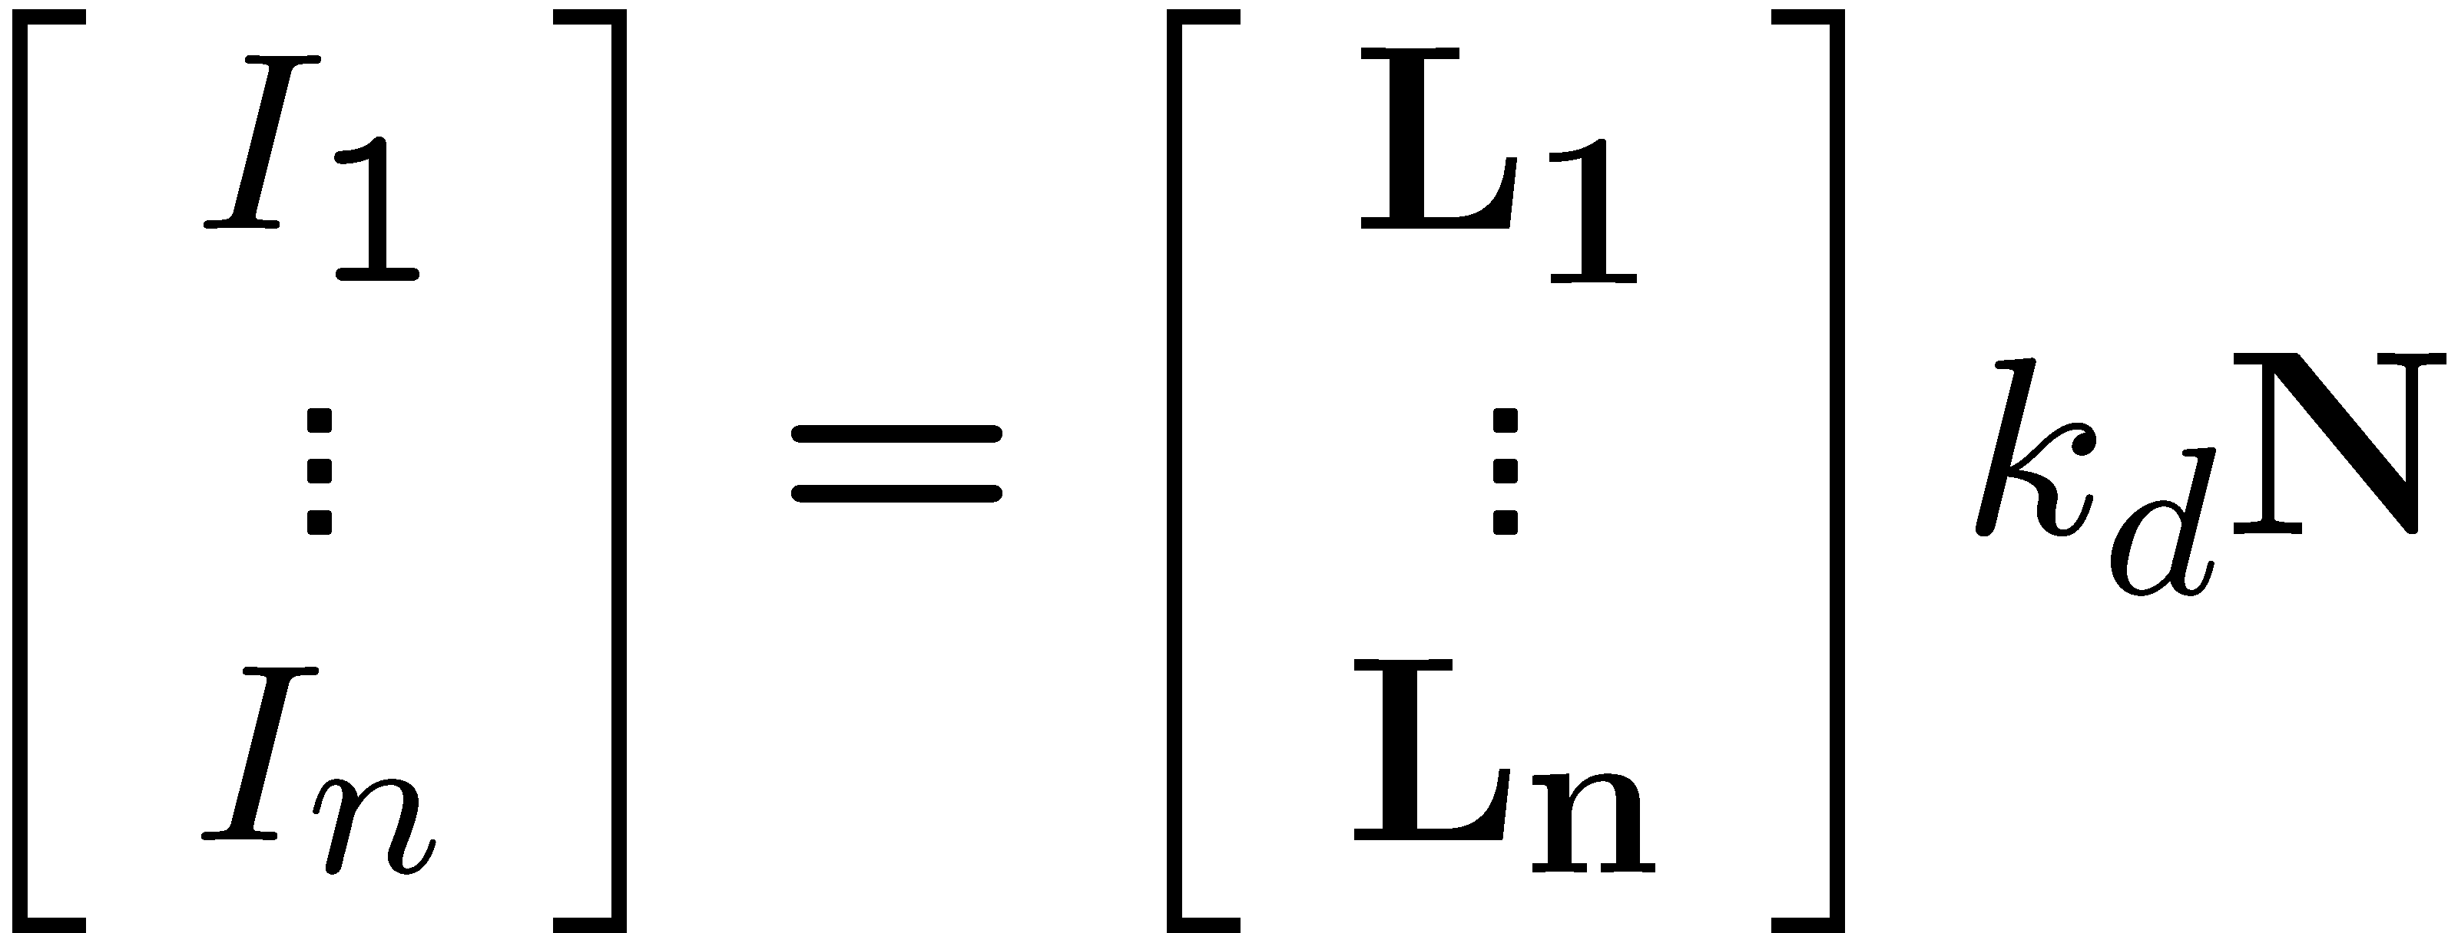
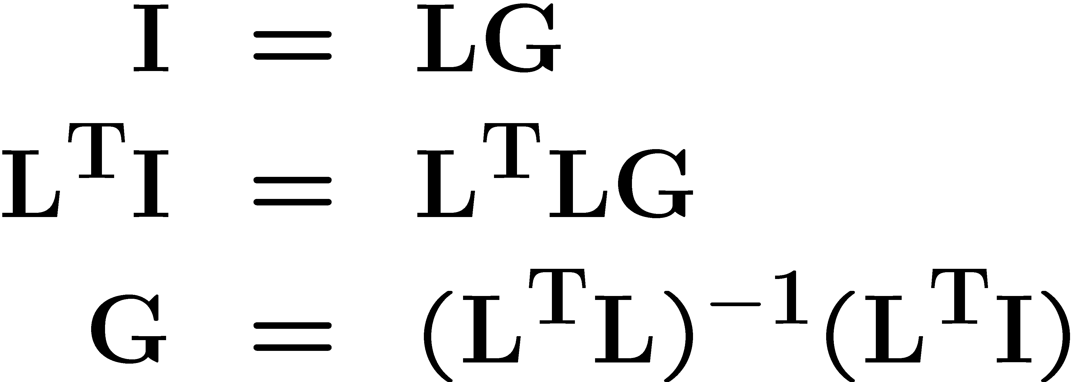
More than three lights
Get better results by using more lights
Least squares solution:
Solve for N, k_{d} as before
What’s the size of L^{T}L?

Slide 14
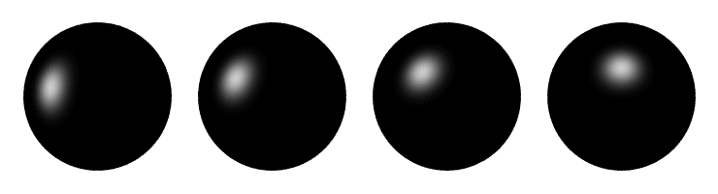
Computing light source directions
Trick: place a chrome sphere in the scene
the location of the highlight tells you where the light source is

Slide 15





Recall the rule for specular reflection
For a perfect mirror, light is reflected about N
We see a highlight when V = R
then L is given as follows:

Slide 16
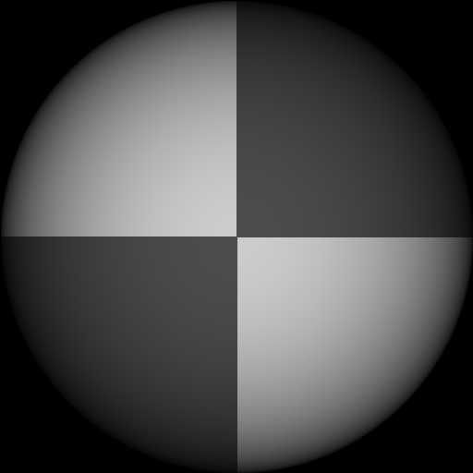
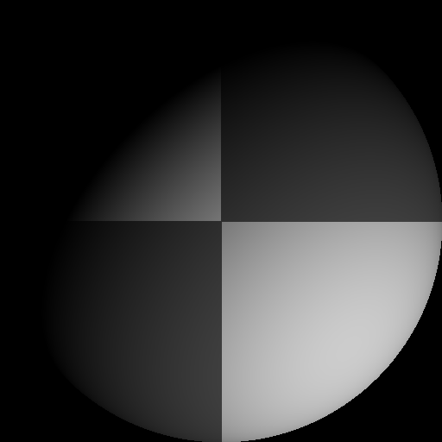
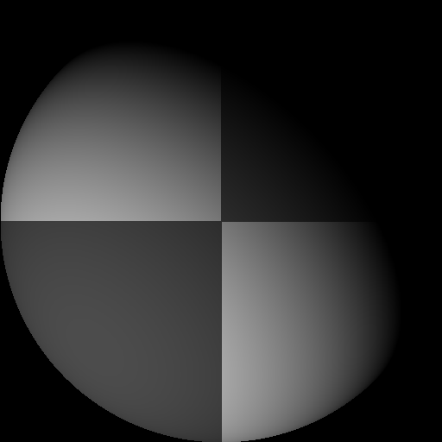
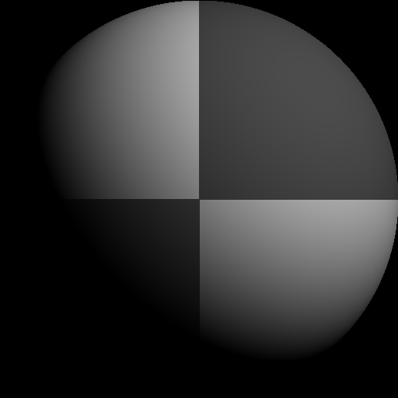
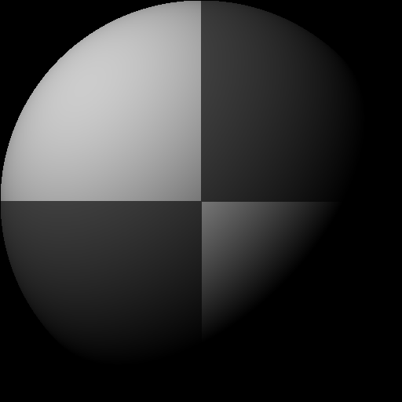
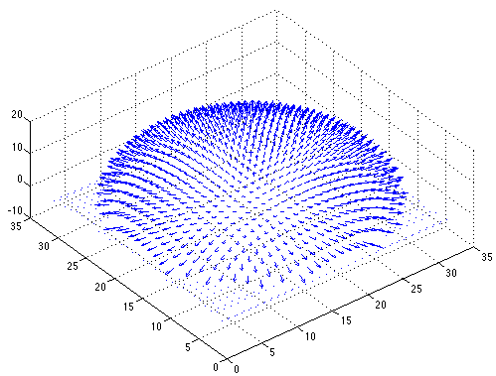

Example
Recovered albedo
Recovered normal field
Forsyth & Ponce, Sec. 5.4

Slide 17

Depth from normals
Solving the linear system per-pixel gives us an estimated surface normal for each pixel
How can we compute depth from normals?
Normals are like the “derivative” of the true depth
Input photo
Estimated normals
Estimated normals (needle diagram)

Slide 18
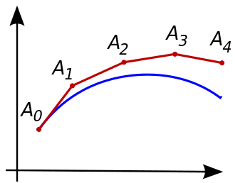
Normal Integration
Integrating a set of derivatives is easy in 1D
(similar to Euler’s method from diff. eq. class)
Could just integrate normals in each column / row separately
Instead, we formulate as a linear system and solve for depths that best agree with the surface normals

Slide 19

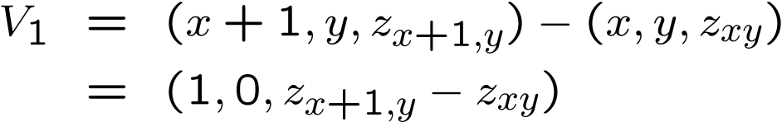


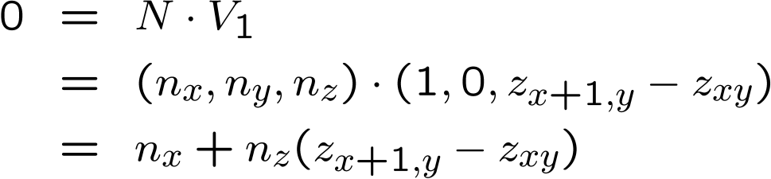

Depth from normals
V₂
V₁
N
Get a similar equation for V₂
Each normal gives us two linear constraints on z
compute z values by solving a matrix equation

Slide 20
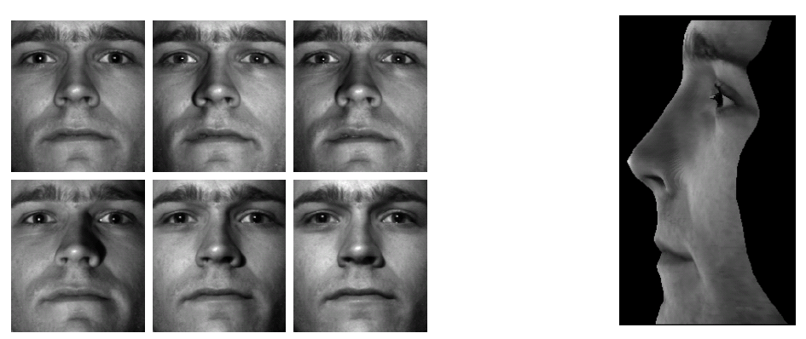
Results
from Athos Georghiades
20

Slide 21
Results

Slide 22
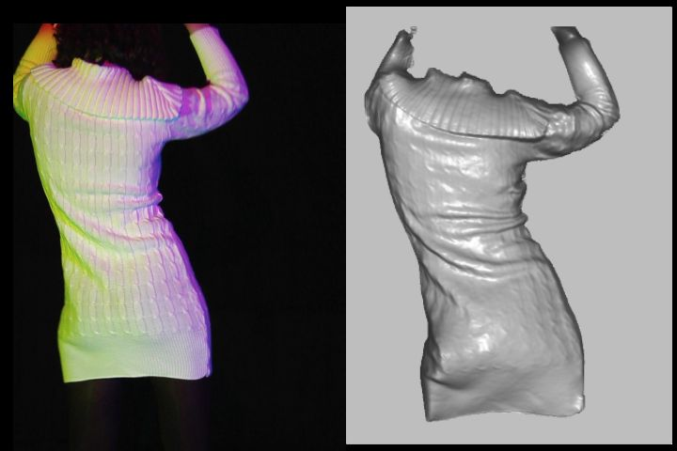
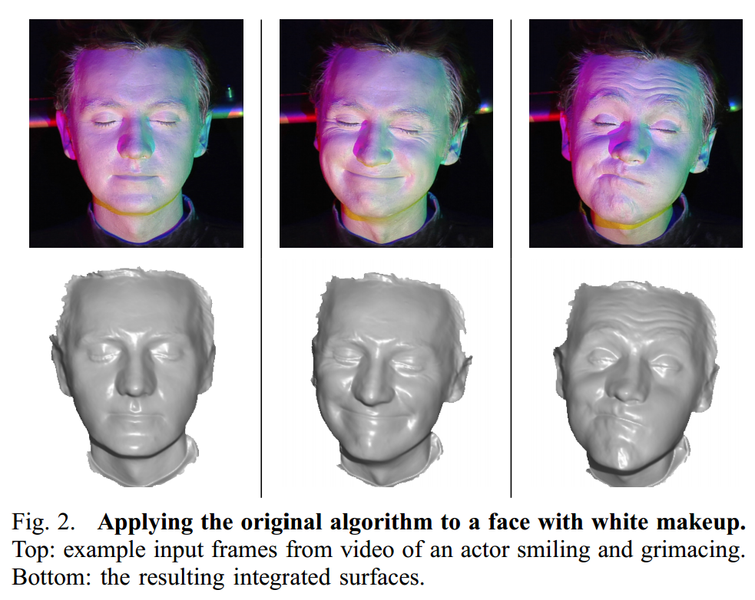
Extension
Photometric Stereo from Colored Lighting
Video Normals from Colored Lights
Gabriel J. Brostow, Carlos Hernández, George Vogiatzis, Björn Stenger, Roberto Cipolla
IEEE TPAMI, Vol. 33, No. 10, pages 2104-2114, October 2011.

Slide 23
Questions?

Slide 24
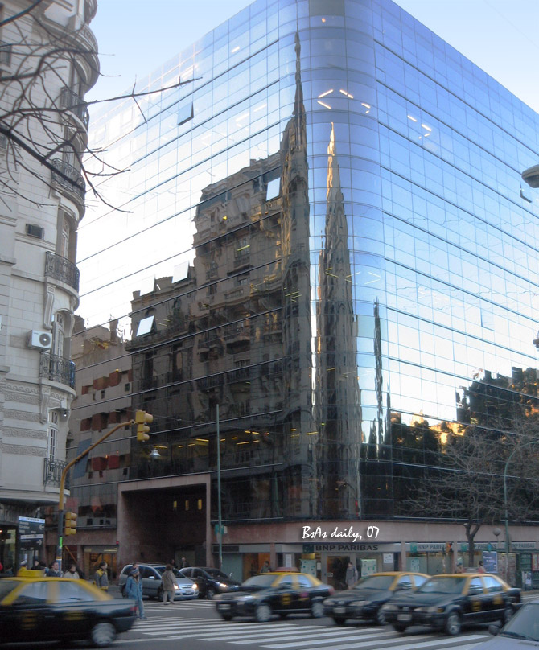
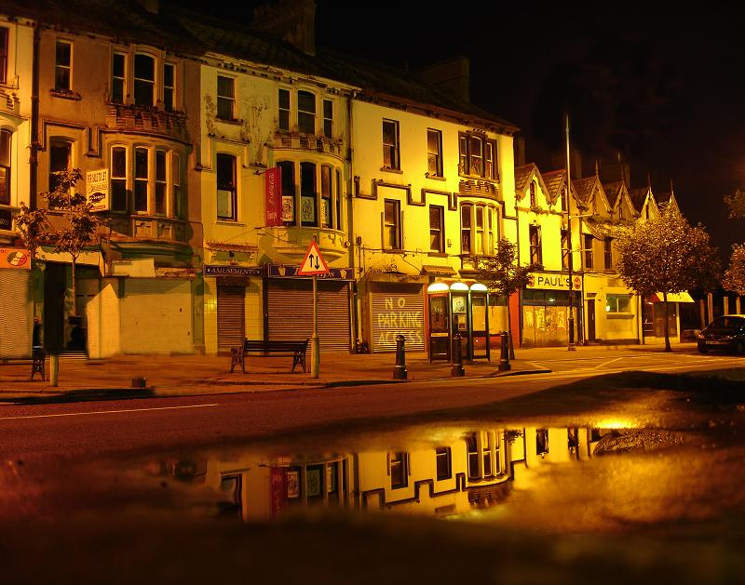
For now, ignore specular reflection
Slides from Photometric Methods for 3D Modeling, Matsushita, Wilburn, Ben-Ezra
Notes:
reflection

Slide 25
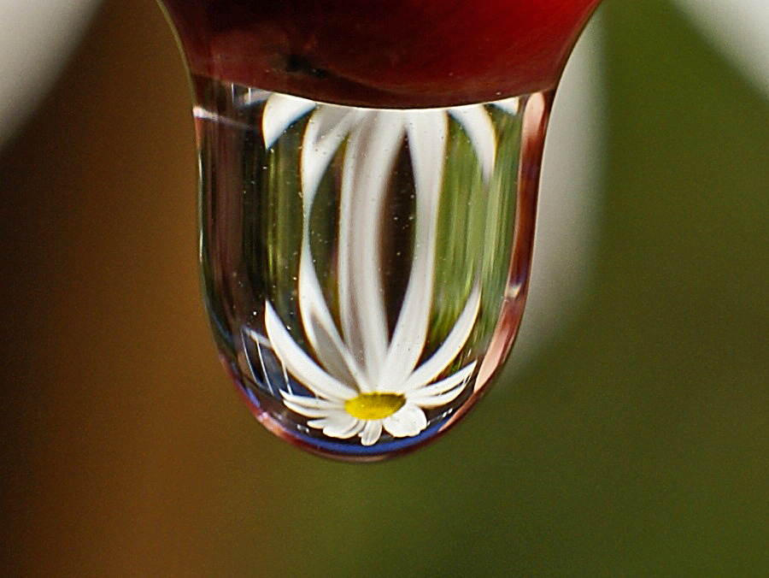
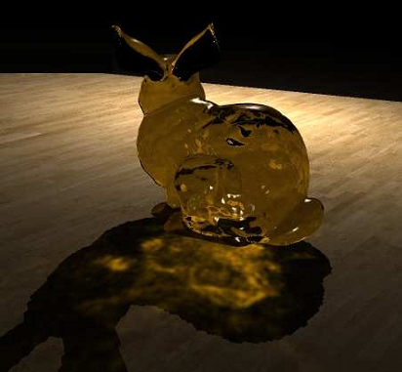
And Refraction…
Slides from Photometric Methods for 3D Modeling, Matsushita, Wilburn, Ben-Ezra

Slide 26
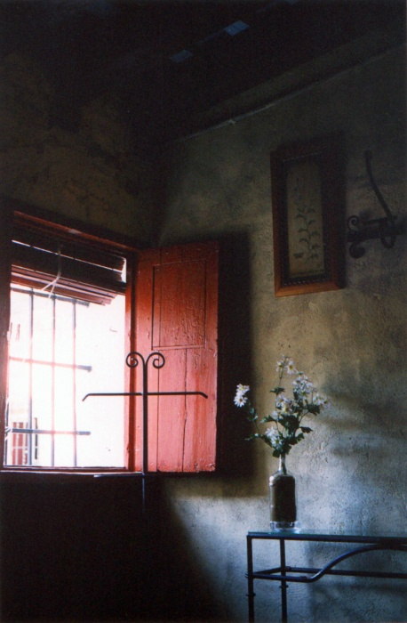
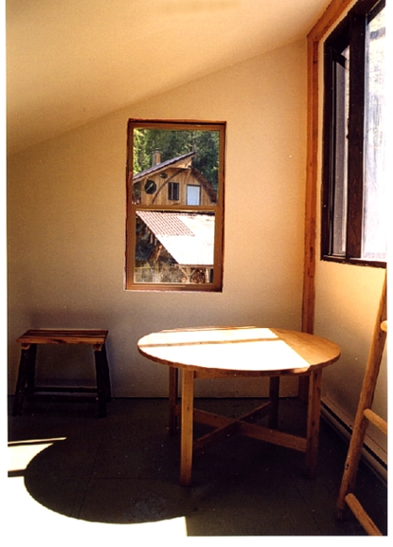
And Interreflections…
Slides from Photometric Methods for 3D Modeling, Matsushita, Wilburn, Ben-Ezra

Slide 27
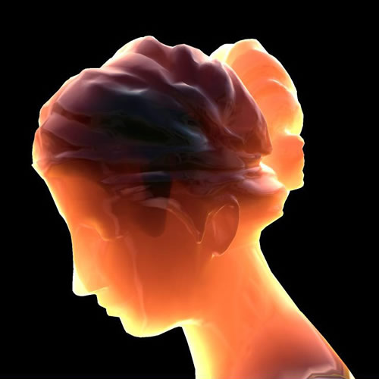
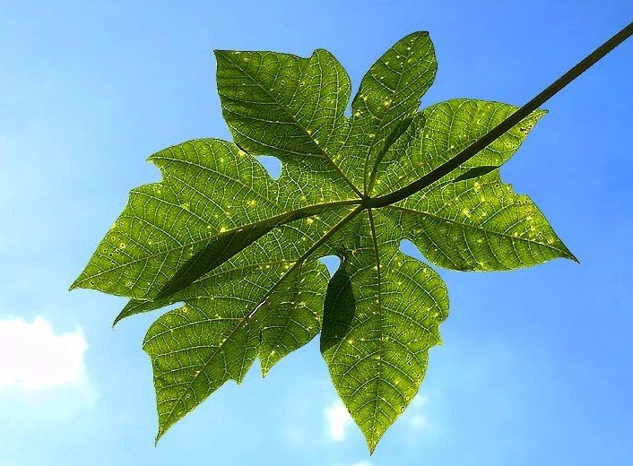
And Subsurface Scattering…
Slides from Photometric Methods for 3D Modeling, Matsushita, Wilburn, Ben-Ezra

Slide 28
Limitations
Bigger problems
doesn’t work for shiny things, semi-translucent things
shadows, inter-reflections
Smaller problems
camera and lights have to be distant
calibration requirements
measure light source directions, intensities
camera response function
Newer work addresses some of these issues
Some pointers for further reading:
Zickler, Belhumeur, and Kriegman, "Helmholtz Stereopsis: Exploiting Reciprocity for Surface Reconstruction." IJCV, Vol. 49 No. 2/3, pp 215-227.
Hertzmann & Seitz, “Example-Based Photometric Stereo: Shape Reconstruction with General, Varying BRDFs.” IEEE Trans. PAMI 2005

Slide 29
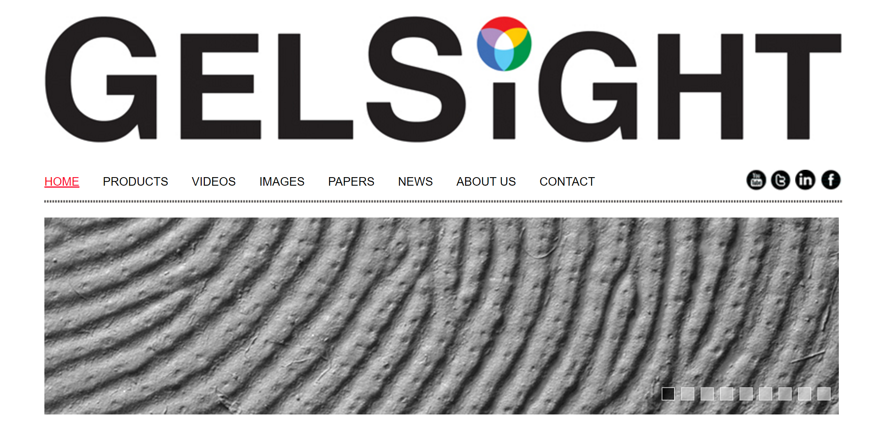
Johnson and Adelson, 2009

Slide 30
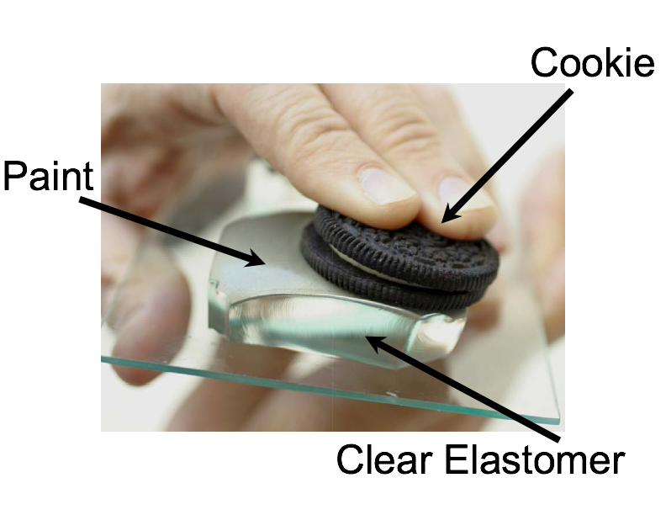
Johnson and Adelson, 2009

Slide 31
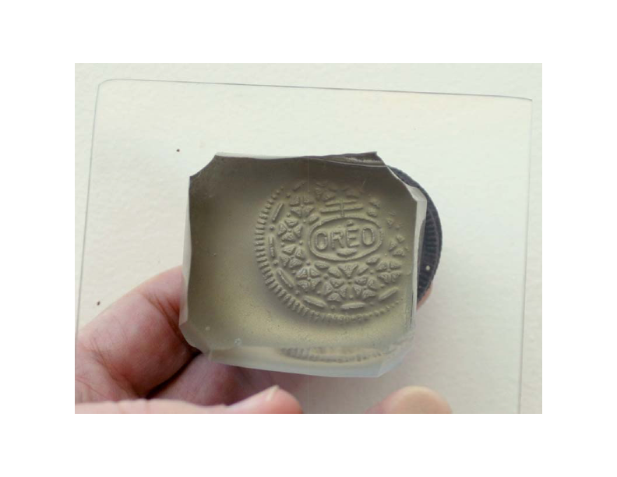

Slide 32
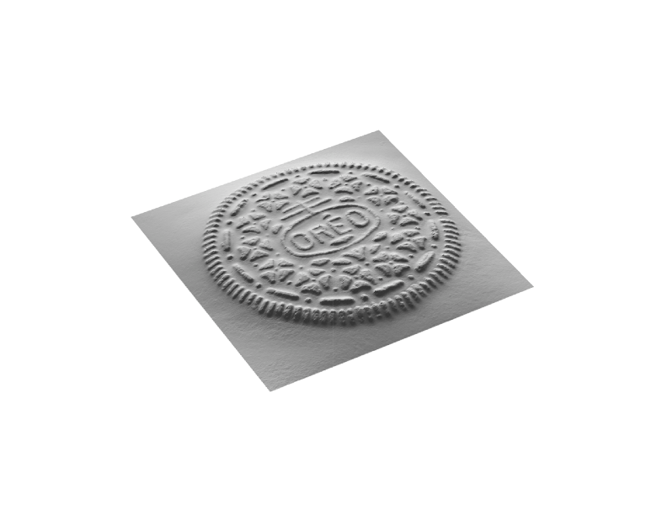

Slide 33
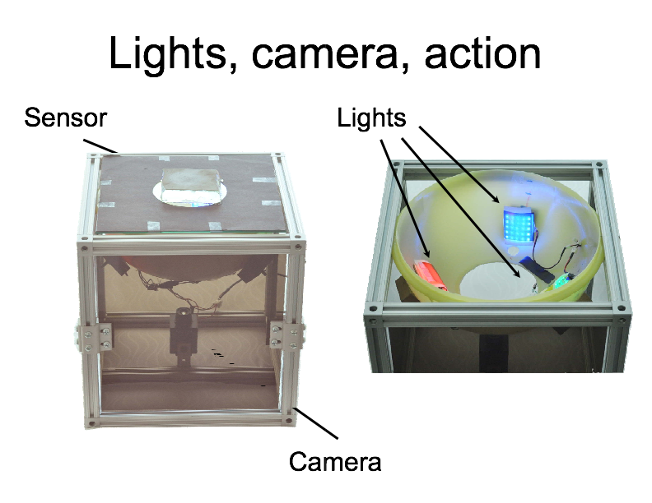

Slide 34
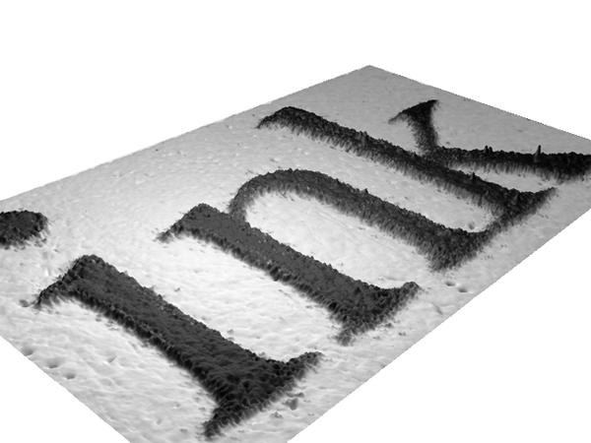

Slide 35
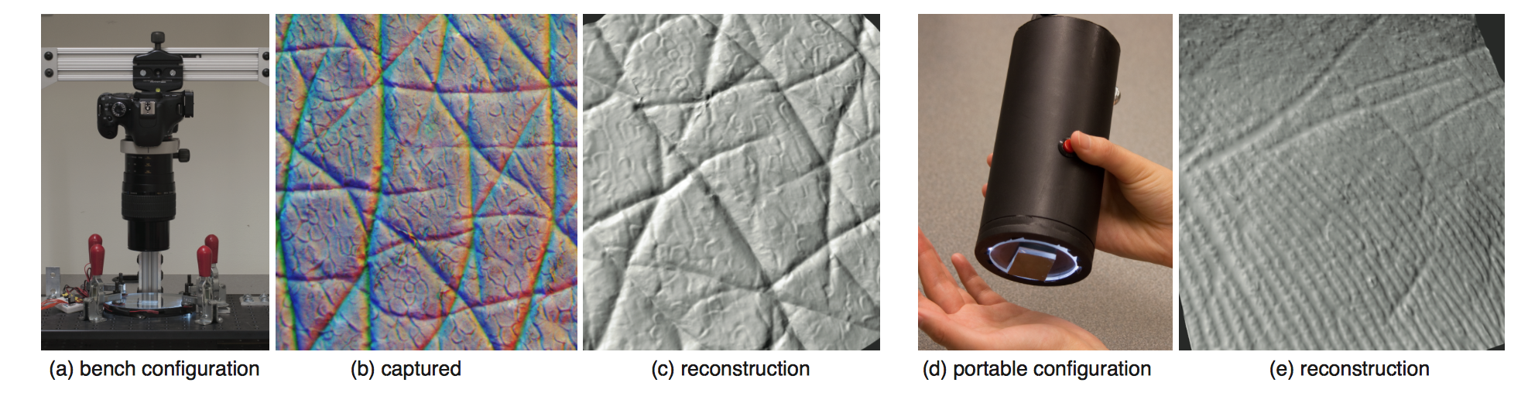
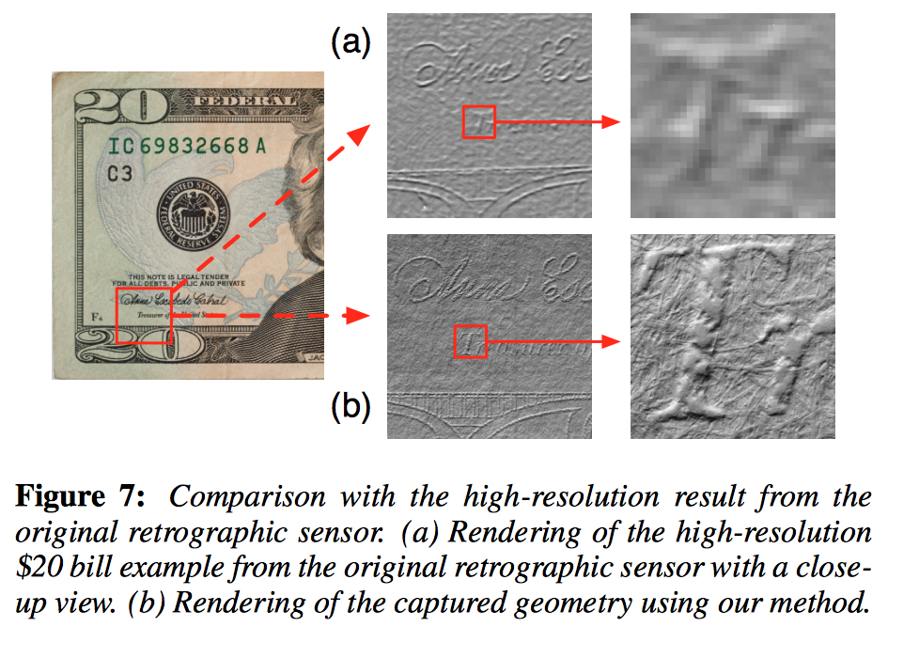

Slide 36
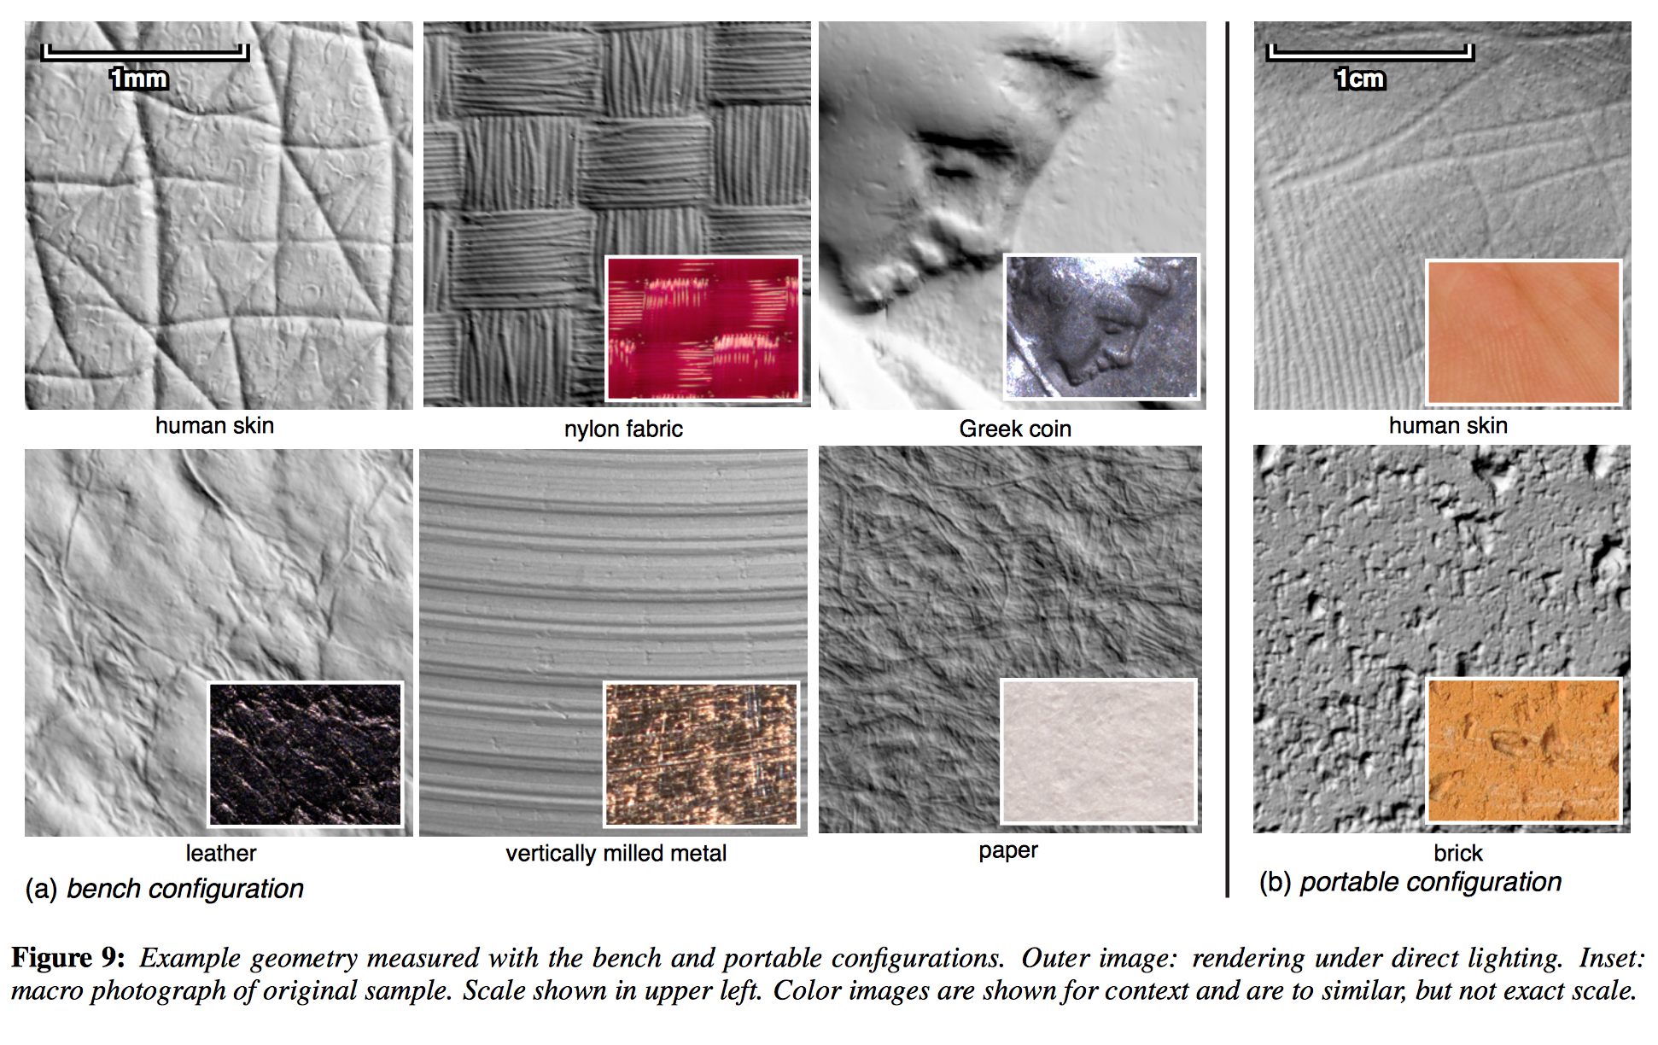

Slide 37
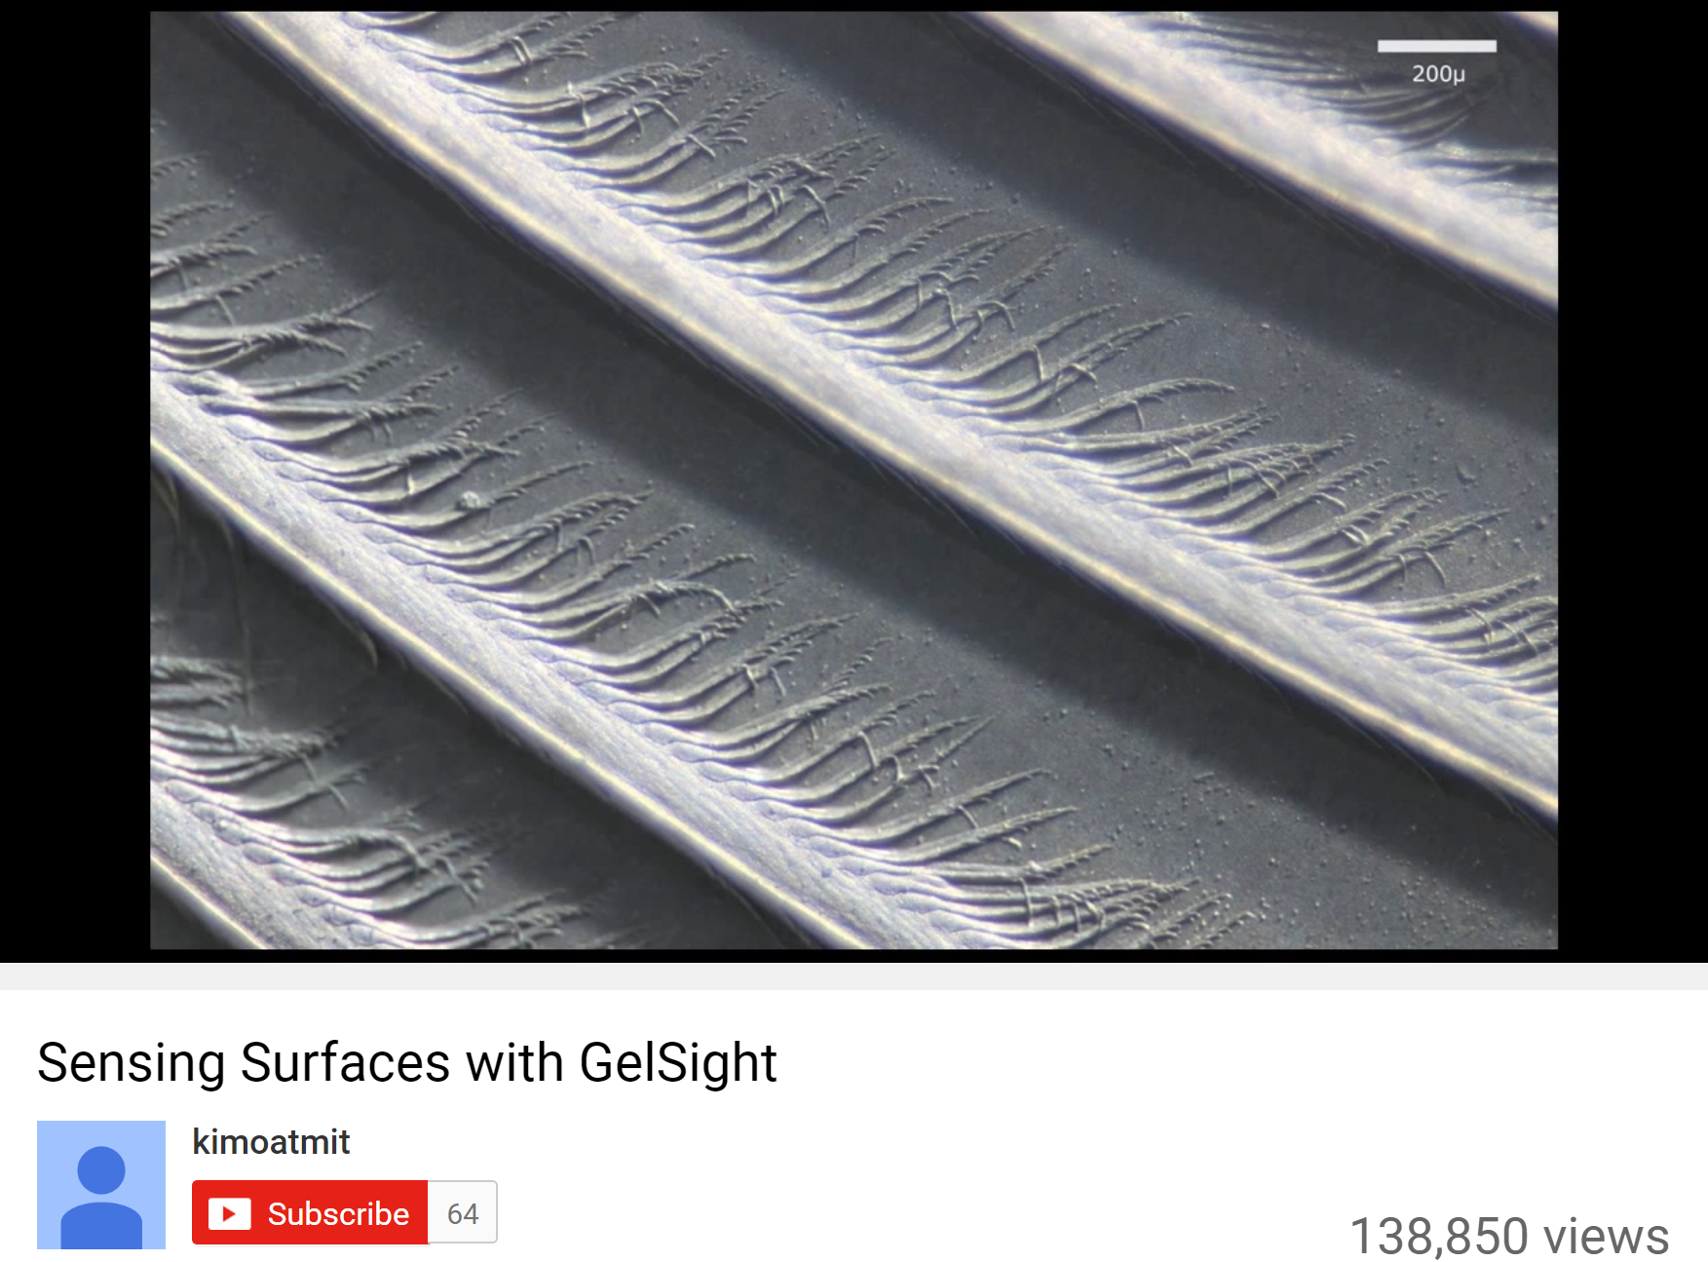
https://www.youtube.com/watch?v=S7gXih4XS7A

Slide 38
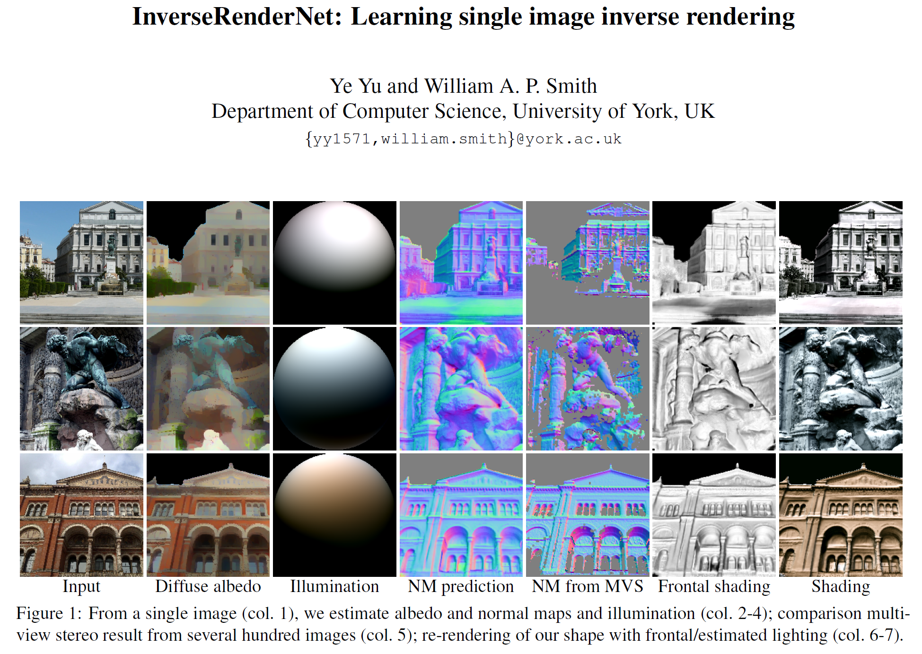

Slide 39
Questions?

