Slide 1
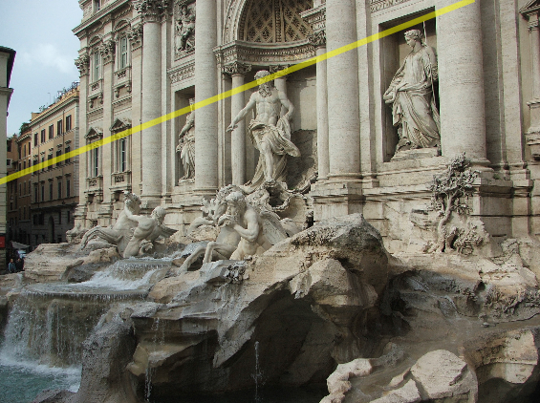
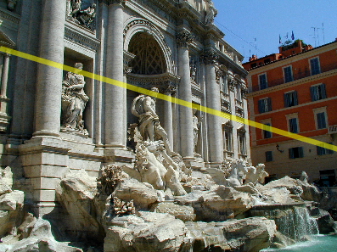
Two-view geometry
CS5670 : Computer Vision
Noah Snavely

Slide 2
Reading
Reading: Szeliski, Ch. 7.2

Slide 3
Fundamental matrix song
https://www.youtube.com/watch?v=DgGV3l82NTk

Slide 4
Annoucements
Midterm grades are out
Please submit any regrade requests via Gradescope
Solutions will be available soon
Project 3 code due tomorrow, 3/28, by 11:59pm
Artifact due on 3/29

Slide 5
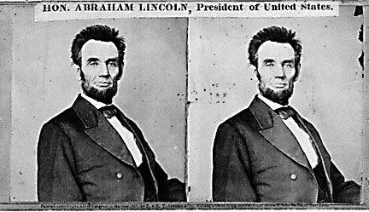
Back to stereo
Where do epipolar lines come from?

Slide 6
Two-view geometry
Where do epipolar lines come from?
3D point lies somewhere along r
epipolar line
epipolar line
(projection of r)
epipolar plane
0
Image 1
Image 2

Slide 7
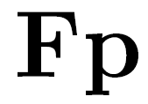
Fundamental matrix
epipolar line
epipolar line
(projection of ray)
epipolar plane
0
Image 1
Image 2
This epipolar geometry of two views is described by a Very Special 3x3 matrix , called the fundamental matrix
maps (homogeneous) points in image 1 to lines in image 2!
The epipolar line (in image 2) of point p is:
Epipolar constraint on corresponding points:

Slide 8
Fundamental matrix
epipolar line
epipolar line
(projection of ray)
epipolar plane
0
Two Special points: e₁ and e₂ (the epipoles): projection of one camera into the other

Slide 9
Fundamental matrix
0
Two Special points: e₁ and e₂ (the epipoles): projection of one camera into the other
All of the epipolar lines in an image pass through the epipole

Slide 10
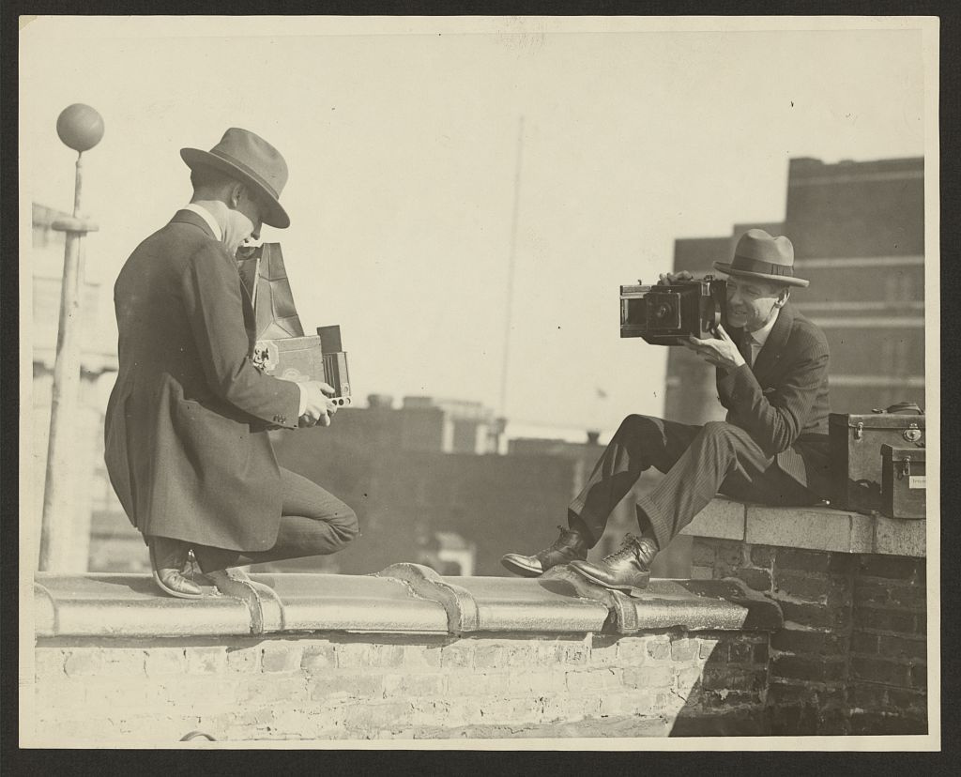
Epipoles

Slide 11
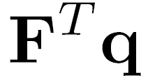
Properties of the Fundamental Matrix
is the epipolar line associated with
is the epipolar line associated with
and
is rank 2
How many parameters does F have?
T

Slide 12
Fundamental matrix
0
Why does F exist?
Let’s derive it…

Slide 13
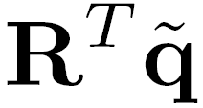
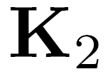
Fundamental matrix – calibrated case
0
: intrinsics of camera 1
: intrinsics of camera 2
: rotation of image 2 w.r.t. camera 1
: ray through p in camera 1’s (and world) coordinate system
: ray through q in camera 2’s coordinate system

Slide 14
Fundamental matrix – calibrated case
0
, , and are coplanar
epipolar plane can be represented as

Slide 15
Fundamental matrix – calibrated case
0

Slide 16
Fundamental matrix – calibrated case
0
One more substitution:
Cross product with t (on left) can be represented as a 3x3 matrix

Slide 17
Fundamental matrix – calibrated case
0

Slide 18
Fundamental matrix – calibrated case
0
: ray through p in camera 1’s (and world) coordinate system
: ray through q in camera 2’s coordinate system
{
the Essential matrix

Slide 19
Cross-product as linear operator
Useful fact: Cross product with a vector t can be represented as multiplication with a (skew-symmetric) 3x3 matrix

Slide 20
Fundamental matrix – uncalibrated case
0
: intrinsics of camera 1
: intrinsics of camera 2
: rotation of image 2 w.r.t. camera 1
the Fundamental matrix

Slide 21
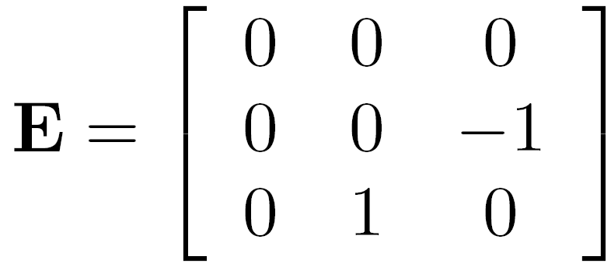
Rectified case

Slide 22
Stereo image rectification
reproject image planes onto a common
plane parallel to the line between optical centers
pixel motion is horizontal after this transformation
two homographies (3x3 transform), one for each input image reprojection
C. Loop and Z. Zhang. Computing Rectifying Homographies for Stereo Vision. IEEE Conf. Computer Vision and Pattern Recognition, 1999.

Slide 23
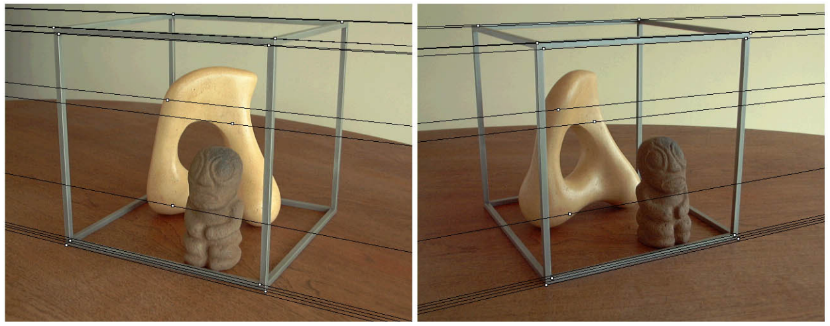
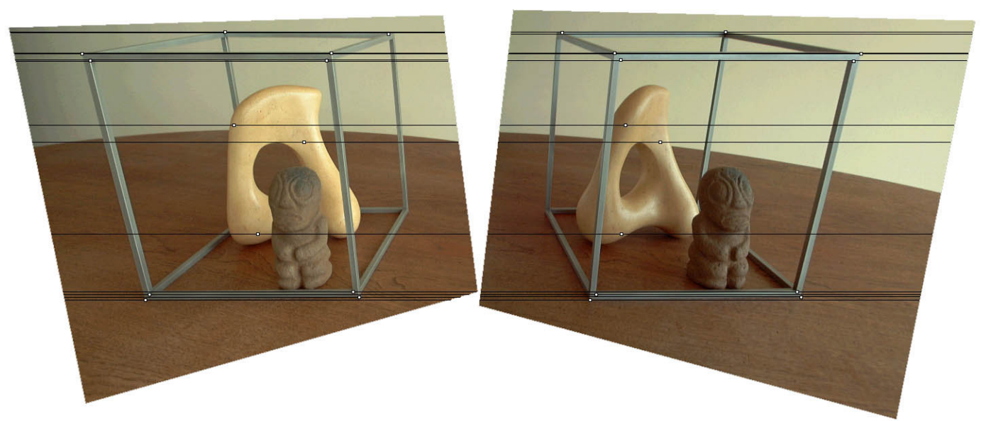
Original stereo pair
After rectification

Slide 24
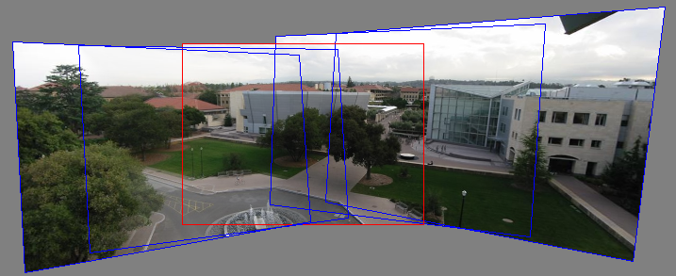
Relationship with homography?
Images taken from the same center of projection? Use a homography!

Slide 25
Questions?

Slide 26
Estimating F
If we don’t know K₁, K₂, R, or t, can we estimate F for two images?
Yes, given enough correspondences

Slide 27
Estimating F – 8-point algorithm
The fundamental matrix F is defined by
for any pair of matches x and x’ in two images.
Let x=(u,v,1)^{T} and x’=(u’,v’,1)^{T},
each match gives a linear equation

Slide 28
8-point algorithm
Like with homographies, instead of solving , we seek f to minimize , least eigenvector of .

Slide 29
8-point algorithm – Problem?
F should have rank 2
To enforce that F is of rank 2, F is replaced by F’ that minimizes subject to the rank constraint.
This is achieved by SVD. Let , where
, let
then is the solution.

Slide 30
8-point algorithm
% Build the constraint matrix
A = [x2(1,:)'.*x1(1,:)' x2(1,:)'.*x1(2,:)' x2(1,:)' ...
x2(2,:)'.*x1(1,:)' x2(2,:)'.*x1(2,:)' x2(2,:)' ...
x1(1,:)' x1(2,:)' ones(npts,1) ];
[U,D,V] = svd(A);
% Extract fundamental matrix from the column of V
% corresponding to the smallest singular value.
F = reshape(V(:,9),3,3)';
% Enforce rank2 constraint
[U,D,V] = svd(F);
F = U*diag([D(1,1) D(2,2) 0])*V';

Slide 31
8-point algorithm
Pros: it is linear, easy to implement and fast
Cons: susceptible to noise

Slide 32
Problem with 8-point algorithm
~10000
~10000
~100
~10000
~10000
~100
~100
~100
1
Orders of magnitude difference
between column of data matrix
→ least-squares yields poor results
!

Slide 33
Normalized 8-point algorithm
normalized least squares yields good results
Transform image to ~[-1,1]x[-1,1]
(0,500)
(700,500)
(-1,1)
(1,1)
(0,0)
(0,0)
(700,0)
(-1,-1)
(1,-1)

Slide 34
Normalized 8-point algorithm
Transform input by ,
Call 8-point on to obtain

Slide 35
Normalized 8-point algorithm
[x1, T1] = normalise2dpts(x1);
[x2, T2] = normalise2dpts(x2);
A = [x2(1,:)'.*x1(1,:)' x2(1,:)'.*x1(2,:)' x2(1,:)' ...
x2(2,:)'.*x1(1,:)' x2(2,:)'.*x1(2,:)' x2(2,:)' ...
x1(1,:)' x1(2,:)' ones(npts,1) ];
[U,D,V] = svd(A);
F = reshape(V(:,9),3,3)';
[U,D,V] = svd(F);
F = U*diag([D(1,1) D(2,2) 0])*V';
% Denormalise
F = T2'*F*T1;

Slide 36
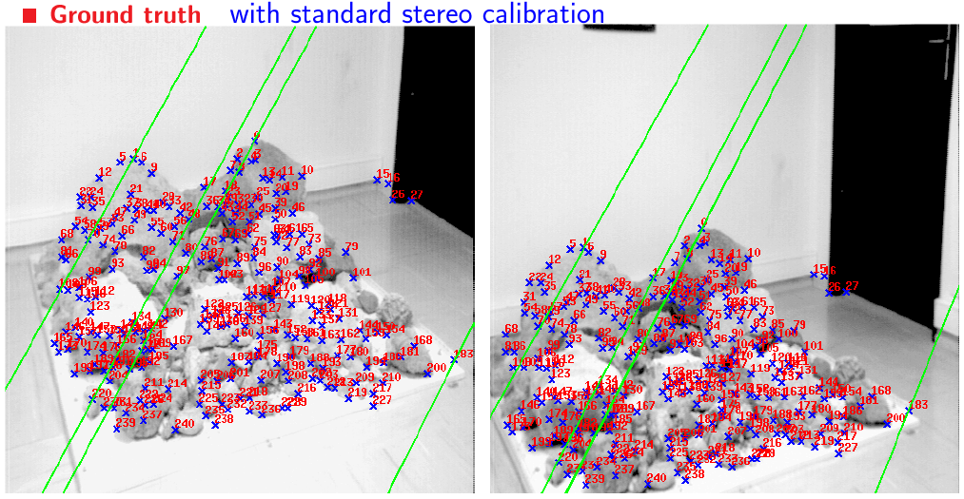
Results (ground truth)

Slide 37
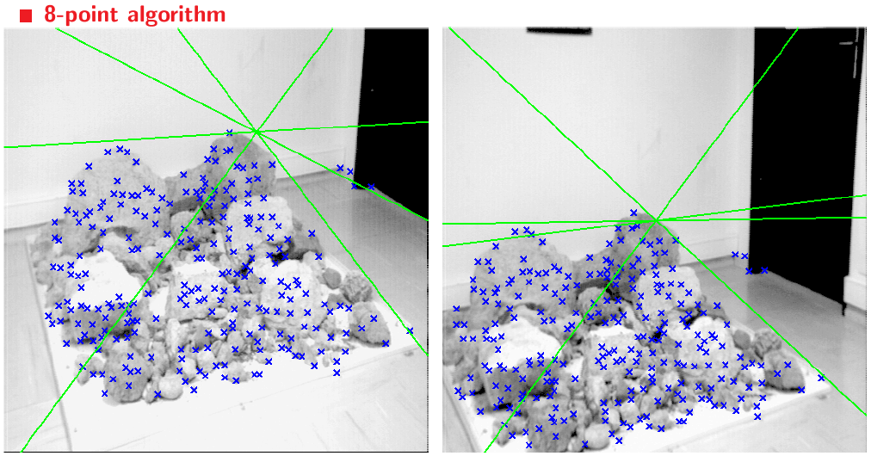
Results (8-point algorithm)

Slide 38
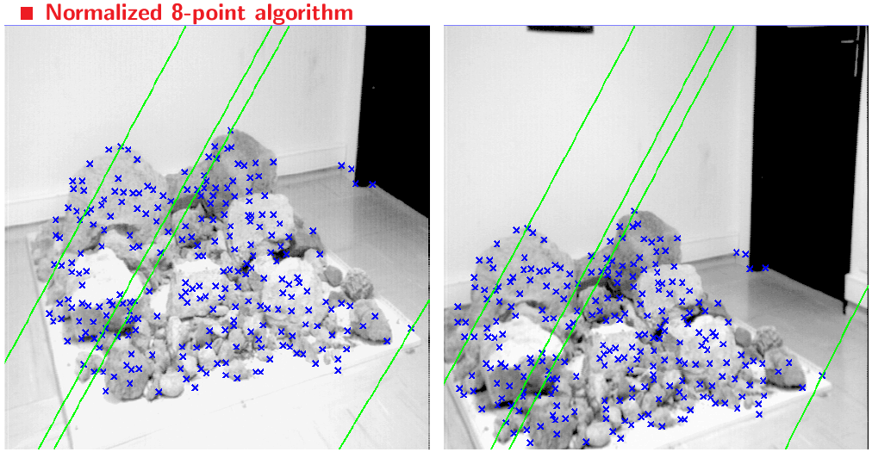
Results (normalized 8-point algorithm)

Slide 39
What about more than two views?
The geometry of three views is described by a 3 x 3 x 3 tensor called the trifocal tensor
The geometry of four views is described by a 3 x 3 x 3 x 3 tensor called the quadrifocal tensor
After this it starts to get complicated…

Slide 40
Large-scale structure from motion
Dubrovnik, Croatia. 4,619 images (out of an initial 57,845).
Total reconstruction time: 23 hours
Number of cores: 352

