Slide 1
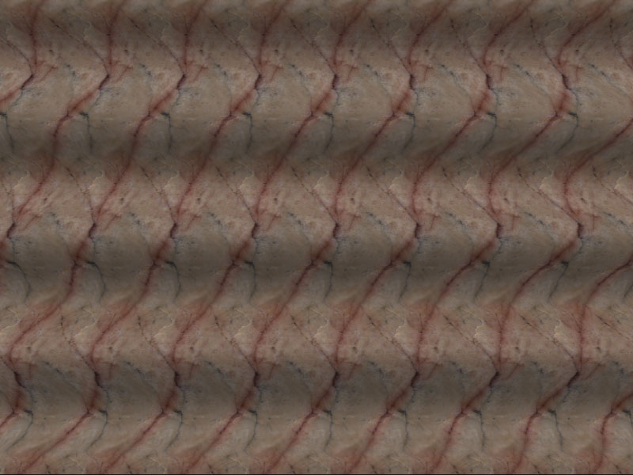
Stereo
CS5670: Computer Vision
Noah Snavely
Single image stereogram, by Niklas Een

Slide 2
Announcements
Project 3 code due this Thursday, 3/28 at 11:59pm
Artifact due Friday, 3/29 at 11:59pm

Slide 3
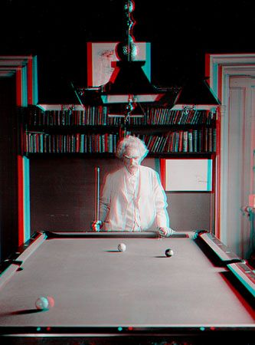
Mark Twain at Pool Table", no date, UCR Museum of Photography

Slide 4
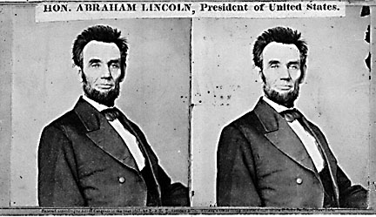
Stereo
Given two images from different viewpoints
How can we compute the depth of each point in the image?
Based on how much each pixel moves between the two images

Slide 5
Epipolar geometry
epipolar lines
(x₁, y₁)
(x₂, y₁)
Two images captured by a purely horizontal translating camera
(rectified stereo pair)
x₂ -x₁ = the disparity of pixel (x₁, y₁)

Slide 6
Your basic stereo matching algorithm
Match Pixels in Conjugate Epipolar Lines
Assume brightness constancy
This is a challenging problem
Hundreds of approaches
A good survey and evaluation: http://www.middlebury.edu/stereo/

Slide 7
Your basic stereo algorithm
For each epipolar line
For each pixel in the left image
compare with every pixel on same epipolar line in right image
pick pixel with minimum match cost
Improvement: match windows

Slide 8
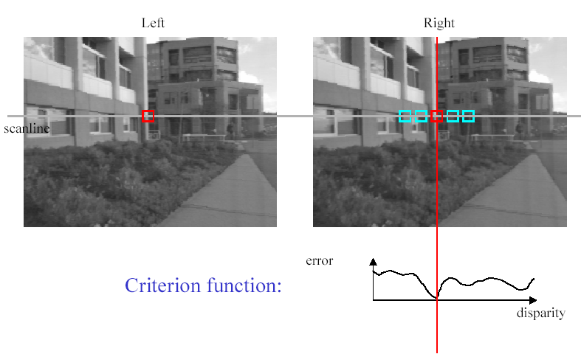
Stereo matching based on SSD
SSD
^{d}min d
Best matching disparity

Slide 9
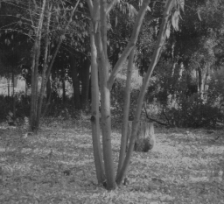
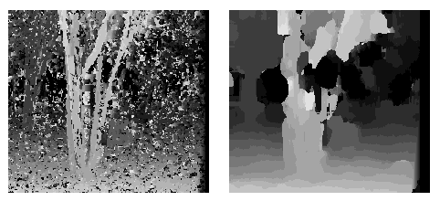
Window size
W = 3
W = 20
Effect of window size
Better results with adaptive window
T. Kanade and M. Okutomi, A Stereo Matching Algorithm with an Adaptive Window: Theory and Experiment,, Proc. International Conference on Robotics and Automation, 1991.
D. Scharstein and R. Szeliski. Stereo matching with nonlinear diffusion. International Journal of Computer Vision, 28(2):155-174, July 1998
Smaller window
Larger window
Notes:
smaller window: more detail, more noise
bigger window: less noise, more detail

Slide 10
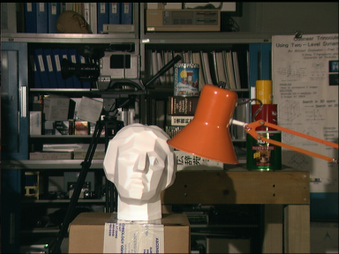

Stereo results
Data from University of Tsukuba
Similar results on other images without ground truth
Scene
Ground truth

Slide 11
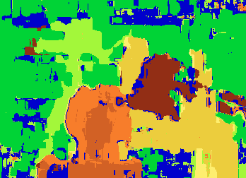

Results with window search
Window-based matching
(best window size)
Ground truth

Slide 12
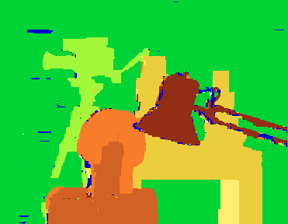
Better methods exist...
State of the art method
Boykov et al., Fast Approximate Energy Minimization via Graph Cuts,
International Conference on Computer Vision, September 1999.
Ground truth
For the latest and greatest: http://www.middlebury.edu/stereo/

Slide 13
Stereo as energy minimization
What defines a good stereo correspondence?
Match quality
Want each pixel to find a good match in the other image
Smoothness
If two pixels are adjacent, they should (usually) move about the same amount

Slide 14

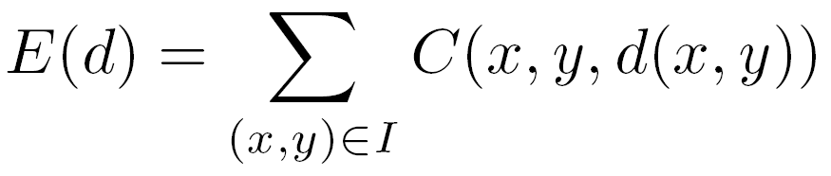

Stereo as energy minimization
Find disparity map d that minimizes an energy function
Simple pixel / window matching
=
SSD distance between windows I(x, y) and J(x + d(x,y), y)

Slide 15
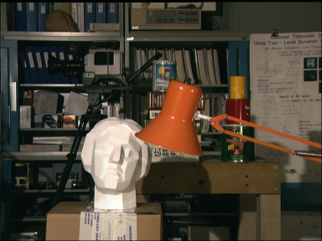
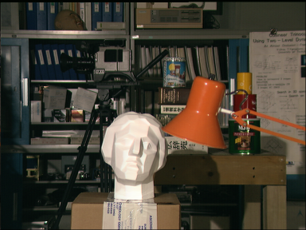
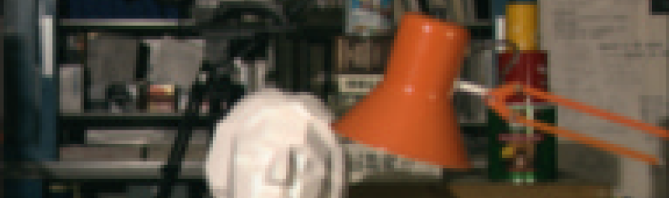
Stereo as energy minimization
I(x, y)
J(x, y)
y = 141
d
x
C(x, y, d); the disparity space image (DSI)

Slide 16
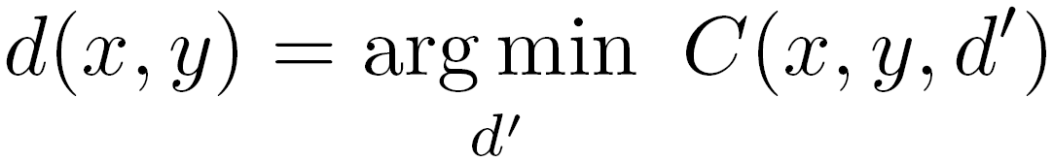
Stereo as energy minimization
y = 141
d
x
Simple pixel / window matching: choose the minimum of each column in the DSI independently:

Slide 17
Greedy selection of best match

Slide 18
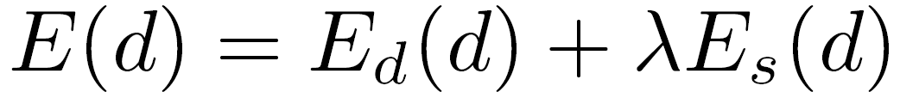
Stereo as energy minimization
Better objective function
{
{
match cost
smoothness cost
Want each pixel to find a good match in the other image
Adjacent pixels should (usually) move about the same amount

Slide 19
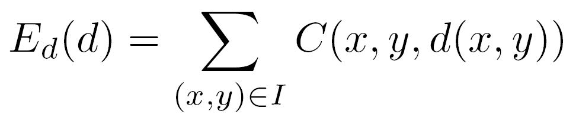
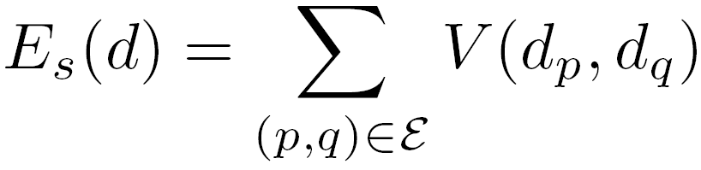

Stereo as energy minimization
match cost:
smoothness cost:
: set of neighboring pixels
4-connected neighborhood
8-connected neighborhood

Slide 20
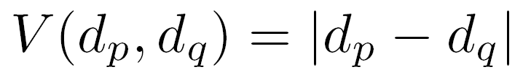
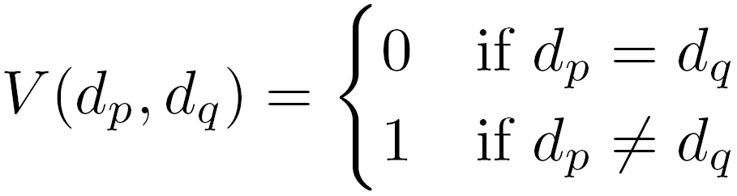
Smoothness cost
How do we choose V?
L₁ distance
“Potts model”

Slide 21
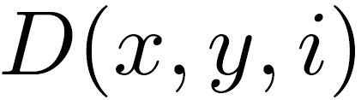
Dynamic programming
Can minimize this independently per scanline using dynamic programming (DP)
Basic idea: incrementally build a table of costs D one column at a time
: minimum cost of solution such that d(x,y) = i
Base case:
(L = max disparity)
Recurrence:

Slide 22
Dynamic programming
y = 141
d
x
Finds “smooth”, low-cost path through DPI from left to right

Slide 23
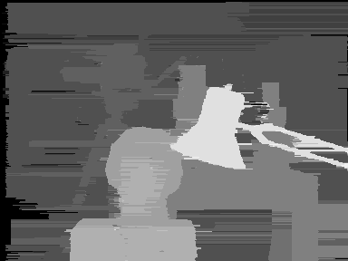
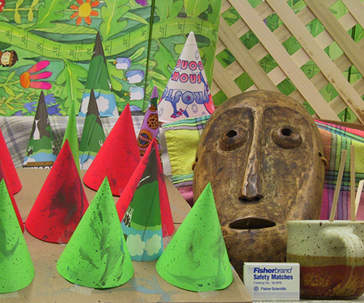
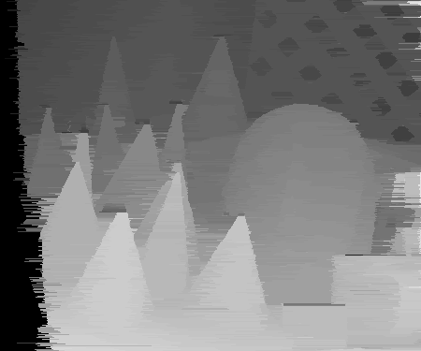
Dynamic Programming

Slide 24
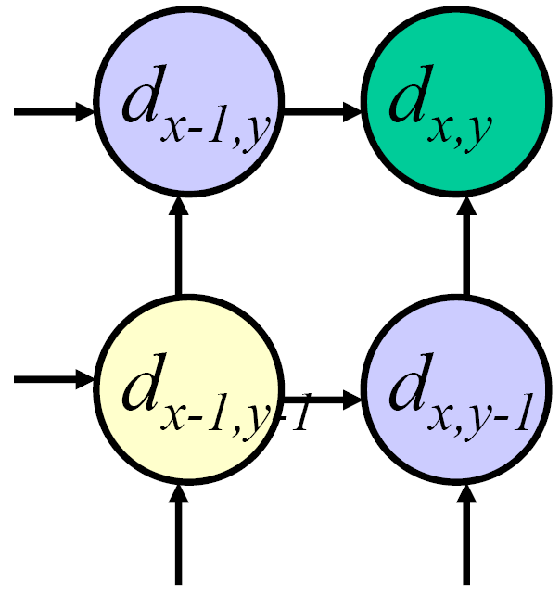
Dynamic programming
Can we apply this trick in 2D as well?
No: d_{x,y-1} and d_{x-1,y} may depend on different values of d_{x-1,y-1}
Slide credit: D. Huttenlocher

Slide 25
Stereo as a minimization problem
The 2D problem has many local minima
Gradient descent doesn’t work well
And a large search space
n x m image w/ k disparities has k^{nm} possible solutions
Finding the global minimum is NP-hard in general
Good approximations exist… we’ll see this soon

Slide 26
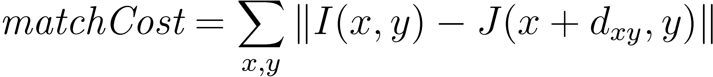
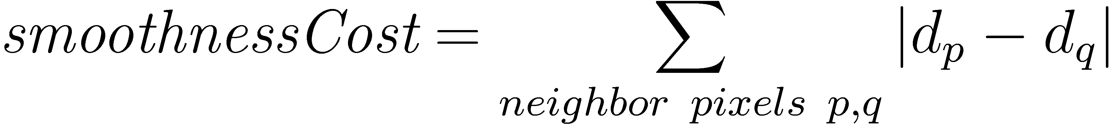
Stereo as energy minimization
Expressing this mathematically
Match quality
Want each pixel to find a good match in the other image
Smoothness
If two pixels are adjacent, they should (usually) move about the same amount
We want to minimize
This is a special type of energy function known as an MRF (Markov Random Field)
Effective and fast algorithms have been recently developed:
Graph cuts, belief propagation….
for more details (and code): http://vision.middlebury.edu/MRF/
Great tutorials available online (including video of talks)

Slide 27
Questions?

Slide 28
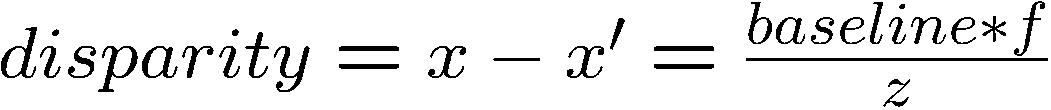
Depth from disparity
X
z
x
x’
f
f
C
baseline
C’

Slide 29
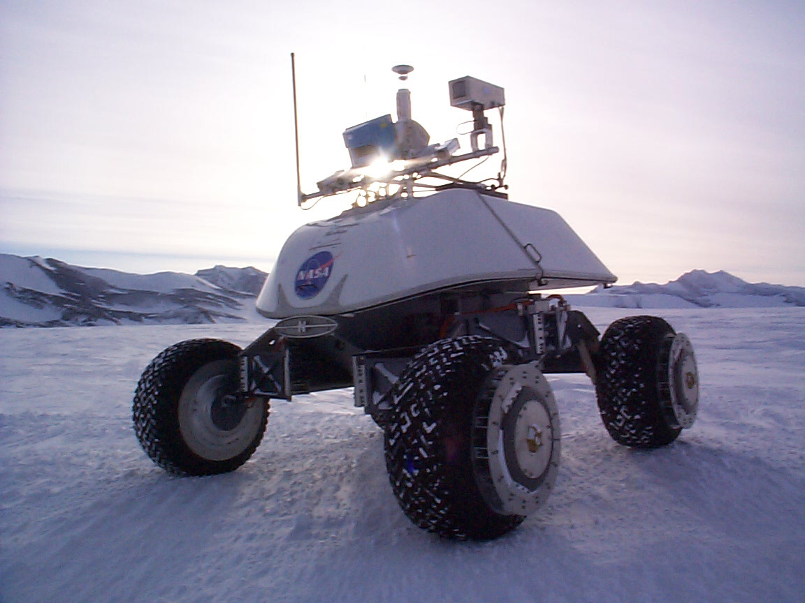
Real-time stereo
Nomad robot searches for meteorites in Antartica
http://www.frc.ri.cmu.edu/projects/meteorobot/index.html
Used for robot navigation (and other tasks)
Several real-time stereo techniques have been developed (most based on simple discrete search)

Slide 30
Stereo reconstruction pipeline
Steps
Calibrate cameras
Rectify images
Compute disparity
Estimate depth
Camera calibration errors
Poor image resolution
Occlusions
Violations of brightness constancy (specular reflections)
Large motions
Low-contrast image regions
What will cause errors?

Slide 31

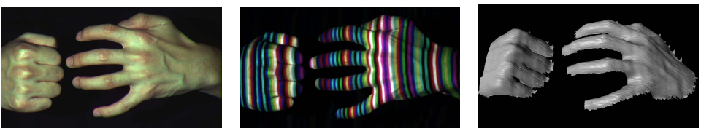
Active stereo with structured light
Li Zhang’s one-shot stereo
camera 1
camera 1
projector
projector
camera 2
Project “structured” light patterns onto the object
simplifies the correspondence problem
basis for active depth sensors, such as Kinect and iPhone X (using IR)

Slide 32
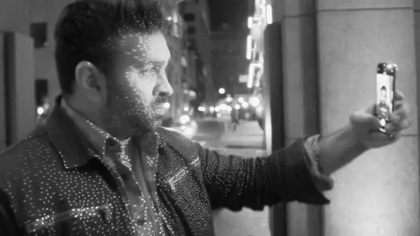
Active stereo with structured light
https://ios.gadgethacks.com/news/watch-iphone-xs-30k-ir-dots-scan-your-face-0180944/

Slide 33
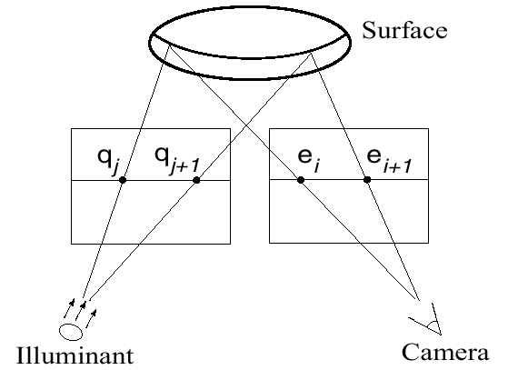
Active stereo with structured light

Slide 34
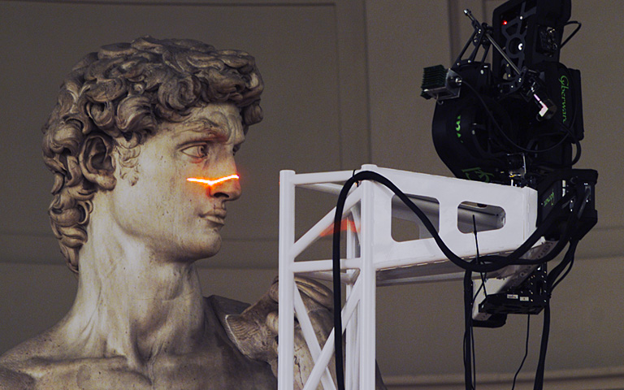
Laser scanning
Digital Michelangelo Project
http://graphics.stanford.edu/projects/mich/
Optical triangulation
Project a single stripe of laser light
Scan it across the surface of the object
This is a very precise version of structured light scanning

Slide 35

Laser scanned models
The Digital Michelangelo Project, Levoy et al.

Slide 36
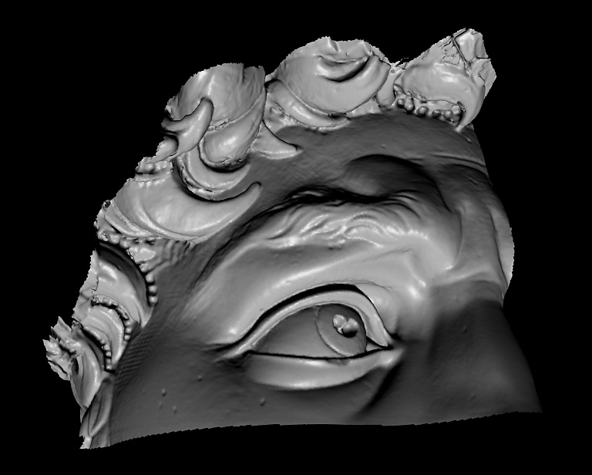
Laser scanned models
The Digital Michelangelo Project, Levoy et al.

Slide 37
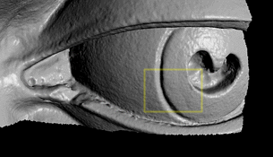
Laser scanned models
The Digital Michelangelo Project, Levoy et al.

Slide 38
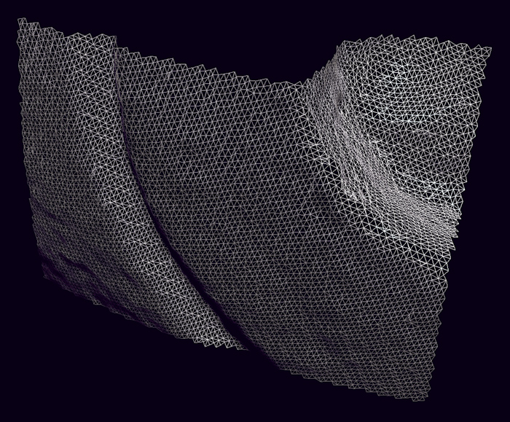
Laser scanned models
The Digital Michelangelo Project, Levoy et al.

Slide 39
Questions?

