Slide 1
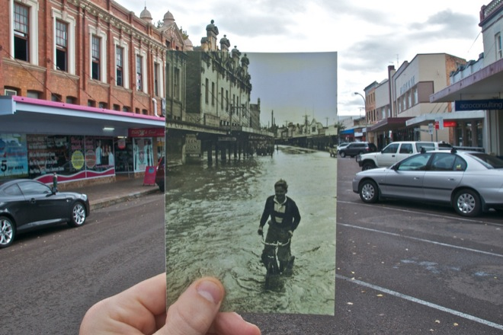
Lecture 8: Image alignment
CS5760: Computer Vision
Noah Snavely
http://www.wired.com/gadgetlab/2010/07/camera-software-lets-you-see-into-the-past/

Slide 2
Reading
Szeliski: Chapter 6.1

Slide 3
Announcements
Project 2 due date extended to Wednesday, 3/6 (code due at 11:59pm to CMS)
  Artifact due Friday, 3/8
Quiz 2 in class next Wednesday, 3/6

Slide 4
Project 1 Artifact Prizes

Slide 5
Third Place

Slide 6
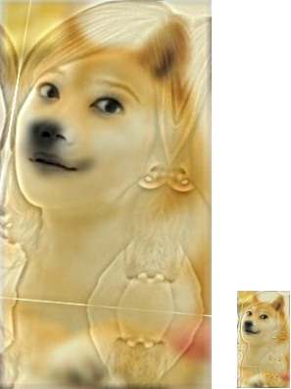
Siqi Ouyang

Slide 7
Second Place

Slide 8
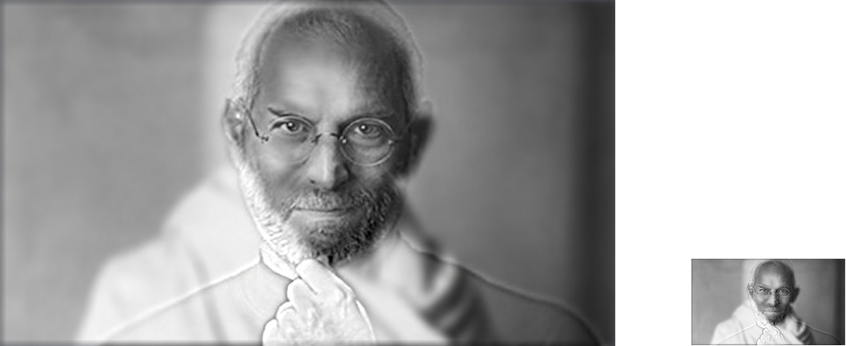
Ishan Virk

Slide 9
First Place

Slide 10
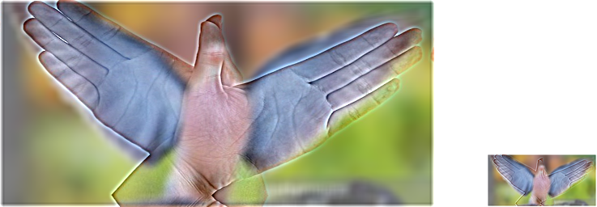
Jingjing Bai

Slide 11
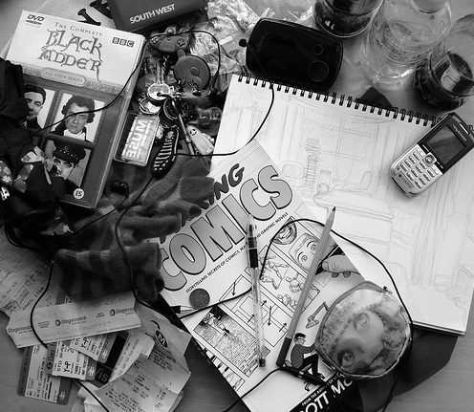
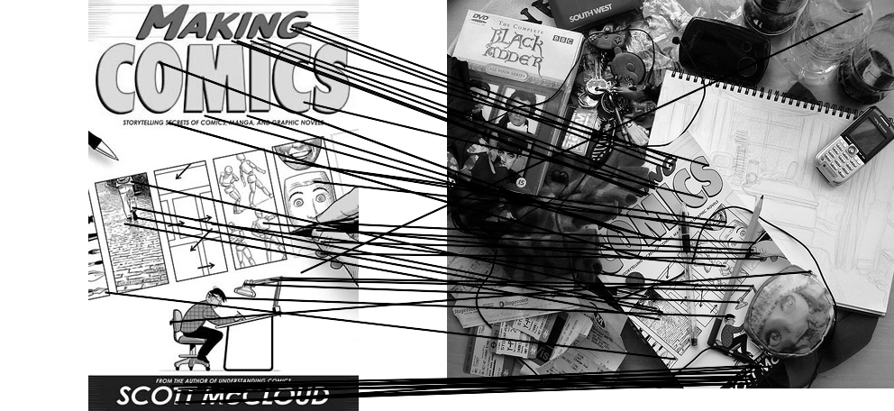
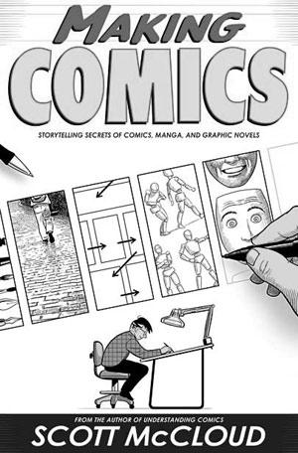
Computing transformations
Given a set of matches between images A and B
  How can we compute the transform T from A to B?
  Find transform T that best “agrees” with the matches

Slide 12
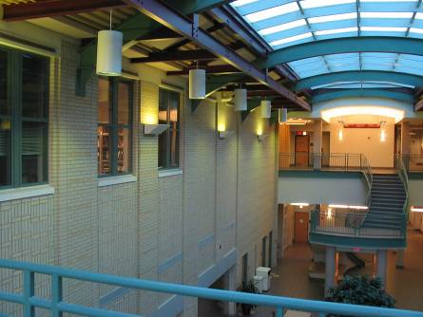
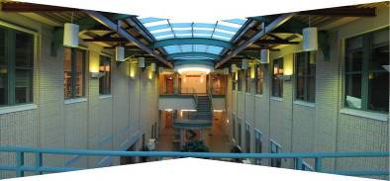
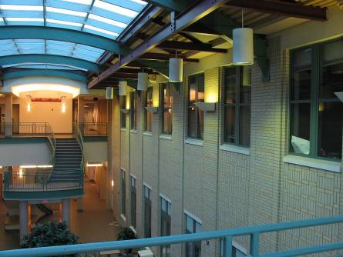
Computing transformations
?

Slide 13
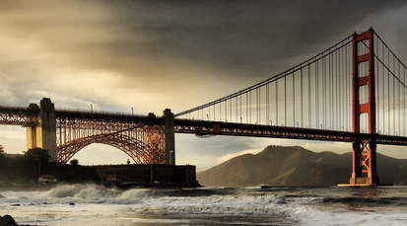


Simple case: translations
How do we solve for
?

Slide 14









Simple case: translations
Displacement of match i =
Mean displacement =

Slide 15

Another view
System of linear equations
  What are the knowns? Unknowns?
  How many unknowns? How many equations (per match)?

Slide 16
Another view
Problem: more equations than unknowns
  “Overdetermined” system of equations
  We will find the least squares solution

Slide 17


Least squares formulation
For each point
we define the residuals as

Slide 18

Least squares formulation
Goal: minimize sum of squared residuals
“Least squares” solution
For translations, is equal to mean (average) displacement

Slide 19




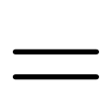
Least squares formulation
Can also write as a matrix equation
2n x 2
2 x 1
2n x 1

Slide 20

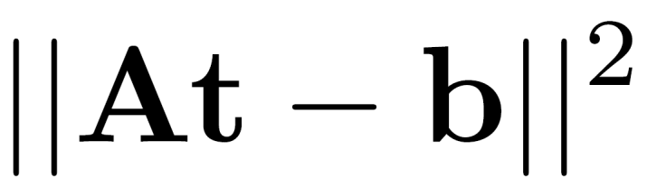


Least squares
Find t that minimizes
To solve, form the normal equations

Slide 21
Questions?

Slide 22
Least squares: linear regression
(y_{i}, x_{i})
y = mx + b

Slide 23
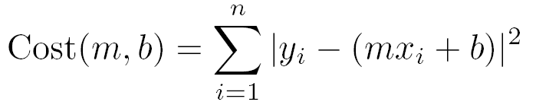
Linear regression
residual error

Slide 24
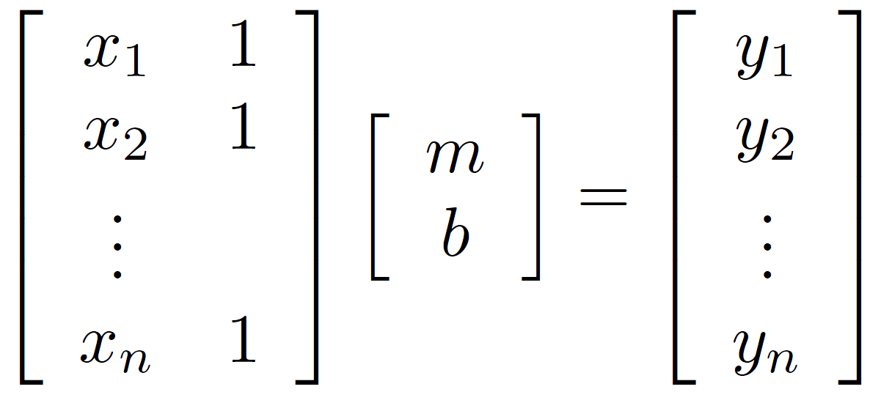
Linear regression

Slide 25

Affine transformations
How many unknowns?
How many equations per match?
How many matches do we need?

Slide 26



Affine transformations
Residuals:
Cost function:

Slide 27

Affine transformations
Matrix form
2n x 6
6 x 1
2n x 1

Slide 28


Homographies
p’
p
To unwarp (rectify) an image
  solve for homography H given p and p’
  solve equations of the form: wp’ = Hp
    linear in unknowns: w and coefficients of H
    H is defined up to an arbitrary scale factor
    how many points are necessary to solve for H?

Slide 29



Solving for homographies
Not linear!

Slide 30

Solving for homographies

Slide 31






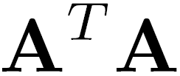
Solving for homographies
2n × 9
9
2n
Defines a least squares problem:
  Since is only defined up to scale, solve for unit vector
  Solution: = eigenvector of with smallest eigenvalue
  Works with 4 or more points

Slide 32
Recap: Two Common Optimization Problems
Problem statement
Solution
(matlab)
Problem statement
Solution

Slide 33
Questions?

Slide 34
Image Alignment Algorithm
Given images A and B
Compute image features for A and B
Match features between A and B
Compute homography between A and B using least squares on set of matches
What could go wrong?

Slide 35
Outliers
outliers
inliers

