Slide 1
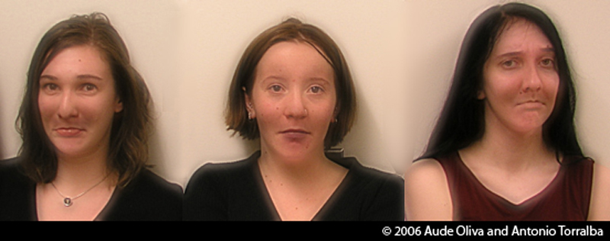
Lecture 1: Images and image filtering
CS5670: Intro to Computer Vision
Noah Snavely
Hybrid Images, Oliva et al., http://cvcl.mit.edu/hybridimage.htm

Slide 2
Lecture 1: Images and image filtering
CS5670: Intro to Computer Vision
Noah Snavely
Hybrid Images, Oliva et al., http://cvcl.mit.edu/hybridimage.htm

Slide 3
Lecture 1: Images and image filtering
CS5670: Intro to Computer Vision
Noah Snavely
Hybrid Images, Oliva et al., http://cvcl.mit.edu/hybridimage.htm

Slide 4

CS5670: Intro to Computer Vision
Noah Snavely
Lecture 1: Images and image filtering
Hybrid Images, Oliva et al., http://cvcl.mit.edu/hybridimage.htm

Slide 5
Reading
Szeliski, Chapter 3.1-3.2

Slide 6
Announcements
You should have been invited to Piazza
We will add students to CMS this week

Slide 7
Announcements
Project 1 (Hybrid Images) will be released tomorrow or Wednesday
  This project will be done solo
  Other projects planned to be done in groups of 2

Slide 8
Announcements
We provide a walkthrough for setting up a python environment for the project
As a backup, we also have a course virtual machine (VM) for you to run the assignments
The assignment also works on lab machines

Slide 9

What is an image?

Slide 10
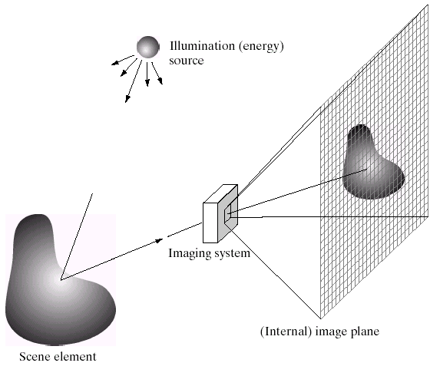
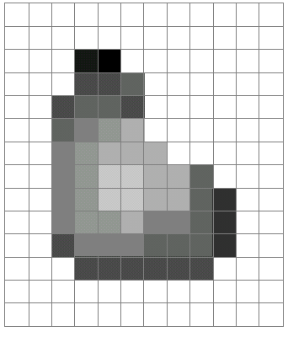
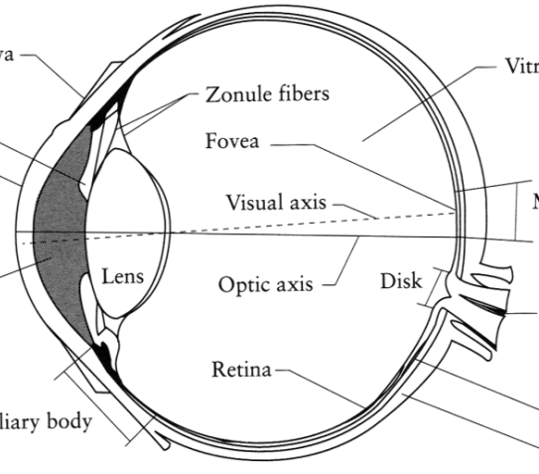
What is an image?
Digital Camera
We’ll focus on these in this class
(More on this process later)
The Eye
Source: A. Efros

Slide 11
What is an image?
A grid (matrix) of intensity values
(common to use one byte per value: 0 = black, 255 = white)
255 | 255 | 255 | 255 | 255 | 255 | 255 | 255 | 255 | 255 | 255 | 255
255 | 255 | 255 | 255 | 255 | 255 | 255 | 255 | 255 | 255 | 255 | 255
255 | 255 | 255 | 20 | 0 | 255 | 255 | 255 | 255 | 255 | 255 | 255
255 | 255 | 255 | 75 | 75 | 75 | 255 | 255 | 255 | 255 | 255 | 255
255 | 255 | 75 | 95 | 95 | 75 | 255 | 255 | 255 | 255 | 255 | 255
255 | 255 | 96 | 127 | 145 | 175 | 255 | 255 | 255 | 255 | 255 | 255
255 | 255 | 127 | 145 | 175 | 175 | 175 | 255 | 255 | 255 | 255 | 255
255 | 255 | 127 | 145 | 200 | 200 | 175 | 175 | 95 | 255 | 255 | 255
255 | 255 | 127 | 145 | 200 | 200 | 175 | 175 | 95 | 47 | 255 | 255
255 | 255 | 127 | 145 | 145 | 175 | 127 | 127 | 95 | 47 | 255 | 255
255 | 255 | 74 | 127 | 127 | 127 | 95 | 95 | 95 | 47 | 255 | 255
255 | 255 | 255 | 74 | 74 | 74 | 74 | 74 | 74 | 255 | 255 | 255
255 | 255 | 255 | 255 | 255 | 255 | 255 | 255 | 255 | 255 | 255 | 255
255 | 255 | 255 | 255 | 255 | 255 | 255 | 255 | 255 | 255 | 255 | 255
=

Slide 12
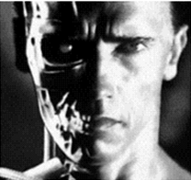
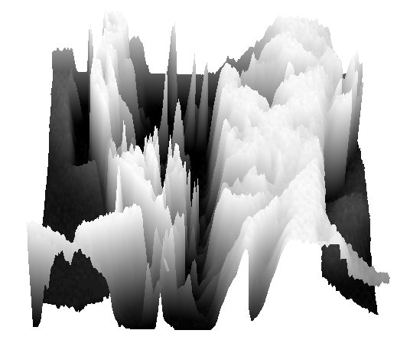
What is an image?
We can think of a (grayscale) image as a function, f, from R² to R:
  f (x,y) gives the intensity at position (x,y)
  A digital image is a discrete (sampled, quantized) version of this function
f (x, y)
x
y
snoop
3D view

Slide 13
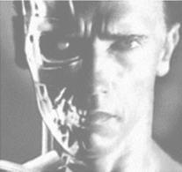
Image transformations
As with any function, we can apply operators to an image
Today we’ll talk about a special kind of operator, convolution (linear filtering)
  g (x,y) = f (x,y) + 20
  g (x,y) = f (-x,y)

Slide 14
Filters
Filtering
  Form a new image whose pixels are a combination of the original pixels
Why?
  To get useful information from images
    E.g., extract edges or contours (to understand shape)
  To enhance the image
    E.g., to remove noise
    E.g., to sharpen and “enhance image” a la CSI
  A key operator in Convolutional Neural Networks

Slide 15
Canonical Image Processing problems
Image Restoration
  denoising
  deblurring
Image Compression
  JPEG, JPEG2000, MPEG..
Computing Field Properties
  optical flow
  disparity
Locating Structural Features
  corners
  edges

Slide 16
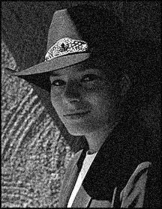
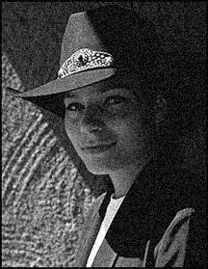

Question: Noise reduction
Given a camera and a still scene, how can you reduce noise?
Take lots of images and average them!
What’s the next best thing?
Source: S. Seitz
Notes:
Answer: take lots of images, average them

Slide 17
Image filtering
Modify the pixels in an image based on some function of a local neighborhood of each pixel
10
5
3
Some function
4
5
1
7
1
1
7
Local image data
Modified image data
Source: L. Zhang

Slide 18
Linear filtering
One simple version of filtering: linear filtering (cross-correlation, convolution)
  Replace each pixel by a linear combination (a weighted sum) of its neighbors
The prescription for the linear combination is called the “kernel” (or “mask”, “filter”)
10
5
3
0
0
0
4
6
1
0
0.5
0
8
1
1
8
0
1
0.5
Local image data
kernel
Modified image data
Source: L. Zhang

Slide 19



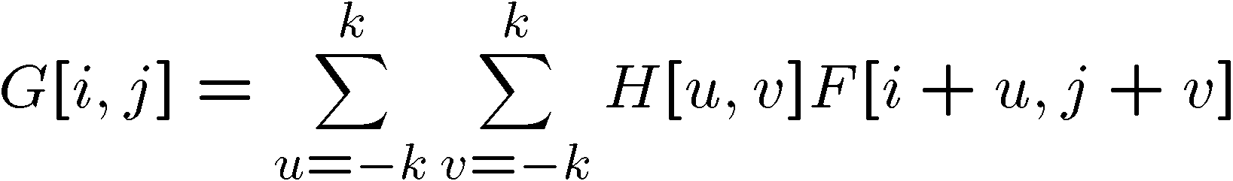

Cross-correlation
Let be the image, be the kernel (of size 2k+1 x 2k+1), and be the output image
Can think of as a “dot product” between local neighborhood and kernel for each pixel
This is called a cross-correlation operation:

Slide 20
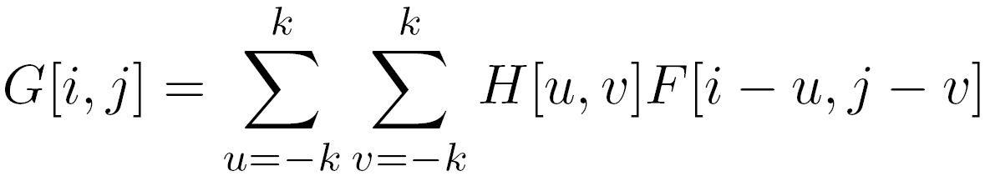

Convolution
Same as cross-correlation, except that the kernel is “flipped” (horizontally and vertically)
Convolution is commutative and associative
This is called a convolution operation:

Slide 21
1D Demo

Slide 22



Convolution
Adapted from F. Durand

Slide 23

Mean filtering
0 | 0 | 0 | 0 | 0 | 0 | 0 | 0 | 0 | 0
0 | 0 | 0 | 0 | 0 | 0 | 0 | 0 | 0 | 0
0 | 0 | 0 | 90 | 90 | 90 | 90 | 90 | 0 | 0
0 | 0 | 0 | 90 | 90 | 90 | 90 | 90 | 0 | 0
0 | 0 | 0 | 90 | 90 | 90 | 90 | 90 | 0 | 0
0 | 0 | 0 | 90 | 0 | 90 | 90 | 90 | 0 | 0
0 | 0 | 0 | 90 | 90 | 90 | 90 | 90 | 0 | 0
0 | 0 | 0 | 0 | 0 | 0 | 0 | 0 | 0 | 0
0 | 0 | 90 | 0 | 0 | 0 | 0 | 0 | 0 | 0
0 | 0 | 0 | 0 | 0 | 0 | 0 | 0 | 0 | 0
 | 0 | 10 | 20 | 30 | 30 | 30 | 20 | 10
 | 0 | 20 | 40 | 60 | 60 | 60 | 40 | 20
 | 0 | 30 | 60 | 90 | 90 | 90 | 60 | 30
 | 0 | 30 | 50 | 80 | 80 | 90 | 60 | 30
 | 0 | 30 | 50 | 80 | 80 | 90 | 60 | 30
 | 0 | 20 | 30 | 50 | 50 | 60 | 40 | 20
 | 10 | 20 | 30 | 30 | 30 | 30 | 20 | 10
 | 10 | 10 | 10 | 0 | 0 | 0 | 0 | 0
*
=
1 | 1 | 1
1 | 1 | 1
1 | 1 | 1

Slide 24
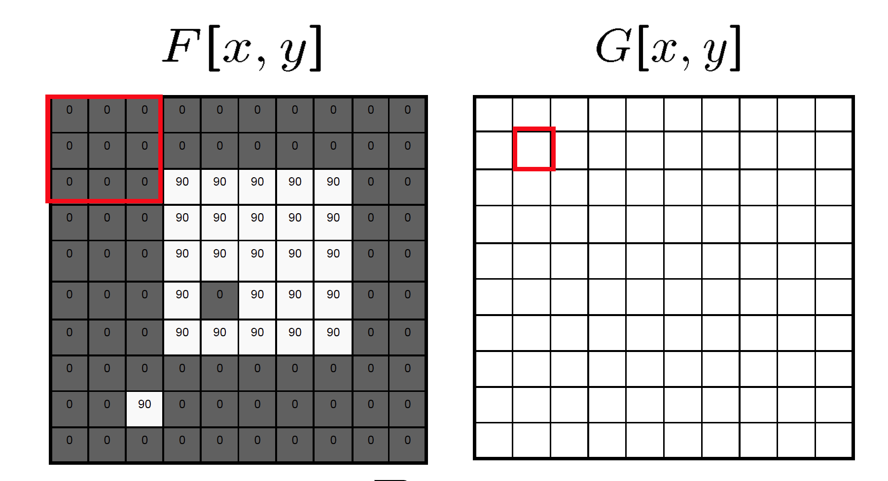
Mean filtering/Moving average

Slide 25
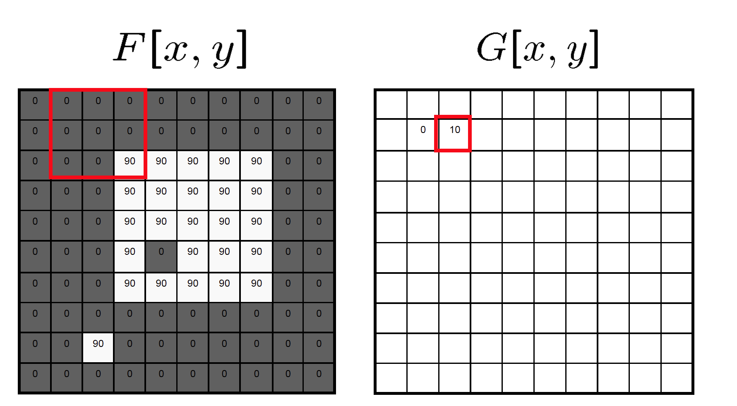
Mean filtering/Moving average

Slide 26

Mean filtering/Moving average

Slide 27
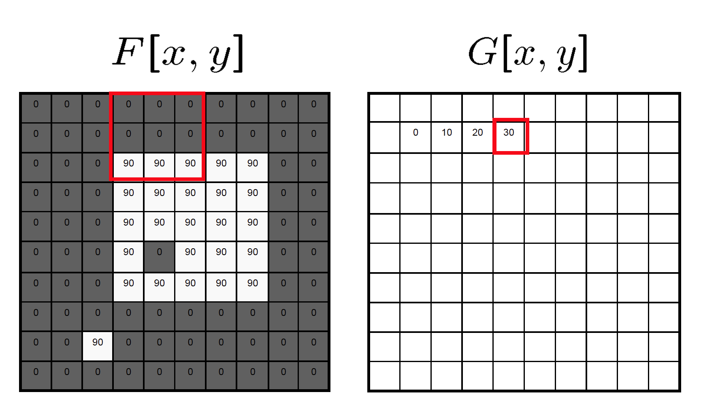
Mean filtering/Moving average

Slide 28
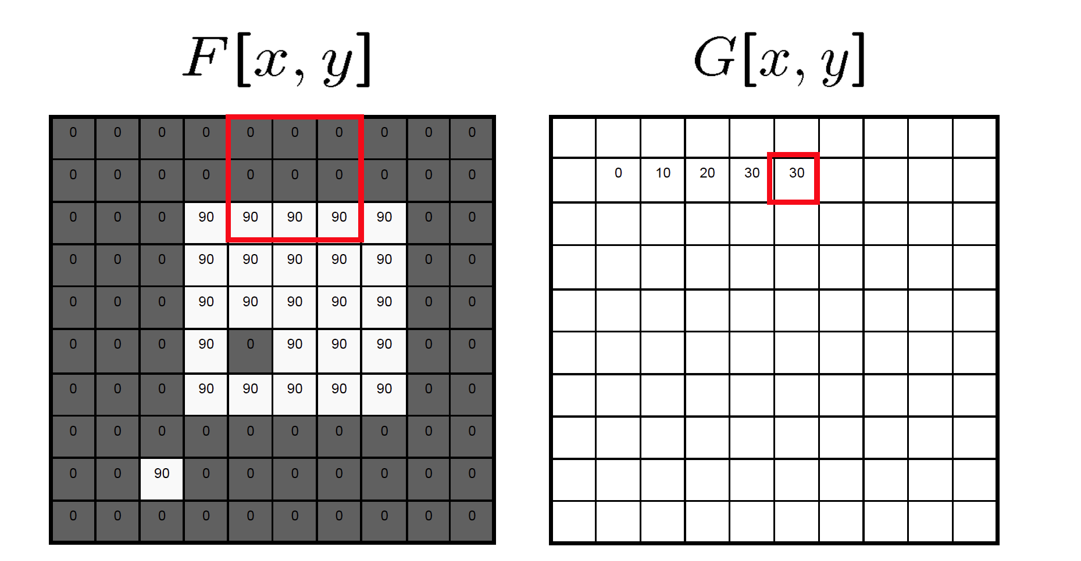
Mean filtering/Moving average

Slide 29
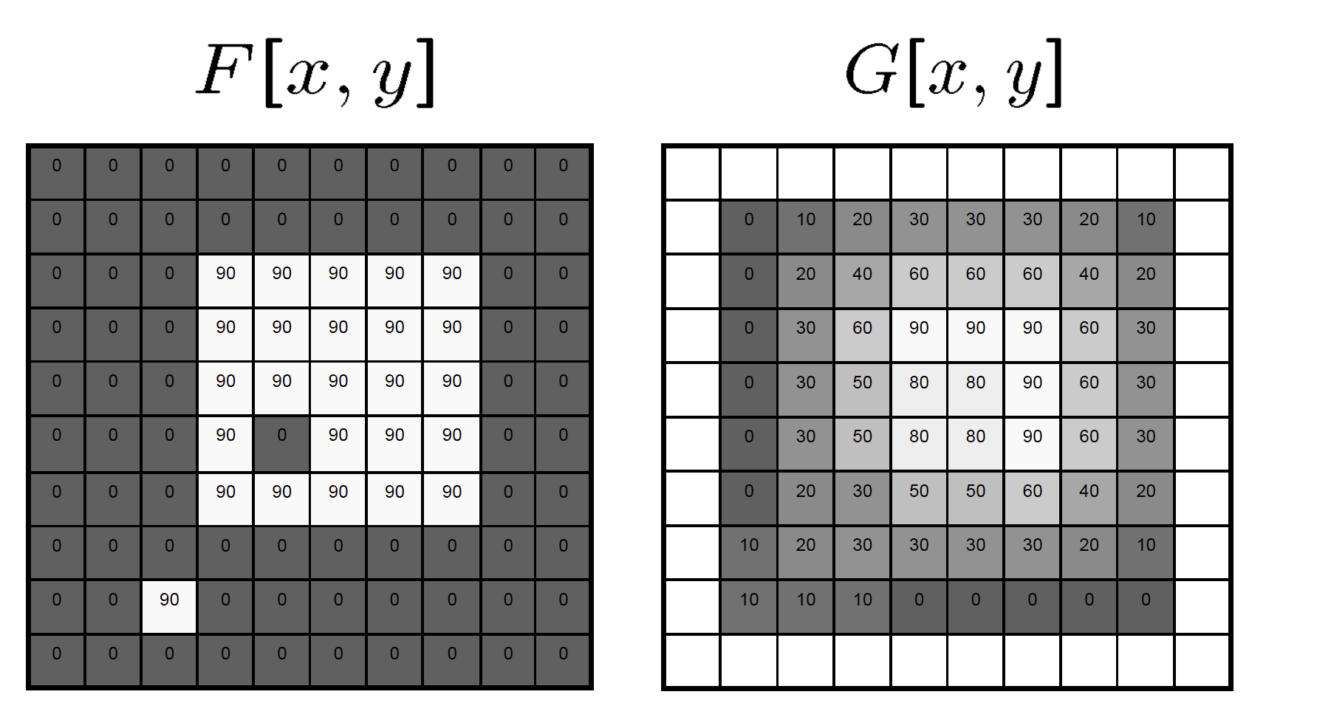
Mean filtering/Moving average

Slide 30
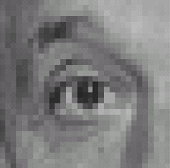
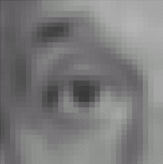

Example filters
1
1
1
1
1
1
1
1
1
Original
Blur (with a
box filter)
Source: D. Lowe

Slide 31
Linear filters: examples
*
0
0
0
=
0
1
0
0
0
0
Original
Identical image
Source: D. Lowe

Slide 32
Linear filters: examples
*
0
0
0
=
1
0
0
0
0
0
Original
Shifted left
By 1 pixel
Source: D. Lowe

Slide 33
Linear filters: examples
*
1
1
1
=
1
1
1
1
1
1
Original
Blur (with a mean filter)
Source: D. Lowe

Slide 34
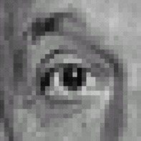



Linear filters: examples
*
0
0
0
-
1
1
1
=
0
2
0
1
1
1
0
0
0
1
1
1
Sharpening filter (accentuates edges)
Original
Source: D. Lowe

Slide 35
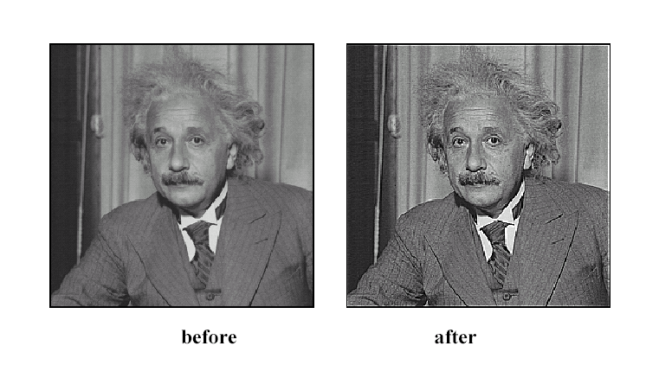
Sharpening
Source: D. Lowe

Slide 36
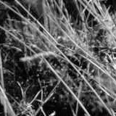
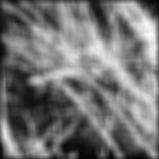
Smoothing with box filter revisited
Source: D. Forsyth
Notes:
I always walk through the argument on the left rather carefully; it gives some insight into the
significance of impulse responses or point spread functions.

Slide 37
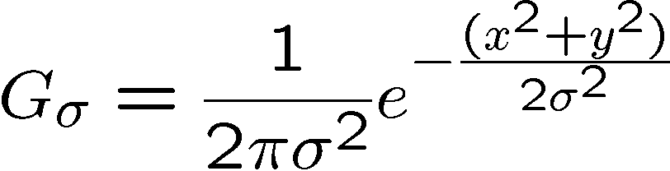
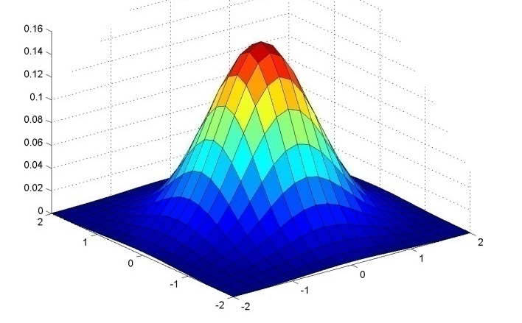
Gaussian Kernel
0.003 0.013 0.022 0.013 0.003
0.013 0.059 0.097 0.059 0.013
0.022 0.097 0.159 0.097 0.022
0.013 0.059 0.097 0.059 0.013
0.003 0.013 0.022 0.013 0.003
5 x 5, σ = 1
Constant factor at front makes volume sum to 1 (can be ignored, as we should re-normalize weights to sum to 1 in any case)
Source: C. Rasmussen

Slide 38
Gaussian Kernel
Source: C. Rasmussen

Slide 39
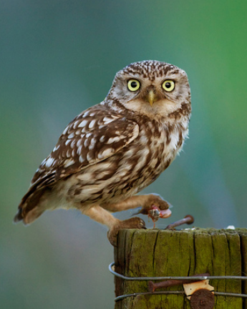
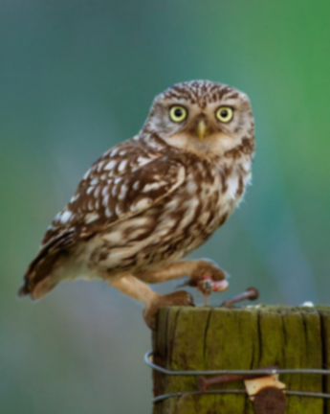








Gaussian filters
= 1 pixel
= 5 pixels
= 10 pixels
= 30 pixels

Slide 40
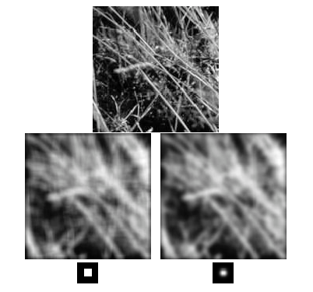
Mean vs. Gaussian filtering

Slide 41



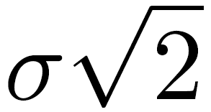
Gaussian filter
Removes “high-frequency” components from the image (low-pass filter)
Convolution with self is another Gaussian
  Convolving twice with Gaussian kernel of width = convolving once with kernel of width
*
=
Source: K. Grauman
Notes:
Linear vs. quadratic in mask size

Slide 42
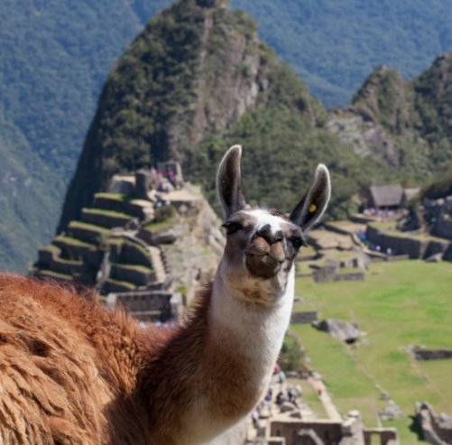

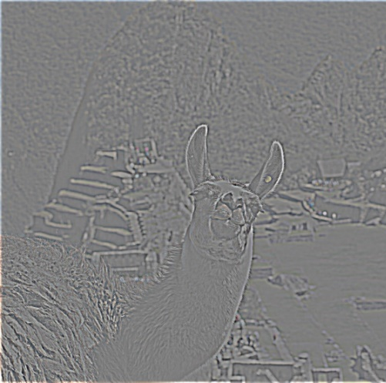
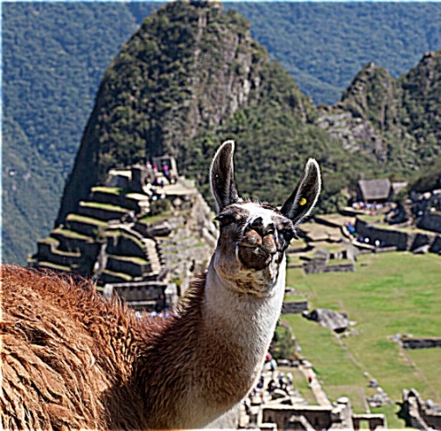
Sharpening revisited
What does blurring take away?
–
=
original
smoothed (5x5)
detail
(This “detail extraction” operation is also called a high-pass filter)
Let’s add it back:
+ α
=
original
detail
sharpened
Photo credit: https://www.flickr.com/photos/geezaweezer/16089096376/

Slide 43
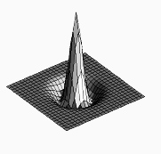

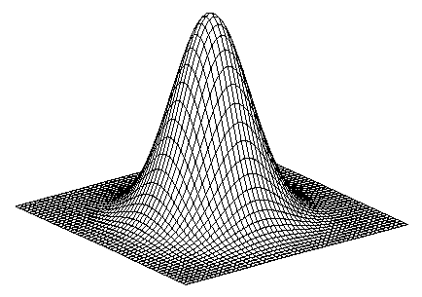
Sharpen filter
blurred
image
image
unit impulse
(identity kernel with single 1 in center, zeros elsewhere)
scaled impulse
Gaussian
Laplacian of Gaussian
Notes:
f + a(f - f * g) = (1+a)f-af*g = f*((1+a)e-ag)

Slide 44

Sharpen filter
unfiltered
filtered

Slide 45
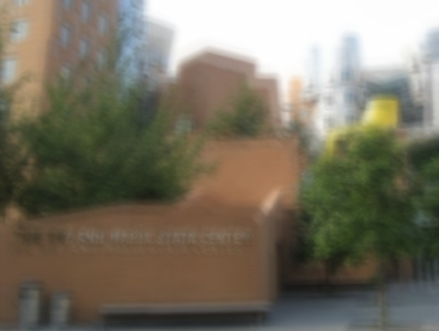
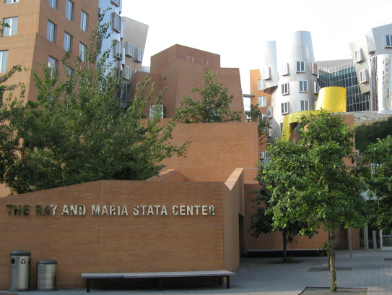
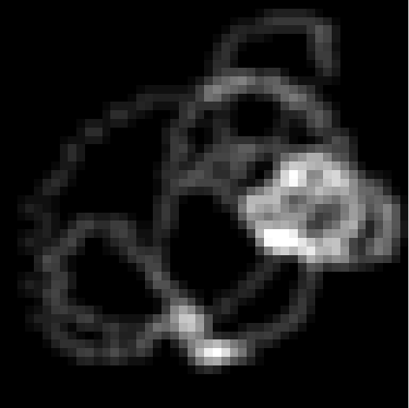
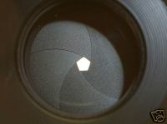


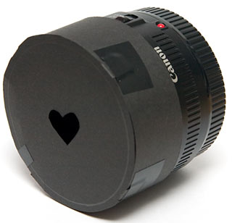
“Optical” Convolution
Camera shake
=
*
Source: Fergus, et al. “Removing Camera Shake from a Single Photograph”, SIGGRAPH 2006
Bokeh: Blur in out-of-focus regions of an image.
Source: http://lullaby.homepage.dk/diy-camera/bokeh.html

Slide 46
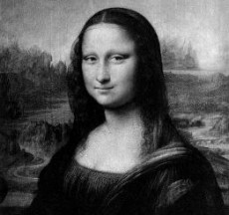
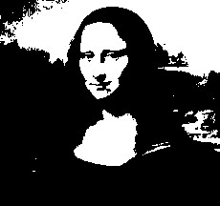

Filters: Thresholding

Slide 47
Linear filters
Is thresholding a linear filter?

Slide 48
Questions?

