Slide 1
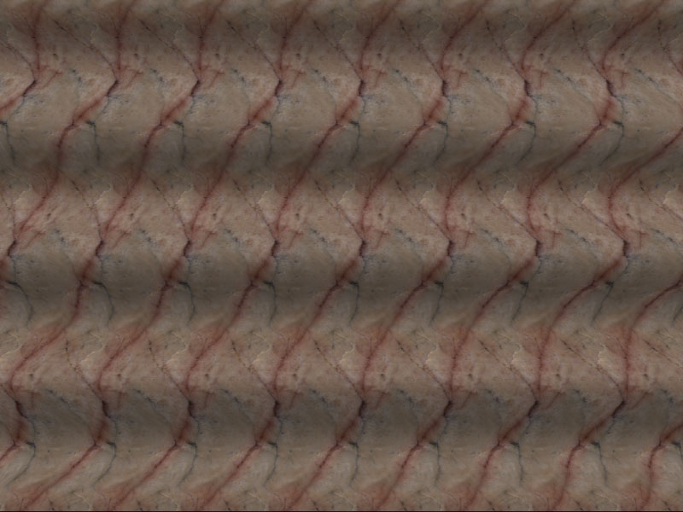
Stereo
CS5670: Computer Vision
Noah Snavely
Single image stereogram, by Niklas Een

Slide 2
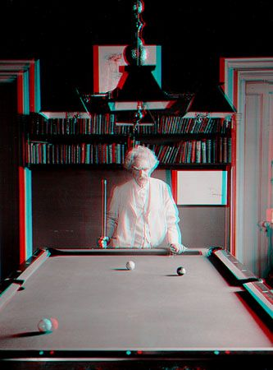
Mark Twain at Pool Table", no date, UCR Museum of Photography

Slide 3
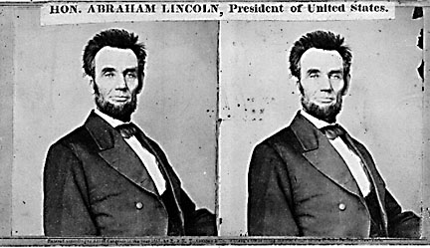
Stereo
Given two images from different viewpoints
  How can we compute the depth of each point in the image?
  Based on how much each pixel moves between the two images

Slide 4
Epipolar geometry
epipolar lines
(x₁, y₁)
(x₂, y₁)
Two images captured by a purely horizontal translating camera
(rectified stereo pair)
x₂ -x₁ = the disparity of pixel (x₁, y₁)

Slide 5
Your basic stereo matching algorithm
Match Pixels in Conjugate Epipolar Lines
  Assume brightness constancy
  This is a challenging problem
  Hundreds of approaches
    A good survey and evaluation: http://www.middlebury.edu/stereo/

Slide 6
Your basic stereo algorithm
For each epipolar line
For each pixel in the left image
    compare with every pixel on same epipolar line in right image
    pick pixel with minimum match cost
Improvement: match windows

Slide 7
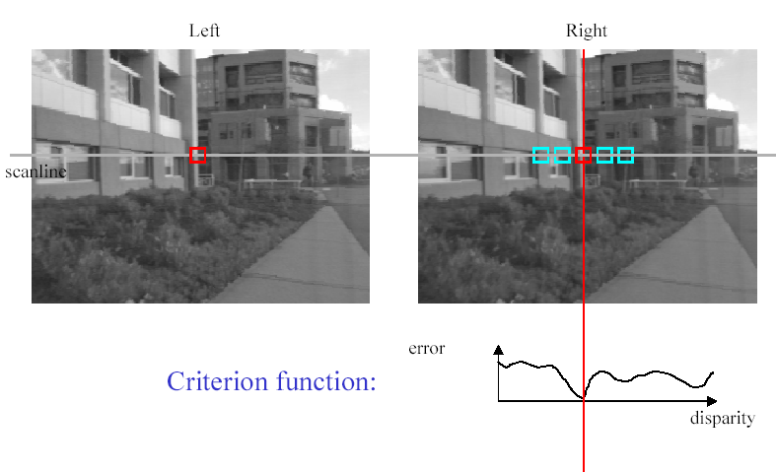
Stereo matching based on SSD
SSD
^{d}min d
Best matching disparity

Slide 8
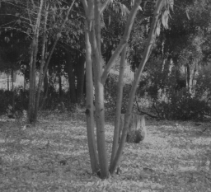
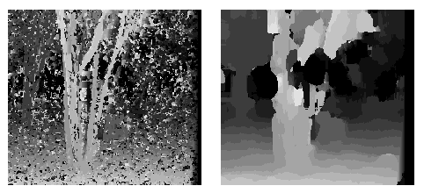
Window size
W = 3
W = 20
Effect of window size
Better results with adaptive window
  T. Kanade and M. Okutomi, A Stereo Matching Algorithm with an Adaptive Window: Theory and Experiment,, Proc. International Conference on Robotics and Automation, 1991.
  D. Scharstein and R. Szeliski. Stereo matching with nonlinear diffusion. International Journal of Computer Vision, 28(2):155-174, July 1998
  Smaller window
  Larger window
Notes:
smaller window: more detail, more noise
bigger window: less noise, more detail

Slide 9
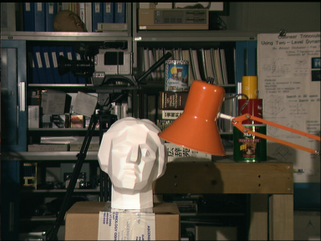

Stereo results
  Data from University of Tsukuba
  Similar results on other images without ground truth
Scene
Ground truth

Slide 10
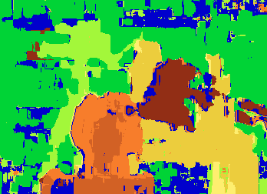

Results with window search
Window-based matching
(best window size)
Ground truth

Slide 11
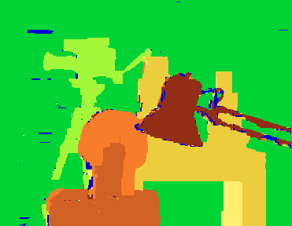
Better methods exist...
State of the art method
  Boykov et al., Fast Approximate Energy Minimization via Graph Cuts,
  International Conference on Computer Vision, September 1999.
Ground truth
    For the latest and greatest: http://www.middlebury.edu/stereo/

Slide 12
Stereo as energy minimization
What defines a good stereo correspondence?
  Match quality
    Want each pixel to find a good match in the other image
  Smoothness
    If two pixels are adjacent, they should (usually) move about the same amount

Slide 13

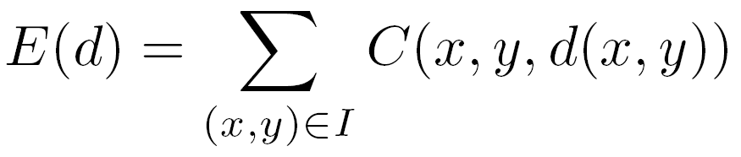

Stereo as energy minimization
Find disparity map d that minimizes an energy function
Simple pixel / window matching
=
SSD distance between windows I(x, y) and J(x + d(x,y), y)

Slide 14
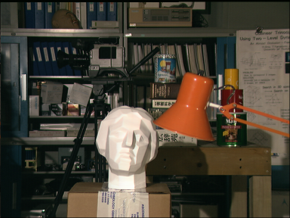
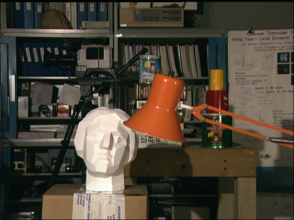
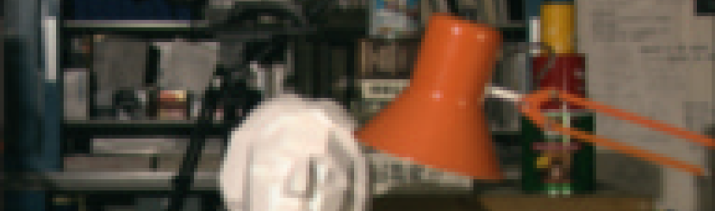
Stereo as energy minimization
I(x, y)
J(x, y)
y = 141
d
x
C(x, y, d); the disparity space image (DSI)

Slide 15
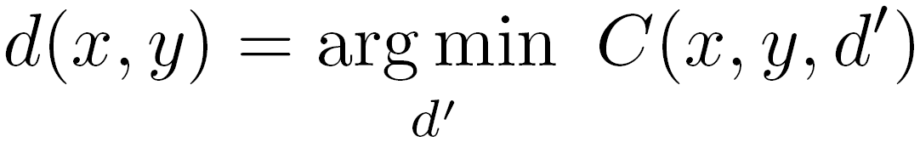
Stereo as energy minimization
y = 141
d
x
Simple pixel / window matching: choose the minimum of each column in the DSI independently:

Slide 16
Greedy selection of best match

Slide 17
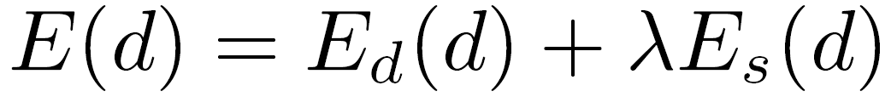
Stereo as energy minimization
Better objective function
{
{
match cost
smoothness cost
    Want each pixel to find a good match in the other image
    Adjacent pixels should (usually) move about the same amount

Slide 18
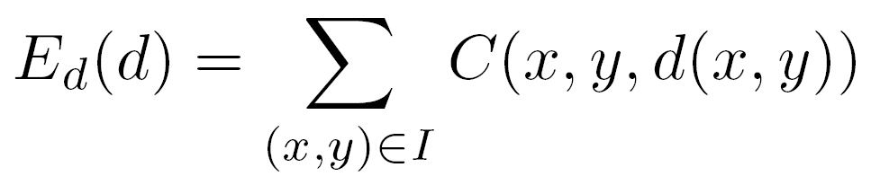
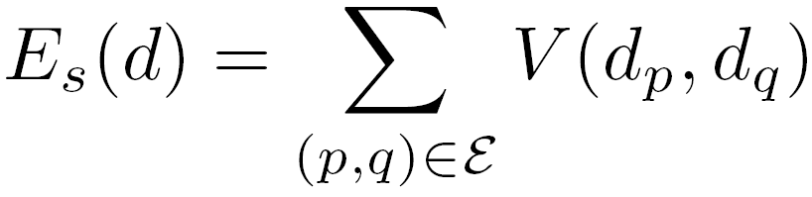

Stereo as energy minimization
match cost:
smoothness cost:
: set of neighboring pixels
4-connected neighborhood
8-connected neighborhood

Slide 19
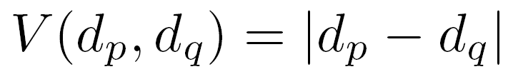
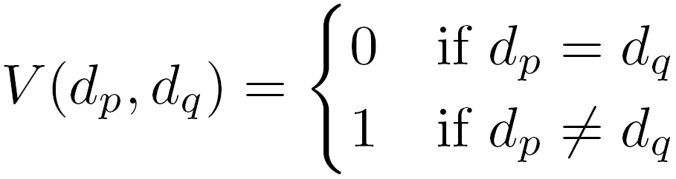
Smoothness cost
How do we choose V?
L₁ distance
“Potts model”

Slide 20
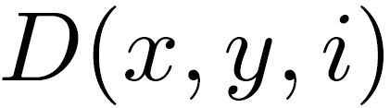
Dynamic programming
Can minimize this independently per scanline using dynamic programming (DP)
Basic idea: incrementally build a table of costs D one column at a time
: minimum cost of solution such that d(x,y) = i
Base case:
(L = max disparity)
Recurrence:

Slide 21
Dynamic programming
y = 141
d
x
Finds “smooth”, low-cost path through DPI from left to right

Slide 22
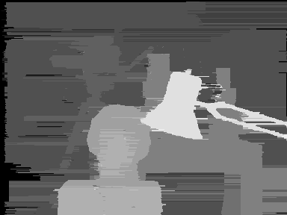
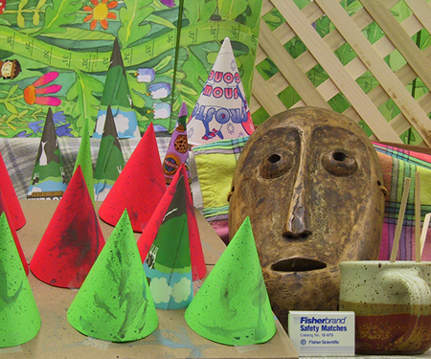
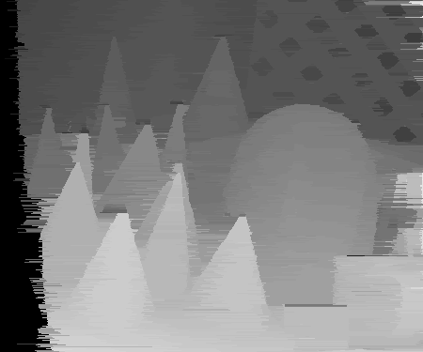
Dynamic Programming

Slide 23
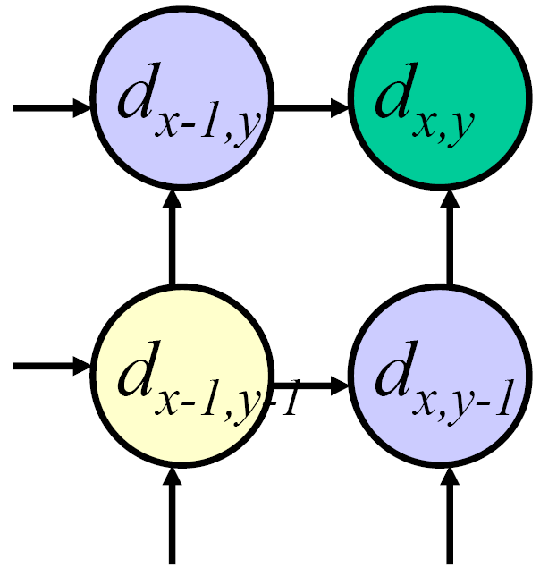
Dynamic programming
Can we apply this trick in 2D as well?
No: d_{x,y-1} and d_{x-1,y} may depend on different values of d_{x-1,y-1}
Slide credit: D. Huttenlocher

Slide 24
Stereo as a minimization problem
The 2D problem has many local minima
  Gradient descent doesn’t work well
And a large search space
  n x m image w/ k disparities has k^{nm} possible solutions
  Finding the global minimum is NP-hard in general
Good approximations exist… we’ll see this soon

Slide 25
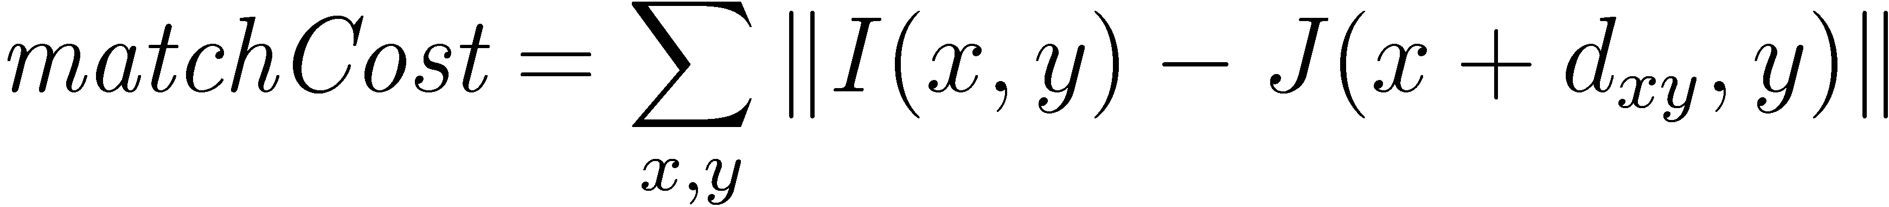
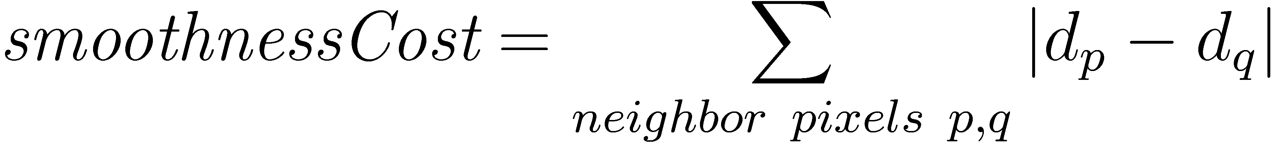
Stereo as energy minimization
Expressing this mathematically
  Match quality
    Want each pixel to find a good match in the other image
  Smoothness
    If two pixels are adjacent, they should (usually) move about the same amount
We want to minimize
  This is a special type of energy function known as an
  MRF (Markov Random Field)
    Effective and fast algorithms have been recently developed:
      Graph cuts, belief propagation….
      for more details (and code): http://vision.middlebury.edu/MRF/
      Great tutorials available online (including video of talks)

Slide 26
Questions?

Slide 27
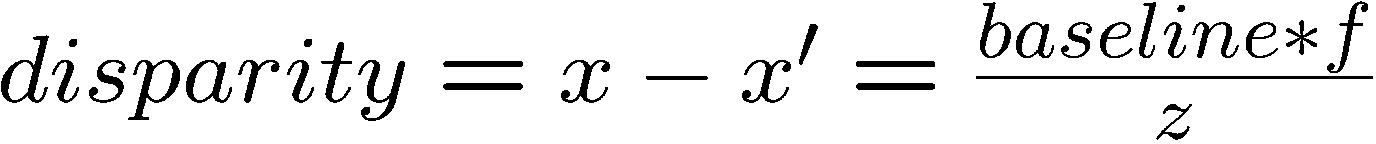
Depth from disparity
X
z
x
x’
f
f
C
baseline
C’

Slide 28
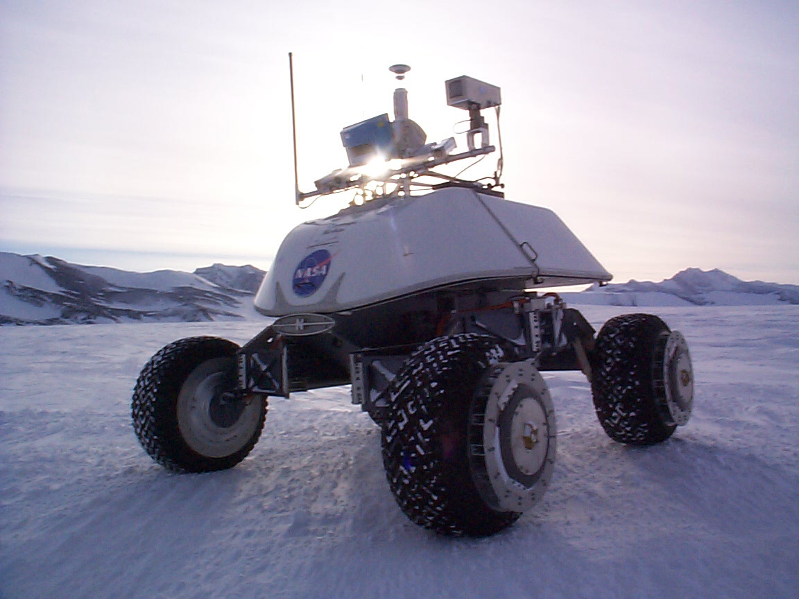
Real-time stereo
Nomad robot searches for meteorites in Antartica
  http://www.frc.ri.cmu.edu/projects/meteorobot/index.html
Used for robot navigation (and other tasks)
  Several real-time stereo techniques have been developed (most based on simple discrete search)

Slide 29
Stereo reconstruction pipeline
Steps
  Calibrate cameras
  Rectify images
  Compute disparity
  Estimate depth
  Camera calibration errors
  Poor image resolution
  Occlusions
  Violations of brightness constancy (specular reflections)
  Large motions
  Low-contrast image regions
What will cause errors?

Slide 30

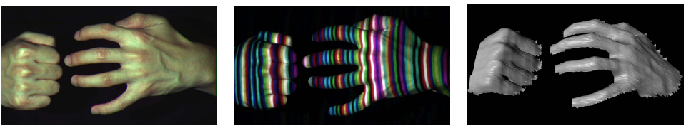
Active stereo with structured light
Li Zhang’s one-shot stereo
camera 1
camera 1
projector
projector
camera 2
Project “structured” light patterns onto the object
  simplifies the correspondence problem
  basis for active depth sensors, such as Kinect and iPhone X (using IR)

Slide 31
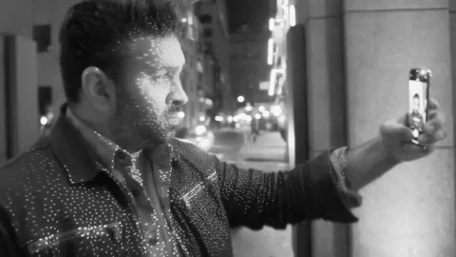
Active stereo with structured light
https://ios.gadgethacks.com/news/watch-iphone-xs-30k-ir-dots-scan-your-face-0180944/

Slide 32
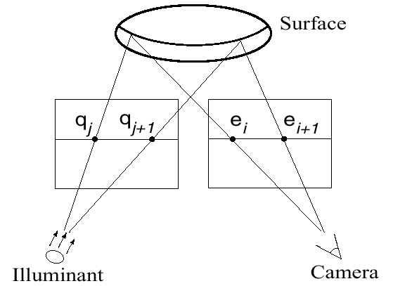
Active stereo with structured light

Slide 33
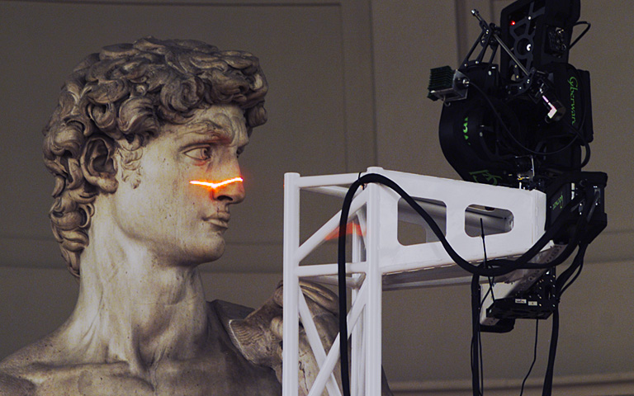
Laser scanning
Digital Michelangelo Project
http://graphics.stanford.edu/projects/mich/
Optical triangulation
  Project a single stripe of laser light
  Scan it across the surface of the object
  This is a very precise version of structured light scanning

Slide 34
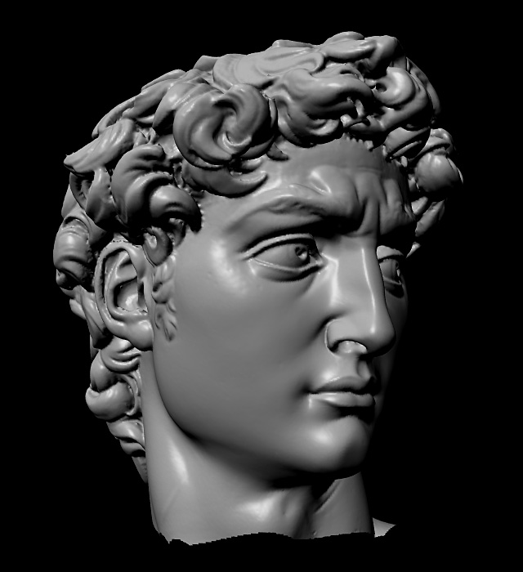
Laser scanned models
  The Digital Michelangelo Project, Levoy et al.

Slide 35
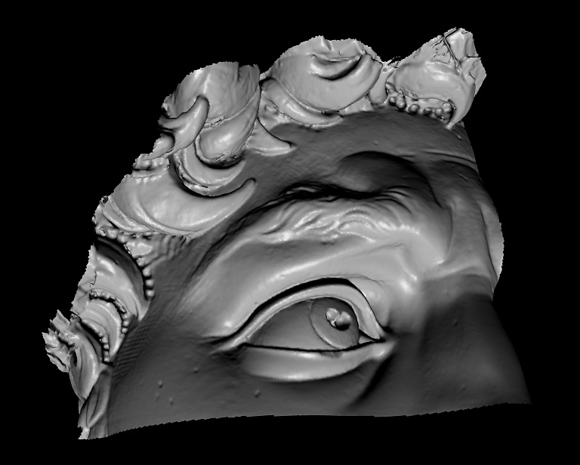
Laser scanned models
  The Digital Michelangelo Project, Levoy et al.

Slide 36
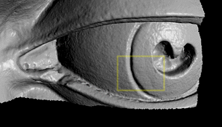
Laser scanned models
  The Digital Michelangelo Project, Levoy et al.

Slide 37
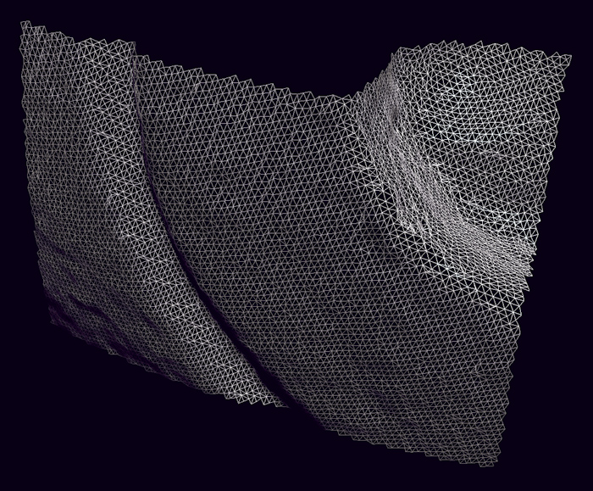
Laser scanned models
  The Digital Michelangelo Project, Levoy et al.

Slide 38
Questions?

