Slide 1
Lecture 24: Convolutional neural networks
CS5670: Computer Vision
Noah Snavely
Image credit: Aphex34, [CC BY-SA 4.0 (http://creativecommons.org/licenses/by-sa/4.0)]
Slides from Andrej Karpathy, Fei-Fei Li, Kavita Bala, and Sean Bell

Slide 2
Today
Deep learning
Field is in rapid motion
Readings: No standard textbooks yet!
Some good resources:
https://sites.google.com/site/deeplearningsummerschool/
http://www.deeplearningbook.org/
http://www.cs.toronto.edu/~hinton/absps/NatureDeepReview.pdf

Slide 3
Announcements
Final project (P5), due Tuesday, 5/9, by 11:59pm, to be done in groups of two
Final exam will be handed out in class Tuesday, due Friday, 5/12, by 5pm

Slide 4
Aside: “CNN” vs “ConvNet”
Note:
•
There are many papers that use either phrase, but
•
“ConvNet” is the preferred term, since “CNN” clashes with other things called CNN

Slide 5
Motivation

Slide 6
Products
[Slide credit: Deva Ramanan]

Slide 7
Helping the Blind
https://www.facebook.com/zuck/videos/10102801434799001/

Slide 8
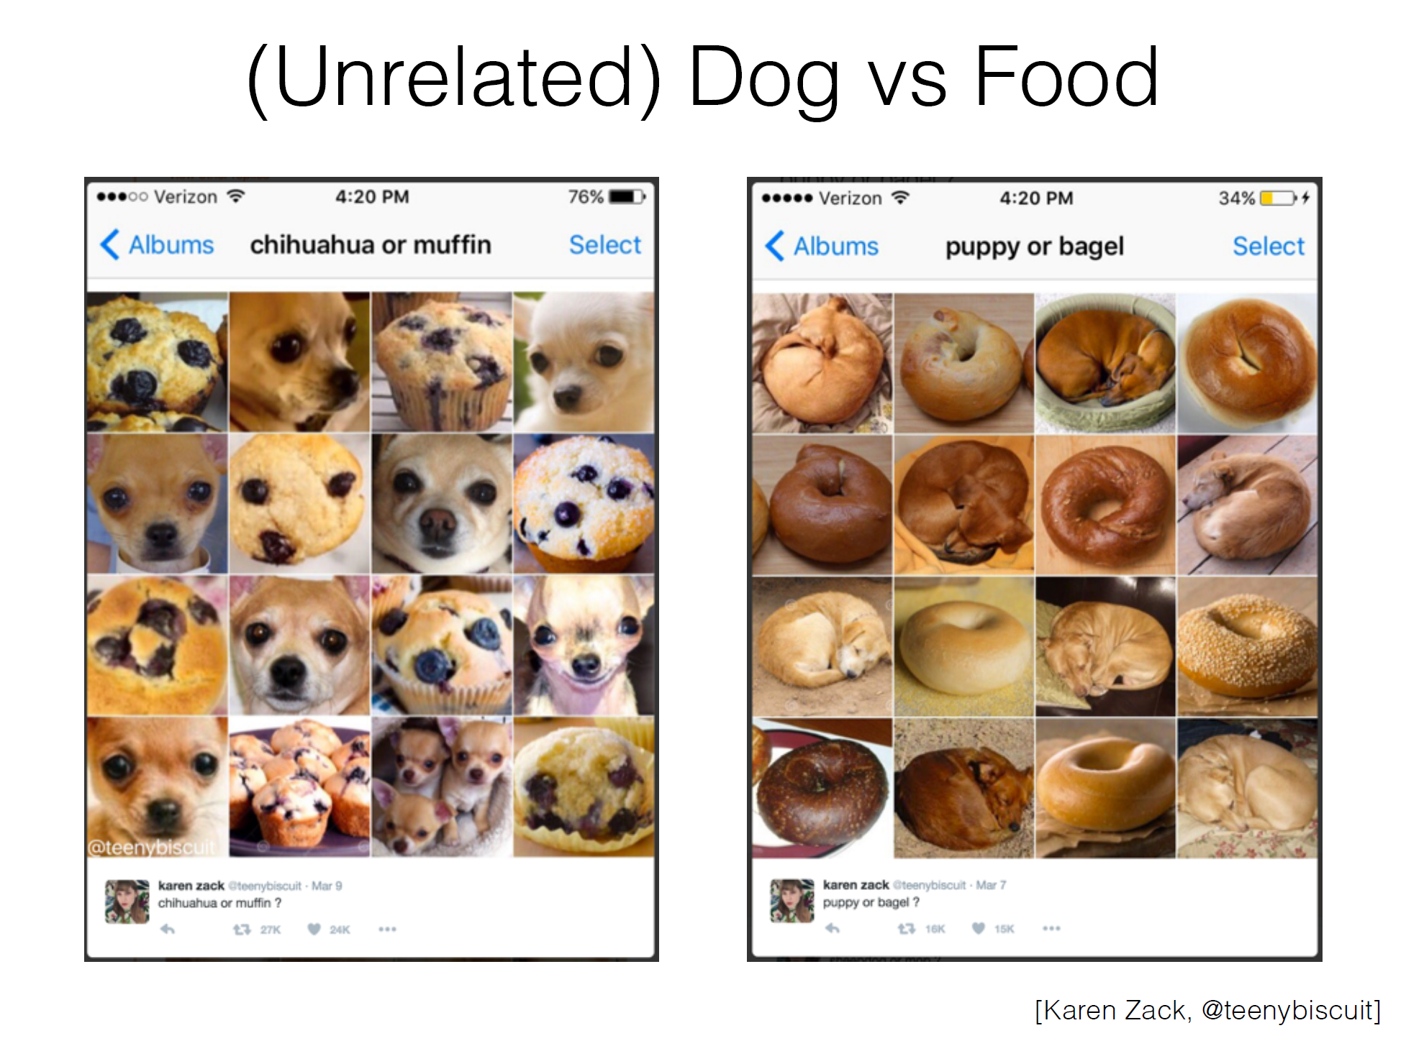

Slide 10
CNNs in 2012: “SuperVision” (aka “AlexNet”)
“AlexNet” — Won the ILSVRC2012 Challenge
Major breakthrough: 15.3% Top-5 error on ILSVRC2012 (Next best: 25.7%)
[Krizhevsky, Sutskever, Hinton. NIPS 2012]

Slide 11
Recap: Before Deep Learning
SVM
Ans
Input Pixels
Extract Features
Concatenate into a vector x
Linear Classifier
Figure: Karpathy 2016

Slide 12
Why use features?
Why not pixels?
Q: What would be a
very hard set of classes for a linear classifier to distinguish?
(assuming x = pixels)
Slide from Karpathy 2016

Slide 13
The last layer of (most) CNNs are linear classifiers
This piece is just a linear classifier
Ans
(GoogLeNet)
Input Pixels
Perform everything with a big neural network, trained end-to-end
Key: perform enough processing so that by the time you get to the end of the network, the classes are linearly separable

Slide 14
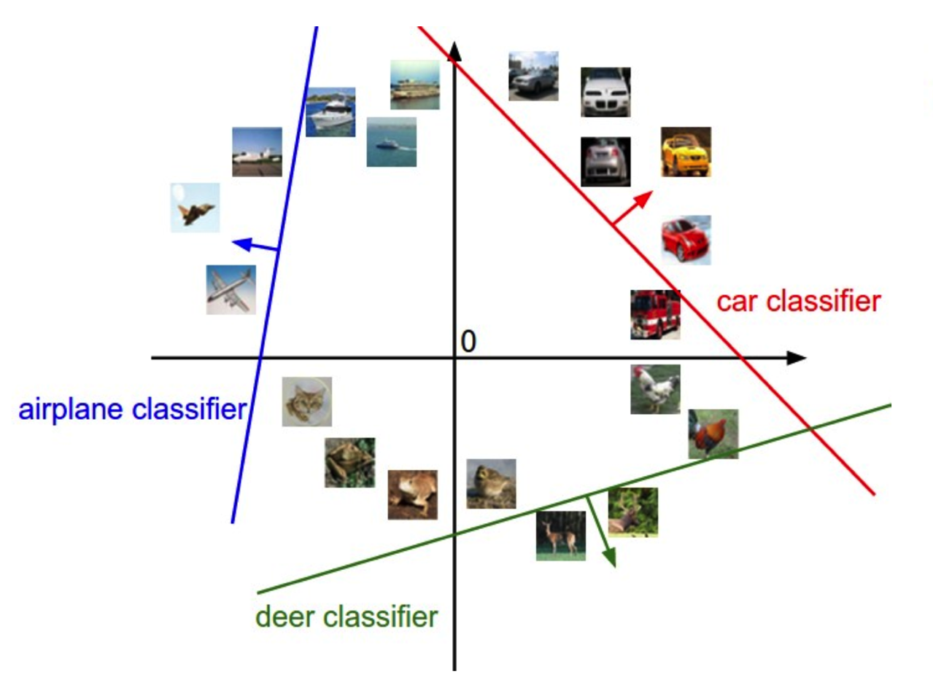
Linearly separable classes

Slide 15
Example: Visualizing AlexNet in 2D with t-SNE
Linear Classifier
(2D visualization using t-SNE)
[Donahue, “DeCAF: DeCAF: A Deep Convolutional …”, arXiv 2013]

Slide 16
Roadmap for today
Neural networks
Convolutional neural networks
Optimization matters!
Backpropagation algorithm

Slide 17
Feature hierarchy with ConvNets End-to-end models
[Zeiler and Fergus, “Visualizing and Understanding Convolutional Networks”, 2013]

Slide 18
Slide: R. Fergus

Slide 19
Neural Networks: The Big Picture
Function
(“layer”)
_{h}(1)
Function
(“layer”)
_{h}(2 )
…
f
x
Key idea: composition of simpler functions called “layers” (e.g., multiple linear layers (not just one))

Slide 20
Neural Networks: The Big Picture
(Hidden Activation)
(Scores)
(Input)
Function
_{h}(1)
Function
_{h}(2 )
…
f
x

Slide 21
Neural Networks: The Big Picture
(Parameters) (Parameters)
_{θ} (1)
_{θ} (2 )
(Hidden Activation)
(Scores)
(Input)
Function
_{h}(1)
Function
_{h}(2 )
…
f
x

Slide 22
Neural Networks: The Big Picture
(Parameters) (Parameters)
_{θ} (1)
_{θ} (2 )
(Hidden Activation)
(Scores)
(Input)
Function
_{h}(1)
Function
_{h}(2 )
…
f
x
Here,θ represents whatever parameters that layer is using (e.g. for a “linear layer” θ ⁽¹⁾ = { W ⁽¹⁾, b⁽¹⁾ }).

Slide 23
Neural Networks: The Big Picture
(Parameters) (Parameters)
_{θ} (1)
_{θ} (2 )
(Hidden Activation)
(Scores)
(Input)
Function
_{h}(1)
Function
_{h}(2 )
…
f
x
(Ground Truth Labels)
y
Here,θ represents whatever parameters that layer is using (e.g. for a “linear layer”θ ⁽¹⁾ = { W ⁽¹⁾, b⁽¹⁾ }).

Slide 24
Neural Networks: The Big Picture
(Parameters) (Parameters)
_{θ} (1)
_{θ} (2 )
(Hidden Activation)
(Scores)
(Input)
Function
_{h}(1)
Function
_{h}(2 )
…
f
x
(Ground Truth Labels)
y
L
(Loss)
Here,θ represents whatever parameters that layer is using (e.g. for a “linear layer” θ ⁽¹⁾ = { W ⁽¹⁾, b⁽¹⁾ }).

Slide 25
Neural Networks: The Big Picture
(Parameters) (Parameters)
_{θ} (1)
_{θ} (2 )
(Hidden Activation)
(Scores)
(Input)
Function
_{h}(1)
Function
_{h}(2 )
…
f
x
(Ground Truth Labels)
y
L
(Loss)
Here,θ represents whatever parameters that layer is using (e.g. for a “linear layer” θ ⁽¹⁾ = { W ⁽¹⁾, b⁽¹⁾ }).
Recall: the loss “L” measures how far the predictions “f” are from the labels “y”. The most common loss is Softmax.

Slide 26
Neural Networks: The Big Picture
(Parameters) (Parameters)
_{θ} (1)
_{θ} (2 )
(Hidden Activation)
(Scores)
(Input)
Function
_{h}(1)
Function
_{h}(2 )
…
f
x
(Ground Truth Labels)
y
L
(Loss)
Here,θ represents whatever parameters that layer is using (e.g. for a “linear layer” θ ⁽¹⁾ = { W ⁽¹⁾, b⁽¹⁾ }).
Key problem: Adjust the weights in all layers to minimize the training loss. We do this with backpropagation.

Slide 27
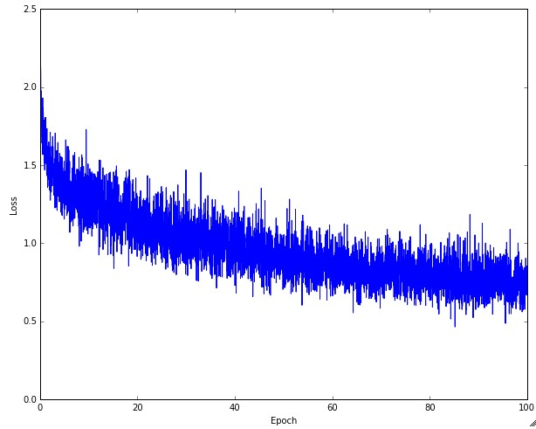
Training Deep Neural Networks
Must run many iterations of batch gradient descent
With lots of other tweaks

Slide 28
Aside: Inspiration from Biology
Figure: Andrej Karpathy

Slide 29
Aside: Inspiration from Biology
Neural nets are loosely inspired by biology
Figure: Andrej Karpathy

Slide 30
Aside: Inspiration from Biology
Neural nets are loosely inspired by biology
But they certainly are not a model of how the brain works, or even how neurons work
Figure: Andrej Karpathy

Slide 31
Simple Neural Net: 1 Layer
Let’s consider a simple 1-layer network:
Wx + b
f
x

Slide 32
Simple Neural Net: 1 Layer
Let’s consider a simple 1-layer network:
Wx + b
f
x
This is just what we’ve seen before (“linear classifier”):

Slide 33
1 Layer Neural Net
Block Diagram:
Wx + b
f
x
(class scores)
(Input)

Slide 34
1 Layer Neural Net
Block Diagram:
Wx + b
f
x
(class scores)
(Input)
Expanded Block Diagram:
W
x
b
=
f
M
+
M
M
D
D
1
1
1
M classes D features 1 example

Slide 35
1 Layer Neural Net
Block Diagram:
Wx + b
f
x
(class scores)
(Input)
Expanded Block Diagram:
W
x
b
=
f
M
+
M
M
D
D
1
1
1
M classes D features 1 example
NumPy:

