Slide 1
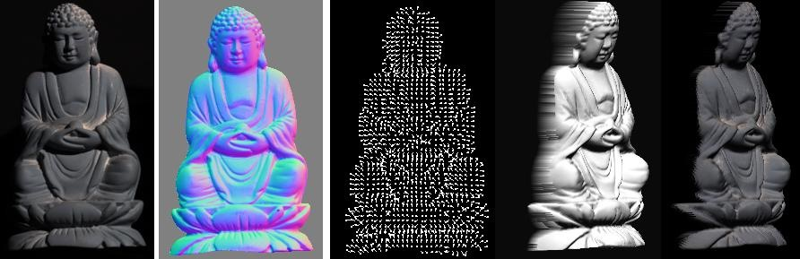
Photometric stereo
CS5670 : Computer Vision
Noah Snavely

Slide 2
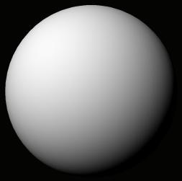
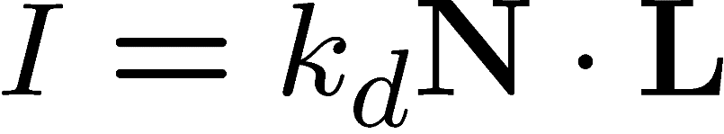


A Single Image: Shape from Shading
Assume is 1 for now.
What can we measure from one image?
  is the angle between N and L
  Add assumptions:
    Constant albedo
    A few known normals (e.g. silhouettes)
    Smoothness of normals
In practice, SFS doesn’t work very well:
assumptions are too restrictive,
too much ambiguity in nontrivial scenes.

Slide 3
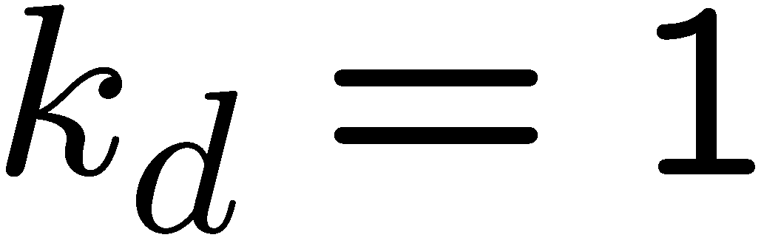
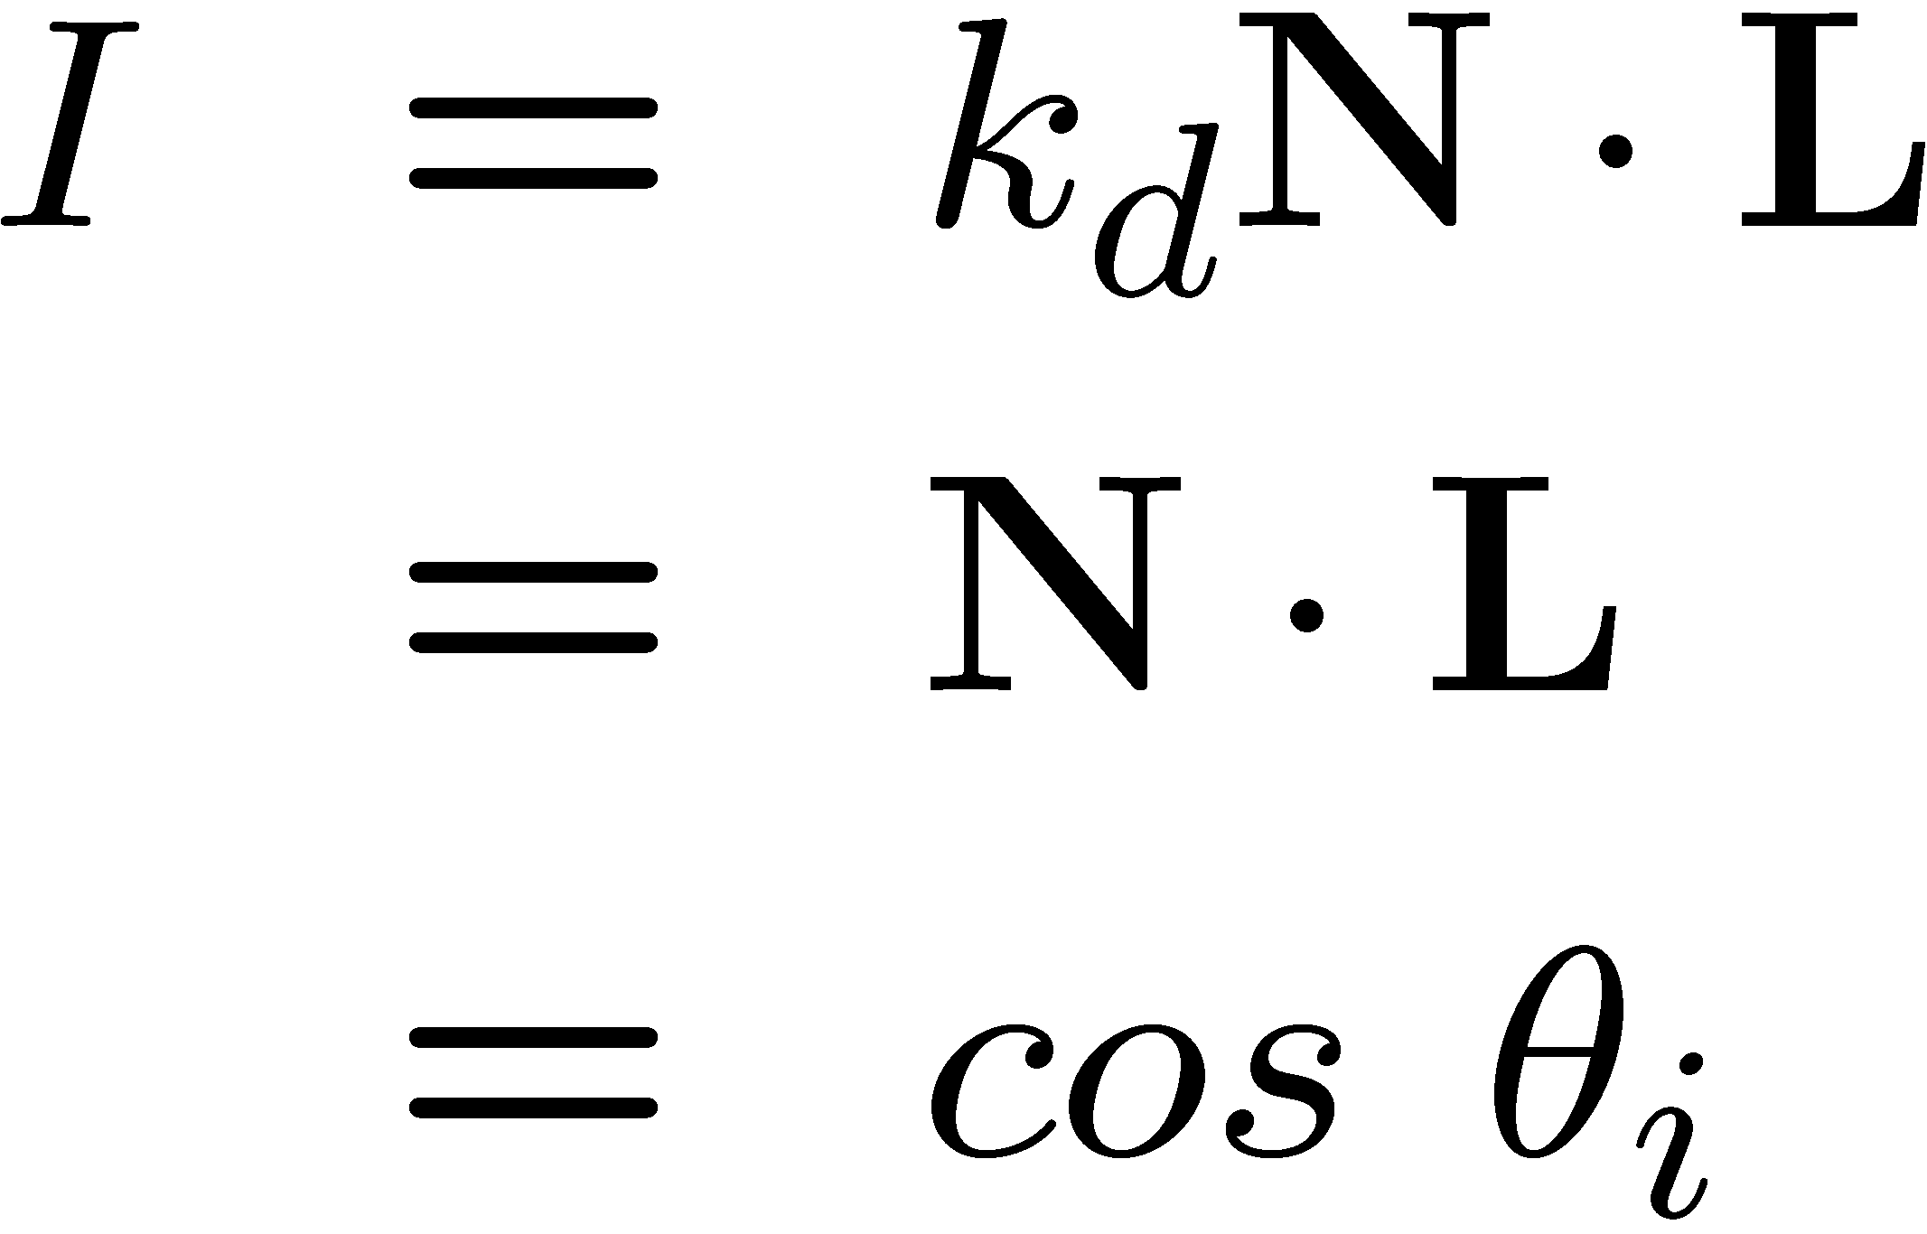


Shape from shading
Suppose
You can directly measure angle between normal and light source
  Not quite enough information to compute surface shape
  But can be if you add some additional info, for example
    assume a few of the normals are known (e.g., along silhouette)
    constraints on neighboring normals—“integrability”
    smoothness
  Hard to get it to work well in practice
    plus, how many real objects have constant albedo?

Slide 4
Diffuse reflection
Demo
http://www.math.montana.edu/frankw/ccp/multiworld/twothree/lighting/applet1.htm
http://www.math.montana.edu/frankw/ccp/multiworld/twothree/lighting/learn2.htm

Slide 5




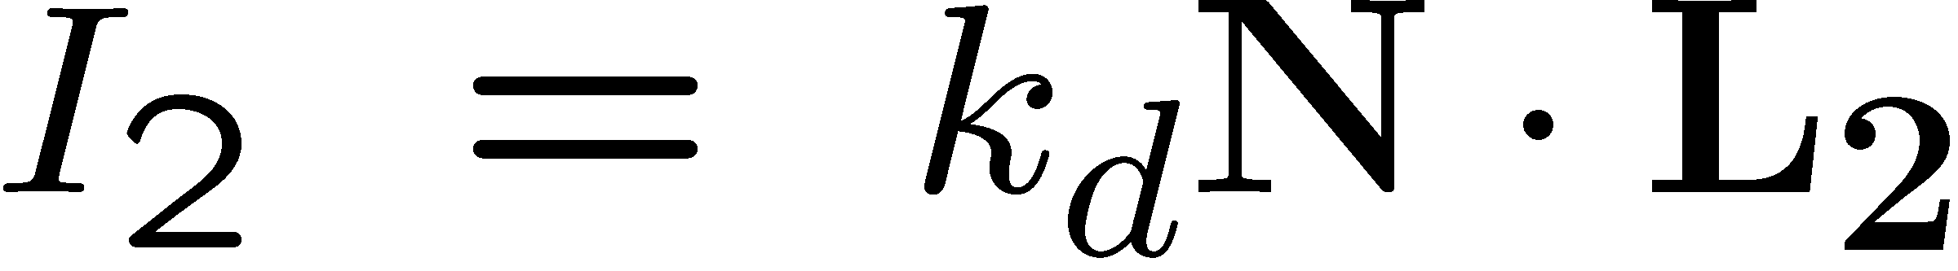
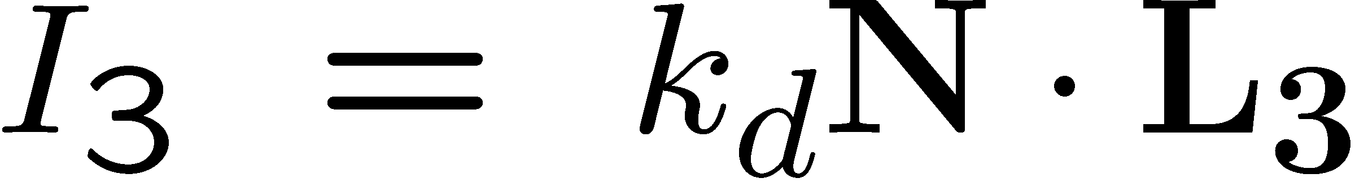
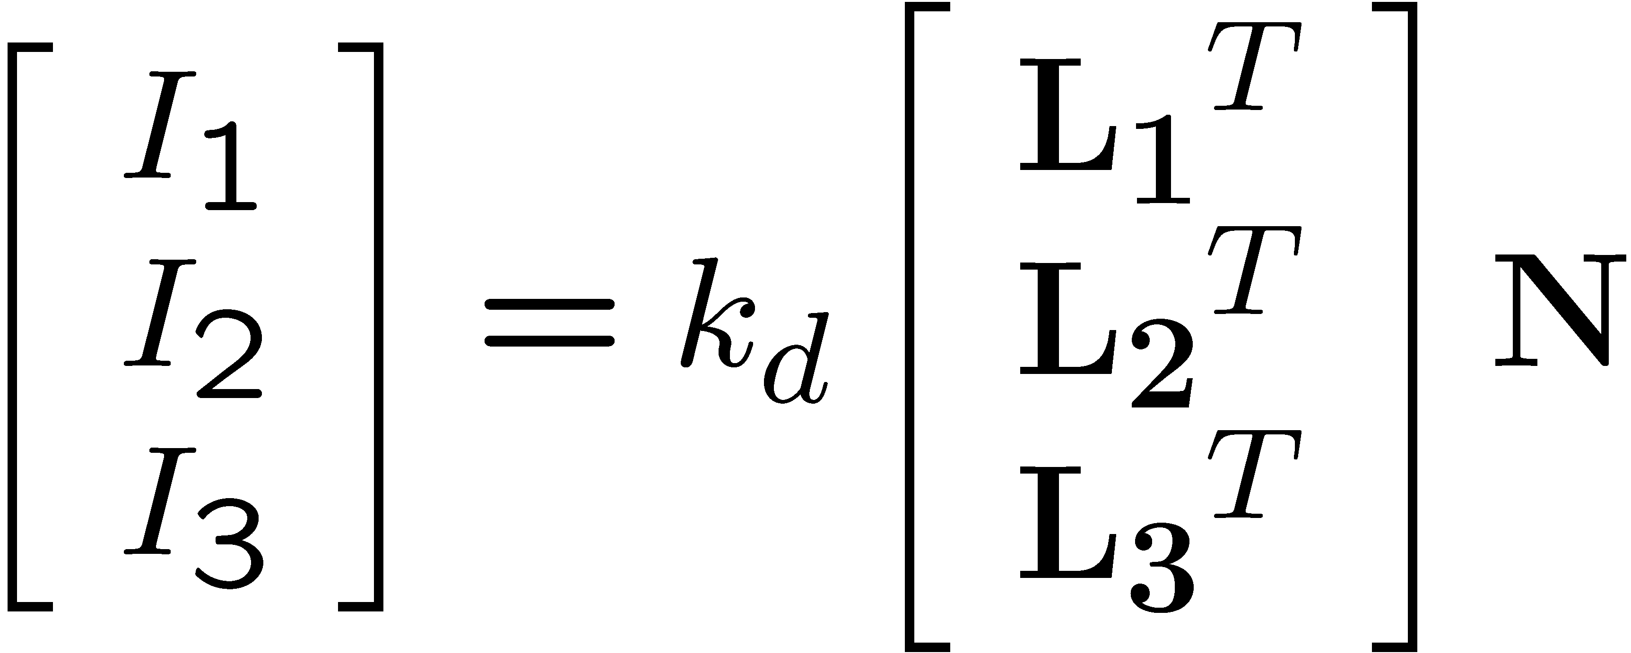
Photometric stereo
N
L₃
L₂
L₁
V
Can write this as a matrix equation:

Slide 6
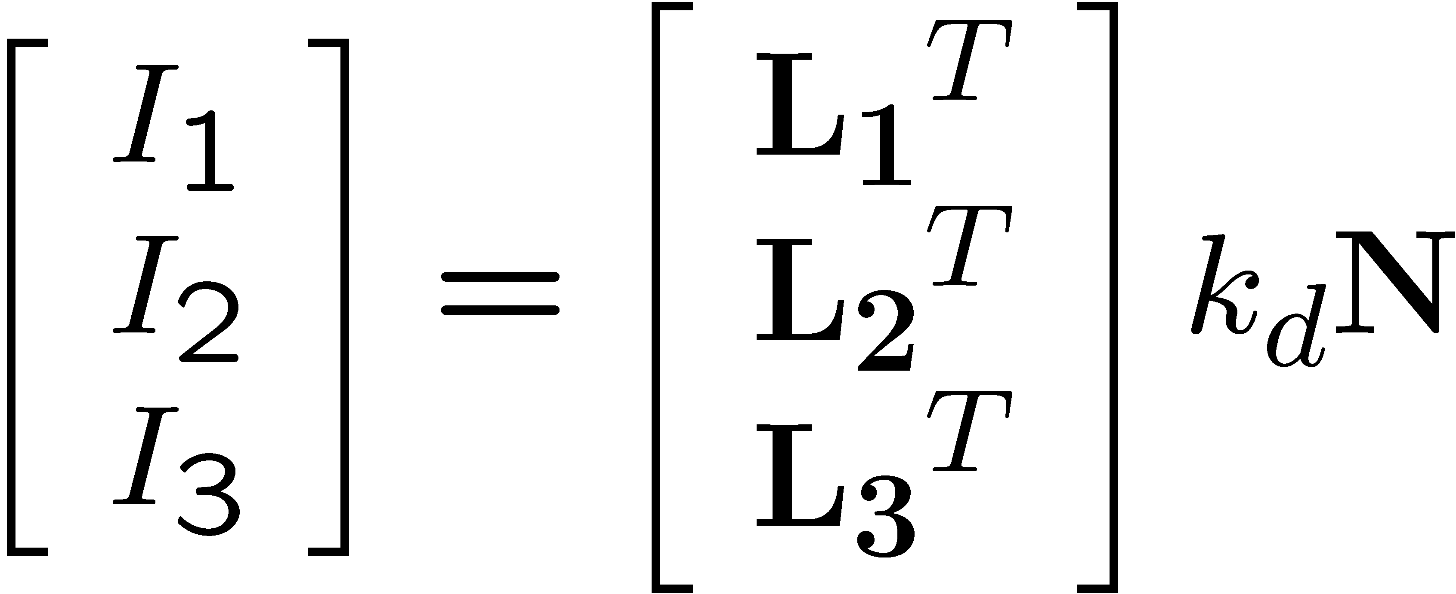







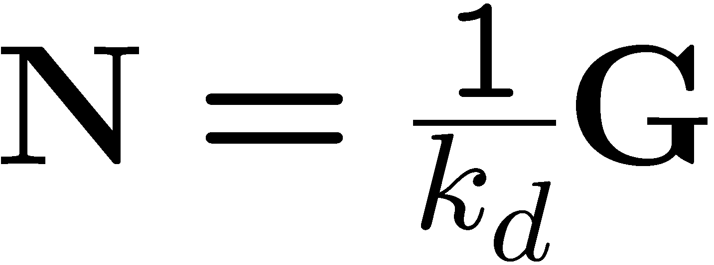
Solving the equations

Slide 7
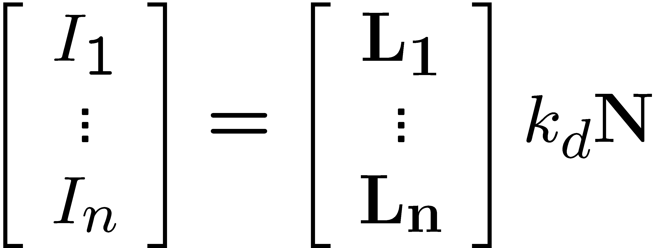
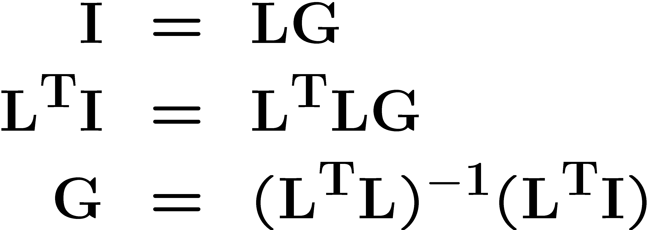
More than three lights
Get better results by using more lights
Least squares solution:
Solve for N, k_{d} as before
What’s the size of L^{T}L?

Slide 8
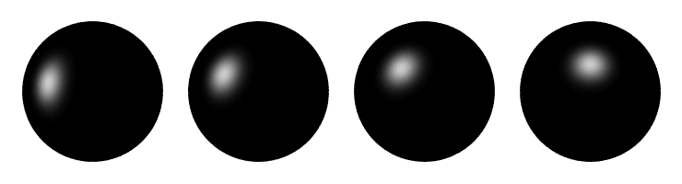
Computing light source directions
Trick: place a chrome sphere in the scene
  the location of the highlight tells you where the light source is

Slide 9





Recall the rule for specular reflection
For a perfect mirror, light is reflected about N
We see a highlight when V = R
  then L is given as follows:

Slide 10
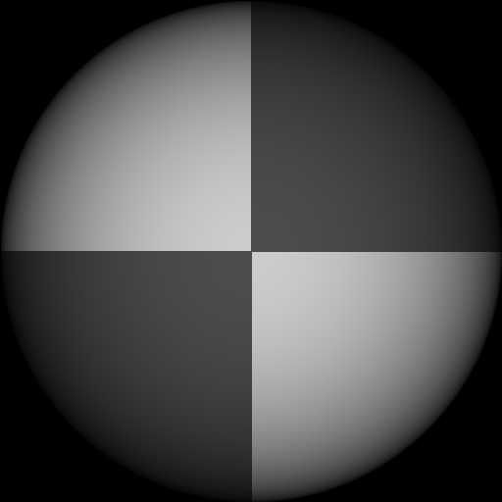
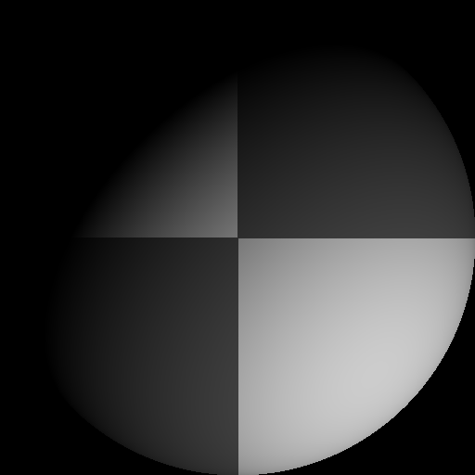
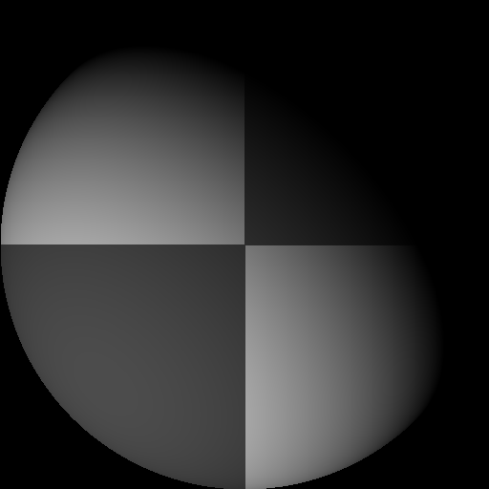
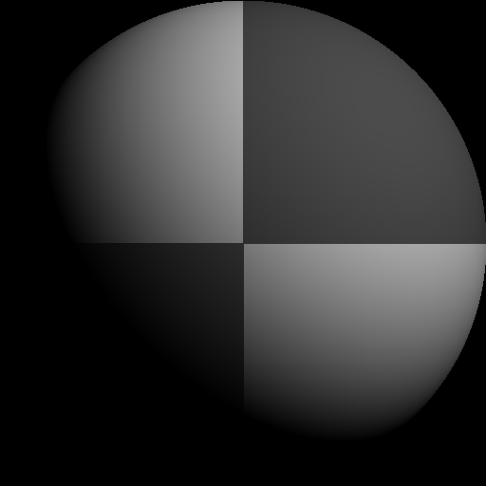
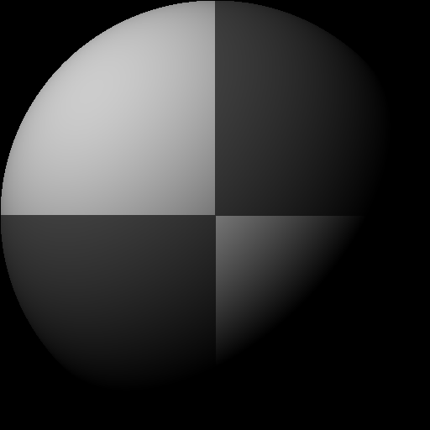
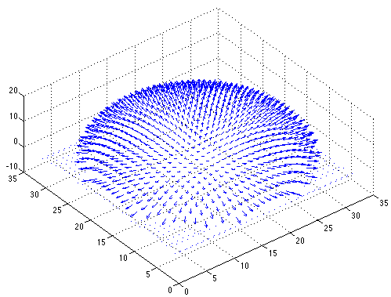

Example
Recovered albedo
Recovered normal field
Forsyth & Ponce, Sec. 5.4

Slide 11

Depth from normals
Solving the linear system per-pixel gives us an estimated surface normal for each pixel
How can we compute depth from normals?
  Normals are like the “derivative” of the true depth
Input photo
Estimated normals
Estimated normals (needle diagram)

Slide 12
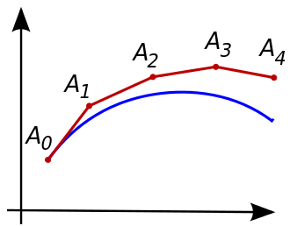
Normal Integration
Integrating a set of derivatives is easy in 1D
  (similar to Euler’s method from diff. eq. class)
Could just integrate normals in each column / row separately
Instead, we formulate as a linear system and solve for depths that best agree with the surface normals

Slide 13

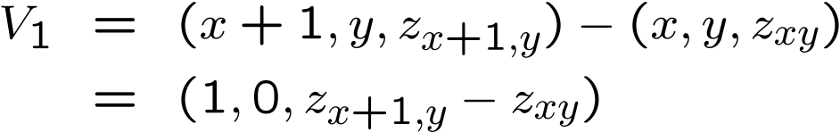


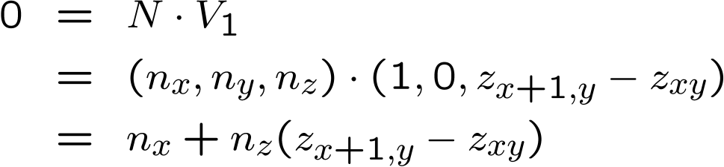

Depth from normals
V₂
V₁
N
Get a similar equation for V₂
  Each normal gives us two linear constraints on z
  compute z values by solving a matrix equation

Slide 14
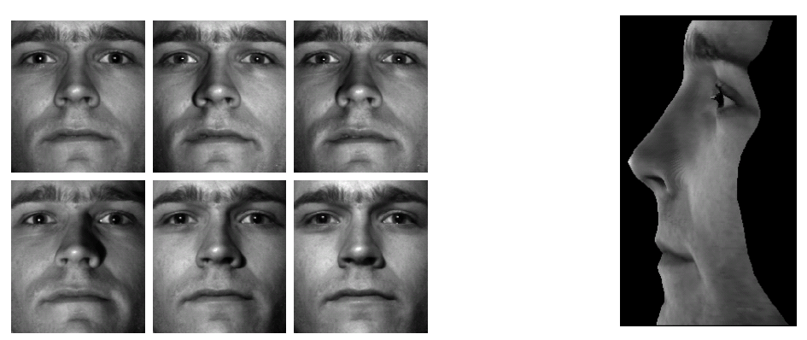
Results
from Athos Georghiades
14

Slide 15
Example

Slide 16
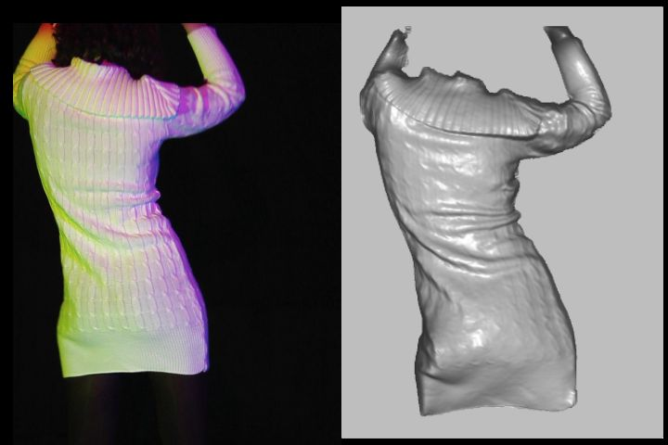
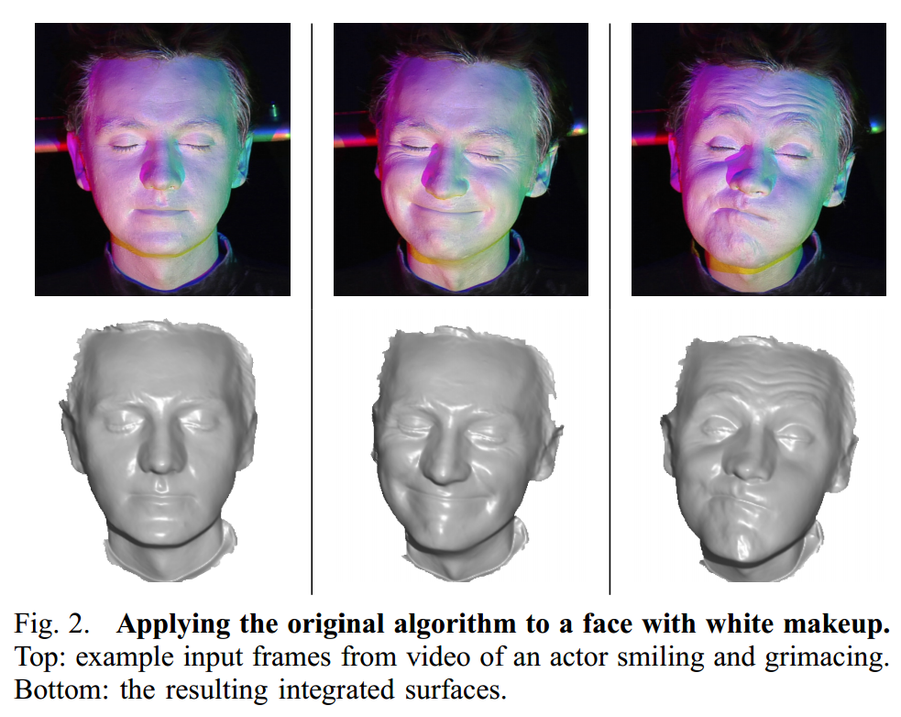
Extension
Photometric Stereo from Colored Lighting
Video Normals from Colored Lights
Gabriel J. Brostow, Carlos Hernández, George Vogiatzis, Björn Stenger, Roberto Cipolla
IEEE TPAMI, Vol. 33, No. 10, pages 2104-2114, October 2011.

