Slide 1
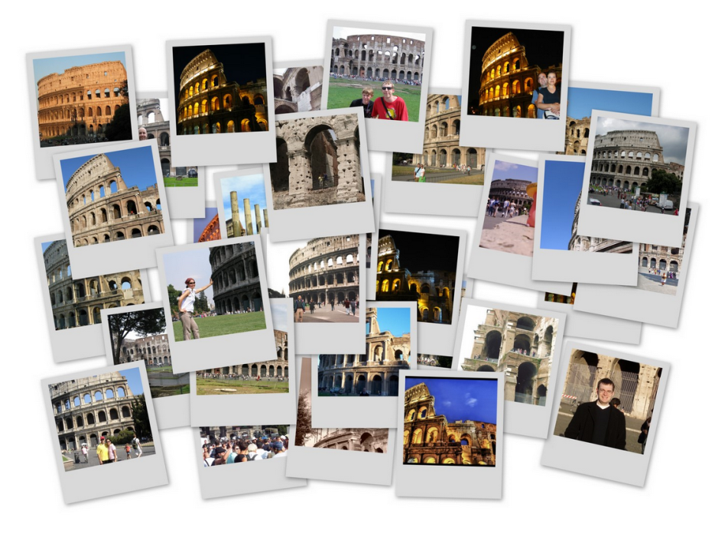
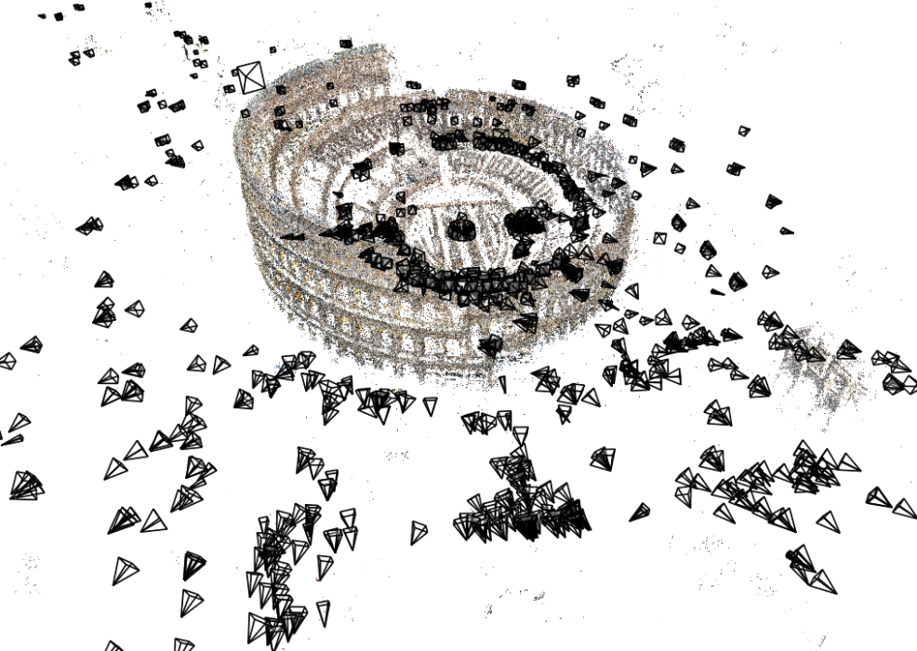
Lecture 15: Structure from motion
CS5670: Computer Vision
Noah Snavely

Slide 2
Readings
Szeliski, Chapter 7.1 – 7.4

Slide 3
Structure from motion
Given many images, how can we
  a) figure out where they were all taken from?
  b) build a 3D model of the scene?
  This is (roughly) the structure from motion problem

Slide 4
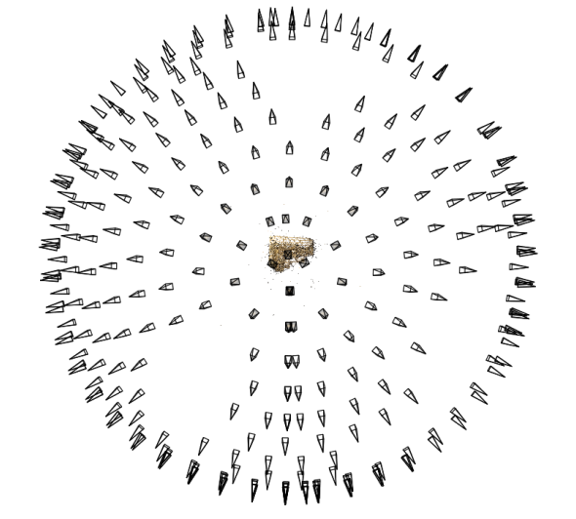
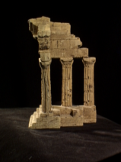
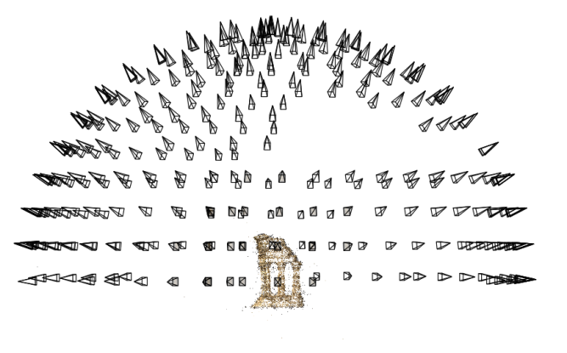
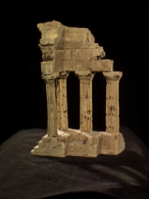
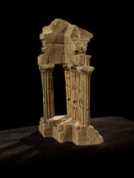
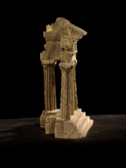
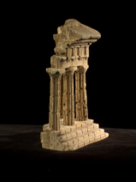
Structure from motion
Reconstruction (side)
(top)
Input: images with points in correspondence p_{i,j} = (u_{i,j},v_{i,j})
Output
  structure: 3D location x_{i} for each point p_{i}
  motion: camera parameters R_{j} , t_{j} possibly K_{j}
Objective function: minimize reprojection error

Slide 5
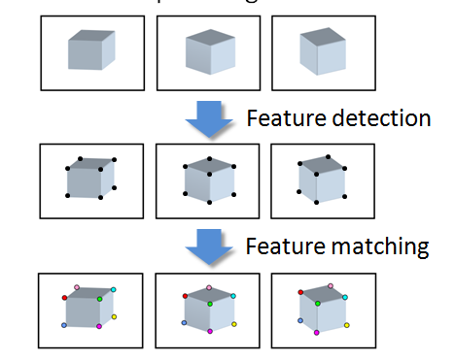
Input

Slide 6
Camera calibration & triangulation
Suppose we know 3D points
  And have matches between these points and an image
  How can we compute the camera parameters?
Suppose we have know camera parameters, each of which observes a point
  How can we compute the 3D location of that point?

Slide 7
Structure from motion
SfM solves both of these problems at once
A kind of chicken-and-egg problem
  (but solvable)

Slide 8
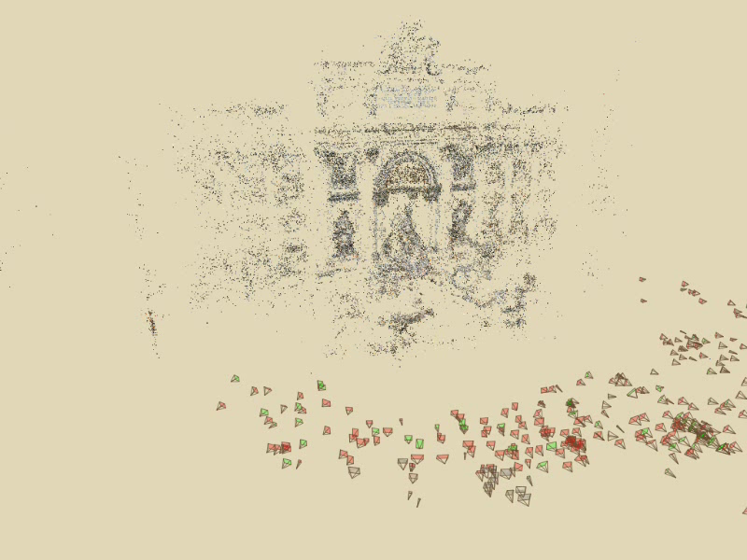
Photo Tourism
Notes:
Here’s how the same set of photos appear in our photo explorer. Our system takes the set of photos and automatically determines the relative positions and orientations from which each photo was taken. We can then load the photos into our immersive 3D browser where the user can visualize and explore the photos using spatial relationships.

Slide 9
First step: how to get correspondence?
Feature detection and matching

Slide 10
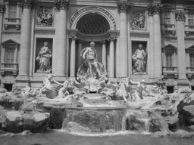
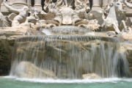
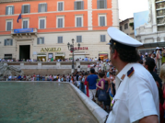
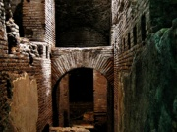

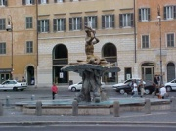
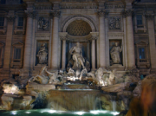
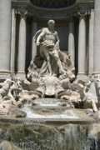
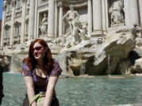
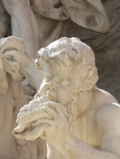
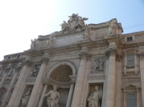
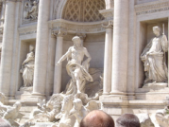
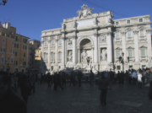
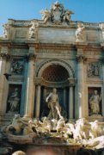
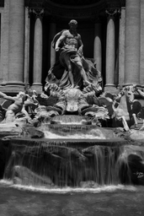
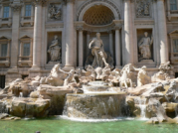
Feature detection
Detect features using SIFT [Lowe, IJCV 2004]
Notes:
So, we begin by detecting SIFT features in each photo.
[We detect SIFT features in each photo, resulting in a set of feature locations and 128-byte feature descriptors…]

Slide 11


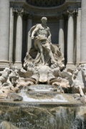

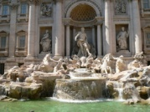
Feature detection
Detect features using SIFT [Lowe, IJCV 2004]

Slide 12
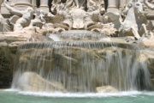



Feature matching
Match features between each pair of images
Notes:
Next, we match features across each pair of photos using approximate nearest neighbor matching.

Slide 13


Feature matching
Refine matching using RANSAC to estimate fundamental matrix between each pair
Notes:
The matches are refined by using RANSAC, which is a robust model-fitting technique, to estimate a fundamental matrix between each pair of matching images and keeping only matches consistent with that fundamental matrix.
We then link connected components of pairwise feature matches together to form correspondences across multiple images.
Once we have correspondences, we run structure from motion to recover the camera and scene geometry. Structure from motion solves the following problem:

Slide 14


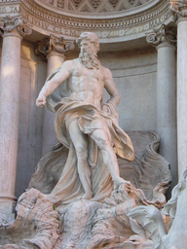
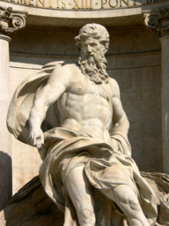
Correspondence estimation
Link up pairwise matches to form connected components of matches across several images
Image 1
Image 2
Image 3
Image 4
Notes:
The next step of our reconstruction algorithm is to link up matches between pairs of images into correspondences between multiple images, by finding connected components of matches. Suppose among these images, these features are matched only between consecutive pairs of images, perhaps because the scales of the images are so different. During correspondence estimation we link these matches and consider them to be 2D projections of a single 3D point in the scene.

Slide 15
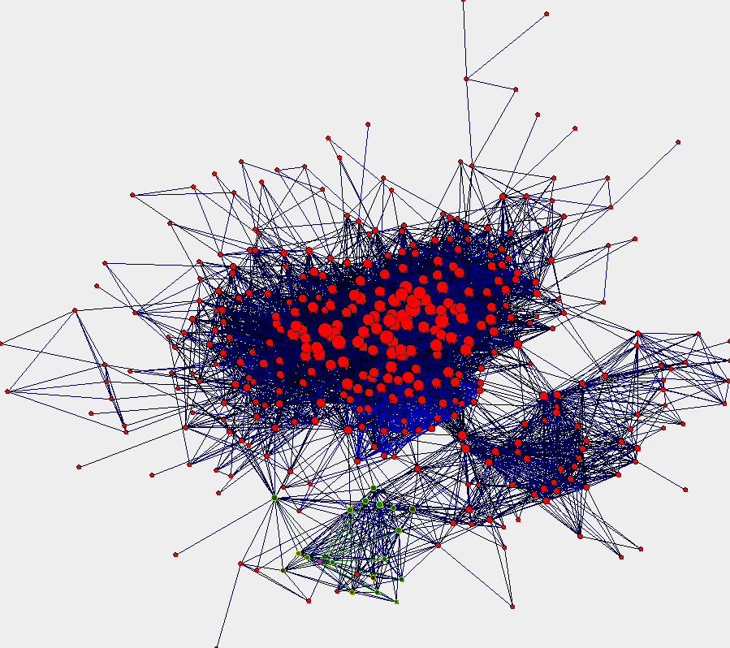
Image connectivity graph
(graph layout produced using the Graphviz toolkit: http://www.graphviz.org/)

Slide 16
x₄
x₁
x₃
x₂
x₅
x₇
x₆
p_{1,1}
p_{1,2}
p_{1,3}
Image 1
Image 3
R₁,t₁
R₃,t₃
Image 2
R₂,t₂

Slide 17
Structure from motion
p₄
p₁
p₃
minimize
p₂
f (R, T, P)
p₅
p₇
p₆
Camera 1
Camera 3
R₁,t₁
R₃,t₃
Camera 2
R₂,t₂
Notes:
Structure from motion solves the following problem:
Given a set of images of a static scene with 2D points in correspondence, shown here as color-coded points, find…
a set of 3D points P and
a rotation R and position t of the cameras that explain the observed correspondences. In other words, when we project a point into any of the cameras, the reprojection error between the projected and observed 2D points is low.
This problem can be formulated as an optimization problem where we want to find the rotations R, positions t, and 3D point locations P that minimize sum of squared reprojection errors f. This is a non-linear least squares problem and can be solved with algorithms such as Levenberg-Marquart. However, because the problem is non-linear, it can be susceptible to local minima. Therefore, it’s important to initialize the parameters of the system carefully. In addition, we need to be able to deal with erroneous correspondences.

Slide 18
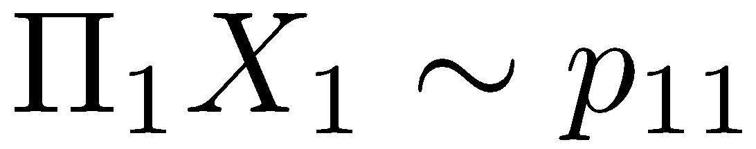
Structure from motion
X₄
X₁
X₃
minimize
X₂
g(R, T, X)
X₅
non-linear least squares
X₇
X₆
p_{1,1}
p_{1,3}
p_{1,2}
Camera 1
Camera 3
R₁,t₁
R₃,t₃
Camera 2
R₂,t₂
Notes:
Structure from motion solves the following problem:
Given a set of images of a static scene with 2D points in correspondence, shown here as color-coded points, find…
a set of 3D points P and
a rotation R and position t of the cameras that explain the observed correspondences. In other words, when we project a point into any of the cameras, the reprojection error between the projected and observed 2D points is low.
This problem can be formulated as an optimization problem where we want to find the rotations R, positions t, and 3D point locations P that minimize sum of squared reprojection errors f. This is a non-linear least squares problem and can be solved with algorithms such as Levenberg-Marquart. However, because the problem is non-linear, it can be susceptible to local minima. Therefore, it’s important to initialize the parameters of the system carefully. In addition, we need to be able to deal with erroneous correspondences.

Slide 19
Problem size
What are the variables?
How many variables per camera?
How many variables per point?
Trevi Fountain collection
  466 input photos
  + > 100,000 3D points
  = very large optimization problem

Slide 20
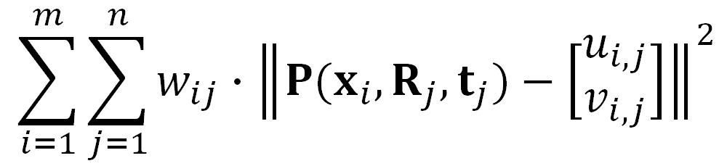

Structure from motion
Minimize sum of squared reprojection errors:
Minimizing this function is called bundle adjustment
  Optimized using non-linear least squares, e.g. Levenberg-Marquardt
predicted
image location
observed
image location
indicator variable:
is point i visible in image j ?

Slide 21
Is SfM always uniquely solvable?

Slide 22
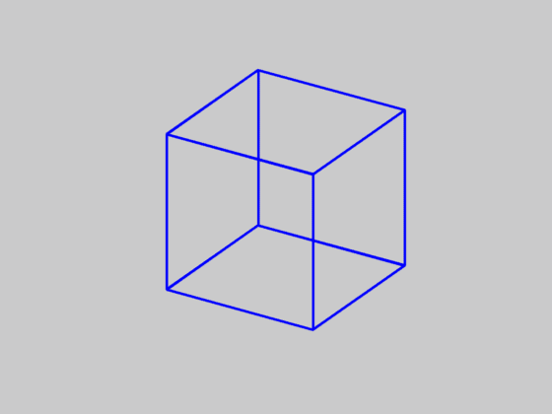
Is SfM always uniquely solvable?
No…

Slide 23





Incremental structure from motion
Notes:
To help get good initializations for all of the parameters of the system, we reconstruct the scene incrementally, starting from two photographs and the points they observe.

Slide 24
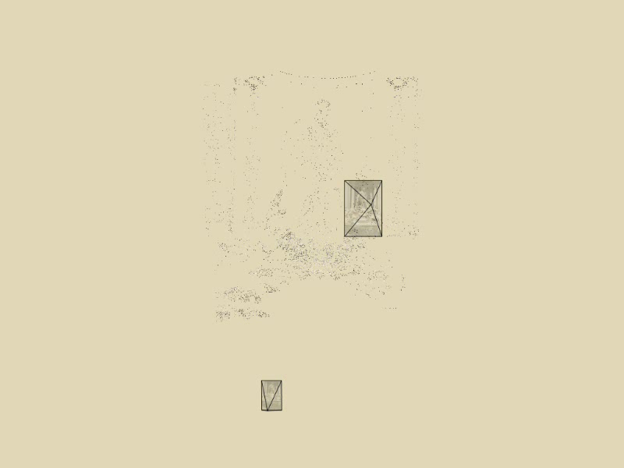
Incremental structure from motion
Notes:
To help get good initializations for all of the parameters of the system, we reconstruct the scene incrementally, starting from two photographs and the points they observe.

Slide 25
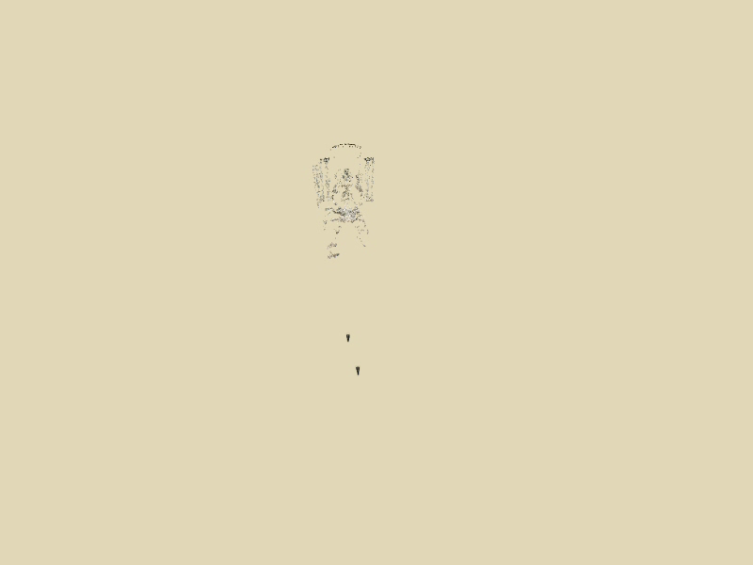
Incremental structure from motion
Notes:
We then add several photos at a time to the reconstruction, refine the model, and repeat until no more photos match any points in the scene.

Slide 26

Incremental structure from motion

Slide 27
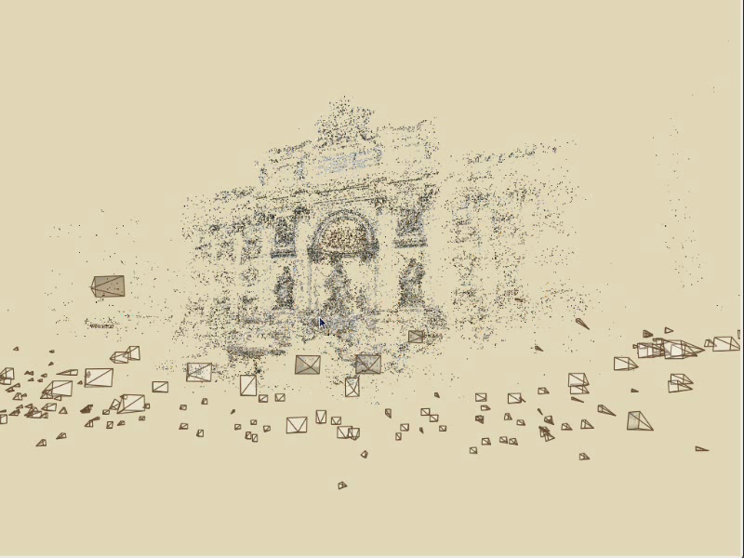
Photo Explorer

Slide 28
Demo

Slide 29
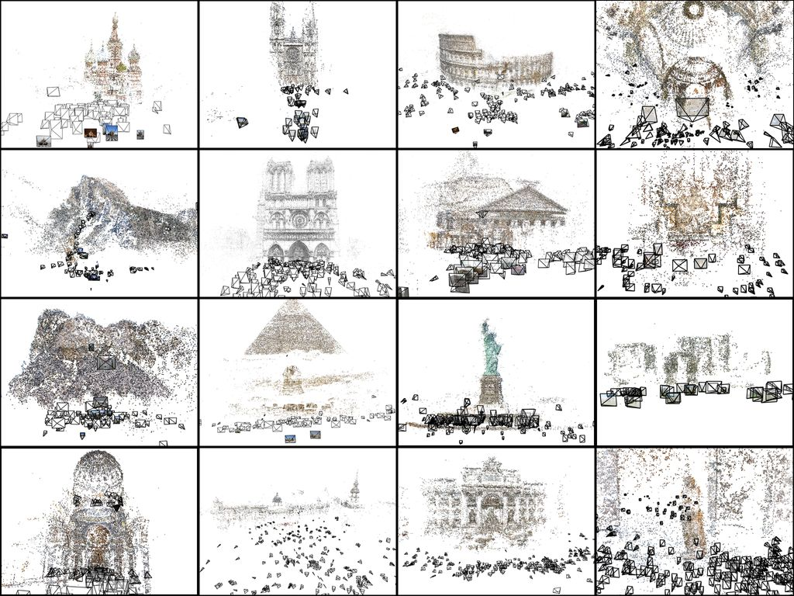

Slide 30
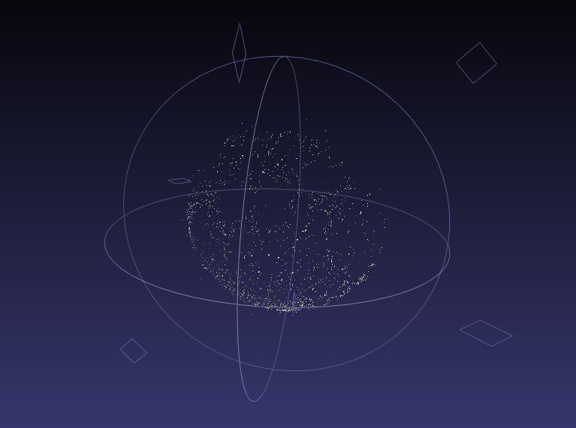

Slide 31
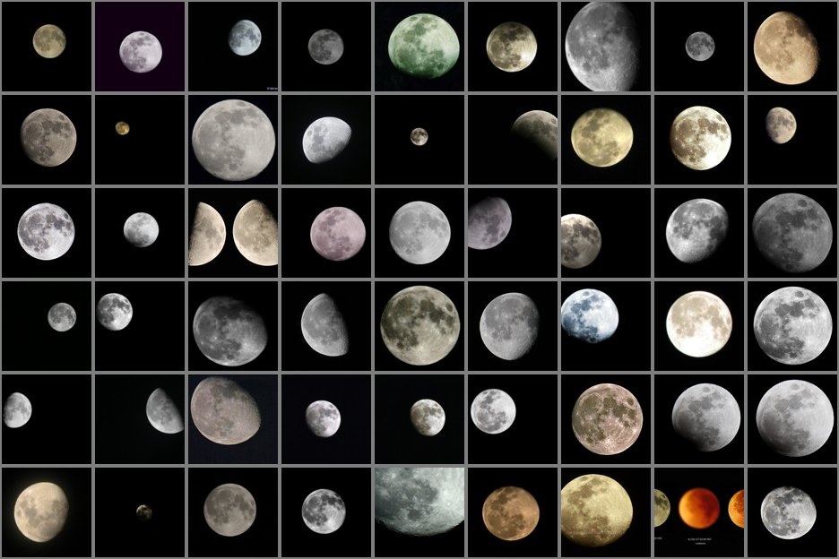

Slide 32
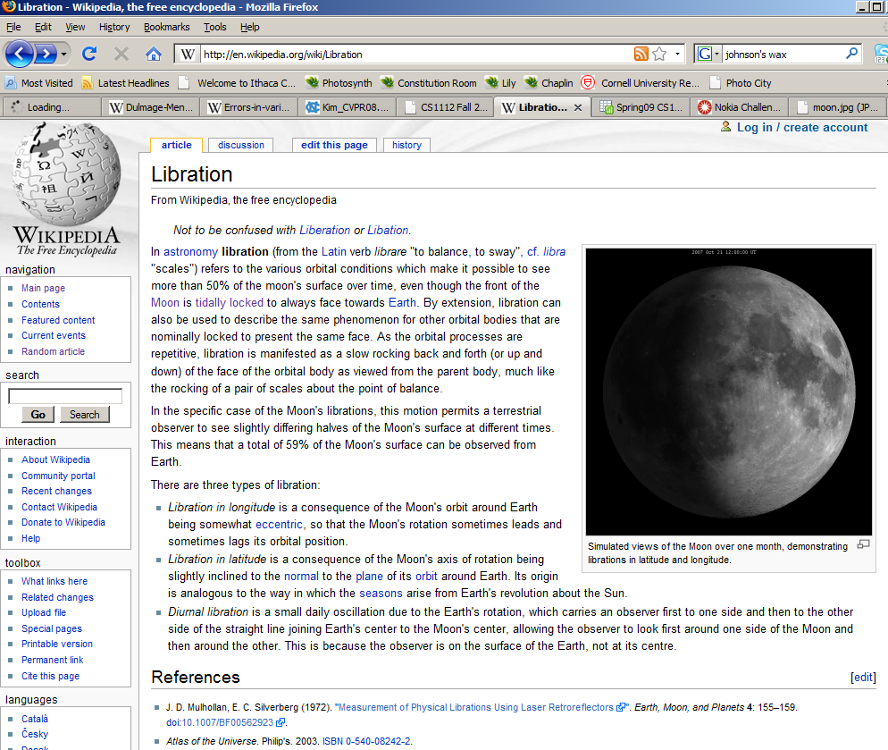

Slide 33
Questions?

Slide 34
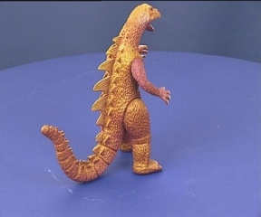
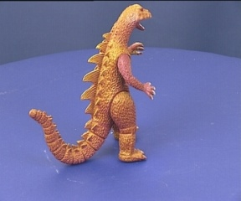
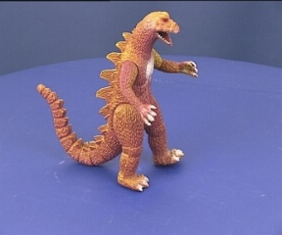
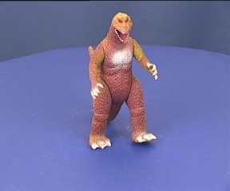
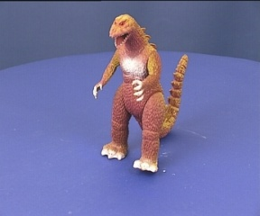
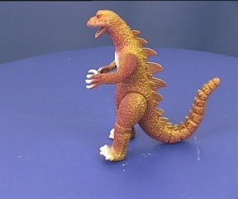
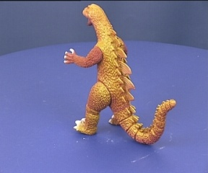
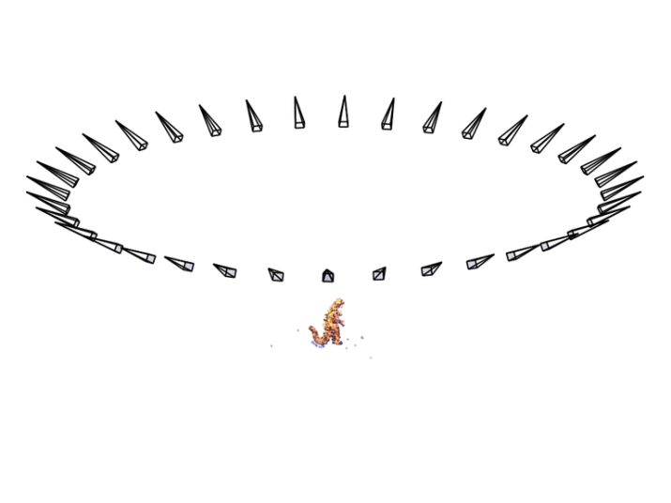

SfM – Failure cases
Necker reversal

Slide 35




Structure from Motion – Failure cases
Repetitive structures

Slide 36
SfM applications
3D modeling
Surveying
Robot navigation and mapmaking
Visual effects (“Match moving”)
  https://www.youtube.com/watch?v=RdYWp70P_kY

Slide 37

Applications – Photosynth

Slide 38

Applications – Hyperlapse
https://www.youtube.com/watch?v=SOpwHaQnRSY

