Slide 1
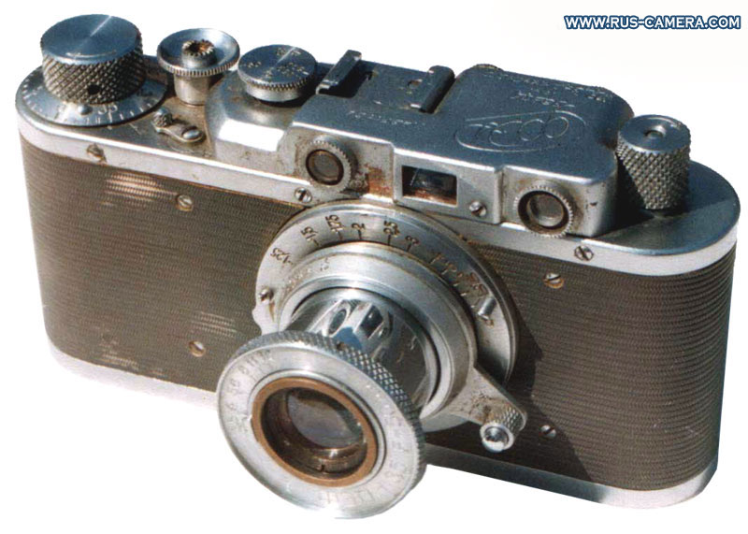
Lecture 9: Cameras
CS5670: Computer Vision
Noah Snavely
Source: S. Lazebnik

Slide 2


Slide 3
Reading
Szeliski 2.1.3-2.1.6

Slide 4
Announcements
Project 2 due Friday by 11:59pm
  If you haven’t created your team on CMS, please do so ASAP
Take-home midterm
  To be handed out next Thursday, due the following Tuesday by the beginning of class
Planning on in-class final, last lecture of class

Slide 5
Third Place

Slide 6


Zhen Liu

Slide 7
Second Place

Slide 8
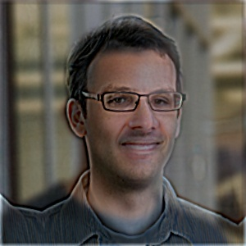

Gabriel Ruttner

Slide 9
First Place

Slide 10
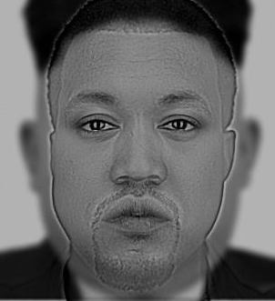

Jaldeep Acharya

Slide 11
Last time

Slide 12
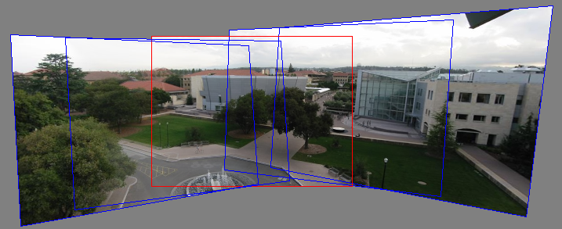
Can we use homographies to create a 360 panorama?
In order to figure this out, we need to learn what a camera is

Slide 13
Image formation
Let’s design a camera
  Idea 1: put a piece of film in front of an object
  Do we get a reasonable image?

Slide 14
Pinhole camera
Add a barrier to block off most of the rays
  This reduces blurring
  The opening known as the aperture
  How does this transform the image?
Notes:
It gets inverted

Slide 15
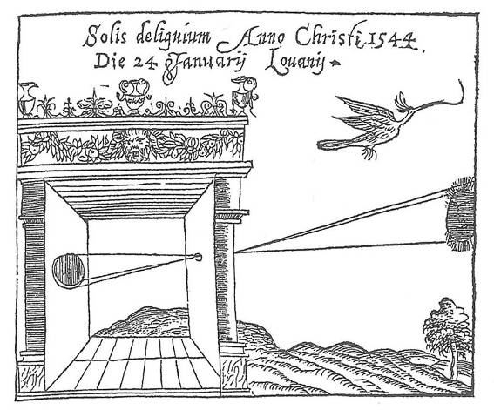
Camera Obscura
Basic principle known to Mozi (470-390 BC), Aristotle (384-322 BC)
Drawing aid for artists: described by Leonardo da Vinci (1452-1519)
Gemma Frisius, 1558
Source: A. Efros

Slide 16
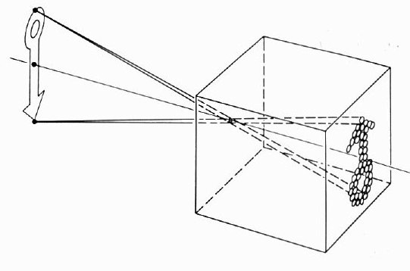
Camera Obscura

Slide 17
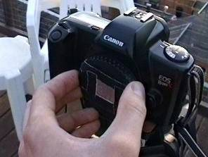
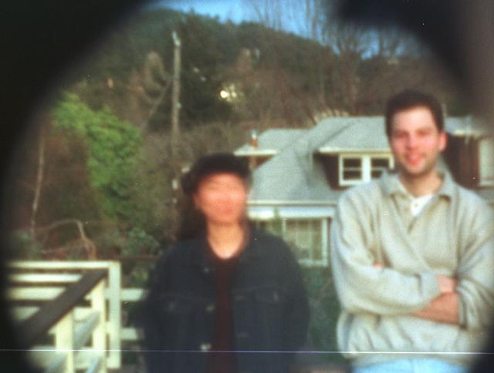
Home-made pinhole camera
Why so
blurry?
Slide by A. Efros
http://www.debevec.org/Pinhole/

Slide 18
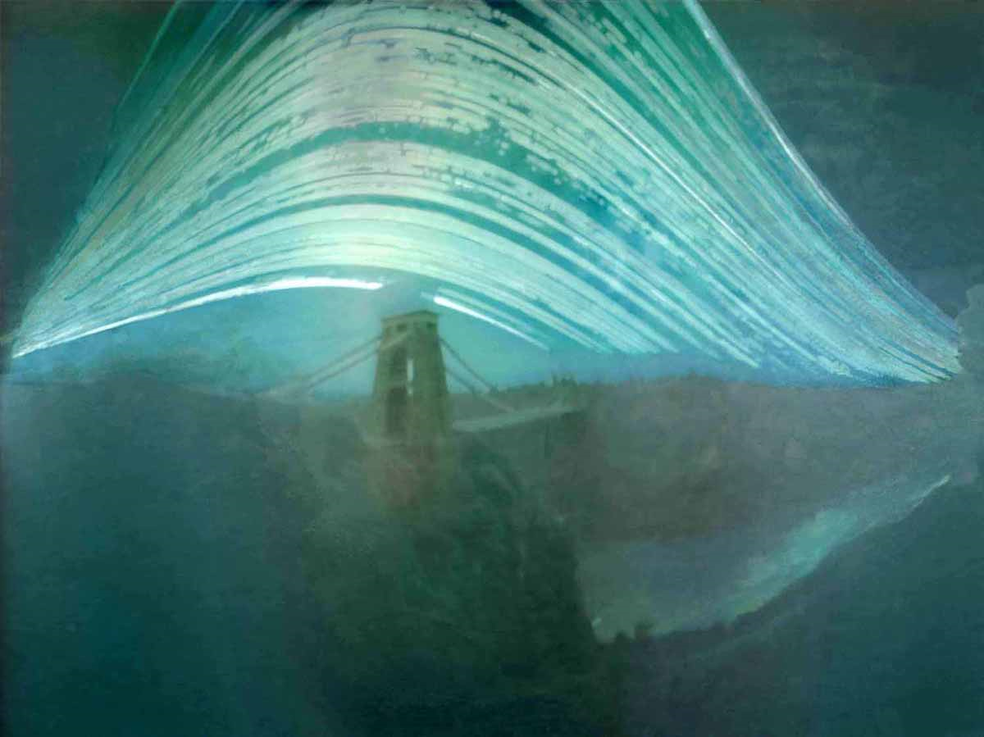
Pinhole photography
Justin Quinnell, The Clifton Suspension Bridge. December 17th 2007 - June 21st 2008
6-month exposure

Slide 19
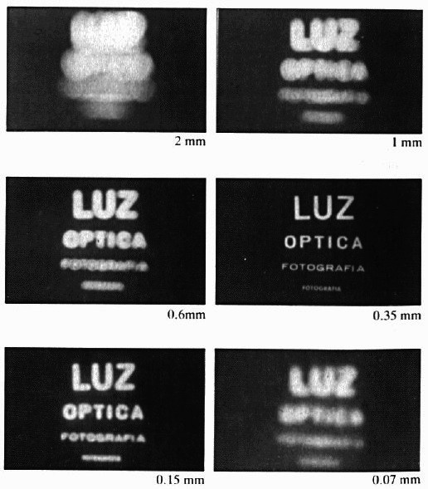
Shrinking the aperture
Why not make the aperture as small as possible?
  Less light gets through
  Diffraction effects...

Slide 20
Shrinking the aperture

Slide 21
Adding a lens
“circle of
confusion”
A lens focuses light onto the film
  There is a specific distance at which objects are “in focus”
    other points project to a “circle of confusion” in the image
  Changing the shape of the lens changes this distance

Slide 22
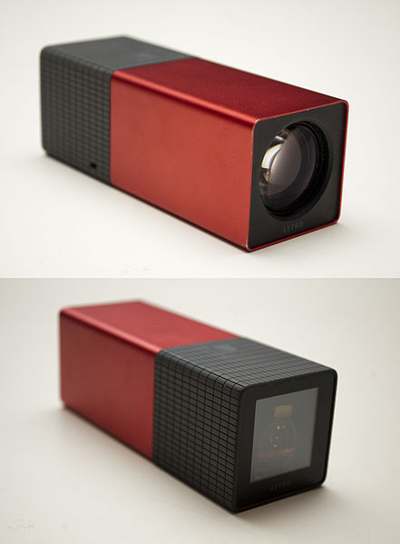
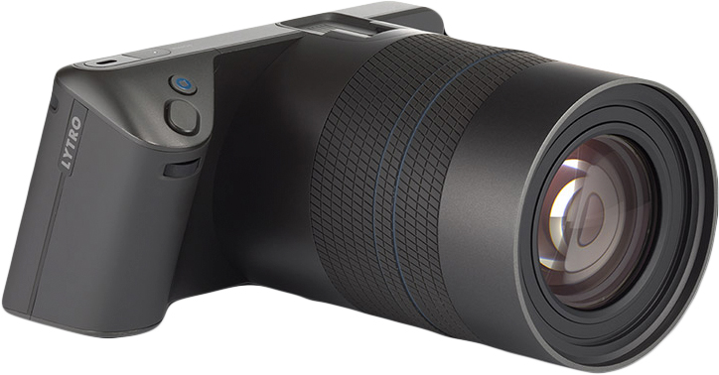
Lytro Lightfield Camera

Slide 23
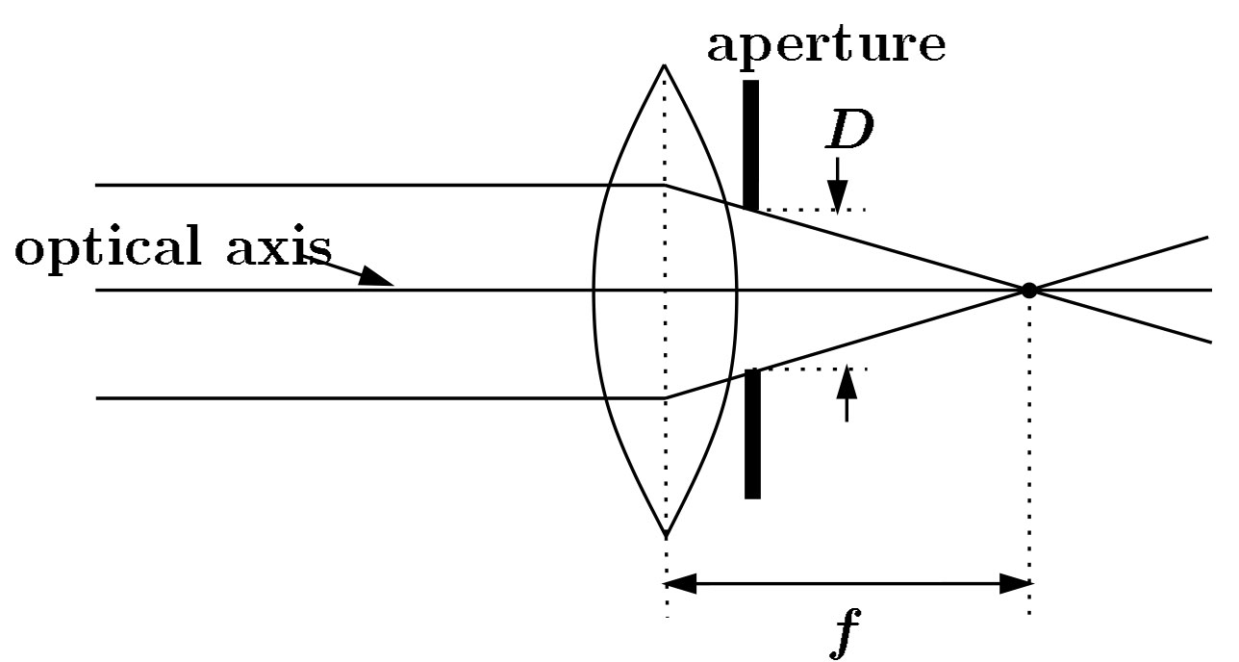
Lenses
F
focal point
A lens focuses parallel rays onto a single focal point
  focal point at a distance f beyond the plane of the lens (the focal length)
    f is a function of the shape and index of refraction of the lens
  Aperture restricts the range of rays
    aperture may be on either side of the lens
  Lenses are typically spherical (easier to produce)

Slide 24
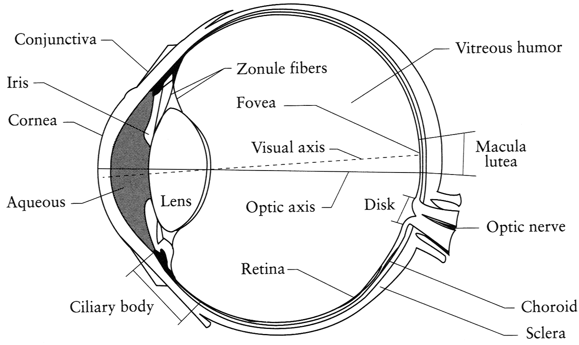
The eye
The human eye is a camera
  Iris - colored annulus with radial muscles
  Pupil - the hole (aperture) whose size is controlled by the iris
  What’s the “film”?
    photoreceptor cells (rods and cones) in the retina
Notes:
Note that the retina is curved

Slide 25
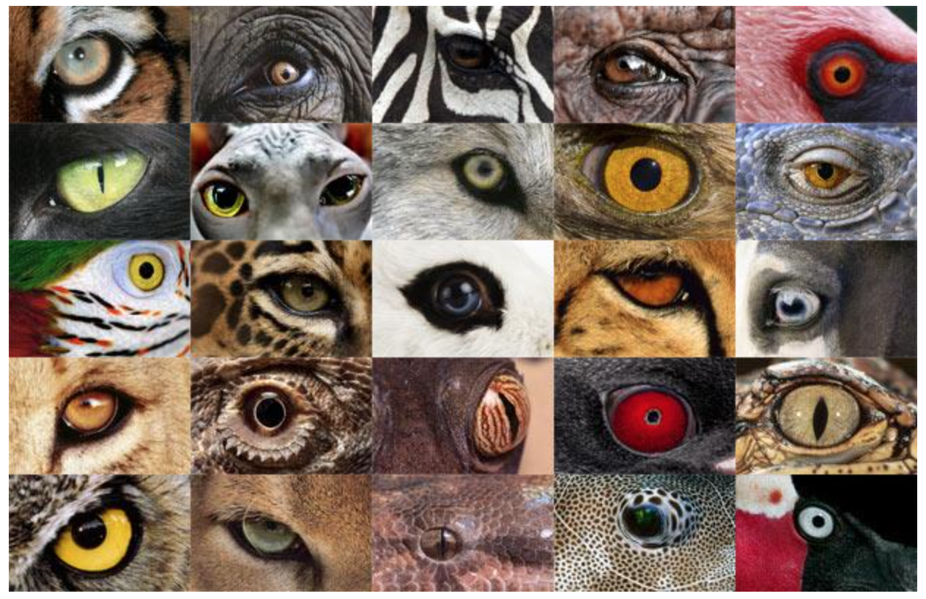
http://www.telegraph.co.uk/news/earth/earthpicturegalleries/7598120/Animal-eyes-quiz-Can-you-work-out-which-creatures-these-are-from-their-eyes.html?image=25

Slide 26
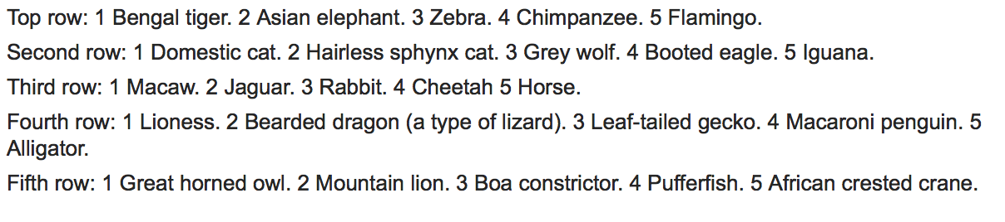
http://www.telegraph.co.uk/news/earth/earthpicturegalleries/7598120/Animal-eyes-quiz-Can-you-work-out-which-creatures-these-are-from-their-eyes.html?image=25

Slide 27

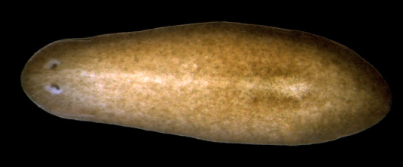
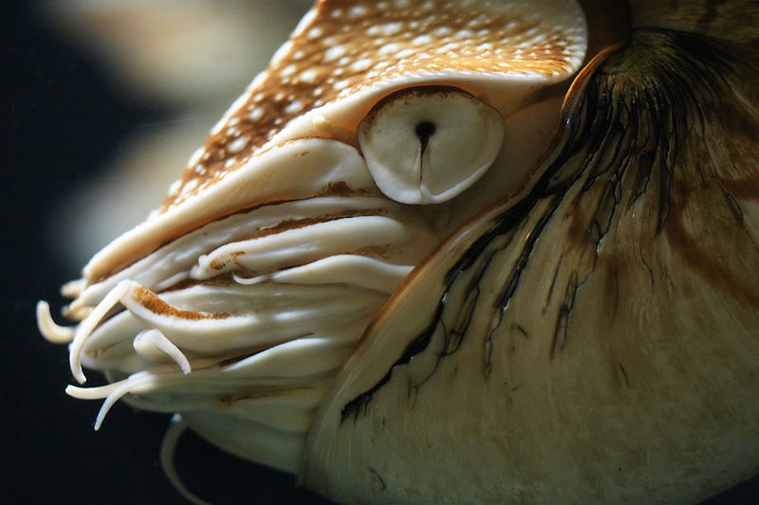
Eyes in nature: eyespots to pinhole camera
http://upload.wikimedia.org/wikipedia/commons/6/6d/Mantis_shrimp.jpg

Slide 28
Eyes in nature: eyespots to pinhole camera

Slide 29
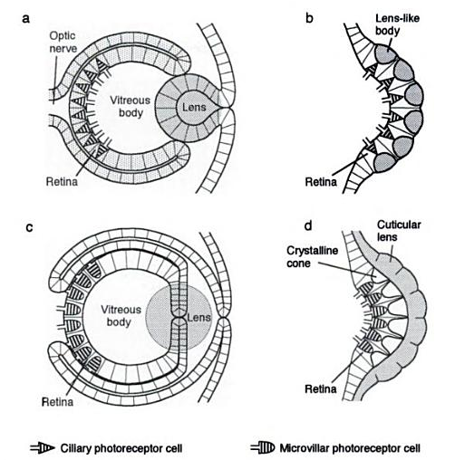
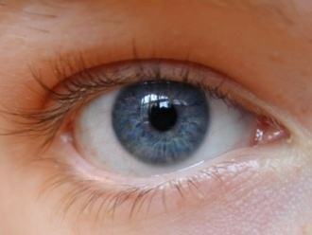

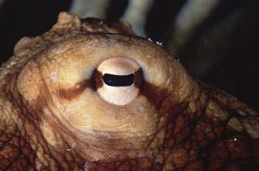
Eyes in nature
(polychaete fan worm)
Source: Animal Eyes, Land & Nilsson

Slide 30
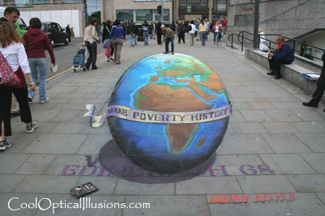
Projection

Slide 31
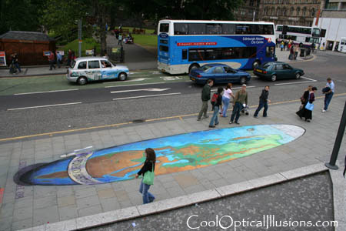
Projection

Slide 32
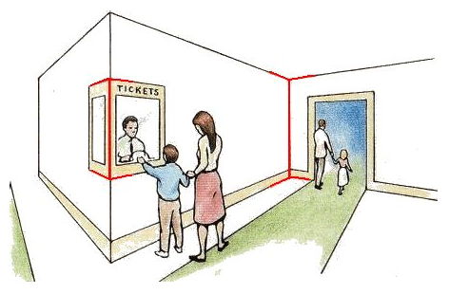
Müller-Lyer Illusion
http://www.michaelbach.de/ot/sze_muelue/index.html

Slide 33
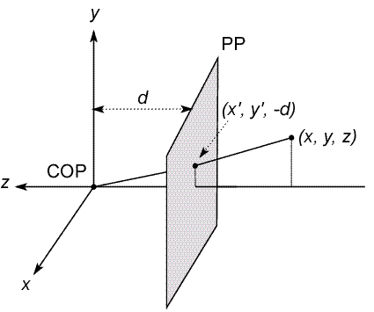
Modeling projection
The coordinate system
  We will use the pinhole model as an approximation
  Put the optical center (Center Of Projection) at the origin
  Put the image plane (Projection Plane) in front of the COP
    Why?
  The camera looks down the negative z axis
    we need this if we want right-handed-coordinates
Notes:
This way the image is right-side-up

Slide 34
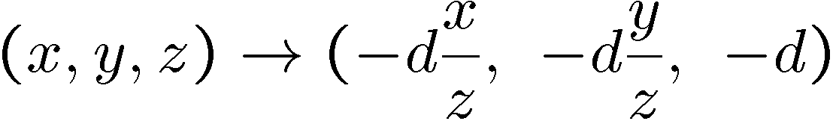
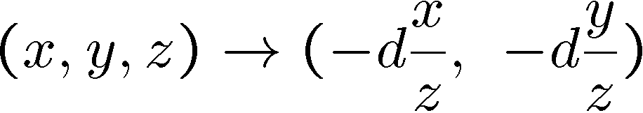
Modeling projection
Projection equations
  Compute intersection with PP of ray from (x,y,z) to COP
  Derived using similar triangles (on board)
  We get the projection by throwing out the last coordinate:

Slide 35
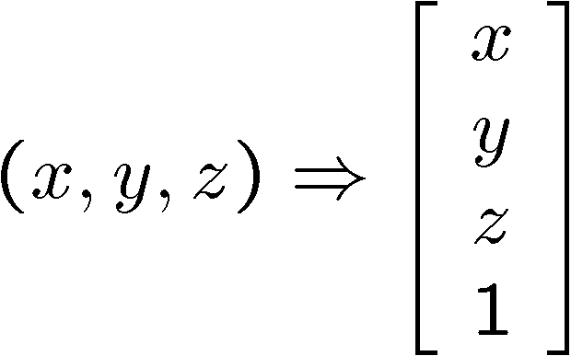
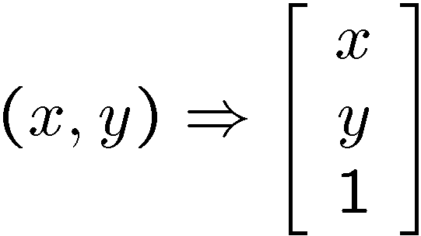
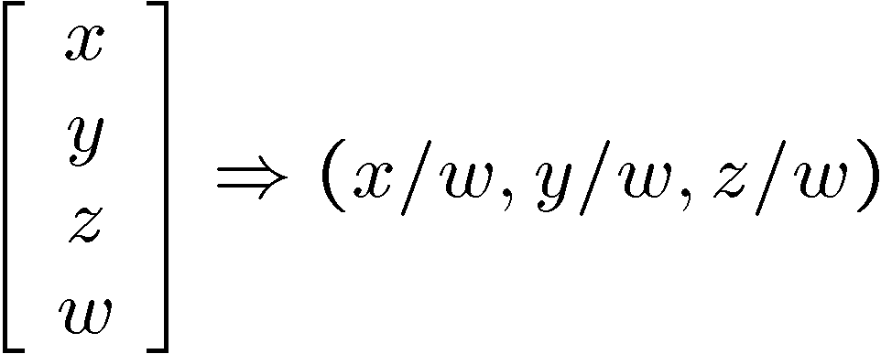
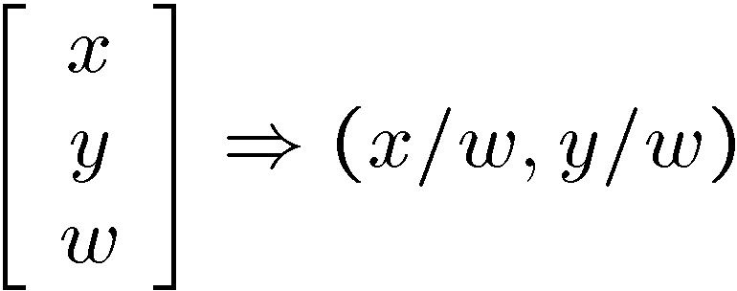
Modeling projection
Is this a linear transformation?
  no—division by z is nonlinear
Homogeneous coordinates to the rescue!
homogeneous image
coordinates
homogeneous scene
coordinates
Converting from homogeneous coordinates

Slide 36
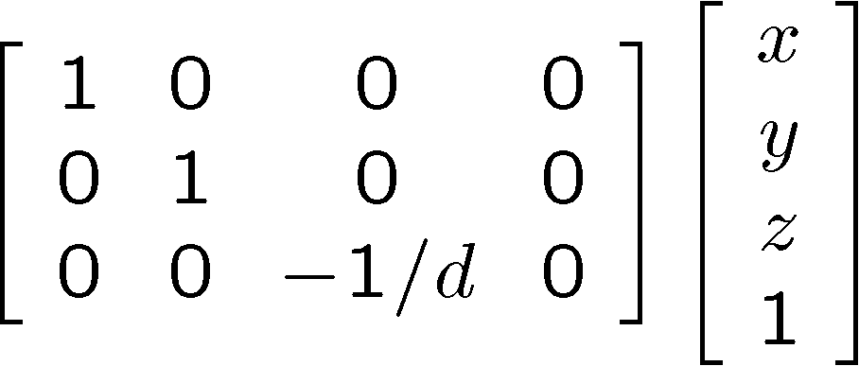
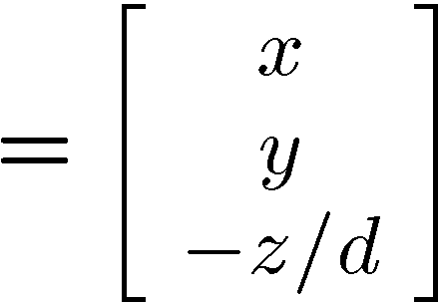
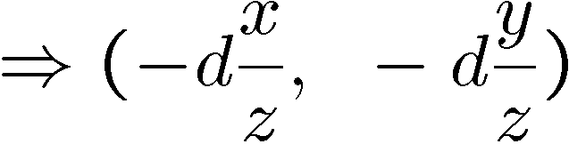
Perspective Projection
Projection is a matrix multiply using homogeneous coordinates:
divide by third coordinate
This is known as perspective projection
  The matrix is the projection matrix
(Can also represent as a 4x4 matrix – OpenGL does something like this)

Slide 37
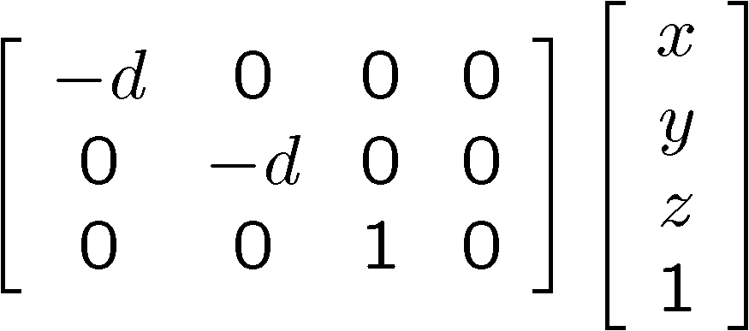
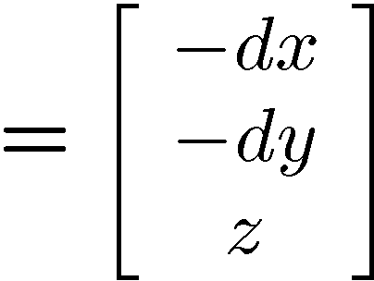
Perspective Projection
How does scaling the projection matrix change the transformation?

Slide 38
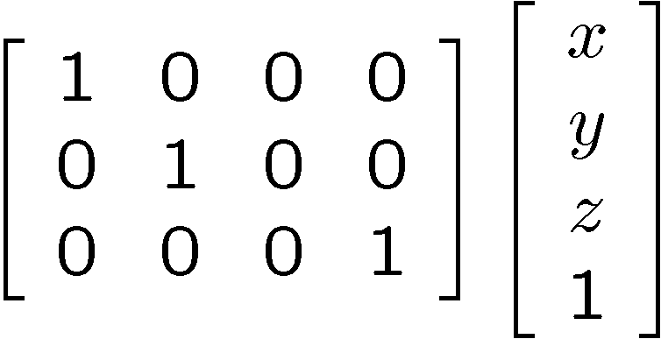
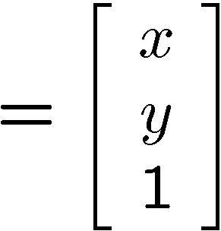

Orthographic projection
Special case of perspective projection
  Distance from the COP to the PP is infinite
  Good approximation for telephoto optics
  Also called “parallel projection”: (x, y, z) → (x, y)
  What’s the projection matrix?
Image
World

Slide 39
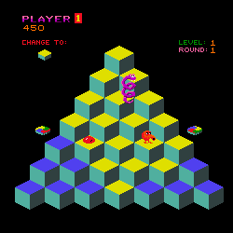
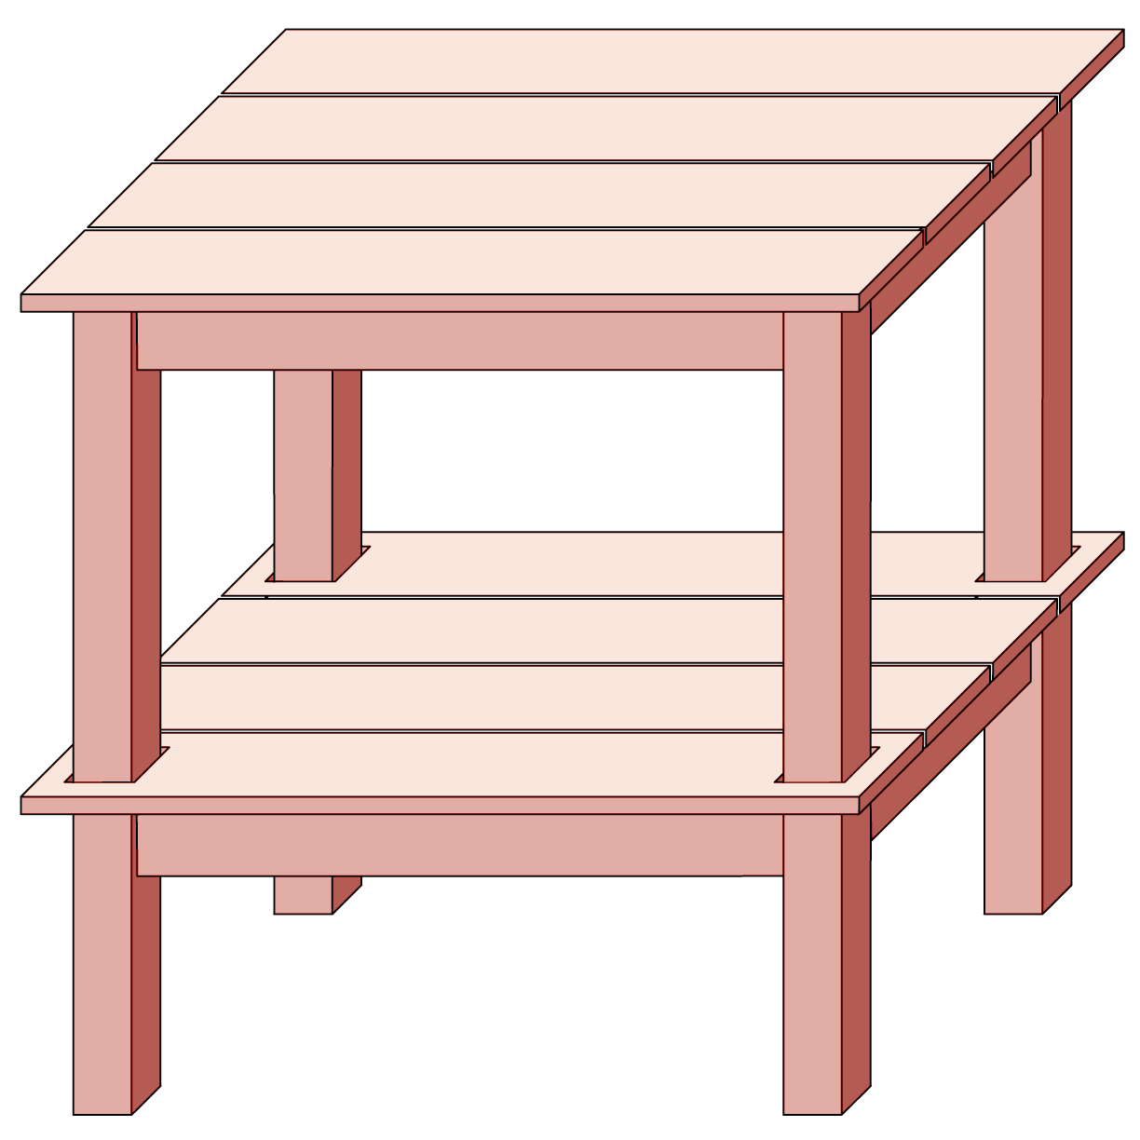
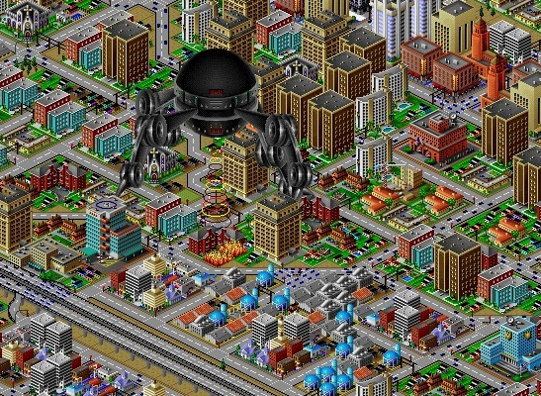
Orthographic projection

Slide 40
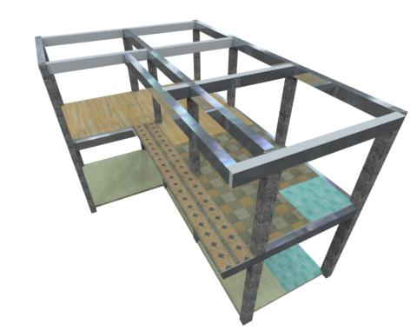
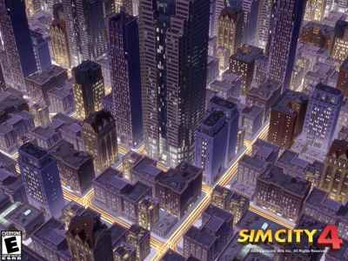
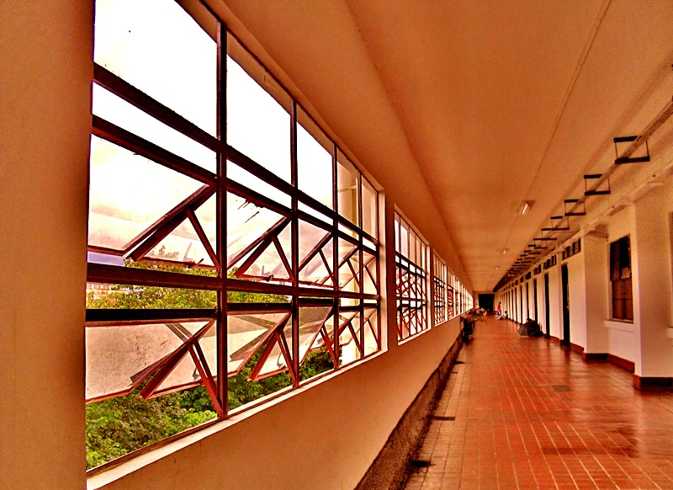
Perspective projection

Slide 41
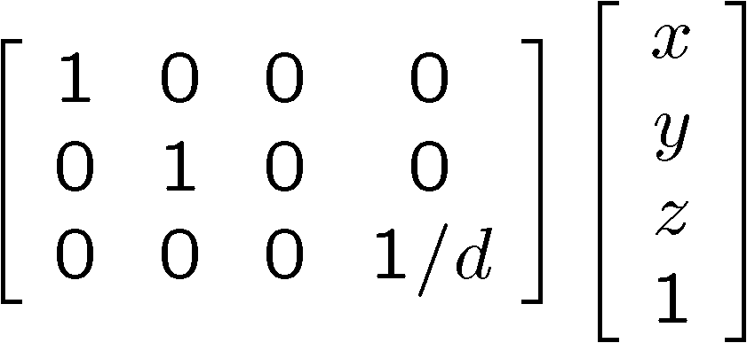
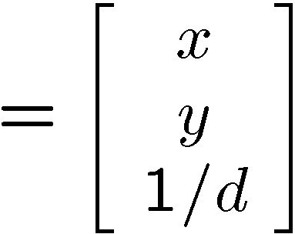

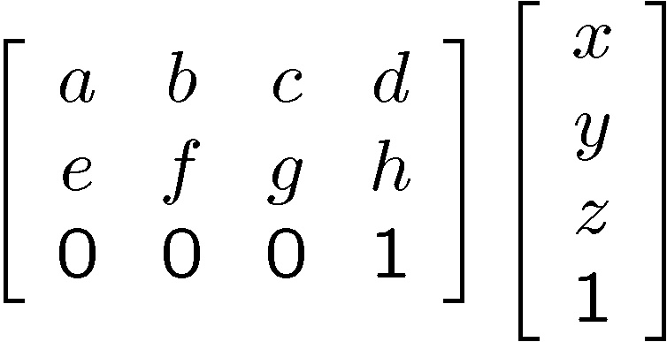
Variants of orthographic projection
Scaled orthographic
  Also called “weak perspective”
Affine projection
  Also called “paraperspective”

Slide 42
Dimensionality Reduction Machine (3D to 2D)
3D world
2D image
What have we lost?
  Angles
  Distances (lengths)
Slide by A. Efros
Figures © Stephen E. Palmer, 2002

Slide 43
Projection properties
Many-to-one: any points along same ray map to same point in image
Points → points
Lines → lines (collinearity is preserved)
  But line through focal point projects to a point
Planes → planes (or half-planes)
  But plane through focal point projects to line

Slide 44
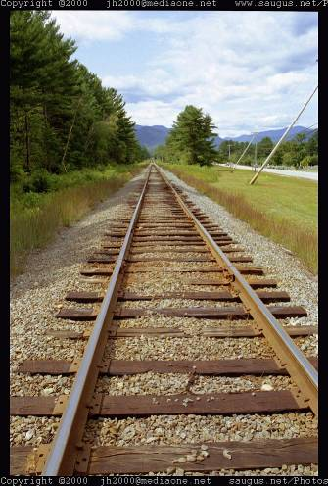
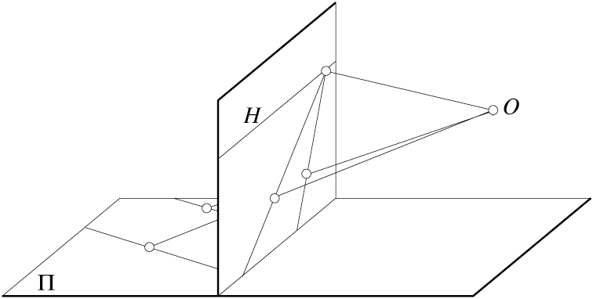
Projection properties
Parallel lines converge at a vanishing point
  Each direction in space has its own vanishing point
  But parallels parallel to the image plane remain parallel

Slide 45
Questions?

Slide 46

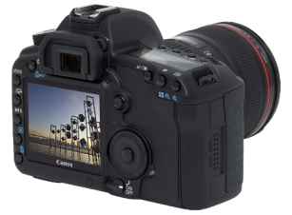
Camera parameters
How can we model the geometry of a camera?
v
y
w
COP
u
Camera
o
x
Two important coordinate systems:
1. World coordinate system
2. Camera coordinate system
z
“The World”

Slide 47
Camera parameters
To project a point (x,y,z) in world coordinates into a camera
First transform (x,y,z) into camera coordinates
Need to know
  Camera position (in world coordinates)
  Camera orientation (in world coordinates)
The project into the image plane
  Need to know camera intrinsics

Slide 48





Camera parameters
A camera is described by several parameters
  Translation T of the optical center from the origin of world coords
  Rotation R of the image plane
  focal length f, principle point (x’_{c}, y’_{c}), pixel size (s_{x}, s_{y})
  blue parameters are called “extrinsics,” red are “intrinsics”
Projection equation
  The projection matrix models the cumulative effect of all parameters
  Useful to decompose into a series of operations
identity matrix
intrinsics
projection
rotation
translation
  The definitions of these parameters are not completely standardized
    especially intrinsics—varies from one book to another

Slide 49







Extrinsics
How do we get the camera to “canonical form”?
  (Center of projection at the origin, x-axis points right, y-axis points up, z-axis points backwards)
Step 1: Translate by -c
0

Slide 50


Extrinsics
How do we get the camera to “canonical form”?
  (Center of projection at the origin, x-axis points right, y-axis points up, z-axis points backwards)
Step 1: Translate by -c
How do we represent translation as a matrix multiplication?
0

Slide 51

Extrinsics
How do we get the camera to “canonical form”?
  (Center of projection at the origin, x-axis points right, y-axis points up, z-axis points backwards)
Step 1: Translate by -c
Step 2: Rotate by R
0
3x3 rotation matrix

Slide 52
Extrinsics
How do we get the camera to “canonical form”?
  (Center of projection at the origin, x-axis points right, y-axis points up, z-axis points backwards)
Step 1: Translate by -c
Step 2: Rotate by R
0

Slide 53







Perspective projection
(converts from 3D rays in camera coordinate system to pixel coordinates)
(intrinsics)
in general,
(upper triangular matrix)
: aspect ratio (1 unless pixels are not square)
: skew (0 unless pixels are shaped like rhombi/parallelograms)
: principal point ((0,0) unless optical axis doesn’t intersect projection plane at origin)

Slide 54






Focal length
Can think of as “zoom”
Also related to field of view
24mm
50mm
200mm
800mm

Slide 55




Projection matrix
intrinsics
projection
rotation
translation
(t in book’s notation)

Slide 56


Projection matrix
(t in book’s notation)
or

Slide 57



Projection matrix
=
0
(in homogeneous image coordinates)

Slide 58
Questions?

