Slide 1
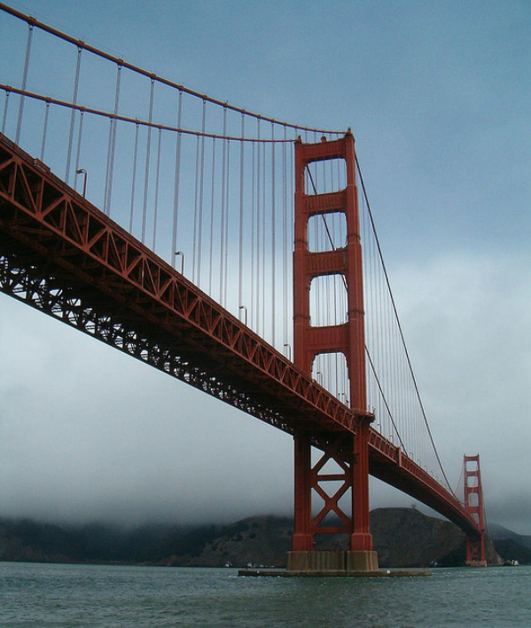

Lecture 6: Feature matching
CS5670: Computer Vision
Noah Snavely

Slide 2
Reading
Szeliski: 4.1

Slide 3
Announcements
Project 1 artifact voting online shortly
Project 2 to be released soon
Quiz at the beginning of class today

Slide 4
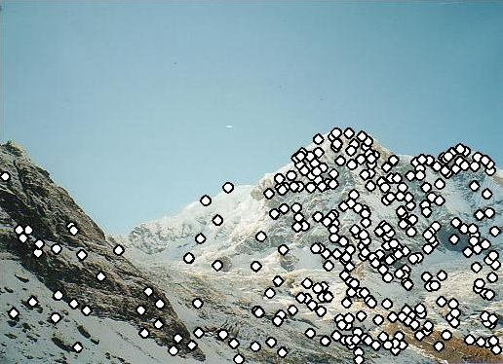
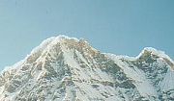

Local features: main components
Detection: Identify the interest points
Description: Extract vector feature descriptor surrounding each interest point.
Matching: Determine correspondence between descriptors in two views
Kristen Grauman

Slide 5

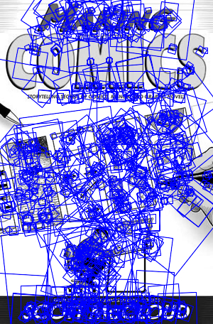
SIFT Example
sift
868 SIFT features

Slide 6
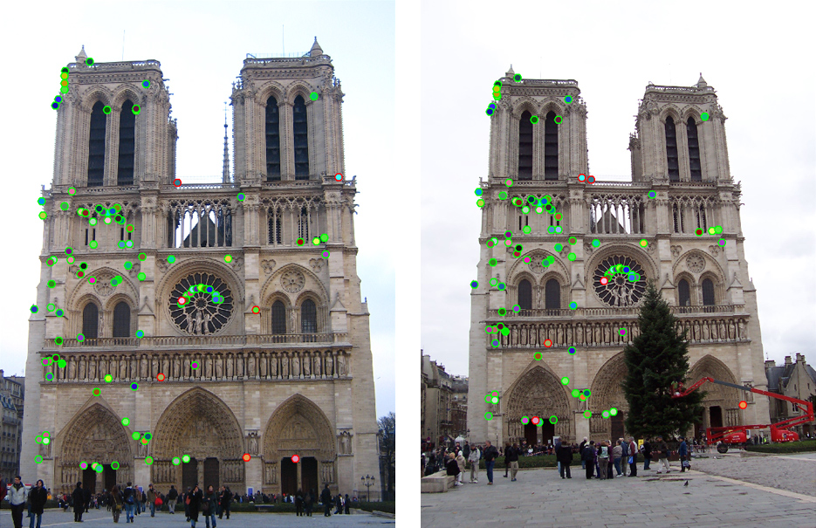
Which features match?

Slide 7
Feature matching
Given a feature in I₁, how to find the best match in I₂?
Define distance function that compares two descriptors
Test all the features in I₂, find the one with min distance

Slide 8
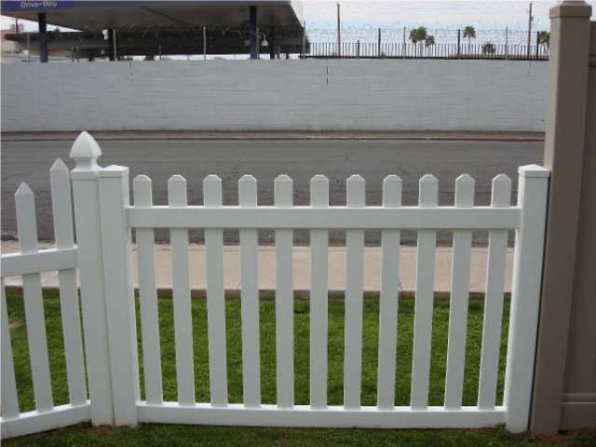
Feature distance
How to define the difference between two features f₁, f₂?
Simple approach: L₂ distance, ||f₁ - f₂ || (aka SSD)
can give good scores to ambiguous (incorrect) matches
f₁
f₂
I₁
I₂

Slide 9
Feature distance
How to define the difference between two features f₁, f₂?
Better approach: ratio distance = ||f₁ - f₂ || / || f₁ - f₂’ ||
f₂ is best SSD match to f₁ in I₂
f₂’ is 2nd best SSD match to f₁ in I₂
gives large values for ambiguous matches
f₁
f₂'
f₂
I₁
I₂

Slide 10
Feature distance
Does the SSD vs “ratio distance” change the best match to a given feature in image 1?

Slide 11



Feature matching example
51 matches (thresholded by ratio score)

Slide 12
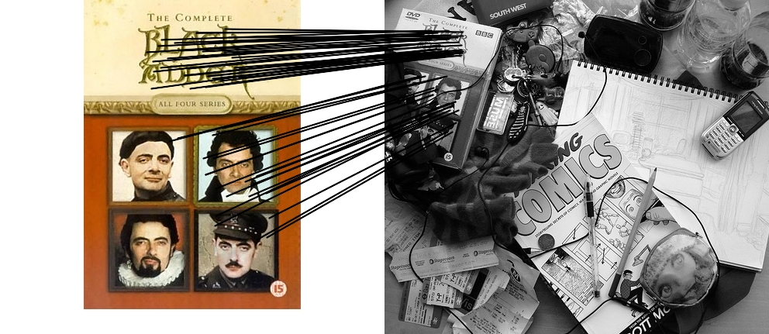

Feature matching example
58 matches (thresholded by ratio score)

Slide 13
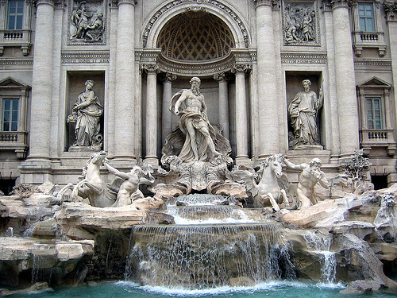
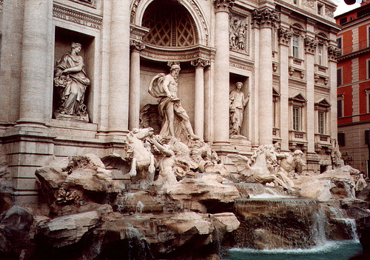
Evaluating the results
How can we measure the performance of a feature matcher?
50
75
200
feature distance

Slide 14
True/false positives
How can we measure the performance of a feature matcher?
The distance threshold affects performance
True positives = # of detected matches that are correct
Suppose we want to maximize these—how to choose threshold?
False positives = # of detected matches that are incorrect
Suppose we want to minimize these—how to choose threshold?
50
true match
75
200
false match
feature distance

Slide 15
Evaluating the results
How can we measure the performance of a feature matcher?
1
0.7
# true positives
# matching features (positives)
true positive rate
“recall”
0
1
false positive rate
0.1
# false positives
# unmatched features (negatives)
1 - “precision”

Slide 16
Evaluating the results
How can we measure the performance of a feature matcher?
ROC curve (“Receiver Operator Characteristic”)
1
0.7
# true positives
# matching features (positives)
true positive rate
“recall”
0
1
false positive rate
0.1
# false positives
# unmatched features (negatives)
1 - “precision”

Slide 17
Available at a web site near you…
For most local feature detectors, executables are available online:
http://www.robots.ox.ac.uk/~vgg/research/affine
http://www.cs.ubc.ca/~lowe/keypoints/
http://www.vision.ee.ethz.ch/~surf

Slide 18
Questions?

