Slide 1

Lecture 2: Edge detection
CS5670: Computer Vision
Noah Snavely
From Sandlot Science

Slide 2
Announcements
Project 1 (Hybrid Images) is now on the course webpage (see “Projects” link)
Due Wednesday, Feb 15, by 11:59pm
Artifact due Friday, Feb 15, by 11:59pm
To be done individually
Voting system for favorite artifacts (with small amount of extra credit)
Files due by CMS
We will provide a course VM for you to run the assignments

Slide 3
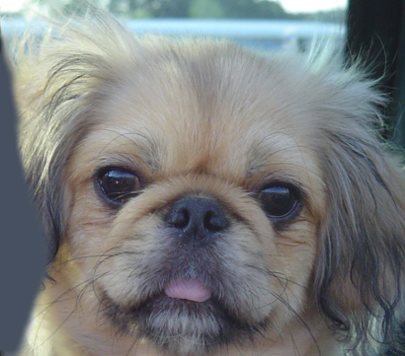
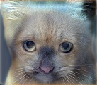
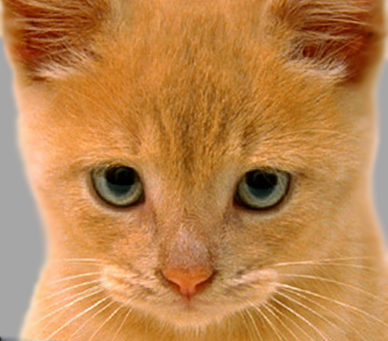
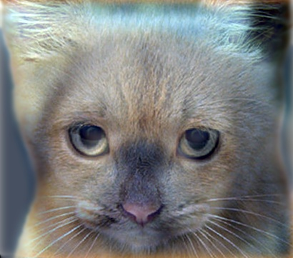

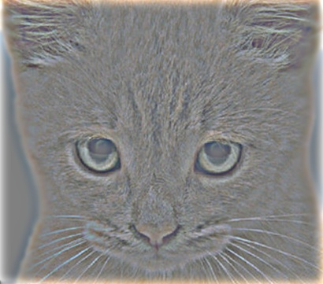
Project 1: Hybrid Images

Slide 4
Project 1 Demo

Slide 5
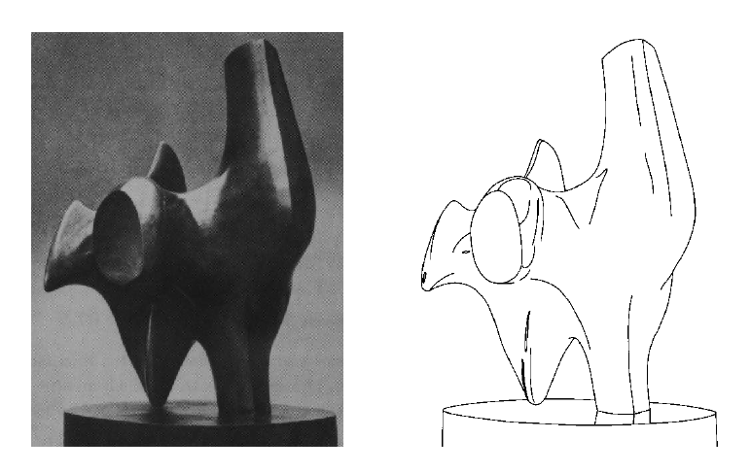
Edge detection
Convert a 2D image into a set of curves
Extracts salient features of the scene
More compact than pixels
TexPoint fonts used in EMF.
Read the TexPoint manual before you delete this box.: AAA

Slide 6
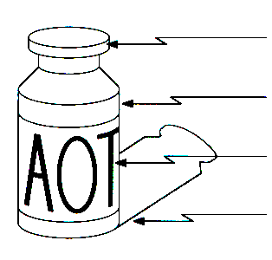
Origin of Edges
surface normal discontinuity
depth discontinuity
surface color discontinuity
illumination discontinuity
Edges are caused by a variety of factors

Slide 7
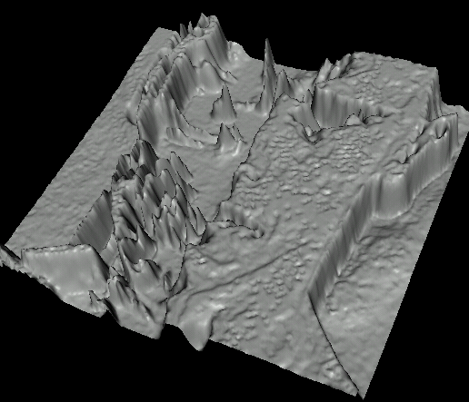

Images as functions…
Edges look like steep cliffs

Slide 8

Characterizing edges
An edge is a place of rapid change in the image intensity function
intensity function (along horizontal scanline)
image
first derivative
edges correspond to extrema of derivative
Source: L. Lazebnik

Slide 9
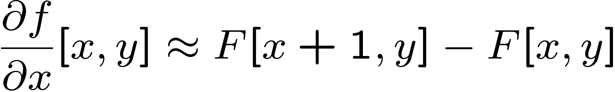




Image derivatives
How can we differentiate a digital image F[x,y]?
Option 1: reconstruct a continuous image, f, then compute the derivative
Option 2: take discrete derivative (finite difference)
How would you implement this as a linear filter?
1 | -1
 | -1
 | 1
:
:
Source: S. Seitz

Slide 10
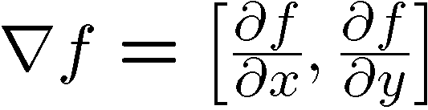
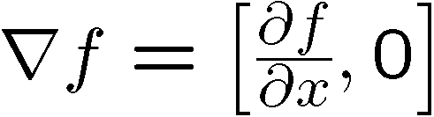
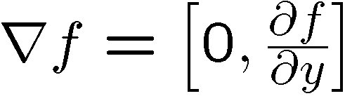
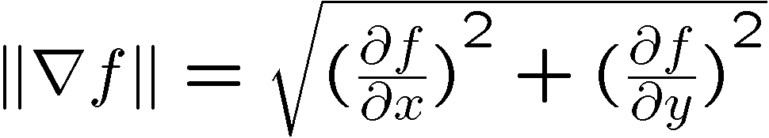
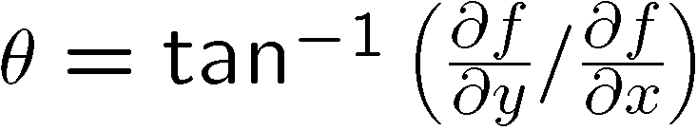
Image gradient
The gradient of an image:
The gradient points in the direction of most rapid increase in intensity
The edge strength is given by the gradient magnitude:
The gradient direction is given by:
how does this relate to the direction of the edge?
Source: Steve Seitz
Notes:
give definition of partial derivative: lim h->0 [f(x+h,y) – f(x,y)]/h

Slide 11
Image gradient
Source: L. Lazebnik

Slide 12


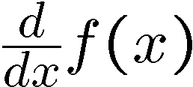
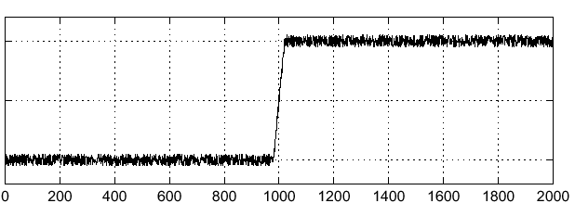
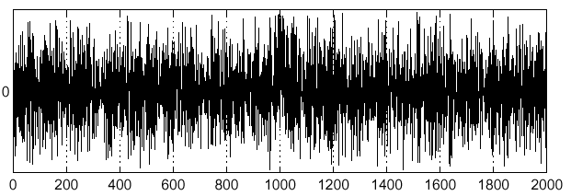
Effects of noise
Noisy input image
Where is the edge?
Source: S. Seitz
Notes:
How to fix?

Slide 13
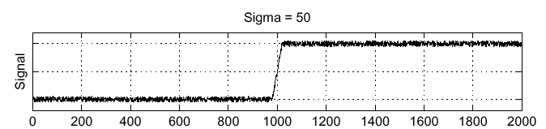
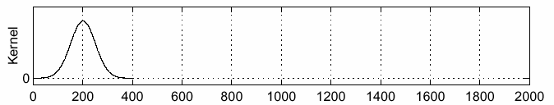
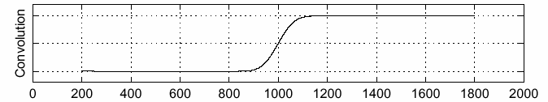
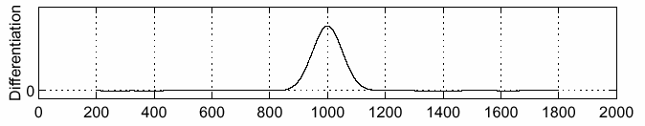
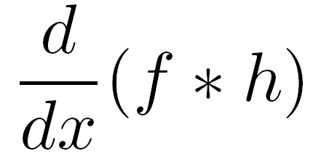
Solution: smooth first
f
h
f * h
To find edges, look for peaks in
Source: S. Seitz

Slide 14
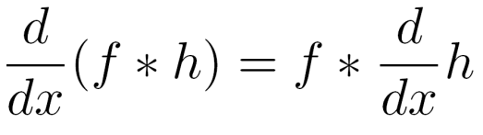
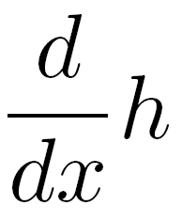
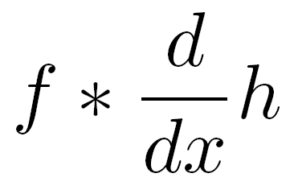
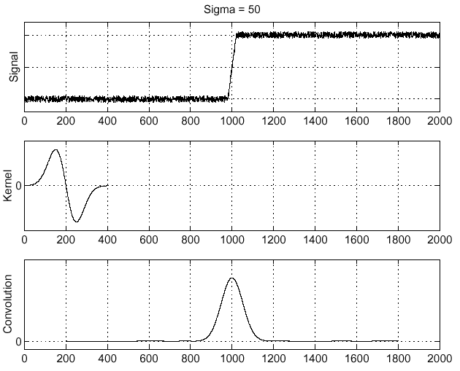
Associative property of convolution
Differentiation is convolution, and convolution is associative:
This saves us one operation:
f
Source: S. Seitz

Slide 15
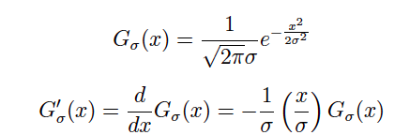
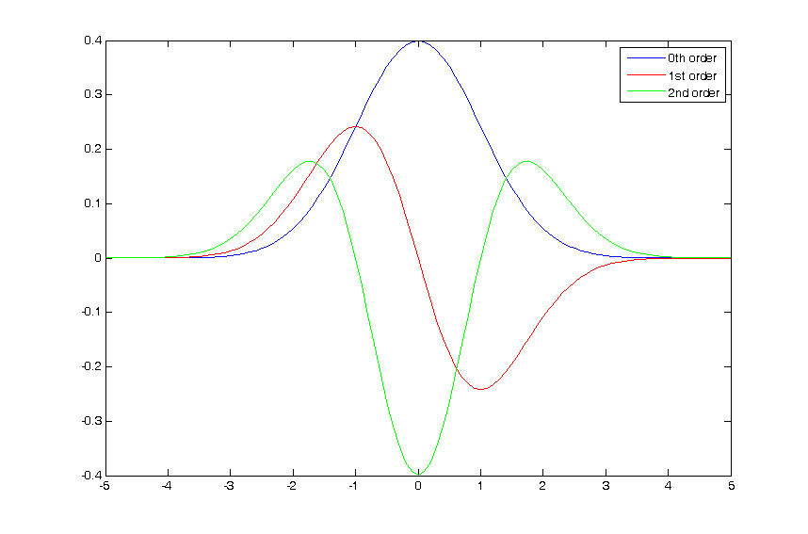
The 1D Gaussian and its derivatives

Slide 16
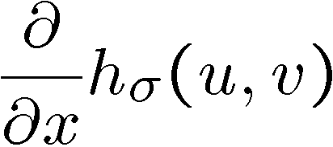
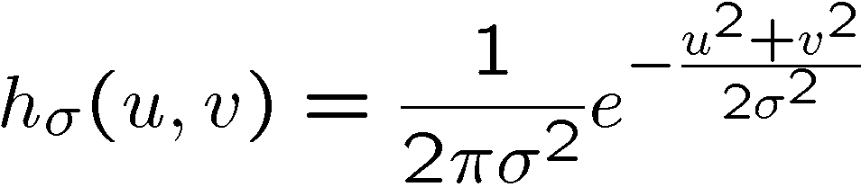
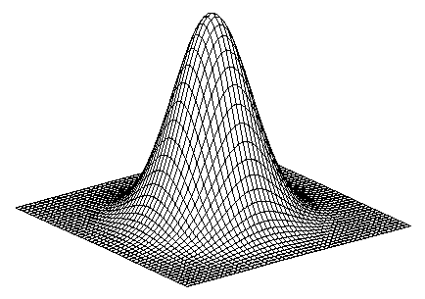
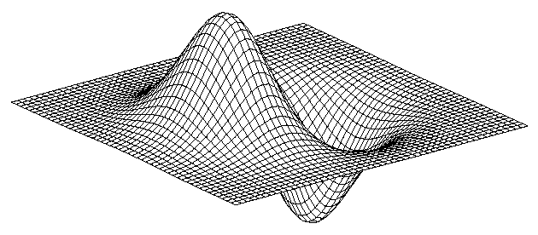
2D edge detection filters
derivative of Gaussian (x)
Gaussian
Notes:
How many 2nd derivative filters are there? There are four 2nd partial derivative filters.
In practice, it’s handy to define a single 2nd derivative filter—the Laplacian

Slide 17
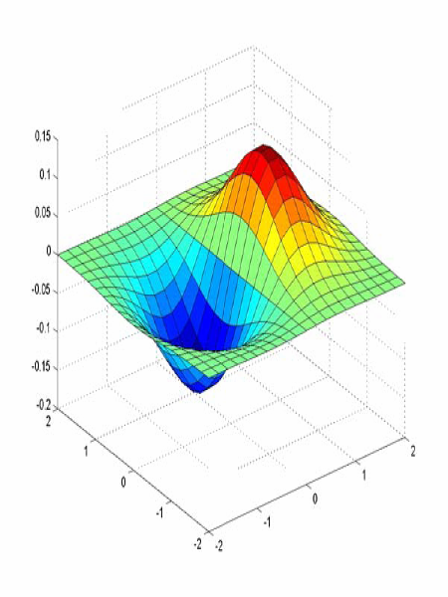
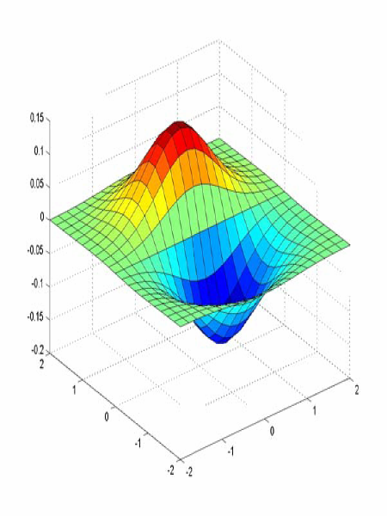
Derivative of Gaussian filter
x-direction
y-direction

Slide 18



The Sobel operator
Common approximation of derivative of Gaussian
-1 | 0 | 1
-2 | 0 | 2
-1 | 0 | 1
1 | 2 | 1
0 | 0 | 0
-1 | -2 | -1
The standard defn. of the Sobel operator omits the 1/8 term
doesn’t make a difference for edge detection
the 1/8 term is needed to get the right gradient magnitude
Notes:
18
Q: Why might these work better?
A: more stable when there is noise

Slide 19
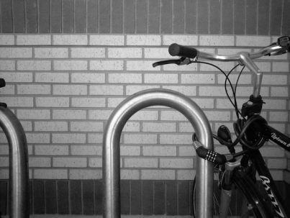
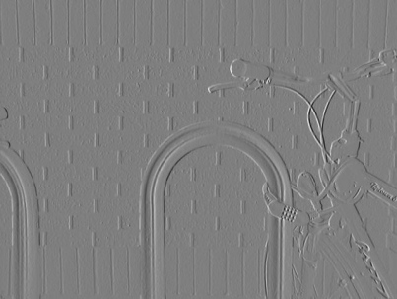
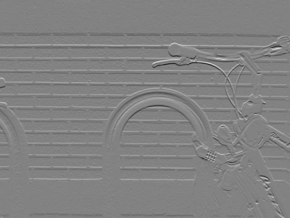
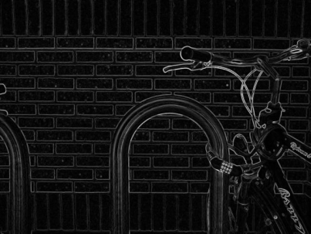

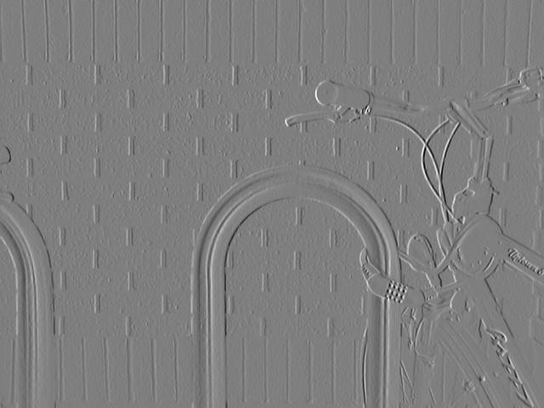
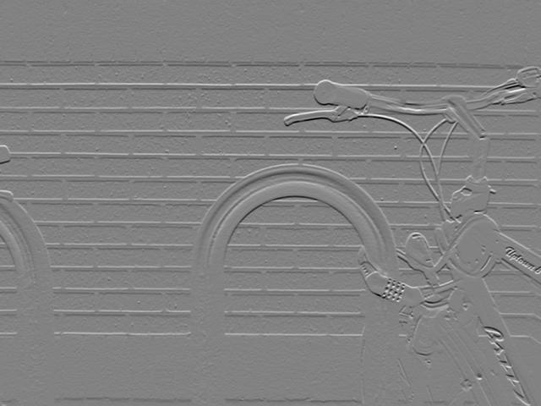
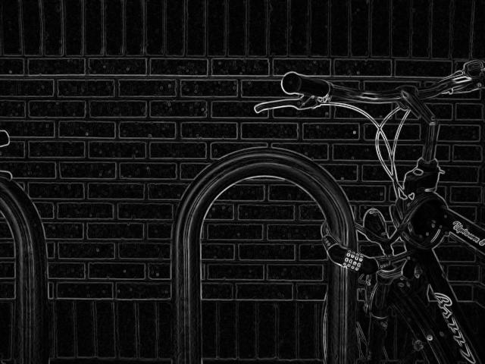
Sobel operator: example
Source: Wikipedia

Slide 20
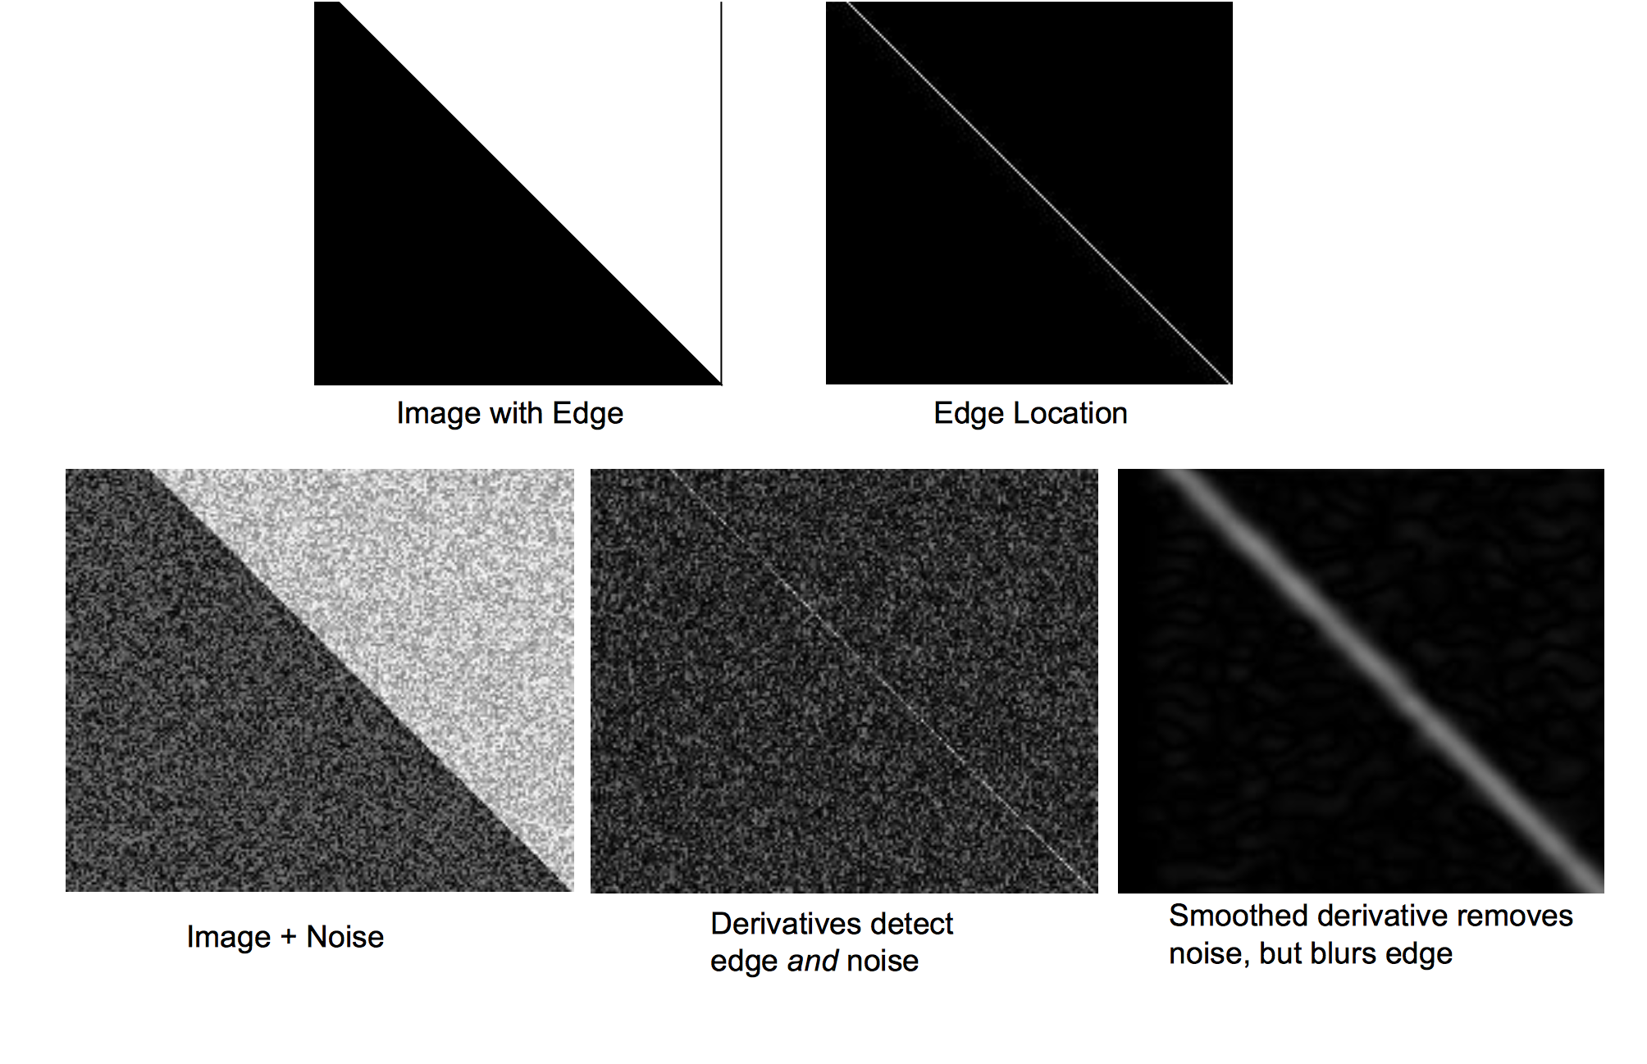

Slide 21
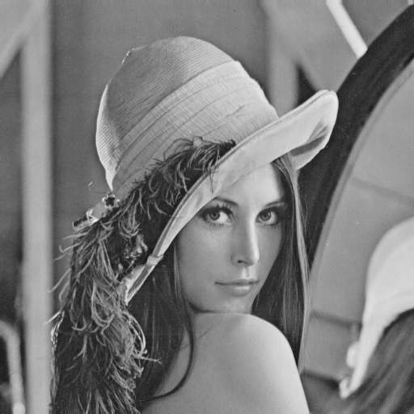
Example
original image (Lena)

Slide 22
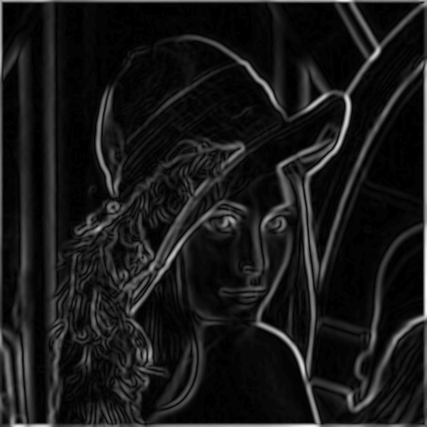
Finding edges
gradient magnitude

Slide 23
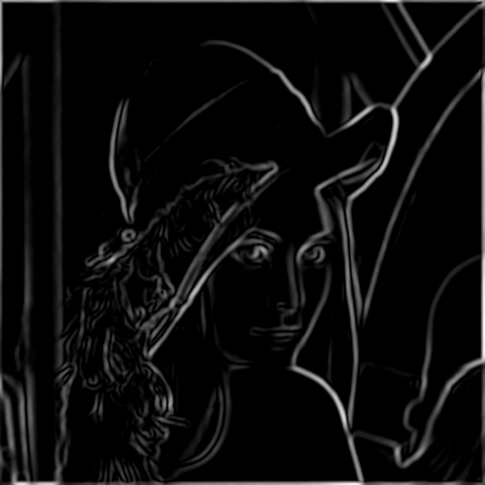
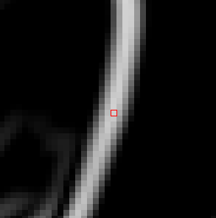
Finding edges
where is the edge?
thresholding

Slide 24
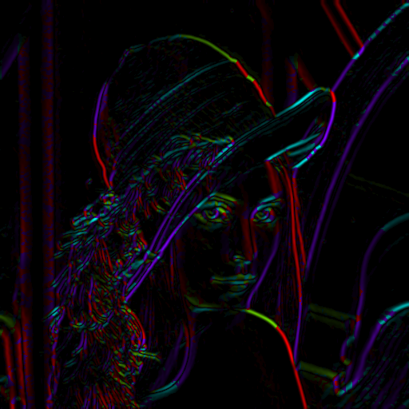
Get Orientation at Each Pixel
Threshold at minimum level
Get orientation
theta = atan2(gy, gx)

Slide 25

Non-maximum supression
Check if pixel is local maximum along gradient direction
requires interpolating pixels p and r

Slide 26
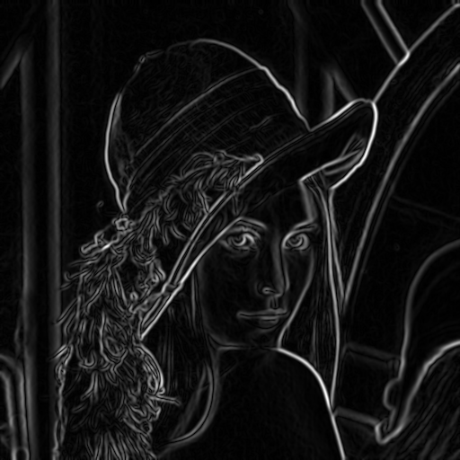
Before Non-max Suppression

Slide 27
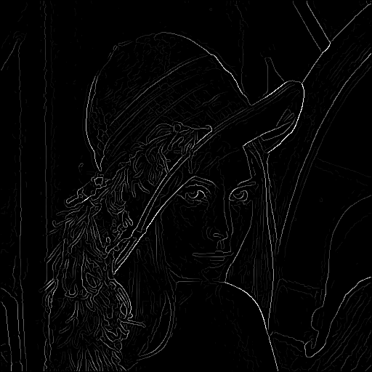
After Non-max Suppression

Slide 28
Finding edges
thresholding

Slide 29
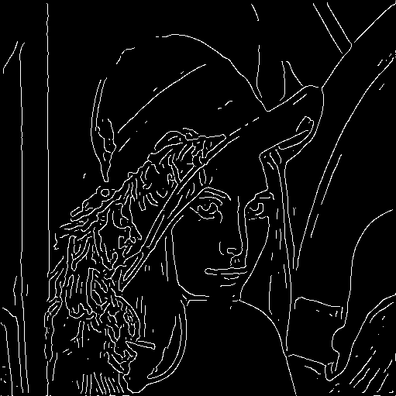
Finding edges
thinning
(non-maximum suppression)

Slide 30

Canny edge detector
MATLAB: edge(image,‘canny’)
Filter image with derivative of Gaussian
Find magnitude and orientation of gradient
Non-maximum suppression
Linking and thresholding (hysteresis):
Define two thresholds: low and high
Use the high threshold to start edge curves and the low threshold to continue them
Source: D. Lowe, L. Fei-Fei

Slide 31

Canny edge detector
Still one of the most widely used edge detectors in computer vision
Depends on several parameters:
J. Canny, A Computational Approach To Edge Detection, IEEE Trans. Pattern Analysis and Machine Intelligence, 8:679-714, 1986.
: width of the Gaussian blur
high threshold
low threshold

Slide 32






Canny edge detector
original
Canny with
Canny with
The choice of depends on desired behavior
large detects “large-scale” edges
small detects fine edges
Source: S. Seitz

Slide 33



Scale space (Witkin 83)
first derivative peaks
larger
Gaussian filtered signal
Properties of scale space (w/ Gaussian smoothing)
edge position may shift with increasing scale (σ)
two edges may merge with increasing scale
an edge may not split into two with increasing scale

Slide 34
Questions?

