Slide 1
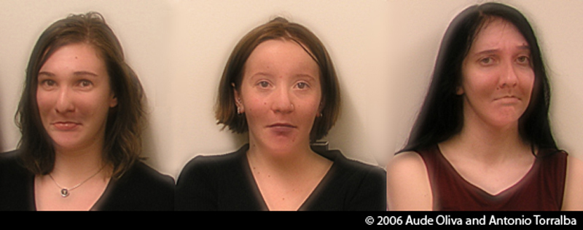
Lecture 1: Images and image filtering
CS5670: Intro to Computer Vision
Noah Snavely
Hybrid Images, Oliva et al., http://cvcl.mit.edu/hybridimage.htm

Slide 2
Lecture 1: Images and image filtering
CS5670: Intro to Computer Vision
Noah Snavely
Hybrid Images, Oliva et al., http://cvcl.mit.edu/hybridimage.htm

Slide 3
Lecture 1: Images and image filtering
CS5670: Intro to Computer Vision
Noah Snavely
Hybrid Images, Oliva et al., http://cvcl.mit.edu/hybridimage.htm

Slide 4
CS5670: Intro to Computer Vision
Noah Snavely
Lecture 1: Images and image filtering
Hybrid Images, Oliva et al., http://cvcl.mit.edu/hybridimage.htm

Slide 5
Reading
Szeliski, Chapter 3.1-3.2

Slide 6
Announcements
You should all be enrolled in Piazza and CMS
Let me know if you need to be added
Office hours
Noah
Thursday 9:30-11am (Baron)
Zhengqi
Tuesday 4:15-5:45pm (Bear Hug)
Thursday 4:15-5:45pm *or* Friday 2-3:30 (preferences?)

Slide 7
Announcements
Project 1 (Hybrid Images) will be released this week or early next week

Slide 8
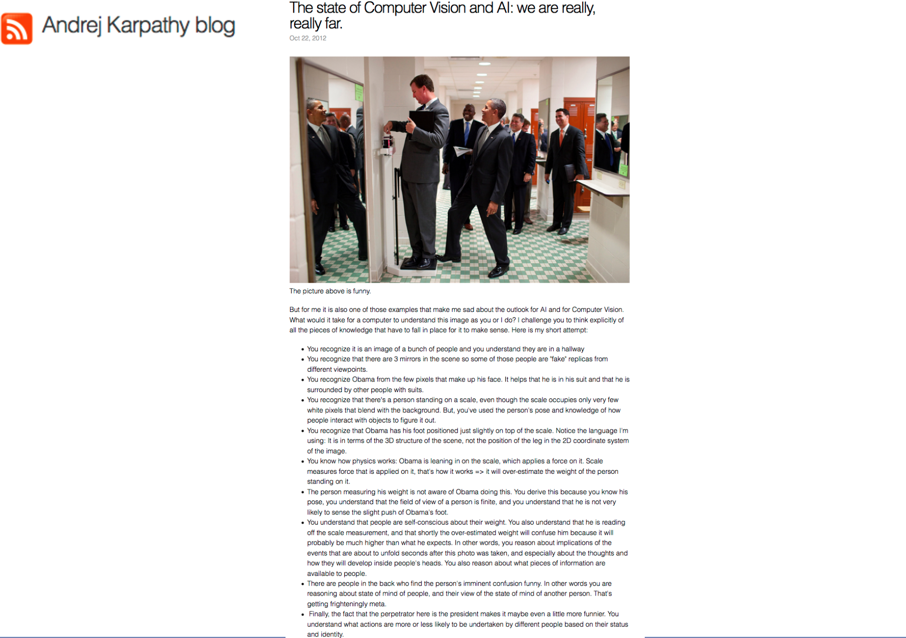

Slide 11
What is an image?

Slide 12
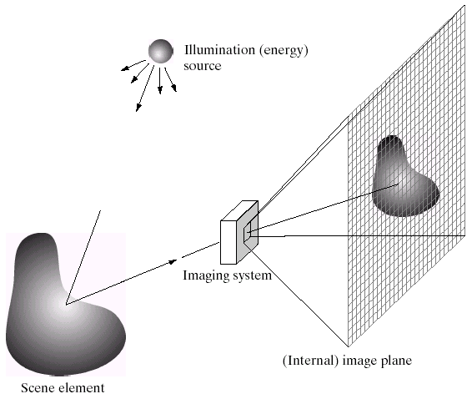
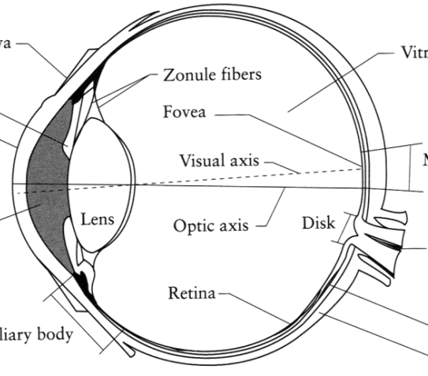
What is an image?
Digital Camera
We’ll focus on these in this class
(More on this process later)
The Eye
Source: A. Efros

Slide 13
What is an image?
A grid (matrix) of intensity values
(common to use one byte per value: 0 = black, 255 = white)
255 | 255 | 255 | 255 | 255 | 255 | 255 | 255 | 255 | 255 | 255 | 255
255 | 255 | 255 | 255 | 255 | 255 | 255 | 255 | 255 | 255 | 255 | 255
255 | 255 | 255 | 20 | 0 | 255 | 255 | 255 | 255 | 255 | 255 | 255
255 | 255 | 255 | 75 | 75 | 75 | 255 | 255 | 255 | 255 | 255 | 255
255 | 255 | 75 | 95 | 95 | 75 | 255 | 255 | 255 | 255 | 255 | 255
255 | 255 | 96 | 127 | 145 | 175 | 255 | 255 | 255 | 255 | 255 | 255
255 | 255 | 127 | 145 | 175 | 175 | 175 | 255 | 255 | 255 | 255 | 255
255 | 255 | 127 | 145 | 200 | 200 | 175 | 175 | 95 | 255 | 255 | 255
255 | 255 | 127 | 145 | 200 | 200 | 175 | 175 | 95 | 47 | 255 | 255
255 | 255 | 127 | 145 | 145 | 175 | 127 | 127 | 95 | 47 | 255 | 255
255 | 255 | 74 | 127 | 127 | 127 | 95 | 95 | 95 | 47 | 255 | 255
255 | 255 | 255 | 74 | 74 | 74 | 74 | 74 | 74 | 255 | 255 | 255
255 | 255 | 255 | 255 | 255 | 255 | 255 | 255 | 255 | 255 | 255 | 255
255 | 255 | 255 | 255 | 255 | 255 | 255 | 255 | 255 | 255 | 255 | 255
=

Slide 14
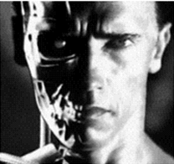
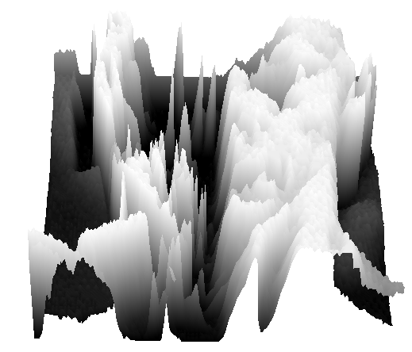
What is an image?
We can think of a (grayscale) image as a function, f, from R² to R:
f (x,y) gives the intensity at position (x,y)
A digital image is a discrete (sampled, quantized) version of this function
f (x, y)
x
y
snoop
3D view

Slide 15
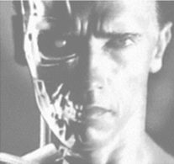
Image transformations
As with any function, we can apply operators to an image
We’ll talk about a special kind of operator, convolution (linear filtering)
g (x,y) = f (x,y) + 20
g (x,y) = f (-x,y)

Slide 16
Filters
Filtering
Form a new image whose pixels are a combination of the original pixels
Why?
To get useful information from images
E.g., extract edges or contours (to understand shape)
To enhance the image
E.g., to remove noise
E.g., to sharpen to “enhance image” a la CSI

Slide 17
Canonical Image Processing problems
Image Restoration
denoising
deblurring
Image Compression
JPEG, JPEG2000, MPEG..
Computing Field Properties
optical flow
disparity
Locating Structural Features
corners
edges

Slide 18
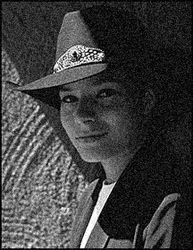
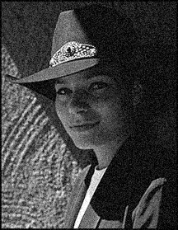
Question: Noise reduction
Given a camera and a still scene, how can you reduce noise?
Take lots of images and average them!
What’s the next best thing?
Source: S. Seitz
Notes:
Answer: take lots of images, average them

Slide 19
Image filtering
Modify the pixels in an image based on some function of a local neighborhood of each pixel
10
5
3
Some function
4
5
1
7
1
1
7
Local image data
Modified image data
Source: L. Zhang

Slide 20
Linear filtering
One simple version of filtering: linear filtering (cross-correlation, convolution)
Replace each pixel by a linear combination (a weighted sum) of its neighbors
The prescription for the linear combination is called the “kernel” (or “mask”, “filter”)
10
5
3
0
0
0
4
6
1
0
0.5
0
8
1
1
8
0
1
0.5
Local image data
kernel
Modified image data
Source: L. Zhang

Slide 21
Cross-correlation
Let be the image, be the kernel (of size 2k+1 x 2k+1), and be the output image
Can think of as a “dot product” between local neighborhood and kernel for each pixel
This is called a cross-correlation operation:

Slide 22
Convolution
Same as cross-correlation, except that the kernel is “flipped” (horizontally and vertically)
Convolution is commutative and associative
This is called a convolution operation:

Slide 23
1D Demo

Slide 24
Convolution
Adapted from F. Durand

Slide 25
Mean filtering
0 | 0 | 0 | 0 | 0 | 0 | 0 | 0 | 0 | 0
0 | 0 | 0 | 0 | 0 | 0 | 0 | 0 | 0 | 0
0 | 0 | 0 | 90 | 90 | 90 | 90 | 90 | 0 | 0
0 | 0 | 0 | 90 | 90 | 90 | 90 | 90 | 0 | 0
0 | 0 | 0 | 90 | 90 | 90 | 90 | 90 | 0 | 0
0 | 0 | 0 | 90 | 0 | 90 | 90 | 90 | 0 | 0
0 | 0 | 0 | 90 | 90 | 90 | 90 | 90 | 0 | 0
0 | 0 | 0 | 0 | 0 | 0 | 0 | 0 | 0 | 0
0 | 0 | 90 | 0 | 0 | 0 | 0 | 0 | 0 | 0
0 | 0 | 0 | 0 | 0 | 0 | 0 | 0 | 0 | 0
 | 0 | 10 | 20 | 30 | 30 | 30 | 20 | 10
 | 0 | 20 | 40 | 60 | 60 | 60 | 40 | 20
 | 0 | 30 | 60 | 90 | 90 | 90 | 60 | 30
 | 0 | 30 | 50 | 80 | 80 | 90 | 60 | 30
 | 0 | 30 | 50 | 80 | 80 | 90 | 60 | 30
 | 0 | 20 | 30 | 50 | 50 | 60 | 40 | 20
 | 10 | 20 | 30 | 30 | 30 | 30 | 20 | 10
 | 10 | 10 | 10 | 0 | 0 | 0 | 0 | 0
*
=
1 | 1 | 1
1 | 1 | 1
1 | 1 | 1

Slide 26
Mean filtering/Moving average

Slide 27
Mean filtering/Moving average

Slide 28
Mean filtering/Moving average

Slide 29
Mean filtering/Moving average

Slide 30
Mean filtering/Moving average

Slide 31
Mean filtering/Moving average

Slide 32
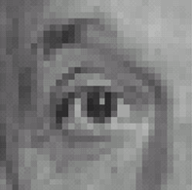
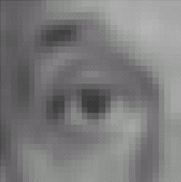
Example filters
1
1
1
1
1
1
1
1
1
Original
Blur (with a
box filter)
Source: D. Lowe

Slide 33
Linear filters: examples
*
0
0
0
=
0
1
0
0
0
0
Original
Identical image
Source: D. Lowe

Slide 34
Linear filters: examples
*
0
0
0
=
1
0
0
0
0
0
Original
Shifted left
By 1 pixel
Source: D. Lowe

Slide 35
Linear filters: examples
*
1
1
1
=
1
1
1
1
1
1
Original
Blur (with a mean filter)
Source: D. Lowe

Slide 36
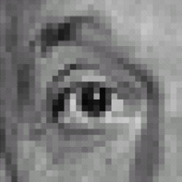
Linear filters: examples
*
0
0
0
-
1
1
1
=
0
2
0
1
1
1
0
0
0
1
1
1
Sharpening filter (accentuates edges)
Original
Source: D. Lowe

Slide 37
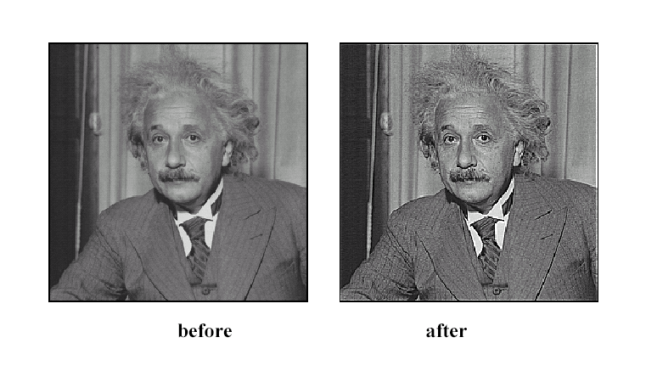
Sharpening
Source: D. Lowe

Slide 38
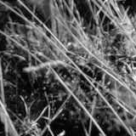
Smoothing with box filter revisited
Source: D. Forsyth
Notes:
I always walk through the argument on the left rather carefully; it gives some insight into the
significance of impulse responses or point spread functions.

Slide 39
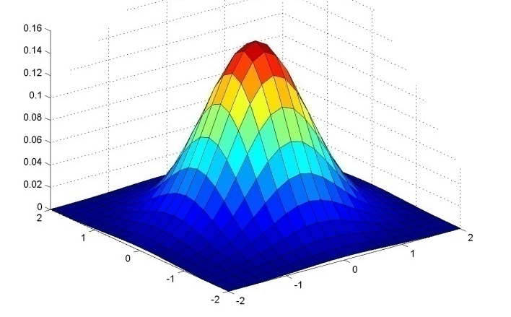
Gaussian Kernel
0.003 0.013 0.022 0.013 0.003
0.013 0.059 0.097 0.059 0.013
0.022 0.097 0.159 0.097 0.022
0.013 0.059 0.097 0.059 0.013
0.003 0.013 0.022 0.013 0.003
5 x 5, σ = 1
Constant factor at front makes volume sum to 1 (can be ignored, as we should re-normalize weights to sum to 1 in any case)
Source: C. Rasmussen

Slide 40
Gaussian Kernel
Source: C. Rasmussen

Slide 41
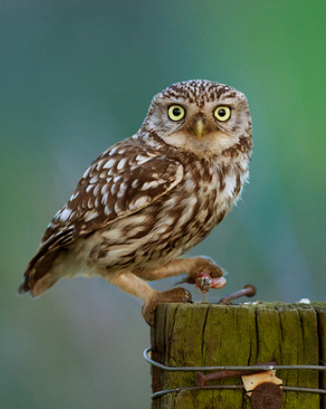
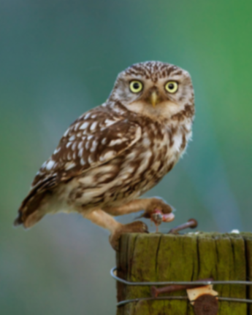
Gaussian filters
= 1 pixel
= 5 pixels
= 10 pixels
= 30 pixels

Slide 42
Mean vs. Gaussian filtering

Slide 43
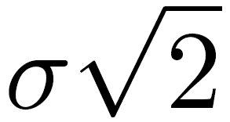
Gaussian filter
Removes “high-frequency” components from the image (low-pass filter)
Convolution with self is another Gaussian
Convolving twice with Gaussian kernel of width = convolving once with kernel of width
*
=
Source: K. Grauman
Notes:
Linear vs. quadratic in mask size

Slide 44
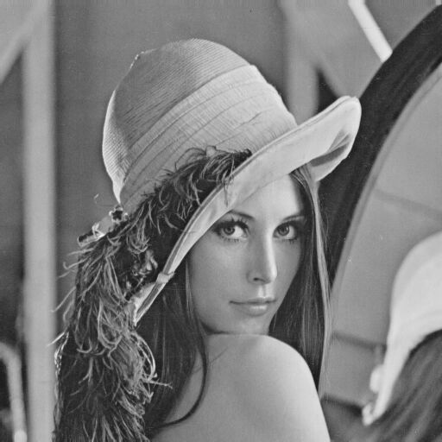
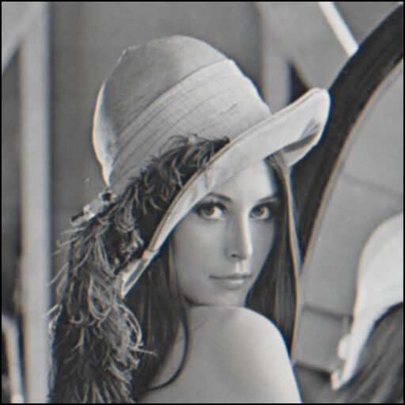
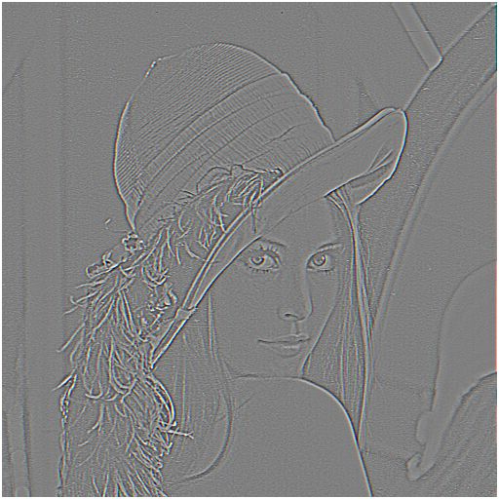
Sharpening revisited
What does blurring take away?
–
=
original
smoothed (5x5)
detail
Let’s add it back:
+ α
=
original
detail
sharpened
Source: S. Lazebnik

Slide 45
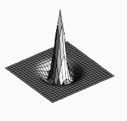
Sharpen filter
blurred image
image
unit impulse (identity)
scaled impulse
Gaussian
Laplacian of Gaussian
Notes:
f + a(f - f * g) = (1+a)f-af*g = f*((1+a)e-g)

Slide 46
Sharpen filter
unfiltered
filtered

Slide 47
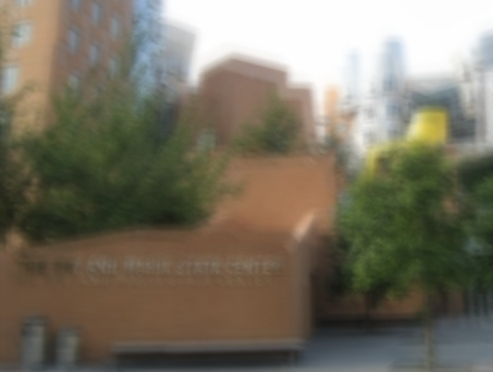
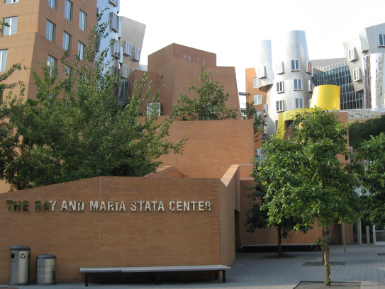
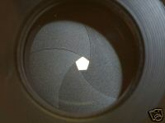
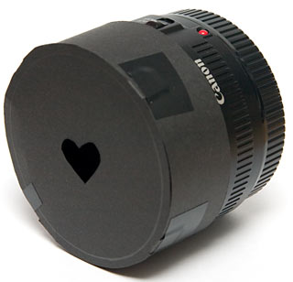
“Optical” Convolution
Camera shake
=
*
Source: Fergus, et al. “Removing Camera Shake from a Single Photograph”, SIGGRAPH 2006
Bokeh: Blur in out-of-focus regions of an image.
Source: http://lullaby.homepage.dk/diy-camera/bokeh.html

Slide 48
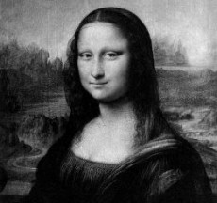
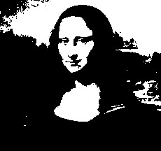
Filters: Thresholding

Slide 49
Linear filters
Is thresholding a linear filter?

Slide 50
Questions?

