Slide 1
CS5540: Computational Techniques for Analyzing Clinical Data
Lecture 7:
Statistical Estimation: Least Squares, Maximum Likelihood and Maximum A Posteriori Estimators
Ashish Raj, PhD
Image Data Evaluation and Analytics Laboratory (IDEAL)
Department of Radiology
Weill Cornell Medical College
New York

Slide 2
Outline
Part I: Recap of Wavelet Transforms
Part II : Least Squares Estimation
Part III: Maximum Likelihood Estimation
Part IV: Maximum A Posteriori Estimation : Next week
Note: you will not be tested on specific examples shown here, only on general principles

Slide 3
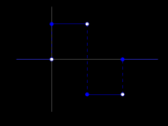
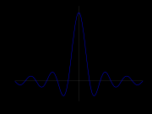
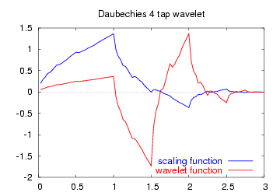
Basis functions in WT
Basis functions are called “wavelets”
Important wavelet property:
All basis functions are scaled, shifted copies of the same mother wavelet
By clever construction of mother wavelet, these scaled, shifted copies can be made either orthonormal, or at least linearly independent
Wavelets form a complete basis, and wavelet transforms are designed to be easily invertible
Online wavelet tutorial:
http://cnx.org/content/m10764/latest/
Haar
Mexican Hat
Daubechies
(orthonormal)

Slide 4
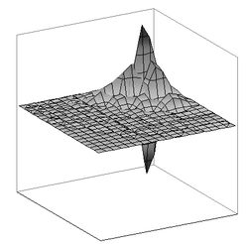
WT in images
Images are piecewise smooth or piecewise constant
Stationarity is even rarer than in 1D signals
FT even less useful (nnd WT more attractive)
2D wavelet transforms are simple extensions of 1D WT, generally performing 1D WT along rows, then columns etc
Sometimes we use 2D wavelets directly, e.g. orthonormal Daubechies 2D wavelet

Slide 5
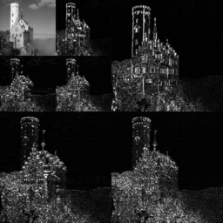
WT on images
2D generalization of scale-time decomposition
Scale 0
H
scale
Scale 1
time
Scale 2
V
H-V
Successive application of dot product with wavelet of increasing width.
Forms a natural pyramid structure. At each scale:
H = dot product of image rows with wavelet
V = dot product of image columns with wavelet
H-V = dot product of image rows then columns with wavelet

Slide 6
Wavelet Applications
Many, many applications!
Audio, image and video compression
New JPEG standard includes wavelet compression
FBI’s fingerprints database saved as wavelet-compressed
Signal denoising, interpolation, image zooming, texture analysis, time-scale feature extraction
In our context, WT will be used primarily as a feature extraction tool
Remember, WT is just a change of basis, in order to extract useful information which might otherwise not be easily seen

Slide 7
WT in MATLAB
MATLAB has an extensive wavelet toolbox
Type help wavelet in MATLAB command window
Look at their wavelet demo
Play with Haar, Mexican hat and Daubechies wavelets

Slide 8
Project Ideas
Idea 1: use WT to extract features from ECG data
  use these features for classification
Idea 2: use 2D WT to extract spatio-temporal features from 3D+time MRI data
  to detect tumors / classify benign vs malignant tumors
Idea 3: use 2D WT to denoise a given image

Slide 9
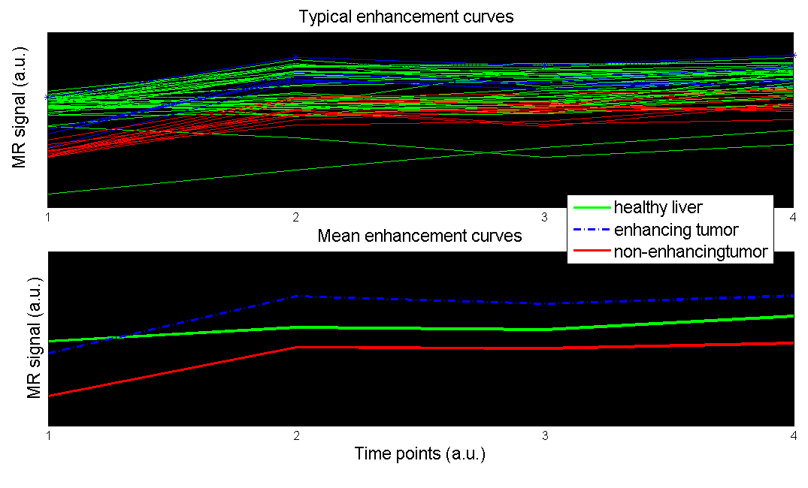
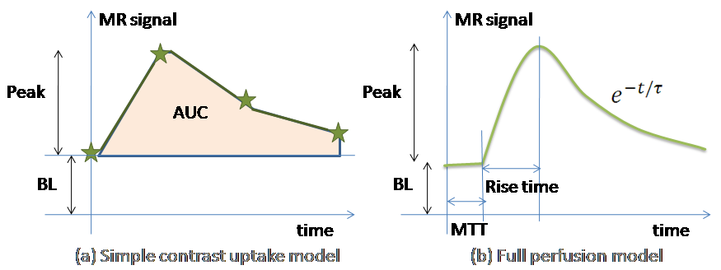
Idea 3: Voxel labeling from contrast-enhanced MRI
Can segment according to time profile of 3D+time contrast enhanced MR data of liver / mammography
Temporal models used to extract features
Typical plot of time-resolved MR signal of various tissue classes
  Instead of such a simple temporal model, wavelet decomposition could provide spatio-temporal features that you can use for clustering

Slide 10
Liver tumour quantification from DCE-MRI

Slide 11
Further Reading on Wavelets
A Linear Algebra view of wavelet transform
http://www.bearcave.com/misl/misl_tech/wavelets/matrix/index.html
Wavelet tutorial
http://users.rowan.edu/~polikar/WAVELETS/WTpart1.html
http://users.rowan.edu/~polikar/WAVELETS/WTpart2.html
http://users.rowan.edu/~polikar/WAVELETS/WTpart3.html
Wavelets application to EKG R wave detection: http://www.ma.utexas.edu/users/davis/reu/ch3/wavelets/wavelets.pdf

Slide 12
Part II : Least Squares Estimation and Examples

Slide 13
A simple Least Squares problem – Line fitting
Goal: To find the “best-fit” line representing a bunch of points
Here: y_{i} are observations at location x_{i},
Intercept and slope of line are the unknown model parameters to be estimated
Which model parameters best fit the observed points?
This can be written in matrix notation, as
θ_{LS} = arg min ||y – Hθ||²
What are H and θ?

Slide 14
Least Squares Estimator
Given linear process
y = H θ + n
Least Squares estimator:
  θ_{LS} = argmin ||y – Hθ||²
Natural estimator– want solution to match observation
Does not use any information about n
There is a simple solution (a.k.a. pseudo-inverse):
    θ_{LS} = (H^{T}H)⁻¹ H^{T}y
In MATLAB, type pinv(y)

Slide 15
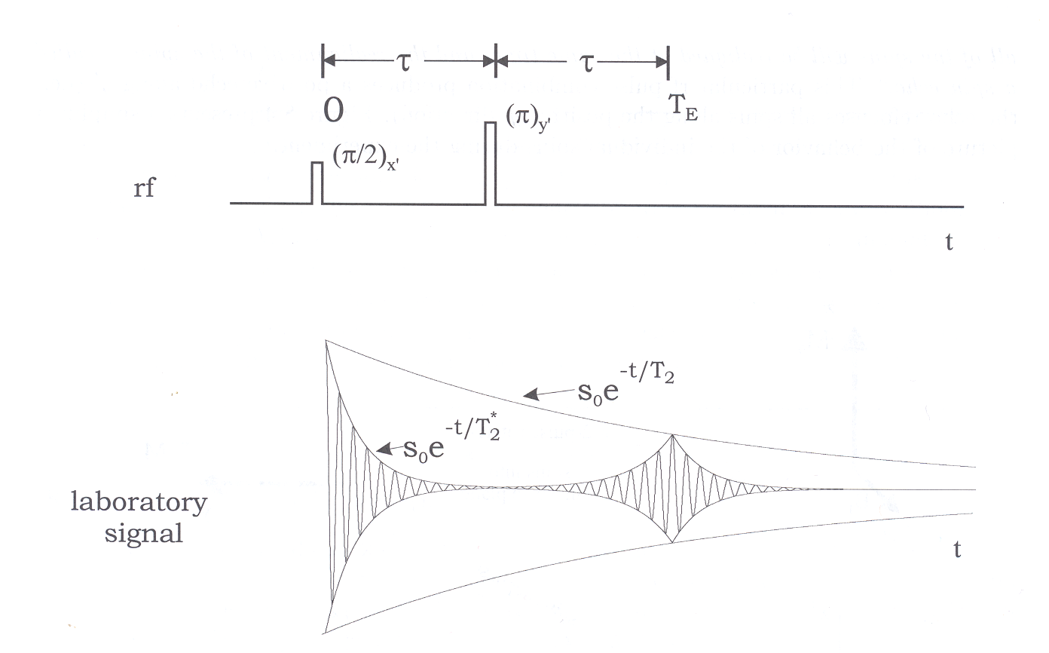
Example - estimating T₂ decay constant in repeated spin echo MR data

Slide 16
Example – estimating T₂ in repeated spin echo data
s(t) = s₀ e^{-t/T2}
Need only 2 data points to estimate T₂:
T_{2est} = [T_{E2} – T_{E1}] / ln[s(T_{E1})/s(T_{E2}) ]
However, not good due to noise, timing issues
In practice we have many data samples from various echoes

Slide 17
Example – estimating T₂
H
y
ln(s(t₁))
ln(s(t₂))
M
ln(s(t_{n}))
1 -t₁
1 -t₂
M
1 -t_{n}
a
r
=
θ
Least Squares estimate:
θ _{LS} = (H^{T}H)⁻¹H^{T}y
T₂ = 1/r_{LS}

Slide 18
Estimation example - Denoising
Suppose we have a noisy MR image y, and wish to obtain the noiseless image x, where
y = x + n
Can we use LSE to find x?
Try: H = I, θ = x in the linear model
LS estimator simply gives x = y!
➔ we need a more powerful model
Suppose the image x can be approximated by a polynomial, i.e. a mixture of 1st p powers of r:
x = Σ_{i=0}^{p} a_{i} r^{i}

Slide 19
Example – denoising
H
y
y₁
y₂
M
y_{n}
1 r₁¹ L r₁^{p}
1 r₂¹ L r₂^{p}
M
1 r_{n}¹ L r_{n}^{p}
n₁
n₂
M
n_{n}
a₀
a₁
M
a_{p}
=
+
θ
Least Squares estimate:
θ _{LS} = (H^{T}H)⁻¹H^{T}y
x = Σ_{i=0}^{p} a_{i} r^{i}

Slide 20
Part III : Maximum Likelihood Estimation and Examples

Slide 21
Estimation Theory
Consider a linear process
y = H θ + n
y = observed data
θ = set of model parameters
n = additive noise
Then Estimation is the problem of finding the statistically optimal θ, given y, H and knowledge of noise properties
Medicine is full of estimation problems

Slide 22
Different approaches to estimation
Minimum variance unbiased estimators
Least Squares
Maximum-likelihood
Maximum entropy
Maximum a posteriori
has no statistical basis
uses knowledge of noise PDF
uses prior information about θ

Slide 23
Probability vs. Statistics
Probability: Mathematical models of uncertainty predict outcomes
  This is the heart of probability
  Models, and their consequences
    What is the probability of a model generating some particular data as an outcome?
Statistics: Given an outcome, analyze different models
  Did this model generate the data?
  From among different models (or parameters), which one generated the data?

Slide 24
Maximul Likelihood Estimator for Line Fitting Problem
What if we know something about the noise? i.e. Pr(n)…
If noise not uniform across samples, LS might be incorrect
noise σ = 10
This can be written in matrix notation, as
θ_{ML} = arg min ||W(y – Hθ)||²
What is W?
ML estimate
noise σ = 0.1

Slide 25
Definition of likelihood
Likelihood is a probability model of the uncertainty in output given a known input
The likelihood of a hypothesis is the probability that it would have resulted in the data you saw
  Think of the data as fixed, and try to chose among the possible PDF’s
  Often, a parameterized family of PDF’s
    ML parameter estimation

Slide 26
Gaussian Noise Models
In linear model we discussed, likelihood comes from noise statistics
Simple idea: want to incorporate knowledge of noise statistics
If uniform white Gaussian noise:
If non-uniform white Gaussian noise:

Slide 27
Maximum Likelihood Estimator - Theory
n = y-Hθ, Pr(n) = exp(- ||n||²/2σ²)
Therefore Pr(y for known θ) = Pr(n)
Simple idea: want to maximize Pr(y|θ) - called the likelihood function
Example 1: show that for uniform independent Gaussian noise
  θ_{ML} = arg min ||y-Hθ||²
Example 2: For non-uniform Gaussian noise
θ_{ML} = arg min ||W(y-Hθ)||²

Slide 28
MLE
Bottomline:
Use noise properties to write Pr(y|θ)
Whichever θ maximize above, is the MLE

Slide 29
Example – Estimating main frequency of ECG signal
Model: y(t_{i}) = a sin(f t_{i}) + n_{i}
What is the MLE of a, f ?
Pr(y | θ ) = exp(-Σ_{i} (y(t_{i}) - a sin(f t_{i}) )² / 2 σ²)

Slide 30
Maximum Likelihood Detection
ML is quite a general, powerful idea
Same ideas can be used for classification and detection of features hidden in data
Example 1: Deciding whether a voxel is artery or vein
There are 3 hypotheses at each voxel:
  Voxel is artery, or voxel is vein, or voxel is parenchyma

Slide 31
Example: MRA segmentation
artery/vein may have similar intensity at given time point
but different time profiles
wish to segment according to time profile, not single intensity

Slide 32
Expected Result

Slide 33
Example: MRA segmentation
First: need a time model of all segments
Lets use ML principles to see which voxel belongs to which model
Artery:
Vein:
Parench:

Slide 34
Maximum Likelihood Classification
Artery:
Vein:
Paren:
So at each voxel, the best model is one that maximizes:
Or equivalently, minimizes:

Slide 35
Liver tumour quantification from Dynamic Contrast Enhanced MRI
Data: Tumor model Rabbit DCE-MR data
Paramegnetic contrast agent , pathology gold standard
Extract temporal features from DCE-MRI
Use these features for accurate detection and quantification of tumour

Slide 36
Liver Tumour Temporal models
Temporal models used to extract features
Typical plot of time-resolved MR signal of various tissue classes

Slide 37
Liver tumour quantification from DCE-MRI

Slide 38
ML Tutorials
Slides by Andrew Moore (CMU): available on course webpage
Paper by Jae Myung, “Tutorial on Maximum Likelihood”: available on course webpage
http://www.cs.cmu.edu/~aberger/maxent.html
Max Entropy Tutorial

Slide 39
Next lecture (Friday)
Non-parametric density estimation
  Histograms + various fitting methods
  Nearest neighbor
  Parzen estimation
Next lecture (Wednesday)
Maximum A Posteriori Estimators
  Several examples

Slide 40
CS5540: Computational Techniques for Analyzing Clinical Data
Lecture 7:
Statistical Estimation: Least Squares, Maximum Likelihood and Maximum A Posteriori Estimators
Ashish Raj, PhD
Image Data Evaluation and Analytics Laboratory (IDEAL)
Department of Radiology
Weill Cornell Medical College
New York

Slide 41
Failure modes of ML
Likelihood isn’t the only criterion for selecting a model or parameter
  Though it’s obviously an important one
Bizarre models may have high likelihood
  Consider a speedometer reading 55 MPH
  Likelihood of “true speed = 55”: 10%
  Likelihood of “speedometer stuck”: 100%
ML likes “fairy tales”
  In practice, exclude such hypotheses
  There must be a principled solution…

Slide 42
Maximum a Posteriori Estimate
This is an example of using an image prior
Priors are generally expressed in the form of a PDF Pr(x)
Once the likelihood L(x) and prior are known, we have complete statistical knowledge
LS/ML are suboptimal in presence of prior
MAP (aka Bayesian) estimates are optimal
likelihood
Bayes Theorem:
  Pr(x|y) = Pr(y|x) . Pr(x)
  Pr(y)
posterior
prior

Slide 43
Maximum a Posteriori (Bayesian) Estimate
Consider the class of linear systems y = Hx + n
Bayesian methods maximize the posterior probability:
Pr(x|y) ∝ Pr(y|x) . Pr(x)
Pr(y|x) (likelihood function) = exp(- ||y-Hx||²)
Pr(x) (prior PDF) = exp(-G(x))
Non-Bayesian: maximize only likelihood
x_{est} = arg min ||y-Hx||²
Bayesian:
x_{est} = arg min ||y-Hx||² + G(x) ,
where G(x) is obtained from the prior distribution of x
If G(x) = ||Gx||² ➔ Tikhonov Regularization

Slide 44
Other example of Estimation in MR
Image denoising: H = I
Image deblurring: H = convolution mtx in img-space
Super-resolution: H = diagonal mtx in k-space
Metabolite quantification in MRSI

Slide 45
What Is the Right Imaging Model?
y = H x + n, n is Gaussian (1)
y = H x + n, n, x are Gaussian (2)
MAP Sense
MAP Sense = Bayesian (MAP) estimate of (2)
Notes:
Now, if you take a horizontal line and look at the intensity profile, it is reasonable to assume that artery is brighter than background within each scan line

Slide 46
Intro to Bayesian Estimation
Bayesian methods maximize the posterior probability:
Pr(x|y) ∝ Pr(y|x) . Pr(x)
Pr(y|x) (likelihood function) = exp(- ||y-Hx||²)
Pr(x) (prior PDF) = exp(-G(x))
Gaussian prior:
Pr(x) = exp{- ½ x^{T} R_{x}⁻¹ x}
MAP estimate:
x_{est} = arg min ||y-Hx||² + G(x)
MAP estimate for Gaussian everything is known as Wiener estimate

Slide 47
Regularization = Bayesian Estimation!
For any regularization scheme, its almost always possible to formulate the corresponding MAP problem
MAP = superset of regularization
Prior model
MAP
Regularization scheme
So why deal with regularization??

Slide 48
Lets talk about Prior Models
Temporal priors: smooth time-trajectory
Sparse priors: L0, L1, L2 (=Tikhonov)
Spatial Priors: most powerful for images
I recommend robust spatial priors using Markov Fields
Want priors to be general, not too specific
Ie, weak rather than strong priors

Slide 49
How to do regularization
First model physical property of image,
then create a prior which captures it,
then formulate MAP estimator,
Then find a good algorithm to solve it!
How NOT to do regularization
DON’T use regularization scheme without bearing on physical property of image!
Example: L1 or L0 prior in k-space!
Specifically: deblurring in k-space (handy b/c convolution becomes multiply)
BUT: hard to impose smoothness priors in k-space ➔ no meaning
49

Slide 50
MAP for Line fitting problem
If model estimated by ML and Prior info do not agree…
MAP is a compromise between the two
LS estimate
MAP estimate
Most probable prior model

Slide 51
Multi-variate FLASH
Acquire 6-10 accelerated FLASH data sets at different flip angles or TR’s
Generate T₁ maps by fitting to:
  Not enough info in a single voxel
  Noise causes incorrect estimates
  Error in flip angle varies spatially!

Slide 52
Spatially Coherent T₁, ρ estimation
First, stack parameters from all voxels in one big vector x
Stack all observed flip angle images in y
Then we can write y = M (x) + n
Recall M is the (nonlinear) functional obtained from
Solve for x by non-linear least square fitting, PLUS spatial prior:
x_{est} = arg min_{x} || y - M (x) ||² + μ²||Dx||²
Minimize via MATLAB’s lsqnonlin function
How? Construct δ = [y - M (x); μ Dx]. Then E(x) = ||δ||²
E(x)
Makes M(x) close to y
Makes x smooth

Slide 53
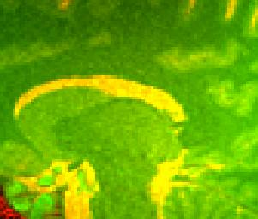
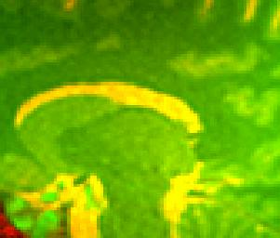
Multi-Flip Results – combined ρ, T₁ in pseudocolour

Slide 54
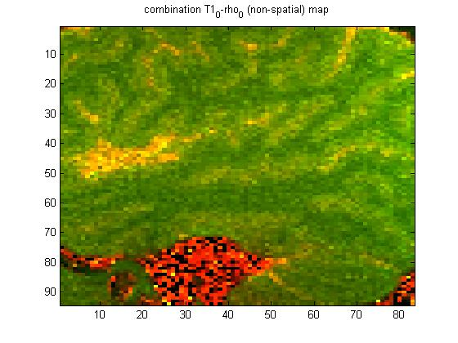

Multi-Flip Results – combined ρ, T₁ in pseudocolour

Slide 55
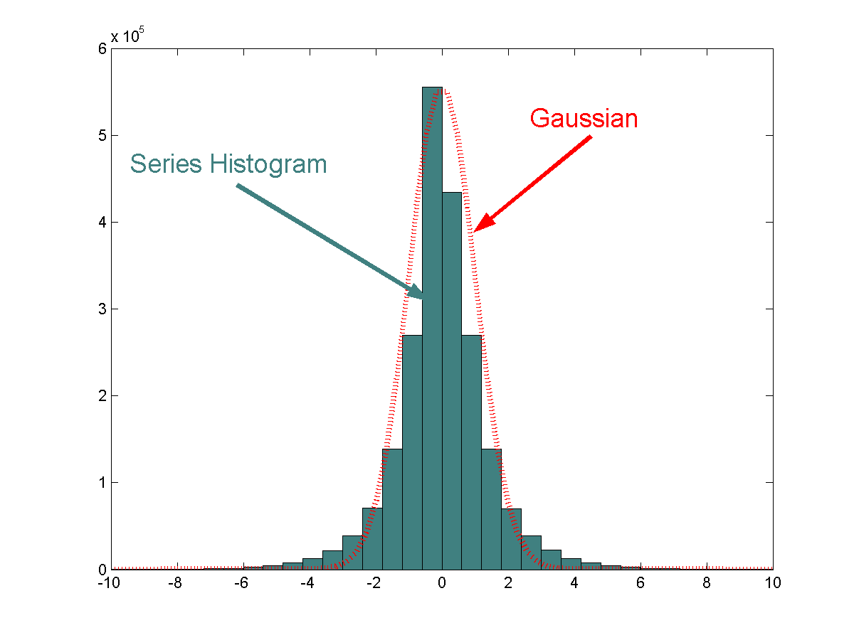
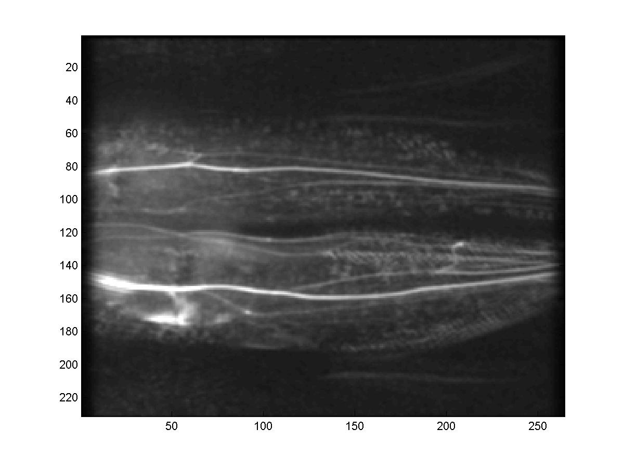
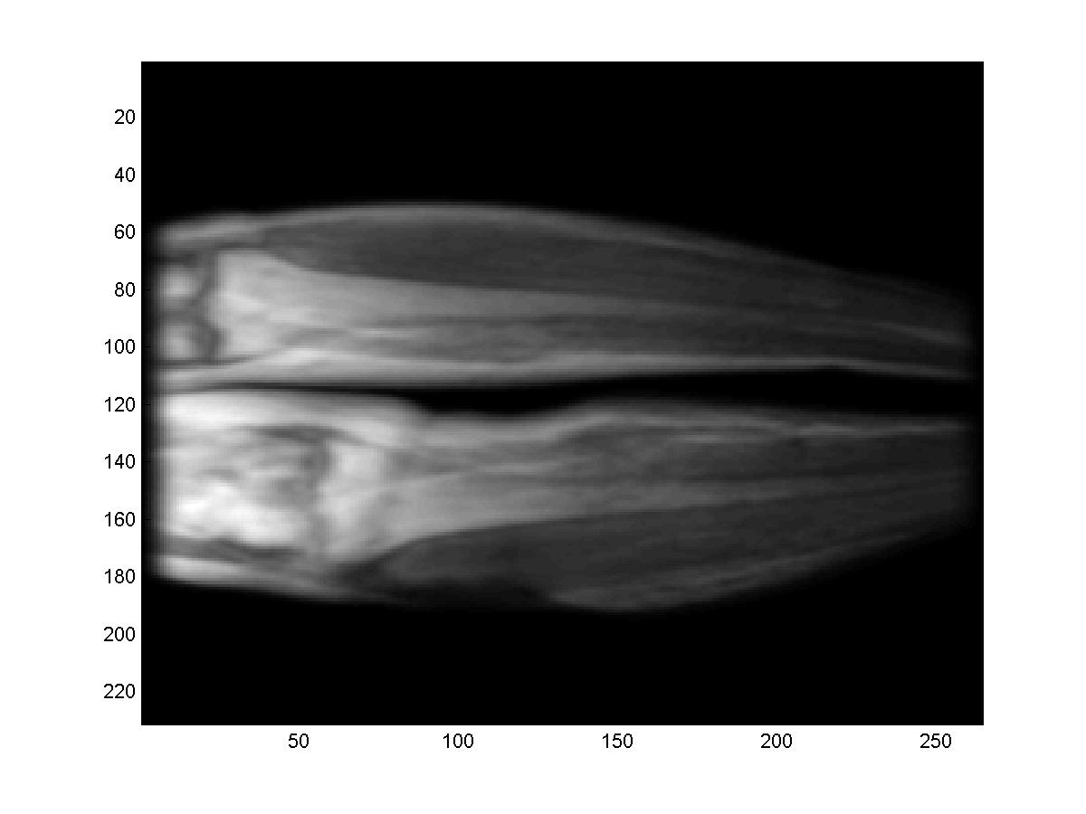

Spatial Priors For Images - Example
Frames are tightly distributed around mean
After subtracting mean, images are close to Gaussian
variance
mean
frame 1
frame 2
time
frame N_{f}
mean μ_{x}(i,j)
envelope a(i,j)
Prior: -mean is μ_{x}
-local std.dev. varies as a(i,j)

Slide 56
Spatial Priors for MR images
stationary
process
Stochastic MR image model:
x(i,j) = μ_{x} (i,j) + a(i,j) . (h ** p)(i,j) (1)
  ** denotes 2D convolution
  μ_{x} (i,j) is mean image for class
  p(i,j) is a unit variance i.i.d. stochastic process
  a(i,j) is an envelope function
  h(i,j) simulates correlation properties of image x
x = ACp + μ (2)
where A = diag(a) , and C is the Toeplitz matrix generated by h
Can model many important stationary and non-stationary cases
r(τ₁, τ₂) = (h ** h)(τ₁, τ₂)

Slide 57
MAP estimate for Imaging Model (3)
The Wiener estimate
x_{MAP} - μ _{x} = HR_{x} (HR_{x}H^{H} + R_{n})⁻¹ (y- μ _{y}) (3)
  R_{x}, R_{n} = covariance matrices of x and n
  Stationarity ➔ R_{x} has Toeplitz structure ➔ fast processing
x_{MAP} - μ _{x} = HACC^{H}A^{H} ( HACC^{H}A^{H}H^{H} + σ_{n}² I )⁻¹ (y- μ _{y}) (4)
Direct inversion prohibitive; so use CG iterative method
(4) better than (3) since A and C are O(N log N) operations, enabling much faster processing

Slide 58
How to obtain estimates of A, C ?
Need a training set of full-resolution images x_{k}, k = 1,…,K
Parallel imaging doesnt provide un-aliased full-res images
Approaches:
  Use previous full-res scans
      - time consuming, need frequent updating
  Use SENSE-reconstructed images for training set
      - very bad noise amplification issues for high speedups
  Directly estimate parameters from available parallel data
      Aliasing may cause inaccuracies

Slide 59
MAP for Dynamic Parallel Imaging
N_{f} images available for parameter estimation!
All images well-registered
Tightly distributed around pixel mean
Parameters can be estimated from aliased data
frame 1
frame 2
frame 1
frame N_{f}
frame 2
k_{y}
time
frame N_{f}
k_{x}
N_{f} /R full-res images

Slide 60
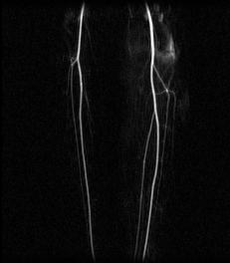
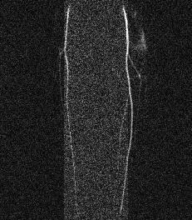
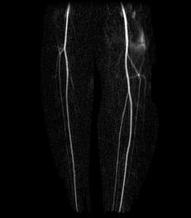
MAP-SENSE Preliminary Results
Scans acceleraty 5x
The angiogram was computed by:
avg(post-contrast) – avg(pre-contrast)
Unaccelerated
5x faster: SENSE
5x faster: MAP-SENSE

Slide 61
References
Simon Kay. Statistical Signal Processing. Part I: Estimation Theory. Prentice Hall 2002
Simon Kay. Statistical Signal Processing. Part II: Detection Theory. Prentice Hall 2002
Haacke et al. Fundamentals of MRI.
Zhi-Pei Liang and Paul Lauterbur. Principles of MRI – A Signal Processing Perspective.
Info on part IV:
Ashish Raj. Improvements in MRI Using Information Redundancy. PhD thesis, Cornell University, May 2005.
Website: http://www.cs.cornell.edu/~rdz/SENSE.htm

Slide 62
Maximum Likelihood Estimator
But if noise is jointly Gaussian with cov. matrix C
Recall C , E(nn^{T}). Then
Pr(n) = e^{-½ nT C-1 n}
L(y|θ) = ½ (y-Hθ)^{T} C⁻¹ (y-Hθ)
θ_{ML} = argmin ½ (y-Hθ)^{T}C⁻¹(y-Hθ)
This also has a closed form solution
θ_{ML} = (H^{T}C⁻¹H)⁻¹ H^{T}C⁻¹y
If n is not Gaussian at all, ML estimators become complicated and non-linear
Fortunately, in MR noise is usually Gaussian

