Slide 1
Lecture 5: Transforms, Fourier and Wavelets
Ashish Raj, PhD
Co-Director, Image Data Evaluation and Analytics Laboratory (IDEAL)
Department of Radiology
Weill Cornell Medical College
New York
Email: ashish@med.cornell.edu
Office: Rhodes Hall Room 528
Website: www.ideal-cornell.com

Slide 2
Outline
Talk involves matrices and vector spaces
  You will not be tested on it
What are Transforms
  = change of basis
  Linear or non-linear (will focus on linear)
Fourier Transforms
Wavelet Transforms
Why??
  Because a transform or a change in basis may allow you to see things differently, see things that couldn’t be seen before, to get a different “perspective”

Slide 3
What are transforms?
Vectorize a signal (ECG, MR image, …) into vector x
A linear transform on this vector is defined as a matrix operation
  y = Tx
  Linearity: T(x₁ + x₂) = T x₁ + T x₂
Matrix examples
T is generally a square, full-rank matrix
If T is a “wide” matrix, then the transform does not have a unique inverse
  Also known as overcomplete transform
T is orthogonal if T^{t} T = diagonal matrix
T is orthonormal if T^{t} T = Identity matrix
Orthonormal transforms retain signal energy
||Tx|| = ||x||

Slide 4
Transforms
Examples:
  Fourier transform is an orthonormal transform
  Wavelet transform is generally overcomplete, but there also exist orthonormal wavelet transforms
A good property of a transform is invertibility
  Both Fourier and wavelet transforms are invertible
Many other image-based processes are not invertible
  E.g. Distance transform, JPEG compression, edge detection, blurring

Slide 5
Transforms
A transform (with full rank T) is a change of basis
Definition: A basis on a vector space is a set of linearly independent vectors that are able to express any other vector of the space as a linear combination of them.
Example: standard basis of R^{n} is simply the set of vectors e₁ … e_{n} where e_{k} = [0 … 0 1 0 … 0]^{t}
                |
                kth
                position
v
c₂ e₂
v = c₁ e₁ + c₂ e₂
c₁ e₁

Slide 6
Basis and basis vectors
A set of such vectors can be expressed as a matrix
T = [t₁ | t₂ | … t_{n}], where each t_{k} is a column vector
Basis matrix
Basis vectors
Any subset of the vectors T_{K} = {t_{k}}_{k=1:K} then defines a subspace of R^{n}
  Technically we say the subspace is spanned by the vectors {t_{k}} or equivalently by the matrix T_{K}
Many basis matrices can span the same space

Slide 7
Basis
Example in R²:
  a pair of vectors rotated by 45 degree:
  If you want to change any vector in standard space to this new basis, just left-multiply it by R⁻¹
  Note: R is orthonormal: R⁻¹ = R^{t}

Slide 8
Transform = change of basis
T is a basis if its columns are linearly independent
  i.e. it is a full rank matrix
Orthonormality simply makes everything easier
T⁻¹ = T^{t} or for complex vectors, T⁻¹ ⁼ T^{H}
So computing the inverse transform is very easy:
If y = Tx, then x = T^{H} y
This is why search for (useful) orthonormal transforms is such a huge deal

Slide 9
Other examples in medical imaging
Radon transform widely used to turn raw CT data into CT images
  X-ray absorption is a line integral
Funk-Radon is an extension of it, and is used to reconstruct orientation distribution function (ODF) from diffusion MRI data
Another transform (spherical harmonic transform) is used to clean up ODF

Slide 10
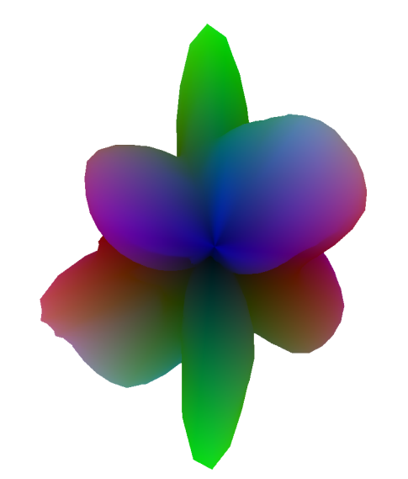
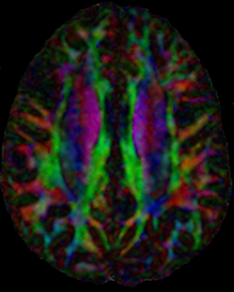
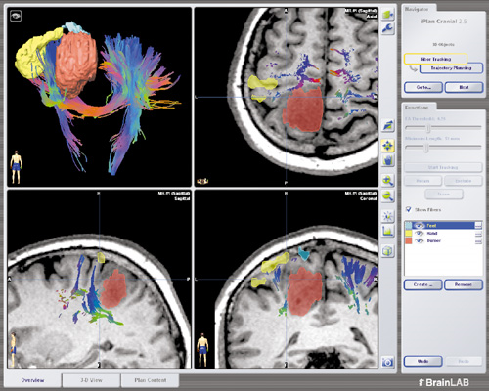
High Angular Resolution Diffusion Imaging
Notes:
10

Slide 11
MR Diffusion Imaging
Diffusion MRI measures the directionally varying diffusion properties of water in tissue
D-MRI involves taking several directional diffusion imaging measurements
Then we fit a 3D shape to these measurements

Slide 12
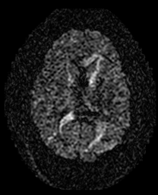
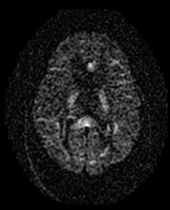
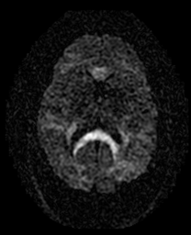
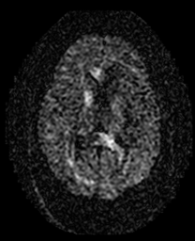
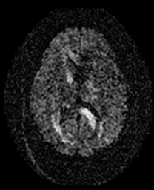
Data Acquisition Strategy
RF
G_{s}
q_{z}
q_{y}
G_{x}
q_{x}
G_{y}
Notes:
HARDI adopts a more general representation in order to allow the intravoxel diffusion function to take on more complex morphologies. Data acquisition is similar to DTI, where large diffusion gradients are applied on both sides of the 180 degree pulse in a spin-echo EPI sequence. Unlike DTI, however, dozens or even hundreds of diffusion directions are obtained with large b values often exceeding 1000.
The excitation for each diffusion gradient direction produces an image which encodes the mobility of water parallel to that direction. By cycling the diffusion gradients in each dimension, these images are effectively acquired on the surface of a sphere in diffusion space. The images are then combined to generate a three-dimensional reconstruction of diffusion in each voxel.

Slide 13
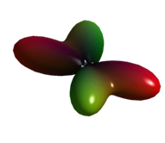
Reconstruction Problem
Basic Approach Construct a function on the unit sphere characterizing the angular structure of diffusion in each voxel.
S(φ,θ)
F(φ,θ)
Recon using spherical harmonic basis Let f and s be vectors representing functions S(.) and F(.). Then
f = [SH transform] [F-R transform] s
Represents ODF as linear mix of spherical harmonics
Transforms raw MR data to function on unit sphere
Notes:
HARDI aims to overcome the limitations of the tensor model by describing the angular dispersion of diffusion. The goal can be stated as defining the likelihood of diffusion in any particular direction in spherical coordinates, phi and theta, representing azimuth and elevation, respectively. With HARDI, raw data are acquired along the surface of a sphere in q-space. Data are heavily diffusion-weighted in order to interrogate diffusion on a smaller spatial scale, with b values usually greatly exceeding 1000.
The HARDI reconstruction problem can then be defined as one of mapping one function on the sphere in the measurement space S into another function on the sphere F, where F acts as a surrogate for the angular probability distribution function. Several methods have been proposed to synthesize HARDI measurements, including model-based techniques, generalized tensor methods, and persistent angular structure. The proposed method combines features of the three final approaches: spherical harmonic ADC, spherical deconvolution, and Q-ball imaging.

Slide 14
High Angular Resolution Diffusion Imaging:
Spherical Harmonic Transform
Point Spread Functions
= Basis functions or vectors
Example ODFs
A linear combination of these (and their rotated versions) can construct an arbitrary ODF on the unit sphere
t₁
t₂
t₃
t₄

Slide 15
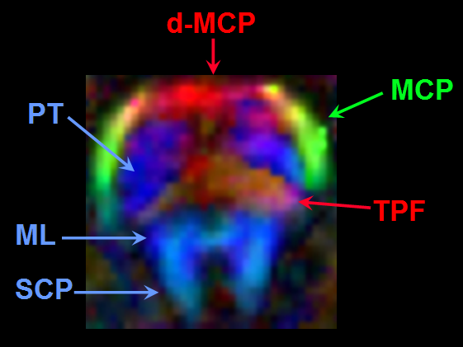
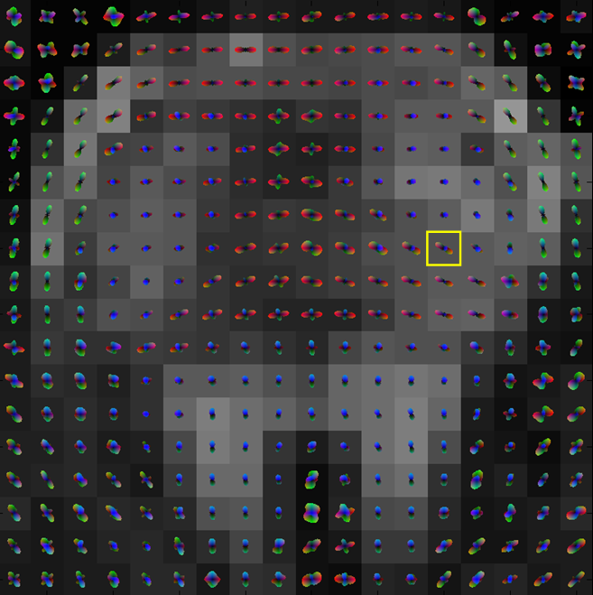
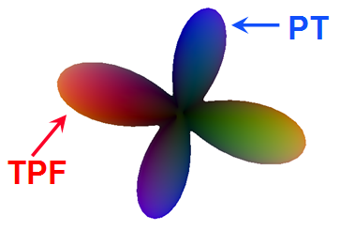
Middle cerebellar peduncle (MCP)
Superior cerebellar peduncle (SCP)
Pyramidal tract (PT)
Trans pontocerebellar fibers (TPF)
Hess CP, Mukherjee P, Han ET, Xu D, Vigneron DB
Magn Reson Med 2006; 56:104-117
Notes:
15
Additional results in the brainstem with higher spatial resolution will be presented tomorrow by my colleague, Dr. Mukherjee. One example in the pons is shown here, where the transverse pontocerebellar fibers are known to interdigitate with the pyramidal tract in histologic studies. On this color-coded anisotropy map, the up-down orientation of the pyramidal tract fibers is depicted in blue and the transversely-oriented pontocerebellar fibers are closer to red. With HARDI, we can resolve the 2-way crossing of fibers at the boundaries of these two tracts. Again, where there is a single fiber orientation as in the medial lemniscus or superior cerebellar peduncle, HARDI produces a unimodal surface.

Slide 16
Fourier Transforms - Audio example
Audio signals like music have various frequencies
  You can change the contribution of various frequency bands by using a band equalizer
Each frequency band is represented by a pure tone at frequency k Hz
Lets say its captured in a vector e_{k}
The contribution of this band = the dot product
s_{k} = <e_{k}, x> = e_{k}^{H} x

Slide 17
Fourier Transforms (FT)
Now do this for each k, and collect the s_{k}‘s in vector s, we have:
s = F^{H} x
This is called the Fourier Transform
Basis vectors
Complex exponentials (like sinusoids)
Class task: show that F is an orthonormal basis
Therefore, FT is easily invertible:
  x = F X
FT = change of basis from standard space to Fourier space

Slide 18
What is Fourier space and why does anyone need it?
Fourier basis is a collection of harmonics
  Note that complex exponentials are simply sines and cosines
Therefore the FT simply decomposes a signal into its harmonic components
FT gives direct information about the sharpness and oscillations present in the data
An “alternate view” of the data

Slide 19
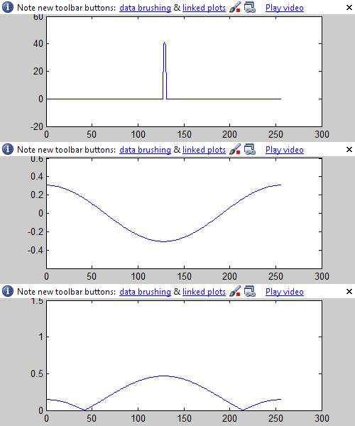
FT Demo
See how a unit pulse signal is constructed from Fourier basis vectors
Fourier coefficients
Basis vectors
Reconstructed signal

Slide 20
Fast Fourier Transform
The computation of FT requires n² mult operations
Can get pretty expensive for large n
An efficient algorithm exists which can do the job in O(n log(n)) operations
This is extremely fast vs original FT for large n
Most programming languages have a FFT library
  In C++ use FFTW, in MATLAB, built-in function fft.m

Slide 21
FT in images
FT is defined on 1D, 2D or nD data.
In 2D for instance you do FT along image rows, then do FT along columns
Again, the FT coefficients are dot products of the image with complex exponential basis vectors
Basis vectors represent frequency (spatial frequency, or how “sharp things are)
The FT coefficients represent the contribution of each spatial frequency
Fourier space in 2D is sometimes called “k-space”

Slide 22
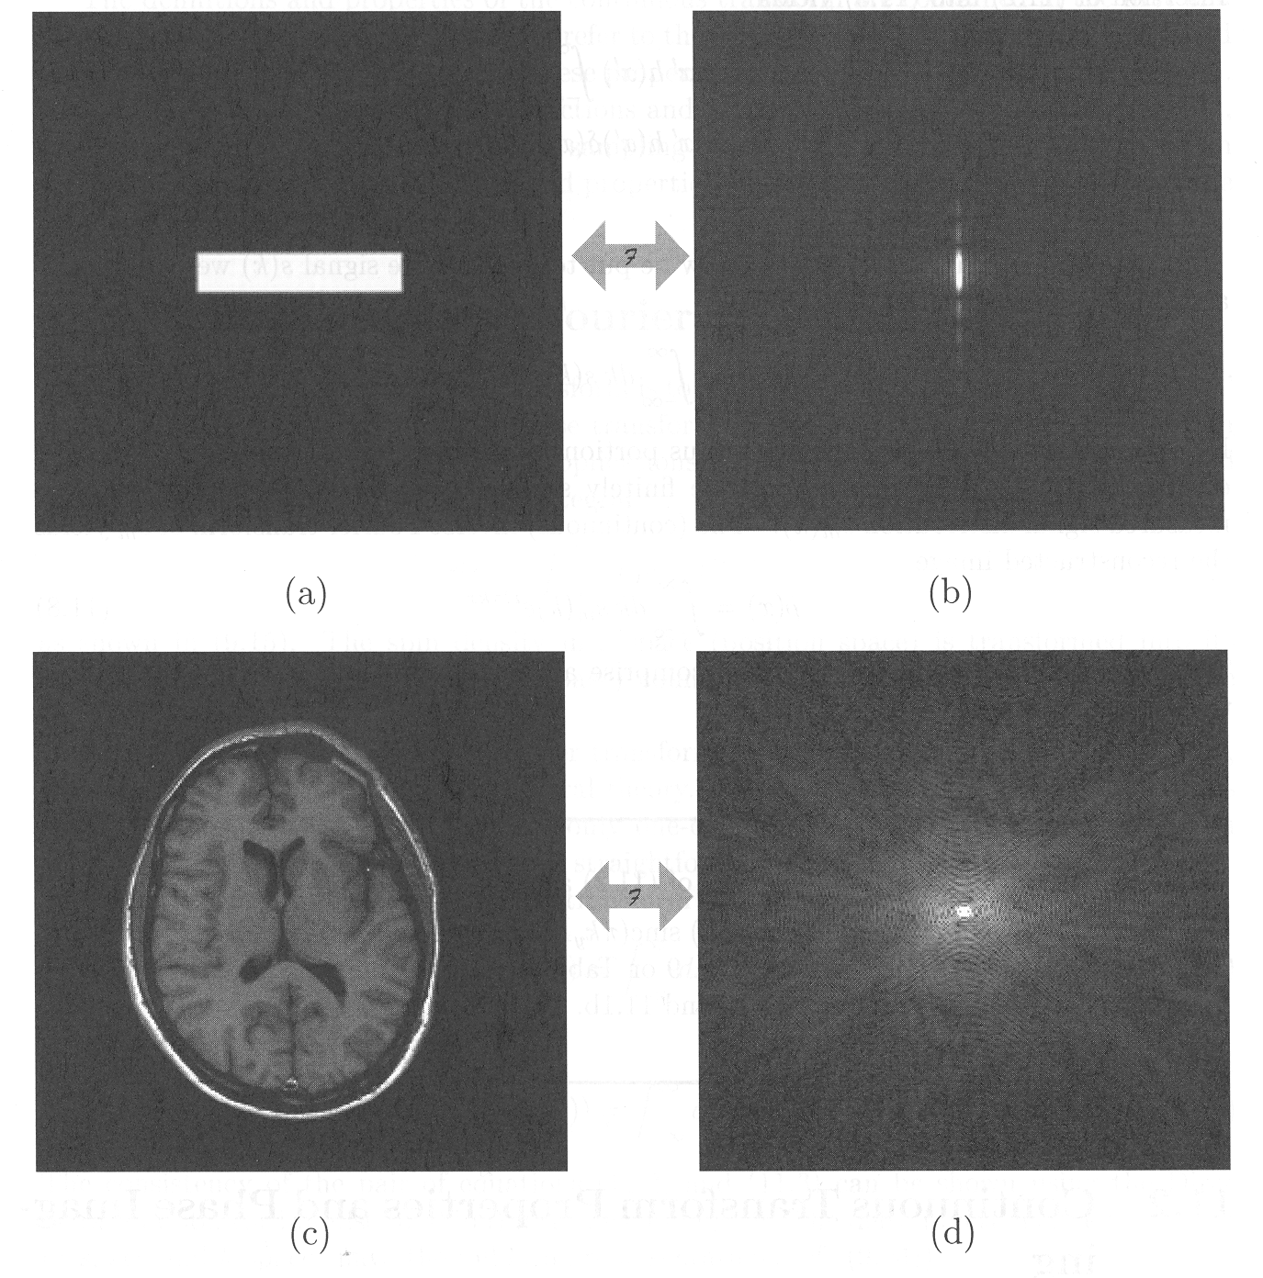
k-space and image-space
k-space & image-space are related by the 2D FT

Slide 23
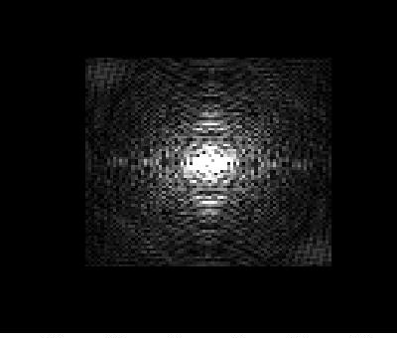
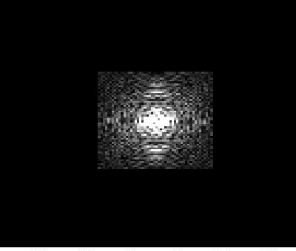
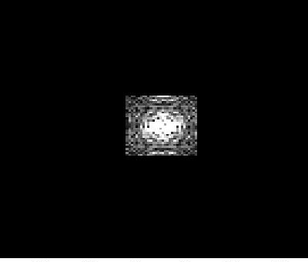

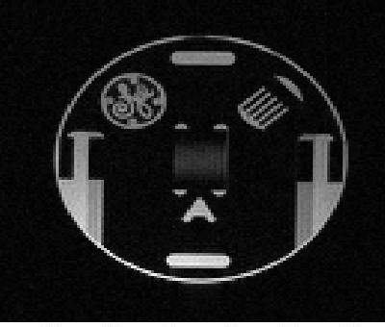
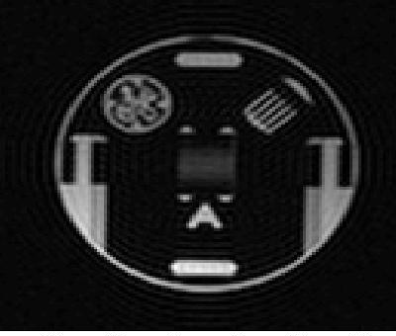

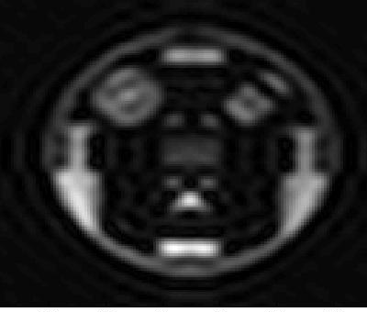
Truncation
Just as the number of frequency bands determines the highest pitch in an audio signal, the number of k-space points determines the sharpest features of an image
Truncation = sampling central part of k-space

Slide 24
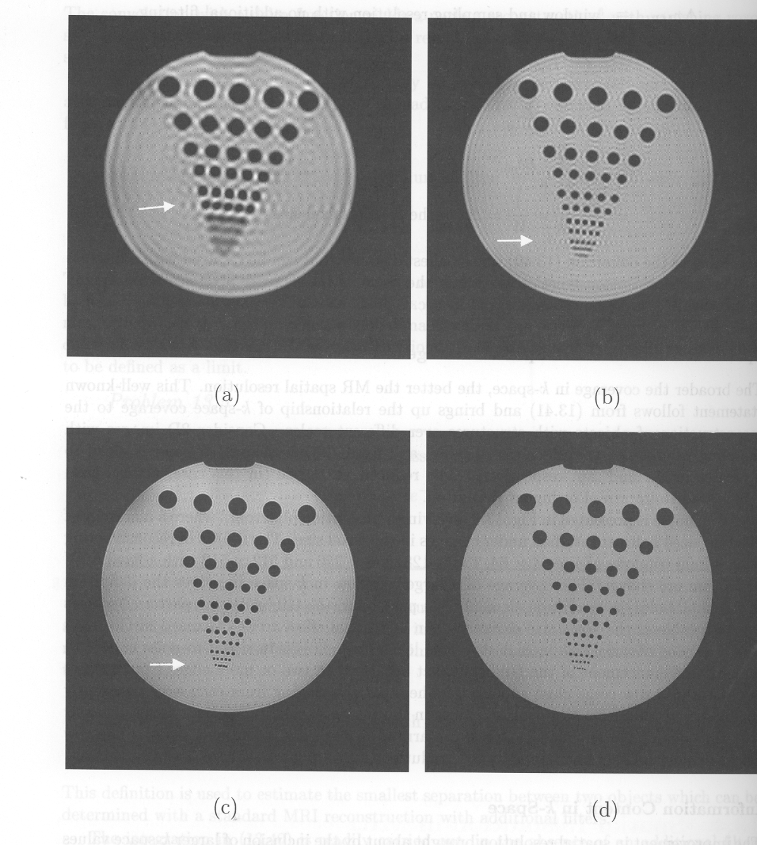
Ringing Example

Slide 25
Further Reading
Lots of reading material online
A great set of lectures given by Dr Kathy Davis at UT Austin
Homework: do at least a couple exercises from below
Basis change: http://www.ma.utexas.edu/users/davis/reu/ch2/basis/basis.pdf
Fourier Transform: http://www.ma.utexas.edu/users/davis/reu/ch2/exponentials/exponentials.pdf
FFT: http://www.ma.utexas.edu/users/davis/reu/ch2/fft/fft.pdf
FFT application to heartbeat analysis: http://www.ma.utexas.edu/users/davis/reu/ch2/heart/heart.pdf

Slide 26
Wavelet Transform
FTs are great, but they capture global features
  Harmonic components of the entire signal
  They are obtained by dot-producting the WHOLE signal
Problem1: local features can get lost
Problem2: if signal is not stationary (features change with time or in space) then this is not captured by FT
Therefore need a transform that provides frequency information LOCALLY

Slide 27
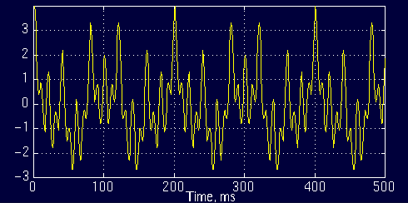
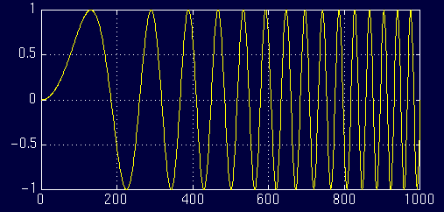
Wavelet Transforms - motivation
For example consider the following signal
x(t)=cos(2*pi*10*t)+cos(2*pi*25*t)+cos(2*pi*50*t)+cos(2*pi*100*t)
Has frequencies 10, 25, 50, and 100 Hz at any given time instant
stationary signal, FT can provide full info
Non-stationary, frequency content changes with time
FT CANNOT provide full info
http://users.rowan.edu/~polikar/WAVELETS/WTpart1.html

Slide 28
Time-frequency, time-scale analysis
What we need is a time-frequency analysis
Do FT in a local time window
generalization of local frequency
frequency
scale
Note different tiling of t-s space
Insight: time window depends on scale
time
time

Slide 29
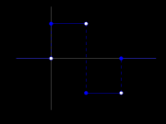
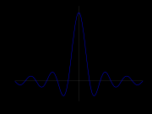
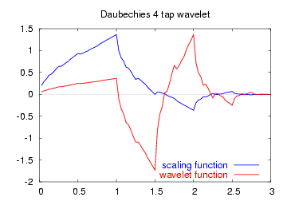
Basis functions in WT
Basis functions are called “wavelets”
Important wavelet property:
All basis functions are scaled, shifted copies of the same mother wavelet
By clever construction of mother wavelet, these scaled, shifted copies can be made either orthonormal, or at least linearly independent
Wavelets form a complete basis, and wavelet transforms are designed to be easily invertible
Online wavelet tutorial:
http://cnx.org/content/m10764/latest/
Haar
Mexican Hat
Daubechies
(orthonormal)

Slide 30
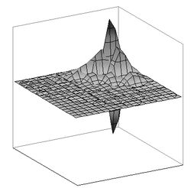
WT in images
Images are piecewise smooth or piecewise constant
Stationarity is even rarer than in 1D signals
FT even less useful (nnd WT more attractive)
2D wavelet transforms are simple extensions of 1D WT, generally performing 1D WT along rows, then columns etc
Sometimes we use 2D wavelets directly, e.g. orthonormal Daubechies 2D wavelet

Slide 31
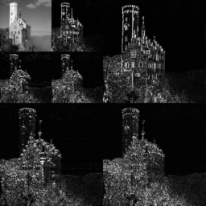
WT on images
2D generalization of scale-time decomposition
Scale 0
H
scale
Scale 1
time
Scale 2
V
H-V
Successive application of dot product with wavelet of increasing width.
Forms a natural pyramid structure. At each scale:
H = dot product of image rows with wavelet
V = dot product of image rows with wavelet
H-V = dot product of image rows then columns with wavelet

Slide 32
Wavelet Applications
Many, many applications!
Audio, image and video compression
New JPEG standard includes wavelet compression
FBI’s fingerprints database saved as wavelet-compressed
Signal denoising, interpolation, image zooming, texture analysis, time-scale feature extraction
In our context, WT will be used primarily as a feature extraction tool
Remember, WT is just a change of basis, in order to extract useful information which might otherwise not be easily seen

Slide 33
WT in MATLAB
MATLAB has an extensive wavelet toolbox
Type help wavelet in MATLAB command window
Look at their wavelet demo
Play with Haar, Mexican hat and Daubechies wavelets

Slide 34
Project Ideas
Idea 1: use WT to extract features from ECG data
  use these features for classification
Idea 2: use 2D WT to extract spatio-temporal features from 3D+time MRI data
  to detect tumors / classify benign vs malignant tumors
Idea 3: use 2D WT to denoise a given image

Slide 35
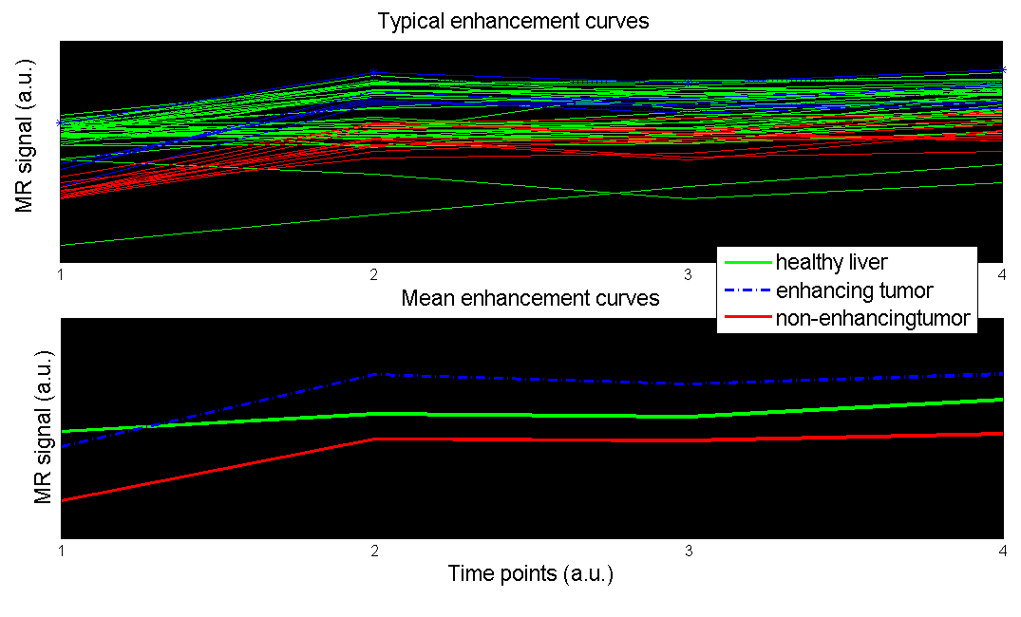
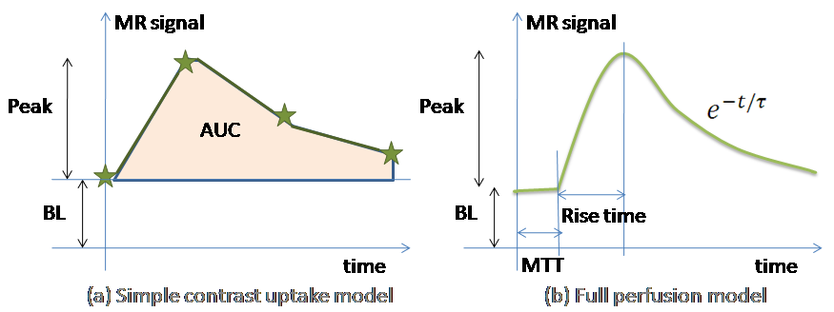
Idea 3: Voxel labeling from contrast-enhanced MRI
Can segment according to time profile of 3D+time contrast enhanced MR data of liver / mammography
Temporal models used to extract features
Typical plot of time-resolved MR signal of various tissue classes
  Instead of such a simple temporal model, wavelet decomposition could provide spatio-temporal features that you can use for clustering

Slide 36
Liver tumour quantification from DCE-MRI

Slide 37
Further Reading on Wavelets
A Linear Algebra view of wavelet transform
http://www.bearcave.com/misl/misl_tech/wavelets/matrix/index.html
Wavelet tutorial
http://users.rowan.edu/~polikar/WAVELETS/WTpart1.html
http://users.rowan.edu/~polikar/WAVELETS/WTpart2.html
http://users.rowan.edu/~polikar/WAVELETS/WTpart3.html
Wavelets application to EKG R wave detection: http://www.ma.utexas.edu/users/davis/reu/ch3/wavelets/wavelets.pdf

Slide 38
Lecture 5: Transforms, Fourier and Wavelets
Ashish Raj, PhD
Image Data Evaluation and Analytics Laboratory (IDEAL)
Department of Radiology
Weill Cornell Medical College
New York
Email: ashish@med.cornell.edu
Office: Rhodes Hall Room 528
Website: www.ideal-cornell.com

