Slide 1
CS5540: Computational Techniques for Analyzing Clinical Data
Prof. Ramin Zabih (CS)
Prof. Ashish Raj (Radiology)

Slide 2
Administrivia
We’re going to try to end class by 2:25
Like the registrar believes
Sign up online!

Slide 3
Preview of Project #1
Shockable | Non shockable

Slide 4
Algorithms
Dynamic programming
Graph algorithms, esp. min cut
Fitting via least squares & its variants
Gradient descent, conjugate gradient, PCG
k-NN, SVM classification

Slide 5
Today’s topics
General methods for analyzing 1D data
Like an ECG
General (as opposed to model-based) techniques are usually more successful
Today we will look at finding the cycles and the pulses

Slide 6
Cycles and pulses
Cycle
Pulse
www.uptodate.com
Note: cycle is standard terminology, but pulse is not. The ECG literature calls these “waves” but we want to be more general than just ECG.

Slide 7
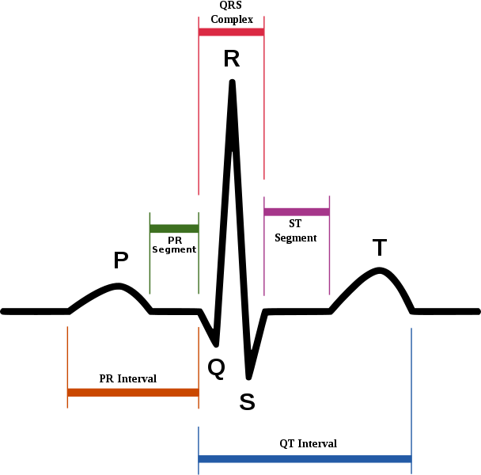
Ideal pulses: P, Q, R, S, T

Slide 8
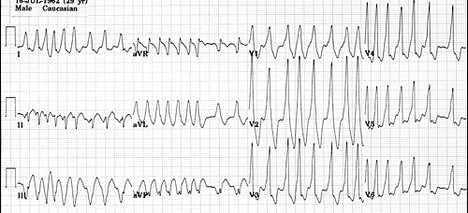
Why a general method??

Slide 9
Ideas?
Let’s try to find the places where the ECG goes above or below its baseline
Almost all medical measurements are in physical units, which is unusual
In a picture, someone’s smile might be 100 pixels wide
How big is a pixel??

Slide 10
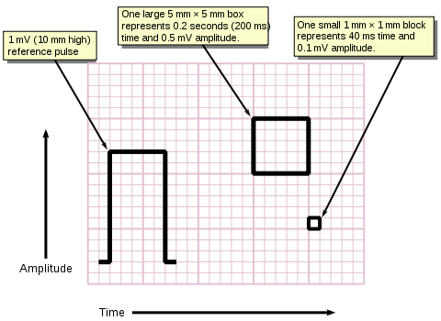
ECG graph paper

Slide 11
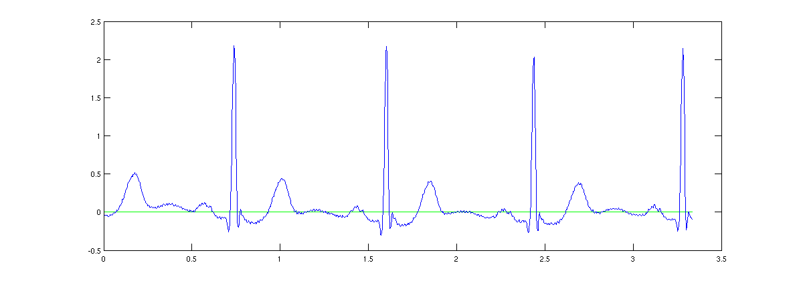
Strategy
Find the long-term trend (0 for ECG) and detect when the ECG crosses this value
This looks too simple.
It is too simple.

Slide 12
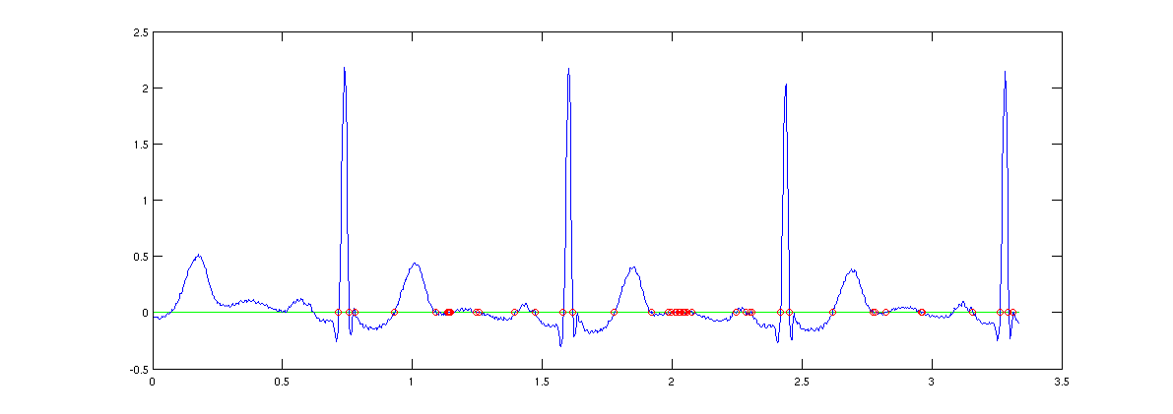
The problem

Slide 13
What is going wrong?
If we look closely the data has a lot of small “wiggles” in it
Usually called “noise”
There are technical uses of the term, but in practice it means small unmodeled variations
Why do you see this in ECG data?

Slide 14
Idea: local averaging
The obvious way to solve this problem, which turns out to be remarkably powerful
Summary: replace every data point by the average with its two neighbors
out[t] = 1/3 in[t-1] + 1/3 in[t] + 1/3 in[t+1]
Example: [… 10 11 9 13…] => [… 10 11 …]
We can write this as a stencil [1/3 1/3 1/3] which is applied to the sequence
At every point, multiply each neighbor by the stencil’s value
Wider average: [1/5 1/5 1/5 1/5 1/5]

Slide 15
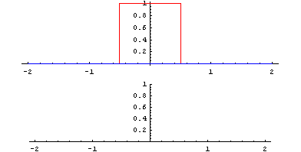
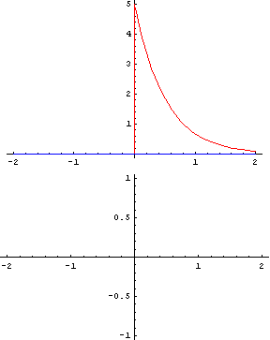
Local averaging in action

Slide 16
Convolution
This idea (generalized to arbitrary stencils) is called convolution
Procedurally, it is totally trivial
Remarkably useful and deep
Useful both for smoothing but also for finding things of known shape
Such as, e.g., a (normal) ECG pulse
Not a panacea, but a vital tool

Slide 17
Convolution for smoothing
The standard way to remove noise is by convolution with a Gaussian (“bell curve”)
Colloquially called a “low pass filter”
Why a Gaussian?
If you really care, the central limit theorem plus a few other important properties
It also generally works pretty well

Slide 18
Parameters
How wide an average do you need?
This is not remotely obvious, and there aren’t any great ideas about it
More annoyingly, it makes a huge impact on practical performance
Too little smoothing means too many zero crossings (like original data)
Too much smoothing means whole ECG it completely blurred out
Can only see cycles, not peaks!

Slide 19
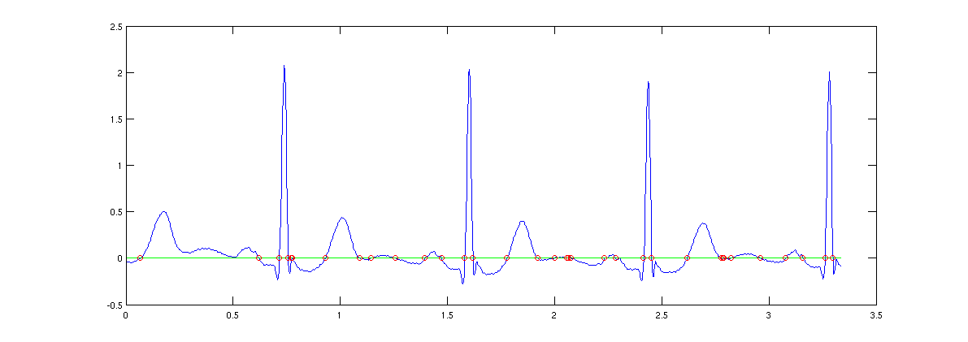
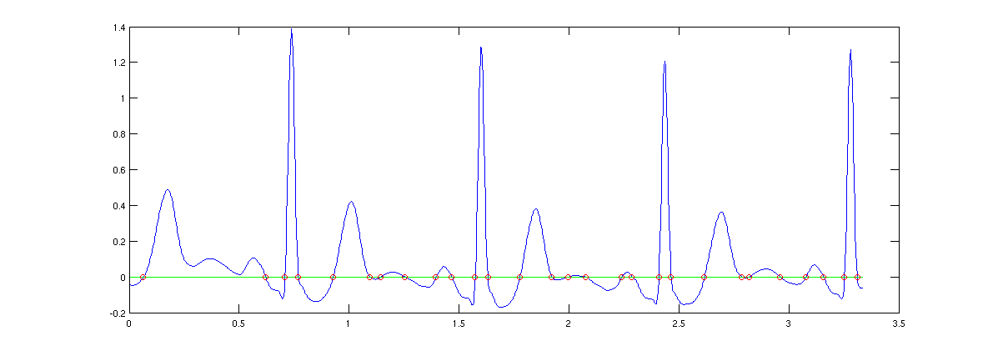
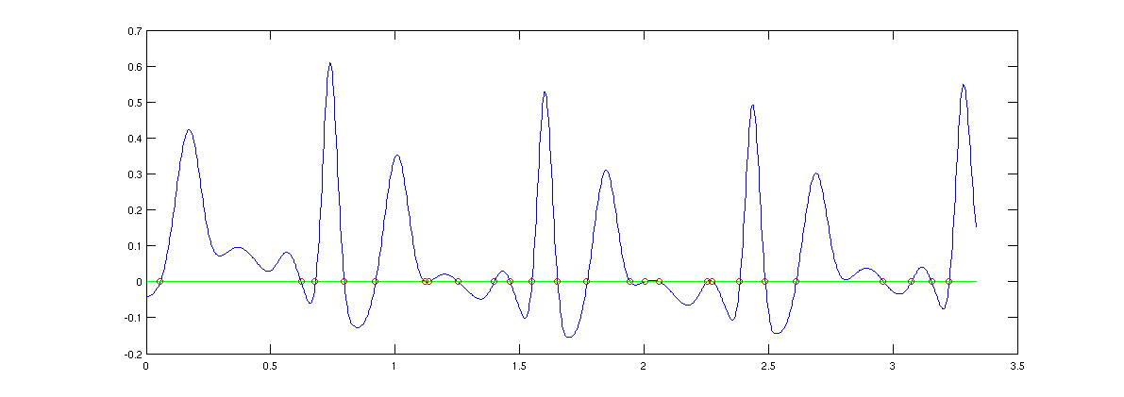
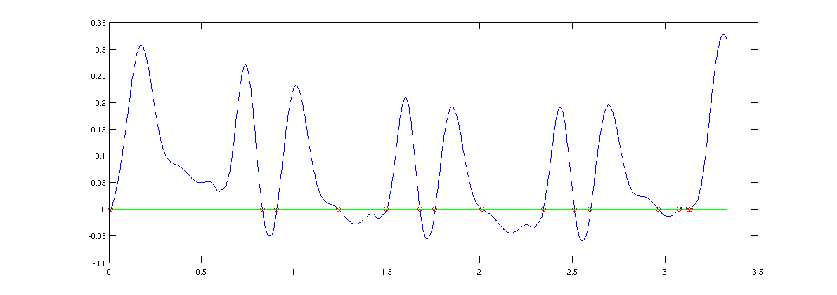
Smoothing parameter effects

Slide 20
Matched filters
Convolution can be used to find pulses
This is actually closely related to smoothing
Ashish’s talk on Friday mentioned a few applications of this to images
How do we find a known pulse in an ECG? Convolve the ECG with our template!
E.g. to find something in the ECG that looks like [1 6 -10] we convolve with [1 6 -10]
Question: what sense does this make?
Anecdotally it worked for finding boxes

Slide 21
Box finding example

Slide 22
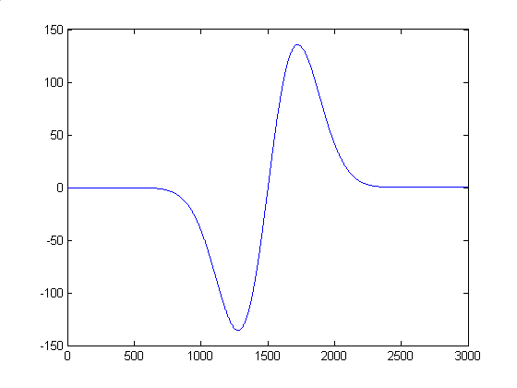
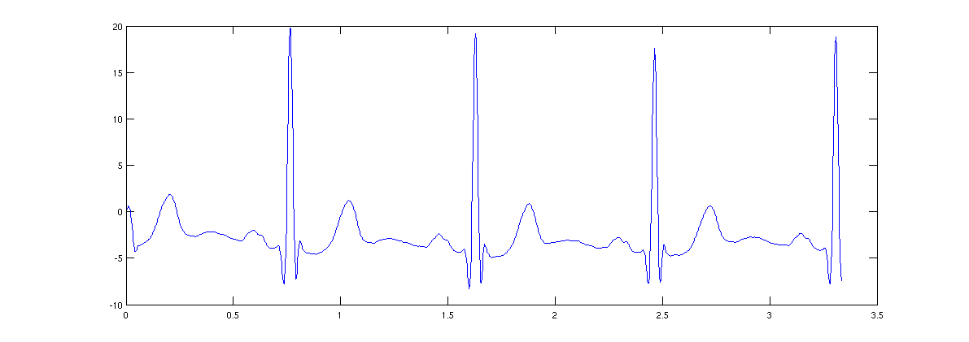
Pulse finding example

Slide 23
Why does this work?
Some nice optimality properties, but the way I described it, the algorithm fails
Idea: the [1 6 -10] template gives biggest response when signal is [… 1 6 -10 …]
Value is 137 at this point
But is this actually correct?
You actually need both the template and the ECG to have a zero mean and unit energy (sum of squares)
Easily accomplished: subtract -1, then divide by 137, get 1/137 * [2 7 -9]

Slide 24
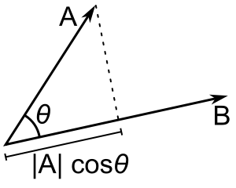
Geometric intuition
Taking the dot product of two vectors
Recall [a b c][e f g] = ae + bf + cg
Basically the projection of a vector on another
The normalized vector with the biggest projection on x is, of course: x!

