Slide 1
CS5540: Computational Techniques for Analyzing Clinical Data Lecture 17: Dynamic MRI Image Reconstruction
Ashish Raj, PhD
Image Data Evaluation and Analytics Laboratory (IDEAL)
Department of Radiology
Weill Cornell Medical College
New York

Slide 2
Parallel Imaging For Dynamic Images
Maximum a posteriori reconstruction for dynamic images, using Gaussian prior on the dynamic part: MAP-SENSE
MAP reconstruction under smoothness priors time: k-t SESNE
MAP recon under sparsity priors in x-f space

Slide 3
Dynamic images:
What is the right imaging model?
y(t) = H x(t) + n(t), n is Gaussian (1)
y(t) = H x(t) + n(t), n Gaussian around 0,
x Gaussian around mean image (2)
y(t) = H x(t) + n(t), n is Gaussian,
x is smooth in time (3)
y(t) = H x(t) + n(t), n is Gaussian,
x is smooth in x-t, space, sparse in k-f space
x is sparse in x-f space (4)
SENSE
MAP Sense
Generalized series, RIGR, TRICKS
K-t SENSE
compressed sensing
Notes:
Now, if you take a horizontal line and look at the intensity profile, it is reasonable to assume that artery is brighter than background within each scan line

Slide 4
“MAP-SENSE” –
Maximum A Posteriori Parallel Reconstruction Under Sensitivity Errors
MAP-Sense : optimal for Gaussian distributed images
Like a spatially variant Wiener filter
But much faster, due to our stochastic MR image model

Slide 5
Recall: Bayesian Estimation
Bayesian methods maximize the posterior probability:
Pr(x|y) ∝ Pr(y|x) . Pr(x)
Pr(y|x) (likelihood function) = exp(- ||y-Hx||²)
Pr(x) (prior PDF) = Gaussian prior:
Pr(x) = exp{- ½ x^{T} R_{x}⁻¹ x}
MAP estimate:
x_{est} = arg min ||y-Hx||² + G(x)
MAP estimate for Gaussian everything is known as Wiener estimate

Slide 6
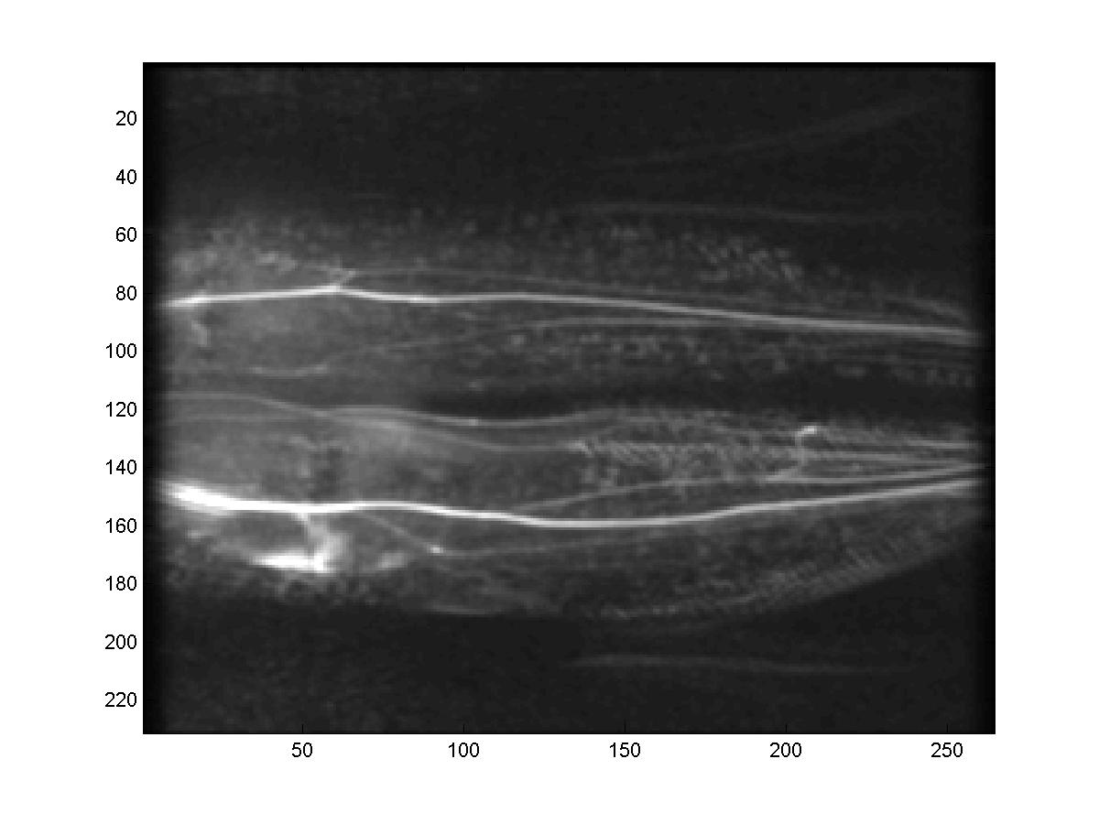
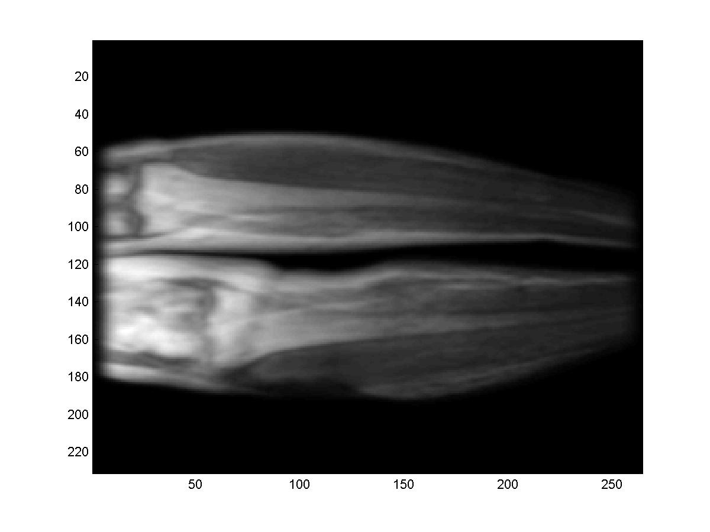
Spatial Priors For Images - Example
Frames are tightly distributed around mean
After subtracting mean, images are close to Gaussian
variance
mean
frame 1
frame 2
time
frame N_{f}
mean μ_{x}(i,j)
envelope a(i,j)
Prior: -mean is μ_{x}
-local std.dev. varies as a(i,j)

Slide 7
Spatial Priors for MR images
stationary
process
Stochastic MR image model:
x(i,j) = μ_{x} (i,j) + a(i,j) . (h ** p)(i,j) (1)
** denotes 2D convolution
μ_{x} (i,j) is mean image for class
p(i,j) is a unit variance i.i.d. stochastic process
a(i,j) is an envelope function
h(i,j) simulates correlation properties of image x
x = ACp + μ (2)
where A = diag(a) , and C is the Toeplitz matrix generated by h
Can model many important stationary and non-stationary cases

Slide 8
MAP estimate for Imaging Model (3)
The Wiener estimate
x_{MAP} - μ _{x} = HR_{x} (HR_{x}H^{H} + R_{n})⁻¹ (y- μ _{y}) (3)
R_{x}, R_{n} = covariance matrices of x and n

Slide 9
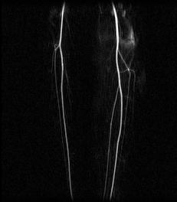
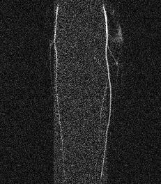
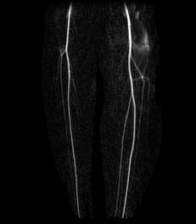
MAP-SENSE Preliminary Results
Scans acceleraty 5x
The angiogram was computed by:
avg(post-contrast) – avg(pre-contrast)
Unaccelerated
5x faster: SENSE
5x faster: MAP-SENSE

Slide 10
Dynamic images:
What is the right imaging model?
y(t) = H x(t) + n(t), n is Gaussian (1)
y(t) = H x(t) + n(t), n Gaussian around 0,
x Gaussian around mean image (2)
y(t) = H x(t) + n(t), n is Gaussian,
x is smooth in time (3)
y(t) = H x(t) + n(t), n is Gaussian,
x is smooth in x-t, space, sparse in k-f space
x is sparse in x-f space (4)
SENSE
MAP Sense
Generalized series, RIGR, TRICKS
K-t SENSE
compressed sensing
Notes:
Now, if you take a horizontal line and look at the intensity profile, it is reasonable to assume that artery is brighter than background within each scan line

Slide 11
“k-t SENSE” –
Maximum A Posteriori Parallel Reconstruction Under smoothness of images in x-t space (ie sparsity in k-f space)
Exploits the smoothness of spatio-temporal signals
➔ sparseness (finite support ) in k-f space
The k-f properties deduced from low spatial frequency training data
Then the model is applied to undersampled acquisition
Jeffrey Tsao, Peter Boesiger, and Klaas P. Pruessmann. k-t BLAST and k-t SENSE: Dynamic MRI With High Frame Rate Exploiting Spatiotemporal Correlations. Magnetic Resonance in Medicine 50:1031–1042 (2003)

Slide 12
K-t SENSE: Sparsity in k-F space
space
time
time
K-t Sampling scheme
PSF
k_{y}
y
t
f
By formulating the x-f sparsity model as a prior distribution, we can think of k-t SENSE as a Bayesian method!

Slide 13
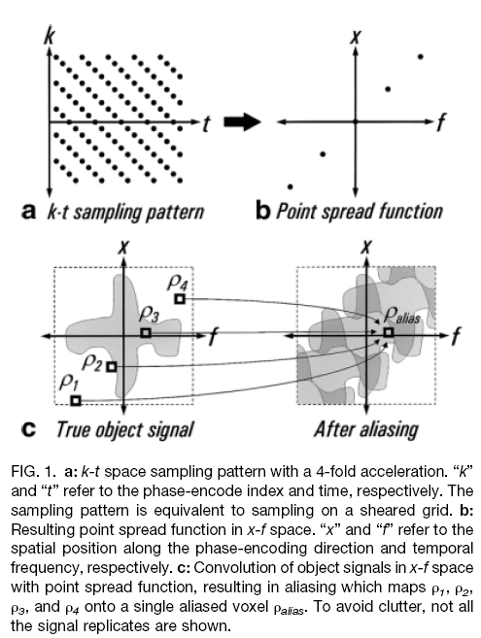
Tsao et al, MRM03

Slide 14
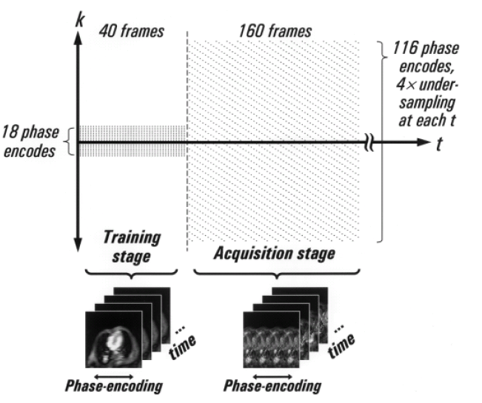
“kT-SENSE” –
2 stages of scanning: training and acquisition

Slide 15
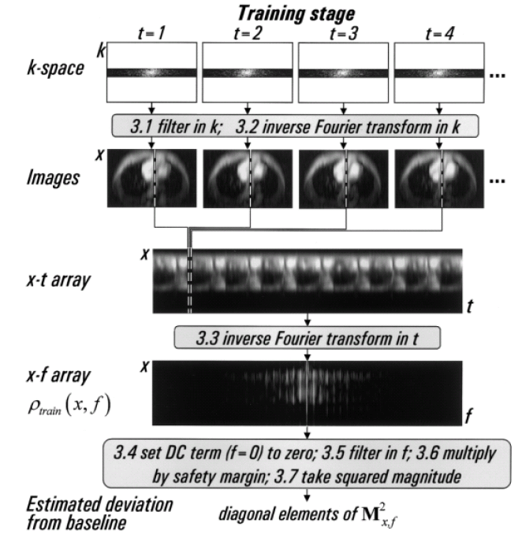
Processing steps of Training stage

Slide 16
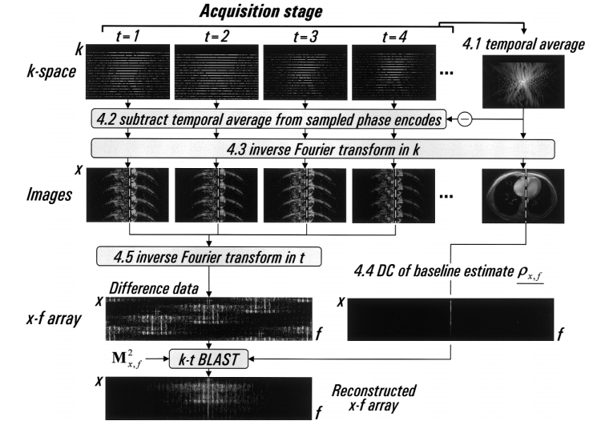
Processing steps of Acquisition stage

Slide 17
Possible neuroimaging applications
All modalities are applicable, but esp. ones that are time-sensitive
Perfusion, flow, DTI, etc
Accelerating Cine Phase-Contrast Flow Measurements Using k-t BLAST and k-t SENSE. Christof Baltes, Sebastian Kozerke, Michael S. Hansen, Klaas P. Pruessmann, Jeffrey Tsao, and Peter Boesiger. Magnetic Resonance in Medicine 54:1430–1438 (2005)

Slide 18
Dynamic images:
y(t) = H x(t) + n(t), n is Gaussian (1)
y(t) = H x(t) + n(t), n Gaussian around 0,
x Gaussian around mean image (2)
y(t) = H x(t) + n(t), n is Gaussian,
x is smooth in time (3)
y(t) = H x(t) + n(t), n is Gaussian,
x is smooth in x-t, space, sparse in k-f space
x is sparse in x-f space (4)
SENSE
MAP Sense
Generalized series, RIGR, Generalized Series, TRICKS
D Xu, L Ying, ZP Liang, Parallel generalized series MRI: algorithm and application to cancer imaging. Engineering in Medicine and Biology Society, 2004. IEMBS'04
K-t SENSE
compressed sensing
Notes:
Now, if you take a horizontal line and look at the intensity profile, it is reasonable to assume that artery is brighter than background within each scan line

Slide 19
References
Overview
Ashish Raj. Improvements in MRI Using Information Redundancy. PhD thesis, Cornell University, May 2005.
Website: http://www.cs.cornell.edu/~rdz/SENSE.htm
SENSE
(1) Pruessmann KP, Weiger M, Scheidegger MB, Boesiger P. SENSE: Sensitivity Encoding For Fast MRI. Magnetic Resonance in Medicine 1999; 42(5): 952-962.
(2) Pruessmann KP, Weiger M, Boernert P, Boesiger P. Advances In Sensitivity Encoding With Arbitrary K-Space Trajectories. Magnetic Resonance in Medicine 2001; 46(4):638--651.
(3) Weiger M, Pruessmann KP, Boesiger P. 2D SENSE For Faster 3D MRI. Magnetic Resonance Materials in Biology, Physics and Medicine 2002; 14(1):10-19.

Slide 20
References
ML-SENSE
Raj A, Wang Y, Zabih R. A maximum likelihood approach to parallel imaging with coil sensitivity noise. IEEE Trans Med Imaging. 2007 Aug;26(8):1046-57
EPIGRAM
Raj A, Singh G, Zabih R, Kressler B, Wang Y, Schuff N, Weiner M. Bayesian Parallel Imaging With Edge-Preserving Priors. Magn Reson Med. 2007 Jan;57(1):8-21
Regularized SENSE
Lin F, Kwang K, BelliveauJ, Wald L. Parallel Imaging Reconstruction Using Automatic Regularization. Magnetic Resonance in Medicine 2004; 51(3): 559-67

Slide 21
References
Generalized Series Models
Chandra S, Liang ZP, Webb A, Lee H, Morris HD, Lauterbur PC. Application Of Reduced-Encoding Imaging With Generalized-Series Reconstruction (RIGR) In Dynamic MR Imaging. J Magn Reson Imaging 1996; 6(5): 783-97.
Hanson JM, Liang ZP, Magin RL, Duerk JL, Lauterbur PC. A Comparison Of RIGR And SVD Dynamic Imaging Methods. Magnetic Resonance in Medicine 1997; 38(1): 161-7.
Compressed Sensing in MR
M Lustig, L Donoho, Sparse MRI: The application of compressed sensing for rapid mr imaging. Magnetic Resonance in Medicine. v58 i6

Slide 22
CS5540: Computational Techniques for Analyzing Clinical Data Lecture 15: MRI Image Reconstruction
Ashish Raj, PhD
Image Data Evaluation and Analytics Laboratory (IDEAL)
Department of Radiology
Weill Cornell Medical College
New York

