Slide 1
CS5540: Computational Techniques for Analyzing Clinical Data
Lecture 15:
Accelerated MRI Image Reconstruction
Ashish Raj, PhD
Image Data Evaluation and Analytics Laboratory (IDEAL)
Department of Radiology
Weill Cornell Medical College
New York

Slide 2
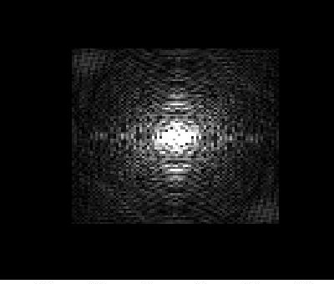
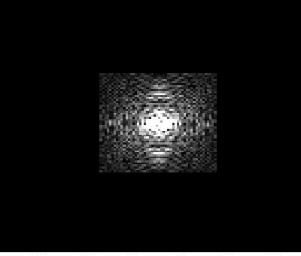
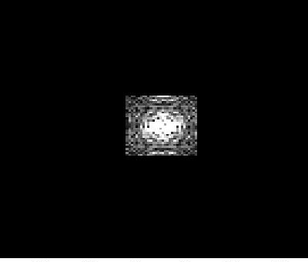

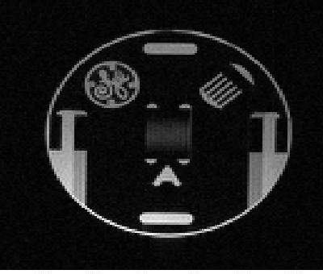
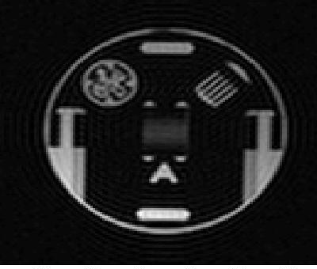

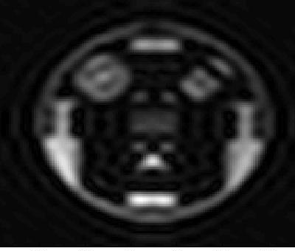
Truncation
Can make MRI faster by sampling less of k-space
Truncation = sampling central part of k-space
Recon = super-resolution (extrapolating k-space)
Very hard, no successful method yet

Slide 3
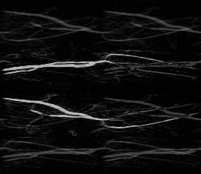
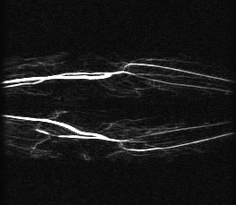
Parallel imaging
Under-sampled k-space
Reconstructed k-space
Under-sampled k-space
ky
ky
kx
kx
Notes:
Delete if not Ashish

Slide 4

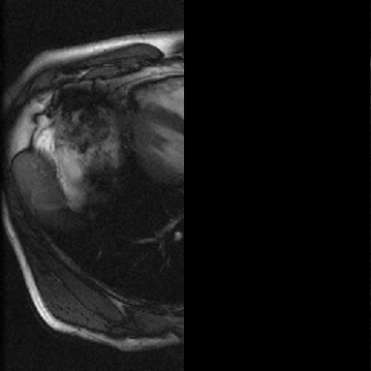
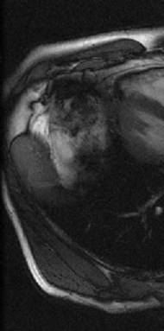
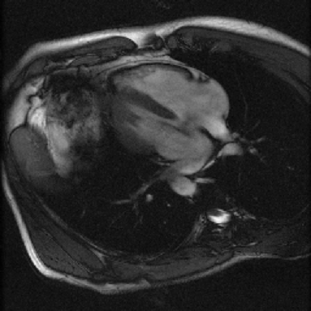
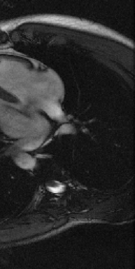

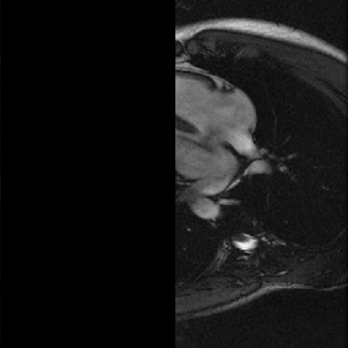
Different coil responses help
Coil #1 response
Coil #1 output
aliasing
=
→
x
x
=
→
aliasing
Coil #2 response
Coil #2 output
Notes:
Probably delete

Slide 5
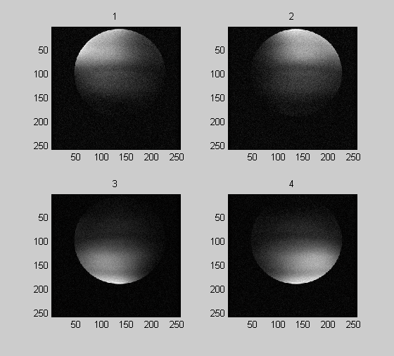
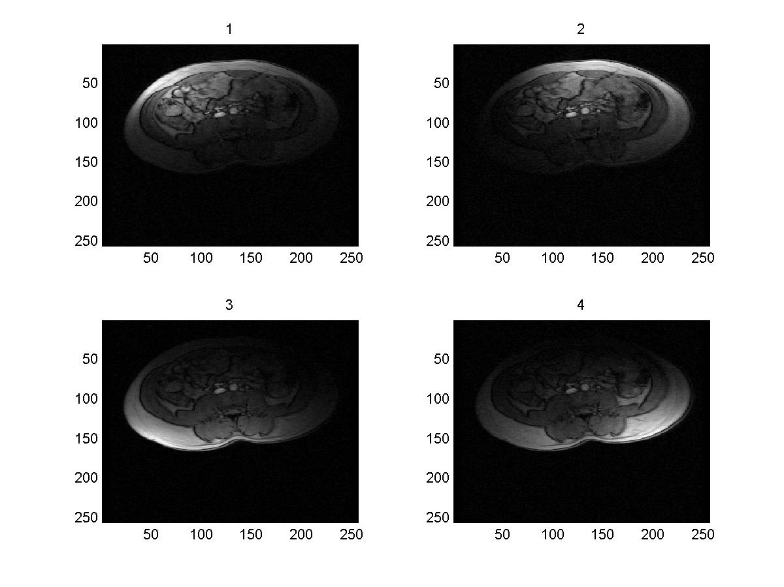
Parallel imaging with real coils
Imaging target

Slide 6



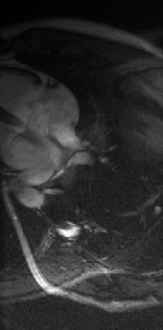
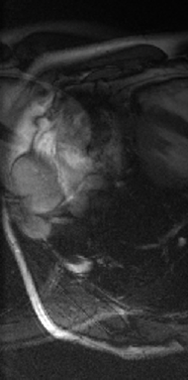
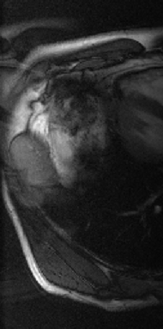
y₁(p)
y₂(p)
y₃(p)
s₁(q)
s₃(p)
s₂(p)
s₂(q)
s₃(q)
s₁(p)
x(p)
x(q)

Slide 7
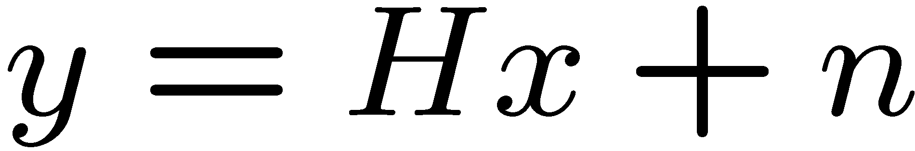

Least squares solution
Least squares estimate:
  Famous MR algorithm: SENSE (1999)
Linear inverse system
Encodes different
Coil outputs
Notes:
Delete this?

Slide 8
Maximum a Posteriori (Bayesian) Estimate
Consider the class of linear systems y = Hx + n
Bayesian methods maximize the posterior probability:
Pr(x|y) ∝ Pr(y|x) . Pr(x)
Pr(y|x) (likelihood function) = exp(- ||y-Hx||²)
Pr(x) (prior PDF) = exp(-G(x))
Non-Bayesian: maximize only likelihood
x_{est} = arg min ||y-Hx||²
Bayesian:
x_{est} = arg min ||y-Hx||² + G(x) ,
where G(x) is obtained from the prior distribution of x
If G(x) = ||Gx||² ➔ Tikhonov Regularization

Slide 9

Maximum a Posteriori (Bayesian) Estimate = Energy Minimization
Since parallel imaging is ill-posed, we need a stabilizing term
Makes x smooth or piecewise smooth
Makes Hx close to y
This has a nice Bayesian interpretation
  Likelihood of x, assuming iid Gaussian noise, is
  Write an arbitrary prior distribution on x as
Then we get above energy minimization!
Questions: What should G be? How do we minimize E?
Notes:
Needs work

Slide 10
Correct Prior Model Depends on Imaging Situation
Temporal priors: smooth time-trajectory
Sparse priors: L0, L1, L2 (=Tikhonov)
Spatial Priors: most powerful for static images
For static images we recommend robust spatial priors using Edge-Preserving Priors (EPPs)
For dynamic images, we can use smoothness and/or sparsity in x-f space

Slide 11
EPIGRAM:Edge-preserving Parallel Imaging Using Graph Cut Minimization
Joint work with: Ramin Zabih, Gurmeet Singh

Slide 12
MRI Reconstruction Using Graph Cuts
A new graph-based algorithm *
Inspired by advanced robotic vision, computer science
Folded MR data
Reconstructed image
Graph
S
T
Operations on this graph produce reconstructed image!
Raj et al, Magnetic Resonance in Medicine, Jan 2007,
Raj et al, Computer Vision and Pattern Recognition, 2006

Slide 13
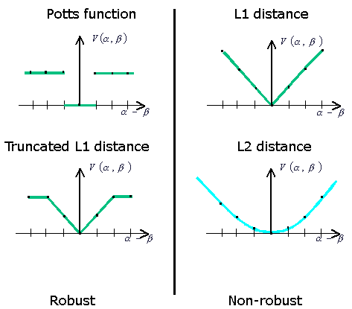
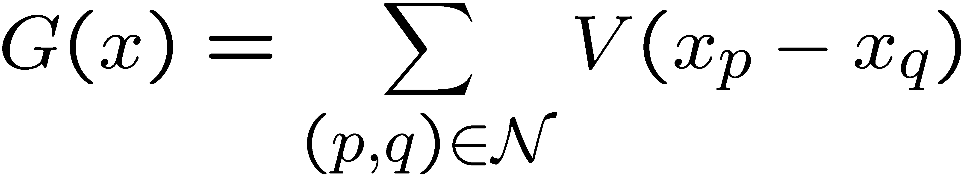
Use Edge-preserving Spatial Penalty
Finds the MAP estimate
Makes Hx close to y
Makes x piecewise smooth
Used Markov Random Field priors
  If V “levels off”, this preserves edges

Slide 14
Examples of distance metrics
Discontinuous, non-convex metric
This is very hard for traditional minimization algorithms

Slide 15
Expansion move algorithm
Original minimization problem is turned into a series of discrete (binary) problems, called EXPANSION MOVES
Input labeling f
_{Green expansion move from f}
  Find green expansion move that most decreases E
    Move there, then find the best blue expansion move, etc
    Done when no α-expansion move decreases the energy, for any label α

Slide 16
Graph Cut minimization
Used Graph Cut technique – a combinatorial optimization method which can solve for non-convex energy functions
Original minimization problem is turned into a series of discrete (binary) problems, called EXPANSION MOVES
Each expansion move is a binary energy minimization problem, call it B(b)
This binary problem is solved by graph cut
Builds a graph whose nodes are image pixels, and whose edges have weights obtained from the energy terms in B(b)
Minimization of B(b) is reduced to finding the minimum cut of this graph
Raj A, Singh G, Zabih R, Kressler B, Wang Y, Schuff N, Weiner M. Bayesian Parallel Imaging With Edge-Preserving Priors. Magn Reson Med. 2007 Jan;57(1):8-21

Slide 17

Binary sub-problem
Input labeling
Expansion move
Binary image

Slide 18
Minimum cut problem
a cut C
Min cut problem:
  Find the cheapest way to cut the edges so that the “source” is separated from the “sink”
  Cut edges going from source side to sink side
  Edge weights now represent cutting “costs”
“source”
“sink”
S
T
A graph with two terminals
Mincut = binary assignment
(source=0, sink=1)

Slide 19
Line Search vs Graph Cut Minimization
Line search vs. global min over 2^{n} candidate points
Vertices of an n-hypercube
Global minima over candidate points, regardless of convexity and local minima!

Slide 20
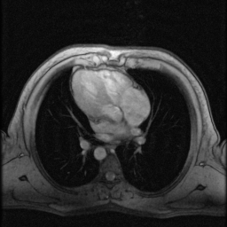
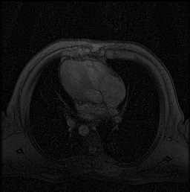
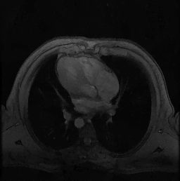
In vivo data
Unaccelerated image
Accelerated X3,
SENSE reconstruction
Accelerated X3,
Graph cuts reconstruction

Slide 21
Unaccelerated

Slide 22
Accelerated X3, SENSE reconstruction

Slide 23
Accelerated X3,Graph cuts reconstruction

Slide 24
Unaccelerated

Slide 26
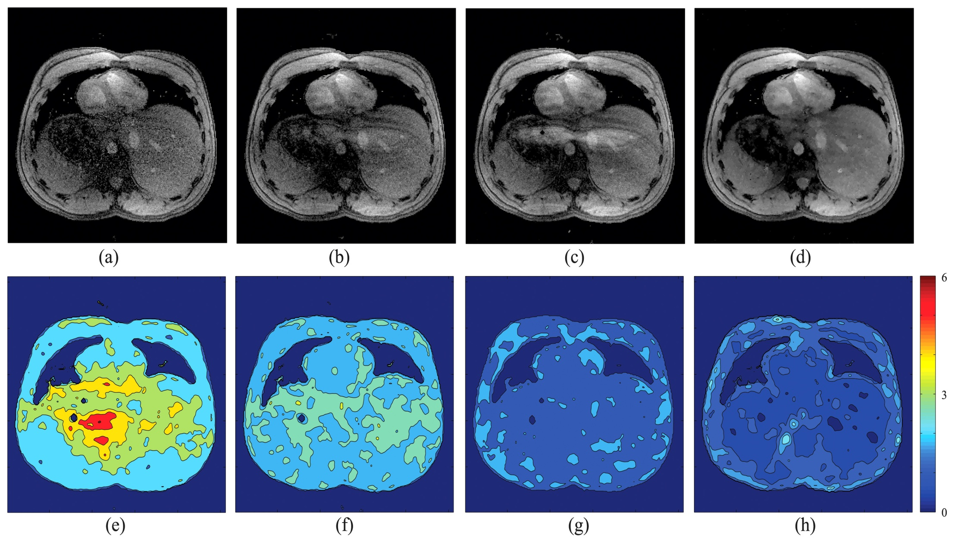
Comparison with SENSE
SENSE μ = 0.1
SENSE μ = 0.3
SENSE μ = 0.6
EPIGRAM

Slide 27
In vivo results - SNR
R
Reg SENSE
EPIGRAM
mean SNR
Mean g
Mean SNR
Mean g
Brain A
4
8
4.6
23
1.7
Brain B
5
10
3.5
17
2.2
Cardiac A
3
20
2.3
33
1.5
Cardiac B
3
15
3.3
36
1.4

Slide 28
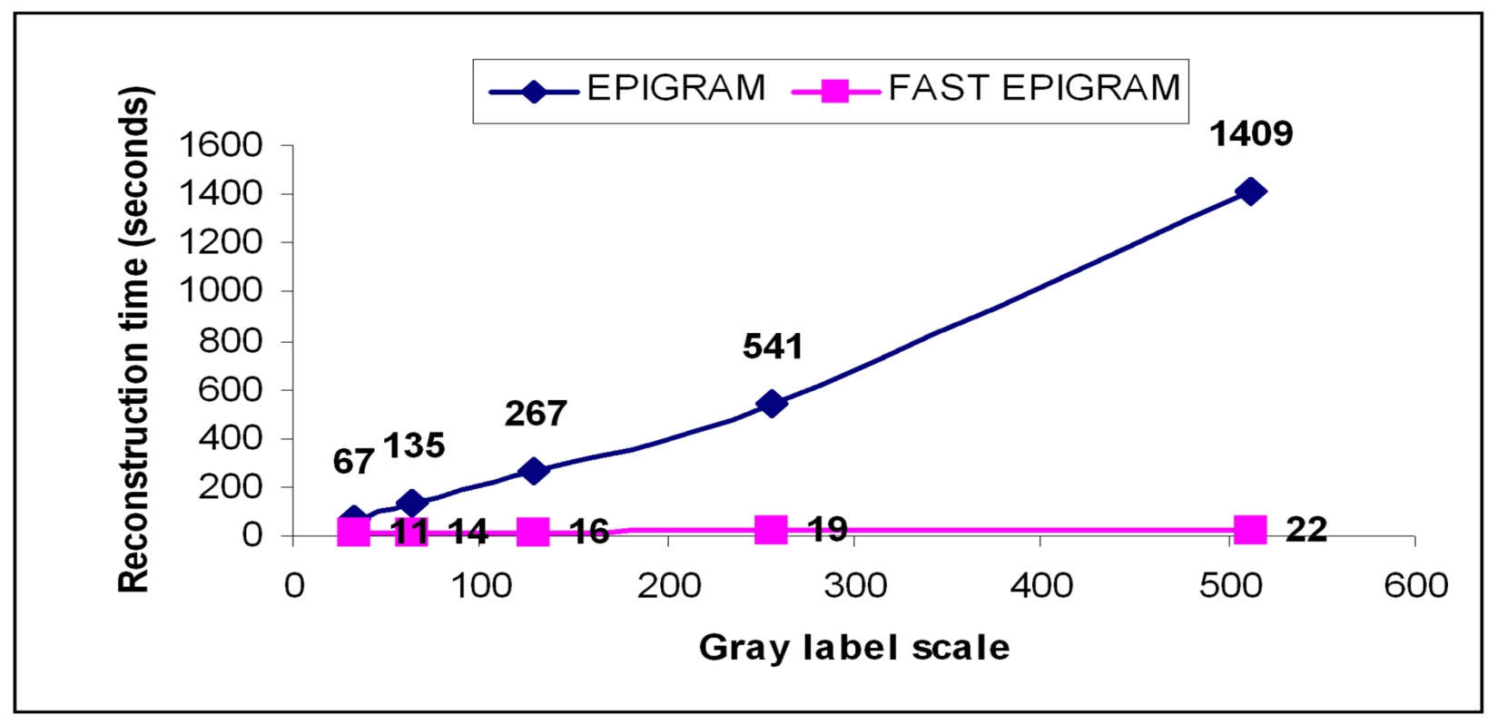
New Algorithm:
Fast EPIGRAM – uses “jump moves” rather than “expansion moves”
  Up to 50 times faster!
New, Faster Graph Cut Algorithm: Jump Moves
Reconstruction time of EPIGRAM (alpha expansion) vs Fast EPIGRAM (jump move)
- after 5 iterations over [32, 64, 128, 256, 512] gray scale labels
- image size 108x108 pixels.
Linear versus exponential growth in in reconstruction time

Slide 29
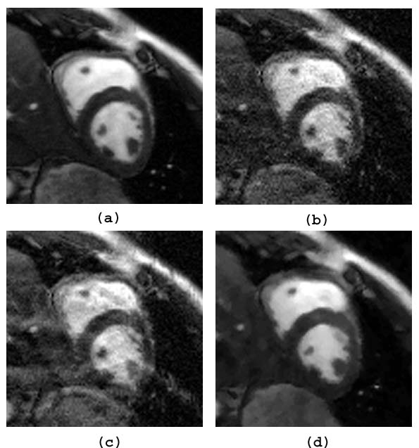
Jump Move Results: Cardiac Imaging, R=4
reconstruction for cine SSFP at R = 4
Reference:
Sum of squares
Regularized SENSE
(μ = 0.1)
Regularized SENSE
(μ = 0.5)
Fast EPIGRAM

Slide 30
References
Overview
Ashish Raj. Improvements in MRI Using Information Redundancy. PhD thesis, Cornell University, May 2005.
Website: http://www.cs.cornell.edu/~rdz/SENSE.htm
SENSE
(1) Pruessmann KP, Weiger M, Scheidegger MB, Boesiger P. SENSE: Sensitivity Encoding For Fast MRI. Magnetic Resonance in Medicine 1999; 42(5): 952-962.
(2) Pruessmann KP, Weiger M, Boernert P, Boesiger P. Advances In Sensitivity Encoding With Arbitrary K-Space Trajectories. Magnetic Resonance in Medicine 2001; 46(4):638--651.
(3) Weiger M, Pruessmann KP, Boesiger P. 2D SENSE For Faster 3D MRI. Magnetic Resonance Materials in Biology, Physics and Medicine 2002; 14(1):10-19.

Slide 31
References
ML-SENSE
Raj A, Wang Y, Zabih R. A maximum likelihood approach to parallel imaging with coil sensitivity noise. IEEE Trans Med Imaging. 2007 Aug;26(8):1046-57
EPIGRAM
Raj A, Singh G, Zabih R, Kressler B, Wang Y, Schuff N, Weiner M. Bayesian Parallel Imaging With Edge-Preserving Priors. Magn Reson Med. 2007 Jan;57(1):8-21
Regularized SENSE
Lin F, Kwang K, BelliveauJ, Wald L. Parallel Imaging Reconstruction Using Automatic Regularization. Magnetic Resonance in Medicine 2004; 51(3): 559-67

Slide 32
References
Generalized Series Models
Chandra S, Liang ZP, Webb A, Lee H, Morris HD, Lauterbur PC. Application Of Reduced-Encoding Imaging With Generalized-Series Reconstruction (RIGR) In Dynamic MR Imaging. J Magn Reson Imaging 1996; 6(5): 783-97.
Hanson JM, Liang ZP, Magin RL, Duerk JL, Lauterbur PC. A Comparison Of RIGR And SVD Dynamic Imaging Methods. Magnetic Resonance in Medicine 1997; 38(1): 161-7.
Compressed Sensing in MR
M Lustig, L Donoho, Sparse MRI: The application of compressed sensing for rapid mr imaging. Magnetic Resonance in Medicine. v58 i6

Slide 33
CS5540: Computational Techniques for Analyzing Clinical Data
Lecture 16:
Accelerated MRI Image Reconstruction
Ashish Raj, PhD
Image Data Evaluation and Analytics Laboratory (IDEAL)
Department of Radiology
Weill Cornell Medical College
New York

