Slide 1
Can this be generalized?
NP-hard for Potts model [K/BVZ 01]
Two main approaches
  1. Exact solution [Ishikawa 03]
    Large graph, convex V (arbitrary D)
    Not the considered the right prior for vision
  2. Approximate solutions [BVZ 01]
    Solve a binary labeling problem, repeatedly
    Expansion move algorithm

Slide 2
Exact construction for L1 distance
Graph for 2 pixels, 7 labels:
  6 non-terminal vertices per pixel (6 = 7 – 1)
  Certain edges (vertical green in the figure) correspond to different labels for a pixel
    If we cut these edges, the right number of horizontal edges will also be cut
Can be generalized for convex V (arbitrary D)
D_{p}(0)
D_{q}(0)
p1
q1
D_{p}(1)
p2
q2
p6
q6
D_{p}(6)
D_{q}(6)

Slide 3
Convex over-smoothing
Convex priors are widely viewed in vision as inappropriate (“non-robust”)
  These priors prefer globally smooth images
    Which is almost never suitable
This is not just a theoretical argument
  It’s observed in practice, even at global min

Slide 4
Appropriate prior?
We need to avoid over-penalizing large jumps in the solution
This is related to outliers, and the whole area of robust statistics
We tend to get structured outliers in images, which are particularly challenging!

Slide 5
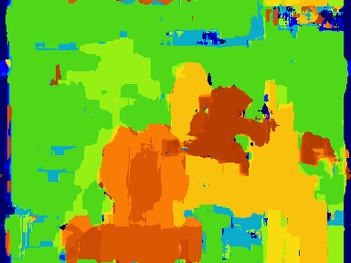

Getting the boundaries right
Right answers
Graph cuts
Correlation

Slide 6
Expansion move algorithm
Input labeling f
_{Green expansion move from f}
Make green expansion move that most decreases E
  Then make the best blue expansion move, etc
  Done when no α-expansion move decreases the energy, for any label α
  See [BVZ 01] for details

Slide 7
Local improvement vs. Graph cuts
Continuous vs. discrete
  No floating point with graph cuts
Local min in line search vs. global min
Minimize over a line vs. hypersurface
  Containing O(2^{n}) candidates
Local minimum: weak vs. strong
  Within 1% of global min on benchmarks!
  Theoretical guarantees concerning distance from global minimum
    2-approximation for a common choice of E

Slide 8
2-approximation for Potts model
optimal solution
local minimum
Summing up over all labels:
Notes:
Now consider only the energy terms that somehow involve pixels in the set A
We write this EA.
The difference between our local minimum and falpha is only in these terms, so our EA is lower.
The EA difference between falpha and the global minimum is only in the V terms (n-links), and in the global minimum all the n-links are broken.
So in terms of EA, our solution is better than the global minimum.
Now sum this over all labels alpha, and we get the bound we want

Slide 9

Binary sub-problem
Input labeling
Expansion move
Binary image

Slide 10
Expansion move energy
Goal: find the binary image with lowest energy
Binary image energy E(b) is restricted version of original E
  Depends on f,α

Slide 11
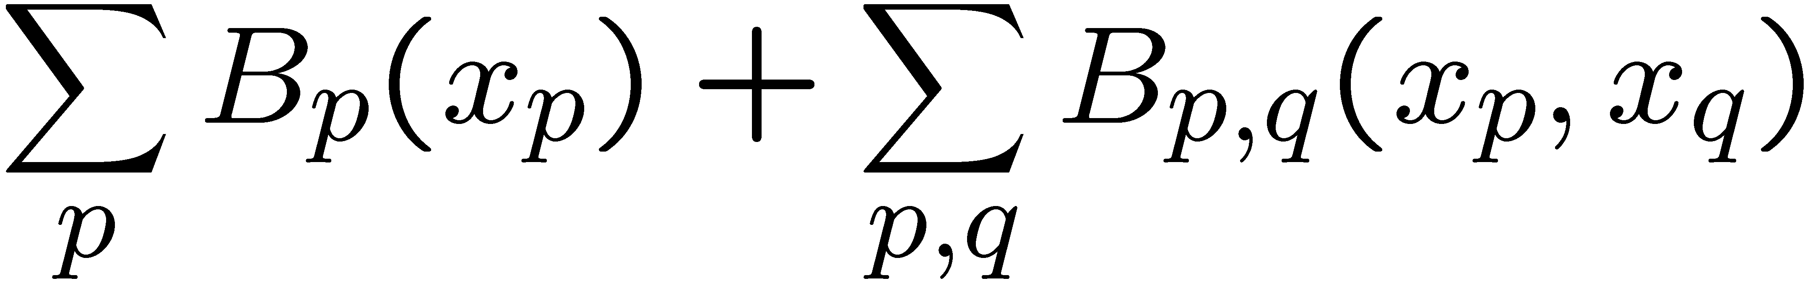
Regularity
The binary energy function
is regular [KZ 04] if
This is a special case of submodularity

