Slide 1
Introduction:
Analysis of Data Derived from Medical Images
Ashish Raj, PhD
Co-Director, Image Data Evaluation and Analytics Laboratory (IDEAL)
Department of Radiology
Weill Cornell Medical College
New York
Email: ashish@med.cornell.edu

Slide 2
Outline
Snippets of examples of medical imaging data
3 main analysis techniques:
  Detection
  Estimation
  Classification / learning

Slide 3
Detection Problems
  edge detection
  arrythmia detection in AED
  detection of onset of Alzheimer’s
  epileptic episode
  Detection of tumor in mammography exams
  Detection of fatty tissue from abdominal CT exam

Slide 4
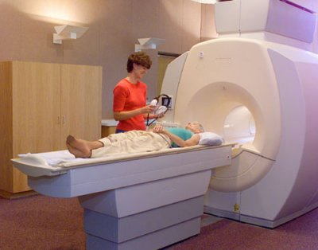
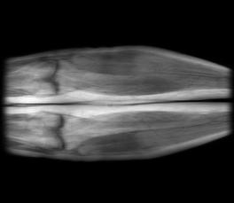
Estimation Problems
  Given instrument data plus noise and artifacts, estimate quantity of interest
  Reconstruction of images from raw scanner data
  Recon of brain fiber shapes from brain diffusion MRI
  Estimation of dipole relaxation properties of various tissue types from MRI
  Heartbeat estimation from ECG
…. 0 1 1 0 1 0 1 0 1….

Slide 5
Classification / learning Problems
  Patient level (e.g. patient is suffering from Alzheimer’s, Parkinsons, epilepsy or healthy?)
  Organ or tissue level (e.g. texture and shape of liver – cirrhosis, carcinoma or normal?)
  Voxel level (e.g. voxel belongs to healthy tissue, malignant or benign tumor?)
  Classification of time-profiles (e.g. contrast uptake of veins vs arteries, of malignant vs benign tumors, brain atrophy of normal aging vs Alzheimer’s)
  Image segmentation is voxel level classification
  Network level (of networks derived from imaging data)

Slide 6
Part I : Detection Problems in Medicine

Slide 7
What is Detection
Deciding whether, and when, an event occurs
Presence/absence of
  signal
  activation (fMRI)
  foreground/background
  tissue – WM/GM/CSF (segmentation)
Measures whether statistically significant change has occurred or not

Slide 8
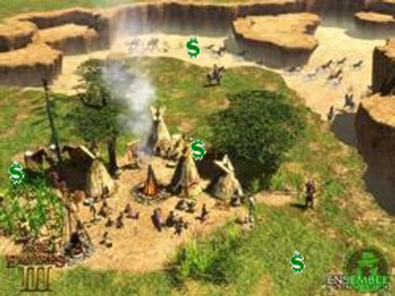
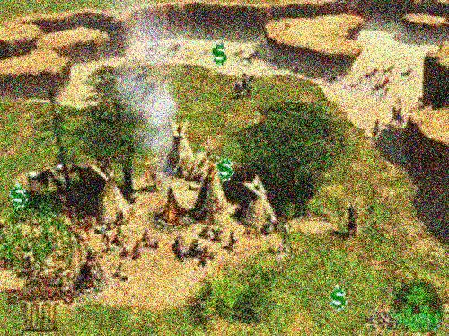

Detection
“Spot the Money”

Slide 9
Hypothesis Testing with Matched Filter
Let the signal be y(t), model be h(t)
Hypothesis testing:
H₀: y(t) = n(t) (no signal)
H₁: y(t) = h(t) + n(t) (signal)
The optimal decision is given by the Likelihood ratio test (Nieman-Pearson Theorem)
Select H₁ if L(y) = Pr(y|H₁)/Pr(y|H₀) > γ
It can be shown (Kay 01) to be equivalent to
y(t) * h(t) > γ’
Matched Filter

Slide 10
Matched Filters
If the profile of a certain signal is known, it can be detected using the Matched Filter
If the question is not IF but WHERE…
Maximum of MF output denotes the most likely location of the object h(t)

Slide 11
Matched Filters
Example 1: activation in fMRI
  Need profile model: hemodynamic response function
Example 2: Detecting malignant tumours in mammograms
  need profile model: temporal response to contrast agent
Example 3: Edge detection
Example 4: detecting contrast arrival in CE-MRA
In each case need a model to “match” the signal

Slide 12
Edge Detection
Edge information can be used for segmentation
Detect edges by finding areas of max intensity change
DoG (Derivative of Gaussian):
∇² (I(x,y) * G(x,y,σ))
G(x,y,σ) = Gaussian
∇² = Laplacian operator
Marr-Hildreth, Canny, Roberts, etc
Problems: very sensitive to noise, choice of σ

Slide 13
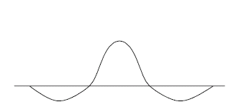
Edge Detection

Slide 14
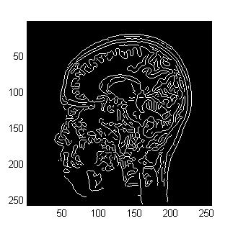
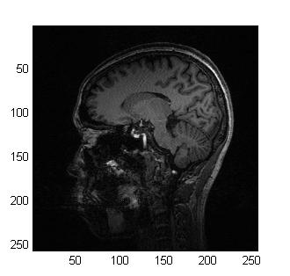
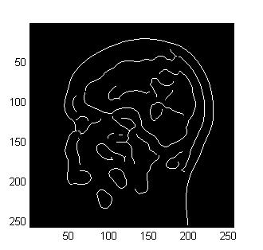
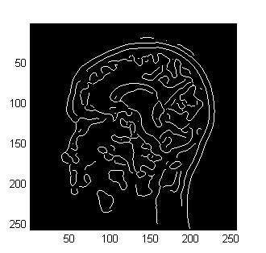
Edge Detection example using MATLAB
bw = edge(I, ‘canny’, sigma);

Slide 15

Example: Contrast Arrival in CE-MRA
Part I:
-
Mask subtraction in MRA gives vasculature
=
Notes:
These are two examples of image series that Time-resolved background subtracted CEMRA generates.
The problem is that time-resolved background subtracted CEMRA gives too many images to look at.
On the other hand, surgeon prefers to look at just one image that shows everything that he or she needs.
Therefore, it would be very nice if we could create a a single best subtraction image and that is our goal.

Slide 16
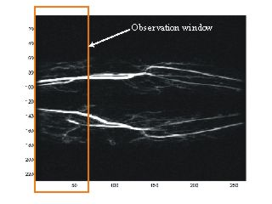
Automatic Detection of Contrast Arrival in MR Angiography
MRA relies on good estimate of contrast arrival
Completely unsupervised, reliable automatic method
>90% accuracy, c.f. earlier reported method (~60% accuracy)
    matched filter - spatial metric
    keyhole - frequency metric
Vasculature strongly oriented horizontally
Notes:
First, we detect when the contrast arrives. Based on that, we pick the best mask and best arterial phase pair.
After that, we select the best mask set and the best arterial phase set. I’ll explain each steps in the subsequent slides.

Slide 17
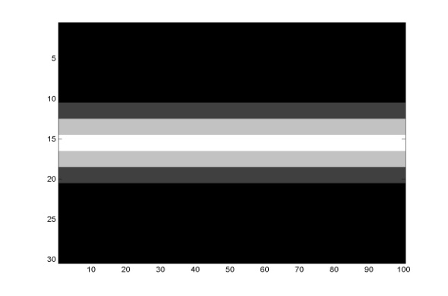
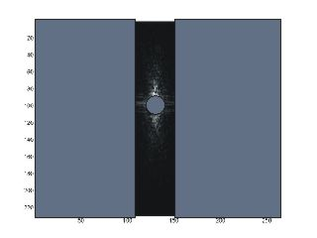


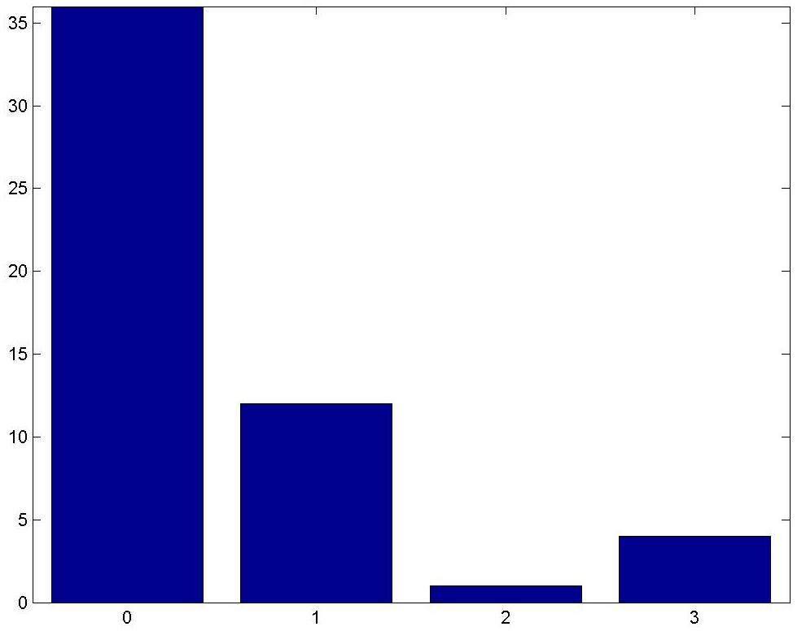
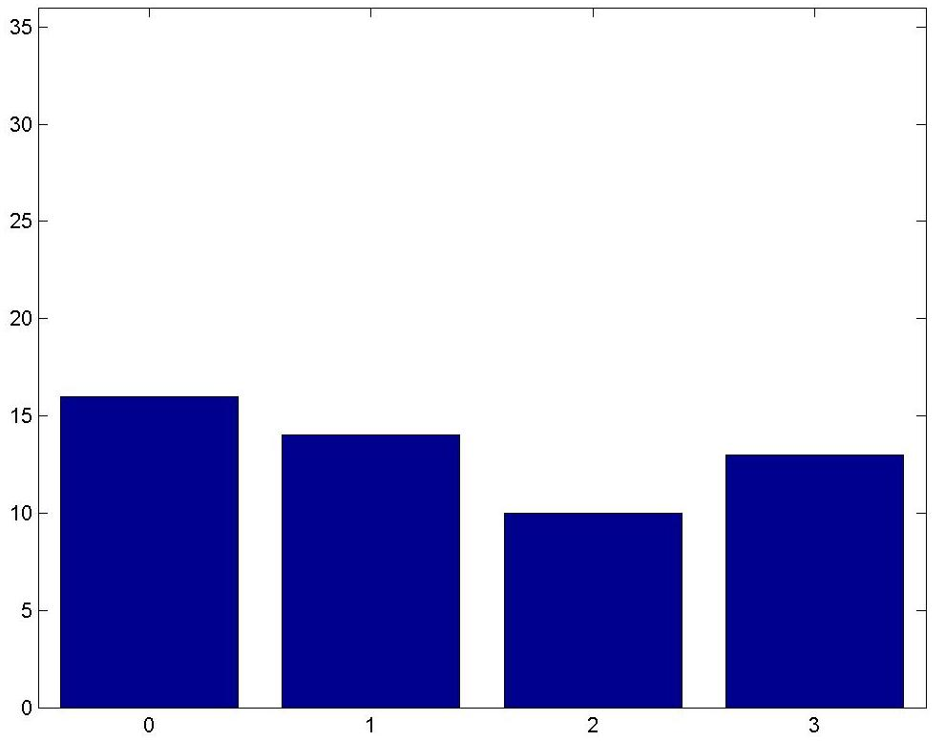
Matched Filter
Keyhole
Results : Our method Earlier method
frequency
frequency
accurate -----→ inaccurate
accurate -----→ inaccurate
Notes:
The current implementation is being used in our daily use. Only in the rare case that the automatic selection program gives unsatisfactory results, we use the manual method. Even in that case, we start from the selection given by the automatic selection program rather than starting from scratch.

Slide 18
Part II : Estimation Examples
Estimating shapes of brain white matter fibers
Reconstructing images from raw MRI scanner data

Slide 19
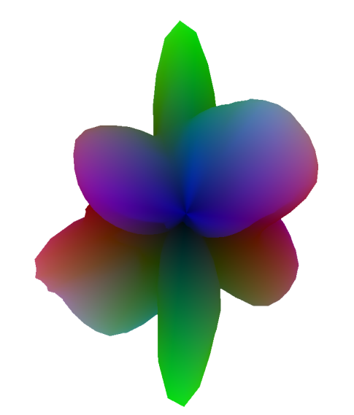
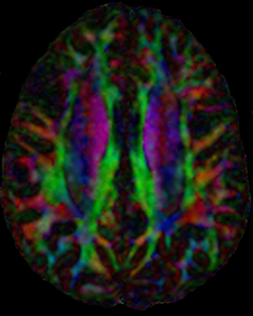
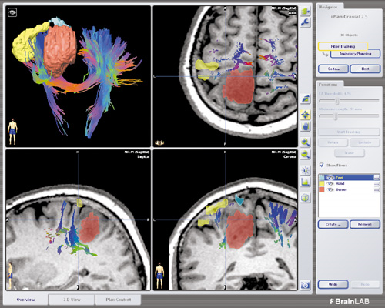
High Angular Resolution Diffusion Imaging
Notes:
19

Slide 20
MR Diffusion Imaging
Diffusion MRI has revolutionized in vivo imaging of brain
Measures the directionally varying diffusion properties of water in tissue
Anisotropy of diffusion is an important marker of extant fiber organization
Enables probing of fiber connectivity in the brain, through tractography
D-MRI involves taking several directional diffusion imaging measurements
Then we fit a 3D shape to these measurements

Slide 21
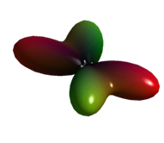
Reconstruction Problem
Basic Approach
Construct a function on the unit sphere that characterizes the angular structure of diffusion anisotropy in each voxel.
S(φ,θ)
F(φ,θ)
Notes:
HARDI aims to overcome the limitations of the tensor model by describing the angular dispersion of diffusion. The goal can be stated as defining the likelihood of diffusion in any particular direction in spherical coordinates, phi and theta, representing azimuth and elevation, respectively. With HARDI, raw data are acquired along the surface of a sphere in q-space. Data are heavily diffusion-weighted in order to interrogate diffusion on a smaller spatial scale, with b values usually greatly exceeding 1000.
The HARDI reconstruction problem can then be defined as one of mapping one function on the sphere in the measurement space S into another function on the sphere F, where F acts as a surrogate for the angular probability distribution function. Several methods have been proposed to synthesize HARDI measurements, including model-based techniques, generalized tensor methods, and persistent angular structure. The proposed method combines features of the three final approaches: spherical harmonic ADC, spherical deconvolution, and Q-ball imaging.

Slide 22
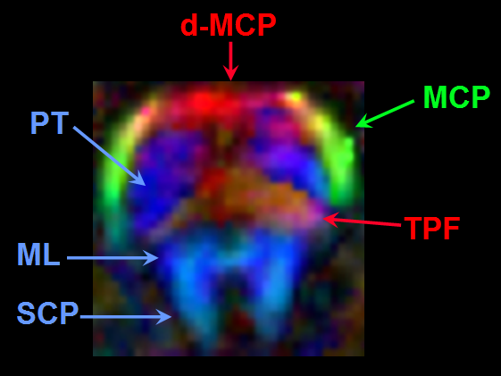
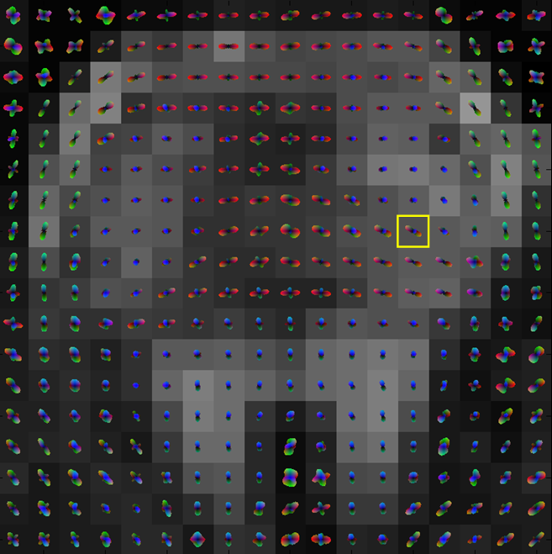
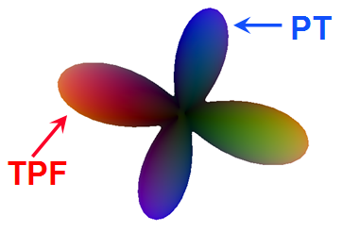
Middle cerebellar peduncle (MCP)
Superior cerebellar peduncle (SCP)
Pyramidal tract (PT)
Trans pontocerebellar fibers (TPF)
Hess CP, Mukherjee P, Han ET, Xu D, Vigneron DB
Magn Reson Med 2006; 56:104-117
Notes:
22
Additional results in the brainstem with higher spatial resolution will be presented tomorrow by my colleague, Dr. Mukherjee. One example in the pons is shown here, where the transverse pontocerebellar fibers are known to interdigitate with the pyramidal tract in histologic studies. On this color-coded anisotropy map, the up-down orientation of the pyramidal tract fibers is depicted in blue and the transversely-oriented pontocerebellar fibers are closer to red. With HARDI, we can resolve the 2-way crossing of fibers at the boundaries of these two tracts. Again, where there is a single fiber orientation as in the medial lemniscus or superior cerebellar peduncle, HARDI produces a unimodal surface.

Slide 23

Clinically Feasible HARDI Tractography
Reconstruction quality depends on algorithm used
Harmonic q-ball
DTI
Berman JI, Chung S, Mukherjee P, Hess CP, Han ET, Henry RG. Neuroimage (2007)
Notes:
23

Slide 24
Problems
ODF reconstruction suffers from noise
Matrix is ill-conditioned
  i.e. its inverse “magnifies” small noise values into large ones
There are not enough diffusion directions
HARDI with high b ➔ very low SNR (<20)

Slide 25
Adding Spatial Constraints
Neighbours are “like” each other, likely to have similar ODFs
But need to allow for discontinuous boundaries

Slide 26
Iterative Algorithm

Slide 27
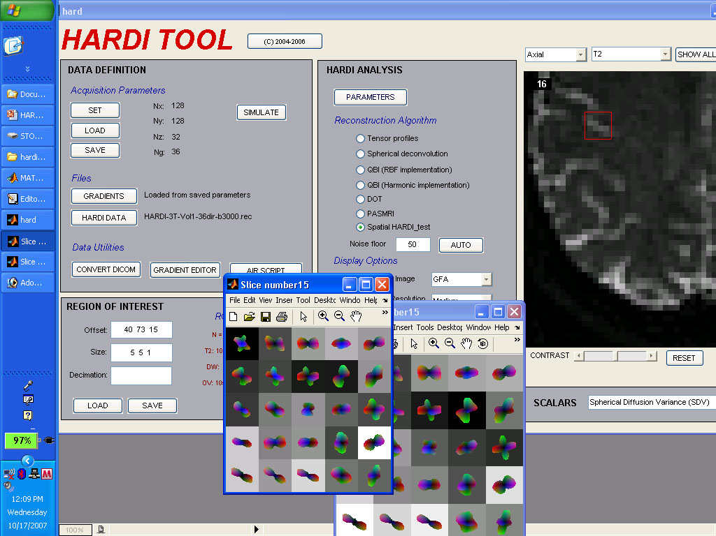
In vivo results

Slide 28
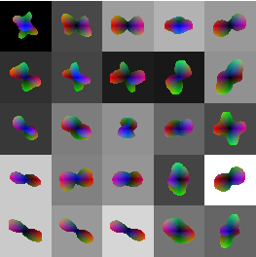
In vivo results
Sh-QBI

Slide 29
Image Reconstruction from Raw MRI data
“Accelerated Imaging”
…. 0 1 1 0 1 0 1 0 1….
Faster brain scans (5x speedup)
Input: Undersampled Fourier-space raw data from scanner
Output: Reconstructed images

Slide 30
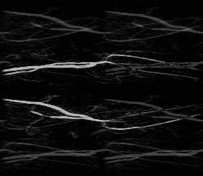
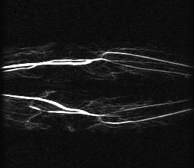
Accelerated Imaging
Under-sampled k-space
Reconstructed k-space
Under-sampled k-space
ky
ky
kx
kx
Notes:
Delete if not Ashish

Slide 31
Background
Fast (accelerated) MR imaging is limited, among other things, by reconstruction algorithm
Acceleration beyond 3x very hard
We have developed novel graph-theory based algorithms to reconstruct MR images from under-sampled raw data
Our aim is to enable higher acceleration factors
Two major NIH grants awarded for this work – R21 and P41

Slide 32
MRI Reconstruction Using Graph Cuts
A new graph-based algorithm *
Inspired by advanced robotic vision, computer science
Folded MR data
Reconstructed image
Graph
S
T
Operations on this graph produce reconstructed image!
Raj et al, Magnetic Resonance in Medicine, Jan 2007,
Raj et al, Computer Vision and Pattern Recognition, 2006
Singh et al., MRM (to appear)

Slide 33
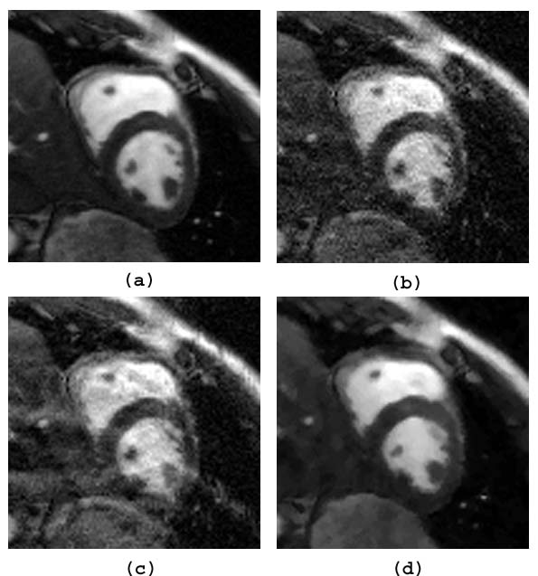
Jump Move Results: Cardiac Imaging, R=4
reconstruction for cine SSFP at R = 4
Reference:
Sum of squares
Regularized SENSE
(μ = 0.1)
Regularized SENSE
(μ = 0.5)
Fast EPIGRAM

Slide 34
Part III : Classification Examples
Voxel labeling problems
Organ labeling problems
Patient classification problems

Slide 35
Distinguishing normal subject from Normal Pressure Hydrocephalus
NPH subjects are known to have elevated whole brain diffusivity in MR-DTI scans
Idea: use these to classify patients into appropriate disease state
Whole brain diffusivity peak

Slide 36
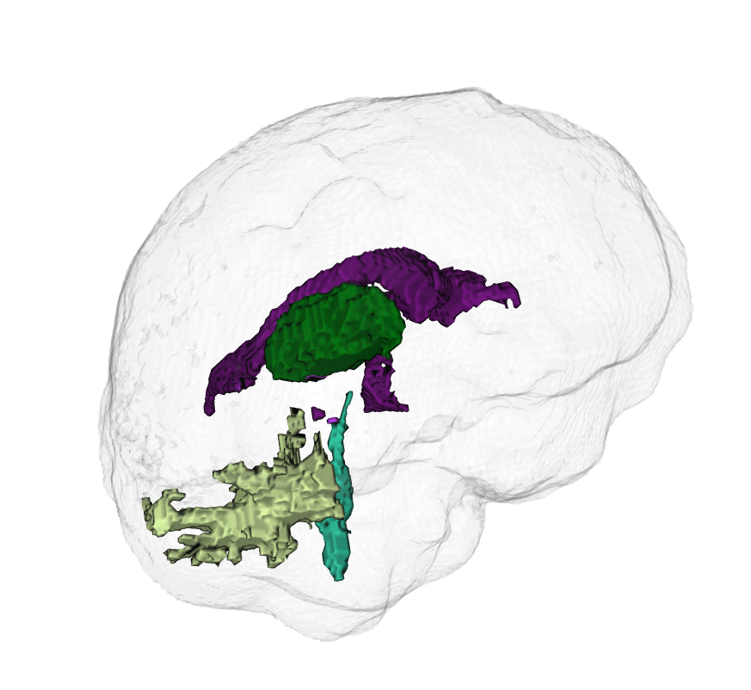
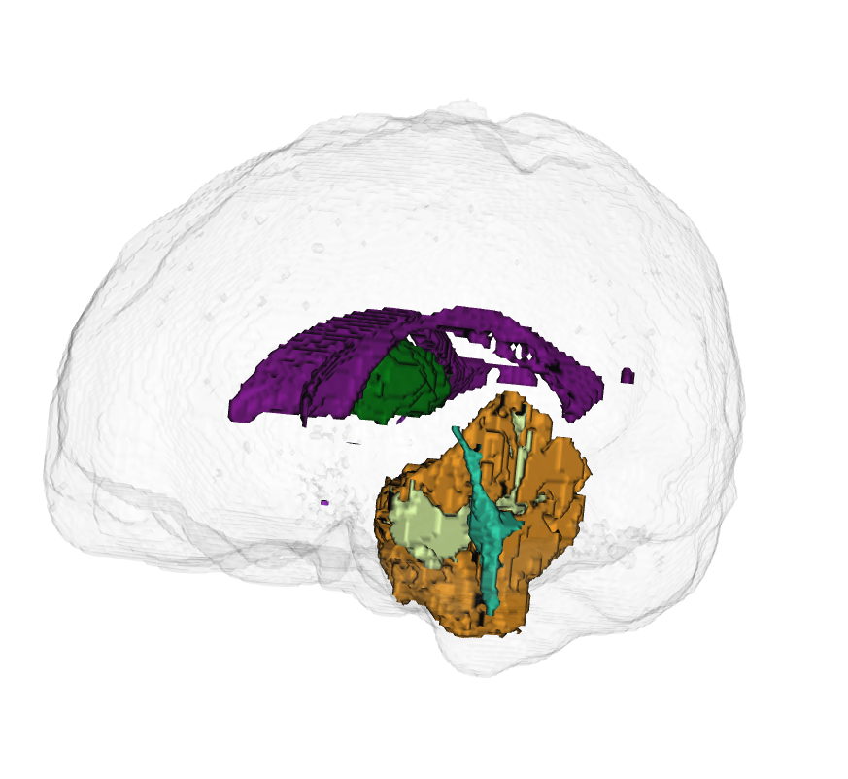
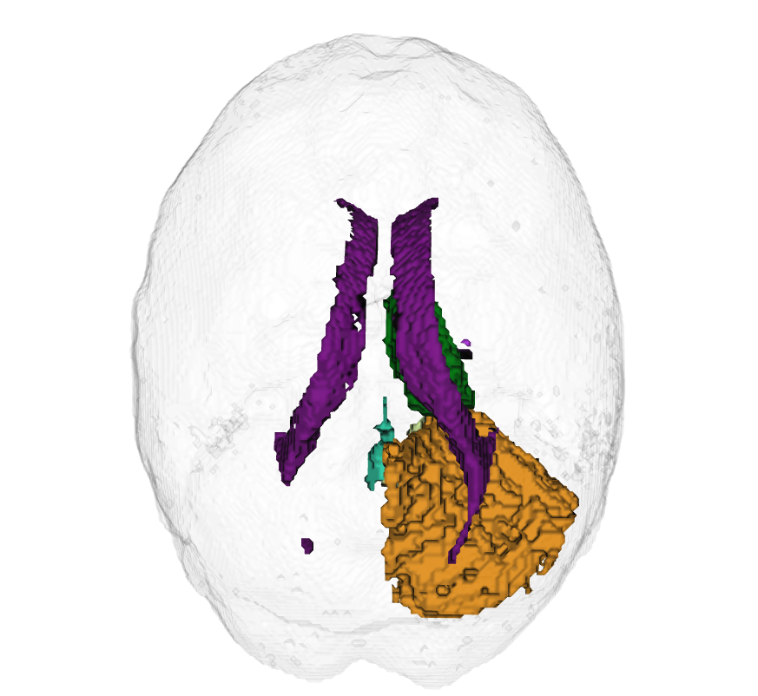
Neurological Disease Classification using Brain Volumetrics
Parcellate brain MRI into various known structures and find their volumes
Can be used for distinguishing between AD, MS, Parkinsons, Epilepsy, etc

Slide 37
Voxel level classification:
Image segmentation via Clustering
Clustering in intensity space = thresholding
Clustering in hybrid intensity-spatial space
Better clustering: make use of edge info
  use distance transform as clustering variable
Even better: use spatial coherence

Slide 38
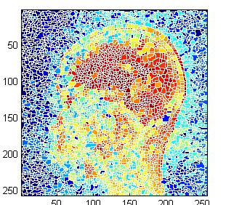
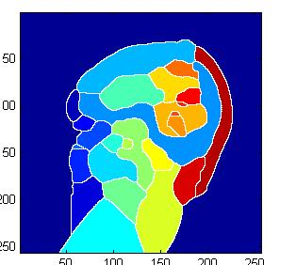
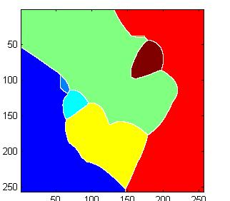
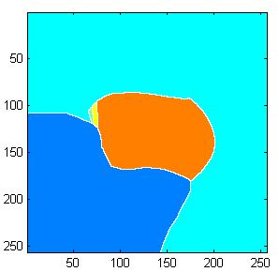
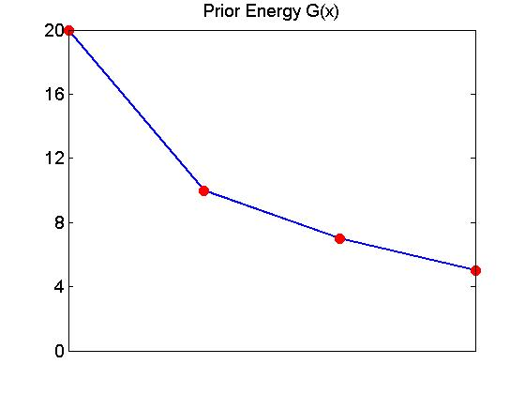
Prior Model – Driven segmentation

Slide 39
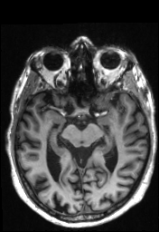

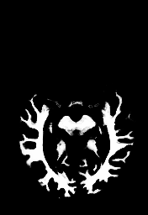
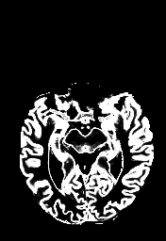
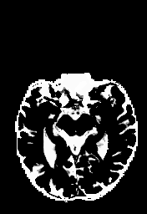
MR Segmentation Using Graph Cuts
Geo Cuts
Original image
Automatically set seeds
CSF
Gray matter
White matter
probability
Parameter estimation
intensity

Slide 40
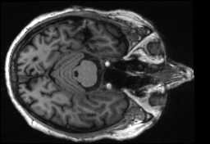
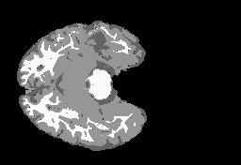
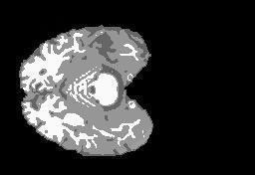
Preliminary results
EMS
Graph Cuts

Slide 41
Non-intensity voxel labeling
Can segment according to other classifications
  activation using hemodynamic response (fMRI)
  MR spectra
  time profile of MR angiography data
need to generalise the clustering approach to multilpe dimensions
“feature space”

Slide 42
Example: MRA segmentation
artery/vein may have similar intensity at given time point
but different time profiles
wish to segment according to time profile, not single intensity

Slide 43
Example: MRA segmentation
First: need a time model of all segments!
Next: fit observed data to these models and see which voxel belongs to which model
(use an energy minimization framework for this)
energy = data cost + prior cost

Slide 44
Fitting data to model
data cost = residual of the least squares fit
prior cost penalises non-piecewise smooth solutions
smoothness cost
residual of LS fit
E(f) minimized over 2^{|P|} configurations,
where |P| = # pixels
2 labels at each pixel: L = {artery, vein}
Efficiently minimized using Graph Cuts

Slide 45
Results

Slide 46
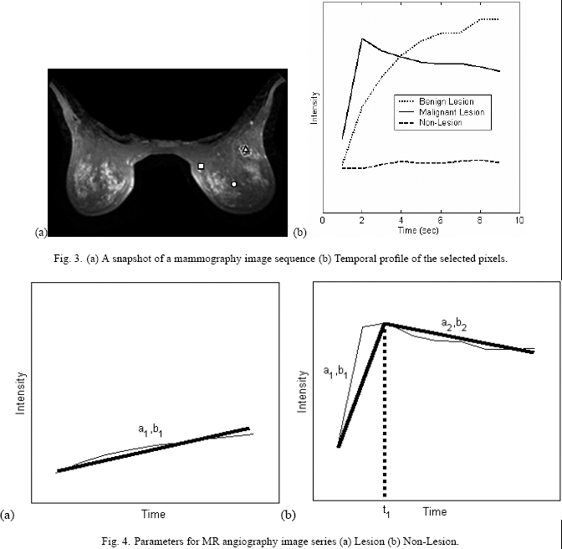
MR mammography

Slide 47
Visceral Fat Quantification
Visceral adipose tissue segmentation and classification
  Subcutaneous fat, visceral fat, fat in stool
Interactive tool for segmenting and voluming VAT from CT scans
Completely unsupervised processing, with interactive validation
Will be used for correlational analysis of heart-related morbidity

Slide 48
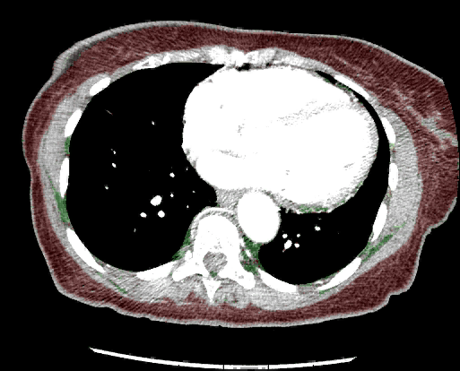
VAT segmentation result

Slide 49
Liver tumour quantification from Dynamic Contrast Enhanced MRI
Data: Tumor model Rabbit DCE-MR data
Paramegnetic contrast agent , pathology gold standard
Extract temporal features from DCE-MRI
Use these features for accurate detection and quantification of tumour

Slide 50
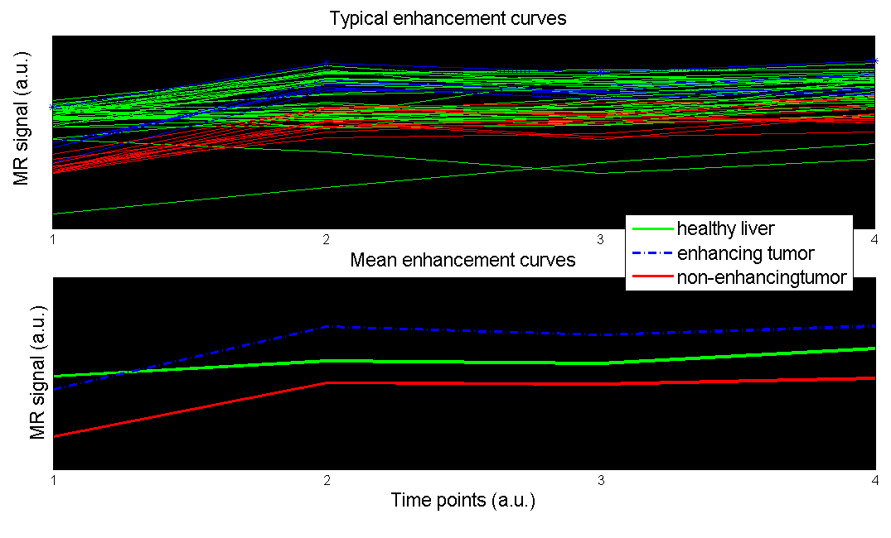
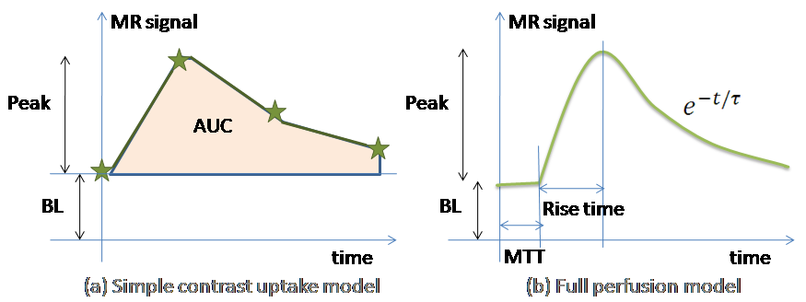
Typical plot of time-resolved MR signal of various tissue classes
Temporal models used to extract features

Slide 51
Liver tumour quantification from DCE-MRI

Slide 52
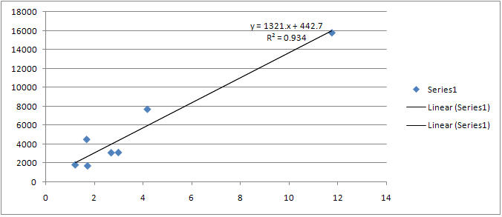
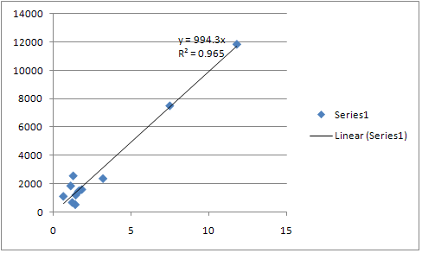
Preliminary Results
Correlation plots of our volumes vs manual voluming (GE Advantage Workstation)
Total tumour volume
(necrotic + enhancing)
Necrotic tumour volume

Slide 53
Graph-Theoretic Methods for Network-Level Analysis of Brain Imaging Data
With Thanks to:
Susanne Mueller, Karl Young (CIND/UCSF)

Slide 54
Biological networks
Networks are EVERYWHERE
Network analysis is going to be the next big thing in biology
Neuroscience: cognitive network models
DTI Tractography
Networks
Metabolic, protein interaction networks
Gene expression arrays
“The connection matrix of the human brain (the human “connectome”) represents an indispensable foundation for basic and applied neurobiological research.”
- From Sporns, Tononi and Kotter, “The Human Connectome: A Structural Description of the Human Brain”, PLoS Computational Bioogy 2005

Slide 55
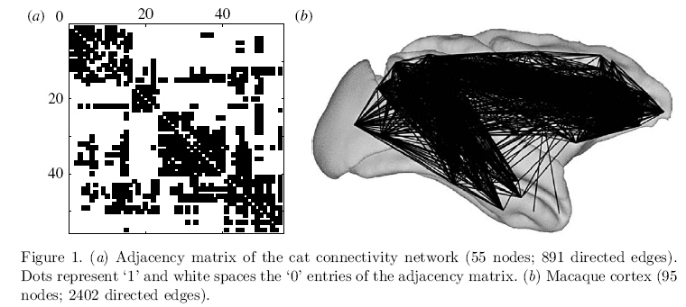
Structural Brain Network from Fiber Tracing – Macaque Brain (Cocomac Project)
MARCUS KAISER. Brain architecture: a design for natural computation.
Phil. Trans. R. Soc. A, 2007.

Slide 56
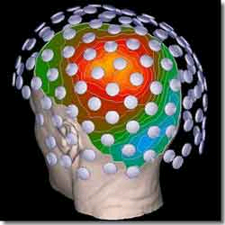
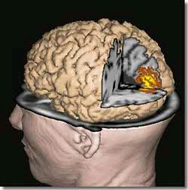
Networks from MagnetoEncephaloGraphy
Some recent work on this – Honey and Sporns, Fox, etc
Time-resolved MEG signal → tomographic reconstruction → source localization → extract connectivity network
Connectivity = correlation between MEG signals

Slide 57
The human brain is intrinsically organized into dynamic, anticorrelated functional networks
Michael D. Fox, Abraham Z. Snyder, Justin L. Vincent, Maurizio Corbetta, David C. Van Essen, and Marcus E. Raichle. PNAS 2005
Fig. 1. Intrinsic correlations between a seed region in the PCC and all other voxels in the brain for a single subject during resting fixation. The spatial distribution of correlation coefficients shows both correlations (positive values) and anticorrelations (negative values), thresholded at R 0.3. The time course for a single run is shown for the seed region (PCC, yellow), a region positively correlated with this seed region in the MPF (orange), and a region negatively correlated with the seed region in the IPS (blue).

Slide 58
Networks from Diffusion MRI
Obtain WM tracts from DTI/HARDI/DSI using tractography
From tracts terminating in cortical ROIs, estimate the strength of “connection” between them
  Examples: Medina-Iterria in NeuroImage, Hagmann in PLoS One 2(7), etc
This gives the connectivity matrix, hence the network

Slide 59

Mapping Human Whole-Brain Structural Networks with Diffusion MRI
Patric Hagmann, Maciej Kurant, Xavier Gigandet, Patrick Thiran, Van J. Wedeen, Reto Meuli, Jean-Philippe Thiran, PLoS ONE 2(7)

Slide 62
Diffusion MRI Networks: A Better Algorithm
Characterizing brain anatomical connections using diffusion weighted MRI and graph theory
Y. Iturria-Medina, E.J. Canales-Rodríguez, L. Melie-García, P.A. Valdés-Hernández, E. Martínez-Montes, Y. Alemán-Gómez and J.M. Sánchez-Bornot, NeuroImage 36 (2007) 645–660

Slide 63
Structural MRI
Acquire MRI of brain
Segment GM/WM/CSF/nonbrain
Parcellate GM into ROI’s based on anatomy (gyri and sulci)
Obtain measure of correlation between ROIs
Examples:
  cortical thickness of each ROI
  Volume change of ROI (longitudinal data)
This gives a correlation / connectivity / adjacency matrix

Slide 64

Connectivity Matrix
j
h
e_{ij}
i
i
m
j
Connectivity matrix = Graph

Slide 65

Cortical Thickness Network from Brain MRI
Acquire MRI of brain
Segment GM/WM/CSF/nonbrain
Parcellate GM into ROI’s based on anatomy (gyri and sulci)
Idea: cortical thickness of various ROIs are not independent but may be correlated across subjects
Each ROI gets a node in the graph
Define edge weight between node i and node j as the strength of correlation between ROI_{i} and ROI_{j}

Slide 66
Cortical Thickness Network
Yong He, Zhang J. Chen and Alan C. Evans. Small-World Anatomical Networks in the Human Brain Revealed by Cortical Thickness from MRI. Cerebral Cortex October 2007;17:2407--2419

Slide 67
Cortical thickness networks in Epilepsy
Xi(k) = average thickness of i-th ROI of k-th subject
Si = standard deviation of i-th ROI, from all 31 healthy subjects
Mi = mean over all 31 healthy subjects
j
z_{i}(k) = (x_{i}(k) – m_{i}) / s_{i}
[C(k)]_{i,j} = |z_{i}(k) – z_{j}(k)|
C(k) = connectivity matrix of subject k
i

Slide 68
Cortical thickness PLUS Curvature
Define cortical curvature variables y_{i}(k) similarly
q_{i}(k) = (y_{i}(k) – m_{y} _{i}) / s_{y} _{i}
C(k) = connectivity matrix of subject k
[C(k)]_{i,j} = |z_{i}(k) – z_{j}(k)| + |q_{i}(k) – q_{j}(k)|

Slide 69
Other ways to define connectivity
Why is max() best? Not sure, but…
  See later

Slide 70

Group Networks
MTS
WNL

Slide 71

Can we use single-network statistics to differentiate population of networks?
Compile network stats for each subject:
  Degree distribution
  Clustering index
  path-length
Perform classification using these stats as feature vector
Epilepsy Cortical thickness Networks
Conventional network summary variables don’t work!
We need some other means of distinguishing between networks

Slide 72
Population of Networks – Graph Theory Approach
New work: proposing a new approach for comparing networks
Given graphs G_{A} and G_{B}, define the GRAPH EDIT DISTANCE between them as:
  Start from G_{A}, and insert/delete nodes and edges in order to convert G_{A} into G_{B}
  The cost of each insertion or deletion is predetermined
  The smallest total cost of this procedure = GED

Slide 73
Example: Classification of Epilepsy Networks
Recall networks were obtained from cortical thickness of subjects, both healthy and epileptic
These networks were presented to the GED algorithm, and the “distance” or “similarity” between the networks of every pair of subjects was computed
The GED data summarized in (yet) another matrix: the network similarity matrix D^{GED}
[D^{GED}]_{k,k’} = GED(G_{k}, G_{k’})

Slide 74

Epilepsy Network Classification – 2/3 Groups

Slide 75

Summary of Classification algorithm

Slide 76
Summary of Classification algorithm
Given subjects s₁ …,s_{k},…s_{N}:
Obtain graphs G₁ …G_{N} (one for each subject)
  Recall C(k) = connectivity matrix of subject [C(k)]_{i,j} = max(|z_{i}(k)|,| z_{j}(k)|) + max(|q_{i}(k)|, |q_{j}(k)|)
Compute D^{GED} [k,k’] = GED(G_{k}, G_{k’})
Perform Linear Discriminant Analysis

Slide 77

Classification of Epilepsy Networks

Slide 78

Classification of Epilepsy Networks

Slide 79
Epilepsy Network Classification – 2/3 Groups

Slide 80

Dispersion and Severity
Well localized
➔ good surgical outcome
Poorly localized
➔ poor surgical outcome

Slide 81
Classification of AD/MCI/Healthy
Our method is applicable to other brain disorders
48 subjects, 18 AD, 30 Healthy

Slide 82

Classification of AD/MCI/Healthy

Slide 83



Slide 84
Introduction:
Analysis of Data Derived from Medical Images
Ashish Raj, PhD
Image Data Evaluation and Analytics Laboratory (IDEAL)
Department of Radiology
Weill Cornell Medical College
New York
Email: ashish@med.cornell.edu

