Slide 1
CS5540: Computational Techniques for Analyzing Clinical Data
Prof. Ramin Zabih (CS)
Prof. Ashish Raj (Radiology)

Slide 2
Today’s topic
Decisions based on densities
Density estimation from data
Parametric (Gaussian)
Non-parametric
Non-parametric mode finding

Slide 3
Decisions from density
Suppose we have a measure of an ECG
Different responses for shockable and normal
Let’s call our measure M (Measurement)
M(ECG) is a number
Tends to be 1 for normal sinus rhythm (NSR), 0 for anything else
We’ll assume non-NSR needs shocking
It’s reasonable to guess that M might be a Gaussian (why?)
Knowing how M looks allows decisions
Even ones with nice optimality properties

Slide 4
What densities do we need?
Consider the values of M we get for patients with NSR
This density, peaked around 1:
f1(x) = Pr(M(ECG) = x | ECG is NSR)
Similarly for not NSR, peaked around 0:
f0(x) = Pr(M(ECG) = x | ECG is not NSR)
What might these look like?

Slide 5
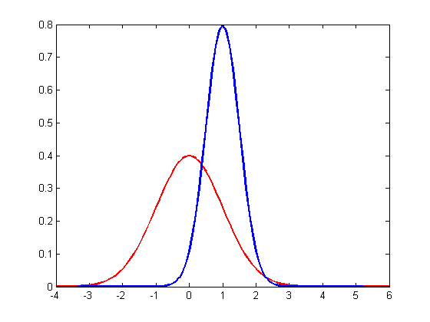
Densities
Probability
f1(x) =
Pr(M(ECG) = x | ECG is NSR)
f0(x) =
Pr(M(ECG) = x | ECG is not NSR)
Value of M

Slide 6
Obvious decision rule

Slide 7
Choice of models
Consider two possible models
E.g., Gaussian vs uniform
Each one is a probability density
More usefully, each one gives each possible observation a probability
E.g., for uniform model they are all the same
This means that each model assigns a probability to what you actually saw
A model that almost never predicts what you saw is probably a bad one!

Slide 8
Maximum likelihood choice
The likelihood of a model is the probability that it generated what you observed
Maximum likelihood: pick the model where this is highest
This justifies the obvious decision rule!
Can derive this in terms of a loss function, which specifies the cost to be incorrect
If you guess X and the answer is Y, the loss typically depends on |X-Y|

Slide 9
Parameter estimation
Generalization of model choice
A Gaussian is an infinite set of models!
Model
Probability of
observations
Parameters Θ

Slide 10
Summary
We start with some training data (ECG’s that we know are NSR or not)
We can compute M on each ECG
Get the densities f0, f1 from this data
How? We’ll see shortly
Based on these densities we can classify a new test ECG
Pick the hypothesis with the highest likelihood

Slide 11
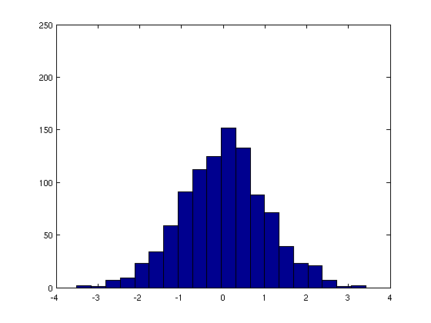
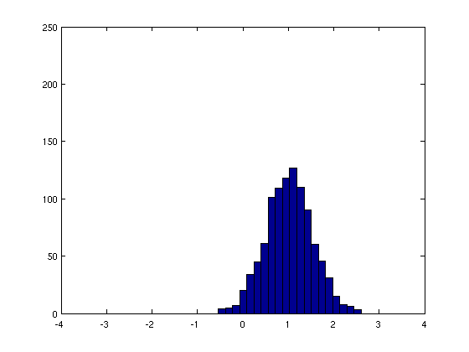
Sample data from models

Slide 12
Density estimation
How do we actually estimate a density from data?
Loosely speaking, if we histogram “enough” data we should get the density
But this depends on bin size
Sparsity is a killer issue in high dimension
What if we know the result is a Gaussian?
Only two parameters (center, width)
Estimating the density means estimating the parameters of the Gaussian

Slide 13
ML density estimation
Among all the infinite number of Gaussians that might have generated the observed data, we can easily compute the one with the highest likelihood!
What are the right parameters?
There is actually a nice closed-form solution!

Slide 14
Harder cases
What if your data came from two Gaussians with unknown parameters?
This is like our ECG example if the training data was not labeled
If you knew which data point came from which Gaussian, could solve exactly
See previous slide!
Similarly, if you knew the Gaussian parameters, you could tell which data point came from which Gaussian

Slide 15
Simplify: intermixed lines
What about cases like this?
Can we find both lines?
“Hidden” variable: which line owns a point

Slide 16
Lines and ownership
Need to know lines and “ownership”
Which point belongs to which lines
We’ll use partial ownership (non-binary)
If we knew the lines we could apportion the ownership
A point is primarily owned by closest line
If we knew ownership we could find the line via weighted LS
Weights from ownership

Slide 17
Solution: guess and iterate
Put two lines down at random
Compute ownership given lines
Each point divides its ownership among the lines, mostly to the closest line
Compute lines given ownership
Weighted LS: weights rise with ownership
Iterate between these

Slide 18
Ownership from lines
Mostly red
Evenly split
Mostly green

Slide 19
Lines from ownership
Low weight
Medium weight
High weight

Slide 20
Convergence

Slide 21
Questions about EM
Does this converge?
Not obvious that it won’t cycle between solutions, or run forever
Does the answer depend on the starting guess?
I.e., is this non-convex?

