Slide 1
CS5540: Computational Techniques for Analyzing Clinical Data
Prof. Ramin Zabih (CS)
Prof. Ashish Raj (Radiology)
Today only:
Gary Dorfman, MD (Radiology)

Slide 2
What is CS5540 about?
The practice of medicine is being transformed by computation
Information about patients is (rapidly) becoming digital and (slowly) becoming available for computers to analyze
This opens huge opportunities for both CS and medicine
CS5540 will cover CS techniques and their application to clinical data
Interest in medicine required; ignorance OK!

Slide 3
What might computers do?
Analyze a patient’s vital signs and automatically delivers treatment
Automatically determine that a drug for inflammation increases heart attack risk
Determine that a patient is suffering from epilepsy
ETC

Slide 4
Autonomous treatment
Sci-Fi fantasy: computer diagnoses and treats the patient all by itself
Especially when the treatment is a major intervention
Suppose the treatment is lifesaving if the patient has one condition, but deadly if they have a different one
The computer diagnosis had better be right!
Could such a device exist this century?
It does, and you’ve seen it

Slide 5
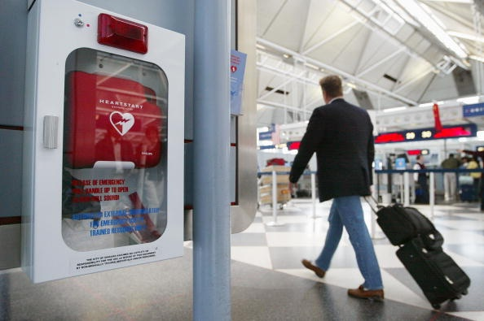

Slide 6
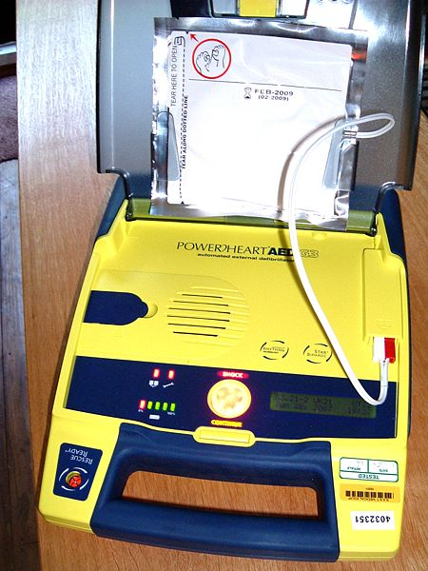
Automatic External Defibrillator

Slide 7
ECG of an idealized heartbeat

Slide 8
AED diagnosis
The AED must quickly determine if the patient has a shockable rhythm
Not all arrhythmias are shockable
Shocking a healthy patient can induce cardiac arrest
To publicly distribute this device, it needs to be resistant to stupid pranks (hazing, etc.)
It’s amazing this is allowed (Gary Dorfman will describe some of the approval issues)

Slide 9
Determining drug side effects
Drug approval is a laborious and expensive process (clinical trials)
Can’t cover all possible contingencies
Combinations of medications, underlying conditions, surgical interventions, etc.
Sometimes nasty surprises emerge only after a drug is in widespread use
Famous examples?
Can be both deadly and extremely expensive

Slide 10
VIOXX saga
Anti-inflammatory without GI upset
Based on blocking the COX2 enzyme
After widespread release, it became clear that VIOXX increased cardiac risk
Careful retrospective analysis of the data
Many believe that the manufacturer (Merck) became aware of this during clinical trials
Can we detect this automatically from patient records?
There is some evidence this is doable

Slide 11
Epilepsy diagnosis by imaging
Many disorders give rise to seizures
With different treatments and prognoses
Quantitative measures from images
Changes in thickness from MR
Ideally this should be like “heart rate” or “red blood cell count”
A number, where normal is a certain range
A large population of patients known to have epilepsy lie outside this range
“Imaging as a biomarker”

Slide 12
Common themes
Computer-aided diagnosis
Usually not autonomous
Treatment monitoring
Surprisingly important
Wide variety of data, and lots of it
Creation and analysis of biomarkers

Slide 13
Computational Techniques Applicable to Medical Data: One Clinician’s View
Gary S. Dorfman, M.D.
Professor and Vice-Chairman for Research
Department of Radiology
Weill Cornell Medical College

Slide 14
Financial Disclosures
Dr. Dorfman serves on the Medical Advisory Board of Vascular Solutions, Inc.
Dr. Dorfman holds patents assigned to a company of which he is the sole owner and officer.
In the opinion of the presenter, neither of these disclosures is relevant to the material included in this presentation.

Slide 15
Medical Data Typology
Qualitative
Text – History, PE, Assessments, Plans, Results, Reports, etc.
Photographs of Lesions, Pathology Slides, etc.
Semi-Quantitative
in vivo Imaging (Radiology)
Linear Data (ECG, EEG, EMG, etc.)
Quantitative
Numerical Lab Results
Extracted Numerical Values from Qualitative and Semi-Quantitative Data (e.g., Mark-ups, Annotations)
Raw vs. Processed vs. Post-Processed

Slide 16
Medical Data Opportunities
Volume (Workload, Needle(s) in a Haystack)
Storage (What, Where, How Long, Format?)
Organization
Presentation
Extraction of “New” or “Hidden” Data
Communication
Query and Analysis
Security
Sharing
Tools & Techniques, Environment & Ergonomics

Slide 18
Administrivia
Some programming experience is needed
Matlab and C are preferable, Java is OK
Some exposure to algorithms & statistics are helpful but not mandatory
Provide a deeper understanding of some topics
Lectures by Prof. Zabih or Prof. Raj
Some guest appearances by physicians, typically on Wednesday (CS7594)
A few guest lectures by physicians

Slide 19
Main topics
1D data: ECG, EEG, EMG, etc
Analyzing repetitive waveforms
2D data: CT, MRI, PET, etc
Analyzing images
Creating high-quality images
Other data: EMR, etc
Finding clinically important correlations

Slide 20
Algorithms
Dynamic programming
Graph algorithms, esp. min cut
Fitting via least squares & its variants
Gradient descent, conjugate gradient, PCG
k-NN, SVM classification

Slide 21
Workload
2 or 3 projects
“Implement this algorithm we discussed in class, try it on these data sets, make some modifications”
Can be done in pairs, in any reasonable language (no Fortran/Postscript!)
Small in-class quizzes every 2 weeks
Intended to be easy, short-answer
Free form final project (express yourself!)
No prelims or final exam

Slide 22
Analyzing 1D signals
Many clinical measurements produce time-varying data that is roughly periodic
Classic example: electrocardiogram (ECG)
Lots of other examples from multiple fields
How to understand an ECG?
One way to proceed is model-based
Look at the electrophysiology of the heart
Understand the sources of measurement errors
We’re not going this route
Too specific, and effectiveness is unclear

Slide 23
Tools for periodic 1D data
Instead we will look at some general methods for roughly periodic 1D data
“Roughly” is important
As a simple case, how does a patient’s ECG change over time?
For instance, as he runs on a treadmill, or holds his breath, or gets a medication
What does a normal ECG look like?
“Simple” question: what is the heart rate?

Slide 24
ECG of an idealized heartbeat

Slide 25
Sometimes, anything works
www.uptodate.com

Slide 26
Slightly harder case
www.uptodate.com

Slide 27
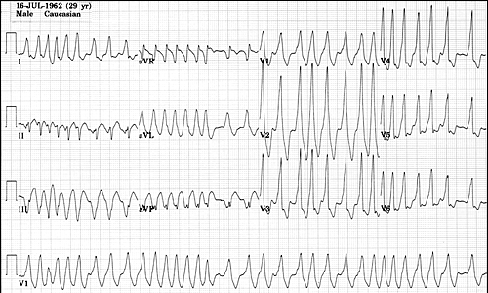
Life isn’t always easy
The Alan E. Lindsay ECG Learning Center ; http://medstat.med.utah.edu/kw/ecg/

Slide 28
Non shockable arrythmias
Brady, Harrigan and Chan, A Tale of Two “Pulseless Electical Activity” Cardiac Arrest Rhythms, Consultant 47(1)

Slide 29
Shockable arrythmias
Source: Wikipedia

Slide 30
Classification for an AED
Shockable | Non shockable

Slide 31
AED accuracy
AHA goal: 90% sensitivity for V-Fib, 99% specificity for NSR
10% false negatives for V-Fib
1% false positives for NSR
Kerber et al., Circulation 95(6):1677-82, 1997

Slide 32
How to look for ECG changes?
Three issues:
Divide the data into cycles
Compensate for speed differences
Analyze each cycle
Important ideas
Segmentation
Alignment
Analysis

