Slide 1
Lecture 28: Trusted Hardware
CS 5430 5/9/2018

Slide 2
Trusted Platform Module (TPM)

Slide 3
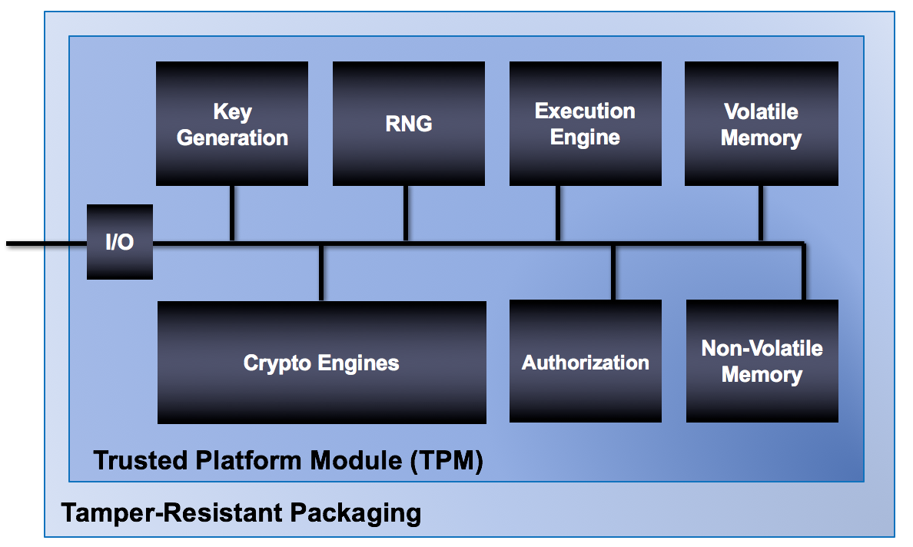
What’s in a TPM?

Slide 4
Volatile Memory
PCR Banks
In-use keys
Sessions
Etc.
Volatile Memory

Slide 5

Platform Configuration Register (PCR)
Contain hashes of programs
Modification: TPM2_Extend()
$PCR_{new}=H(PCR_{old}||{ data}_{new}$)
Attestation: TPM2_Quote()
Notes:
secure boot
measured boot/attestation

Slide 6
Non-Volatile Memory
Platform Seed
Endorsement Seed
Storage Seed
Monotonic Counters
Etc.
Non-Volatile Memory

Slide 7

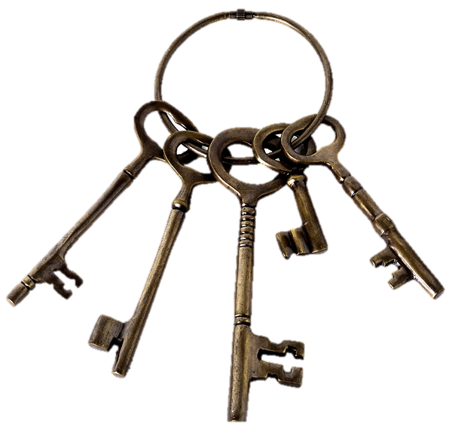

Seeds used for attestation, etc
Endorsement seed used to derive endorsement keys (EKs)
Manufacturer attests validity of EKs
EKs used to attest other TPM-derived values including
  other keys: TPM2_Certify()
  audit logs: TPM2_GetSessionAuditDigest()

Slide 8
Binding and Sealing

Slide 9
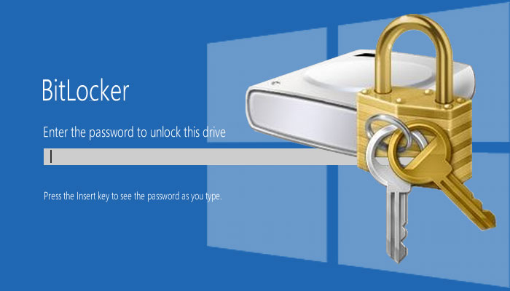
Bitlocker

Slide 10
ARM TrustZone

Slide 11
Android Full Disk Encryption

Slide 12
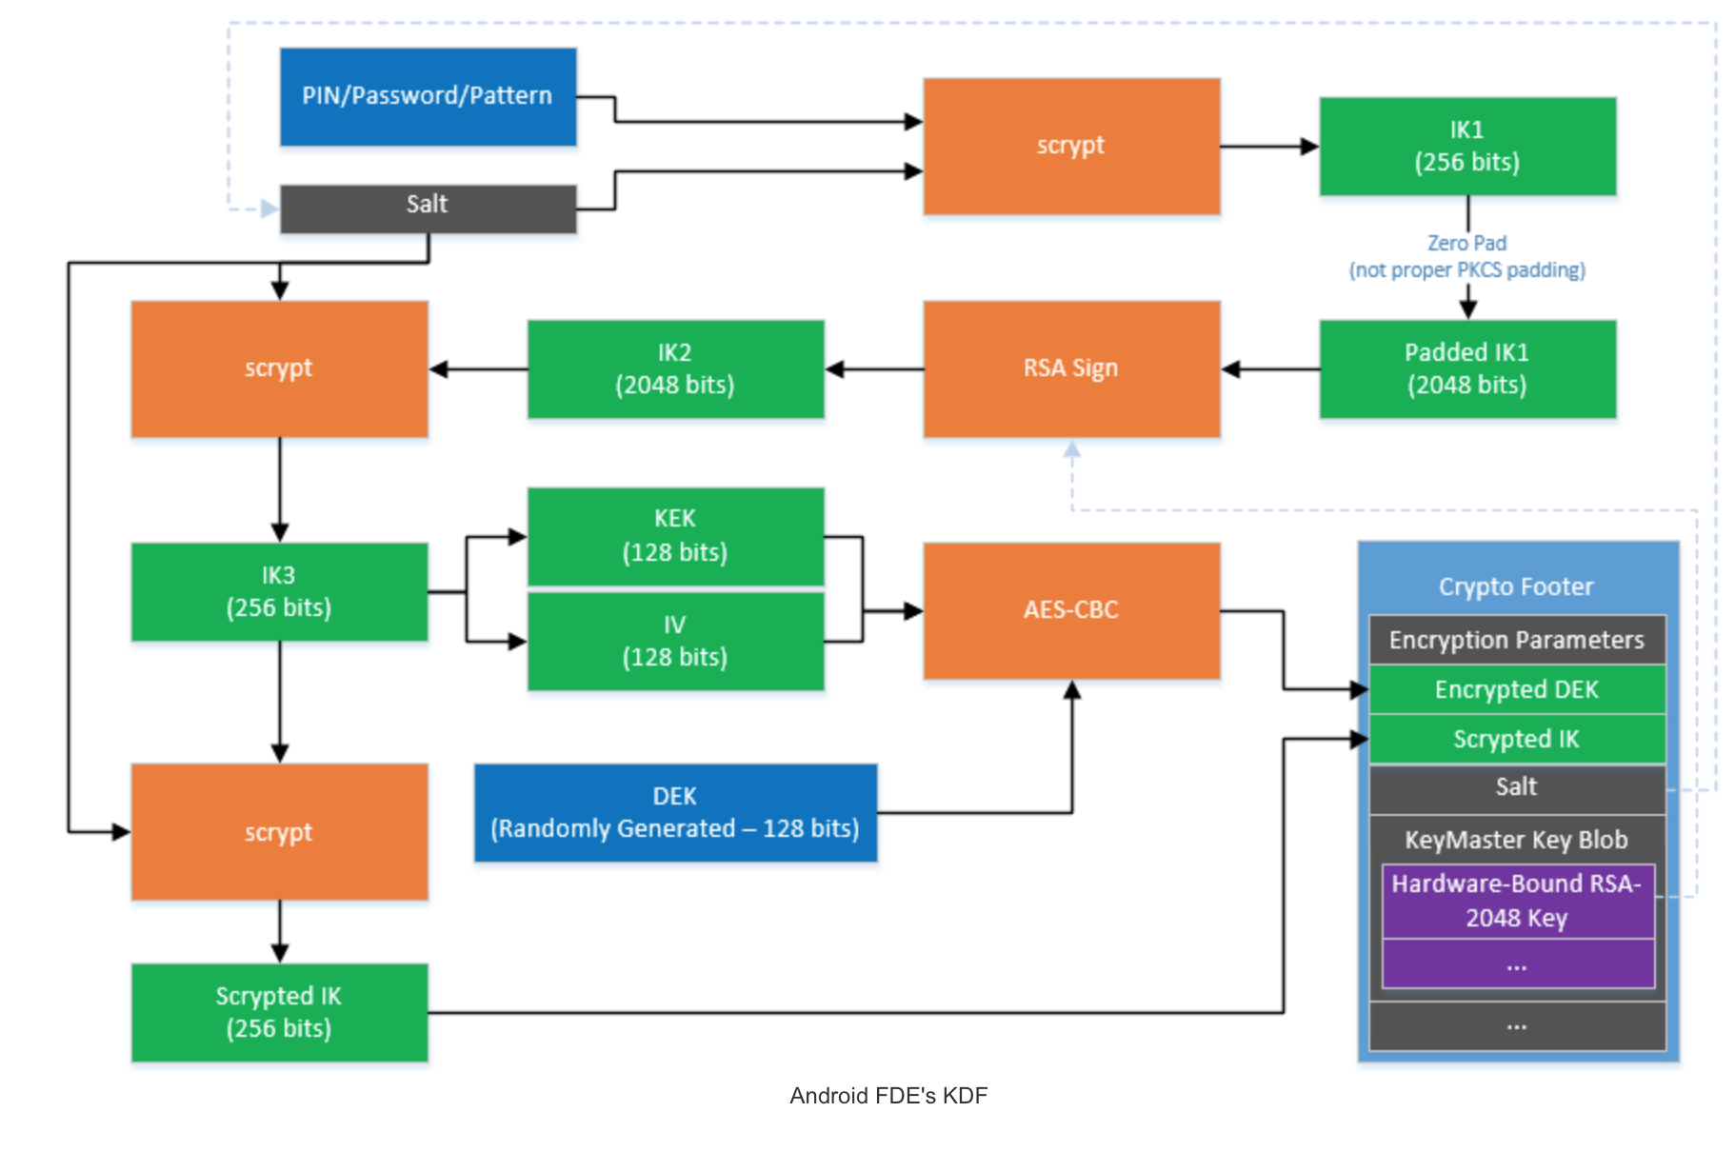
Android Full Disk Encryption

Slide 13
SGX

Slide 14
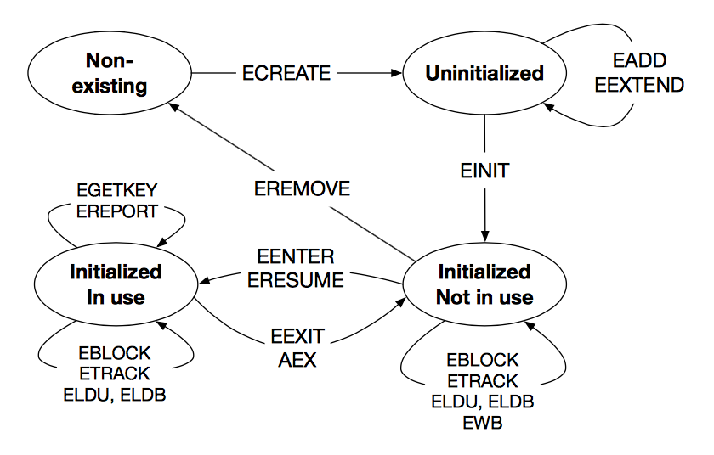
Enclaves
Isolated computing environments
Access hardware-derived keys
Provide
Provide local and remote attestation

Slide 15
Isolation

Slide 16
Sealing

Slide 17
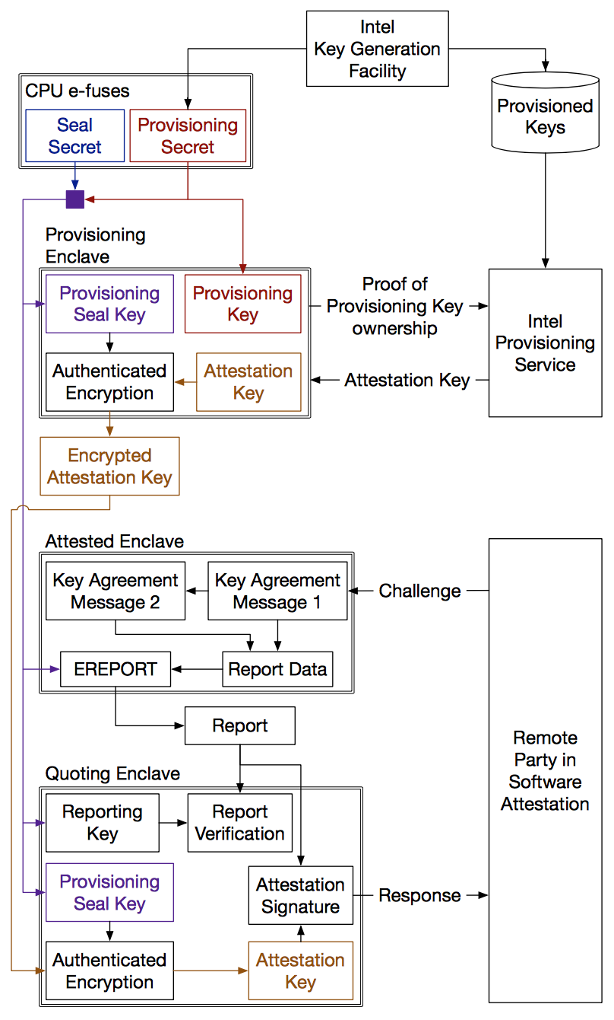
Attestation

Slide 18
SGX in use

Slide 19
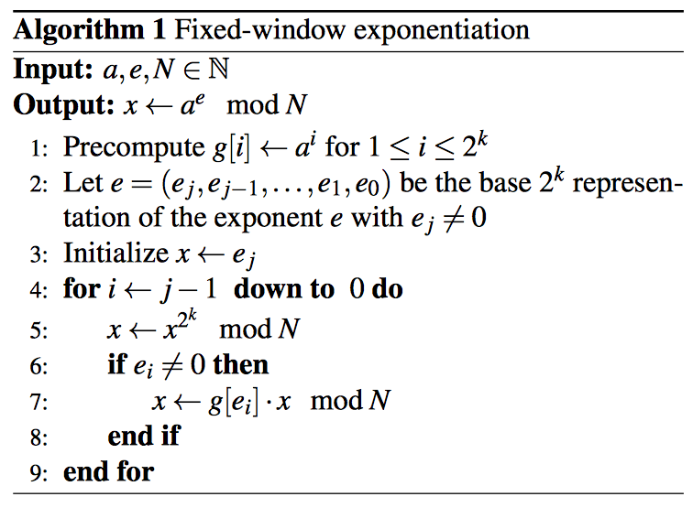
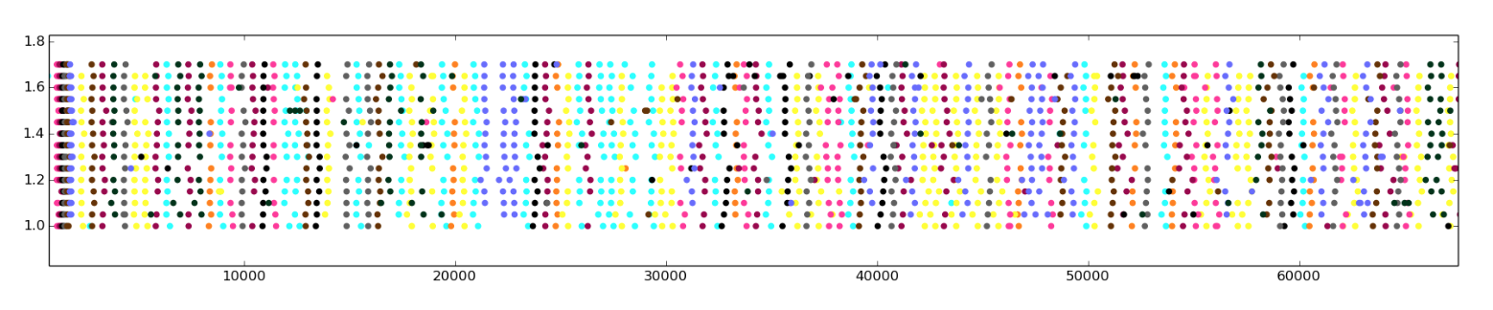
Vulnerabilities
Trustworthiness of Trusted Code
Side Channels

Slide 20
Comparison of Hardware Solutions
Adversary | Attack | TPM | TrustZone | SGX
OS | direct probing | n/a (OS measured) | access checks on TLB misses | Access checks on TLB misses
OS | page faults | n/a (OS measured) | secure page tables | X
OS | cache timing | n/a (OS measured) | X | X
Another container | direct probing | n/a | n/a (secure world trusted) | access checks on TLB misses
Another container | cache timing | n/a | n/a (secure world trusted) | X
Peripheral | DMA | X | bus bounces accesses | IOMMU bounces DMA
Physical attacker | Physical DRAM | X | n/a (on-chip SRAM only) | memory encryption

Slide 21
So where are we?

Slide 22
The Bigger Picture
Attacks
are perpetrated by
threats
that inflict
harm
by exploiting
vulnerabilities
which are controlled by
countermeasures.

Slide 23
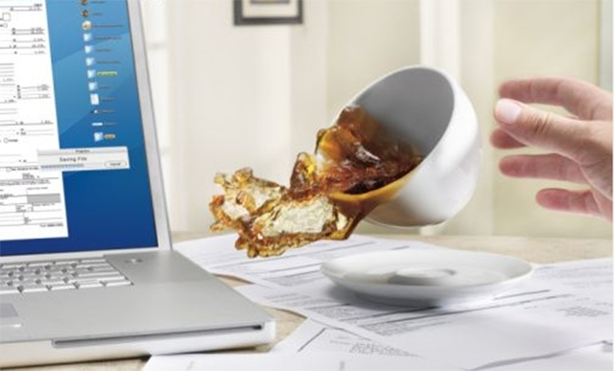
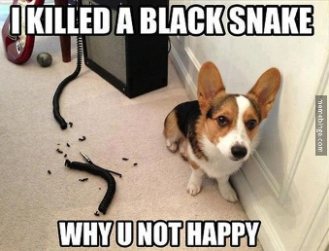
Threats
A principal that has potential to cause harm to assets
Adversary or attacker: a human threat, motivated and capable
Sometimes humans aren't malicious: accidents happen
Sometimes non-humans cause harm: floods, earthquakes, power outage, hardware failure

Slide 24
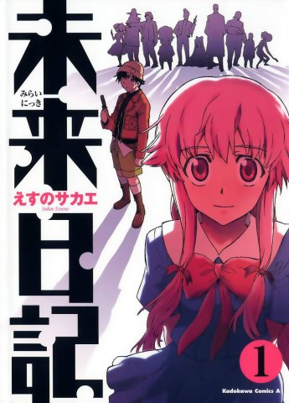
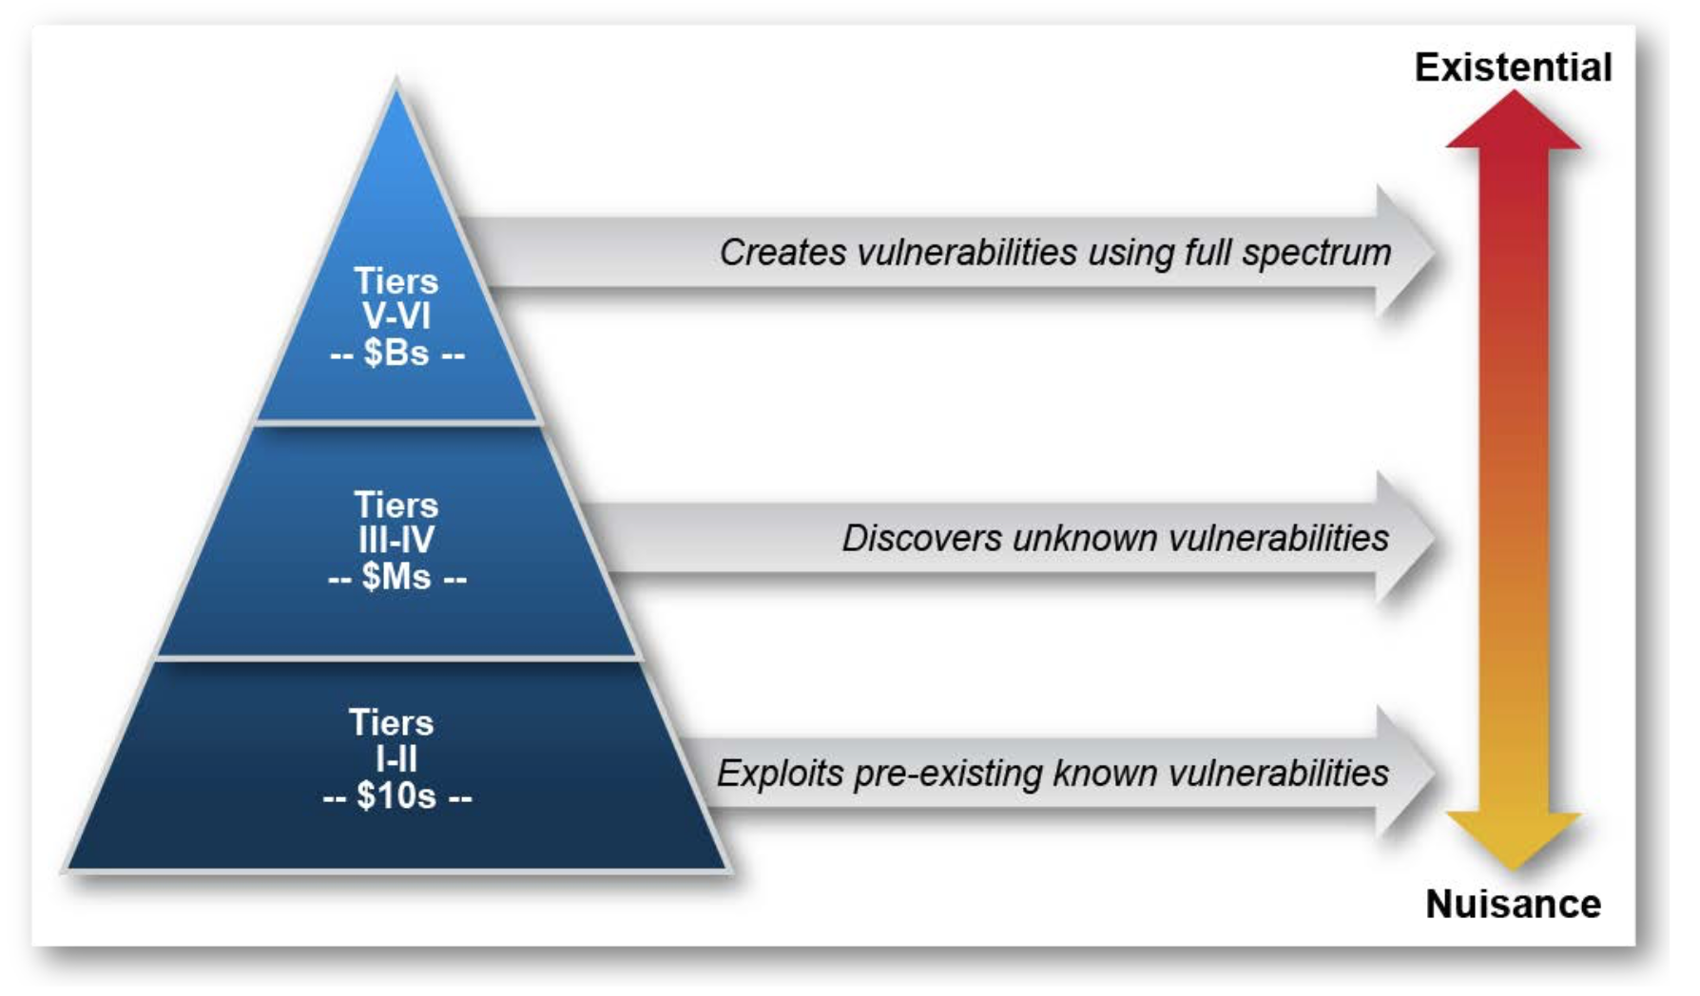
Threats

Slide 25

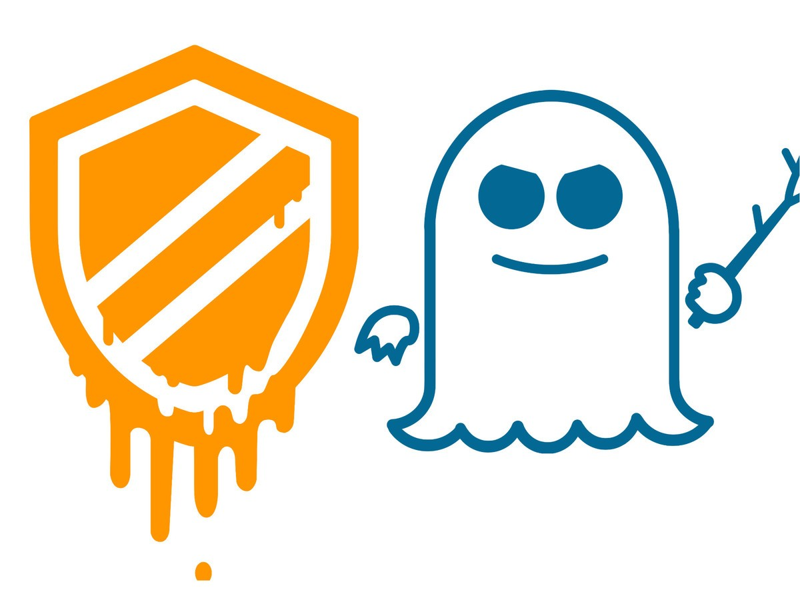
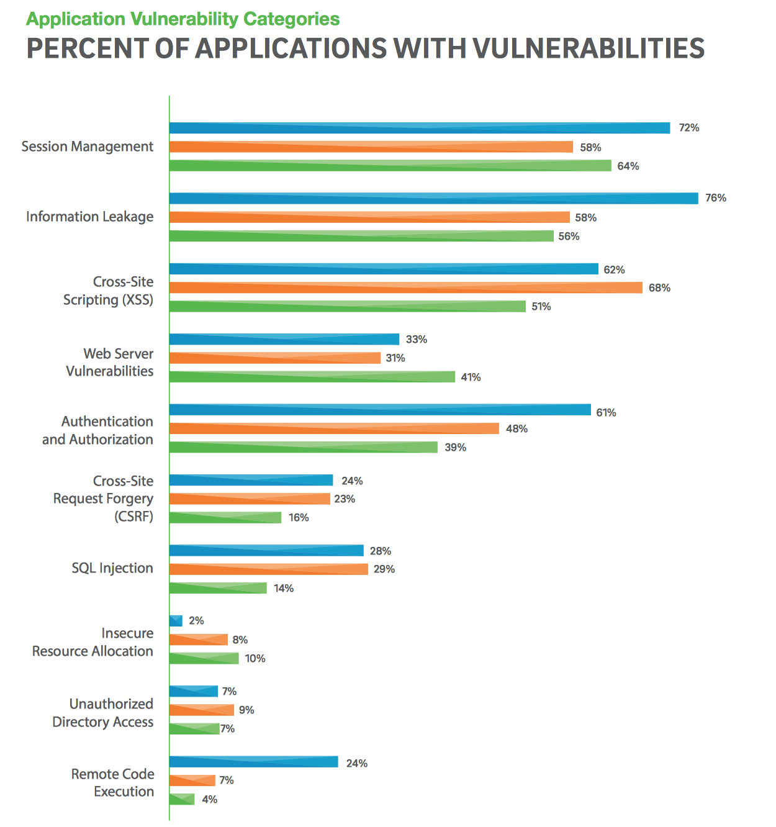

Vulnerabilities

Slide 26
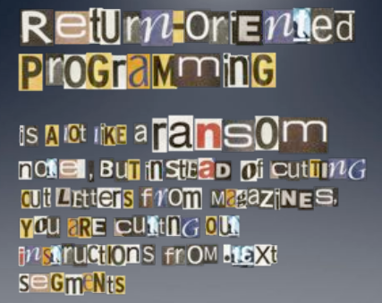
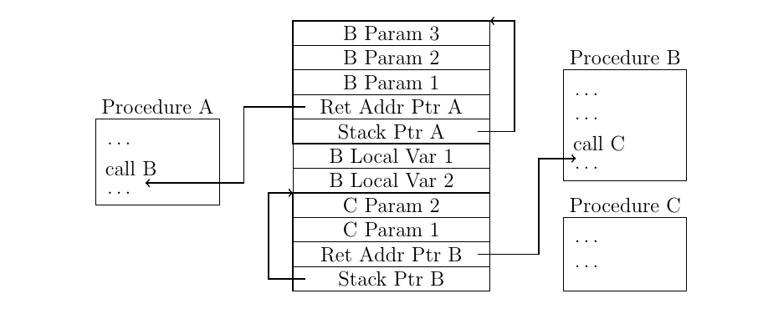
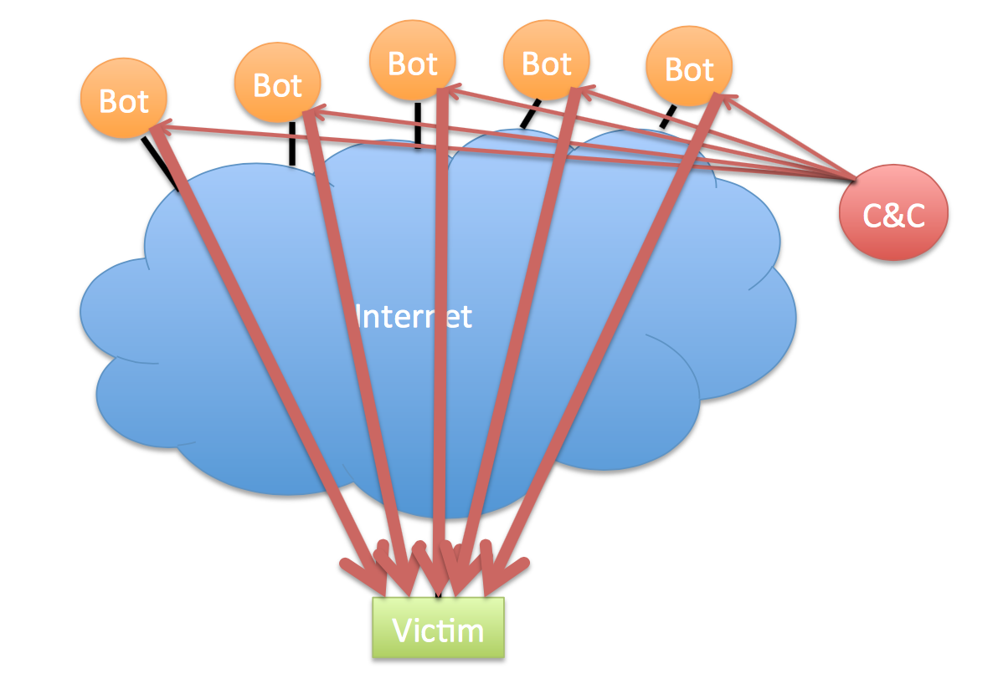
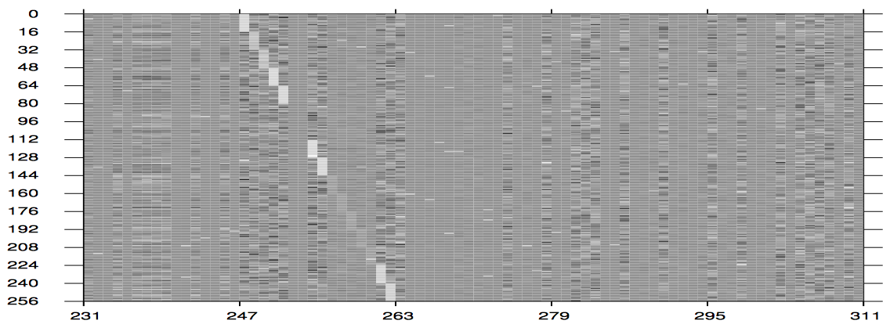
Attacks

Slide 27
Functional Goals -> Harms -> Security Goals
C I A
Confidentiality
Integrity
Availability

Slide 28
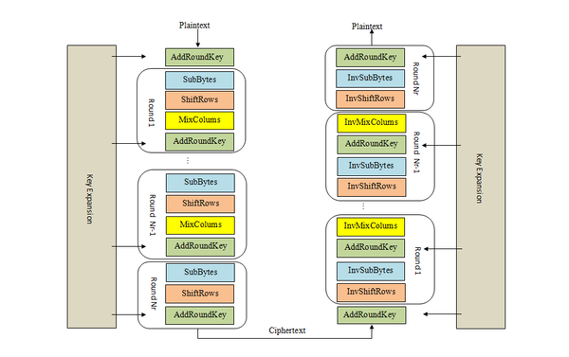
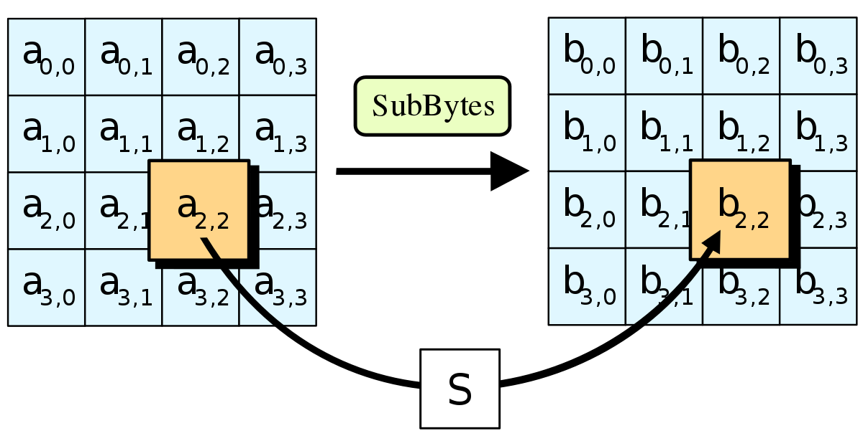
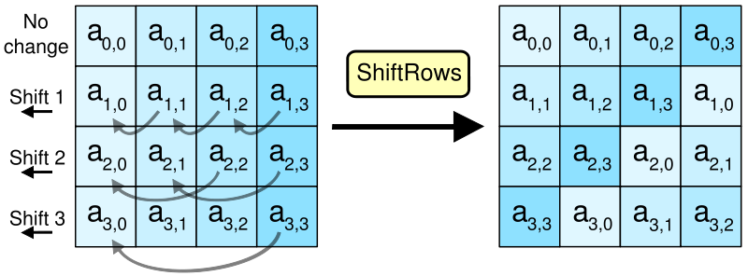
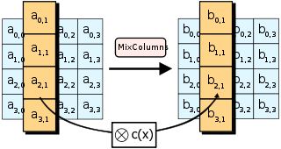
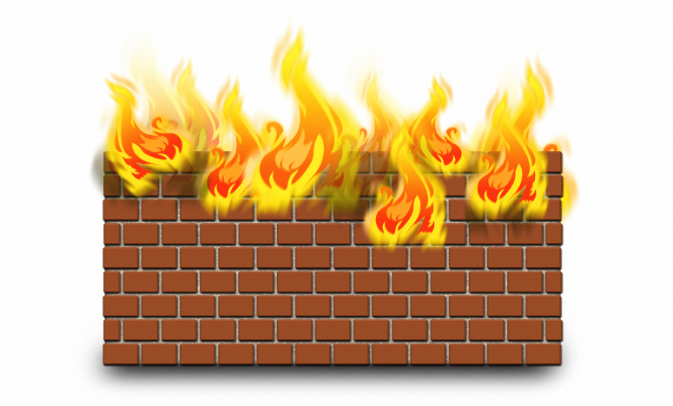
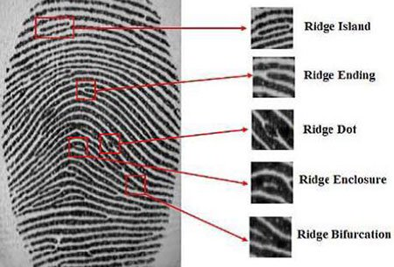
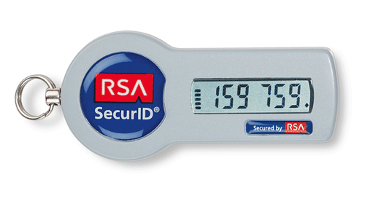
Countermeasures

Slide 29
And now…

