Slide 1
Lecture 27: Privacy
CS 5430 5/7/2018

Slide 2
C I A
Confidentiality
Integrity
Availability

Slide 3
Privacy
Privacy concerns information about individuals (people, organizations, etc.)
Often construed as legal right
Privacy is not a synonym for confidentiality or for secrecy

Slide 4

What is Privacy?
Notes:
discuss
Privacy as confidentiality
Nissenbaum (contextual integrity)

Slide 5
What is a privacy violation?
Police read papers stored in your home
Police read papers you threw in the trash
Police read your medical records
Your parents read your medical records
Gannett uses your medical records in a research study
Police read your texts/Facebook messages
Police read your emails
Google employee reads your emails
Google uses your emails to target personalized ads
Someone tracks your location for months (using phone)
Notes:
Assume all actions occur without your consent and without a warrant

Slide 6
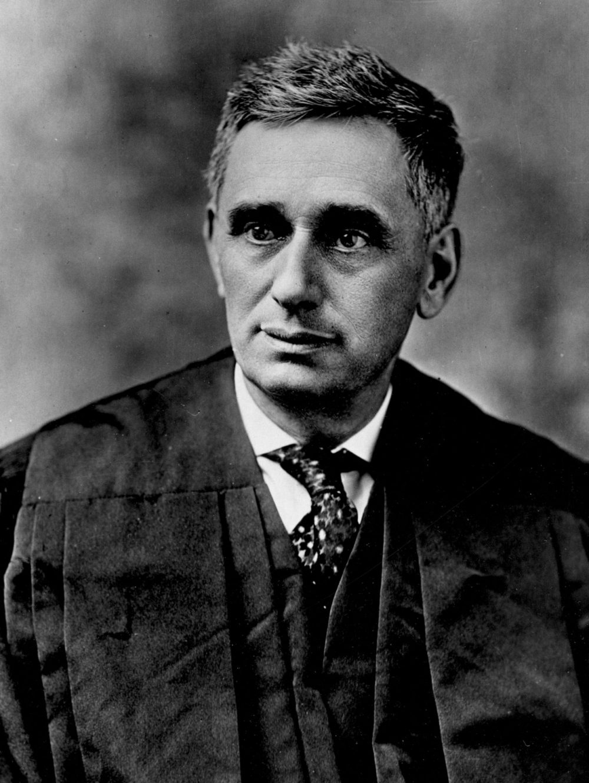
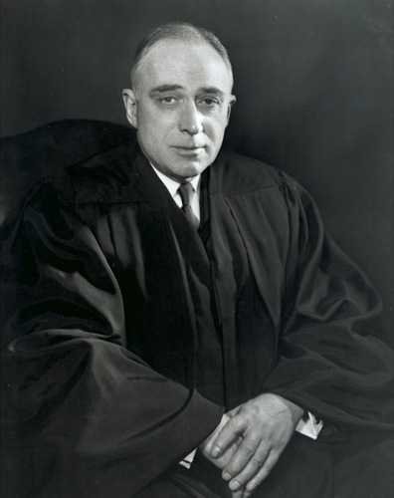
Privacy in American Law
Notes:
Louis Brandeis was an American lawyer and Supreme Court justice, also a leader of the progressive party
With his law partner Samual Warren, influential early writer on privacy law, including "The Right to Privacy" [Harvard Law Review, 1890], which developed the idea of a right to be left alone, and a right to control private data.
John Harlan (supreme court justice) outlined a two-prong test for a "reasonable expectation of privacy" in his concurrence to Katz v. United States (1967) to identify when laws or behaviors violated fourth amendment protections.
Current cases to watch: Carpenter v. United States

Slide 7
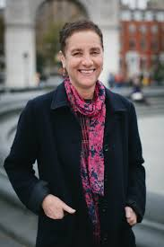
Contextual Integrity
defines privacy relative to appropriate context
considers information type, time, location, purpose, principals involved (subject, sender, receiver)
dependent on social norms
norms can change over time

Slide 8
General Guidelines
The FTC's Fair Information Practice Principals (FIPPs) are the most broadly recognized guidelines for handling private data in information systems
  Seek consent
  Minimize data use
  Limit storage
  Avoid linking

Slide 9
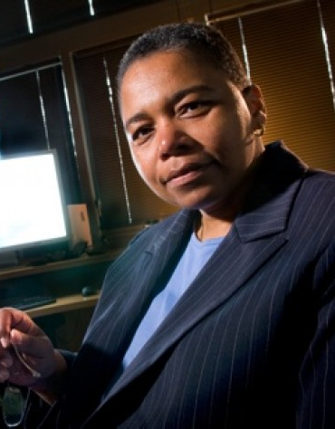
Deanonymization
Zip Code
Gender
Date of Birth
You
Notes:
Sweeney 97: identified Massachusetts governor from anonymized insurance dataset using voter records
Massachusettes Group Insurance Commission “anonymized” health records for state employees + voter rolls.
Sweeney 02: 87% of Americans uniquely identified by Zip Code, Gender, DOB

Slide 10

Deanonymization
Notes:
In 2006, AOL released 20 million "anonymized" search results from 650,000 users for research purposes.

Slide 11

Deanonymization
Notes:
In 2006, Netflix released a challenge. They released a data set of 100 million ratings by 480,000 anonymized users. The first group to best Netflix's in-house recommendation system by 10% would receive a reward of $1 million. Awarded to a group from AT&T labs in 2009.

Slide 12
k-Anonymity
Name | Gender | Year | Grade
Alice | F | 2018 | 95
Bob | M | 2018 | 80
Charlie | M | 2018 | 95
David | M | 2018 | 60
Edward | M | 2019 | 80
Flora | F | 2019 | 99
Georgia | F | 2019 | 60
Notes:
quasi-identifiers: (sets of) attributes that can be exploited for linking
k-anonymity: each quasi-identifier must be ambiguously mapped to at least k different individuals
Techniques: suppression and generalization
Problems: identifying QIs, homogenity attack, background knowledge attack
Refinement: \ell-diversity additionally requires \ell "well represented" values for each QI

Slide 13

Database Privacy
Offline Privacy
Online Privacy
DB
“Private” data
DB

Slide 14
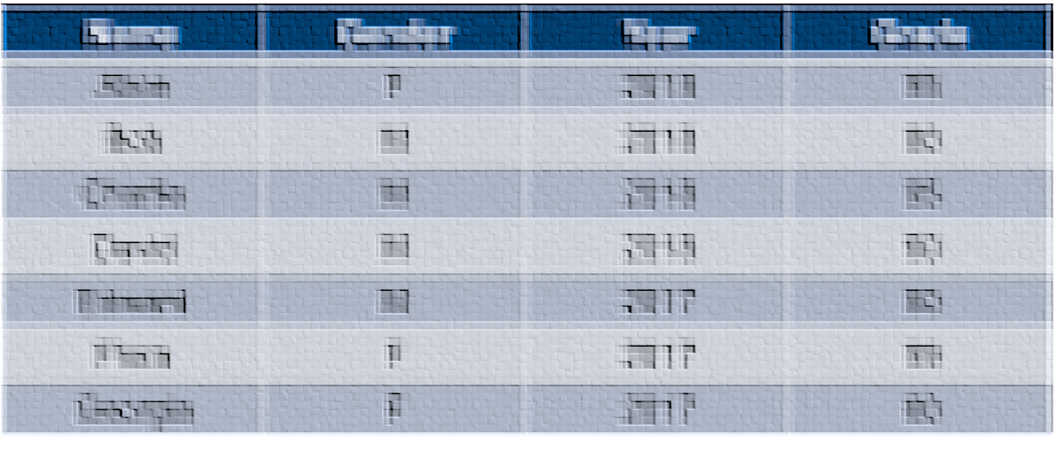
Data Perturbation
Notes:
-online or offline
-problem: utility
-problem: noise cancels out

Slide 15

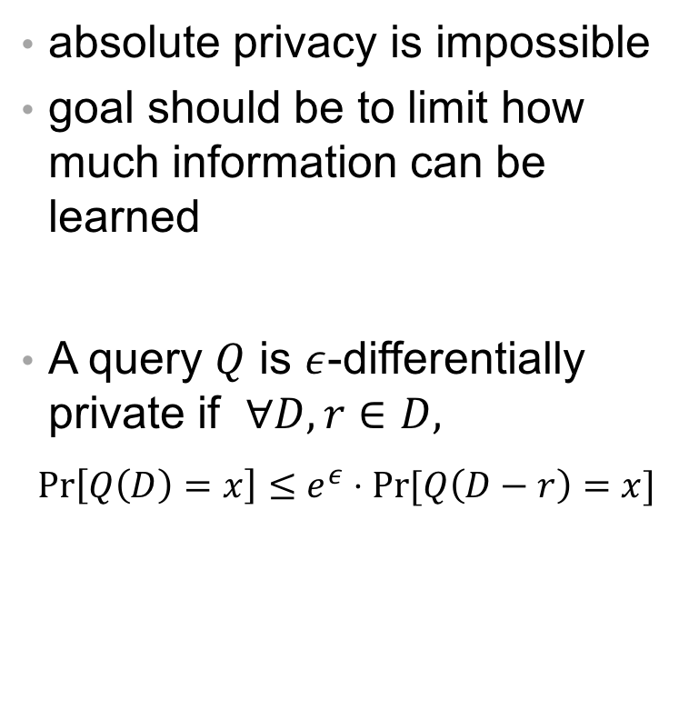
Differential Privacy
absolute privacy is impossible
goal should be to limit how much information can be learned
A query $Q$ is $ε$-differentially private if $∀D,r∈D,$
$$\operatorname{Pr}\left[Q\left(D\right)=x\right]≤e^{ε}⋅Pr⁡[Q\left(D−r\right)=x]$$

Slide 16
Differential Privacy
Key Idea: Changing a single user’s record does not significantly affect the result of any analysis or query

Slide 17
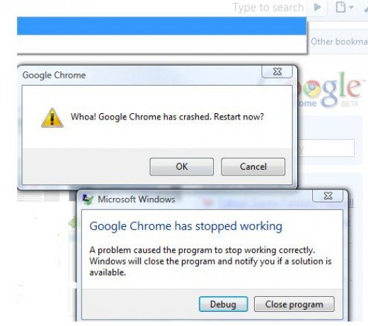

DP in action…

Slide 18
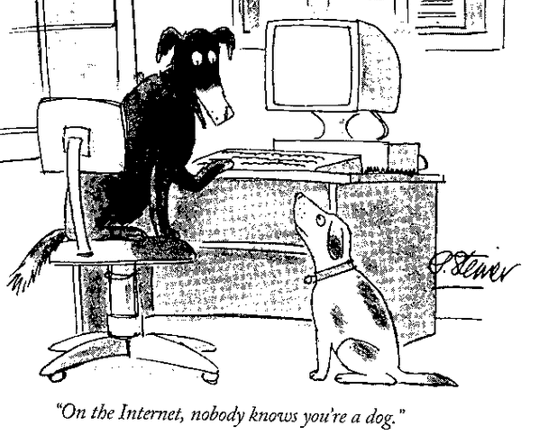
Internet Privacy

Slide 19
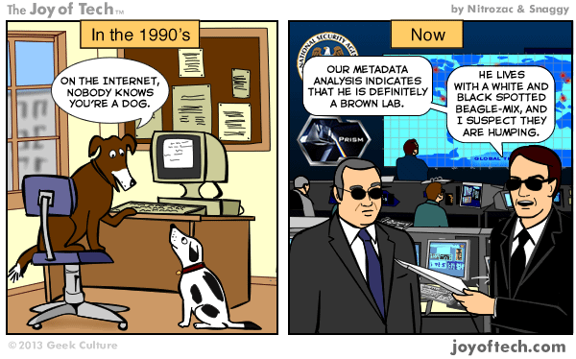
Internet Privacy

Slide 20
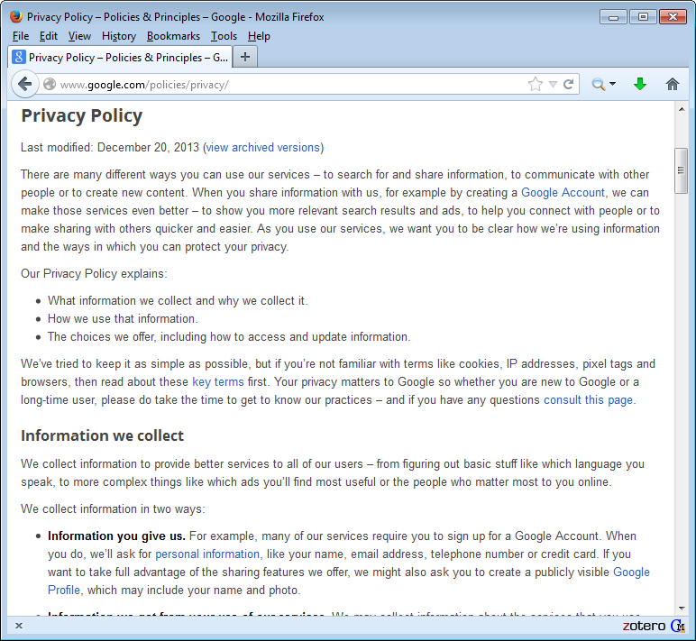
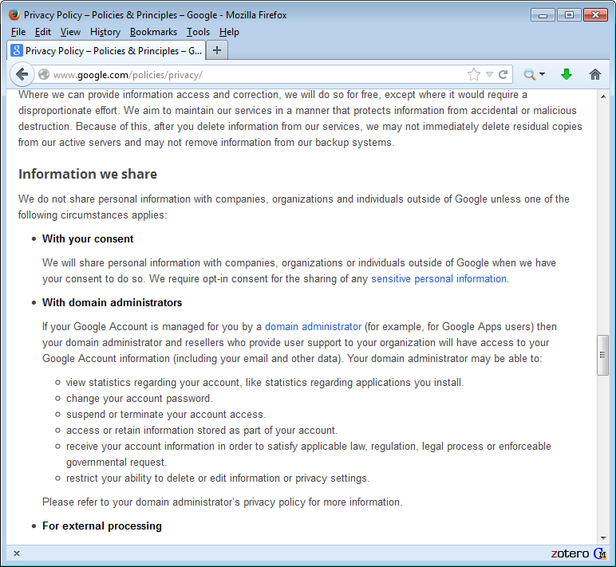
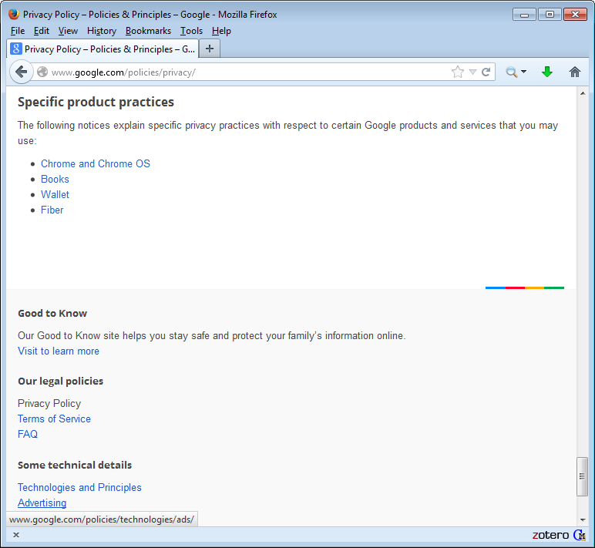
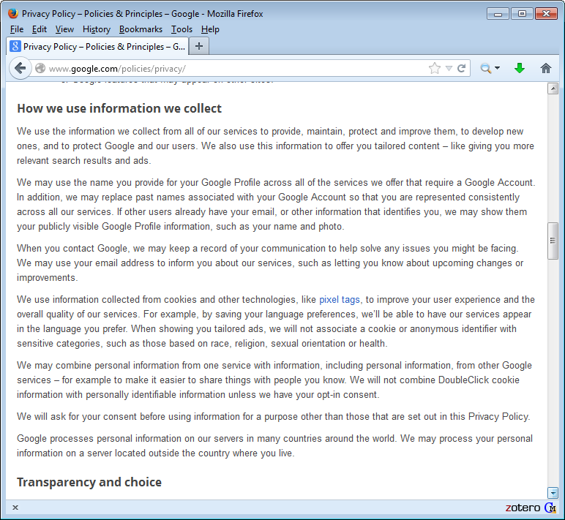
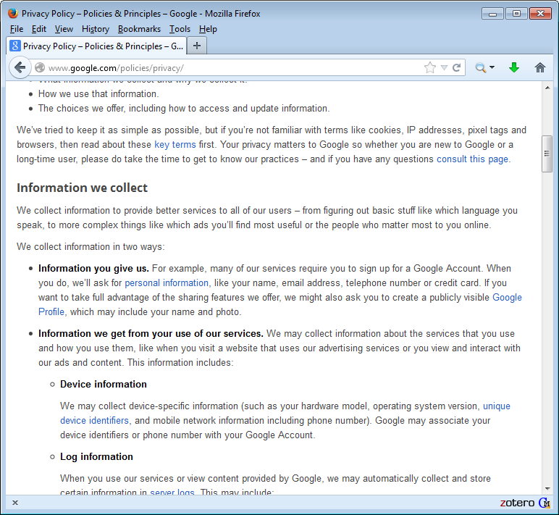
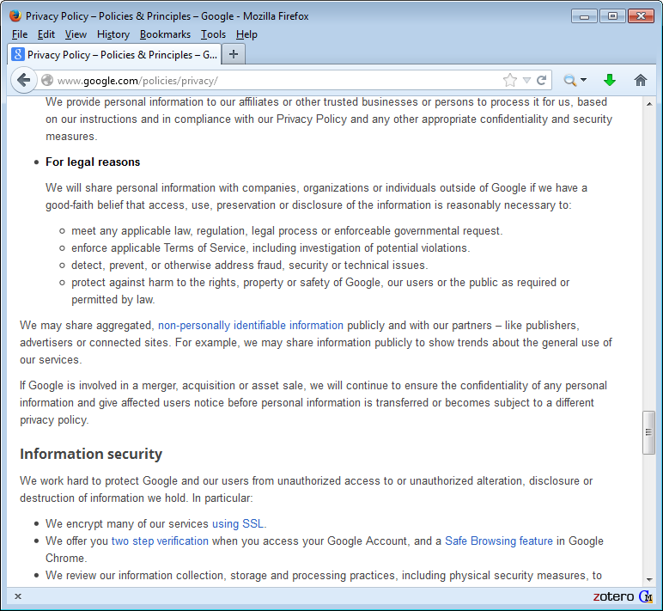
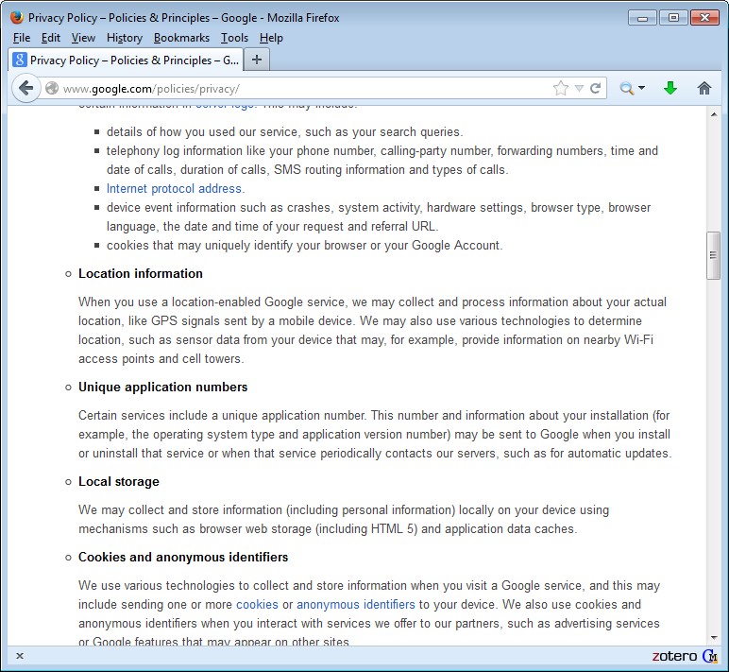
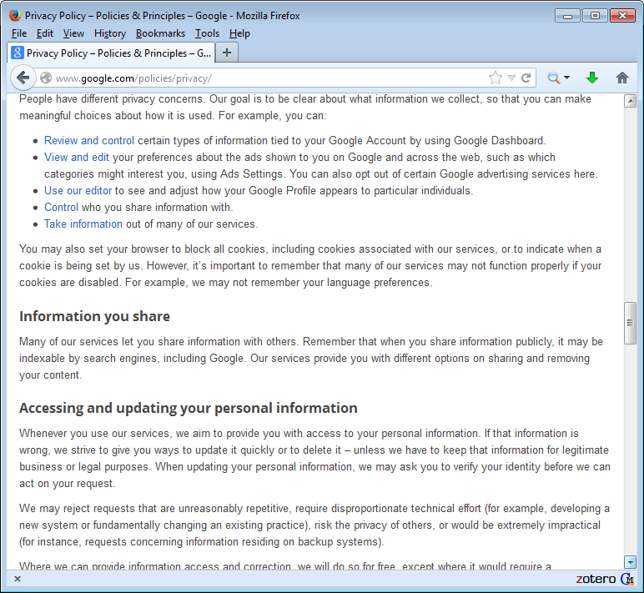
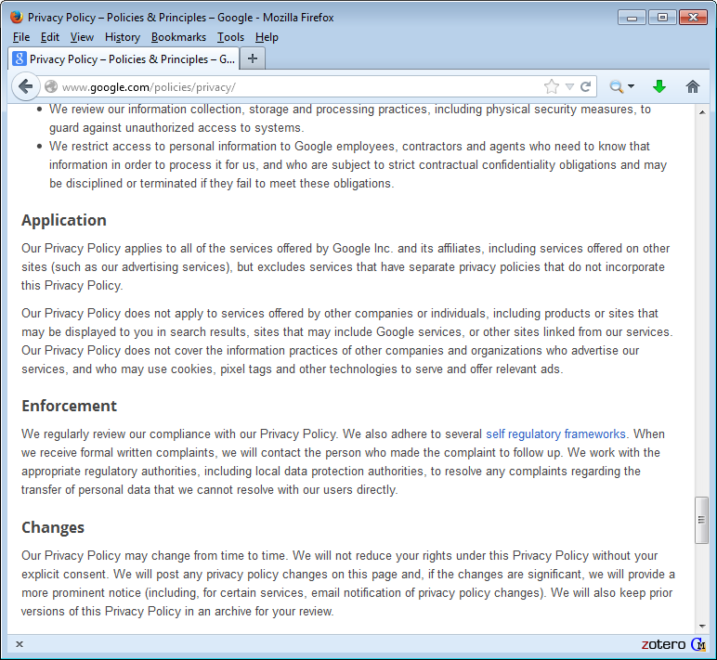
Notice & Consent

Slide 21
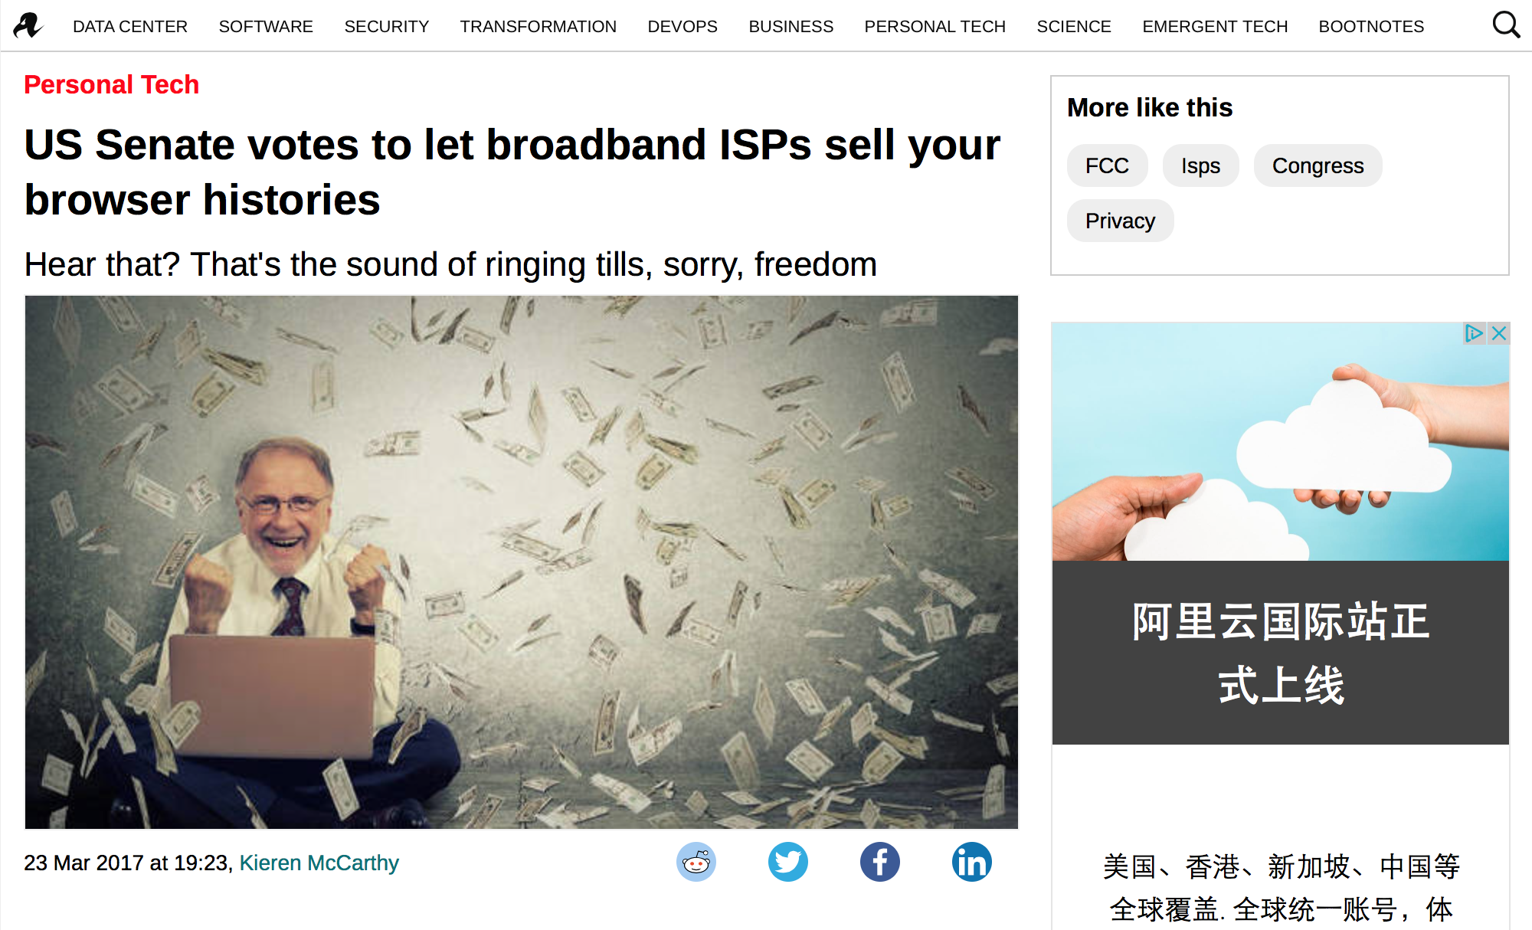
Browser Tracking

Slide 22
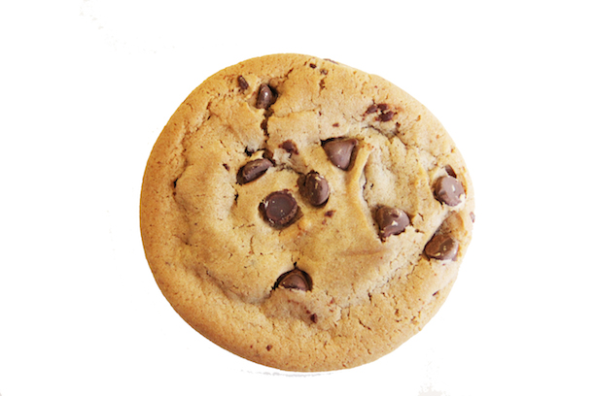
Browser Tracking
Notes:
-standard cookies, third party cookies

Slide 23
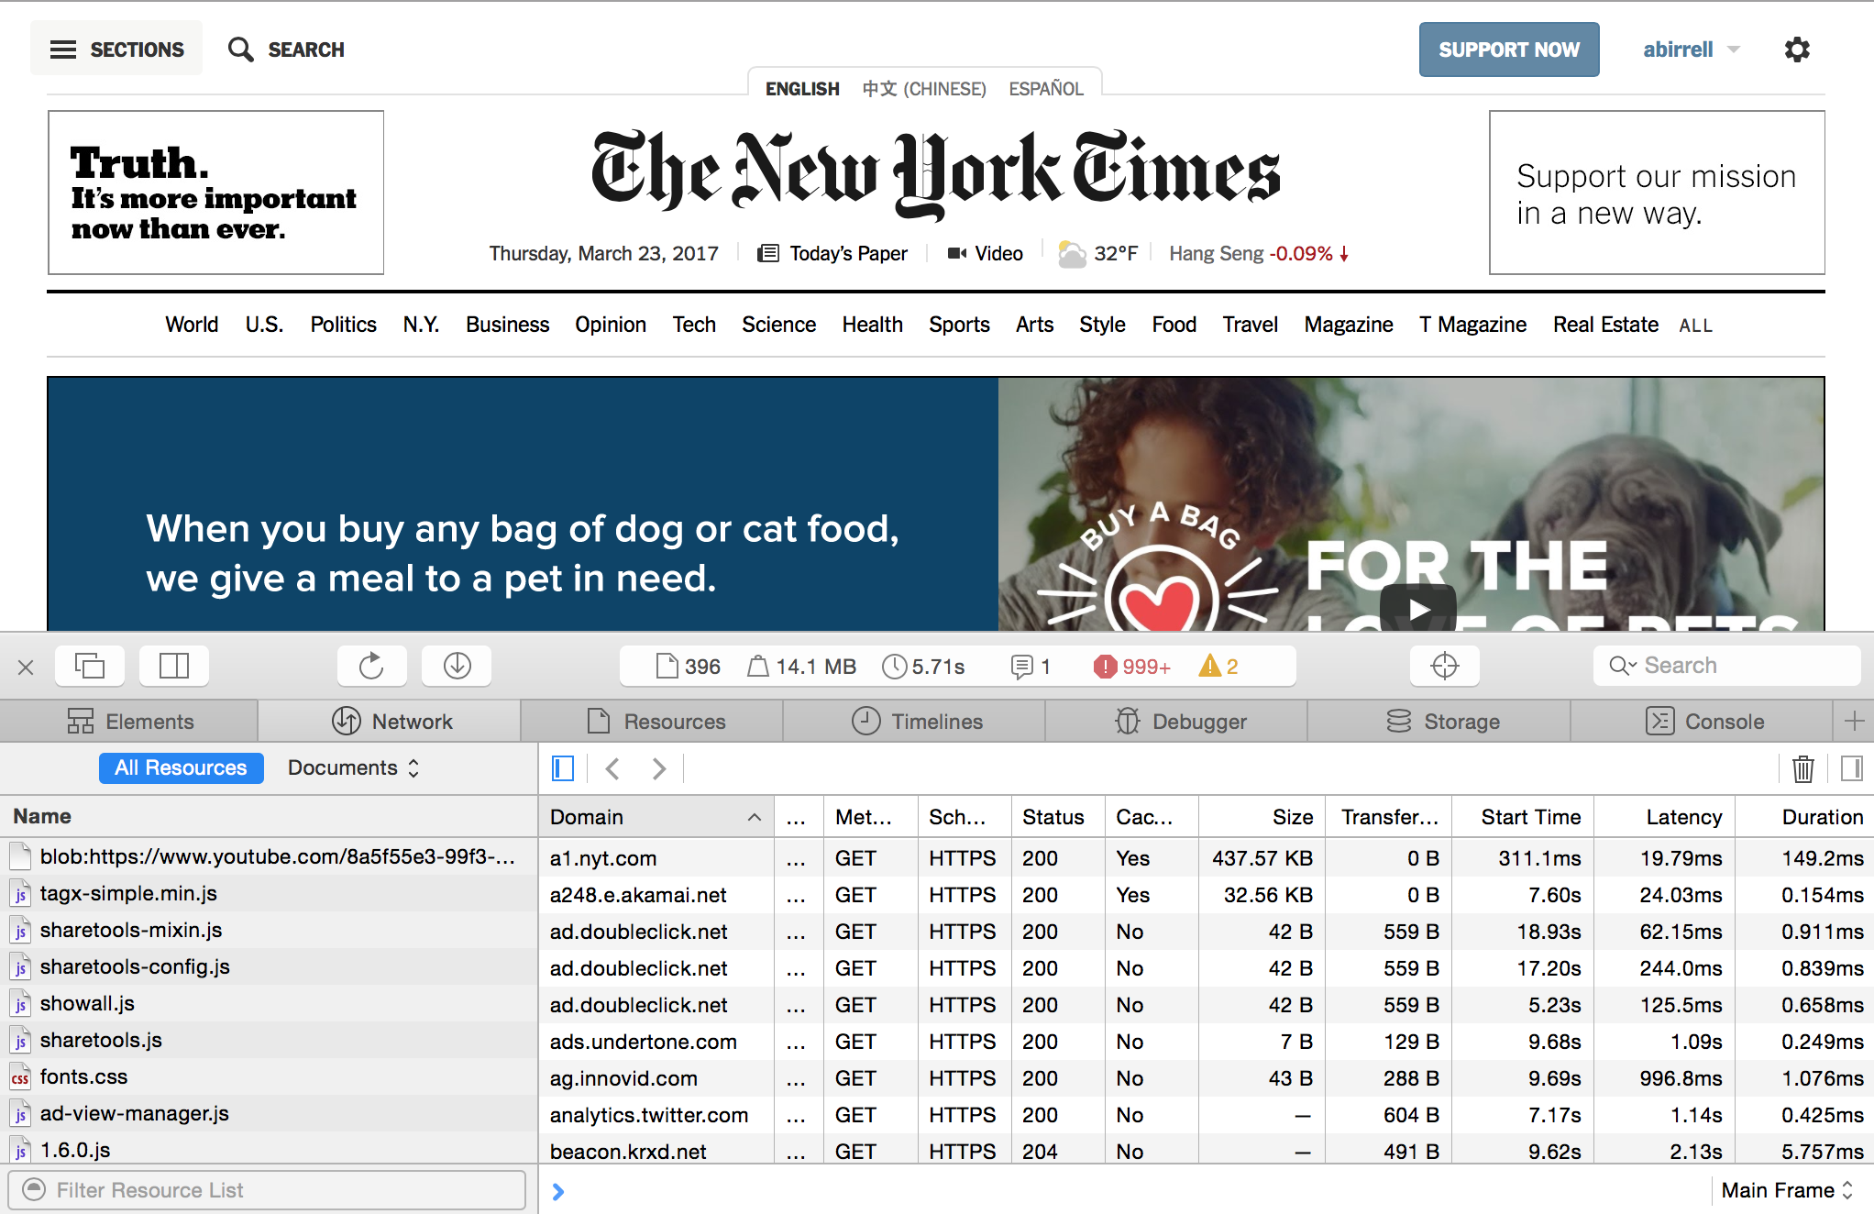
Browser Tracking

Slide 24
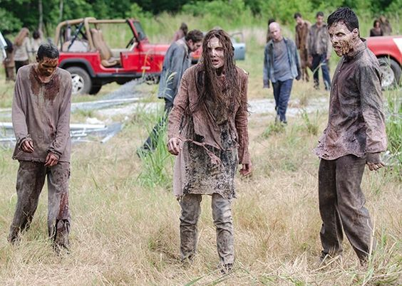
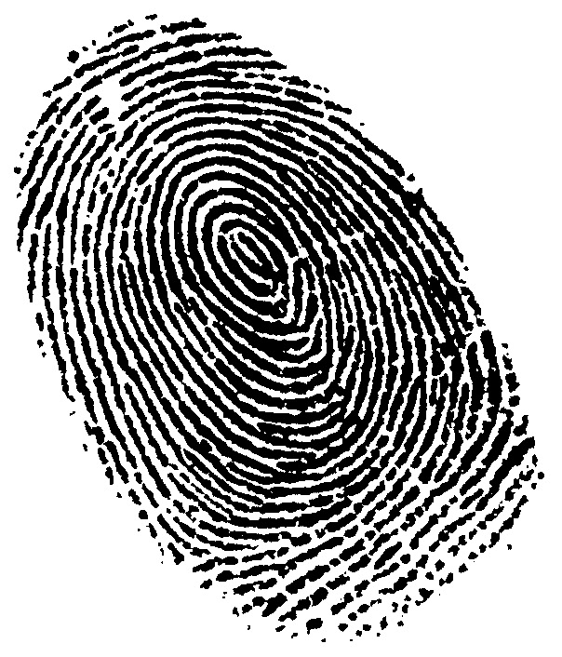
Beyond Cookies
Zombie Cookies
Browser Fingerprinting
Notes:
Zombie cookie mechanisms: browser history, encode as RGB values in cached image, local storage (e.g., flash cookie), HTML session/local storage (evercookie: javascript API that stores zombie cookie copies in all available forms)
browser fingerprinting (canvas = GPU + driver +etc, clock skew, fonts, history, etc)

Slide 25
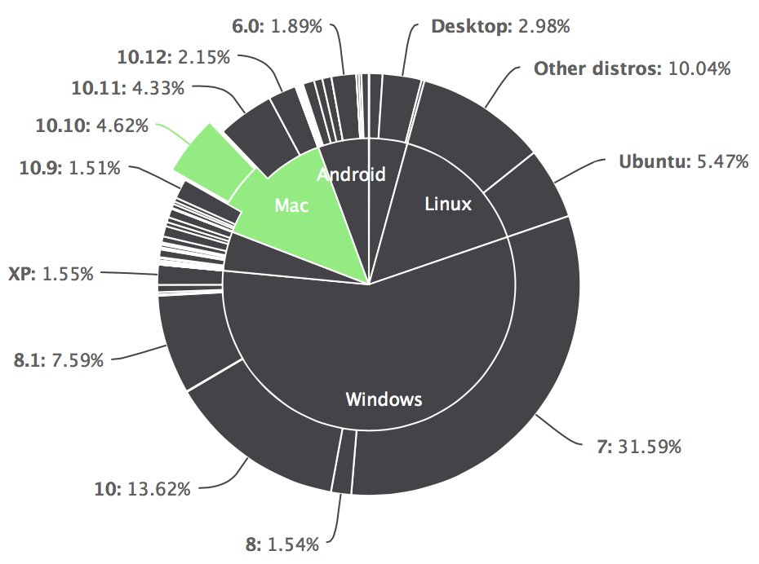
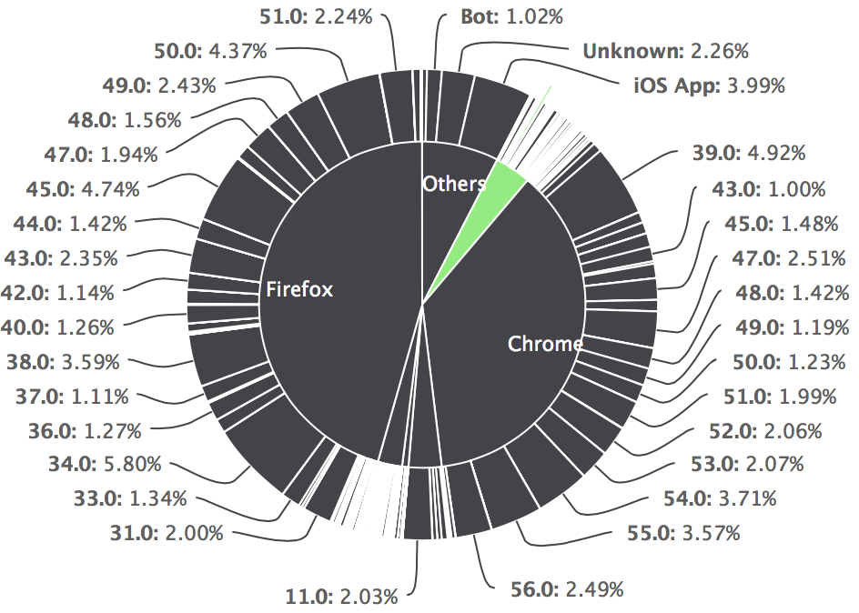
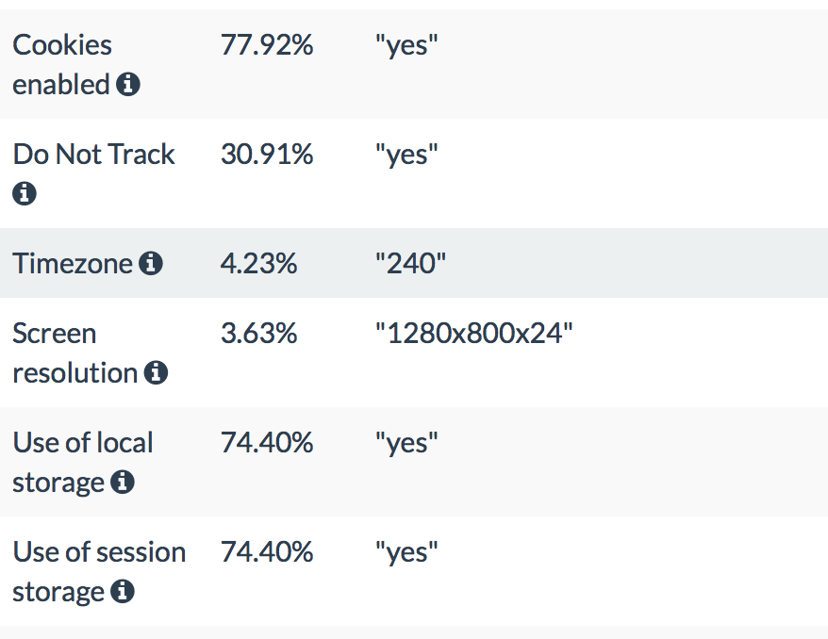
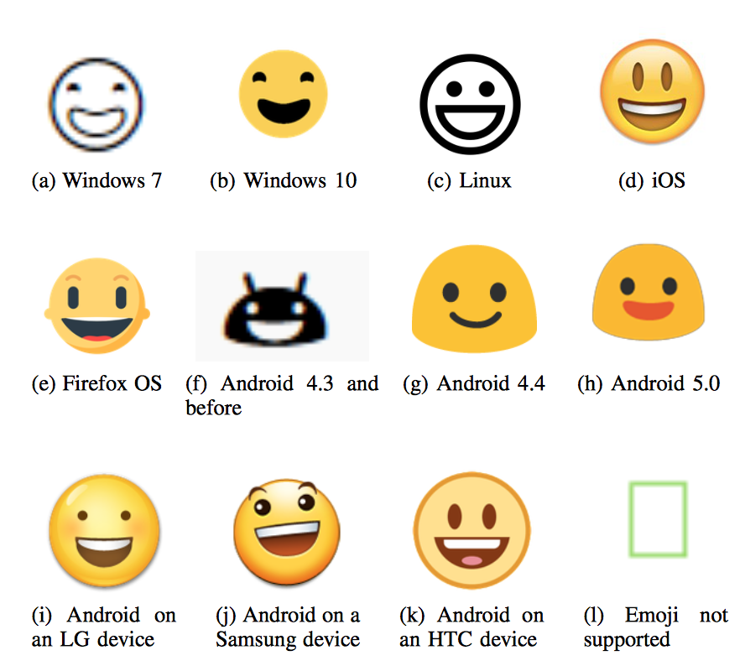
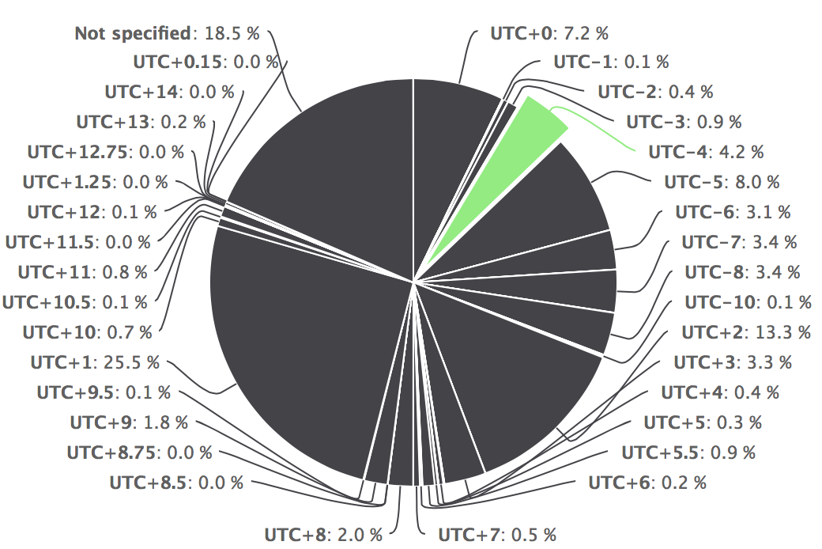
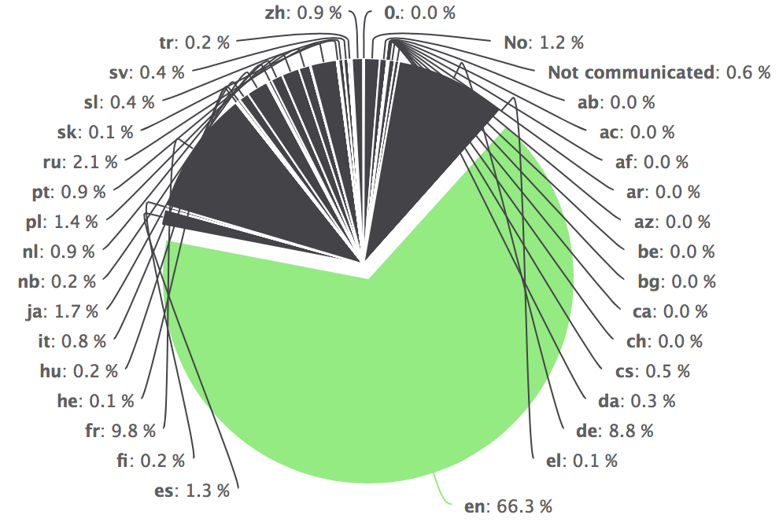
Fingerprinting Works
Operating System
Browser
Settings
Time Zone
Language
Canvas

Slide 26
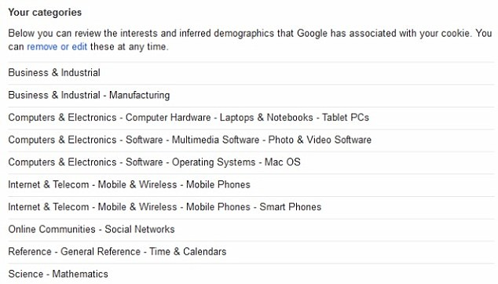
The result…

Slide 27
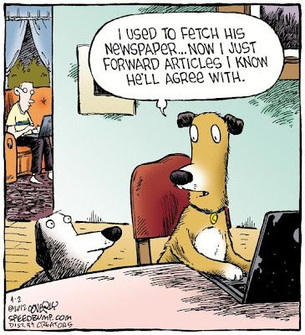
Personalized Content

Slide 28
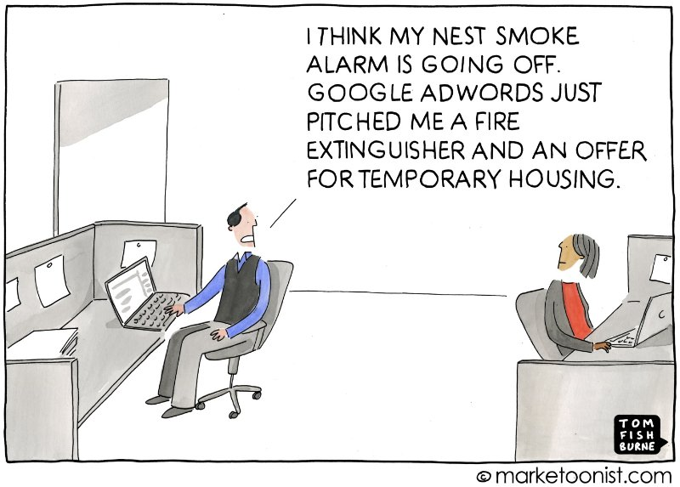
Targeted Advertising

Slide 29
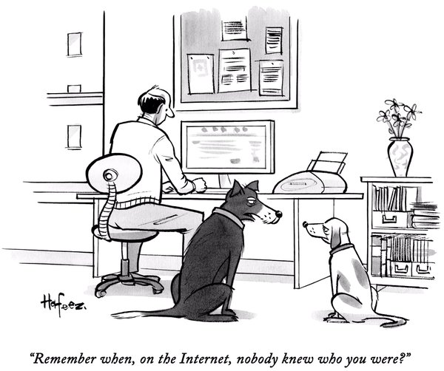
Data Collection is Here to Stay…

