Slide 1
Lecture 21: Dynamic Information Flow Control
CS 5430 4/16/2018

Slide 2

Information flow policies
Can flow to:
Alice
Doc
Automatic deduction of policies!
computation
Can flow to:
Alice
Can flow to:
Alice
Doc’
Doc’’
Notes:
For example, if a document Doc is allowed to flow only to Alice, then any document derived from Doc is allowed to flow only to Alice, too. Otherwise, the IF policy on Doc would be violated.

Slide 3
Labels represent policies
Secret, {nuc, crypto}
Secret, {nuc}
Conf, {nuc,crypto}
Secret, {crypto}
Conf, {nuc}
Secret, {}
Conf, {crypto}
Conf, {}
Notes:
Hasse diagram

Slide 4
Noninterference
[Goguen and Meseguer 1982]
An interpretation of noninterference for a program:
Changes on H inputs should not cause changes on L outputs.
H
H
L
L
Inputs
Outputs
Program

Slide 5


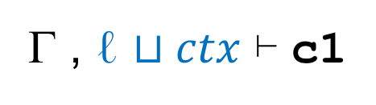




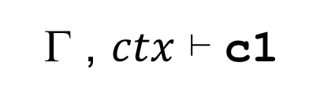
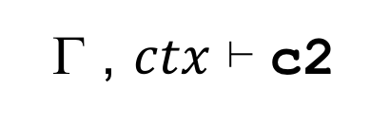

Static type system
Γ ⊢ e : ℓ
ℓ $⊔ctx ⊑$ Γ(x)
Assignment-Rule:
  Γ , $ctx$ ⊢ x:=e
Γ ⊢ e : ℓ
  Γ , ℓ $⊔ctx$ ⊢ c1
  Γ , ℓ $⊔ctx$ ⊢ c2
If-Rule:
  Γ , $ctx$ ⊢ if e then c1 else c2
Γ ⊢ e : ℓ
  Γ , ℓ $⊔ctx$⊢ c
While-Rule:
  Γ , $ctx$ ⊢ while e do c
  Γ , $ctx$ ⊢ c1
  Γ , $ctx$ ⊢ c2
Sequence-Rule:
  Γ , $ctx$ ⊢ c1;c2

Slide 6
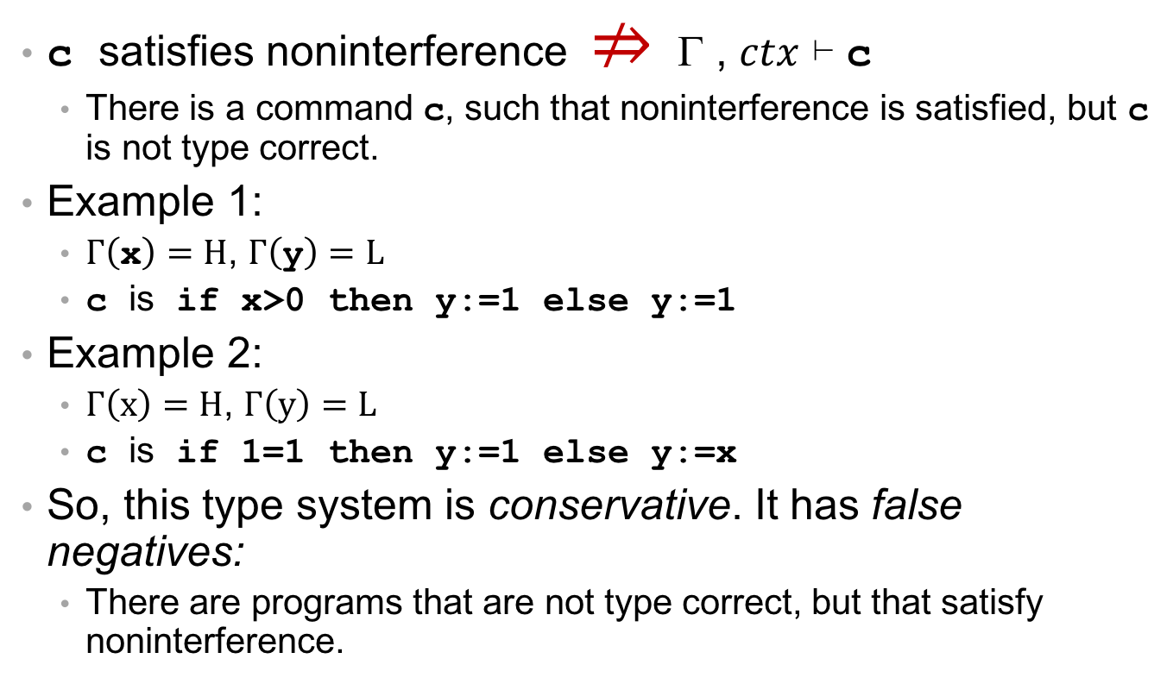
This type system is not complete.
c satisfies noninterference $⇏$ Γ , $ctx$ ⊢ c
  There is a command c, such that noninterference is satisfied, but c is not type correct.
Example 1:
  $Γ\left(\text{x}\right)=H$, $Γ\left(\text{y}\right)=L$
  c is if x>0 then y:=1 else y:=1
Example 2:
  $Γ\left(x\right)=H$, $Γ\left(y\right)=L$
  c is if 1=1 then y:=1 else y:=x
So, this type system is conservative. It has false negatives:
  There are programs that are not type correct, but that satisfy noninterference.

Slide 7
Can we build a complete mechanism?
Is there an enforcement mechanism for information flow control that has no false negatives?
  A mechanism that rejects only programs that do not satisfy noninterference?
No! [Sabelfeld and Myers, 2003]
  “The general problem of confidentiality for programs is undecidable.”
  The halting problem can be reduced to the information flow control problem.
  Example:
  if h>1 then c; l:=2 else skip
    If we could precisely decide whether this program is secure, we could decide whether c terminates!

Slide 8
Dynamic enforcement

Slide 9
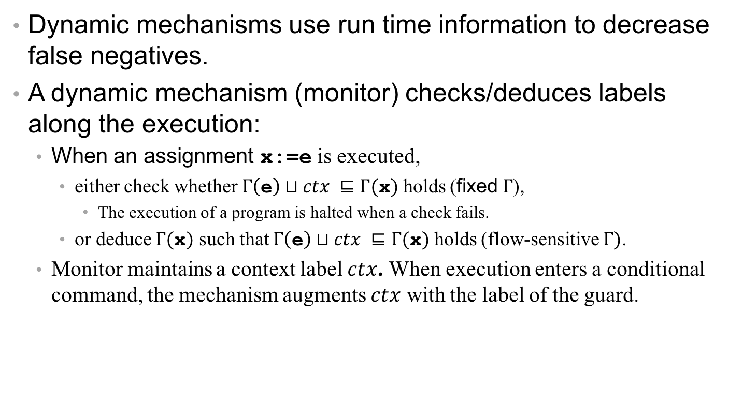
Dynamic Enforcement
Dynamic mechanisms use run time information to decrease false negatives.
A dynamic mechanism (monitor) checks/deduces labels along the execution:
  When an assignment x:=e is executed,
    either check whether $Γ\left(\text{e}\right)⊔ctx ⊑Γ(\text{x})$ holds (fixed $Γ$),
      The execution of a program is halted when a check fails.
    or deduce $Γ(\text{x})$ such that $Γ\left(\text{e}\right)⊔ctx ⊑Γ(\text{x})$ holds (flow-sensitive Γ).
  Monitor maintains a context label $ctx$. When execution enters a conditional command, the mechanism augments $ctx$ with the label of the guard.

Slide 10
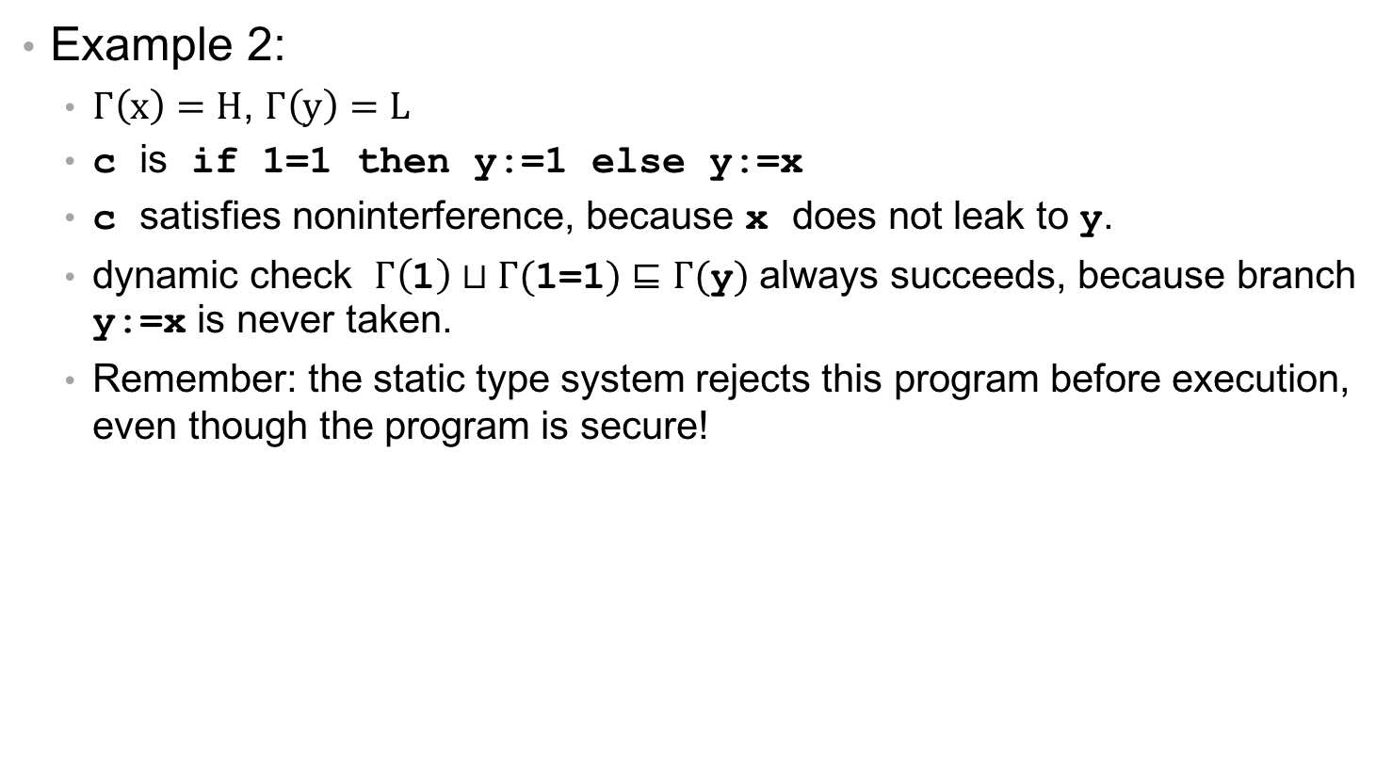
Dynamic Enforcement
Example 2:
  $Γ\left(x\right)=H$, $Γ\left(y\right)=L$
  c is if 1=1 then y:=1 else y:=x
  c satisfies noninterference, because x does not leak to y.
  dynamic check $Γ\left(\text{1}\right)⊔Γ(\text{1=1})⊑Γ(\text{y})$ always succeeds, because branch y:=x is never taken.
  Remember: the static type system rejects this program before execution, even though the program is secure!

Slide 11

But, there is a caveat…
A dynamic mechanism may leak information
  when deciding to halt an execution due to a failed check (fixed $Γ$), or
  when deducing labels during execution (flow-sensitive $Γ$).

Slide 12
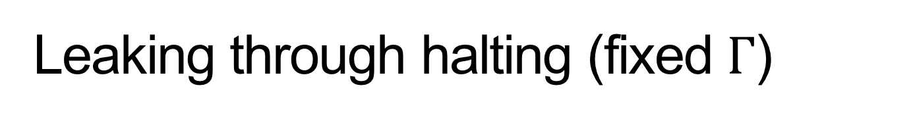
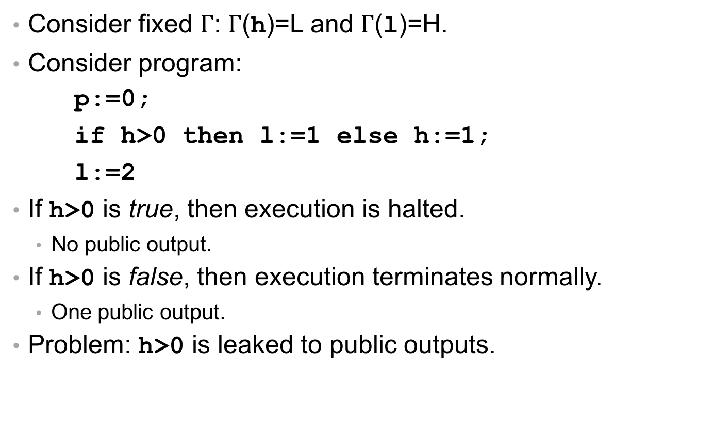
Leaking through halting (fixed $Γ$)
Consider fixed $Γ$: $Γ$(h)=L and $Γ$(l)=H.
Consider program:
p:=0;
if h>0 then l:=1 else h:=1;
l:=2
If h>0 is true, then execution is halted.
  No public output.
If h>0 is false, then execution terminates normally.
  One public output.
Problem: h>0 is leaked to public outputs.
Output

Slide 13
But, there is a caveat…
A dynamic mechanism may leak information
  when deciding to halt an execution due to a failed check (fixed $Γ$), or
  when deducing labels during execution (flow-sensitive $Γ$).

Slide 14
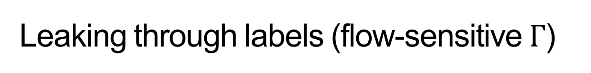
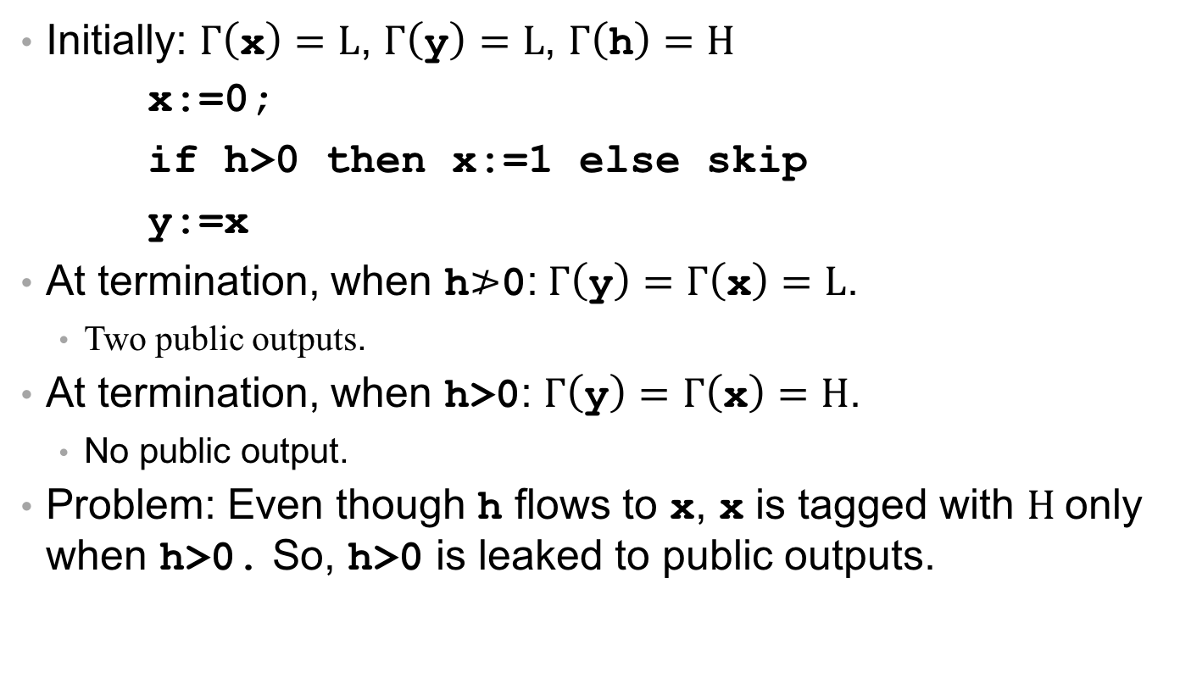
Leaking through labels (flow-sensitive $Γ$)
Initially: $Γ\left(\text{x}\right)=L$, $Γ\left(\text{y}\right)=L$, $Γ\left(\text{h}\right)=H$
x:=0;
if h>0 then x:=1 else skip
y:=x
At termination, when h$≯$0:$Γ\left(\text{y}\right)=Γ\left(\text{x}\right)=L$.
  Two public outputs.
At termination, when h>0: $Γ\left(\text{y}\right)=Γ\left(\text{x}\right)=H$.
  No public output.
Problem: Even though h flows to $\text{x}$, $\text{x}$ is tagged with $H$only when h>0. So, h>0 is leaked to public outputs.
Output

Slide 15
The Problem with Dynamic Mechanisms
Purely dynamic mechanisms are usually unsound.
Purely dynamic mechanism with additional restrictions can become sound:
  Restriction: Stop execution whenever the guard expression of a conditional command is high.
  But, the resulting mechanism is more conservative than desired.
Alternatively…

Slide 16
Use on-the-fly static analysis
Use on-the-fly static analysis to update the labels of target variables in untaken branch.
The resulting mechanism is sound and less conservative.

Slide 17
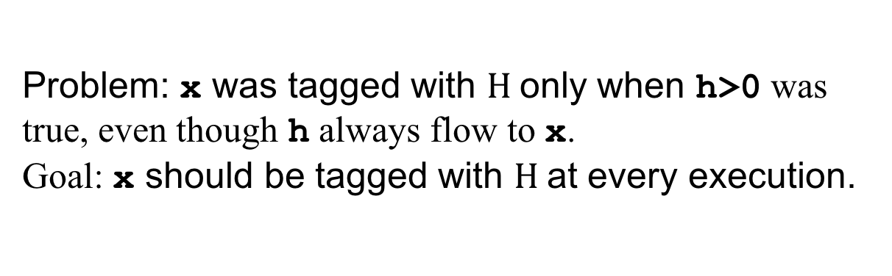
Use on-the-fly static analysis
Problem: $\text{x}$ was tagged with $H$only when h>0 was true, even though h always flow to $\text{x}$.
Goal: $\text{x}$ should be tagged with $H$at every execution.
x:=0;
if h>0 then x:=1 else skip
h>0 is evaluated to false.
Execute taken branch.

Slide 18
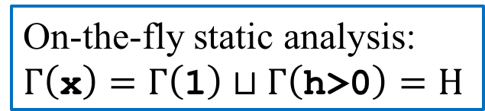
Use on-the-fly static analysis
Problem: $\text{x}$ was tagged with $H$only when h>0 was true, even though h always flow to $\text{x}$.
Goal: $\text{x}$ should be tagged with $H$at every execution.
x:=0;
if h>0 then x:=1 else skip
Οn-the-fly static analysis:
$$Γ\left(\text{x}\right)=Γ\left(\text{1}\right)⊔Γ\left(\text{h}\text{>0}\right)=Η$$
Apply on-the-fly static analysis to the untaken branch.

Slide 19

Use on-the-fly static analysis
Problem: $\text{x}$ was tagged with $H$only when h>0 was true, even though h always flow to $\text{x}$.
Goal: $\text{x}$ should be tagged with $H$at every execution.
x:=0;
if h>0 then x:=1 else skip
$$Γ\left(\text{x}\right)=Η$$

Slide 20
Static versus Dynamic
Static:
  Low run time overhead.
  No new covert channels.
  More conservative.
Dynamic
  Increased run time overhead.
  Possible new covert channels.
  Less conservative.
Ongoing research for both static and dynamic.
  Different expressiveness of policies, different NI versions, different mechanisms.

Slide 21
Information Flow Control In practice(ISH)

Slide 22
Past and current research on dynamic analysis
RIFLE (ISA) [Vachharajani et al. 2004]
HiStar (OS) [Zeldovich et al. 2006]
Trishul (JVM) [Nair et al. 2008]
TaintDroid (Android) [Enck et al. 2010]
LIO (Haskell) [Stefan et al. 2011]
...

Slide 23
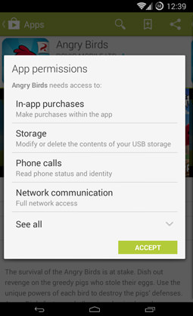
TaintDroid
Smartphones run apps developed by (potentially untrusted) third parties
Apps can access sensitive information (location, contacts, etc.)
In Android, users grant apps particular permissions on download
End-user license agreement (EULA) states how information will be used
How can you tell whether app behavior follows its permissions?

Slide 24


TaintDroid Labels
$$⊤$$
Sensitive, {GPS,camera}
Sensitive, {GPS, contacts}
Sens, {camera, contacts}
Sensitive, {GPS}
Sensitive, {camera}
Sensitive, {contacts}
Public
Notes:
automatically associated with data based on source
32 binary taint markings

Slide 25
Android Background Info
Linux-based, open source, mobile-phone platform
Middleware written in Java and C/C++.
Functionality implemented by (3rd party) applications.
Apps run on top of middleware.
Applications written in Java.
Compiled into Dalvik Executable(DEX) byte-code format.
  custom byte-code
  Register-based as opposed to stack-based.
Executes within Dalvik VM interpreter instance.
  Runs isolated on the platform.
  Has unique UNIX user ids.
  Communicate via binder IPC mechanism.

Slide 26
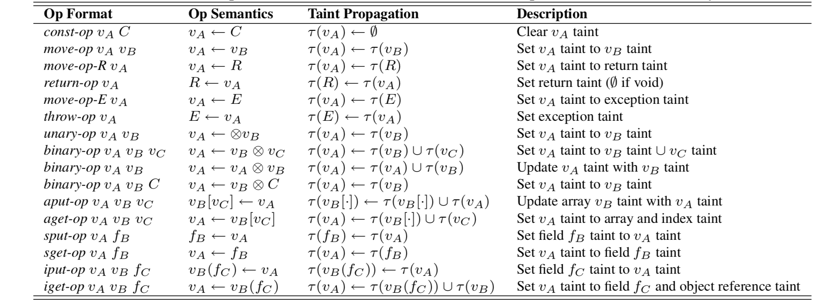
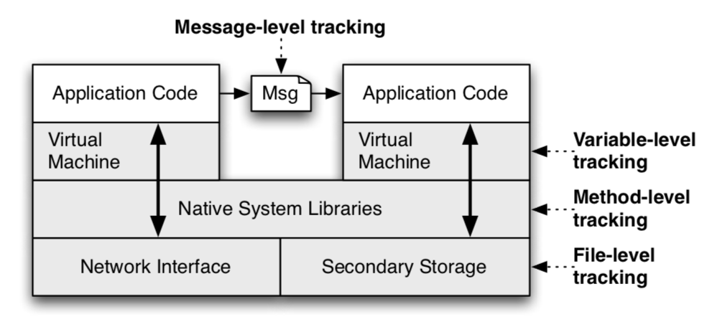
TaintTracking
Instrument VM interpreter to provide variable-level taint tracking
Use message-level tracking between apps
Use method-level tracking in native libraries
Use file-level tracking for persistent data

Slide 27
Limitations
Dynamic IFC mechanisms incur run-time overhead
  14% for CPU bound microbenchmark
  Negligible for interactive applications
Doesn't capture implicit flows

Slide 28
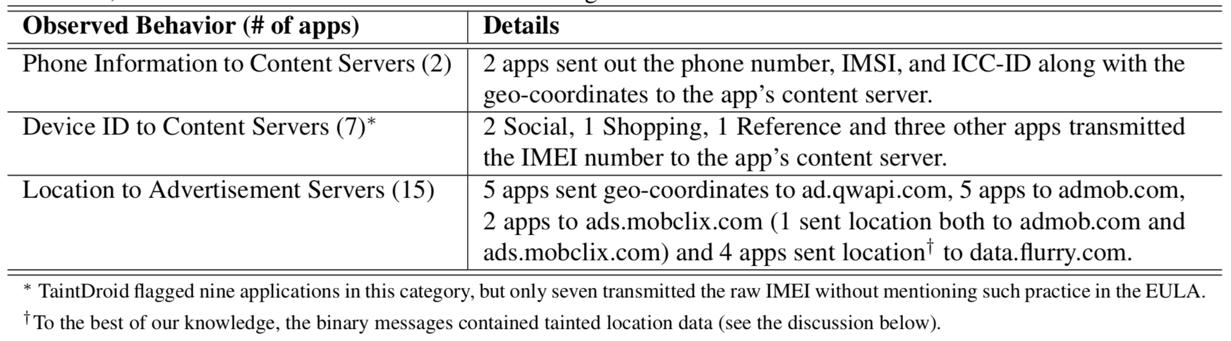
Experimental Findings
Researchers studied real-world apps with TaintDroid
Of 30 apps, found:

Slide 29
Flume
Extends linux with process-level information flow control
User-level implementation
No new OS, can use existing communication abstractions

Slide 30
Flume Labels
Lattice of labels
  Label summarizes which categories of data a process is assumed to have seen.
  Examples:
    { “Financial Reports” }
    { “HR Documents” }
    { “Financial Reports” and “HR Documents” }
Processes have an integrity label and a confidentiality label
  Processes can upgrade their labels
  Processes can create new tags, can declassify tags they created
  Inter-process communication mediated by Flume to enforce IFC
“tag”
“label”

Slide 31
Information Flow Control in Flume
Linux processes communicate via a variety of channels: sockets, pipes, shared memory
Endpoint abstraction: process can specify which privileges can be used when communicating through each endpoint

Slide 32
Information Flow Control in Flume
Linux processes communicate via a variety of channels: sockets, pipes, shared memory
Endpoint abstraction: process can specify which privileges can be used when communicating through each endpoint
Flume mediates all communications between endpoints (system call delegation)
Flume RM
Web App
glibc
Flume Libc
Linux Kernel
Secret Data

Slide 33
Information Flow Control in Flume
Linux processes communicate via a variety of channels: sockets, pipes, shared memory
Endpoint abstraction: process can specify which privileges can be used when communicating through each endpoint
Flume mediates all communications between endpoints (system call delegation)
Flume enforces IFC
Flume RM
Web App
glibc
Flume Libc
Linux Kernel
Secret Data
Process p
Process q
S_{p} = {}
D_{p} = { HR }
e
f
S_{q} = { HR }
S_{e} = { HR }
S_{f} = { HR }

Slide 34
Limitations
Dynamic IFC mechanisms incur run-time overhead
  30-40% reduction in throughput for file I/O
  Increased latency
Large trusted computing base
Coarse granularity
Alternative solutions:
  Dedicated OS (e.g., Asbestos, HiStar)
  PL-level techniques (e.g., DLM, TaintDroid)

Slide 35
Past and current research on static analysis
[Denning and Denning 1977]
VSI type system [Volpano, Smith, and Irvine 1996]
Jif [Myers 1999] Java + Information Flow (originally JFlow)
FlowCaml [Simonet 2003] OCaml + Information Flow
Aura, PCML5, Fine, ...

Slide 36
Jif

Slide 37
Jif
Security type: only root may learn information in this field

Slide 38
Jif
Declassification: okay to leak whether password matches

Slide 39
Jif type checking
Variables (fields, methods, etc.) may have additional label as part of their type, e.g., int {lbl} x;
Label constrains information flow to and from variable
  reader label: alice -> bob, charlie
    Alice owns this constraint; her permission required to violate it
    Alice permits the information to flow to Bob and Charlie
    On previous slide: root: is short for root -> root
  writer label: alice <- bob, charlie
    Alice owns this constraint; her permission required to violate it
    Alice permits the information to flow from Bob and Charlie
  can have multiple such constraints as part of label
  can read these arrows as the may flow relation →
  Decentralized label model (DLM) [Myers and Liskov 1997]

