Slide 1
Lecture 19: Information Flow
CS 5430 4/9/2018

Slide 2
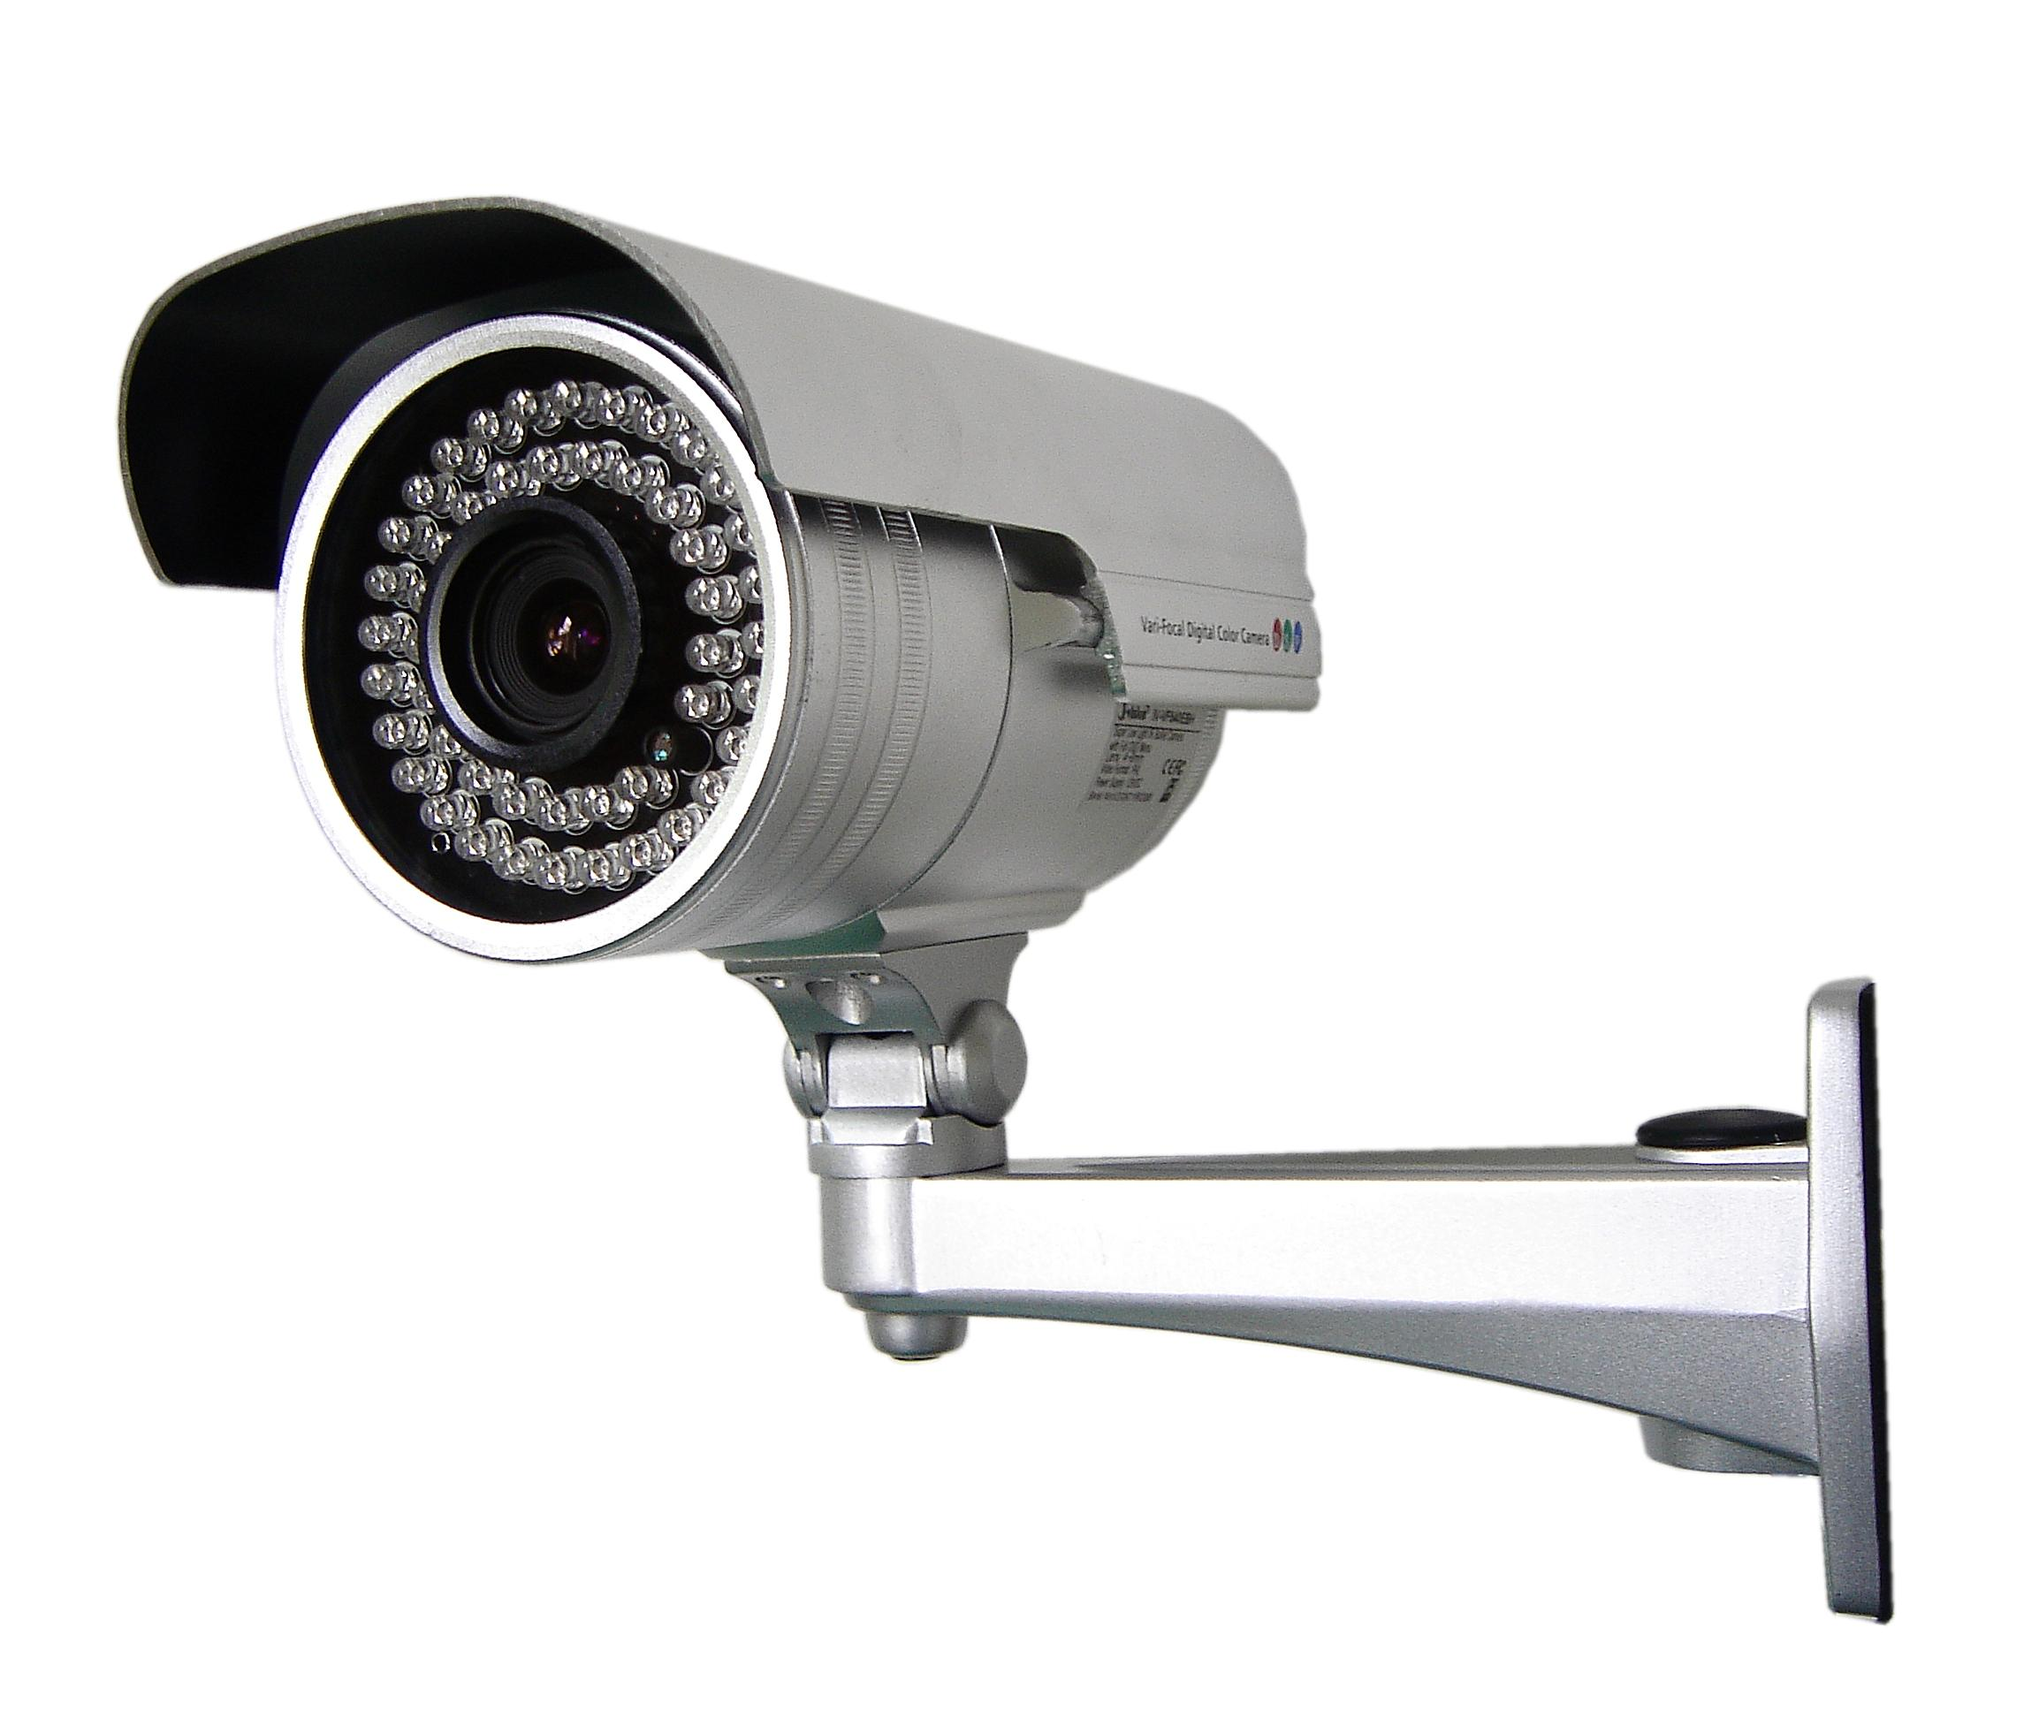
Where we were…
Authentication: mechanisms that bind principals to actions
Authorization: mechanisms that govern whether actions are permitted
Audit: mechanisms that record and review actions
Notes:
Examples:
Authentication: passwords, digital signatures, EV certificates in browsers
Authorization: file permissions, firewalls, visibility restrictions in FB
Audit: log files, log browsers, intrusion detection systems

Slide 3
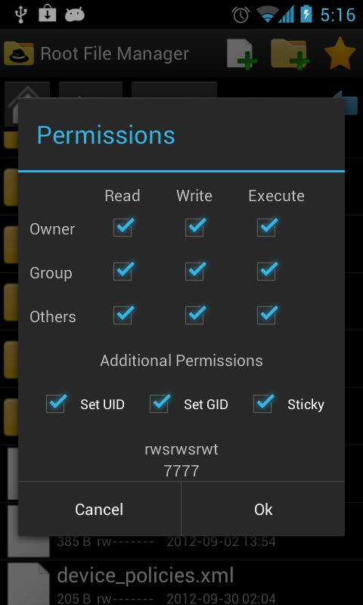
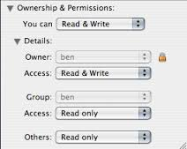
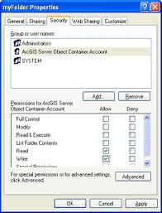
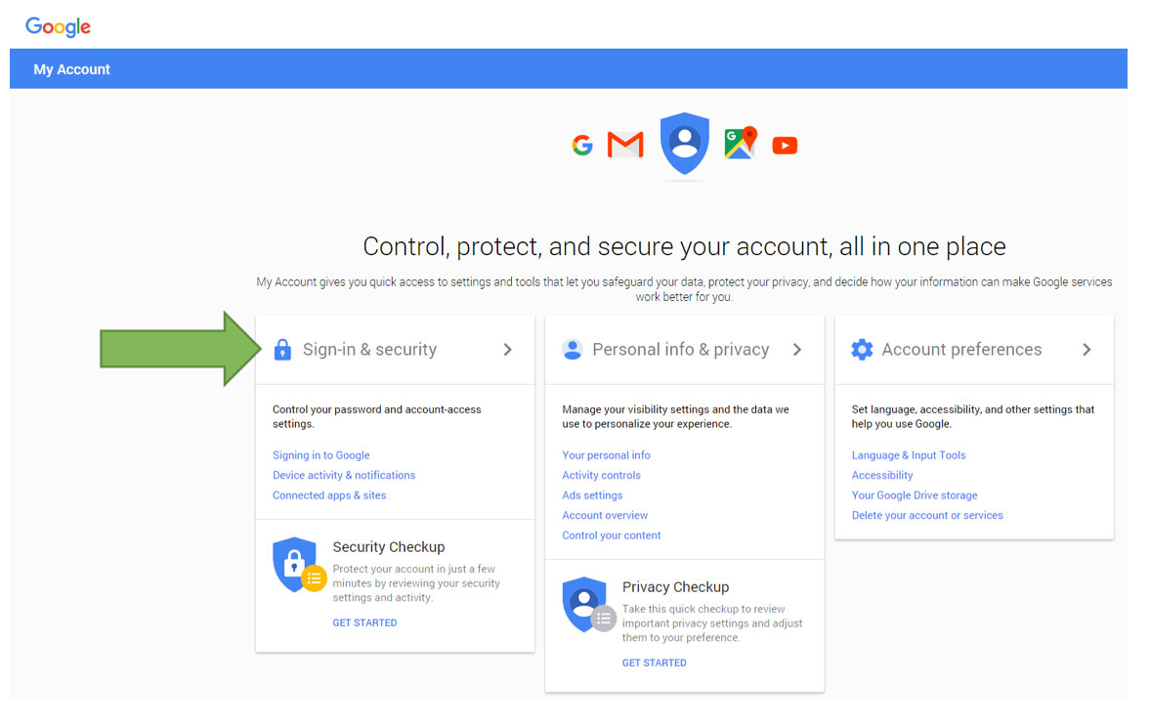
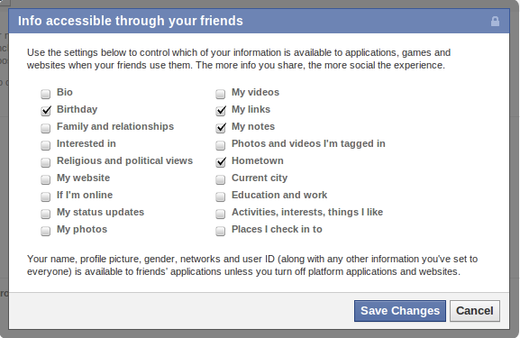
Access Control Policy
An access control policy specifies which of the operations associated with any given object each subject is authorized to perform
Expressed as a relation $Auth$:
$$Auth$$ |  | Objects
 |  | dac.tex | dac.pptx
subject | ebirrell | r,w | r,w
 | clarkson | r | r
 | student |  | r

Slide 4
Who defines Policies?
Discretionary access control (DAC)
Philosophy: users have the discretion to specify policy themselves
Commonly, information belongs to the owner of object
Access control lists, privilege lists, capabilities
Mandatory access control (MAC)
Philosophy: central authority mandates policy
Information belongs to the authority, not to the individual users
MLS and BLP, Chinese wall, Clark-Wilson, etc.

Slide 5
Access control for computed data
Can read:
Alice
Bob
Doc
computation
Can read:
Alice
Bob
Can read:
Alice
Bob
Doc’
Doc’’
Notes:
Consider a document doc associated with an access control policy …. Assume that some computation is applied to doc producing several new documents that needs to be used later. What should be the access control policy on these new documents? A human should make this decision and should manually associate the desired policies to the new documents.

Slide 6
Scaling to many pieces of data…
Notes:
This manual work becomes harder and harder, when we scale to a system that stores multiple pieces of data that are owned by multiple users,
and supports rich interactions between data of different users.

Slide 7
Scaling to many users…

Slide 8
Scaling to many interactions…
?
?
?
?
?

Slide 9
Information Flows between Principals
Channel: means to communicate information
Storage channel: written by one program and read by another
Legitimate channel: intended for communication between programs
Covert channel: not intended for information transfer yet exploitable for that purpose
Sometimes, we really want to restrict access to information
Notes:
Example covert chanels: Lampson 1973] Malicious program could:
Leak information in metadata (billing reports, nonces chosen in protocols, ...)
Use shared resources and OS API to encode information (e.g., file locking, CPU cycles)

Slide 10
Information Flow (IF) Policies
Focus on information not objects
An IF policy specifies restrictions on the associated data, and on all its derived data.
IF policy for confidentiality:
Value $v$ and all its derived values are allowed to be read only by Alice
Different from the access control policy:
Value $v$ is allowed to be read at most by Alice.
The enforcement mechanism automatically deduces the restrictions for derived data.
Notes:
Information flow policies are proposed to address the limitations of access control. [from slide]

Slide 11
Information flow policies
Can flow to:
Alice
Doc
Automatic deduction of policies!
computation
Can flow to:
Alice
Can flow to:
Alice
Doc’
Doc’’
Notes:
For example, if a document Doc is allowed to flow only to Alice, then any document derived from Doc is allowed to flow only to Alice, too. Otherwise, the IF policy on Doc would be violated.

Slide 12
Scaling to many interactions…
Notes:
When documents with different policies are combined to produce a new document, that document is associated with a policy that satisfies all policies of the constituent documents.

Slide 13
Scaling to many interactions…
Notes:
When documents with different policies are combined to produce a new document, that document is associated with a policy that satisfies all policies of the constituent documents.

Slide 14
Labels represent policies
Secret, {nuc, crypto}
Secret, {nuc}
Conf, {nuc,crypto}
Secret, {crypto}
Conf, {nuc}
Secret, {}
Conf, {crypto}
Conf, {}
Notes:
Hasse diagram

Slide 15
Labels represent policies
High
Low
Notes:
Hasse diagram

Slide 16
Labels represent policies
H
Doc
H
H
Doc’
Doc’’

Slide 17
Policy Granularity
Objects can be system principles (files, programs, sockets…)
Objects can be program variables
Notes:
[from slide]

Slide 18
Noninterference [Goguen and Meseguer 1982]
An interpretation of noninterference for a program:
Changes on H inputs should not cause changes on L outputs.
H
H
L
L
Inputs
Outputs
Program

Slide 19
Noninterference: Example
1
H
H
3
$$h$$
$$h′$$
$$h^{′}≔h+l;$$
$$l^{′}≔l+1$$
2
L
L
3
$$l$$
$$l′$$
3
H
H
5
$$h$$
$$h′$$
$$h^{′}≔h+l;$$
$$l^{′}≔l+1$$
2
L
L
3
$$l$$
$$l′$$
The program satisfies noninterference!

Slide 20
Noninterference: Example
1
H
H
$$h$$
2
L
$$l′≔h ∗2$$
L
2
$$l′$$
3
H
H
$$h$$
2
L
$$l′≔h ∗2$$
L
6
$$l′$$
The program does not satisfy noninterference!

Slide 21
Noninterference: Example
1
H
H
if($h==1)${
$l′≔1$
} else {
$l′≔0$
}
$$h$$
2
L
L
1
$$l′$$
3
H
H
if($h==1)${
$l′≔1$
} else {
$l′≔0$
}
$$h$$
2
L
L
0
$$l′$$
The program does not satisfy noninterference!

Slide 22
Noninterference
Consider a program $C$.
Consider two memories $M_{1}$ and $M_{2}$, such that
they agree on values of variables tagged with $L$:
$M_{1}=_{L}M_{2}$.
$M_{1}$ and $M_{2}$ may not agree on values of variables tagged with $H$.
$C(M_{i})$ are the observations produced by executing $C$ to termination on initial memory $M_{i}$:
final outputs, or
intermediate and final outputs.
Then, observations tagged with $L$ should be the same:
$C\left(M_{1}\right)=_{L}C\left(M_{2}\right)$.

Slide 23
Noninterference
For a program $C$ and a mapping from variables to labels in $\left\{L,H\right\}$:
$∀M_{1}$, $M_{2}$: if $M_{1}=_{L}M_{2},$ then $C\left(M_{1}\right)=_{L}C\left(M_{2}\right)$.
Notes:
Discussion: is this the right security goal?

Slide 24
Less restrictive than necessary…
2
H
H
$$h$$
while $h>5$ do
skip;
$$l^{′}≔4$$
2
L
L
4
$$l′$$
9
H
H
$$h$$
while $h>5$ do
skip;
$$l^{′}≔4$$
2
L
L
$$l′$$
Notes:
The previous statement of NI considers only programs that terminate. What if the termination behavior of a program depends on secret data?

Slide 25
Termination sensitive noninterference
If
$M_{1}=_{L}M_{2}$,
then
$C$ terminates on $M_{1}$ iff $C$ terminates on $M_{2}$, and
$C\left(M_{1}\right)=_{L}C\left(M_{2}\right)$.

Slide 26
Less restrictive than necessary…
Required to be L.
L
L
L
m := Match(students; grades)
Wanted to be H!
Notes:
Other operations may increase the restrictions imposed on outputs comparing to restrictions imposed on inputs.
For example the list of students in cs and the list of addressed in Ithaca may be public, but a list that maps students to home addresses is no longer public.

Slide 27
More restrictive than necessary…
Required to be H.
H
H
H
H
x := maj( v1, v2, …, vn )
Wanted to be L!
Notes:
These labels represent policies that are more restrictive than necessary: the restrictions on derived data should be the same as the restrictions on initial data. However, there are cases where restrictions on some outputs of an operation are different from the restrictions on inputs.

Slide 28
More restrictive than necessary…
Required to be H.
H
H
H
x := Enc( v; k )
Wanted to be L!
Notes:
Similarly, the encryption operation takes as input values tagged with H, but the result is wanted to be tagged with L.

Slide 29
Declassification
What: specify what information may be declassified
e.g., LastFourDigits(credit card number) should be low
Partial Equivalence Relation (PER) Model
Who: specify who may declassify information
e.g., high object owner can write to low objects
Decentralized Label Model
Where: specify which pieces of code may declassify
e.g., encryption function can write to low objects
Intransitive Noninterference, Reactive Noninterference
When: specify when information may be declassified
e.g., software key may be shared after payment has been received

Slide 30
Enforcement Mechanisms
taint-tracking
runtime monitoring
type checking

