Slide 1
Lecture 10: Secure Channels
CS 5430 3/07/2018

Slide 2
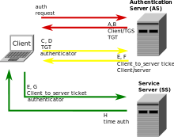
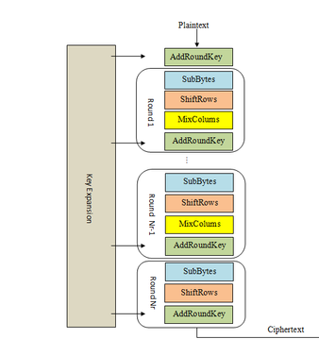
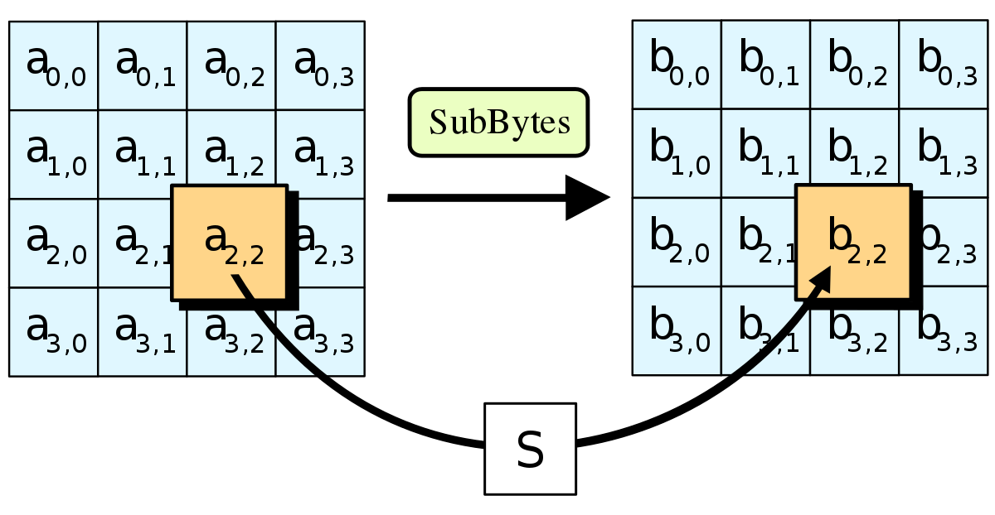
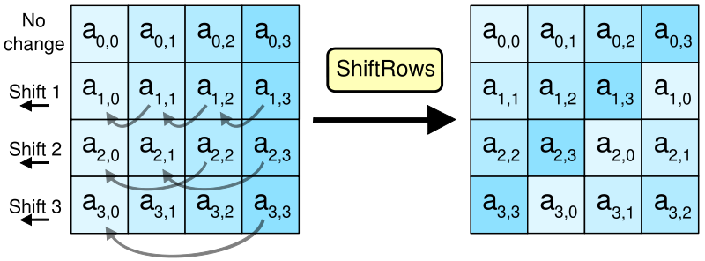
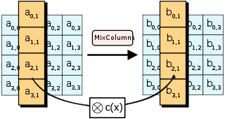
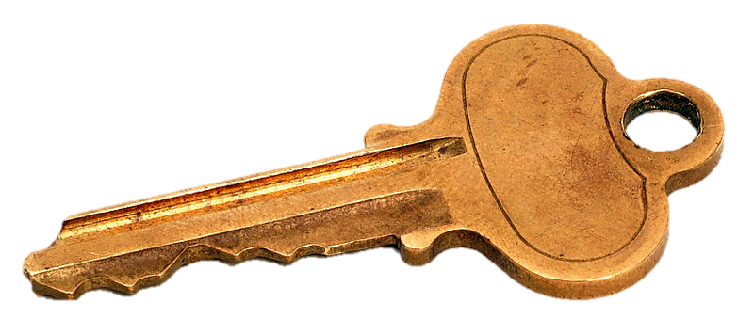
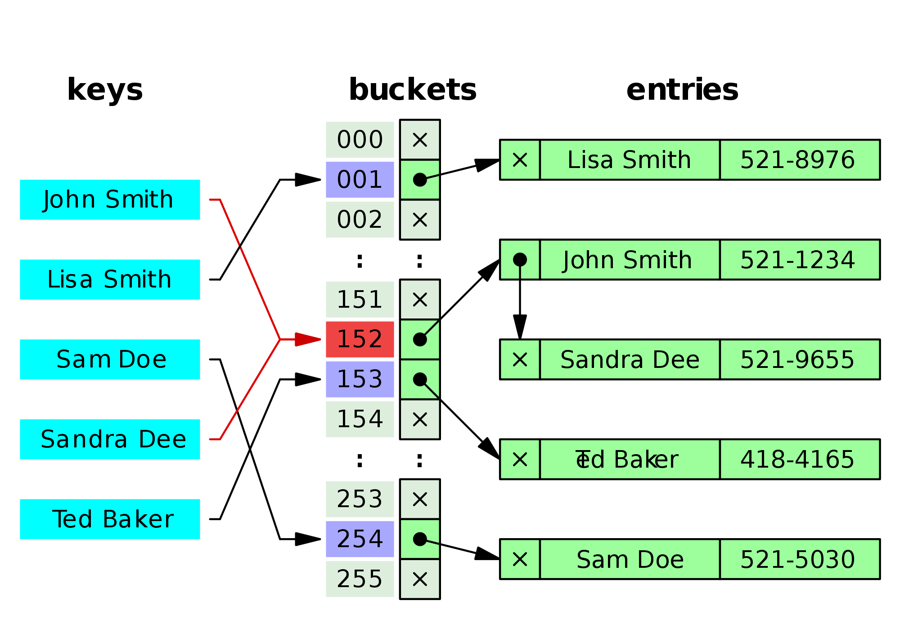
Review: Crypto

Slide 3
Today: Secure Channels

Slide 4
Protection of conversation
Threat: attacker who controls the network
Dolev-Yao model: attacker can read, modify, delete messages
Harm: conversation can be learned (violating confidentiality) or changed (violating integrity) by attacker
Vulnerability: communication channel between sender and receiver can be controlled by other principals
Countermeasure: all the crypto we’ve seen so far…

Slide 5
Today: Secure Channels
Requirements:
Channel must provide both confidentiality and integrity
A and B must agree on session key(s)
A and B must agree on cipher suite (crypto protocols, encryption mode, key lengths)
Must detecting missing messages & replay attacks.
Must maintain connection (and be able to end it)

Slide 6
Encrypt and MAC
0. k_E = Gen_E(len)
k_M = Gen_M(len)
1. A: c = Enc(m; k_E)
t = MAC(m; k_M)
2. A -> B: c, t
3. B: m' = Dec(c; k_E)
t' = MAC(m'; k_M)
if t = t'
then output m'
else abort
m
c
t

Slide 7
Aside: Key reuse
Never use same key for both encryption and MAC schemes
Principle: every key in system should have unique purpose

Slide 8
Encrypt and MAC
Pro: can compute Enc and MAC in parallel
Con: MAC must protect confidentiality
(not actually a requirement we ever stipulated)
Example: ssh (Secure Shell) protocol
recommends AES-128-CBC for encryption
recommends HMAC with SHA-2 for MAC

Slide 9
Encrypt then MAC
m
1. A: c = Enc(m; k_E)
t = MAC(c; k_M)
2. A -> B: c, t
3. B: t' = MAC(c; k_M)
if t = t'
then output Dec(c; k_E)
else abort
c
t

Slide 10
Encrypt then MAC
Pro: provably most secure of three options [Bellare & Namprepre 2001]
Pro: don't have to decrypt if MAC fails
resist DoS
Example: IPsec (Internet Protocol Security)
recommends AES-CBC for encryption and HMAC-SHA2 for MAC, among others
or AES-GCM

Slide 11
MAC then encrypt
m
1. A: t = MAC(m; k_M)
c = Enc(m,t; k_E)
2. A -> B: c
3. B: m',t' = Dec(c; k_E)
if t' = MAC(m'; k_M)
then output m'
else abort
c

Slide 12
MAC then encrypt
Pro: provably next most secure
and just as secure as Encrypt-then-MAC for strong enough MAC schemes
HMAC and CBC-MAC are strong enough
Example: SSL (Secure Sockets Layer)
Many options for encryption, e.g. AES-128-CBC
For MAC, standard is HMAC with many options for hash, e.g. SHA-256

Slide 13
Authenticated encryption
Three combinations:
Enc and MAC
Enc then MAC
MAC then Enc
Let's unify all with a pair of algorithms:
AuthEnc(m; ke; km): produce an authenticated ciphertext x of message m under encryption key ke and MAC key km
AuthDec(x; ke; km): recover the plaintext message m from authenticated ciphertext x, and verify that the MAC is valid, using ke and km
Abort if MAC is invalid

Slide 14
Authenticated encryption
Newer block cipher modes designed to provide confidentiality and integrity
OCB: Offset Codebook Mode
CCM: Counter with CBC-MAC Mode
GCM: Galois Counter Mode

Slide 15
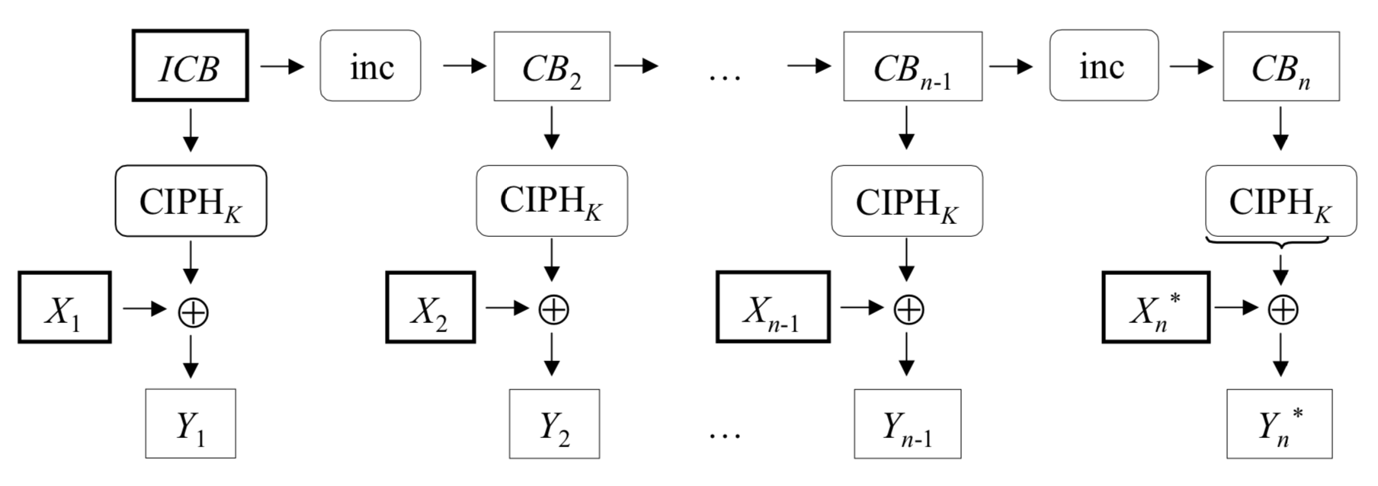
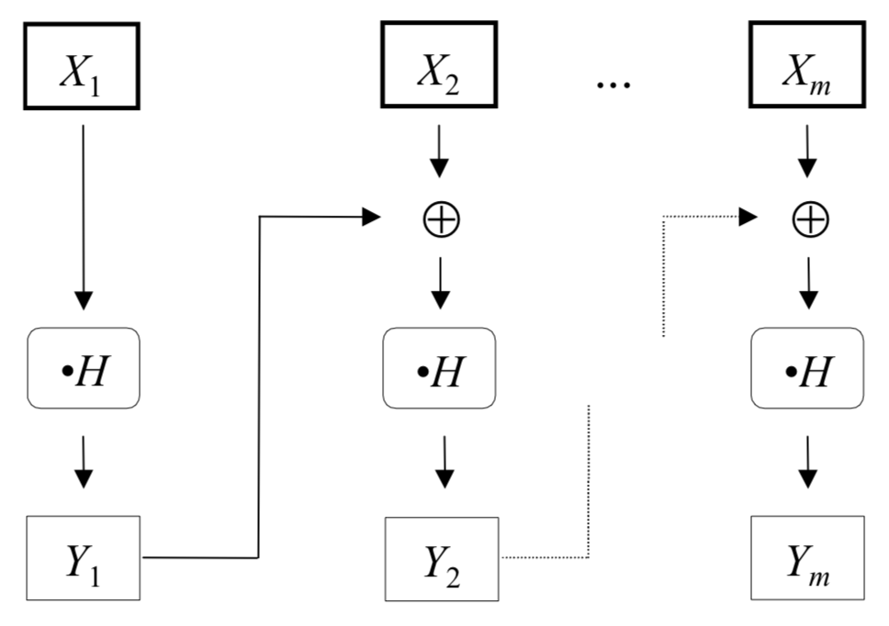
Galois Counter Mode (GCM)
Notes:
The GF(2¹²⁸) field used is defined by the polynomial x^128+x^7+x^2+x+1

Slide 16
Today: Secure Channels
Requirements:
Channel must provide both confidentiality and integrity
A and B must agree on session key(s)
A and B must agree on cipher suite (crypto protocols, encryption mode, key lengths)
Must detecting missing messages & replay attacks.
Must maintain connection (and be able to end it)

Slide 17
Agreeing on a session key
Hybrid Encryption (RSA)
Diffie-Hellman
A -> B: g, p, g^a mod p
B -> A: g^b mod p
A,B: k_s := g^ab mod p
DH, ECDH
Notes:
Liger cub: cross between lion and tiger
ECDH has smaller keys and faster performance for same security

Slide 18
Session keys
So now, let's assume Alice and Bob already have a single shared session key k
Recall: session key is used for limited time then discarded
Here, the session duration is a single conversation
But a single key isn't good enough...
Need a key for the block cipher
Need a key for the MAC
And recall:
Principle: every key in system should have unique purpose
Implies: should not use same key for both Enc and MAC algorithms
Also implies: should not use same keys for
Alice -> Bob, vs.
Bob -> Alice

Slide 19
Key derivation
Have one key: k_s
Need four keys:
kea: Encrypt Alice to Bob
keb: Encrypt Bob to Alice
kma: MAC Alice to Bob
kmb: MAC Bob to Alice
How to get four out of one: use a cryptographic hash function H to derive keys...
kea = H(k, "Enc Alice to Bob")
keb = H(k, "Enc Bob to Alice")
kma = H(k, "MAC Alice to Bob")
kmb = H(k, "MAC Bob to Alice")

Slide 20
Key derivation
Why hash?
Destroys any structure in input
Produces a fixed-size output that can be truncated, as necessary, to produce key for underlying algorithm
Unlikely to ever cause any of four keys to collide
Even if one of four keys ever leaks, hard to invert hash to recover k and learn the other keys
Small problem: maybe the output of H isn't compatible with the output of Gen
For most block ciphers and MACs, not a problem
they happily take any uniformly random sequence of bits of the right length as keys
For DES, it is a problem
has weak keys that Gen should reject
For many asymmetric algorithms, it would be a problem
keys have to satisfy certain algebraic properties
Notes:
How to solve that last problem? Use it to seed PRNG and use that PRNG as input to Gen.

Slide 21
Today: Secure Channels
Requirements:
Channel must provide both confidentiality and integrity
A and B must agree on session key(s)
A and B must agree on cipher suite (crypto protocols, encryption mode, key lengths)
Must detecting missing messages & replay attacks.
Must maintain connection (and be able to end it)

Slide 22
Secure Socket Layer (SSL)
SSL 2.0 (1995): designed by Netscape, contains a number of security flaws, prohibited since 2011
SSL 3.0 (1996): complete re-design, all accepted cipher suites now have known vulnerabilities, prohibited since 2015
TLS 1.0 (1999): contains known vulnerabilities, suggested migration by June 2018
TLS 1.1 (2006): update with significant changes in how IVs/padding are handled to prevent known attacks
TLS 1.2 (2008): update with modern cipher suites
TLS 1.3 (proposed): plans to drop insecure features and introduce additional cipher suites
Notes:
TLS = Transport Layer Security

Slide 23
SSL/TLS Handshake
Version, cipher suites, rClient
ClientHello
Version, cipher suite, rServer,
certificate
ServerHello
ServerKeyExchange
(optional)
ClientKeyExchange
Enc_pks(ms_p)
Compute master secret
Compute master secret
ChangeCipherSpec
ChangeCipherSpec

Slide 24
Padding Oracle On Downgraded Legacy Encryption (POODLE)
Notes:
The most severe problem of CBC encryption in SSL 3.0 is that its block cipher padding is not deterministic, and not covered by the MAC (Message Authentication Code): thus, the integrity of padding cannot be fully verified when decrypting. Padding by 1 to L bytes (where L is the block size in bytes) is used to obtain an integral number of blocks before performing blockwise CBC (cipher­block chaining) encryption. The weakness is the easiest to exploit if there’s an entire block of padding, which (before encryption) consists of L­1 arbitrary bytes followed by a single byte of value L­1. To process an incoming ciphertext record C1 ... Cn also given an initialization vector C0 (where each Ci is one block), the recipient first determines P1 ... Pn as Pi = DK(Ci) ⊕ Ci­1 (where DK denotes block­cipher decryption using per­connection key K), then checks and removes the padding at the end, and finally checks and removes a MAC. Now observe that if there’s a full block of padding and an attacker replaces Cn by any earlier ciphertext block Ci from the same encrypted stream, the ciphertext will still be accepted if DK(Ci) ⊕ Cn­1 happens to have L­1 as its final byte, but will in all likelihood be rejected otherwise, giving rise to a padding oracle attack [tls­cbc].
https://www.openssl.org/~bodo/ssl-poodle.pdf

Slide 25
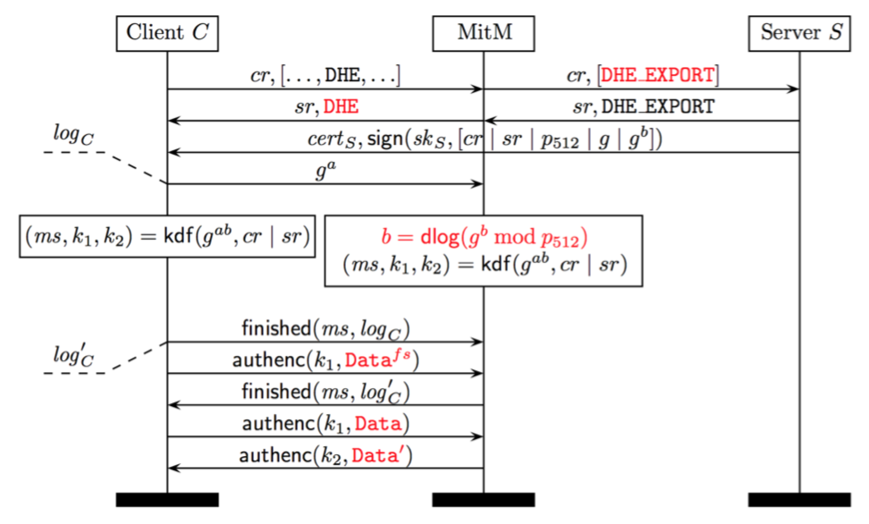
Logjam
Notes:
When a server selects DHE_EXPORT for a handshake, it proceeds by issuing a signed ServerKeyExchange message containing a 512-bit p512, but the structure of this message is identical to the message sent during standard DHE ciphersuites. Critically, the signed portion of the server’s message fails to include any indication of the specific cipher- suite that the server has chosen. Provided that a client offers DHE, an active attacker can rewrite the client’s ClientHello to offer a corresponding DHE_EXPORT ciphersuite accepted by the server and remove other ciphersuites that could be chosen instead. The attacker rewrites the ServerHello response to replace the chosen DHE_EXPORT ciphersuite with a matching non-export ciphersuite and forwards the ServerKeyExchange message to the client as is. The client will interpret the export-grade tuple (p512, g, gb) as valid DHE parameters cho- sen by the server and proceed with the handshake. The client and server have different handshake transcripts at this stage, but an attacker who can compute b in close to real time can then derive the master secret and connection keys to complete the handshake with the client, and then freely read and write application data pretending to be the server.
https://weakdh.org/imperfect-forward-secrecy-ccs15.pdf

Slide 26
Return of Beichenbacher's Oracle Threat (ROBOT)
Notes:
ROBOT is the return of a 19-year-old vulnerability that allows performing RSA decryption and signing operations with the private key of a TLS server.
In 1998, Daniel Bleichenbacher discovered that the error messages given by SSL servers for errors in the PKCS #1 v1.5 padding allowed an adaptive-chosen ciphertext attack; this attack fully breaks the confidentiality of TLS when used with RSA encryption.
In December 2017, researchers discovered that by using some slight variations this vulnerability can still be used against many HTTPS hosts in today's Internet.
Recommendation: Don't use RSA for key exchange (use ECDH instead)

Slide 27
Today: Secure Channels
Requirements:
Channel must provide both confidentiality and integrity
A and B must agree on session key(s)
A and B must agree on cipher suite (crypto protocols, encryption mode, key lengths)
Must detecting missing messages & replay attacks.
Must maintain connection (and be able to end it)

Slide 28
Message numbers
Aka sequence numbers
Every message that Alice sends is numbered
1, 2, 3, ...
numbers increase monotonically
never reuse a number
Bob keeps state to remember last message number he received
Bob accepts only increasing message numbers
And ditto all the above, for Bob sending to Alice
so each principal keeps two independent counters: messages sent, messages received

Slide 29
Message numbers
What if Bob detects a gap? e.g. 1, 2, 5
Maybe Mallory deleted messages 3 and 4 from network
Maybe Mallory detectably changed 3 and 4, causing Bob to discard them
In either case, channel is under active attack
Absent availability goals, time to PANIC: abort protocol, produce appropriate information for later auditing, shut down channel
What if network non-maliciously dropped messages or will deliver them later?
Let's assume underlying transport protocol guarantees that won't happen (e.g. TCP)

Slide 30
Message numbers
Message number usually implemented as a fixed-size unsigned integer, e.g., 32 or 48 or 64 bits
What if that int overflows and wraps back around to 0?
Message number must be unique within conversation to prevent Mallory from replaying old conversation
So conversation must stop at that point
Can start a new conversation with a new session key
Notes:
Note: in SSL, sequence number is implicit (included in MAC)

Slide 31
To send a message from A to B
1. A:
increment sent_ctr;
if sent_ctr overflows then abort;
x = AuthEnc(sent_ctr, m; kea; kma)
2. A -> B: x
3. B:
i,m = AuthDec(x; kea; kma);
increment rcvd_ctr;
if i != rcvd_ctr then abort;
output m

Slide 32
To send a message from B to A
1. B:
increment sent_ctr;
if sent_ctr overflows then abort;
x = AuthEnc(sent_ctr, m; keb; kmb)
2. B -> A: x
3. A:
i,m = AuthDec(x; keb; kmb);
increment rcvd_ctr;
if i != rcvd_ctr then abort;
output m

Slide 33
Today: Secure Channels
Requirements:
Channel must provide both confidentiality and integrity
A and B must agree on session key(s)
A and B must agree on cipher suite (crypto protocols, encryption mode, key lengths)
Must detecting missing messages & replay attacks.
Must maintain connection (and be able to end it)

Slide 34
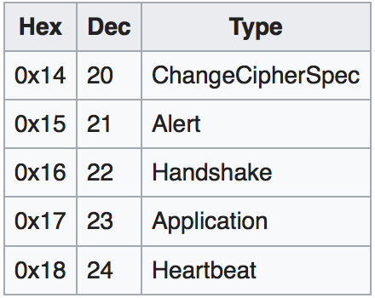
TLS record

Slide 36
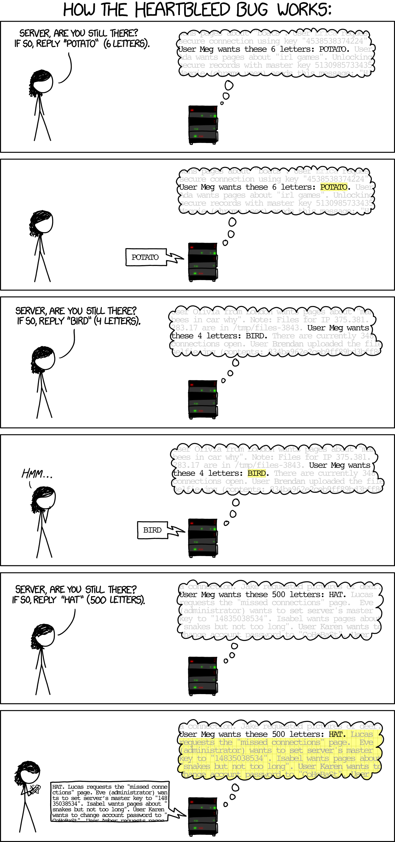
Heartbeat

Slide 37
Heartbleed
Notes:
Heartbleed was a vulnerability in the OpenSSL resulting from a missing bounds check (a buffer overread vulnerability) in its implementation of the TLS heartbeat extension; it was discovered in April 2014. Transport Layer Security (TLS) is the standard protocol for creating secure, encrypted communication channels. The TLS heartbeat extension is designed to keep the connection alive, avoiding the overhead of negotiating a new connection; it works by having one end of the connection send an arbitrary message which the other end echoes back, proving that the connection is OK. The heartbeat message, according to the RFC, has the following structure:\begin{verbatim} struct { HeartbeatMessageType type; uint16 payload_length; opaque payload[HeartbeatMessage.payload_length]; opaque padding[padding_length]; } HeartbeatMessage;\end{verbatim}Unfortunately, OpenSSL's implementation did not check the claimed {\verb payload_length } against the actual length of the TLS record sent. If the claimed length (which could be up to 64KB) exceeded the length of the actual payload (which could be just one byte), the ``echo'' message returned by the server would send back a copy of the one byte message as well as the next 64KB-1 bytes of memory. Because this memory often contains sensitive values, this approach allowed an attacker to access servers' private keys as well as users' session cookies and passwords. At the time it was disclosed, 17\% of secure web servers on the Internet were believed to be vulnerable. Experts estimate that as of January 2017, as many as 200,000 services remain vulnerable.

Slide 38
Truncation Attack
Notes:
A TLS (logout) truncation attack blocks a victim's account logout requests so that the user unknowingly remains logged into a web service. When the request to sign out is sent, the attacker injects an unencrypted TCP FIN message (no more data from sender) to close the connection. The server therefore doesn't receive the logout request and is unaware of the abnormal termination.^{[251]}
Published in July 2013, the attack causes web services such as Gmail and Hotmail to display a page that informs the user that they have successfully signed-out, while ensuring that the user's browser maintains authorization with the service, allowing an attacker with subsequent access to the browser to access and take over control of the user's logged-in account. The attack does not rely on installing malware on the victim's computer; attackers need only place themselves between the victim and the web server (e.g., by setting up a rogue wireless hotspot).This vulnerability also requires access to the victim's computer. Another possibility is when using FTP the data connection can have a false FIN in the data stream, and if the protocol rules for exchanging close_notify alerts is not adhered to a file can be truncated.

