Slide 1
Lecture 5: Beyond Threats
CS 5430 2/7/2018

Slide 2
The Big Picture
Attacks
are perpetrated by
threats
that inflict
harm
by exploiting
vulnerabilities
which are controlled by
countermeasures.

Slide 3
Engineering methodology
Functional requirements
Threat analysis
Harm analysis
Security goals
Feasibility analysis
Security requirements

Slide 4
1. Functional requirements
Security = does what it should + nothing more
Should be testable: a 3rd party could determine whether requirement is met
User stories:
  brief description of single kind of interaction user can have with system
  "As a user I can action so that purpose"
  Examples from CMS:
    As a professor, I can create a new assignment by specifying its name, number of possible points, and due date.
    As a student, I can submit a file as a solution to an assignment.
These stories reveal system assets

Slide 5
Assets
Types of Assets:
  physical objects (e.g., money)
  intangible objects (e.g., bank account balance)
In computer systems:
  information is typically the main asset
  hardware and software could be assets
  people are not typically considered to be assets
Notes:
HW and SW typically easily replaceable
Can't control or protect people with computers, usually

Slide 6
Stakeholders
Anything of value to a stakeholder in system could be an asset
  direct value: damage affects asset itself
  indirect value: damage affects something else, e.g. reputation
An object is not an asset if it doesn't have value to some stakeholder
A principal isn't a stakeholder if it doesn't value some system object
  We won't consider a generic "attacker" to be a stakeholder
Notes:
Cash has direct value to bank. Also indirect: affects reputation when it gets lost
Your mobile phone: direct value in HW, in SW configuration, in photos and texts stored on it
Some values: credit card numbers: $0.85 to $30, depending on evidence of usability; bank account credentials $15-$850; email accounts $1-20; list of email addresses $1.70-$15 per thousand [Symantec 2010 global internet threat report]

Slide 7
Example: GMS
Grade Management System: manages just the final grade for a single course
Functional requirements:
As a student, I can view my final grade.
As a professor, I can view and change final grades for all students.
As an administrator, I can add/remove students and professors to/from the course

Slide 8
Ex: GMS
Asset: a numeric score for each student

Slide 9
2. Threat analysis
Identify threats of concern to system
  Especially malicious, human threats
  What kinds of attackers will system resist?
  What are their motivations, resources, and capabilities?
Best if analysis is specific to system and its functionality
Non threats?
  Trusted hardware
  Trusted environment
  e.g., physically secured machine room reachable only by trustworthy system operators

Slide 10
Example: GMS
Threat analysis:
Students:
  Motivations: increase their own grade, lower others' grades, learn others' grades
  Capabilities: network access to servers, some physical access to others' computers, social engineering; probably not extensive computational or financial resources
Out of scope: assume that threats cannot physically access any servers, profs are trusted, system admins

Slide 11
3. Harm analysis
Harm: a negative consequence to a system asset
Harm to...
  confidentiality: disclosure, interception
  integrity: modification, fabrication
  availability: deprivation, interruption
"Performing action on/to/with asset could cause harm"
  e.g., "stealing money could cause loss of revenue"
  e.g., "erasing account balances could cause loss of customers"
Notes:
Failure of confidentiality:
• An unauthorized person accesses a data item.
• An unauthorized process or program accesses a data item.
• A person authorized to access certain data accesses other data not authorized (which is a specialized version of an unauthorized person accesses a data item).
• An unauthorized person accesses an approximate data value (for example, not knowing someone’s exact salary but knowing that the salary falls in a particular range or exceeds a particular amount).
• An unauthorized person learns the existence of a piece of data (for example, knowing that a company is developing a certain new product or that talks are under way about the merger of two companies).
Failure of integrity:
• imprecise
• inaccurate
• modified in unacceptable way
• modified by unauthorized people
• inconsistent
• unmeaningful
Failure of availability:
• Unusable
• Insufficient capacity
• Insufficiently quick response
• Unfair allocation of resources

Slide 12
Harm triples
<action, asset, harm>
  e.g., <theft, money, loss of revenue>
  e.g., <erasure, account balance, loss of customer>
Useful methodology:
  start with asset
  brainstorm actions that could harm asset
  let brainstorming be guided by CIA triad

Slide 13
Ex: GMS
Asset: a numeric score for each student
Functional requirements: students view grades, profs view and change grades, admins manage enrollment
Threat analysis: students might be malicious or curious; profs are trusted; threats can't access servers physically
Harm analysis: performing action on/to/with asset could cause harm
Exercise: invent some harm triples
<action, asset, harm>

Slide 14
4. Security goals
"The system shall prevent/detect action on/to/with asset."
  e.g., "The system shall prevent theft of money"
  e.g., "The system shall prevent erasure of account balances"
Specify what not how
Poor goals:
  "the system shall use encryption to prevent reading of messages"
  "the system shall use authentication to verify user identities"
  "the system shall resist attacks"

Slide 15
Ex: GMS
Exercise: transform harm triples
<action, asset, harm>
into security goals
the system shall prevent/detect
action on/to/with asset

Slide 16
5. Feasibility analysis
Not all goals are feasible to achieve
Relax goals:
  "prevent theft of items from a vault"
  to "resist penetration for 30 minutes"
  or to "detect theft of items from a vault"

Slide 17
From goals to requirements
Goals: what should never happen in any situation
  not testable
Requirements: what should happen in specific situations
  testable

Slide 18
6. Security requirements
Constraints on functional requirements, in service of security goals
Example:
  Functional requirement: allow people to cash checks
  Security goal: prevent loss of revenue through bad checks
  Security requirement: check must be drawn on bank where it's being cashed (so funds can be verified), or customer must be account holder at bank and depositing funds in account (so funds could be reversed)

Slide 19
Security requirements
Constraints on functional requirements, in service of security goals
Another example:
  Functional requirement: allow two users to chat using IM
  Security goal: prevent disclosure of message contents to other users
  (Poor) security requirement: contents of message cannot be read by anyone other than the two users
  (Improved) security requirement: message is encrypted by key shared with the two users
    doesn't over-commit to encryption algorithm, key size, etc.

Slide 20
Goals vs. requirements
Goals | Requirements
Broad scope | Narrow scope
Apply to system | Apply to individual functional requirements
State desires | State constraints
Not testable | Testable
Not about design/implementation details | Provide some details

Slide 21
Example: GMS
Functional requirements: students view grades, profs view and change grades, admins manage enrollment
Security goals: ...
Security requirements: combine functional requirements with goals to invent constraints on system

Slide 22
Engineering methodology
Functional requirements
Threat analysis
Harm analysis
Security goals
Feasibility analysis
Security requirements

Slide 23
Iteration
Inventing new functional requirements
Inventing new security requirements
Introducing new assets
Inventing new security goals

Slide 24
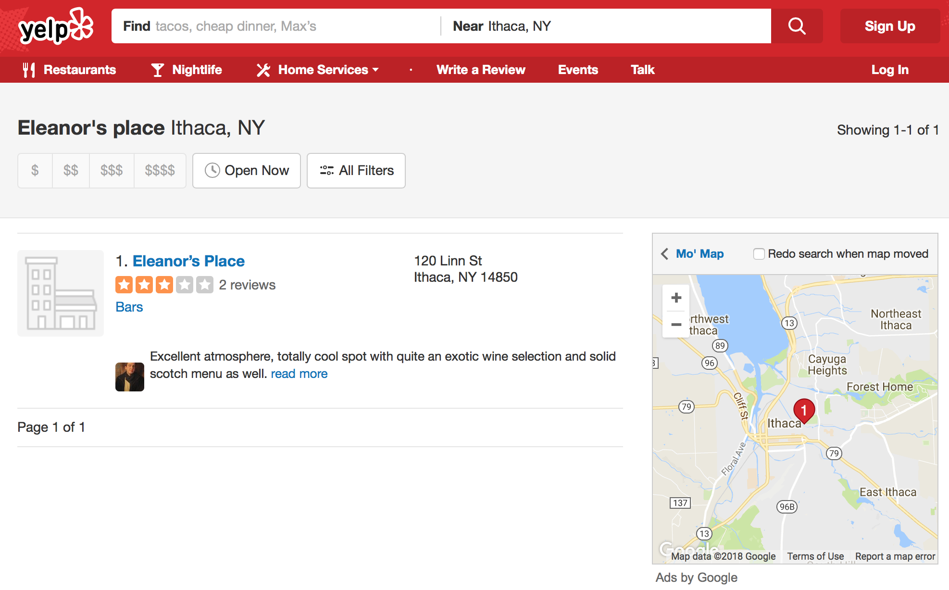
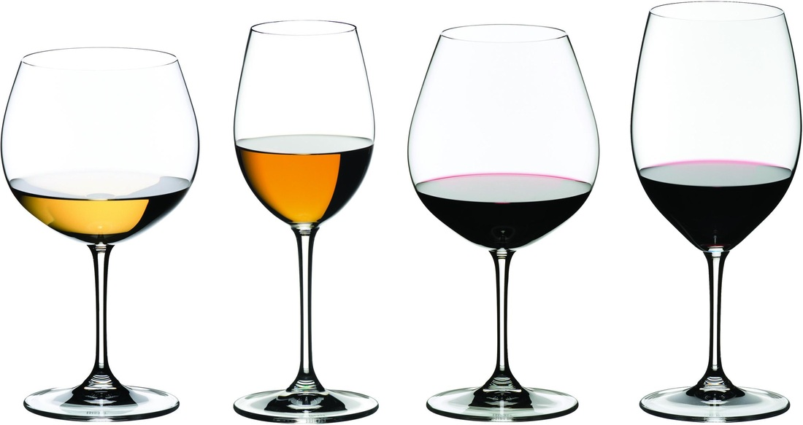
Notes:
No, this is not my real address.

Slide 25
Example: Eleanor's Place
New restaurant in Ithaca
Contracts with opentable.com to make online reservations possible
What are the functionality requirements for this reservation system?
What is the threat model?
What confidentiality, integrity, and availability harms does Eleanor's Place face?
What security goals should it have? Are they feasible? How could these be refined to security requirements?
What vulnerabilities might there be? What countermeasures could be employed to control those vulnerabilities?

Slide 26
Countermeasures
A defense that protects against attacks by neutralizing either the threat or vulnerability involved
Strategy:
Prevent: block attack or close vulnerability
Deter: make attack harder but not impossible
Deflect: make other targets more attractive
Mitigate: make harm less severe
Detect: as it happens or after the fact
Recover: undo harm

