Slide 1
Lecture 4: Threats
CS 5430 2/5/2018

Slide 2
The Big Picture
Attacks
are perpetrated by
threats
that inflict
harm
by exploiting
vulnerabilities
which are controlled by
countermeasures.

Slide 3
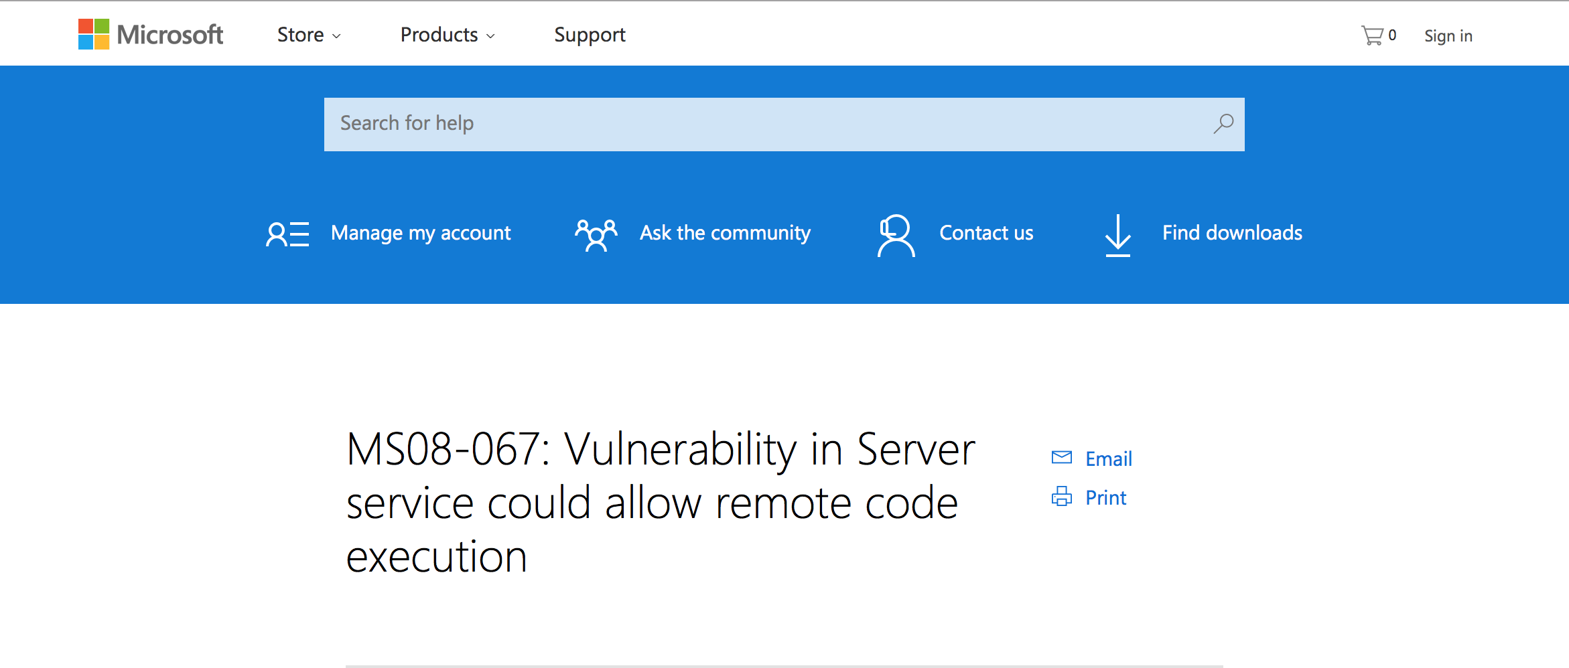
Once Upon a Time…

Slide 4
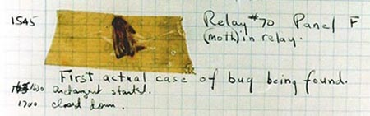
Bugs
"bug": suggests something just wandered in
[IEEE 729]
Fault: result of human error in software system
  E.g., implementation doesn't match design, or design doesn't match requirements
  Might never appear to end user
Failure: violation of requirement
  Something goes wrong for end user
Human error
Fault
Failure
Notes:
First bug found by Grace Hopper

Slide 5
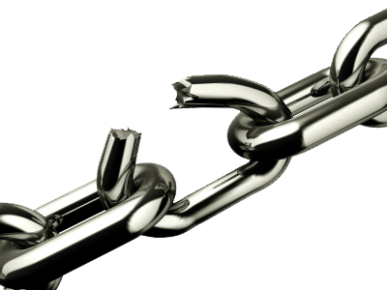
Vulnerability
An unintended aspect of a system (design, implementation, or configuration) that can cause the system to do something it shouldn't, or fail to do something it should
E.g., buffer overflows, code injection, cross-site scripting, missing authentication or access control, misconfiguration
National databases: CVE, NVD
Ignoring vulnerabilities is risky
  Too often: "no one would/could ever exploit that"
  Weakest link phenomenon
  umptions are vulnerabilities
  Timing, failure modes, message delivery,
  input format, etc.

Slide 6
Memory: A Quick Review
Stack
Heap
Globals
Code
0x00000000

Slide 7
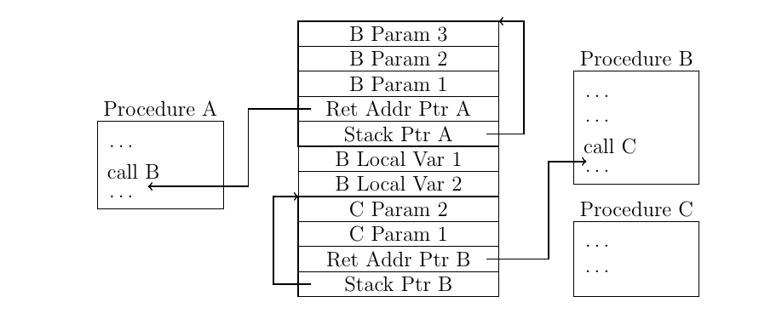
The Stack

Slide 8

Buffer Overflows

Slide 9
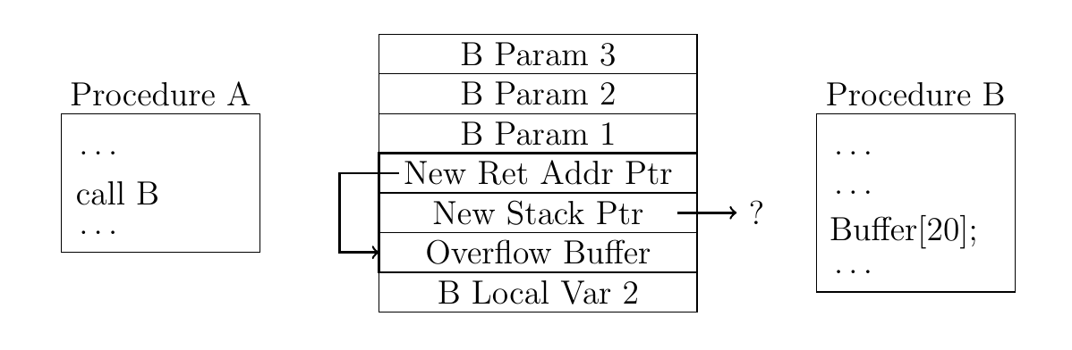
Stack Smashing

Slide 10
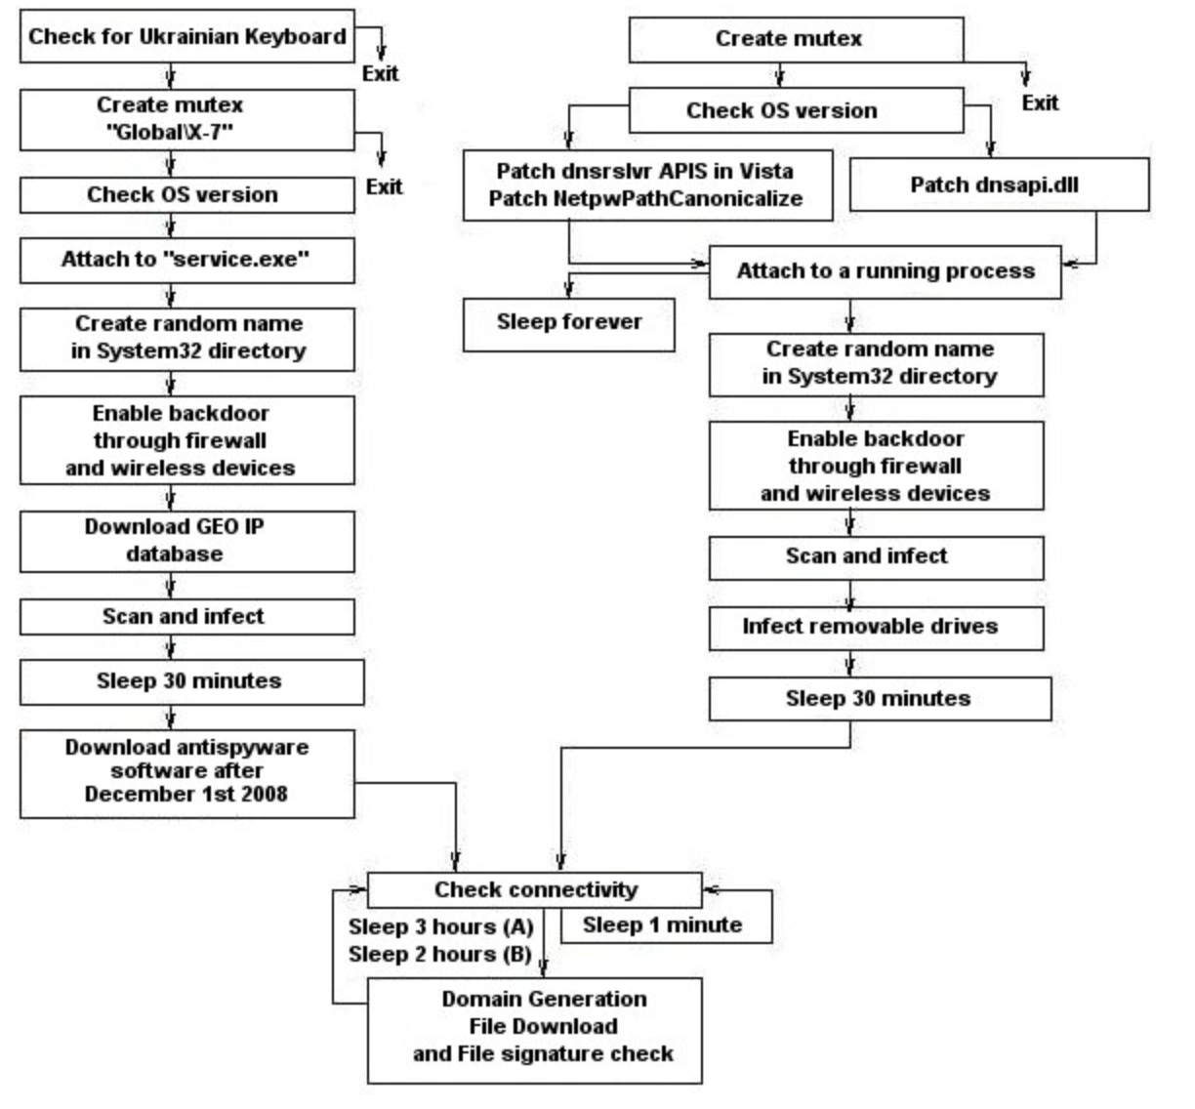
Conficker

Slide 11
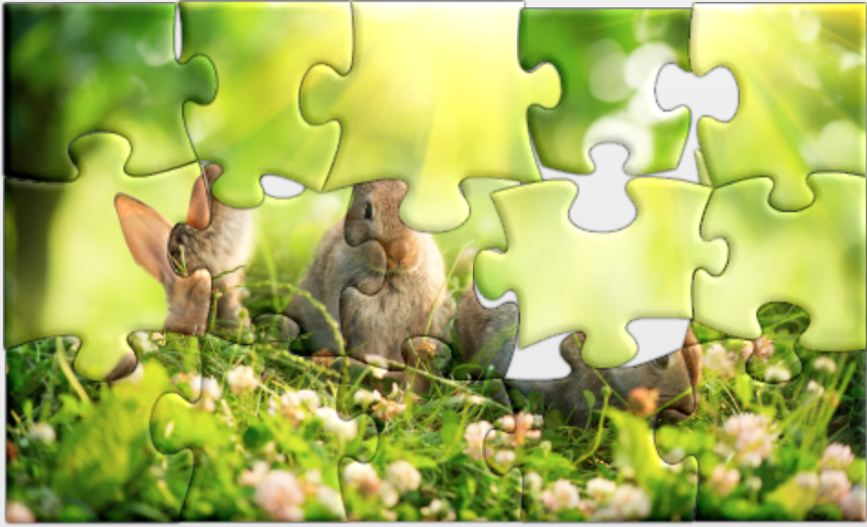
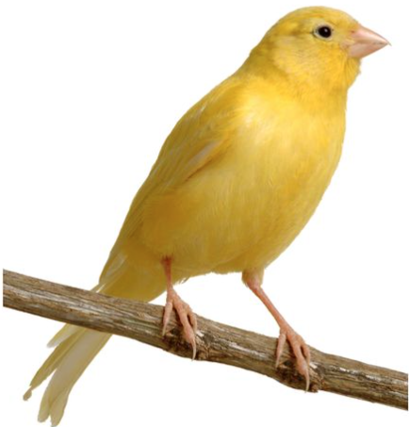
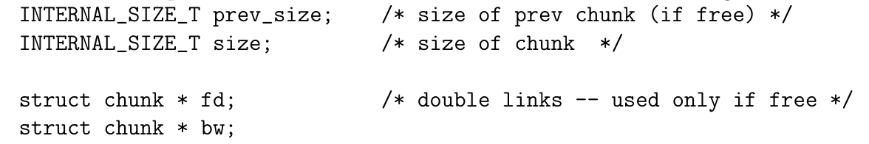

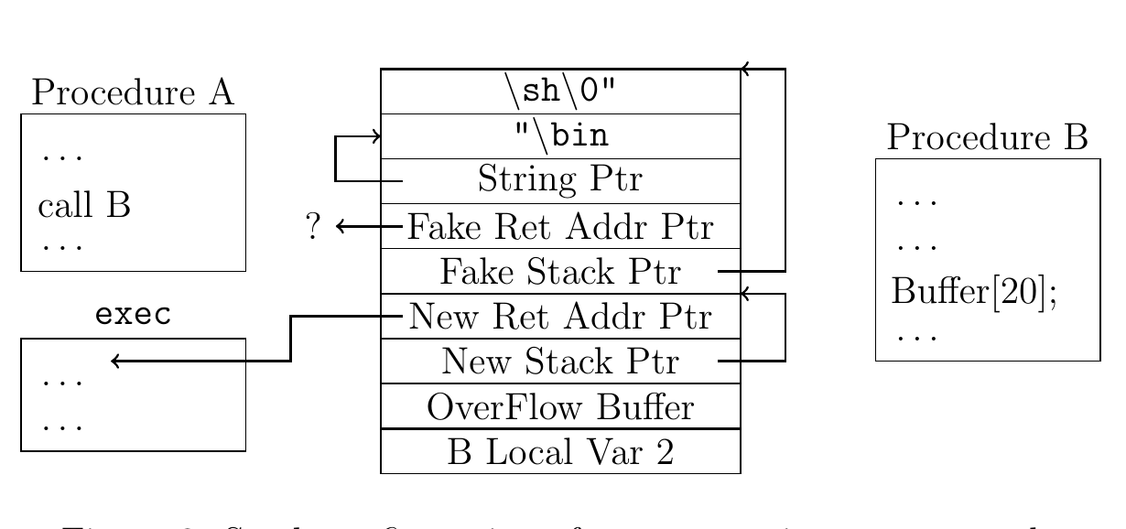
Standard Countermeasures
Attacks
Defenses
W $⊕$ X
Notes:
how successfully are we?
threat models?

Slide 12
x86
Intel Instruction Set Architecture (ISA)
Introduced 1978, still supported
As of 2018, most common architecture on servers, PCs, and laptops
dense instruction set
variable length instructions
not word aligned

Slide 13
Gadgets
f7 c7 07 00 00 00
0f 95 45 c3
test $0x00000007, %edi
setnzb -61 (%ebp)
c7 07 00 00 00 0f
95
45
c3
movl $0x0f0000000, (%edi)
xchg %ebp, %eax
inc %ebp
ret

Slide 14
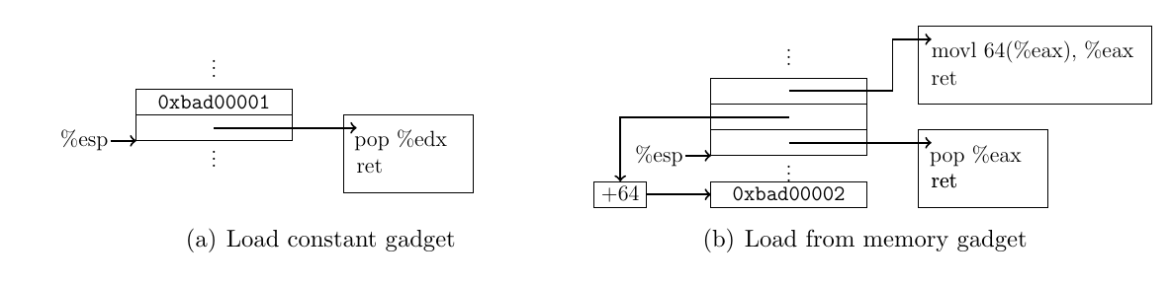
Gadgets

Slide 15
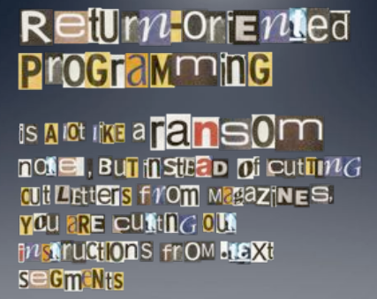
Return Oriented Programming
Image By: Dino Dai Zovi

Slide 16
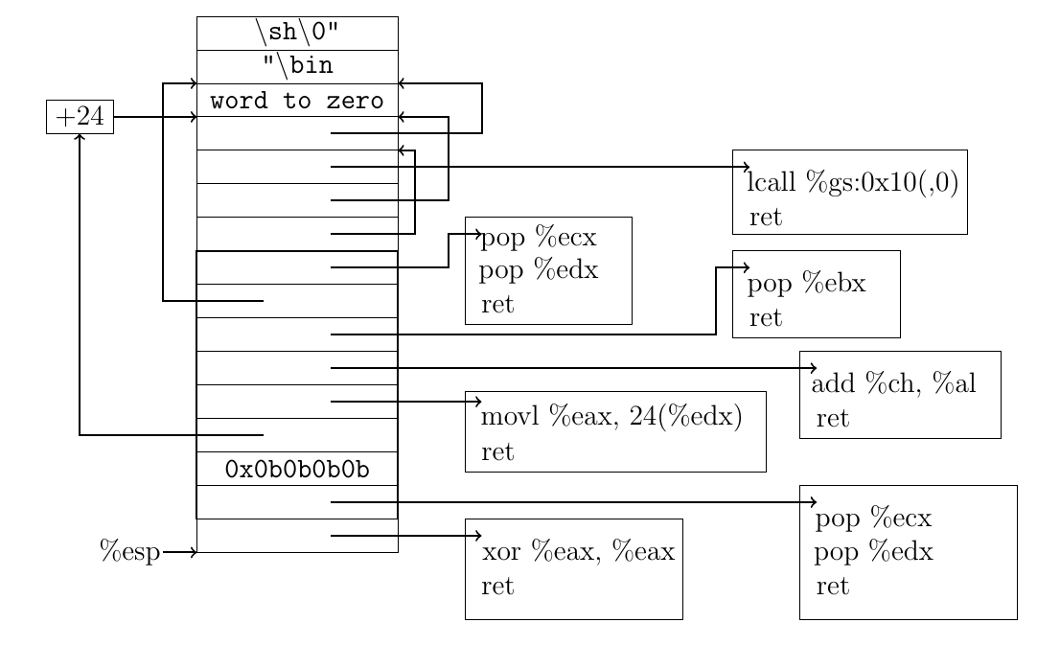
Return-Oriented Shellcode

Slide 17
Testing
Goal is to expose existence of faults, so that they can be fixed
Unit testing: isolated components
Integration testing: combined components
System testing: functionality, performance, acceptance

Slide 18
Testing
When do you stop testing?
Bad answer: when time is up
Bad answer: what all tests pass
Fun fact: Pr[undetected faults] increases with # detected faults [Myers 1979, 2004]
Better answer: when methodology is complete (code coverage, paths, boundary cases, etc.)
Future answer: statistical estimation says Pr[undetected faults] is low enough (active research)
Testing for security?

Slide 19

Penetration testing
Experts attempt to attack
  Internal vs. external
  Overt vs. covert
Typical vulnerabilities exploited:
  Passwords (cracking)
  Buffer overflows
  Bad input validation
  Race conditions / TOCTOU
  Filesystem misconfiguration
  Kernel flaws

Slide 20
Fuzz testing
[Barton Miller, 1989, 2000, 2006]
Generate random inputs and feed them to programs:
  Crash? hang? terminate normally?
  Of ~90 utilities in '89, crashed about 25-33% in various Unixes
  Crash implies buffer overflow potential
Since then, "fuzzing" has become a standard practice for security testing
Results have been repeated for X-windows system, Windows NT, Mac OS X
  Results keep getting worse in GUIs but better on command line
Notes:
Literally was a dark and stormy night: noise on telephone line was inserting random character into shell session, causing Unix utilities to crash

Slide 21
Fuzz testing
Testing strategy:
Purely random no longer so good, just gets low-hanging fruit
Better:
  Use grammar to generate inputs
  Or randomly mutate good inputs in small ways
    especially for testing of network protocols
  Research: use analysis of source code to guide mutation of inputs
Notes:
Literally was a dark and stormy night: noise on telephone line was inserting random character into shell session, causing Unix utilities to crash
Example of research: Microsoft SAGE for finding bugs in media and Office applications; not released AFAIK

Slide 22
FindBugs
Looks for patterns in code that are likely faults and that are likely to cause failures
Categorizes and prioritizes bugs for presentation to developer
Watch video of Prof. Bill Pugh, developer of FindBugs, present it to a Google audience:
  https://www.youtube.com/watch?v=8eZ8YWVl-2s

Slide 23
Web Vulnerabilities by Year

Slide 24
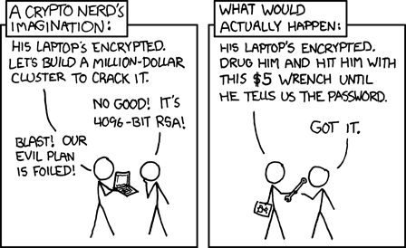
Threat Models

Slide 25
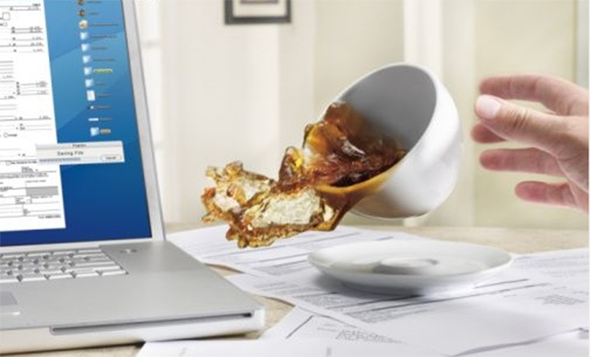
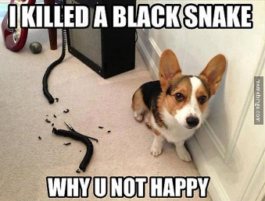
Threats
A principal that has potential to cause harm to assets
Adversary or attacker: a human threat, motivated and capable
Sometimes humans aren't malicious: accidents happen
Sometimes non-humans cause harm: floods, earthquakes, power outage, hardware failure

Slide 26
Threat Models
Identify threats of concern to system
  Especially malicious, human threats
  What kinds of attackers will system resist?
  What are their motivations, resources, and capabilities?
Best if analysis is specific to system and its functionality
Non threats?
  Trusted hardware
  Trusted environment
  e.g., physically secured machine room reachable only by trustworthy system operators

Slide 27
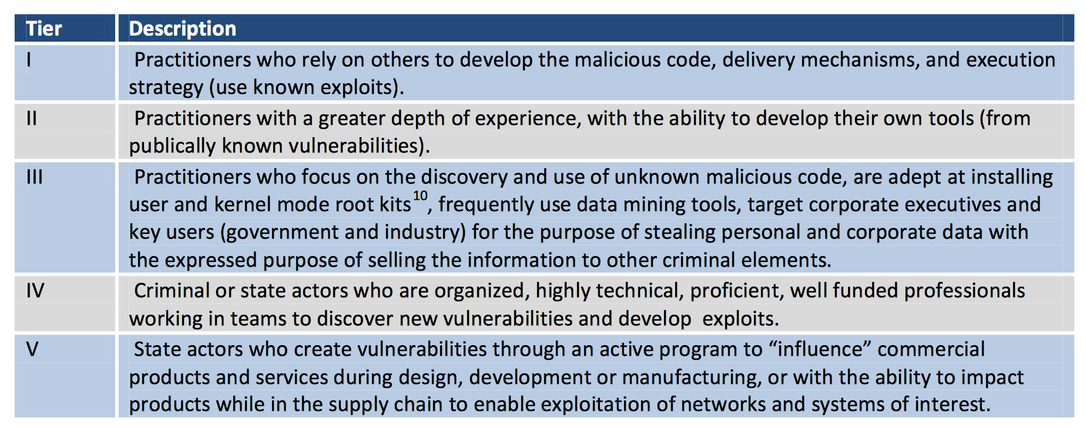
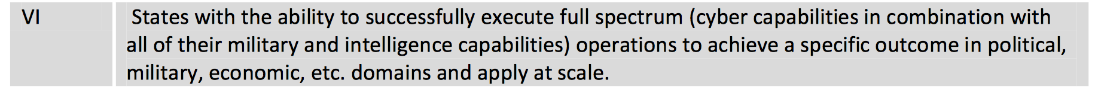
Threats (DoD)

Slide 28
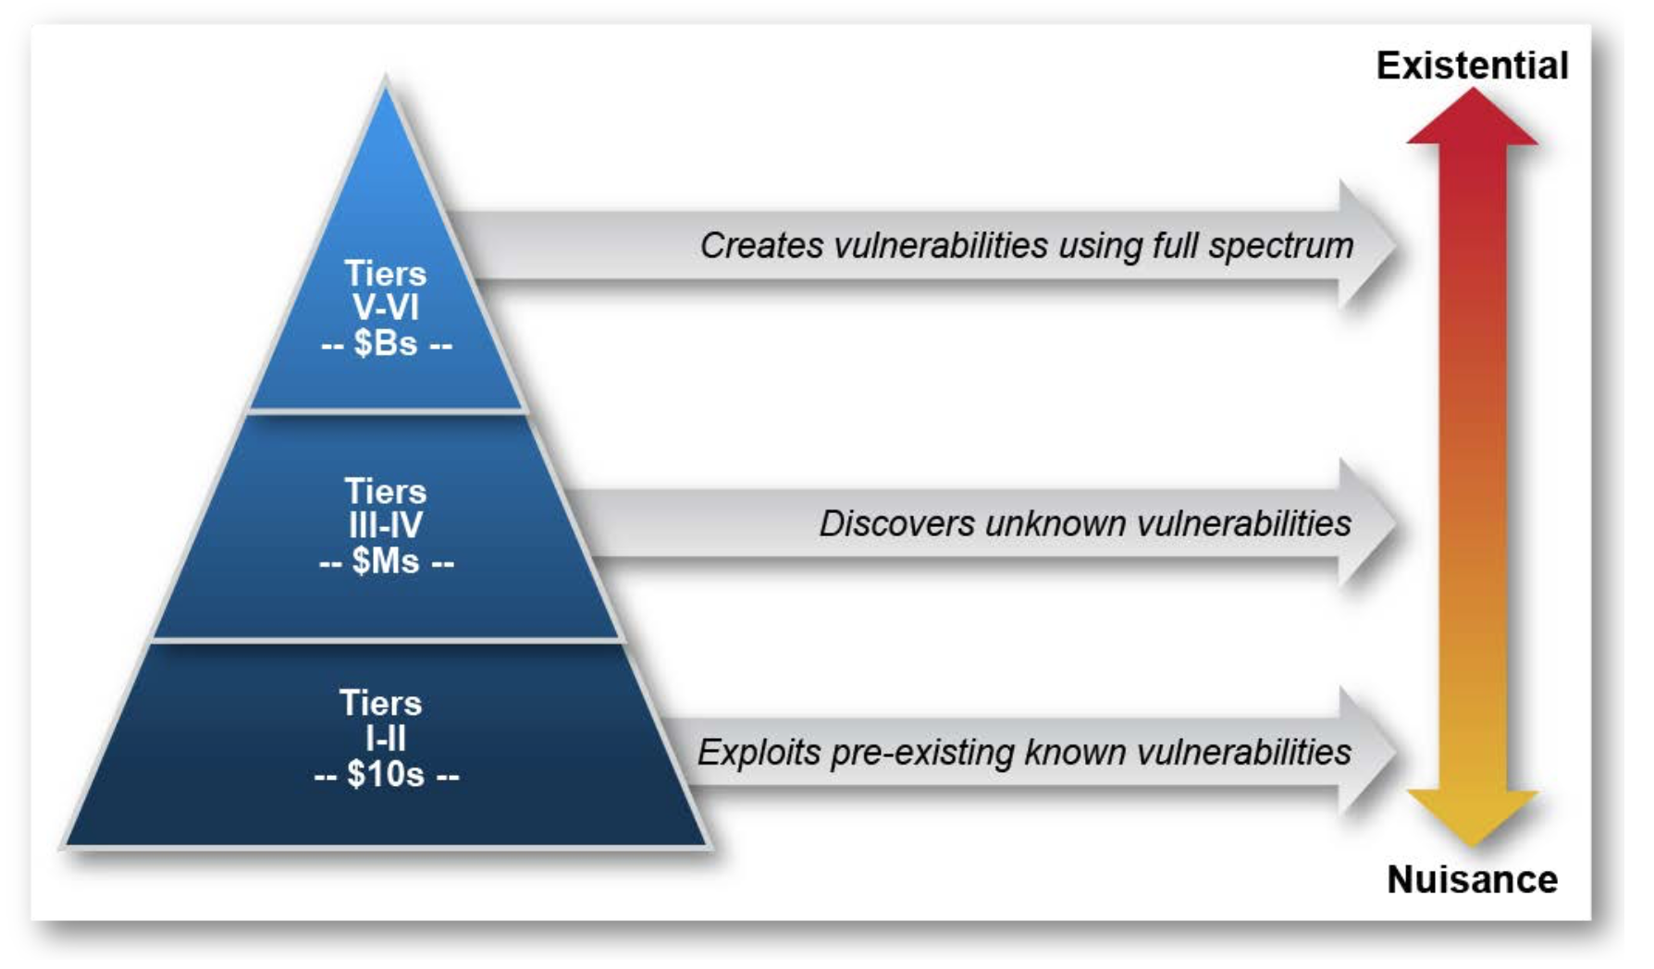
Threats (DoD)

Slide 29
Classifying Threats
[S1, based on U.S. Defense Science Board]
Inquisitive people, unintentional blunders
Hackers driven by technical challenges
Disgruntled employees or customers seeking revenge
Criminals interested in personal financial gain, stealing services, or industrial espionage
Organized crime with the intent of hiding something or financial gain
Organized terrorist groups attempting to influence policy by isolated attacks
Foreign espionage agents seeking to exploit information for economic, political, or military purposes
Tactical countermeasures intended to disrupt specific weapons or command structures
Multifaceted tactical information warfare applied in a broad orchestrated manner to disrupt a major military missions
Large organized groups or nation-states intent on overthrowing a government
Notes:
Ordered from least to most harmful.

Slide 30
Threat Model = Capabilities
privilege levels

Slide 31


Slide 32
Threat Model = Capabilities
privilege levels
memory access

Slide 33

Heartbleed

Slide 34
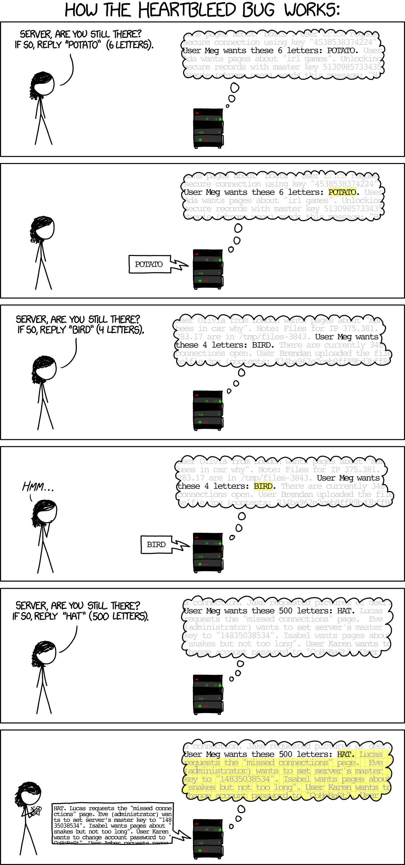
Heartbleed

Slide 35
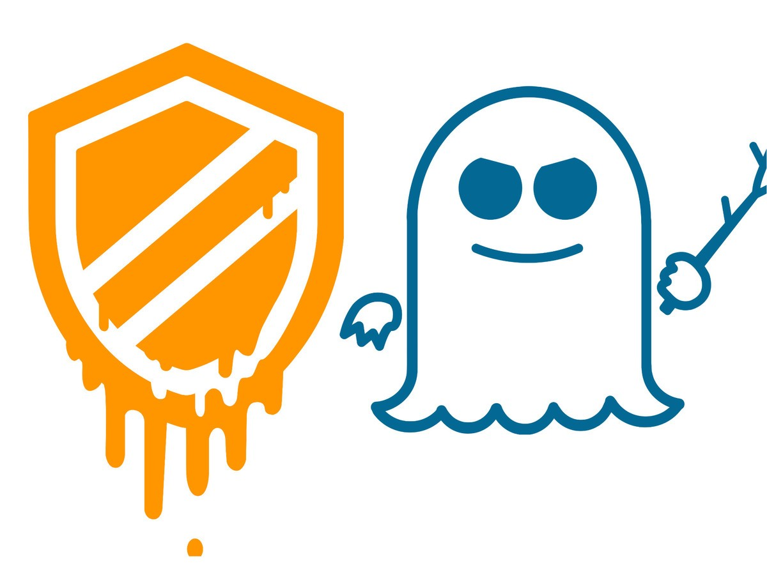

Slide 36

Memory Management
Notes:
Translation: if(Access(Page)): Frame(Page)||Offset
Lots of implementation details: size, caching, indexing
Pros: easy allocation (keep bitmap of free frames), no external fragmentation, still allows access permissions, still allows sharing, easy to grow
Cons: internal fragmentation, slower (size of page tables etc -> multiple lookups)
Cons:

Slide 37
Speculative Execution
int i1, i2;
boolean b1,b2;
boolean[] a1,a2;
if (i1 < a1.length()) {
boolean bval= a1[i1];
if(bval){i2= 1;} else{i2= 0;}
if(i2 < a2.length()){
b2 = a2[i2];
}
}
Notes:
If arr1->length is uncached, the processor can speculatively load data from arr1->data[untrusted_offset_from_caller]. This is an out-of-bounds read. That should not matter because the processor will effectively roll back the execution state when the branch has executed

Slide 38
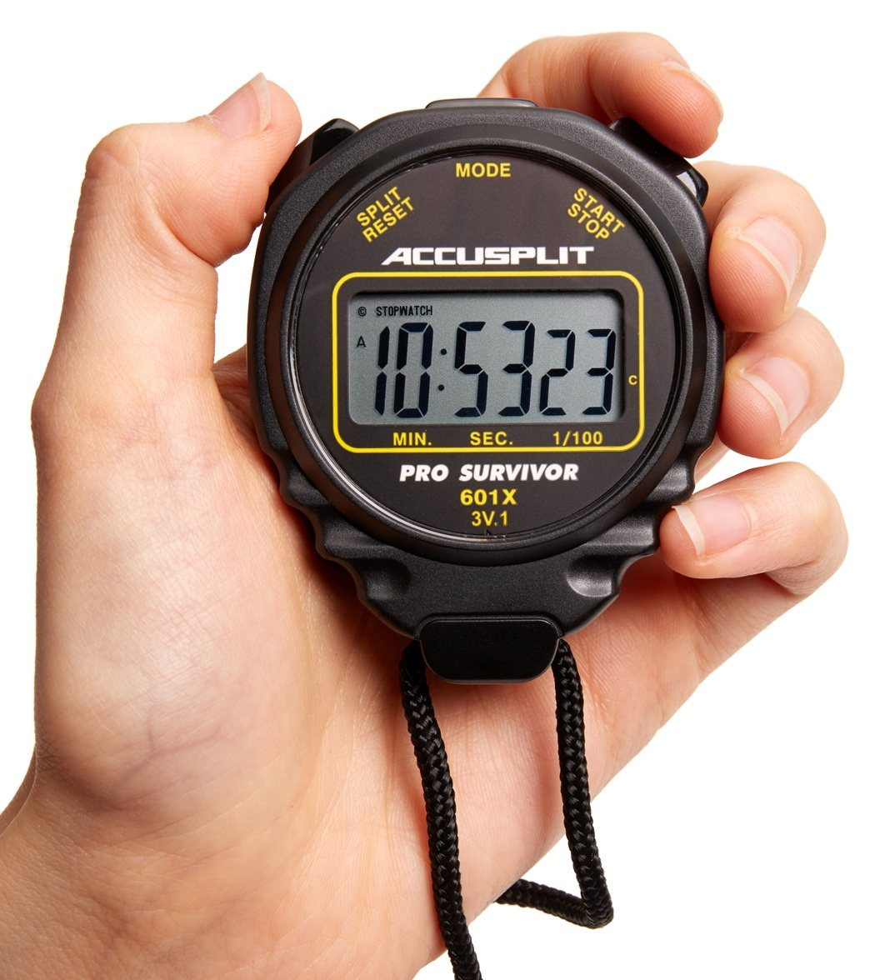
Timing

Slide 39
Threat Model = Capabilities
privilege levels
memory access
physical access

Slide 40
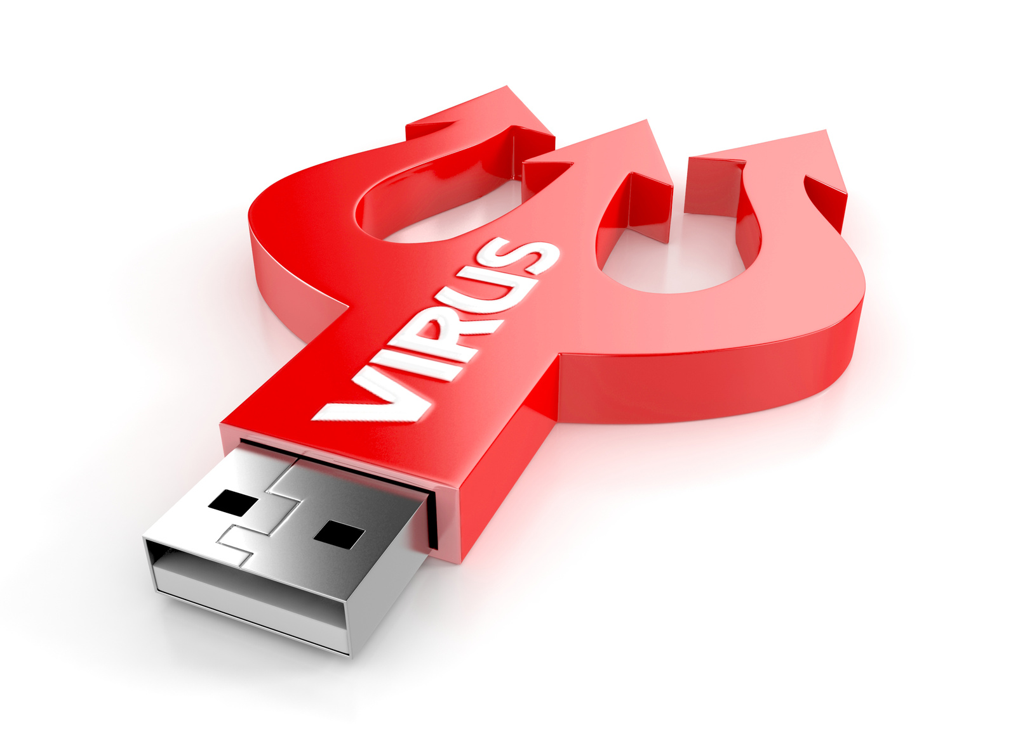
Stuxnet

Slide 41
Threat Model = Capabilities
privilege levels
memory access
physical access
key access

Slide 42

FileVault

Slide 43
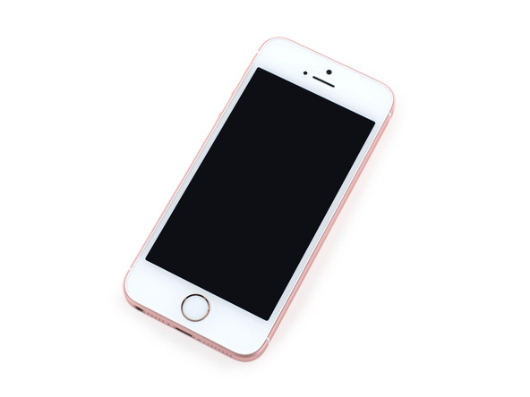
The iPhone Case

Slide 44
Threat Model = Capabilities
privilege levels
memory access
physical access
key access
network access

Slide 45
Network Adversaries
Attacker Properties
Membership | insider |  | outsider
Method | active |  | passive
Adaptability | dynamic |  | static
Organization | cooperative |  | individual
Scope | global | extended | local
Motivation | malicious | rational | opportunistic

Slide 46
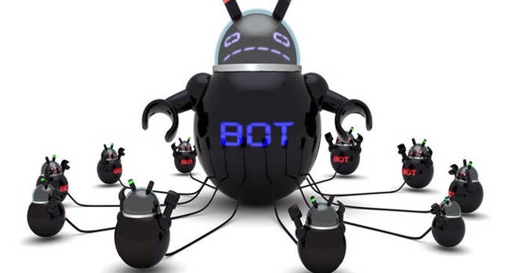
Dyn DDoS

Slide 47
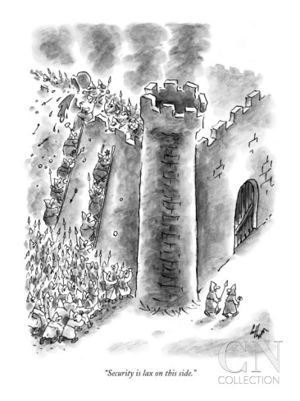
Threat Models

