Slide 1
Datacenter Virtualization:
Global-scale software switches
Hakim Weatherspoon
Assistant Professor, Dept of Computer Science
CS 5413: High Performance Systems and Networking
May 8, 2017
Slides from “Follow the Sun through the Clouds: Application Migration for
Geographically Shifting Workloads “, Z. Shen, Q. Jia, E. Sela, B. Rainero, W. Song,
R. van Renesse, H. Weatherspoon. In Proceedings of the ACM Symposium on Cloud
Computing (SoCC), October 2016.

Slide 2
Where are we in the semester?
Overview and Basics
  Overview
  Basic Switch and Queuing (today)
  Low-latency and congestion avoidance (DCTCP)
Data Center Networks
  Data Center Network Topologies
  Software defined networking
    Software control plane (SDN)
    Programmable data plane (hardware [P4] and software [Netmap])
  Rack-scale computers and networks
  Disaggregated datacenters
  Alternative Switching Technologies
  Data Center Transport
  Virtualizing Networks
  Middleboxes
Advanced topics

Slide 3
Where are we in the semester?
Interested Topics:
  SDN and programmable data planes
  Disaggregated datacenters and rack-scale computers
  Alternative switch technologies
  Datacenter topologies
  Datacenter transports
  Advanced topics

Slide 4
High Performance Systems and Networks
Core Switch
…
Aggregate Switch
Top of Rack Switch
…

Slide 5
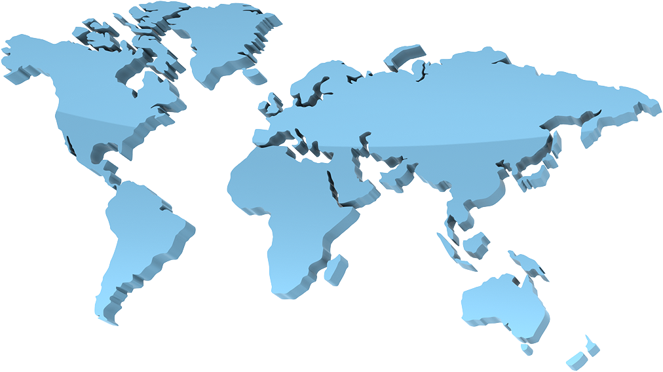

High Performance Systems and Networks
How to optimize a global network of data centers?
And, across multiple heterogeneous clouds

Slide 6
Goals for Today
Plug into the Supercloud
  D. Williams, H. Jamjoom, and H. Weatherspoon. IEEE Internet Computing, Vol. 17, No 2, March/April 2013, pages 28-34
Follow the Sun through the Clouds: Application Migration for Geographically Shifting Workloads
  Z. Shen, Q. Jia, E. Sela, B. Rainero, W. Song, R. van Renesse, H. Weatherspoon. In the ACM Symposium on Cloud Computing (SoCC), October 2016.

Slide 7
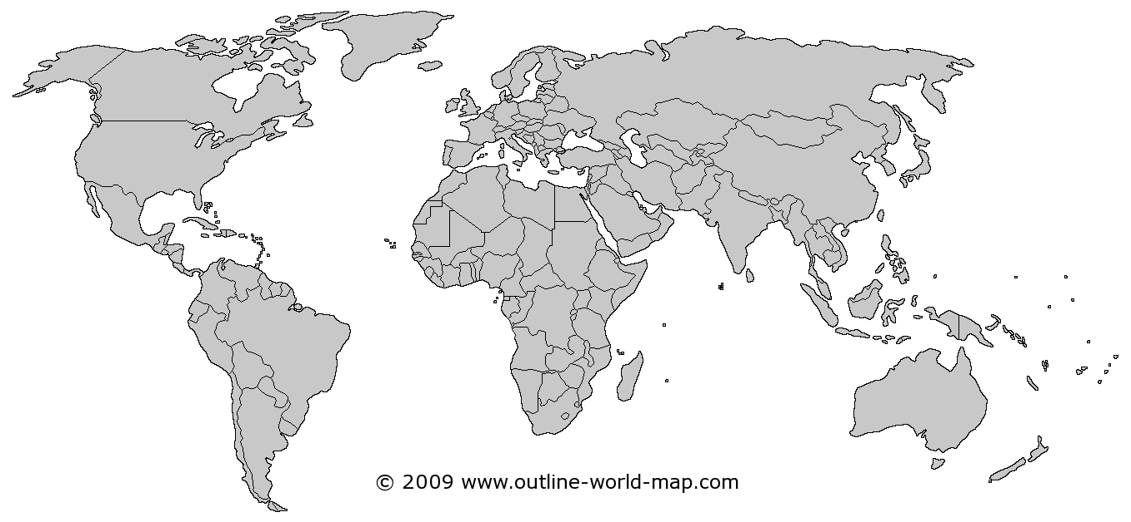
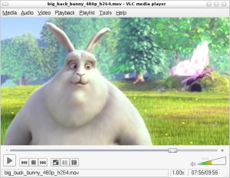
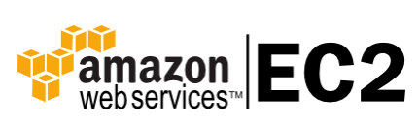
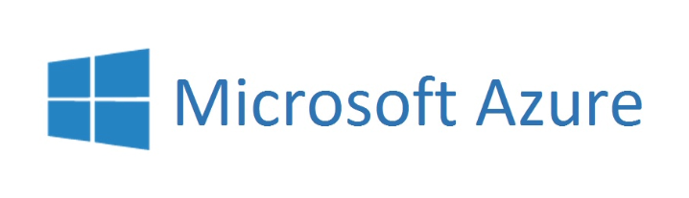
Supercloud Demo
VM
VM
HTTP
Nested VM
HTTP
Notes:
At the beginning of this talk, let me show you something that you have never seen before.
I am going to show you a video of a demo. In this demo, we are going to deploy an application to two different cloud providers in two different locations, including …

Slide 8
Highlights
Automatic VM placement and migration
Migrated VMs are LIVE
IP addresses are not changed
TCP connections are not broken
Notes:
Say a little bit more about each point

Slide 9
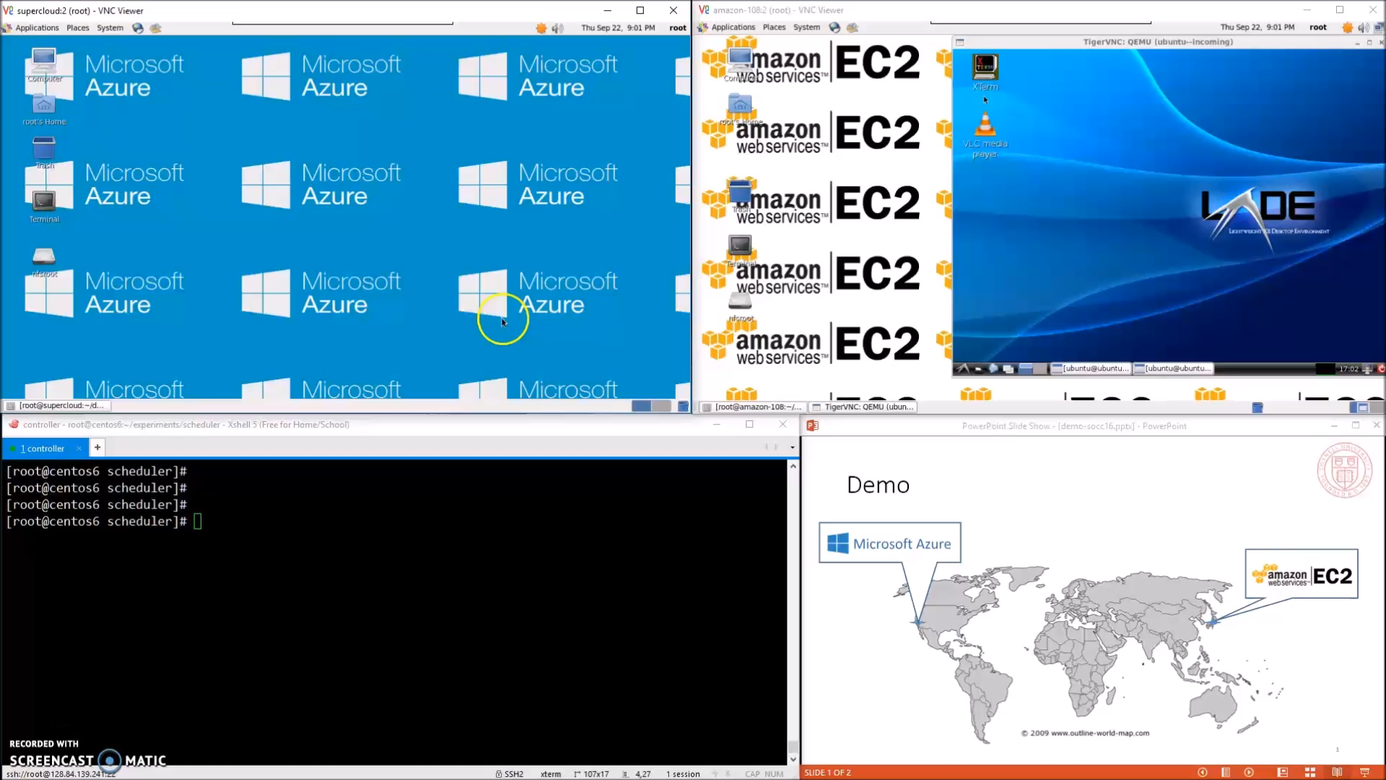
Demo
(Full video available at http://supercloud.cs.cornell.edu)
Notes:
Use word instead of pointers

Slide 10
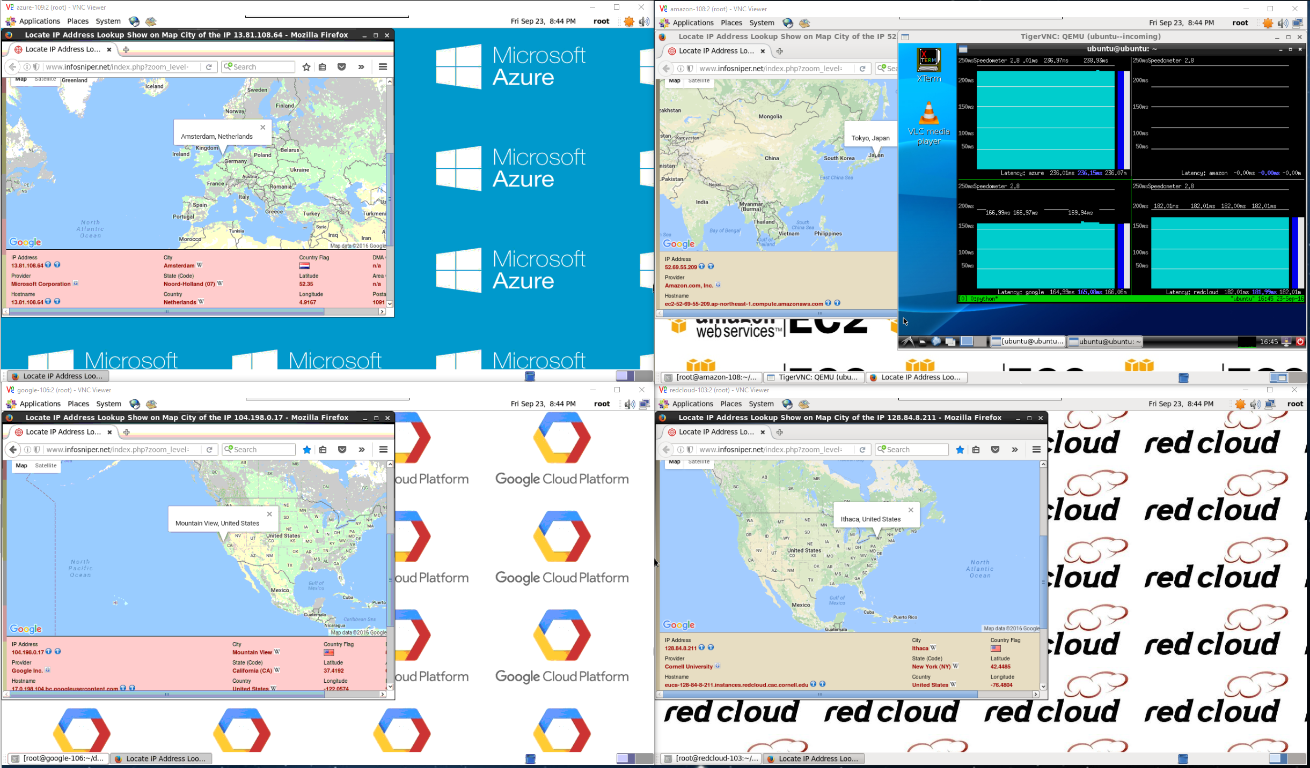
Full Demo (http://supercloud.cs.cornell.edu)
Notes:
Migrate around the earth in minutes
Live demo in the poster section

Slide 11
Highlights
Automatic VM placement and migration
Migrated VMs are LIVE
IP addresses are not changed
TCP connections are not broken
Appears as a unified private cloud that spans all clouds
Controlled by the user!
Notes:
STOP
Pause and emphasis the last point

Slide 12
Research Challenges
How to migrate across incompatible virtualization platforms?
How to keep IP addresses unchanged and TCP connections unbroken?
How to decide when and where to migrate?
How to make the system efficient?
Notes:
Theses are the questions we had to answer

Slide 13
Supercloud is the first system that supports
  automatic,
  efficient,
  and live
  VM migration
  across heterogeneous cloud providers
  without changing IP addresses
  or breaking TCP connections.
Notes:
STOP

Slide 14
Supercloud Architecture
Computation
  Nested hypervisor: Xen-Blanket
  Support all major platforms
Network
  SDN overlay
  Support migration with
  public IP
Storage:
  Geo-replicated storage
  Optimized for serving VM images
Resource management
  OpenStack platform
  Automatic scheduling framework
First-layer VM
Second-layer VM
Cloud Provider 1
Cloud Provider 2
Availability Zone 1
Availability Zone 2
User VMs
User VMs
User VMs
User VMs
User VMs
User VMs
First Layer
Second Layer
Dom0
Dom0
OpenStack
OpenStack
OpenStack
Xen-Blanket
Xen-Blanket
Xen-Blanket
Xen/PV-on-HVM
KVM/virtio
KVM/virtio
Software-Defined Network (SDN)
Geo-replicated Image Storage
First-layer hypervisor
Second-layer hypervisor
Notes:
STOP
Supercloud supports all major platforms
In the paper, we show two examples of how to use the scheduling framework . In this talk, we will focus on the networking and storage.

Slide 15
Supercloud Compute Instances
Xen-Blanket
Second Layer Hypervisor
Uniformity
Guest VM
Dom0
DomU
Second-layer provider
Xen-Blanket
First-layer provider
Xen
KVM
Hyper-V
Notes:
More about the introduction -> case studies -> implementation -> current status
Case studies:
Spot market things
List cases study
Latency test
Private -> public
----- Meeting Notes (10/17/14 13:45) -----
X

Slide 16
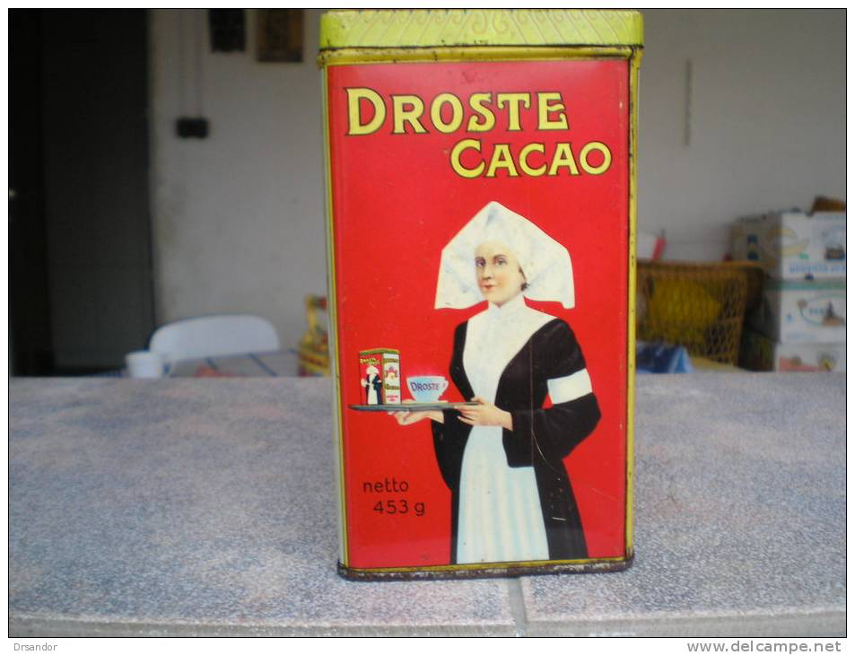

Slide 17
Supercloud Compute Instances
Move computation via Virtualization
  Virtualize processor Instruction Set Architecture
  Full Virtualization vs Paravirtualization (of hardware)
  VMWare vs (Original) Xen
Migrate computation among different machines
Notes:
Full Virtualization
Virtualizing the entire instruction set
Virtual hardware is functionally identical to underlying machine
Previously Problematic for certain privileged instructions
Problematic for certain privileged instructions
Failed silently rather than trapping
Shadow structures
Vmware traps every update page table event
No real time available
Paravirtalization
rtualization
Virtual hardware is similar, not identical to the underlying hardware
Partial view of the underlying hardware
No modification of applications
VMs handle paging
No shadow tables required
Real, virtual and clock time provided
Need modifications to the OS
porting to Xen for every version of every OS

Slide 18
Supercloud Compute Instances
Xen
  DomU hosts guest operating system in virtual machine
  Dom0 manages devices and guests
  Control Transfer: Hypercalls and Events
  (like syscalls and device interrupts)
…
Dom 0
Dom U: VM
Dom U: VM
Backend
PCI-Driver
Frontend
Xen
Baremetal
How do we migrate to different virtualization system?
Notes:
Who/what is the user
Who/what is the provider
Why do we need the provider to migrate?
A famous aphorism of David Wheeler goes: All problems in computer science can be solved by another level of indirection
Diomidis Spinellis. Another level of indirection. In Andy Oram and Greg Wilson, editors, Beautiful Code: Leading Programmers Explain How They Think, chapter 17, pages 279–291. O'Reilly and Associates, Sebastopol, CA, 2007.

Slide 19


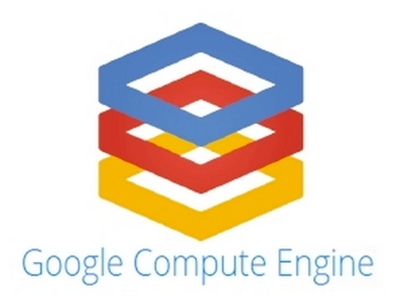
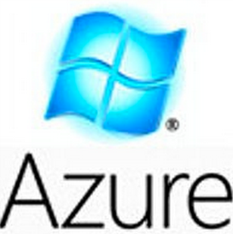
Supercloud Compute Instances
Virtualization enables migration of computation across a single cloud
App
Guest OS
VMM
App
Guest OS
VMM
VMM
App
Guest OS
VMM
VMM

Slide 20
Supercloud Compute Instances
Need another layer of virtualization (indirection)
Blanket drivers enable access to baremetal
Blanket drivers support memory address translation
Hypercalls provides privilege support for HVM
…
Dom 0
Dom U: VM
Dom U: VM
Dom 0 for XB
…
Backend
DomU
DomU
Frontend
Frontend
PCI-Driver
Xen-Blanket
Hyper
call
Xen
Baremetal

Slide 21
Supercloud Compute Instances
Can create your own
Cloud-within-a-Cloud
aka a “Supercloud”
Migrate computation among different cloud providers
App
Guest OS
Xen-Blanket
VMM 1
App
Guest OS
App
Xen-Blanket
Guest OS
VMM 2
Xen-Blanket
VMM
Xen-Blanket
VMM 3
Xen-Blanket
VMM 4

Slide 22
Supercloud Compute Instances
Migration of computation among different cloud providers
Small overhead
Migration: 1 second downtime
Is VM migration sufficient?
Xen-Blanket
VMM 1
Xen-Blanket
VMM 2
Xen-Blanket
VMM
Xen-Blanket
VMM 3
App
Guest OS
Xen-Blanket
VMM 4

Slide 23
Supercloud Networking
VM migration is not enough for large systems
  Single application includes an ecosystem
  E.g. load balancer, app logic, database, and nw policies
Network configuration is necessary
  Policy based routing (e.g. firewall, load balancer, etc.)
  Broadcast
  Multicast
Cloud providers’ support is limited
We need user centric virtual wire; i.e. SDN!

Slide 24
Supercloud Networking
How to build a “Supercloud” SDN?
Blanket drivers enable access to baremetal
Blanket drivers support memory address translation
Hypercalls provides privilege support for HVM
…
Dom 0
Dom U: VM
Dom U: VM
Dom 0 for XB
…
Backend
DomU
DomU
Switch
Frontend
PCI-Driver
Xen-Blanket
Hyper
call
Xen
Baremetal

Slide 25
Supercloud Networking
Switch
VM
VM
VM
Xen-Blanket
VM
VMM 1
Xen-Blanket
VMM 2
Xen-Blanket
VMM
Xen-Blanket
VMM 3
Xen-Blanket
VMM 4

Slide 26
Supercloud Networking
Virtual Wires via SDN
  Uses virtual switches
  Installation of virtual connectors
  Encapsulates and sends packets
Migration of Network Configs
  Migrates network topology
  Obviates administrative configs
Xen-Blanket
VMM 1
Switch
VM
VM
Xen-Blanket
VM
VM
VMM 2
Xen-Blanket
VMM
Xen-Blanket
VMM 3
Xen-Blanket
VMM 4

Slide 27
Supercloud Networking
Challenges:
  Optimal routing without extra forwarding
  Migration without changing IP addresses
Solution:
  VPN overlay with full-mesh tunnels
  Frenetic SDN controller
Cloud 1
VM
vSwitch
vSwitch
vSwitch
vSwitch
vSwitch
VM
Cloud 2

Slide 28


VM Migration with Public IP Address
VM
Dynamic DNS?
Can be delayed due to cache
Can cause connection interrupts
Some applications might not work
Pub IP front-end
54.172.26.213
54.172.26.213
Notes:
Use the same map as the demo

Slide 29
VM Migration with Public IP Address
VM
Pub IP front-end
54.172.26.213
Pub IP front-end
52.69.94.195
Notes:
By taking the extra hop, the internet traffic is routed much more efficiently.

Slide 30
Centralized VM Image Storage
Long latency; Low throughput
VM
Image
Notes:
Traditionally,
However, if you migration the VM across the wide area network

Slide 31
Supercloud Geo-Replicated VM Image Storage
VM
Image
Image
Challenges:
Strong consistency requirement
Long latency and low throughput in WAN
Supercloud VM image storage:
Decoupling consistency from data propagation.
Propagating data according to disk access patterns.
Notes:
STOP
Instead of using a centralized image storage, supercloud provides a geo-replicated image storage. We maintain multiple replicas of the same image file in different locations.
When a VM is migrated from on datacenter to another, it is going to be disconnected from the original replica, and connected to another replica in the destination.
The challenge here is that the VM is expecting a strong consistency in the image file, but maintaining strong consistency across the wide area network needs to deal with the latency and throughput.
Supercloud provides a geo-replicated image storage which de-couples the consistency model from data propagation.
In the meta-data layer, it is strong consistent. So no matter where the vm is located, it is going to always see a consistent image file.
In the real data layer, it is eventual consistent. And because it is de-coupled from the meta-data layer, it can be optimized separately without sacrificing the consistency requirement.
For example, the supercloud image storage propagates the image data according to the VM’s disk access patterns.

Slide 32
Supercloud Geo-Replicated VM Image Storage

Slide 33
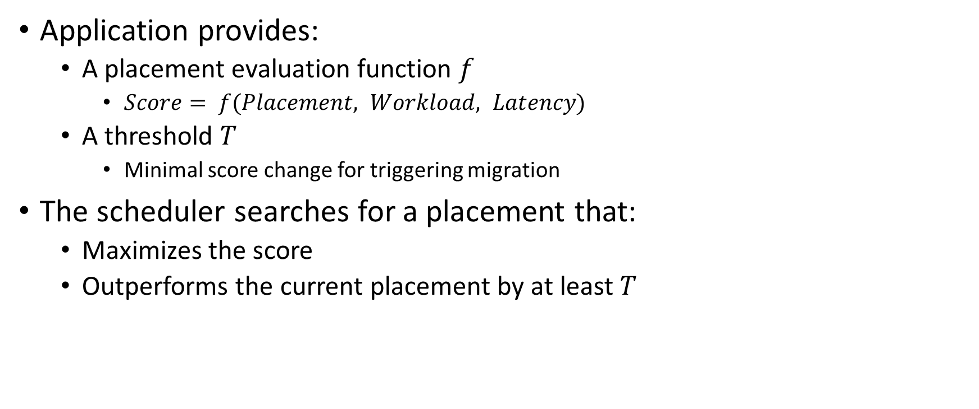
Scheduling Framework
Application provides:
  A placement evaluation function $f$
    $Score= f(Placement, Workload, Latency)$
  A threshold $T$
    Minimal score change for triggering migration
The scheduler searches for a placement that:
  Maximizes the score
  Outperforms the current placement by at least $T$

Slide 34
Benefits of the Supercloud
Case studies
  Follow the Sun
  Smart Spot Market
  Smart Dynamic Resource Scheduler (SDRS)

Slide 35


Benefits of the Supercloud
By leveraging cloud diversity, users can:
  Reduce cost
  Reduce energy
  Handle bursts
  Improve availability
  Reduce service response time
  Improve performance
  Improve security
  And more…
Notes:
Reduce cost: best matching between price and performance guarantee
Improve performance: leverage different services
Improve security: putting computation and communications to different data centers or clouds

Slide 36
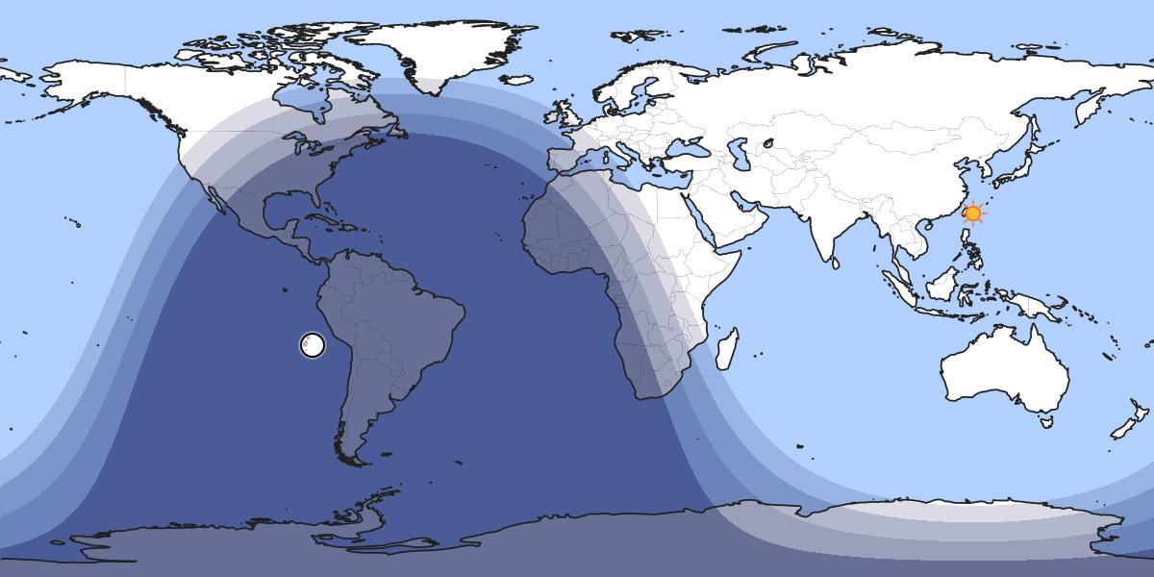

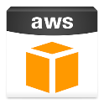

Follow the Sun with Zookeeper
Master

Slide 37
Follow the Sun with Zookeeper
ZooKeeper Master in US
ZooKeeper Master migrates

Slide 38
Benefits of Exploiting Diversity
By leveraging cloud diversity, users can:
  Reduce cost
  Reduce energy
  Handle bursts
  Improve availability
  Reduce service response time
  Improve performance
  Improve security
  And more…
Notes:
Reduce cost: best matching between price and performance guarantee
Improve performance: leverage different services
Improve security: putting computation and communications to different data centers or clouds

Slide 39
Spot Instance
Amazon Spot Instance
  Dramatic Price Change
  Usually Cheap
  Charges hourly
  Ready to be terminated
Prices can jump up
Only stateless jobs!
Notes:
Amazon provide spot instances for the cloud users. The spot instance has very dramatic price changes. But they are usually very cheap. It is charged at the beginning of each billing hour although price may change every five minutes. The user set up a max bid for the instance, and amazon will terminate the instance when the price goes above it. So it should be ready to be terminated. There are two drawbacks of the spot instance – it can’t save money when the price goes high. And we can only run stateless jobs because it is unpredictable when it will be terminated.
----- Meeting Notes (10/21/14 10:33) -----
amazon will notify the user (grace period)

Slide 40
Smart Spot Instance
Supercloud on Spot Instances
  Migrate instances before being terminated
  Migrate to the cheapest location before starting new billing hour
Benefits
  No termination
  Reduced cost
Notes:
Most cloud providers don’t offer migration, so when you chose one availability zone and want to move to another, you need to stop the instance and start it again. Supercloud can migrate out to other places when the instances is being terminated, so the service will not be stopped. It can also migrate to the cheapest place when a new billing cycle starts. This could lower the budget.

Slide 41
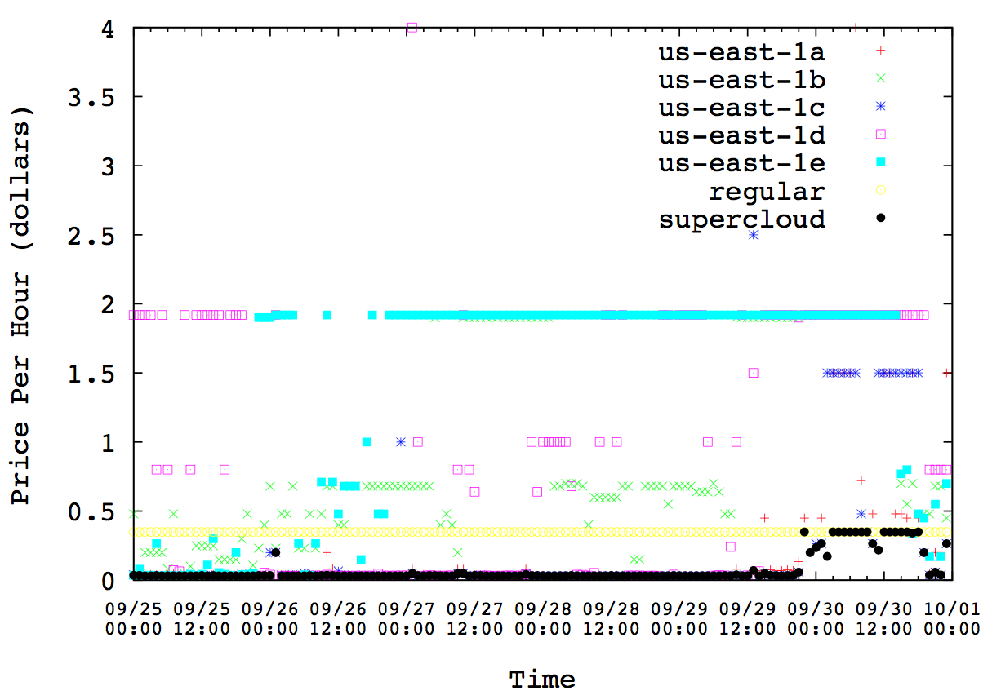
Spot Instance Price History
Spot price goes very high sometimes
Regular instances have stable price
Migrate supercloud to regular instances
Supercloud is migrated to the cheapest place every hour
Spot price is usually low
Notes:
This figure shows the price history of spot instances from all five availability zones in us east, regular instance and supercloud instance from september 25 to Oct 1. As shown in the figure, the price for the regular instance remains unchanged. Most of the time, the price of the spot instances remains very low. But sometimes, the price goes very high, much higher than the regular price. As for the supercloud, it is migrated to the cheapest place every hour so its cost is always low. When the spot instances in all availability zones becomes high, it is possible to migrate supercloud to the regular instances. In addition to that, we can also migrate to other clouds, if their price is cheaper although it is not shown in the figure.
----- Meeting Notes (10/21/14 10:33) -----
m1.xlarge
game

Slide 42
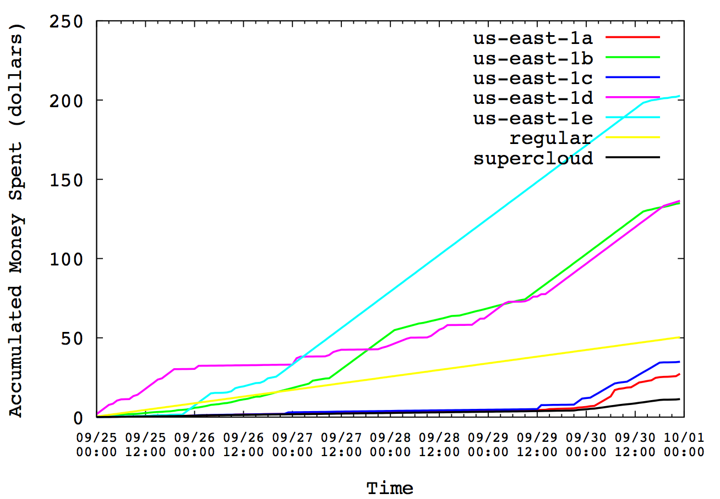
Accumulated Price
Smart spot instances save money!
Notes:
This figure shows the accumulated price for running spot instances for the period. Supercloud costs much less than any other availability zones and regular instances.
----- Meeting Notes (10/20/14 17:30) -----
Mention we can also migrate to other places.
Mention migration is not support the migration

Slide 43
Benefits of Exploiting Diversity
By leveraging cloud diversity, users can:
  Reduce cost
  Reduce energy
  Handle bursts
  Improve availability
  Reduce service response time
  Improve performance
  Improve security
  And more…
Notes:
Reduce cost: best matching between price and performance guarantee
Improve performance: leverage different services
Improve security: putting computation and communications to different data centers or clouds

Slide 44



Resource Oversubscription
Pack VMs when loads becomes light
Cloud VM
Cloud VM
Cloud VM
VM1
VM2
VM3
Migration
Cloud VM
VM1
VM2
VM3

Slide 45
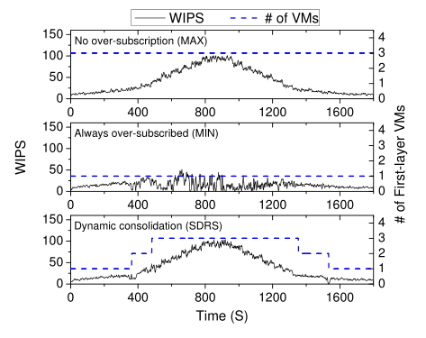
Resource Oversubscription
29% cost saving with 1.5% performance degredation.

Slide 46
In the Paper
Comparison with application-level migration
Placement policies for different types of applications
Detail design of the image storage
Hierarchical network topology
Evaluations

Slide 47
Perspective
Supercloud: application migration for geographically shifting workloads
  Crossing heterogeneous cloud providers
  Automatic placement and migration
  Geo-replicated image storage
  Wide-area SDN
A unified private cloud that spans all clouds
Controlled by the user!

Slide 48
Paper Trail
  Supercloud Multicloud Deployment: SoCC 2016
  Supercloud Economics: CrossCloud 2016
  Supercloud: Opportunities/Challenges in OSR-2015
  Plug into the Supercloud in IEEE Internet Computing-2013
  Supercloud/Xen-Blanket in EuroSys-2012
  Supercloud in HotCloud-2011/2014
  Overdriver in VEE-2011
  RACS in SOCC-2010
  See also, Storage: Gecko in FAST 2013 / HotStorage 2012,
  Antiquity in EuroSys 2007 and SMFS in FAST 2009
  Networking: SoNIC in SIGCOMM 2016, NSDI 2013/2014, Maelstrom NSDI 2008
  Wireless DC in ANCS 2012, and NetSlice in ANCS 2012
More at http://supercloud.cs.cornell.edu
and also http://fireless.cs.cornell.edu
Email: hweather@cs.cornell.edu

