Slide 1
Data Center Networks and Software-defined Networking
Hakim Weatherspoon
Associate Professor, Dept of Computer Science
CS 5413: High Performance Computing and Networking
March 20, 2017
Slides taken liberally from Jennifer Rexford’s Computer Networks, COS 461 http://www.cs.princeton.edu/courses/archive/spr12/cos461/docs/lec24-sdn.ppt

Slide 2
Agenda for semester
HW2 grading
Sign up interactive demo session
This Wednesday and Thursday
Project
Continue to make progress.
Intermediate project report due Mar 24. BOOM proposal due Mar 31.
Spring break, week of April 2nd
Intermediate project report 2 due April 12th.
BOOM, Wednesday, April 19
End of Semester, Wednesday, May 10
Check website for updated schedule

Slide 3
Where are we in the semester?
Overview and Basics
Overview
Basic Switch and Queuing (today)
Low-latency and congestion avoidance (DCTCP)
Data Center Networks
Data Center Network Topologies
Software defined networking
Software control plane (SDN)
Programmable data plane (hardware [P4] and software [Netmap])
Rack-scale computers and networks
Disaggregated datacenters
Alternative Switching Technologies
Data Center Transport
Virtualizing Networks
Middleboxes
Advanced topics

Slide 4
Results from Survey
Interested Topics:
SDN and programmable data planes
Disaggregated datacenters and rack-scale computers
Alternative switch technologies
Datacenter topologies
Datacenter transports
Advanced topics
Interest in student presentations
Not really

Slide 5
Results from Survey
Load
A bit High
Interesting: lectures, Lab’s, homeworks, projects
4 out of 5 on average.
How to make the class a 5 out of 5
Easier or no homework!
In class labs
Guidance and assistance on project
Linux kernel modules!
Labs about the cloud.

Slide 6

The Internet: A Remarkable Story
Tremendous success
From research experiment to global infrastructure
Brilliance of under-specifying
Network: best-effort packet delivery
Hosts: arbitrary applications
Enables innovation in applications
Web, P2P, VoIP, social networks, virtual worlds
But, change is easy only at the edge… ☹

Slide 7
Inside the ‘Net: A Different Story…
Closed equipment
Software bundled with hardware
Vendor-specific interfaces
Over specified
Slow protocol standardization
Few people can innovate
Equipment vendors write the code
Long delays to introduce new features
Impacts performance, security, reliability, cost…

Slide 8



Networks are Hard to Manage
Operating a network is expensive
More than half the cost of a network
Yet, operator error causes most outages
Buggy software in the equipment
Routers with 20+ million lines of code
Cascading failures, vulnerabilities, etc.
The network is “in the way”
Especially a problem in data centers
… and home networks

Slide 9
Creating Foundation for Networking
A domain, not (yet?) a discipline
Alphabet soup of protocols
Header formats, bit twiddling
Preoccupation with artifacts
From practice, to principles
Intellectual foundation for networking
Identify the key abstractions
… and support them efficiently
To build networks worthy of society’s trust

Slide 10
Rethinking the “Division of Labor”

Slide 11
Traditional Computer Networks
Data plane:
Packet streaming
Forward, filter, buffer, mark,
rate-limit, and measure packets
Notes:
Maybe this is a better picture… though need some details of what happens in each plane… like in next slides… or, have both?

Slide 12
Traditional Computer Networks
Control plane:
Distributed algorithms
Track topology changes, compute routes, install forwarding rules
Notes:
Maybe this is a better picture… though need some details of what happens in each plane… like in next slides… or, have both?

Slide 13
Traditional Computer Networks
Management plane:
Human time scale
Collect measurements and configure the equipment
Notes:
Maybe this is a better picture… though need some details of what happens in each plane… like in next slides… or, have both?

Slide 14
Death to the Control Plane!
Simpler management
No need to “invert” control-plane operations
Faster pace of innovation
Less dependence on vendors and standards
Easier interoperability
Compatibility only in “wire” protocols
Simpler, cheaper equipment
Minimal software

Slide 15
Software Defined Networking (SDN)
Logically-centralized control
Smart,
slow
API to the data plane
(e.g., OpenFlow)
Dumb,
fast
Switches

Slide 16
OpenFlow Networks

Slide 17
Data-Plane: Simple Packet Handling
Simple packet-handling rules
Pattern: match packet header bits
Actions: drop, forward, modify, send to controller
Priority: disambiguate overlapping patterns
Counters: #bytes and #packets
src=1.2.*.*, dest=3.4.5.* → drop
src = *.*.*.*, dest=3.4.*.* → forward(2)
3. src=10.1.2.3, dest=*.*.*.* → send to controller

Slide 18
Unifies Different Kinds of Boxes
Router
Match: longest destination IP prefix
Action: forward out a link
Switch
Match: destination MAC address
Action: forward or flood
Firewall
Match: IP addresses and TCP/UDP port numbers
Action: permit or deny
NAT
Match: IP address and port
Action: rewrite address and port

Slide 19
Controller: Programmability
Controller Application
Network OS
Events from switches
Topology changes,
Traffic statistics,
Arriving packets
Commands to switches
(Un)install rules,
Query statistics,
Send packets

Slide 20
Example OpenFlow Applications
Dynamic access control
Seamless mobility/migration
Server load balancing
Network virtualization
Using multiple wireless access points
Energy-efficient networking
Adaptive traffic monitoring
Denial-of-Service attack detection
See http://www.openflow.org/videos/

Slide 21

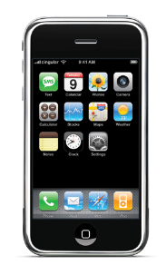
E.g.: Dynamic Access Control
Inspect first packet of a connection
Consult the access control policy
Install rules to block or route traffic

Slide 22
E.g.: Seamless Mobility/Migration
See host send traffic at new location
Modify rules to reroute the traffic

Slide 23
E.g.: Server Load Balancing
Pre-install load-balancing policy
Split traffic based on source IP
src=0*
src=1*

Slide 24
E.g.: Network Virtualization
Controller #1
Controller #2
Controller #3
Partition the space of packet headers

Slide 25
OpenFlow in the Wild
Open Networking Foundation
Google, Facebook, Microsoft, Yahoo, Verizon, Deutsche Telekom, and many other companies
Commercial OpenFlow switches
HP, NEC, Quanta, Dell, IBM, Juniper, …
Network operating systems
NOX, Beacon, Floodlight, Nettle, ONIX, POX, Frenetic
Network deployments
Eight campuses, and two research backbone networks
Commercial deployments (e.g., Google backbone)

Slide 26
A Helpful Analogy
From Nick McKeown’s talk “Making SDN Work” at the Open Networking Summit, April 2012

Slide 27
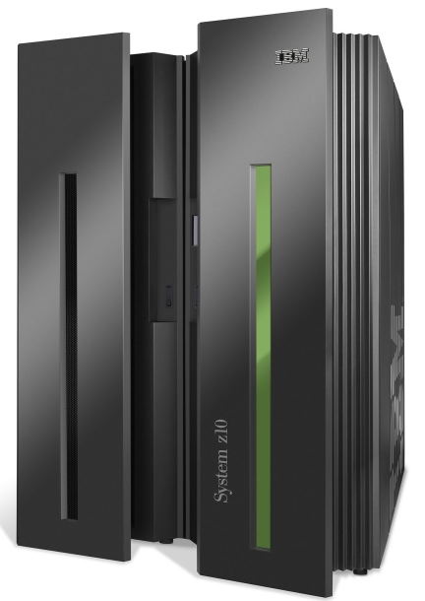
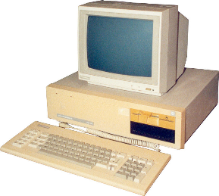
Mainframes
App
App
App
App
App
App
App
App
App
App
App
Specialized
Applications
Open Interface
Windows
(OS)
Linux
Mac
OS
Specialized
Operating
System
or
or
Open Interface
Specialized
Hardware
Microprocessor
Vertically integrated
Closed, proprietary
Slow innovation
Small industry
Horizontal
Open interfaces
Rapid innovation
Huge industry

Slide 28
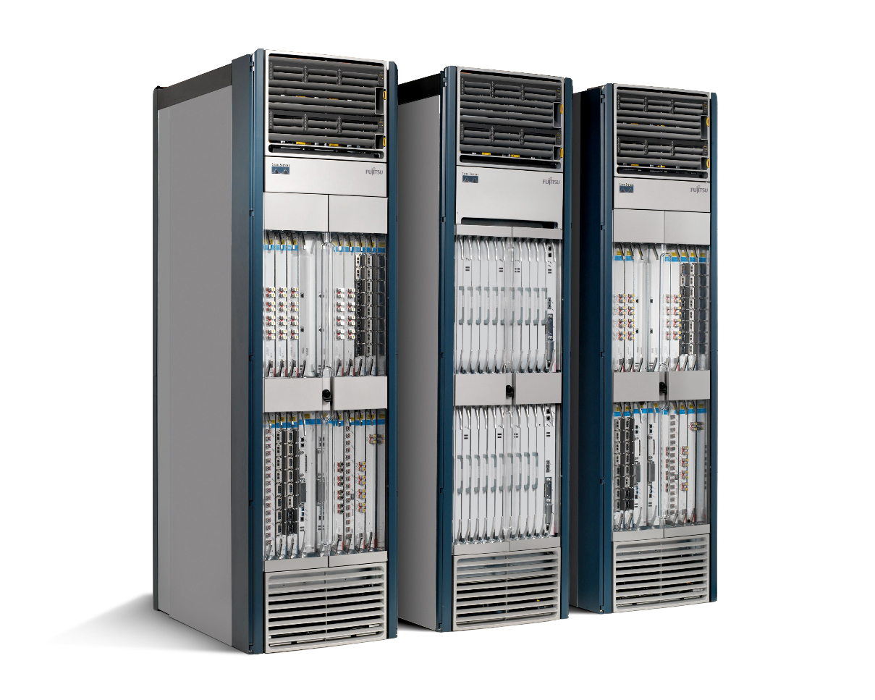
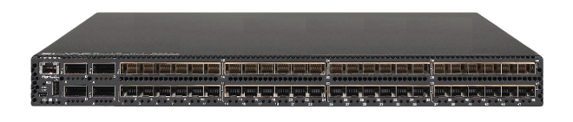
Routers/Switches
App
App
App
App
App
App
App
App
App
App
App
Specialized
Features
Open Interface
Control
Plane
Control
Plane
Control
Plane
or
or
Specialized
Control
Plane
Open Interface
Specialized
Hardware
Merchant
Switching Chips
Vertically integrated
Closed, proprietary
Slow innovation
Horizontal
Open interfaces
Rapid innovation

Slide 29
Challenges

Slide 30
Heterogeneous Switches
Number of packet-handling rules
Range of matches and actions
Multi-stage pipeline of packet processing
Offload some control-plane functionality (?)
access
control
MAC
look-up
IP
look-up

Slide 31
Controller Delay and Overhead
Controller is much slower the the switch
Processing packets leads to delay and overhead
Need to keep most packets in the “fast path”
packets

Slide 32
Distributed Controller
For scalability and reliability
Controller Application
Controller Application
Partition and replicate state
Network OS
Network OS

Slide 33
Testing and Debugging
OpenFlow makes programming possible
Network-wide view at controller
Direct control over data plane
Plenty of room for bugs
Still a complex, distributed system
Need for testing techniques
Controller applications
Controller and switches
Rules installed in the switches

Slide 34
Programming Abstractions
Controller APIs are low-level
Thin veneer on the underlying hardware
Need better languages
Composition of modules
Managing concurrency
Querying network state
Network-wide abstractions
Ongoing at Princeton
http://www.frenetic-lang.org/
Controller
Switches

Slide 35
Perspective
Rethinking networking
Open interfaces to the data plane
Separation of control and data
Leveraging techniques from distributed systems
Significant momentum
In both research and industry

