Slide 1
Queues don’t matter when you can JUMP them!
Matthew P. Grosvenor, Malte Schwarzkopf, Ionel Gog,
Robert N. M. Watson, Andrew W. Moore,
Steven Hand, Jon Crowcroft
University of Cambridge Computer Laboratory
Presented by
Vishal Shrivastav, Cornell University

Slide 2
Introduction
Datacenters comprise of varying mixture of workloads
some require very low latencies, some sustained high throughput, and others require some combination of both
Statistical Multiplexing leads to in-network interference
can lead to large latency variance and long latency tails
leads to poor user experience and impacts revenue
How to achieve strong (bounded?) latency guarantees in present day datacenters?

Slide 3
What causes latency variance?
Queue build-up
packets from throughput intensive flows block a latency-sensitive packet
Need a way to separate throughput intensive flows from latency-sensitive flows
Incast
packets from many different latency-sensitive flows hit the queue at the same time
Need a way to proactively rate-limit latency-sensitive flows

Slide 4
Setup
1 server running ptpd v2.1.0 synchronizing with a timeserver
1 server generating mixed GET/SET workload of 1 KB requests in TCP mode sent to memcached server
4 servers running 4-way barrier-synchronization benchmark
using Naiad v0.2.3 benchmark
8 servers running Hadoop, performing a natural join between two 512 MB data sets (39M rows each)

Slide 5
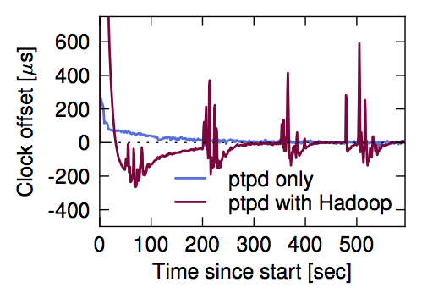
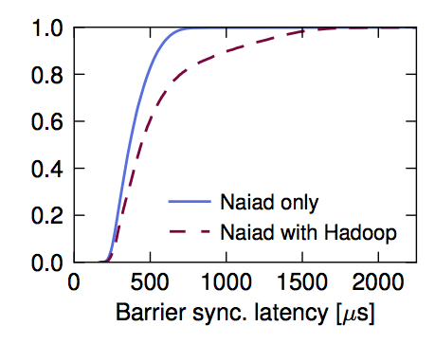
How bad it really is?
CDF
In-network interference can lead to significant increase in latencies and eventual performance degradation for latency-sensitive applications
CDF

Slide 6
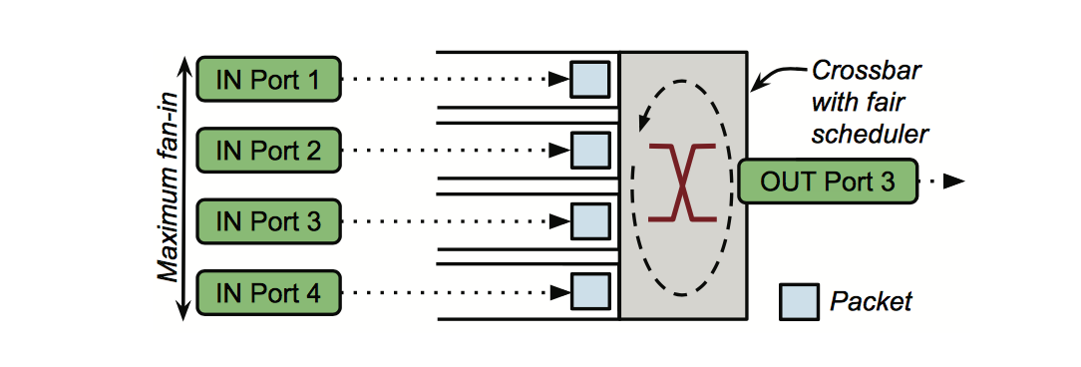
Towards achieving bounded latency
Servicing delay
Time since a packet got assigned to an output port to when it is finally ready to be transmitted over the outgoing link
Servicing delay is a function of the queue length
Packets fanning in to a 4-port, virtual output queued switch.
Output queues shown for port 3 only.

Slide 7
Maximum servicing delay
Assumptions
Entire network abstracted as a “single big switch”
Initially idle network
Each host connected to the network via a single link
Link rates do not decrease from edges to network core
$$worst case servicing delay≤ n ∗ \frac{P}{R} + ε$$
n = number of hosts
P = maximum packet size
R = bandwidth of slowest link
$ε$ = switch processing delay

Slide 8
Rate-limiting to achieve bounded latency
Network epoch
maximum time that an idle network will take to service one packet from every sending host
All hosts are rate-limited so that they can issue atmost one packet per epoch
bounded queuing => bounded latency
$$network epoch=2n ∗ \frac{P}{R} + ε$$
epoch 2
epoch 1

Slide 9
What about throughput?
Configure the value of n to create different QJump levels
n = number of hosts -- highest QJump level
bounded latency; very low throughput
n = 1 -- lowest QJump level
latency variance; line rate throughput

Slide 10
QJump within switches
Datacenter switches support 8 hardware enforced priorities
Map each “logical” QJump level to “physical” priority level on switches
Highest QJump level mapped to highest priority level on switches and so on
Packets from higher QJump levels can now “jump” the queue in the switches

Slide 11
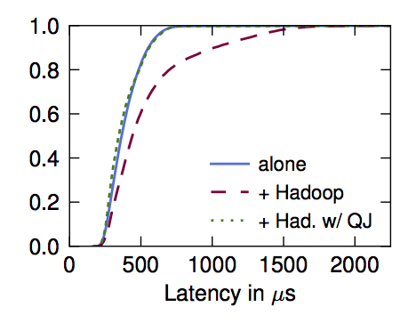
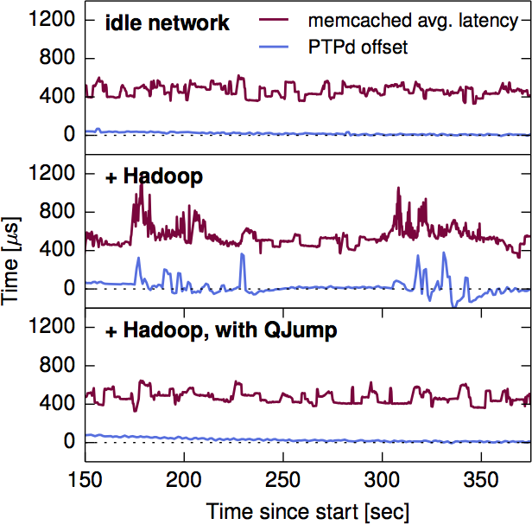
Evaluation
CDF - Naiad barrier sync latency
QJump resolves in-network interference
and attains near-ideal performance for real applications
CDF - Memcached request latency

Slide 12
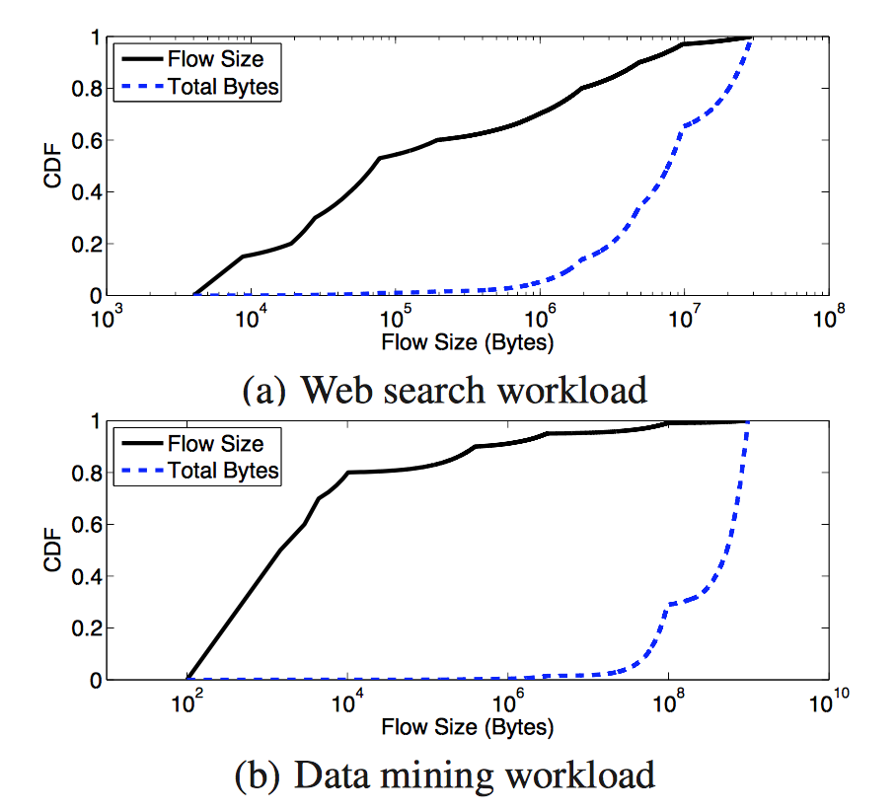
Simulation : Workload
In web search workload, 95% of all bytes are from 30% of the flows that are 1-20 MB
In data mining workload, 80% of flows are less than 10KB and 95% of all bytes are from 4% of the flows that are >35 MB

Slide 13
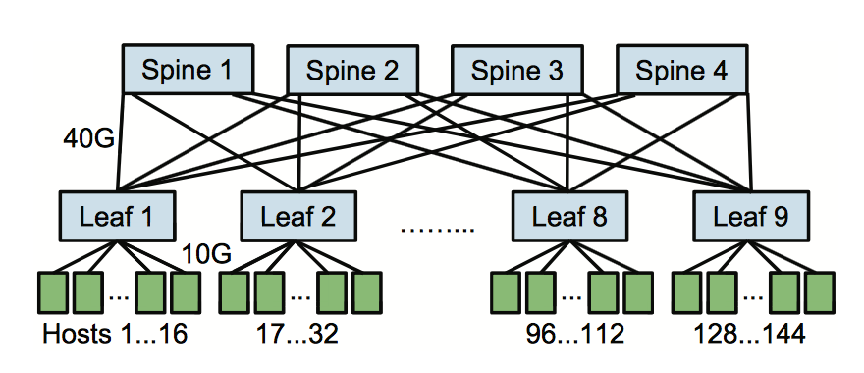
Simulation : Setup
QJump parameters
Maximum bytes that can be transmitted in an epoch (P) = 9KB
Bandwidth of slowest link (R) = 10Gbps
QJump levels = {1, 1.44, 7.2, 14.4, 28.8, 48, 72, 144}
varying value of n from lowest -> highest level

Slide 14
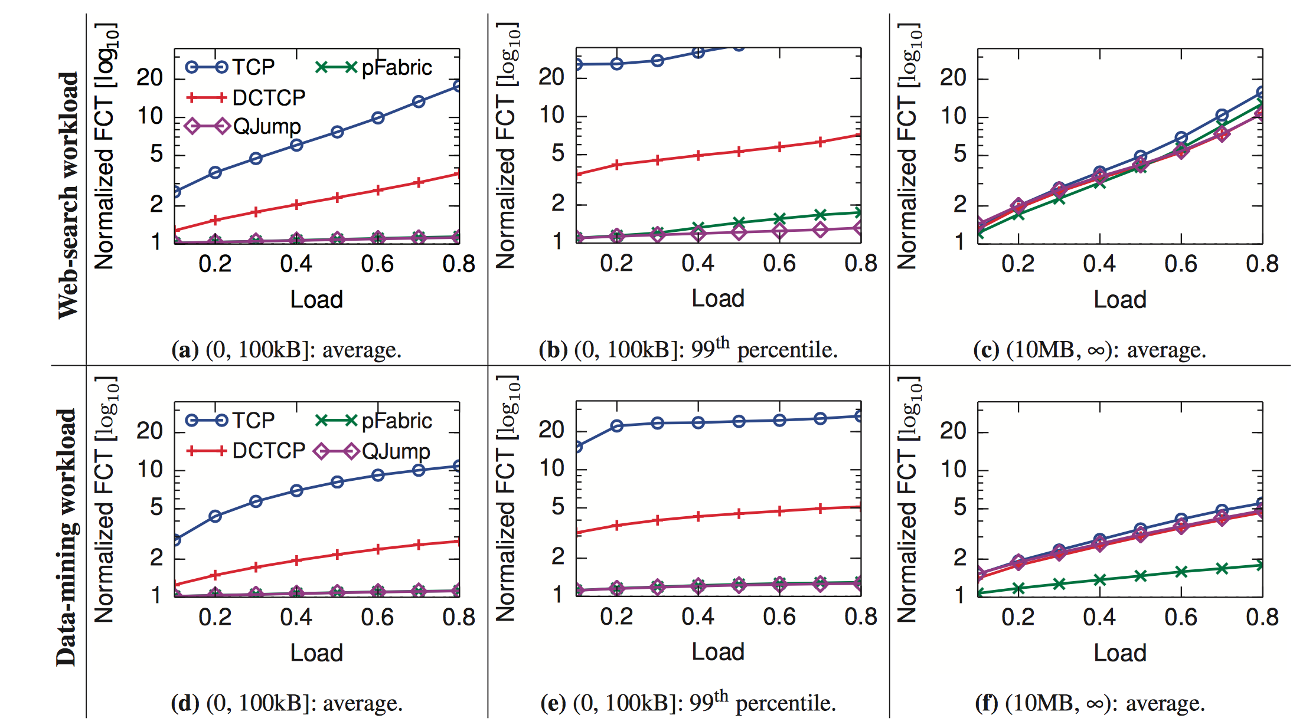
Simulation : Results
For short flows, on both workloads, QJUMP achieves average and 99th percentile FCTs close to or better than pFabric
For long flows, on web search workload, QJump beats pFabric by up to 20% at high load, but loses by 15% at low load
For long flows, on data mining workload, QJump average FCTs are between 30% and 63% worse than pFabric’s

Slide 15
Conclusion
QJump applies QoS-inspired concepts to datacenter applications to mitigate network interference
Offers multiple service levels with different latency variance vs. throughput tradeoffs
Attains near-ideal performance for real applications in the testbed and good flow completion times in simulations
QJump is immediately deployable and requires no modifications to the hardware

Slide 16
Final thoughts
The Good …
can provide bounded latencies for applications that require it
does a good job of resolving interference via priorities
immediately deployable
The Bad …
QJump levels are determined by applications (instead of automatic classification)
and The Ugly …
no principled way to figure out rate limit values for different QJump levels

Slide 17
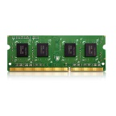
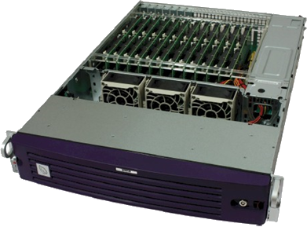
Discussion
Are we fundamentally limited by statistical multiplexing when it comes to achieving strong guarantees (latency, throughput, queuing) about the network?
Is it reasonable to trade-off throughput for strong latency guarantees?
Resource disaggregation
Rack-scale computing
Controllers: IO, memory...
CPU
NIC/Packet switch
Network
SoC
d ports
Boston Viridis
Server = Calxeda SoC
900 CPUs

Slide 18
Thank you!

Slide 19
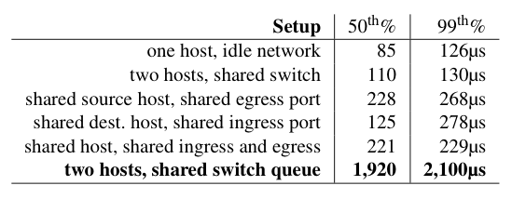
Where in the network interference happens?
One instance of ping and two instances of iperf sharing the same network
Paper focusses only on interference at shared switch queues
Median and 99th percentile ping latencies

