Slide 1
Data Center Networks and Basic Switching Technologies
Hakim Weatherspoon
Assistant Professor, Dept of Computer Science
CS 5413: High Performance Systems and Networking
February 27, 2017
Slides used and adapted judiciously from Computer Networking, A Top-Down Approach

Slide 2
Goals for Today
Basic Switching Technologies/Router Architecture Overview
See Section 4.3 in book
A 50-Gb/s IP Router
Craig Partridge , Senior Member , Philip P. Carvey , Isidro Castineyra , Tom Clarke , John Rokosz , Joshua Seeger , Michael Sollins , Steve Starch , Benjamin Tober , Gregory D. Troxel , David Waitzman , Scott Winterble. IEEE/ACM Transactions on Networking (ToN), Volume 6, Issue 3 (June 1998), pages 237-248.

Slide 3
Router Architecture Overview
two key router functions:
run routing algorithms/protocol (e.g. RIP, OSPF, BGP)
forwarding datagrams from incoming to outgoing link
forwarding tables computed,
pushed to input ports
routing
processor
routing, management
control plane (software)
forwarding data plane (hardware)
high-seed
switching
fabric
router input ports
router output ports

Slide 4
Router Architecture Overview
Input Port Functions
lookup,
forwarding
queueing
line
termination
link
layer
protocol
(receive)
switch
fabric
physical layer:
bit-level reception
data link layer:
e.g., Ethernet
see chapter 5
decentralized switching:
given datagram dest., lookup output port using forwarding table in input port memory (“match plus action”)
goal: complete input port processing at ‘line speed’
queuing: if datagrams arrive faster than forwarding rate into switch fabric

Slide 5
Router Architecture Overview
Switching Fabrics
transfer packet from input buffer to appropriate output buffer
switching rate: rate at which packets can be transfered from inputs to outputs
often measured as multiple of input/output line rate
N inputs: switching rate N times line rate desirable
three types of switching fabrics
memory
memory
bus
crossbar

Slide 6
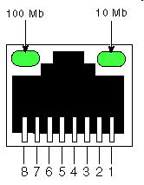
Router Architecture Overview
Switching via Memory: First Generation Routers
traditional computers with switching under direct control of CPU
packet copied to system’s memory
speed limited by memory bandwidth (2 bus crossings per datagram)
input
port
(e.g.,
Ethernet)
output
port
(e.g.,
Ethernet)
memory
system bus

Slide 7
Router Architecture Overview
Switching via a bus
datagram from input port memory
to output port memory via a shared bus
bus contention: switching speed limited by bus bandwidth
32 Gbps bus, Cisco 5600: sufficient speed for access and enterprise routers
bus

Slide 8
Router Architecture Overview
Switching via interconnection network
overcome bus bandwidth limitations
banyan networks, crossbar, other interconnection nets initially developed to connect processors in multiprocessor
advanced design: fragmenting datagram into fixed length cells, switch cells through the fabric.
Cisco 12000: switches 60 Gbps through the interconnection network
crossbar

Slide 9
Router Architecture Overview
Output Ports
datagram
buffer
queueing
switch
fabric
link
layer
protocol
(send)
line
termination
buffering required when datagrams arrive from fabric faster than the transmission rate
scheduling discipline chooses among queued datagrams for transmission

Slide 10
Router Architecture Overview
Output Port Queuing
switch
fabric
switch
fabric
at t, packets more
from input to output
one packet time later
buffering when arrival rate via switch exceeds output line speed
queueing (delay) and loss due to output port buffer overflow!

Slide 11
Router Architecture Overview
How much buffering?
RFC 3439 rule of thumb: average buffering equal to “typical” RTT (say 250 msec) times link capacity C
e.g., C = 10 Gpbs link: 2.5 Gbit buffer
recent recommendation: with N flows, buffering equal to
.
RTT C
N

Slide 12
Router Architecture Overview
Input Port Queuing
fabric slower than input ports combined -> queueing may occur at input queues
queueing delay and loss due to input buffer overflow!
Head-of-the-Line (HOL) blocking: queued datagram at front of queue prevents others in queue from moving forward
switch
fabric
switch
fabric
output port contention:
only one red datagram can be transferred. lower red packet is blocked
one packet time later: green packet experiences HOL blocking

Slide 13
Goals for Today
Basic Switching Technologies/Router Architecture Overview
See Section 4.3 in book
A 50-Gb/s IP Router
Craig Partridge , Senior Member , Philip P. Carvey , Isidro Castineyra , Tom Clarke , John Rokosz , Joshua Seeger , Michael Sollins , Steve Starch , Benjamin Tober , Gregory D. Troxel , David Waitzman , Scott Winterble. IEEE/ACM Transactions on Networking (ToN), Volume 6, Issue 3 (June 1998), pages 237-248.

Slide 14
Multigigabit Router (MGR)
Architecture
Network interfaces (Line cards)
Forwarding Engine
Network Processor
Switching Fabric
.

Slide 15
Multigigabit Router (MGR)
Contributions
Network interfaces (Line cards)
Forwarding Engine distinct from line cards
Forwarding Engine
Complete set of forwarding tables, fast path
QoS
Network Processor
Updates Routing Table
Separates and handles slow path
Switching Fabric
Switched backplane

Slide 16
Multigigabit Router (MGR)
Forwarding Engine
RISC Architecture
64-bit, 415MHz, Alpha 21164
Quad issue (two integer and two floating point every cycle)
Cache
Dcache and icache 8kB each
Secondary Cache (Scache; unified, 96kB)
Entire routing table fits in cache
Tertiary cache (Bcache; 16MB)
32 Byte cacheline
Hardware
Software

Slide 17
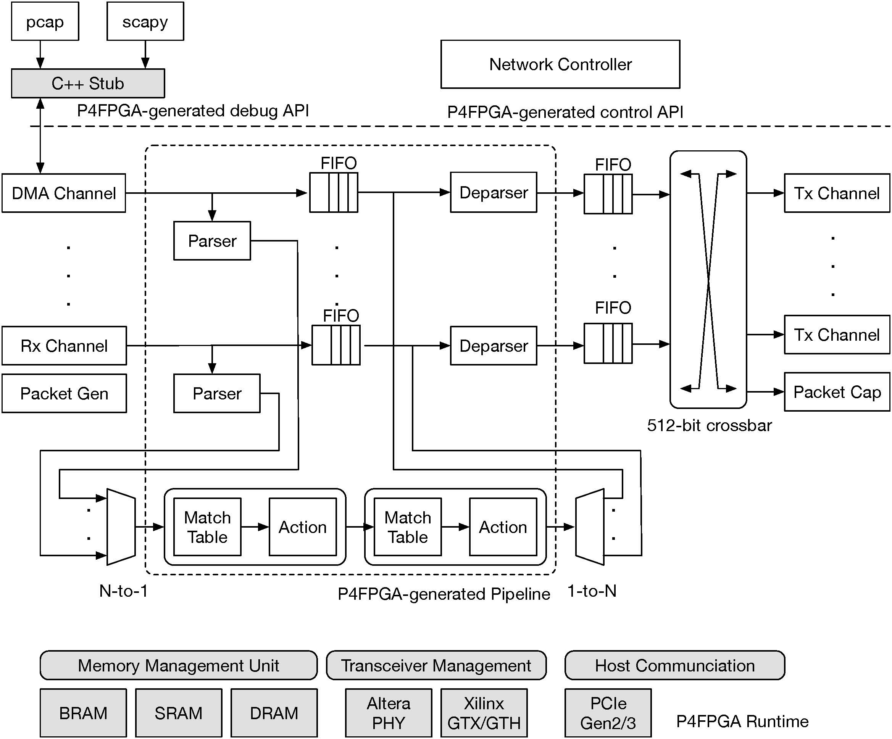
Case study: P4FPGA Switch
P4FPGA: A Rapid Prototyping Framework for P4, Han Wang, Robert Soulé, Huynh Tu Dang, Ki Suh Lee, Vishal Shrivastav, Nate Foster, and Hakim Weatherspoon, To Appear in Proceedings of the ACM Symposium of Software-defined networking Research (SOSR), April 2017

Slide 18
Goals for Today
Basic Switching Technologies/Router Architecture Overview
See Section 4.3 in book
A 50-Gb/s IP Router
Craig Partridge , Senior Member , Philip P. Carvey , Isidro Castineyra , Tom Clarke , John Rokosz , Joshua Seeger , Michael Sollins , Steve Starch , Benjamin Tober , Gregory D. Troxel , David Waitzman , Scott Winterble. IEEE/ACM Transactions on Networking (ToN), Volume 6, Issue 3 (June 1998), pages 237-248.

Slide 19
Before Next time
Project Proposal
due this Friday, March 3
Meet with groups, TA, and professor
HW2
Chat Server
Due this next Friday, March 10
Required review and reading
“The Worlds Fastest and Programmable Networks”, Barefoot Whitepaper
https://www.barefootnetworks.com/media/white_papers/Barefoot-Worlds-Fastest-Most-Programmable-Networks.pdf
Check website for updated schedule

