Slide 1
Data Link and Physical Layers and 10 GbE Protocol
Hakim Weatherspoon
Associate Professor, Dept of Computer Science
CS 5413: High Performance Systems and Networking
February 22, 2017
Slides used and adapted judiciously from Computer Networking, A Top-Down Approach

Slide 2
Goals for Today
Link Layer and Physical Layer
  Abstraction / services
  Switches and Local Area Networks
    Ethernet Switch
    Addressing, ARP (address resolution protocol)
    Ethernet
Data Center Network
  10GbE (10 Gigabit Ethernet)
Backup Slides
  Multiple Access Protocols
  Virtual Local Area Networks (VLAN)
  Multiple Access Protocols
  Putting it all together: A day and a life of a web request

Slide 3
Link layer
goals:
understand principles behind link layer services:
  error detection, correction
  sharing a broadcast channel: multiple access
  link layer addressing
  local area networks: Ethernet, VLANs
instantiation, implementation of various link layer technologies

Slide 4













Link Layer
terminology:
hosts and routers: nodes
communication channels that connect adjacent nodes along communication path: links
  wired links
  wireless links
  LANs
layer-2 packet: frame, encapsulates datagram
global ISP
data-link layer has responsibility of
transferring datagram from one node
to physically adjacent node over a link

Slide 5
Link Layer
datagram transferred by different link protocols over different links:
  e.g., Ethernet on first link, frame relay on intermediate links, 802.11 on last link
each link protocol provides different services
  e.g., may or may not provide reliability over link
transportation analogy:
trip from Ithaca to Lausanne
  bus: Ithaca to JFK
  plane: JFK to Geneva
  train: Geneva to Lausanne
tourist = datagram
transport segment = communication link
transportation mode = link layer protocol
travel agent = routing algorithm

Slide 6
Link Layer
Services
framing, link access:
  encapsulate datagram into frame, adding header, trailer
  channel access if shared medium
  “MAC” addresses used in frame headers to identify source, dest
    different from IP address!
reliable delivery between adjacent nodes
  we learned how to do this already (chapter 3)!
  seldom used on low bit-error link (fiber, some twisted pair)
  wireless links: high error rates
    Q: why both link-level and end-end reliability?

Slide 7
Link Layer
Services
flow control:
  pacing between adjacent sending and receiving nodes
error detection:
  errors caused by signal attenuation, noise.
  receiver detects presence of errors:
    signals sender for retransmission or drops frame
error correction:
  receiver identifies and corrects bit error(s) without resorting to retransmission
half-duplex and full-duplex
  with half duplex, nodes at both ends of link can transmit, but not at same time

Slide 8
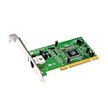
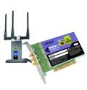

Link Layer
Where is the link layer implemented?
in each and every host
link layer implemented in “adaptor” (aka network interface card NIC) or on a chip
  Ethernet card, 802.11 card; Ethernet chipset
  implements link, physical layer
attaches into host’s system buses
combination of hardware, software, firmware
application
transport
network
link
cpu
memory
link
physical
host
bus
(e.g., PCI)
controller
physical
transmission
network adapter
card

Slide 9
Link Layer
Adapters communicating
datagram
datagram
controller
controller
sending host
receiving host
datagram
frame
sending side:
  encapsulates datagram in frame
  adds error checking bits, rdt, flow control, etc.
receiving side
  looks for errors, rdt, flow control, etc
  extracts datagram, passes to upper layer at receiving side

Slide 10
Goals for Today
Link Layer and Physical Layer
  Abstraction / services
  Switches and Local Area Networks
    Ethernet switch
    Addressing, ARP (address resolution protocol)
    Ethernet
Data Center Network
  10GbE (10 Gigabit Ethernet)
Backup Slides
  Multiple Access Protocols
  Virtual Local Area Networks (VLAN)
  Multiple Access Protocols
  Putting it all together: A day and a life of a web request

Slide 11
Ethernet Switch
link-layer device: takes an active role
  store, forward Ethernet frames
  examine incoming frame’s MAC address, selectively forward frame to one-or-more outgoing links when frame is to be forwarded on segment, uses CSMA/CD to access segment
transparent
  hosts are unaware of presence of switches
plug-and-play, self-learning
  switches do not need to be configured

Slide 12


Ethernet Switch
Switch: Multiple Simultaneous Transmission
hosts have dedicated, direct connection to switch
switches buffer packets
Ethernet protocol used on each incoming link, but no collisions; full duplex
  each link is its own collision domain
switching: A-to-A’ and B-to-B’ can transmit simultaneously, without collisions
A
C’
B
6
1
2
5
4
3
B’
C
A’
switch with six interfaces
(1,2,3,4,5,6)

Slide 13
Ethernet Switch
Switch Forwarding Table
Q: how does switch know A’ reachable via interface 4, B’ reachable via interface 5?
A
C’
B
6
1
2
A: each switch has a switch table, each entry:
  (MAC address of host, interface to reach host, time stamp)
  looks like a routing table!
5
4
3
B’
C
A’
Q: how are entries created, maintained in switch table?
  something like a routing protocol?
switch with six interfaces
(1,2,3,4,5,6)

Slide 14
Ethernet Switch
Source: A
Switch: Self-learning
Dest: A’
switch learns which hosts can be reached through which interfaces
  when frame received, switch “learns” location of sender: incoming LAN segment
  records sender/location pair in switch table
A
A A’
C’
B
6
1
2
5
4
3
B’
C
A’
MAC addr interface TTL
A
1
60
Switch table
(initially empty)

Slide 15
Ethernet Switch
Ethernet Switch
Switch: Frame filtering/forwarding
When frame received at switch:
  1. record incoming link, MAC address of sending host
  2. index switch table using MAC destination address
  3. if entry found for destination
  then {
  if destination on segment from which frame arrived
  then drop frame
  else forward frame on interface indicated by entry
  }
  else flood /* forward on all interfaces except arriving
  interface */

Slide 16
Ethernet Switch
Source: A
Example: Self-learning, forwarding
Dest: A’
A
A A’
frame destination, A’, locaton unknown:
flood
C’
B
destination A location known:
6
1
2
A A’
A A’
A A’
A A’
selectively send
on just one link
A A’
5
4
3
B’
C
A’ A
A’
MAC addr interface TTL
A
1
60
switch table
(initially empty)
A’
4
60

Slide 17

Ethernet Switch
Interconnecting Switches
switches can be connected together
S₄
S₁
S₃
A
S₂
F
I
B
C
D
E
G
H
Q: sending from A to G - how does S₁ know to forward frame destined to F via S₄ and S₃?
A: self learning! (works exactly the same as in single-switch case!)

Slide 18
Ethernet Switch
Example: Multiple Switch, Self-learning
Suppose C sends frame to I, I responds to C
S₄
S₁
S₃
A
S₂
F
I
B
C
D
E
G
H
Q: show switch tables and packet forwarding in S₁, S₂, S₃, S₄

Slide 19
Ethernet Switch
Institutional Network
mail server
to external
network
router
web server
IP subnet

Slide 20
Ethernet Switch
Switches vs Routers
application
transport
network
link
physical
both are store-and-forward:
routers: network-layer devices (examine network-layer headers)
switches: link-layer devices (examine link-layer headers)
both have forwarding tables:
routers: compute tables using routing algorithms, IP addresses
switches: learn forwarding table using flooding, learning, MAC addresses
datagram
frame
link
physical
frame
switch
network
link
physical
datagram
frame
application
transport
network
link
physical

Slide 21
Goals for Today
Link Layer and Physical Layer
  Abstraction / services
  Switches and Local Area Networks
    Addressing, ARP (address resolution protocol)
    Ethernet
    Ethernet switch
  Multiple Access Protocols
Data Center Network
  10GbE (10 Gigabit Ethernet)
Backup Slides
  Virtual Local Area Networks (VLAN)
  Multiple Access Protocols
  Putting it all together: A day and a life of a web request

Slide 22
Switches and Local Area Networks
MAC (medium access control) addresses and
ARP (address resolution protocol)
32-bit IP address:
  network-layer address for interface
  used for layer 3 (network layer) forwarding
MAC (or LAN or physical or Ethernet) address:
  function: used ‘locally” to get frame from one interface to another physically-connected interface (same network, in IP-addressing sense)
  48 bit MAC address (for most LANs) burned in NIC ROM, also sometimes software settable
  e.g.: 1A-2F-BB-76-09-AD
hexadecimal (base 16) notation
(each “number” represents 4 bits)

Slide 23
Switches and Local Area Networks
LAN (MAC) addresses and ARP
each adapter on LAN has unique LAN address
1A-2F-BB-76-09-AD
LAN
(wired or
wireless)
adapter
71-65-F7-2B-08-53
58-23-D7-FA-20-B0
0C-C4-11-6F-E3-98

Slide 24
Switches and Local Area Networks
LAN (MAC) addresses and ARP
MAC address allocation administered by IEEE
manufacturer buys portion of MAC address space (to assure uniqueness)
analogy:
  MAC address: like Social Security Number
  IP address: like postal address
MAC flat address ➜ portability
  can move LAN card from one LAN to another
IP hierarchical address not portable
  address depends on IP subnet to which node is attached

Slide 25

Switches and Local Area Networks
LAN (MAC) addresses and ARP: Address
Resolution Protocol
Question: how to determine
interface’s MAC address, knowing its IP address?
ARP table: each IP node (host, router) on LAN has table
  IP/MAC address mappings for some LAN nodes:
< IP address; MAC address; TTL>
  TTL (Time To Live): time after which address mapping will be forgotten (typically 20 min)
137.196.7.78
1A-2F-BB-76-09-AD
137.196.7.23
137.196.7.14
LAN
71-65-F7-2B-08-53
58-23-D7-FA-20-B0
0C-C4-11-6F-E3-98
137.196.7.88

Slide 26
Switches and Local Area Networks
ARP: Address Resolution Protocol; Same LAN
A wants to send datagram to B
  B’s MAC address not in A’s ARP table.
A broadcasts ARP query packet, containing B's IP address
  dest MAC address = FF-FF-FF-FF-FF-FF
  all nodes on LAN receive ARP query
B receives ARP packet, replies to A with its (B's) MAC address
  frame sent to A’s MAC address (unicast)
A caches (saves) IP-to-MAC address pair in its ARP table until information becomes old (times out)
  soft state: information that times out (goes away) unless refreshed
ARP is “plug-and-play”:
  nodes create their ARP tables without intervention from net administrator

Slide 27
Switches and Local Area Networks
ARP: Address Resolution Protocol; different LAN
walkthrough: send datagram from A to B via R
  focus on addressing – at IP (datagram) and MAC layer (frame)
  assume A knows B’s IP address
  assume A knows IP address of first hop router, R (how?)
  assume A knows R’s MAC address (how?)
A
B
R
111.111.111.111
222.222.222.222
74-29-9C-E8-FF-55
49-BD-D2-C7-56-2A
222.222.222.220
1A-23-F9-CD-06-9B
111.111.111.112
111.111.111.110
222.222.222.221
CC-49-DE-D0-AB-7D
E6-E9-00-17-BB-4B
88-B2-2F-54-1A-0F

Slide 28
Switches and Local Area Networks
ARP: Address Resolution Protocol; different LAN
A creates IP datagram with IP source A, destination B
A creates link-layer frame with R's MAC address as dest, frame contains A-to-B IP datagram
MAC src: 74-29-9C-E8-FF-55
MAC dest: E6-E9-00-17-BB-4B
IP
Eth
Phy
IP src: 111.111.111.111
IP dest: 222.222.222.222
A
B
R
111.111.111.111
222.222.222.222
74-29-9C-E8-FF-55
49-BD-D2-C7-56-2A
222.222.222.220
1A-23-F9-CD-06-9B
111.111.111.112
111.111.111.110
222.222.222.221
CC-49-DE-D0-AB-7D
E6-E9-00-17-BB-4B
88-B2-2F-54-1A-0F

Slide 29
Switches and Local Area Networks
ARP: Address Resolution Protocol; different LAN
frame sent from A to R
frame received at R, datagram removed, passed up to IP
MAC src: 74-29-9C-E8-FF-55
MAC dest: E6-E9-00-17-BB-4B
IP src: 111.111.111.111
IP dest: 222.222.222.222
IP
Eth
Phy
IP src: 111.111.111.111
IP dest: 222.222.222.222
IP
Eth
Phy
A
B
R
111.111.111.111
222.222.222.222
74-29-9C-E8-FF-55
49-BD-D2-C7-56-2A
222.222.222.220
1A-23-F9-CD-06-9B
111.111.111.112
111.111.111.110
222.222.222.221
CC-49-DE-D0-AB-7D
E6-E9-00-17-BB-4B
88-B2-2F-54-1A-0F

Slide 30
Switches and Local Area Networks
ARP: Address Resolution Protocol; different LAN
R forwards datagram with IP source A, destination B
R creates link-layer frame with B's MAC address as dest, frame contains A-to-B IP datagram
MAC src: 1A-23-F9-CD-06-9B
MAC dest: 49-BD-D2-C7-56-2A
IP
Eth
Phy
IP
Eth
Phy
IP src: 111.111.111.111
IP dest: 222.222.222.222
A
B
R
111.111.111.111
222.222.222.222
74-29-9C-E8-FF-55
49-BD-D2-C7-56-2A
222.222.222.220
1A-23-F9-CD-06-9B
111.111.111.112
111.111.111.110
222.222.222.221
CC-49-DE-D0-AB-7D
E6-E9-00-17-BB-4B
88-B2-2F-54-1A-0F

Slide 31
Switches and Local Area Networks
ARP: Address Resolution Protocol; different LAN
R forwards datagram with IP source A, destination B
R creates link-layer frame with B's MAC address as dest, frame contains A-to-B IP datagram
MAC src: 1A-23-F9-CD-06-9B
MAC dest: 49-BD-D2-C7-56-2A
IP
Eth
Phy
IP
Eth
Phy
IP src: 111.111.111.111
IP dest: 222.222.222.222
A
B
R
111.111.111.111
222.222.222.222
74-29-9C-E8-FF-55
49-BD-D2-C7-56-2A
222.222.222.220
1A-23-F9-CD-06-9B
111.111.111.112
111.111.111.110
222.222.222.221
CC-49-DE-D0-AB-7D
E6-E9-00-17-BB-4B
88-B2-2F-54-1A-0F

Slide 32
Switches and Local Area Networks
ARP: Address Resolution Protocol; different LAN
R forwards datagram with IP source A, destination B
R creates link-layer frame with B's MAC address as dest, frame contains A-to-B IP datagram
MAC src: 1A-23-F9-CD-06-9B
MAC dest: 49-BD-D2-C7-56-2A
IP src: 111.111.111.111
IP dest: 222.222.222.222
IP
Eth
Phy
A
B
R
111.111.111.111
222.222.222.222
74-29-9C-E8-FF-55
49-BD-D2-C7-56-2A
222.222.222.220
1A-23-F9-CD-06-9B
111.111.111.112
111.111.111.110
222.222.222.221
CC-49-DE-D0-AB-7D
E6-E9-00-17-BB-4B
88-B2-2F-54-1A-0F

Slide 33
Goals for Today
Link Layer and Physical Layer
  Abstraction / services
  Switches and Local Area Networks
    Ethernet switch
    Addressing, ARP (address resolution protocol)
    Ethernet
Data Center Network
  10GbE (10 Gigabit Ethernet)
Backup Slides
  Multiple Access Protocols
  Virtual Local Area Networks (VLAN)
  Multiple Access Protocols
  Putting it all together: A day and a life of a web request

Slide 34
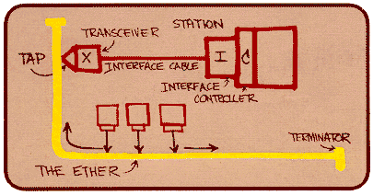
Link and Physical Layer: Ethernet
“dominant” wired LAN technology:
cheap $20 for NIC
first widely used LAN technology
simpler, cheaper than token LANs and ATM
kept up with speed race: 10 Mbps – 100 Gbps
Metcalfe’s Ethernet sketch

Slide 35
Link and Physical Layer: Ethernet
Ethernet Physical Topologies
bus: popular through mid 90s
  all nodes in same collision domain (can collide with each other)
star: prevails today
  active switch in center
  each “spoke” runs a (separate) Ethernet protocol (nodes do not collide with each other)
switch
star
bus: coaxial cable

Slide 36
Link and Physical Layer: Ethernet
Ethernet frame structure/format
sending adapter encapsulates IP datagram (or other network layer protocol packet) in Ethernet frame
preamble:
7 bytes with pattern 10101010 followed by one byte with pattern 10101011
used to synchronize receiver, sender clock rates
type
preamble
dest.
address
source
address
data (payload)
CRC

Slide 37
Link and Physical Layer: Ethernet
Ethernet frame structure/format
addresses: 6 byte source, destination MAC addresses
  if adapter receives frame with matching destination address, or with broadcast address (e.g. ARP packet), it passes data in frame to network layer protocol
  otherwise, adapter discards frame
type: indicates higher layer protocol (mostly IP but others possible, e.g., Novell IPX, AppleTalk)
CRC: cyclic redundancy check at receiver
  error detected: frame is dropped
type
preamble
dest.
address
source
address
data (payload)
CRC

Slide 38
Link and Physical Layer: Ethernet
Ethernet service abstraction and implementation
connectionless: no handshaking between sending and receiving NICs
unreliable: receiving NIC doesnt send acks or nacks to sending NIC
  data in dropped frames recovered only if initial sender uses higher layer rdt (e.g., TCP), otherwise dropped data lost
Ethernet’s MAC protocol: unslotted CSMA/CD wth binary backoff

Slide 39
Link and Physical Layer: Ethernet
IEEE 802.3 Ethernet Standards: link & physical layers
many different Ethernet standards
  common MAC protocol and frame format
  different speeds: 2 Mbps, 10 Mbps, 100 Mbps, 1Gbps, 10Gbps, 40Gbps, 100Gbps
  different physical layer media: fiber, cable
application
transport
network
link
physical
MAC protocol
and frame format
100BASE-TX
100BASE-T2
100BASE-FX
100BASE-T4
100BASE-SX
100BASE-BX
copper (twister
pair) physical layer
fiber physical layer

Slide 40
Goals for Today
Link Layer and Physical Layer
  Abstraction / services
  Switches and Local Area Networks
    Ethernet switch
    Addressing, ARP (address resolution protocol)
    Ethernet
Data Center Network
  10GbE (10 Gigabit Ethernet)
Backup Slides
  Multiple Access Protocols
  Virtual Local Area Networks (VLAN)
  Multiple Access Protocols
  Putting it all together: A day and a life of a web request

Slide 41
10GbE (10 gigabit Ethernet)
Application
Data
Transport
L3 Hdr
Data
Network
L2 Hdr
L3 Hdr
Data
Data Link
Preamble
Eth Hdr
L2 Hdr
L3 Hdr
Data
CRC
Gap
Physical
64 bit
Idle characters (/I/)
2 bit syncheader
10.3125 Gigabits
64/66b PCS
Encode
Encode
Decode
/S/
/S/
/D/
/D/
/D/
/D/
/D/
/D/
/D/
/D/
/T/
/T/
/E/
/E/
Scrambler
16 bit
Scrambler
Descrambler
Gearbox
Gearbox
Blocksync
PMA
PMA
011010010110100101101001011010010110100101101001011010010110100101101
PMD
Notes:
I need you to pay attention for 30 seconds,
I will discuss the details of a network stack.
Most of this you know, some you do not know
Going from the Data link layer to the physical layer:
The physical layer encodes an Ethernet frame into a sequence of 64 bit block.
Then for each 64bit block it adds 2 bit syncheaders.
That is why this is called 64/66bit encoding.
maintain eqaul number of zeros and ones, which we call it DC balance.
Where is /I/ characters?

Slide 42
10GbE (10 gigabit Ethernet)
Sync
Block Payload
Application
0 8 16 24 32 40 48 56 65
Application
Data Block
01
D0
D1
D2
D3
D4
D5
D6
D7
Transport
Block Type
Transport
/E/
10
0x1e
C0
C1
C2
C3
C4
C5
C6
C7
Network
/S/
10
0x33
C0
C1
C2
C3
D5
D6
D7
Network
10
0x78
D1
D2
D3
D4
D5
D6
D7
Data Link
/T/
10
0x87
C1
C2
C3
C4
C5
C6
C7
Data Link
10
0x99
D0
C2
C3
C4
C5
C6
C7
Physical
10
0xaa
D0
D1
C3
C4
C5
C6
C7
Physical
10
0xb4
D0
D1
D2
C4
C5
C6
C7
64/66b PCS
10
0xcc
D0
D1
D2
D3
C5
C6
C7
10
0xd2
D0
D1
D2
D3
D4
C6
C7
PMA
10
0xe1
D0
D1
D2
D3
D4
D5
C7
PMD
10
0xff
D0
D1
D2
D3
D4
D5
D6
Ethernet Frame
Gap
/S/
Start of Frame block
/T/
End of Frame block
/S/
/D/
/D/
/D/
/D/
/T/
/E/
/E/
Idle block
/D/
Data block

Slide 43


10GbE (10 gigabit Ethernet)
SoNIC: Software network interface card
Hyper-fidelity network measurements
Application
Interpacket gap, spacing, arrival time, …
Important metric for network measurements
  Can be improved with access to the PHY
Transport
IPG
Network
Packet i
Packet i+1
Data Link
IPD
Physical
Increasing Throughput
Detecting timing channel
Packet Capture
Packet
Generation
Characterization
Estimating bandwidth
Notes:
Definition of IPD
How it is being used for network research.
We argue here that we Can improve them with access to the physical layer of network protocol stack

Slide 44
10GbE (10 gigabit Ethernet)
SoNIC: Software network interface card
Hyper-fidelity network measurements
Application
Valuable information: Idle characters
  Can provide precise timing base for control
    Each bit is ~97 ps wide
Transport
IPG
Network
Packet i
Packet i+1
Data Link
IPD
Physical
Notes:
How can access to the physical layer of a network protocol stack improve network research?
Because of special characeters that only reside in the physical layer, called idle characters
Idle characters fills any gaps between two packets in 10 Gigabit Ethernet
In particular, 10GbE protocol always sends 10 Gigabits per second, as a result each bit is about 100 ps wide, I need 7~8 of those to make up a idle characters
Therefore, if we count the number of /I/s or the bits between two packets, we can measure the interpacket gaps very precisely.
For example, <click>

Slide 45
10GbE (10 gigabit Ethernet)
SoNIC: Software network interface card
Hyper-fidelity network measurements
Application
Valuable information: Idle characters
  Can provide precise timing base for control
    Each bit is ~97 ps wide
12 /I/s = 100bits = 9.7ns
Transport
IPG
Network
Packet i
Packet i+1
Data Link
One Idle character (/I/)
= 7~8 bits
Physical
Detecting timing channel
Packet Capture
Packet
Generation
Notes:
* 12 /I/s can be translated into 100 bits, and consequently 9.7 ns
Therefore, by accessing and controlling bits, we can achieve unheard level of precision and control, which subsequently can improve network research applications that I previously mentioned.
specifically, for example, with 10GBE standard, there has to be minimum 12 characters, 7~8 bits and each bit is 97 ps wide.
For example, 10GbE protoco always sends at 10 Gigabit, each bit is 97 ps wide, I need 7~8 of those to make up a idle characters
Idle character, /I/ equals 7~8 bits

Slide 46
Goals for Today
Link Layer and Physical Layer
  Abstraction / services
  Switches and Local Area Networks
    Ethernet switch
    Addressing, ARP (address resolution protocol)
    Ethernet
Data Center Network
  10GbE (10 Gigabit Ethernet)
Backup Slides
  Multiple Access Protocols
  Virtual Local Area Networks (VLAN)
  Multiple Access Protocols
  Putting it all together: A day and a life of a web request

Slide 47
Perspective
principles behind data link layer services:
  link layer addressing
  sharing a broadcast channel: multiple access
  error detection, correction
instantiation and implementation of various link layer technologies
  Ethernet
  switched LANS

Slide 48
Perspective
Journey down protocol stack complete
Basic understanding of networking practices and principles
lots of interesting topics in data center and high performance systems and networks

Slide 49
Before Next time
Project Proposal
  due today, Monday
  Meet with groups, TA, and professor
HW2
  Chat service
  Available later today
In-class Lab on Friday
Monday: Required review and reading
  Section 4.3 in book
  “A 50-Gb/s IP Router,” Craig Partridge , Senior Member , Philip P. Carvey , Isidro Castineyra , Tom Clarke , John Rokosz , Joshua Seeger , Michael Sollins , Steve Starch , Benjamin Tober , Gregory D. Troxel , David Waitzman , Scott Winterble. IEEE/ACM Transactions on Networking (ToN), Volume 6, Issue 3 (June 1998), pages 237-248.
  http://ieeexplore.ieee.org/xpl/articleDetails.jsp?arnumber=700888
  http://citeseerx.ist.psu.edu/viewdoc/download?doi=10.1.1.129.3926&rep=rep1&type=pdf
Check website for updated schedule

Slide 50
Goals for Today
Link Layer and Physical Layer
  Abstraction / services
  Switches and Local Area Networks
    Addressing, ARP (address resolution protocol)
    Ethernet
    Ethernet switch
Data Center Network
  10GbE (10 Gigabit Ethernet)
Backup Slides
  Multiple Access Protocols
  Virtual Local Area Networks (VLAN)
  Multiple Access Protocols
  Putting it all together: A day and a life of a web request

Slide 51



Multiple Access Links, Protocols
two types of “links”:
point-to-point
  PPP for dial-up access
  point-to-point link between Ethernet switch, host
broadcast (shared wire or medium)
  old-fashioned Ethernet
  upstream HFC
  802.11 wireless LAN
shared wire (e.g.,
cabled Ethernet)
shared RF
(e.g., 802.11 WiFi)
shared RF
(satellite)
humans at a
cocktail party
(shared air, acoustical)

Slide 52
Multiple Access Links, Protocols
MAC Protocols: Taxonomy
three broad classes:
channel partitioning
  divide channel into smaller “pieces” (time slots, frequency, code)
  allocate piece to node for exclusive use
random access
  channel not divided, allow collisions
  “recover” from collisions
“taking turns”
  nodes take turns, but nodes with more to send can take longer turns

Slide 53
Multiple Access Links, Protocols
MAC Protocols: Tradeoffs
channel partitioning MAC protocols:
  share channel efficiently and fairly at high load
  inefficient at low load: delay in channel access, 1/N bandwidth allocated even if only 1 active node!
random access MAC protocols
  efficient at low load: single node can fully utilize channel
  high load: collision overhead
“taking turns” protocols
  look for best of both worlds!

Slide 54
Multiple Access Links, Protocols
MAC Protocols
channel partitioning, by time, frequency or code
  Time Division, Frequency Division
random access (dynamic),
  ALOHA, S-ALOHA, CSMA, CSMA/CD
  carrier sensing: easy in some technologies (wire), hard in others (wireless)
  CSMA/CD used in Ethernet
  CSMA/CA used in 802.11
taking turns
  polling from central site, token passing
  bluetooth, FDDI, token ring

Slide 55
Goals for Today
Link Layer and Physical Layer
  Abstraction / services
  Switches and Local Area Networks
    Addressing, ARP (address resolution protocol)
    Ethernet
    Ethernet switch
  Multiple Access Protocols
Data Center Network
  10GbE (10 Gigabit Ethernet)
Backup Slides
  Virtual Local Area Networks (VLAN)
  Multiple Access Protocols
  Putting it all together: A day and a life of a web request

Slide 56


Virtual Local Area Networks (VLAN)
consider:
CS user moves office to EE, but wants connect to CS switch?
single broadcast domain:
  all layer-2 broadcast traffic (ARP, DHCP, unknown location of destination MAC address) must cross entire LAN
  security/privacy, efficiency issues
Computer
Science
Computer
Engineering
Electrical
Engineering

Slide 57
Virtual Local Area Networks (VLAN)
port-based VLAN: switch ports grouped (by switch management software) so that single physical switch ……
Virtual Local
Area Network
1
7
9
15
switch(es) supporting VLAN capabilities can be configured to define multiple virtual LANS over single physical LAN infrastructure.
2
8
10
16
…
…
Electrical Engineering
(VLAN ports 1-8)
Computer Science
(VLAN ports 9-15)
… operates as multiple virtual switches
1
7
9
15
2
8
10
16
…
…
Electrical Engineering
(VLAN ports 1-8)
Computer Science
(VLAN ports 9-16)

Slide 58

Virtual Local Area Networks (VLAN)
Port-based VLAN
router
traffic isolation: frames to/from ports 1-8 can only reach ports 1-8
  can also define VLAN based on MAC addresses of endpoints, rather than switch port
1
7
9
15
2
8
10
16
dynamic membership: ports can be dynamically assigned among VLANs
…
…
Electrical Engineering
(VLAN ports 1-8)
Computer Science
(VLAN ports 9-15)
forwarding between VLANS: done via routing (just as with separate switches)
  in practice vendors sell combined switches plus routers

Slide 59
Virtual Local Area Networks (VLAN)
VLANs spanning multiple switches
1
7
9
15
1
3
5
7
2
8
10
16
2
4
6
8
…
…
Electrical Engineering
(VLAN ports 1-8)
Computer Science
(VLAN ports 9-15)
Ports 2,3,5 belong to EE VLAN
Ports 4,6,7,8 belong to CS VLAN
trunk port: carries frames between VLANS defined over multiple physical switches
  frames forwarded within VLAN between switches can’t be vanilla 802.1 frames (must carry VLAN ID info)
  802.1q protocol adds/removed additional header fields for frames forwarded between trunk ports

Slide 60
Virtual Local Area Networks (VLAN)
802.1Q VLAN frame format
type
preamble
dest.
address
source
address
data (payload)
CRC
802.1 frame
type
preamble
dest.
address
source
address
data (payload)
CRC
802.1Q frame
2-byte Tag Protocol Identifier
(value: 81-00)
Recomputed
CRC
Tag Control Information (12 bit VLAN ID field,
3 bit priority field like IP TOS)

Slide 61
Goals for Today
Link Layer and Physical Layer
  Abstraction / services
  Switches and Local Area Networks
    Addressing, ARP (address resolution protocol)
    Ethernet
    Ethernet switch
  Multiple Access Protocols
Data Center Network
  10GbE (10 Gigabit Ethernet)
Backup Slides
  Virtual Local Area Networks (VLAN)
  Multiple Access Protocols
  Putting it all together: A day and a life of a web request

Slide 62
Multiple Access Links, Protocols
two types of “links”:
point-to-point
  PPP for dial-up access
  point-to-point link between Ethernet switch, host
broadcast (shared wire or medium)
  old-fashioned Ethernet
  upstream HFC
  802.11 wireless LAN
shared wire (e.g.,
cabled Ethernet)
shared RF
(e.g., 802.11 WiFi)
shared RF
(satellite)
humans at a
cocktail party
(shared air, acoustical)

Slide 63
Multiple access protocols
single shared broadcast channel
two or more simultaneous transmissions by nodes: interference
  collision if node receives two or more signals at the same time
multiple access protocol
distributed algorithm that determines how nodes share channel, i.e., determine when node can transmit
communication about channel sharing must use channel itself!
  no out-of-band channel for coordination

Slide 64
An ideal multiple access protocol
given: broadcast channel of rate R bps
desiderata:
  1. when one node wants to transmit, it can send at rate R.
  2. when M nodes want to transmit, each can send at average rate R/M
  3. fully decentralized:
    no special node to coordinate transmissions
    no synchronization of clocks, slots
  4. simple

Slide 65
Multiple Access Links, Protocols
MAC Protocols: Taxonomy
three broad classes:
channel partitioning
  divide channel into smaller “pieces” (time slots, frequency, code)
  allocate piece to node for exclusive use
random access
  channel not divided, allow collisions
  “recover” from collisions
“taking turns”
  nodes take turns, but nodes with more to send can take longer turns

Slide 66
Multiple Access Links, Protocols
Channel Partitioning MAC protocols: TDMA
TDMA: time division multiple access
access to channel in "rounds"
each station gets fixed length slot (length = pkt trans time) in each round
unused slots go idle
example: 6-station LAN, 1,3,4 have pkt, slots 2,5,6 idle
6-slot
frame
6-slot
frame
1
3
4
1
3
4

Slide 67
Multiple Access Links, Protocols
Channel Partitioning MAC protocols: FDMA
FDMA: frequency division multiple access
channel spectrum divided into frequency bands
each station assigned fixed frequency band
unused transmission time in frequency bands go idle
example: 6-station LAN, 1,3,4 have pkt, frequency bands 2,5,6 idle
time
frequency bands
FDM cable

Slide 68
Multiple Access Links, Protocols
Random Access Protocols
when node has packet to send
  transmit at full channel data rate R.
  no a priori coordination among nodes
two or more transmitting nodes ➜ “collision”,
random access MAC protocol specifies:
  how to detect collisions
  how to recover from collisions (e.g., via delayed retransmissions)
examples of random access MAC protocols:
  slotted ALOHA
  ALOHA
  CSMA, CSMA/CD, CSMA/CA

Slide 69
Multiple Access Links, Protocols
Slotted ALOHA
assumptions:
all frames same size
time divided into equal size slots (time to transmit 1 frame)
nodes start to transmit only slot beginning
nodes are synchronized
if 2 or more nodes transmit in slot, all nodes detect collision
operation:
when node obtains fresh frame, transmits in next slot
  if no collision: node can send new frame in next slot
  if collision: node retransmits frame in each subsequent slot with prob. p until success

Slide 70
Multiple Access Links, Protocols
Slotted ALOHA
node 1
1
1
1
1
node 2
2
2
2
node 3
3
3
3
C
E
C
S
E
C
E
S
S
Pros:
single active node can continuously transmit at full rate of channel
highly decentralized: only slots in nodes need to be in sync
simple
Cons:
collisions, wasting slots
idle slots
nodes may be able to detect collision in less than time to transmit packet
clock synchronization

Slide 71
Multiple Access Links, Protocols
Slotted ALOHA: Efficiency
efficiency: long-run
fraction of successful slots
(many nodes, all with many frames to send)
max efficiency: find p* that maximizes
Np(1-p)^{N-1}
for many nodes, take limit of Np*(1-p*)^{N-1} as N goes to infinity, gives:
max efficiency = 1/e = .37
suppose: N nodes with many frames to send, each transmits in slot with probability p
prob that given node has success in a slot = p(1-p)^{N-1}
prob that any node has a success = Np(1-p)^{N-1}
at best: channel
used for useful
transmissions 37%
of time!
!

Slide 72
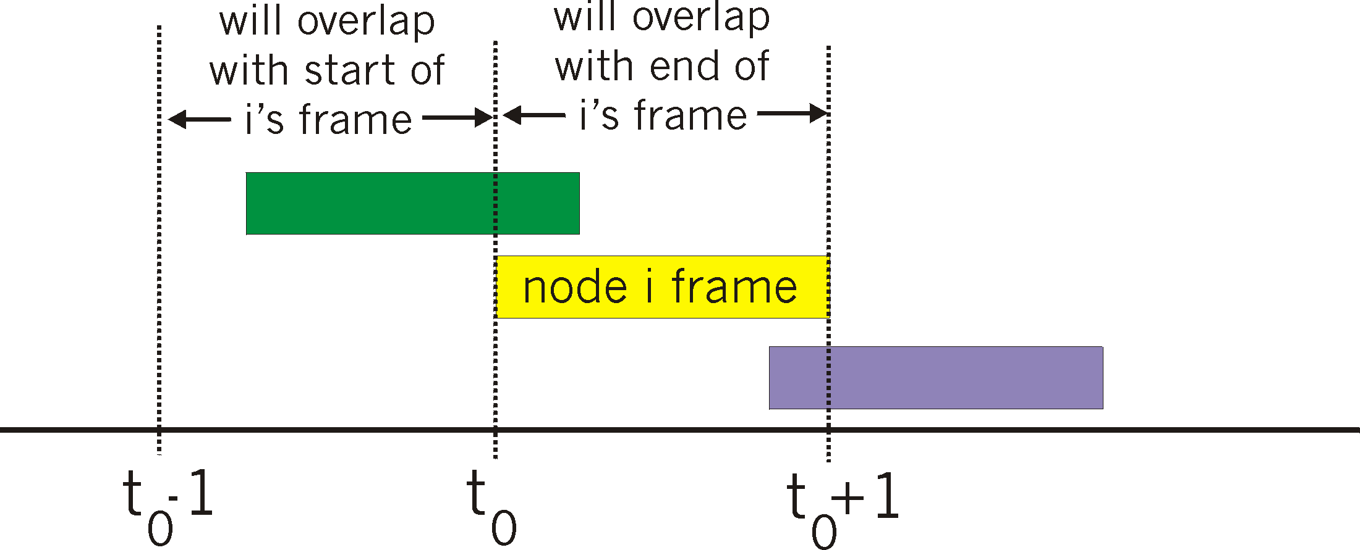
Multiple Access Links, Protocols
Pure (unslotted) ALOHA
unslotted Aloha: simpler, no synchronization
when frame first arrives
  transmit immediately
collision probability increases:
  frame sent at t₀ collides with other frames sent in [t₀-1,t₀+1]

Slide 73
Multiple Access Links, Protocols
Pure (unslotted) ALOHA
P(success by given node) = P(node transmits) .
P(no other node transmits in [t₀-1,t₀] .
P(no other node transmits in [t₀-1,t₀]
= p . (1-p)^{N-1 .} (1-p)^{N-1}
= p . (1-p)^{2(N-1)}
… choosing optimum p and then letting n
= 1/(2e) = .18
even worse than slotted Aloha!

Slide 74
Multiple Access Links, Protocols
CSMA: Carrier Sense Multiple Access
CSMA: listen before transmit:
if channel sensed idle: transmit entire frame
if channel sensed busy, defer transmission
human analogy: don’t interrupt others!

Slide 75
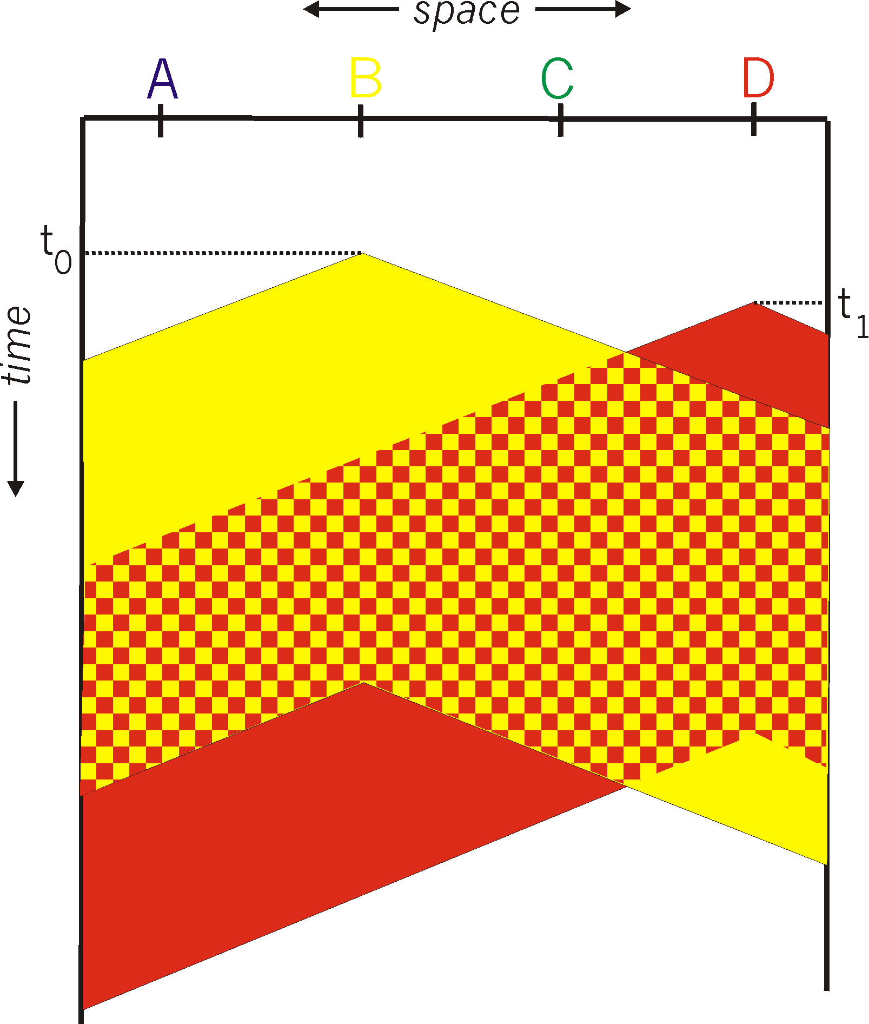
Multiple Access Links, Protocols
CSMA collisions
spatial layout of nodes
collisions can still occur: propagation delay means two nodes may not hear each other’s transmission
collision: entire packet transmission time wasted
  distance & propagation delay play role in in determining collision probability

Slide 76
Multiple Access Links, Protocols
CSMA/CD (collision detection)
CSMA/CD: carrier sensing, deferral as in CSMA
  collisions detected within short time
  colliding transmissions aborted, reducing channel wastage
collision detection:
  easy in wired LANs: measure signal strengths, compare transmitted, received signals
  difficult in wireless LANs: received signal strength overwhelmed by local transmission strength
human analogy: the polite conversationalist

Slide 77
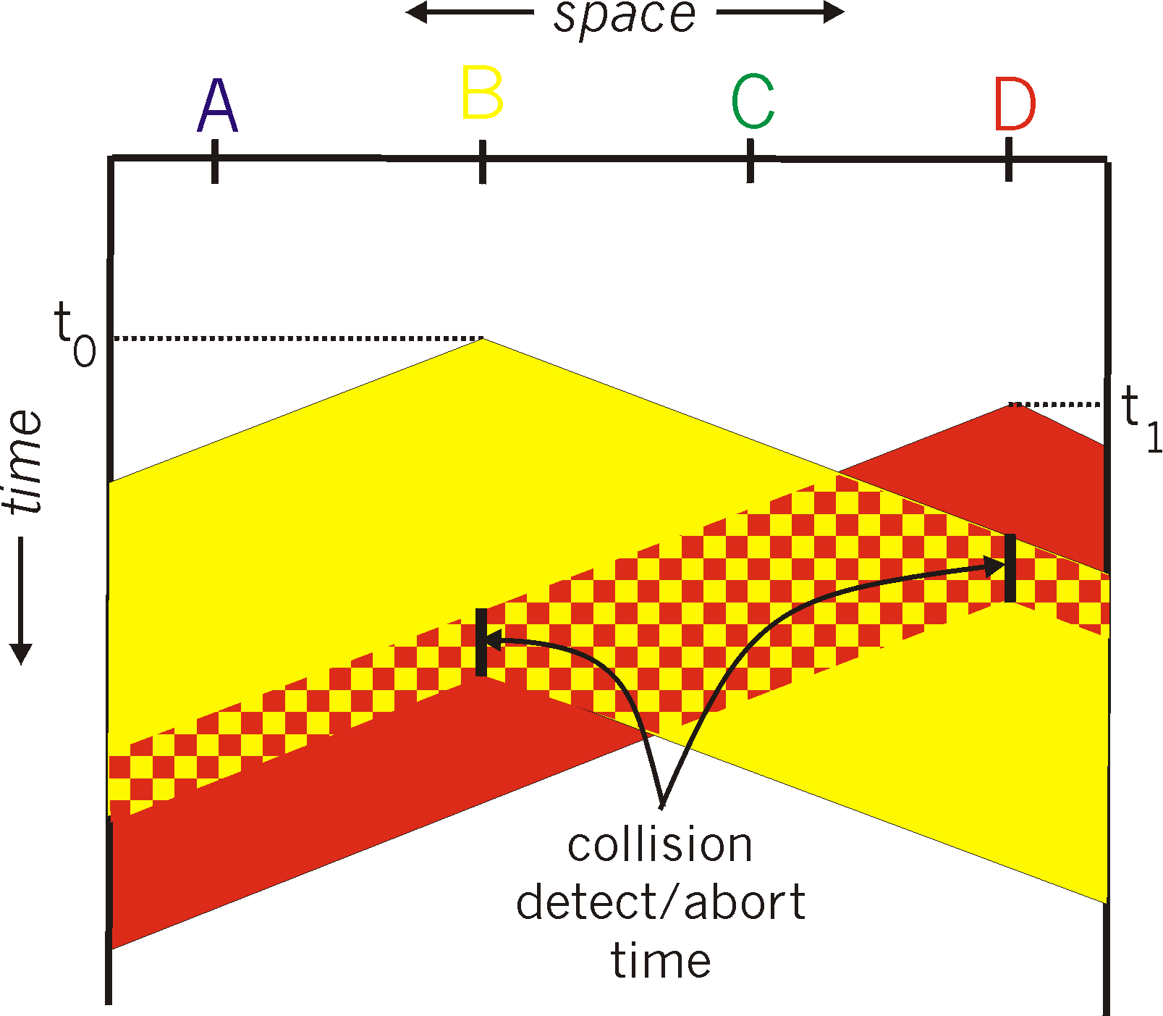
Multiple Access Links, Protocols
CSMA/CD (collision detection)
spatial layout of nodes

Slide 78
Multiple Access Links, Protocols
Ethernet CSMA/CD algorithm
1. NIC receives datagram from network layer, creates frame
2. If NIC senses channel idle, starts frame transmission. If NIC senses channel busy, waits until channel idle, then transmits.
3. If NIC transmits entire frame without detecting another transmission, NIC is done with frame !
4. If NIC detects another transmission while transmitting, aborts and sends jam signal
5. After aborting, NIC enters binary (exponential) backoff:
  after mth collision, NIC chooses K at random from {0,1,2, …, 2^{m}-1}. NIC waits K·512 bit times, returns to Step 2
  longer backoff interval with more collisions

Slide 79
Multiple Access Links, Protocols
CSMA/CD efficiency
T_{prop} = max prop delay between 2 nodes in LAN
t_{trans} = time to transmit max-size frame
efficiency goes to 1
  as t_{prop} goes to 0
  as t_{trans} goes to infinity
better performance than ALOHA: and simple, cheap, decentralized!

Slide 80
Multiple Access Links, Protocols
channel partitioning MAC protocols:
  share channel efficiently and fairly at high load
  inefficient at low load: delay in channel access, 1/N bandwidth allocated even if only 1 active node!
random access MAC protocols
  efficient at low load: single node can fully utilize channel
  high load: collision overhead
“taking turns” protocols
  look for best of both worlds!

Slide 81
Multiple Access Links, Protocols
“Taking turns” MAC protocols
polling:
master node “invites” slave nodes to transmit in turn
typically used with “dumb” slave devices
concerns:
  polling overhead
  latency
  single point of failure (master)
data
poll
master
data
slaves

Slide 82
Multiple Access Links, Protocols
“Taking turns” MAC protocols
token passing:
control token passed from one node to next sequentially.
token message
concerns:
  token overhead
  latency
  single point of failure (token)
T
(nothing
to send)
T
data

Slide 83
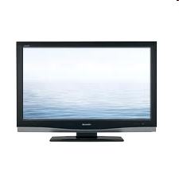


Multiple Access Links, Protocols
“Taking turns” MAC protocols: Cable Access Networks
Internet frames,TV channels, control transmitted
downstream at different frequencies
cable headend
…
CMTS
…
splitter
cable
modem
cable modem
termination system
ISP
upstream Internet frames, TV control, transmitted
upstream at different frequencies in time slots
multiple 40Mbps downstream (broadcast) channels
  single CMTS transmits into channels
multiple 30 Mbps upstream channels
  multiple access: all users contend for certain upstream channel time slots (others assigned)

Slide 84
Multiple Access Links, Protocols
“Taking turns” MAC protocols: Cable Access Networks
cable headend
MAP frame for
Interval [t1, t2]
CMTS
Downstream channel i
Upstream channel j
t₁
t₂
Residences with cable modems
Minislots containing
minislots request frames
Assigned minislots containing cable modem
upstream data frames
DOCSIS: data over cable service interface spec
FDM over upstream, downstream frequency channels
TDM upstream: some slots assigned, some have contention
  downstream MAP frame: assigns upstream slots
  request for upstream slots (and data) transmitted random access (binary backoff) in selected slots

Slide 85
Multiple Access Links, Protocols
MAC Protocols
channel partitioning, by time, frequency or code
  Time Division, Frequency Division
random access (dynamic),
  ALOHA, S-ALOHA, CSMA, CSMA/CD
  carrier sensing: easy in some technologies (wire), hard in others (wireless)
  CSMA/CD used in Ethernet
  CSMA/CA used in 802.11
taking turns
  polling from central site, token passing
  bluetooth, FDDI, token ring

Slide 86
Goals for Today
Link Layer and Physical Layer
  Abstraction / services
  Switches and Local Area Networks
    Addressing, ARP (address resolution protocol)
    Ethernet
    Ethernet switch
  Multiple Access Protocols
Data Center Network
  10GbE (10 Gigabit Ethernet)
Backup Slides
  Virtual Local Area Networks (VLAN)
  Multiple Access Protocols
  Putting it all together: A day and a life of a web request

Slide 87
Putting it all together: A day and a life of a web req
journey down protocol stack complete!
  application, transport, network, link
putting-it-all-together: synthesis!
  goal: identify, review, understand protocols (at all layers) involved in seemingly simple scenario: requesting www page
  scenario: student attaches laptop to campus network, requests/receives www.google.com

Slide 88




Putting it all together: A day and a life of a web req
Scenerio
browser
DNS server
Comcast network
68.80.0.0/13
school network
68.80.2.0/24
web page
web server
Google’s network
64.233.160.0/19
64.233.169.105

Slide 89
Putting it all together: A day and a life of a web req
Connecting to the Internet
DHCP
DHCP
UDP
IP
Eth
Phy
connecting laptop needs to get its own IP address, addr of first-hop router, addr of DNS server: use DHCP
DHCP
DHCP
DHCP
DHCP
DHCP request encapsulated in UDP, encapsulated in IP, encapsulated in 802.3 Ethernet
DHCP
DHCP
UDP
IP
Eth
Phy
DHCP
DHCP
DHCP
DHCP
router
(runs DHCP)
Ethernet frame broadcast (dest: FFFFFFFFFFFF) on LAN, received at router running DHCP server
Ethernet demuxed to IP demuxed, UDP demuxed to DHCP

Slide 90
Putting it all together: A day and a life of a web req
Connecting to the Internet
DHCP
DHCP
UDP
IP
Eth
Phy
DHCP server formulates DHCP ACK containing client’s IP address, IP address of first-hop router for client, name & IP address of DNS server
DHCP
DHCP
DHCP
encapsulation at DHCP server, frame forwarded (switch learning) through LAN, demultiplexing at client
DHCP
DHCP
UDP
IP
Eth
Phy
DHCP
DHCP
DHCP
router
(runs DHCP)
DHCP
DHCP client receives DHCP ACK reply
Client now has IP address, knows name & addr of DNS
server, IP address of its first-hop router

Slide 91
Putting it all together: A day and a life of a web req
ARP (before DNS, before HTTP)
DNS
UDP
IP
Eth
Phy
before sending HTTP request, need IP address of www.google.com: DNS
DNS
DNS
DNS
ARP
ARP query
DNS query created, encapsulated in UDP, encapsulated in IP, encapsulated in Eth. To send frame to router, need MAC address of router interface: ARP
ARP
ARP reply
Eth
Phy
router
(runs DHCP)
ARP query broadcast, received by router, which replies with ARP reply giving MAC address of router interface
client now knows MAC address of first hop router, so can now send frame containing DNS query

Slide 92
Putting it all together: A day and a life of a web req
Using DNS
DNS
UDP
IP
Eth
Phy
DNS
DNS server
DNS
UDP
IP
Eth
Phy
DNS
DNS
DNS
DNS
DNS
DNS
DNS
DNS
Comcast network
68.80.0.0/13
IP datagram forwarded from campus network into comcast network, routed (tables created by RIP, OSPF, IS-IS and/or BGP routing protocols) to DNS server
router
(runs DHCP)
IP datagram containing DNS query forwarded via LAN switch from client to 1st hop router
demux’ed to DNS server
DNS server replies to client with IP address of www.google.com

Slide 93
Putting it all together: A day and a life of a web req
TCP Connection to carry HTTP
HTTP
HTTP
TCP
IP
Eth
Phy
SYNACK
SYN
SYNACK
SYN
SYNACK
SYN
SYN
to send HTTP request, client first opens TCP socket to web server
router
(runs DHCP)
TCP SYN segment (step 1 in 3-way handshake) inter-domain routed to web server
TCP
IP
Eth
Phy
SYNACK
SYN
SYNACK
SYN
SYNACK
SYNACK
SYN
web server responds with TCP SYNACK (step 2 in 3-way handshake)
web server
64.233.169.105
TCP connection established!

Slide 94
Putting it all together: A day and a life of a web req
HTTP Request/Reply
HTTP
HTTP
TCP
IP
Eth
Phy
web page finally (!!!) displayed
HTTP
HTTP
HTTP
HTTP
HTTP
HTTP
HTTP
HTTP
HTTP request sent into TCP socket
router
(runs DHCP)
IP datagram containing HTTP request routed to www.google.com
HTTP
HTTP
TCP
IP
Eth
Phy
HTTP
HTTP
HTTP
web server responds with HTTP reply (containing web page)
HTTP
web server
64.233.169.105
IP datagram containing HTTP reply routed back to client

