Slide 1
Overview: Cloud Datacenters II
Hakim Weatherspoon
Associate Professor, Dept of Computer Science
CS 5413: High Performance Systems and Networking
January 30, 2017

Slide 2
Background: The Internet
How do we get bits into and out of datacenters?

Slide 3
Background: The Internet
Internet Protocol / Internet Protocol Stack
application: supporting network applications
  FTP, SMTP, HTTP
transport: process-process data transfer
  TCP, UDP
network: routing of datagrams from source to destination
  IP, routing protocols
link: data transfer between neighboring network elements
  Ethernet, 802.111 (WiFi), PPP
physical: bits “on the wire”
application
transport
network
link
physical

Slide 4

Background: The Internet
source
message
M
application
transport
network
link
physical
segment
H_{t}
M
H_{t}
datagram
H_{n}
H_{n}
H_{t}
M
frame
H_{l}
H_{n}
H_{t}
M
link
physical
switch
destination
H_{n}
H_{t}
M
network
link
physical
M
application
transport
network
link
physical
H_{l}
H_{n}
H_{t}
M
H_{n}
H_{t}
M
H_{t}
M
H_{n}
H_{t}
M
H_{l}
H_{n}
H_{t}
M
router

Slide 5
Network Protocol “Layers”
Network Protocol “Layers” similar to traveling protocol
ticket (purchase)
baggage (check)
gates (load)
runway (takeoff)
airplane routing
ticket (complain)
baggage (claim
gates (unload)
runway (land)
airplane routing
ticket
baggage
gate
takeoff/landing
airplane routing
airplane routing
airplane routing
departure
airport
intermediate air-traffic
control centers
arrival
airport
layers: each layer implements a service
  via its own internal-layer actions
  relying on services provided by layer below

Slide 6
Tech Titans Building Boom
What does it take to build a million server datacenter?
Titan tech boom, randy katz, 2008

Slide 7
Tech Titans Building Boom
What does it take to build a million server datacenter?
Challenges
  Readily available (fiber-optic) networking
  Abundant water
  Inexpensive electricity
    How much electricity?
    200W per server * 1M servers = 200MW!
    Equivalent to 200k houses!
  Management (e.g. installation, failures)
  Environmental impact
Titan tech boom, randy katz, 2008
Notes:
Also
Cheaper building and operating costs
Consume less energy (efficiency)
Greener material and processes
Make the facility more flexible and easier to manage

Slide 8
Tech Titans Building Boom
What does it take to build a million server datacenter?
Challenges
  Readily available (fiber-optic) networking
  Abundant water
  Inexpensive electricity
    How much electricity?
    200W per server * 1M servers = 200MW!
    Equivalent to 200k houses!
  Management (e.g. installation, failures)
  Environmental impact
Prior state of the art, dot-com era of 1990’s to 2000’s
  1k to 2k servers -> 1MW to 2MW
  Setup and management was fairly manual
Notes:
A house = 10x 100W lightbulbs or 1kW, so 200MW is 200k houses
Also
Cheaper building and operating costs
Consume less energy (efficiency)
Greener material and processes
Make the facility more flexible and easier to manage

Slide 9
Tech Titans Building Boom
What does it take to build a million server datacenter?
Locations (power/cooling/water)
  Washington, N.C., S.C., Iowa, Oklahoma,…,Siberia!
Titan tech boom, randy katz, 2008
Notes:
Also
Cheaper building and operating costs
Consume less energy (efficiency)
Greener material and processes
Make the facility more flexible and easier to manage

Slide 10
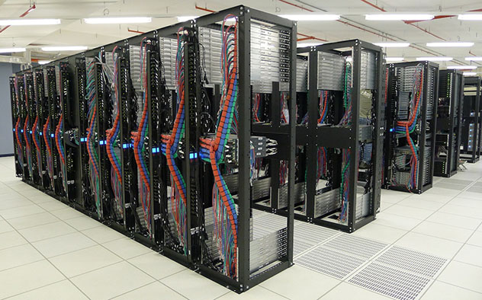
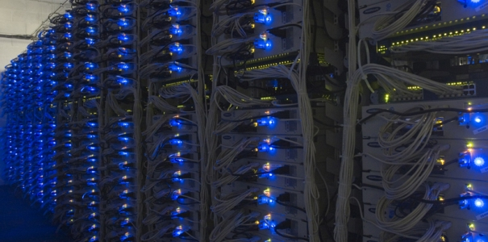
Tech Titans Building Boom
What does it take to build a million server datacenter?
Server Utilization
  40x 200W pizza boxes
  CPUs are 60% of power
  8 to 16kW per rack
  0.5kW/m²
  Air cooling
Google/Microsoft
  - Better power mgmt.
    . Avg instead of peak
  - Better power supplies
  voltage regulators, fans
  - Remove GPU
  - Water cooling
Notes:
A house = 10x 100W lightbulbs or 1kW, so 200MW is 200k houses
Also
Cheaper building and operating costs
Consume less energy (efficiency)
Greener material and processes
Make the facility more flexible and easier to manage

Slide 11
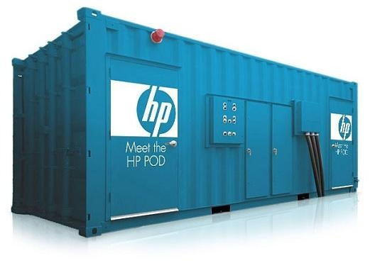
Tech Titans Building Boom
What does it take to build a million server datacenter?
Containers (server, power, cooling efficiency)
  2500 to 3000 servers, instead of 40 to 80
  Power and cooling efficiency
  Power density, 16kW/m² instead of 0.5 kW/m²
Notes:
A house = 10x 100W lightbulbs or 1kW, so 200MW is 200k houses
Also
Cheaper building and operating costs
Consume less energy (efficiency)
Greener material and processes
Make the facility more flexible and easier to manage

Slide 12
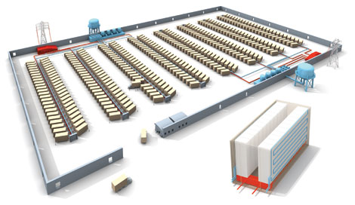
Tech Titans Building Boom
What does it take to build a million server datacenter?
Cooling Efficiency
Power supply and distribution
Software
Server efficiency and density
Titan tech boom, randy katz, 2008

Slide 13
Tech Titans Building Boom
What does it take to build a million server datacenter?
  Power efficiency
  Cooling efficiency
  Server efficiency
    Power proportionality
    utilization
  Power density
    0.5 kW/m² – raised floor datacenter
    16 kW/m² – containerized datacenter
  Management/failure
    Software masked failures
    containerization
Titan tech boom, randy katz, 2008

Slide 14
Tech Titans Building Boom
Power efficiency
  Tune power supply for average, not peak
  Voltage regulators
  Remove unnecessary components
Cooling efficiency
  HP “smart cooling”
  Air-side economization
  Containers

Slide 15
Tech Titans Building Boom
PUE
  Total power consumption / total power used by consumers
Results
  Typical enterprise DC
    2007 – 2
    2011 – 1.7 (with optimizations may reach 1.3)
  Google DCs
    Avg – 1.21
    Best – 1.15
  Microsoft
    Chicago – 1.22

Slide 16
Tech Titans Building Boom
Virtualization
  DCs run at 15% of their capacity without virtualization
  DCs run at 80% with virtualization
Other SW tools
  Power usage control
  Shared distributed data
  Handle software failures

Slide 17
Perspective
To build large and efficient datacenters
  Better power efficiency
  Better cooling efficiency
  Specialized systems for datacenters

Slide 18
Before Next time
Finish Lab0 by Tuesday
Fill out survey to help form groups
Create a project group
  Start asking questions about possible projects
Check website for updated schedule

