Slide 1
Overview: Cloud Datacenters
Hakim Weatherspoon
Associate Professor, Dept of Computer Science
CS 5413: High Performance Systems and Networking
January 27, 2017

Slide 2


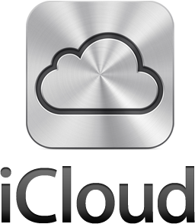




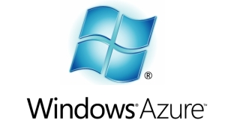



Context
The promise of the Cloud
  ubiquitous, convenient, on-demand network access to a shared pool of configurable computing resources (e.g., networks, servers, storage, applications, and services) that can be rapidly provisioned and released with minimal management effort or service provider interaction.
NIST Cloud Definition
SEATTLE
Notes:
The cloud completes the commoditization process and makes storage and computation a commodity.
Public vs private
IaaS, PaaS, SaaS
On demand (self service), network access, resource pooling, rapid elasticity, measured service

Slide 3
Context
The promise of the Cloud
  ubiquitous, convenient, on-demand network access to a shared pool of configurable computing resources (e.g., networks, servers, storage, applications, and services) that can be rapidly provisioned and released with minimal management effort or service provider interaction.
NIST Cloud Definition
SEATTLE
Notes:
The cloud completes the commoditization process and makes storage and computation a commodity.
Public vs private
IaaS, PaaS, SaaS
On demand (self service), network access, resource pooling, rapid elasticity, measured service

Slide 4



















What is the network?
PC
millions of connected computing devices:
  hosts = end systems
  running network apps
mobile network
server
wireless
laptop
global ISP
smartphone
home
network
communication links
  fiber, copper, radio, satellite
  transmission rate: bandwidth
regional ISP
wireless
links
wired
links
Packet switches: forward packets (chunks of data)
  routers and switches
router
institutional
network
Notes:
4

Slide 5


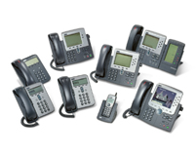

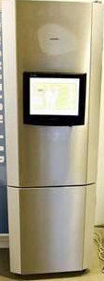
What is the network?
Web-enabled toaster +
weather forecaster
IP picture frame
http://www.ceiva.com/
Tweet-a-watt:
monitor energy use
Slingbox: watch,
control cable TV remotely
Internet
refrigerator
Internet phones

Slide 6
What is the network?
Internet: “network of networks”
  Interconnected ISPs
protocols control sending, receiving of msgs
  e.g., TCP, IP, HTTP, Skype, 802.11
Internet standards
  RFC: Request for comments
  IETF: Internet Engineering Task Force
mobile network
global ISP
home
network
regional ISP
institutional
network

Slide 7
What is the network?
mobile network
Infrastructure that provides services to applications:
  Web, VoIP, email, games, e-commerce, social nets, …
provides programming interface to apps
  hooks that allow sending and receiving app programs to “connect” to Internet
  provides service options, analogous to postal service
global ISP
home
network
regional ISP
institutional
network

Slide 8
Context
The promise of the Cloud
  ubiquitous, convenient, on-demand network access to a shared pool of configurable computing resources (e.g., networks, servers, storage, applications, and services) that can be rapidly provisioned and released with minimal management effort or service provider interaction.
NIST Cloud Definition
SEATTLE
Notes:
The cloud completes the commoditization process and makes storage and computation a commodity.
Public vs private
IaaS, PaaS, SaaS
On demand (self service), network access, resource pooling, rapid elasticity, measured service

Slide 9

Shared Pool = Data Centers
Internet
Core Switch (CS)
Aggregate
Switch (AS)
…
…
…
ToR
…
…
…
…
…
…

Slide 10
What is different about Data Centers?
Cost
  “It is the economics stupid”
    James Hamilton, VP & Distinguished engineer, Amazon Web Services
  In 2008, data center staff to servers was 1:1000
  Today, closer to 1:10,000
Scale
  Millions of servers, billions of users, trillions of objects
  Scale out instead of scale up
Efficient
  Massive scale in the same location eases design and lowers costs
Global scale data centers
  Data Centers strategically placed where power is cheap and close to consumers

Slide 11
Where do the costs go?
Breakdown
  45% Servers - CPU, memory, storage subsystems
  25% Infrastructure - Power distribution and cooling
  15% Power draw - Electrical utility costs
  15% Network - Links, transit, equipment

Slide 12
Where do the costs go?
Breakdown
  45% Servers - CPU, memory, storage subsystems
  25% Infrastructure - Power distribution and cooling
  15% Power draw - Electrical utility costs
  15% Network - Links, transit, equipment
Walk through problems in paper
  Server cost
  Infrastructure cost
  Power
  Network

Slide 13
Networking in Data Centers
Internet
Core Switch (CS)
Aggregate
Switch (AS)
…
…
…
ToR
…
…
…
…
…
…

Slide 14


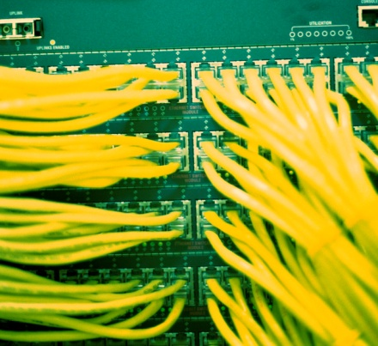
Networking in Data Centers
Internet
Core Switch (CS)
Aggregate
Switch (AS)
…
…
…
ToR
…
…
…
…
…
…

Slide 15
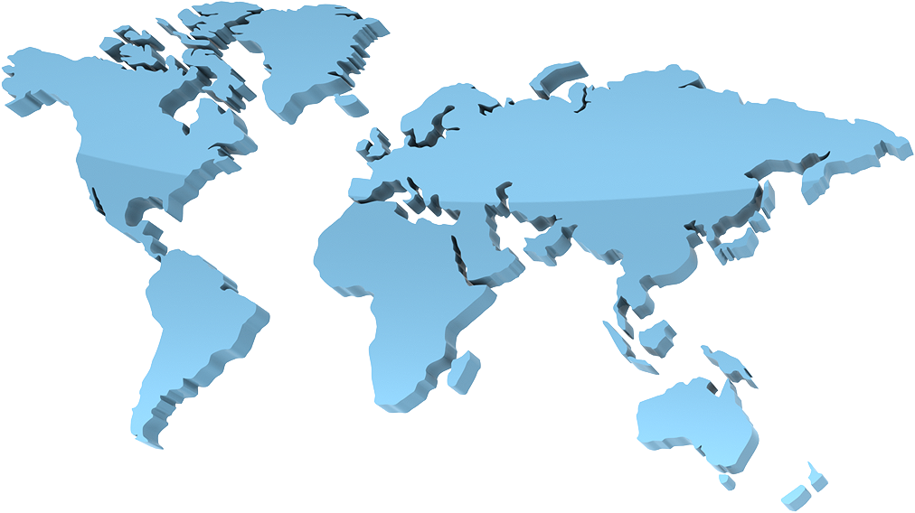

Geo-distributed Data Centers

Slide 16
Where do the costs go?
Breakdown
  45% Servers - CPU, memory, storage subsystems
  25% Infrastructure - Power distribution and cooling
  15% Power draw - Electrical utility costs
  15% Network - Links, transit, equipment
How to reduced costs
  Servers and Infrastructure
    Let servers fail and infrastructure fail
    Software, Replication and network efficiency can help
  Power and Network
    High utilization (better on than off)
    Agility (ability to run applications anywhere in data center)

Slide 17
Networking in Data Centers
Internet
Core Switch (CS)
Aggregate
Switch (AS)
…
…
…
ToR
…
…
…
…
…
…

Slide 18
Perspective
Large cloud service provides have deployed their own networks
  Private networks, perhaps as large as the Internet
  But, bypass the Internet core and connect directly with ISPs
  Near instantaneous access betwee consumers and data centers
Economies of scale dominate in cloud data centers
Notes:
As discussed in Section 1.3.3, online service providers, such as Google and
Microsoft, have deployed their own extensive private networks, which not only
connect together their globally distributed data centers, but are used to bypass
the Internet as much as possible by peering directly with lower-tier ISPs. As a
result, Google provides search results and email access almost instantaneously,
as if their data centers were running within one’s own computer.
• Many Internet commerce companies are now running their applications in the
“cloud”—such as in Amazon’s EC2, in Google’s Application Engine, or in
Microsoft’s Azure. Many companies and universities have also migrated their Internet
applications (e.g., email and Web hosting) to the cloud. Cloud companies not
only provide applications scalable computing and storage environments, but also
provide the applications implicit access to their high-performance private networks.

Slide 19
Before Next time
Read Tech Titan Building Boom
  Answer question via CMS
Lab0 due before Tuesday
Create a project group
  Start asking questions about possible projects
Check website for updated schedule

